Slide 1

LEMON
TEAM

Slide 2

Contents
About us
Idea
Tech Stack
Implementation

Slide 3
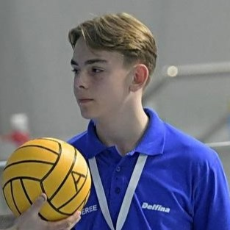
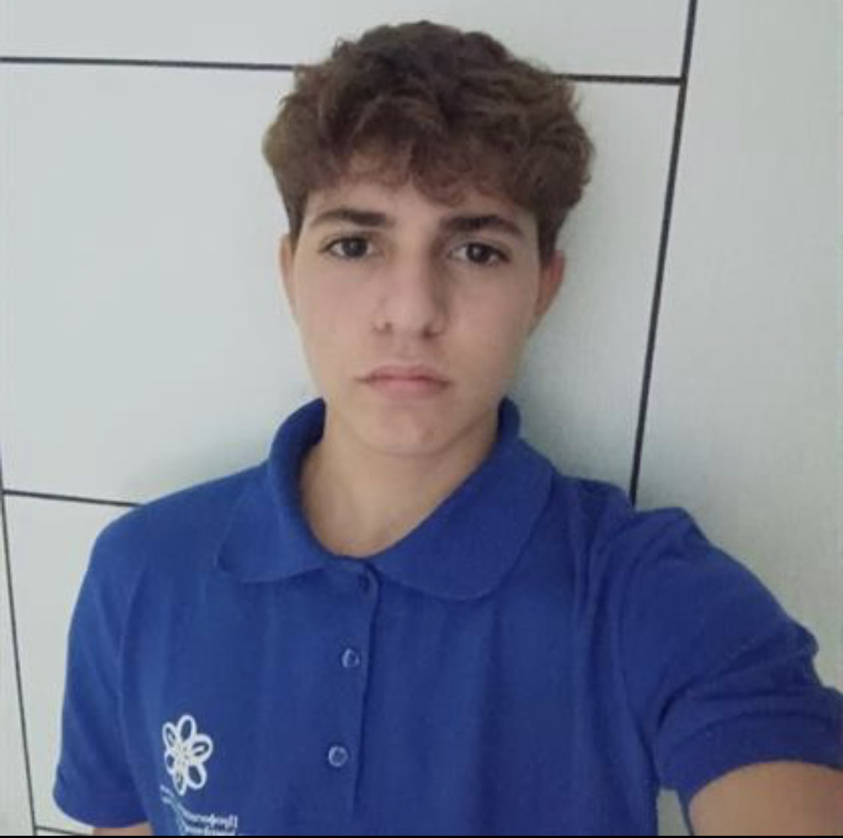
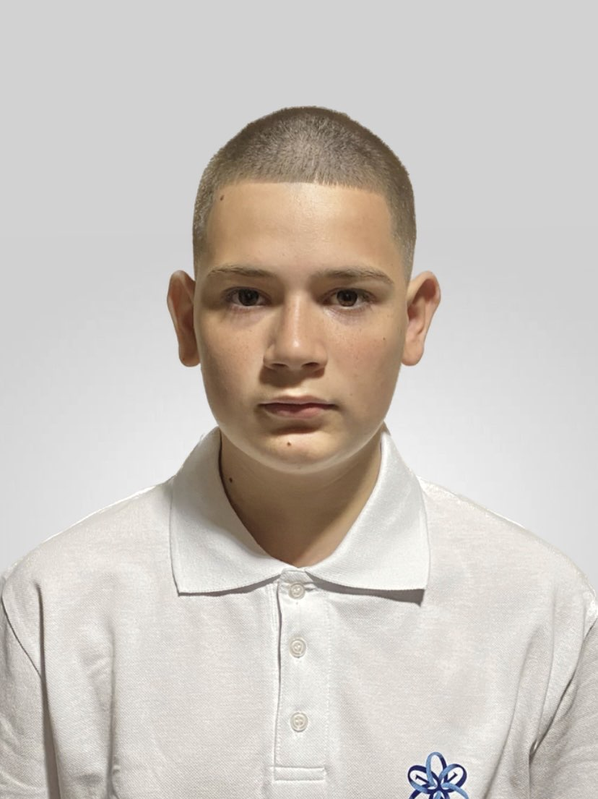
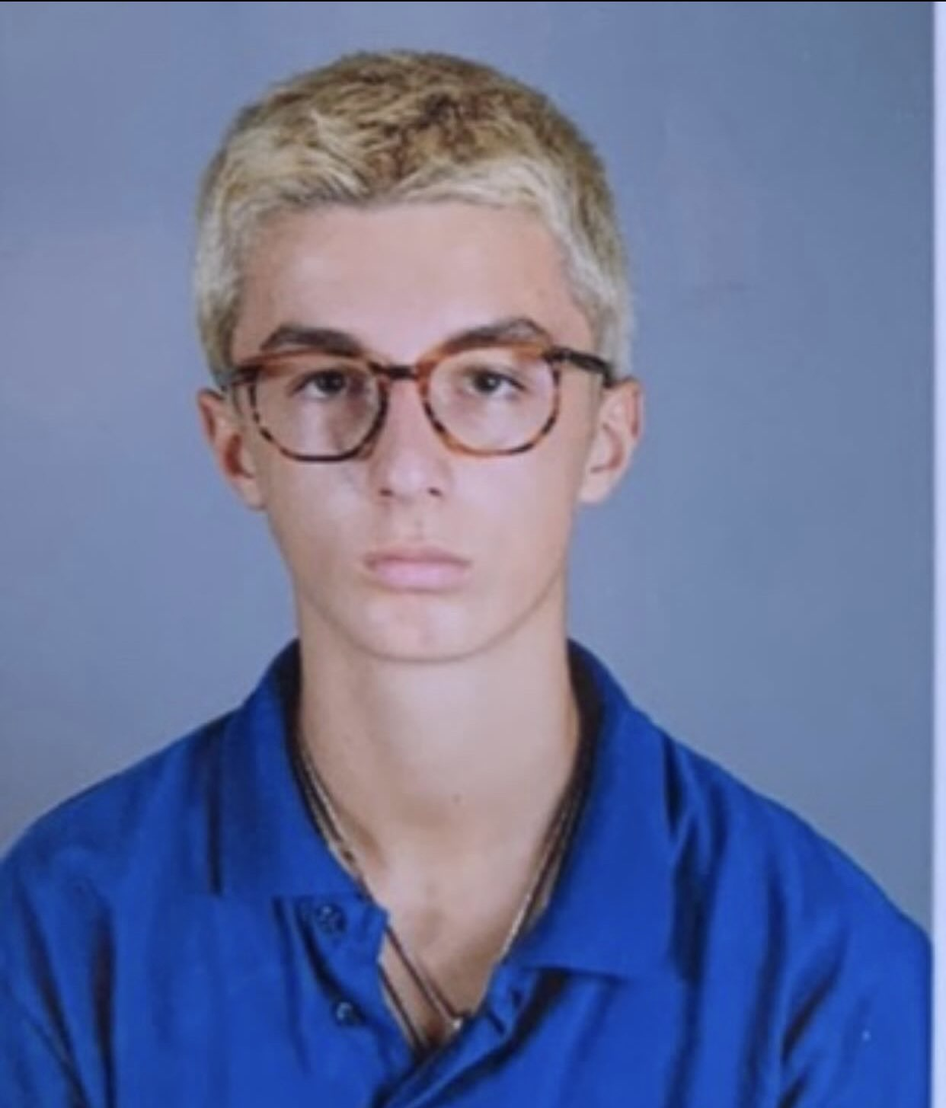
About us
Iliyan Stanchev Zarko Vladkov
Scrum Trainer Front-End Developer
Alexandar Stanev Plamen Petkov
Front-End Developer Designer

Slide 4
Idea
The goal of our project is to get people to know more about robotics and it’s useful features.

Slide 5




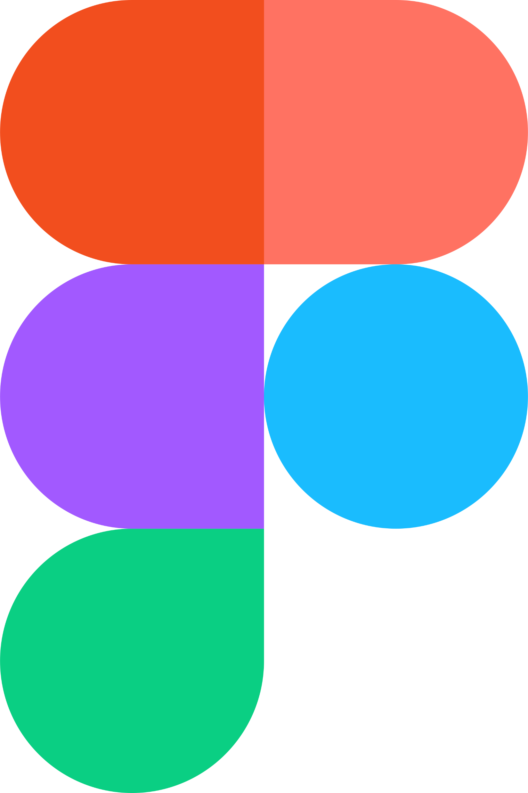
Tech Stack

Slide 6
Implementation
We built our application from the ground up in the span of three weeks, meaning that our project will hopefully be deemed successful.
This time around though, our time for set up and organization could have gone better. That however didn’t discourage us from working stably throughout the rest of our given time.

Slide 7
Thanks for listening!

