Slide 1
GRAPE LEAF DISEASE PREDICTION AND MANAGEMENT SYSTEM
CSE7301 Capstone Project
Final Review
Batch Number: CAI-G34
Roll Number | Student Name
20211CAI0030 20211CAI0059 20211CAI0106 20211CAI0176 | Asif Pasha.B Mohamed Azeem Fardeen Pasha Ismail Ahmed Khan Beldona Visweswara
Under the Supervision of,
Mr. John Bennet
Professor
School of Computer Science and Engineering
Presidency University
Name of the Program: Capstone Project
Name of the HoD: Dr. Zafar Ali Khan
Name of the Program Project Coordinator:
Name of the School Project Coordinators: Dr. Afroz Pasha

Slide 2
Introduction
Agriculture plays a pivotal role in the global economy, and grapevine cultivation is a significant part of the agricultural sector, especially for wine production, consumption, and direct consumption as fruits. Grapevines, however, are susceptible to various diseases caused by fungi, bacteria, and viruses. These diseases can have a detrimental impact on grape yield and quality, potentially leading to significant financial losses for vineyard owners.
The grapevine industry faces numerous challenges, including the prevalence of diseases that can severely impact crop yield and quality. Timely identification of grapevine diseases is critical for effective management and prevention.
Traditional methods of disease detection, relying on visual inspection by experts, are often time-consuming, inconsistent, and prone to human error. To address this challenge, we propose a state- of-the-art Grape Disease Detection System using YOLOv8 (You Only Look Once), an advanced deep learning-based object detection algorithm, for real-time identification and classification of grapevine diseases.
These technologies can automate the disease detection process, enabling timely, accurate, and efficient identification of grapevine diseases from images. By leveraging deep learning-based systems, farmers can quickly identify affected plants, reduce crop losses, and take appropriate preventive measures, ensuring healthier grape production.

Slide 3
Literature Review
Numerous studies have explored AI and machine learning applications in agriculture, particularly for disease detection. Image-based recognition techniques using convolutional neural networks (CNNs) have demonstrated high accuracy in identifying crop diseases.
Research indicates that models trained on large datasets, such as the Plant Village dataset, achieve high accuracy in classifying diseases in crops like tomatoes, apples, and wheat. These models can differentiate between diseases based on distinct patterns in leaf discoloration, spots, and structural changes.
A. Surampalli, K. Gemini, R. Velpula, S. Suchitra, S.G. Sophia, and B. Pavithra. ” Tomato leaf disease detection using deep learning techniques.” In 2020 5th International Conference on Communication and Electronics Systems (ICCES), pp. 979-983. IEEE, 2020.
D. Das, M. Singh, S.S. Mohanty and S. Chakravarty, “Leaf disease detection using support vector machine.” In 2020 International Conference on Communication and Signal Process- ing (ICCSP), pp. 1036-1040. IEEE, 2020.
K.M. Sudar, P. Nagaraj, B. Prakash, M.M. Reddy, M. M. Naidu, H. Kumar, Development of Tomato Leaf Disease Prediction System to the Farmers by using Artificial Intelligent Network.” In 2022 6th International Conference on Intelligent Computing and Control Systems (ICICCS), pp. 955-961. IEEE, 2022.

Slide 4
Existing method Drawback
Many AI models rely heavily on pre-existing, static datasets for training. This restricts the adaptability of the system to real-time environmental changes and dynamic field conditions.
Another prevalent concern is misclassification, especially among diseases with similar visual symptoms. The inability of some models to accurately differentiate between such diseases may lead to incorrect diagnoses and inappropriate treatment recommendations, thereby exacerbating the problem rather than solving it.
Data scarcity and annotation challenges also hinder model development. High-quality, labelled datasets for various crops and disease types are limited. Moreover, the processes of data collection and annotation are resource-intensive, making them time-consuming and expensive, which restricts the scalability of such projects.
Scalability and processing constraints pose technical hurdles. Most deep learning models demand high computational power, rendering them impractical for deployment in low-resource settings.
Many of these systems lack real-time processing capabilities, preventing immediate detection and response, which is critical for disease management in agriculture.

Slide 5
Proposed Method
The purpose of this project is to develop an intelligent and automated Grape Disease Detection System using YOLOv8, a state-of-the-art deep learning-based object detection algorithm.
The system aims to revolutionize grapevine disease management by automating the process of detecting diseases such as ESCA, Leaf Blight, and other common grapevine diseases, which significantly affect grape yield and quality.
The system will enable accurate and early detection of diseases, thus allowing vineyard owners and farmers to take timely and effective actions to manage and mitigate the spread of diseases.
This project leverages the power of deep learning and computer vision to build an automated tool capable of processing grapevine leaf images and classifying them into healthy or diseased categories.
The system is designed to not only detect the disease but also provide recommendations for disease management, thus enhancing overall grapevine productivity and quality.

Slide 6
Objectives
To Develop an Automated Disease Detection System The primary goal is to create a fully automated system capable of detecting and classifying grapevine diseases. By utilizing the YOLOv8 model, the system will analyze images of grape leaves to identify symptoms associated with various diseases such as ESCA, Leaf Blight, and distinguish healthy leaves.
To Train the YOLOv8 Model Using a Grape Disease Dataset Another essential objective is to build and preprocess a comprehensive dataset consisting of grapevine leaf images representing different disease conditions. This dataset will be used to train the YOLOv8 model.
To Provide Disease Management Recommendations Beyond detection, the system aims to support users by offering relevant disease management guidelines. After identifying a disease, the system will provide tailored recommendations and best practices for disease mitigation, such as fungicide usage, pruning strategies, and preventive care.
To Optimize the System for Real-Time Deployment Finally, the project seeks to ensure that the disease detection system operates efficiently in real-time. The model will be optimized for deployment on resource-constrained devices such as mobile phones and low-power computers.

Slide 7
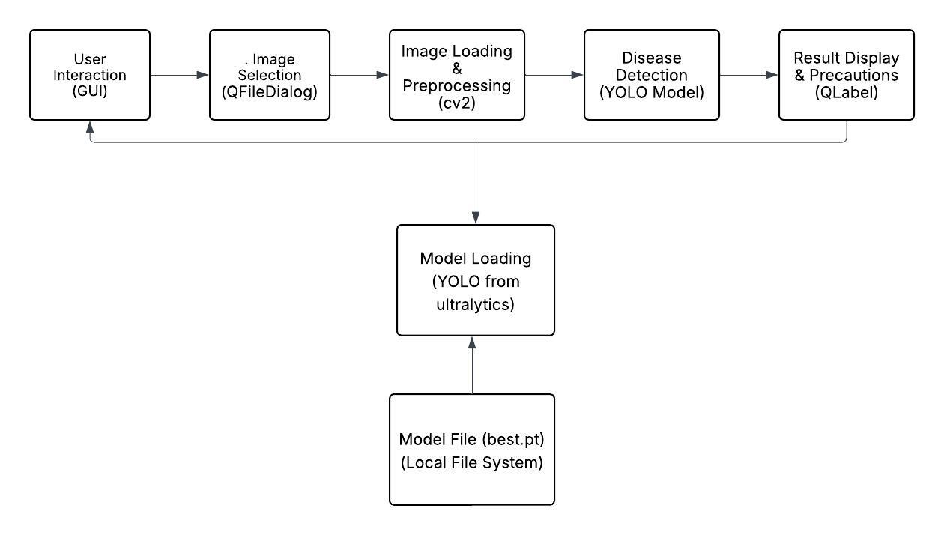
Architecture

Slide 8
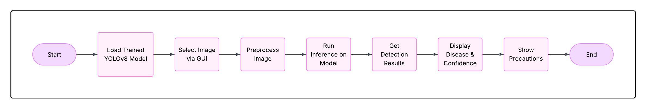
Architecture

Slide 9
Hardware & Software components
Hardware Components
GPU (Graphics Processing Unit): NVIDIA RTX 3080 or NVIDIA A100
CPU (Central Processing Unit): Intel Core i7 or AMD Ryzen 7
RAM (Random Access Memory): 16 GB or higher
Storage: At least 500 GB of SSD storage
Software Components
Operating System : Windows 10 or 11
Python : Pytorch and Ultralytics
Visual Studio

Slide 10
Timeline of Project
Phase-wise Breakdown:
Research & Proposal (Review-0): The focus is on understanding the problem, gathering literature, and defining project objectives.
Design and Early Implementation (Review-1): Focus on system architecture and core component development.
Full Implementation & Testing (Review-2): Complete the development and conduct initial testing.
Final Development & Adjustments (Review-3): Integrate the system and finalize testing.
Final Review & Viva: Prepare for final presentations and viva-voce.

Slide 11
Expected Outcomes
The evaluation metrics—namely accuracy, precision, and recall—indicate that the YOLOv8-based model is highly effective in identifying grapevine diseases under diverse conditions.
One of the system’s key strengths lies in its high accuracy and precision rates. These suggest that the model can correctly identify the presence of grapevine diseases with minimal false positives, providing confidence to users in its diagnoses.
The user interface also contributes to the system's effectiveness, as it is designed to be intuitive and user-friendly. This ensures that even users without technical backgrounds can navigate the system easily and interpret the results with confidence.
Expanding the model to recognize a broader spectrum of grapevine diseases would also enhance its value to farmers, especially in regions where different or less common diseases are prevalent.
the incorporation of environmental data—such as humidity levels and temperature readings—could further improve the system’s prediction accuracy by providing contextual information that influences disease development.

Slide 12
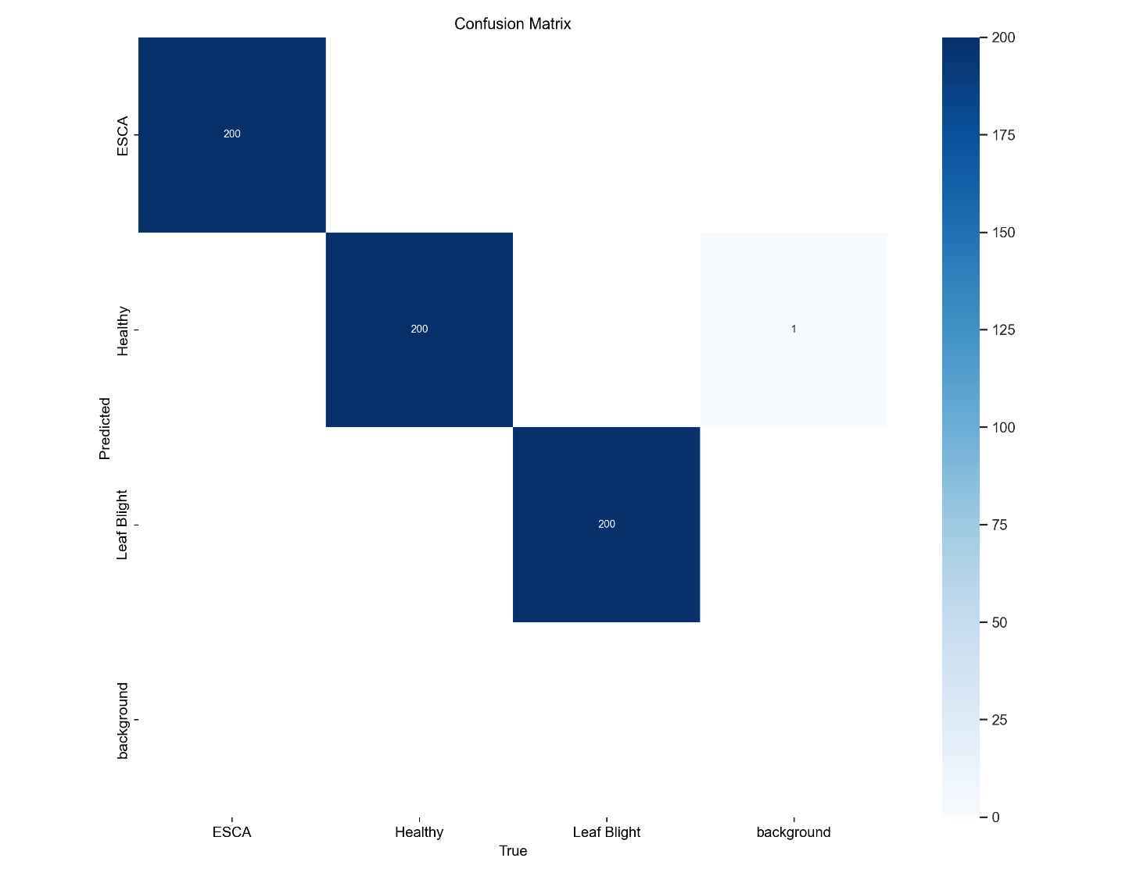
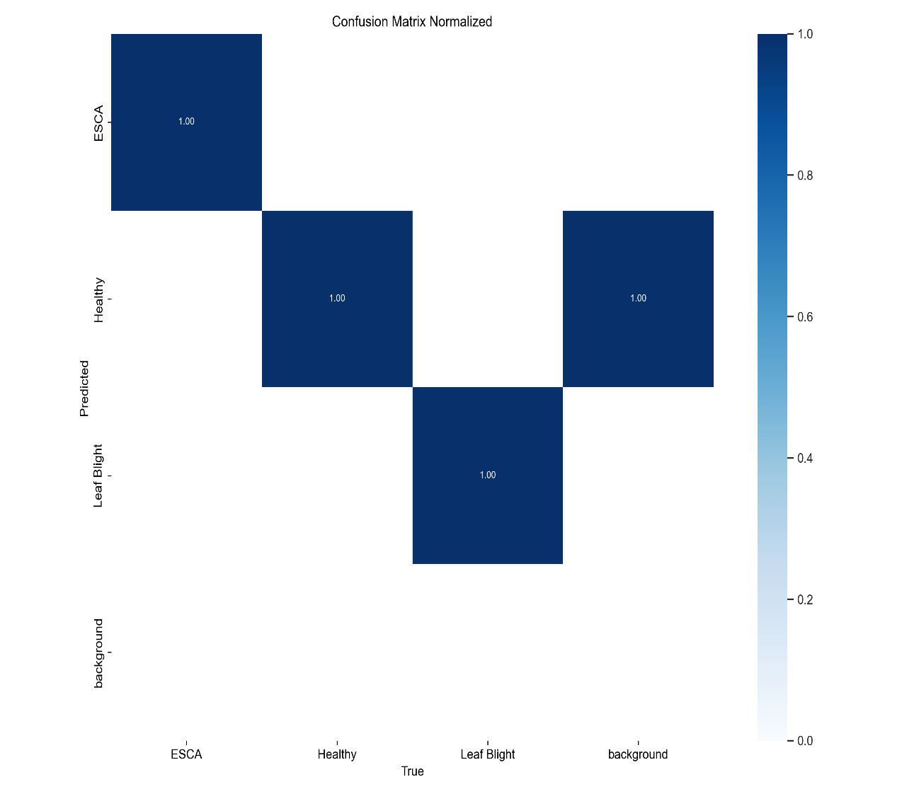
Expected Outcomes

Slide 13
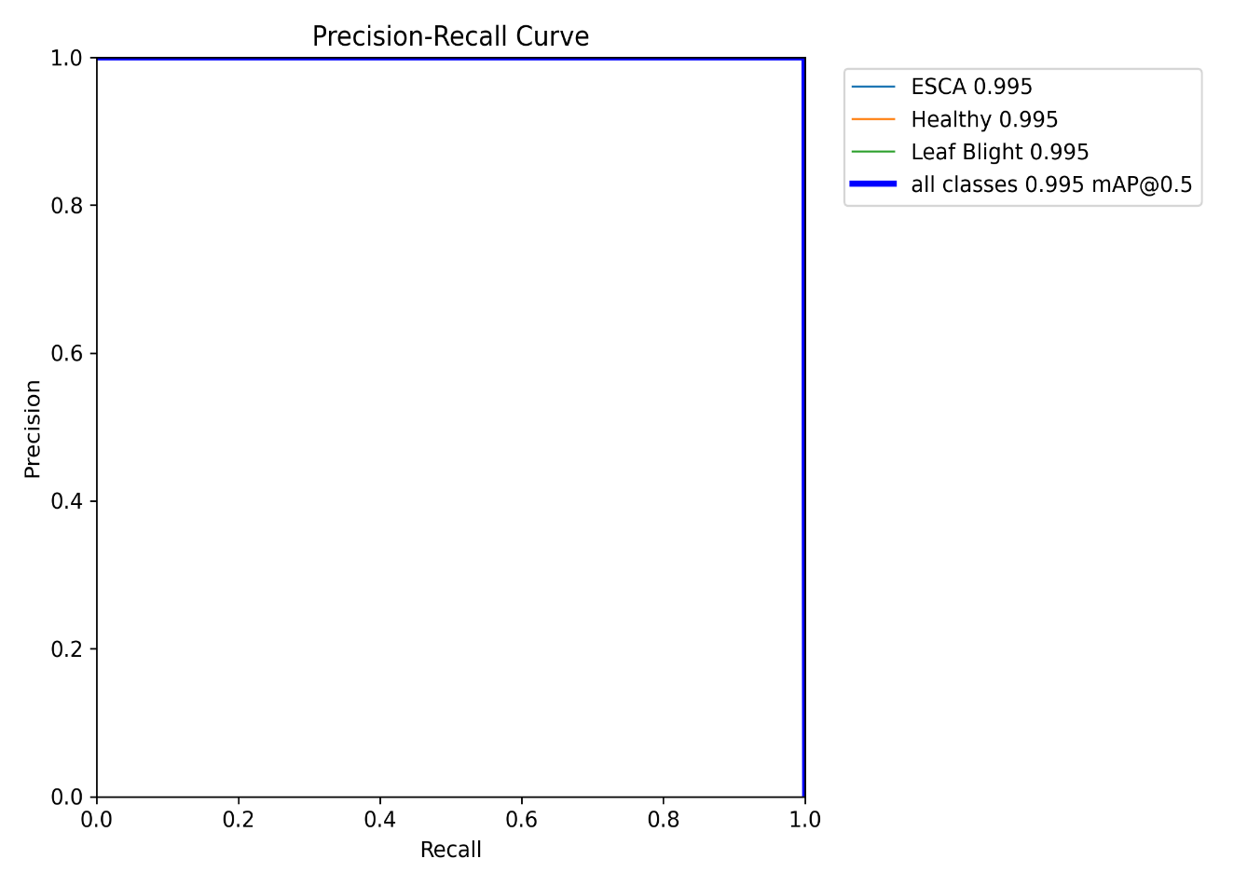
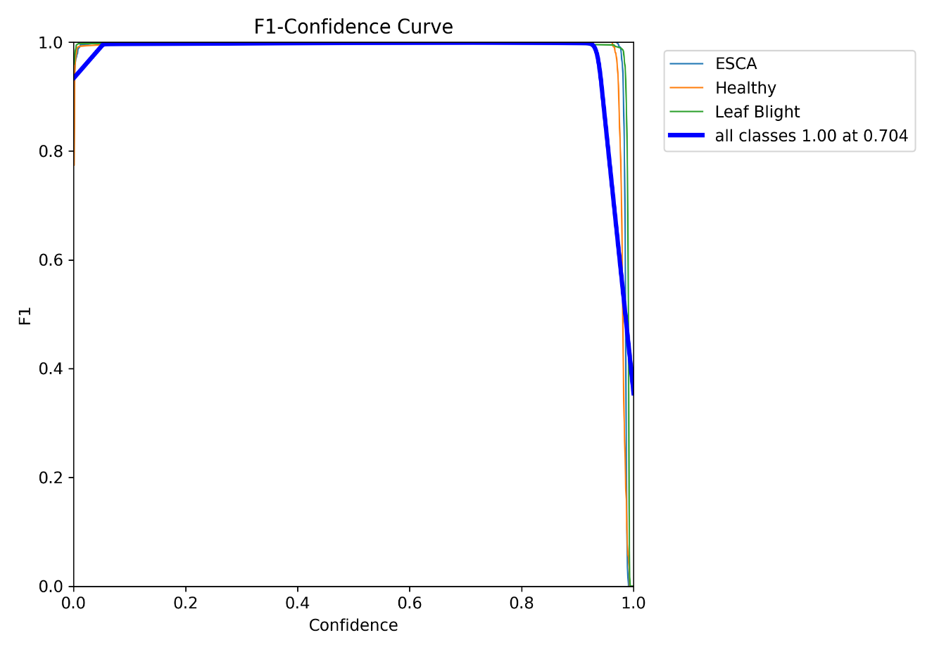
Expected Outcomes

Slide 14
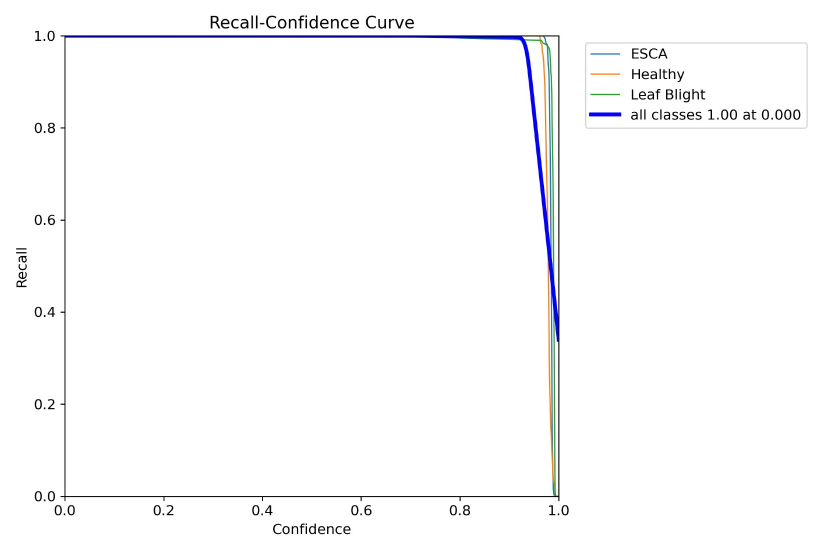
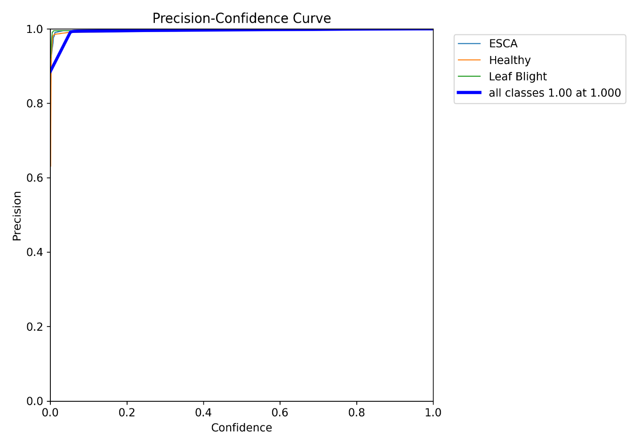
Expected Outcomes

Slide 15
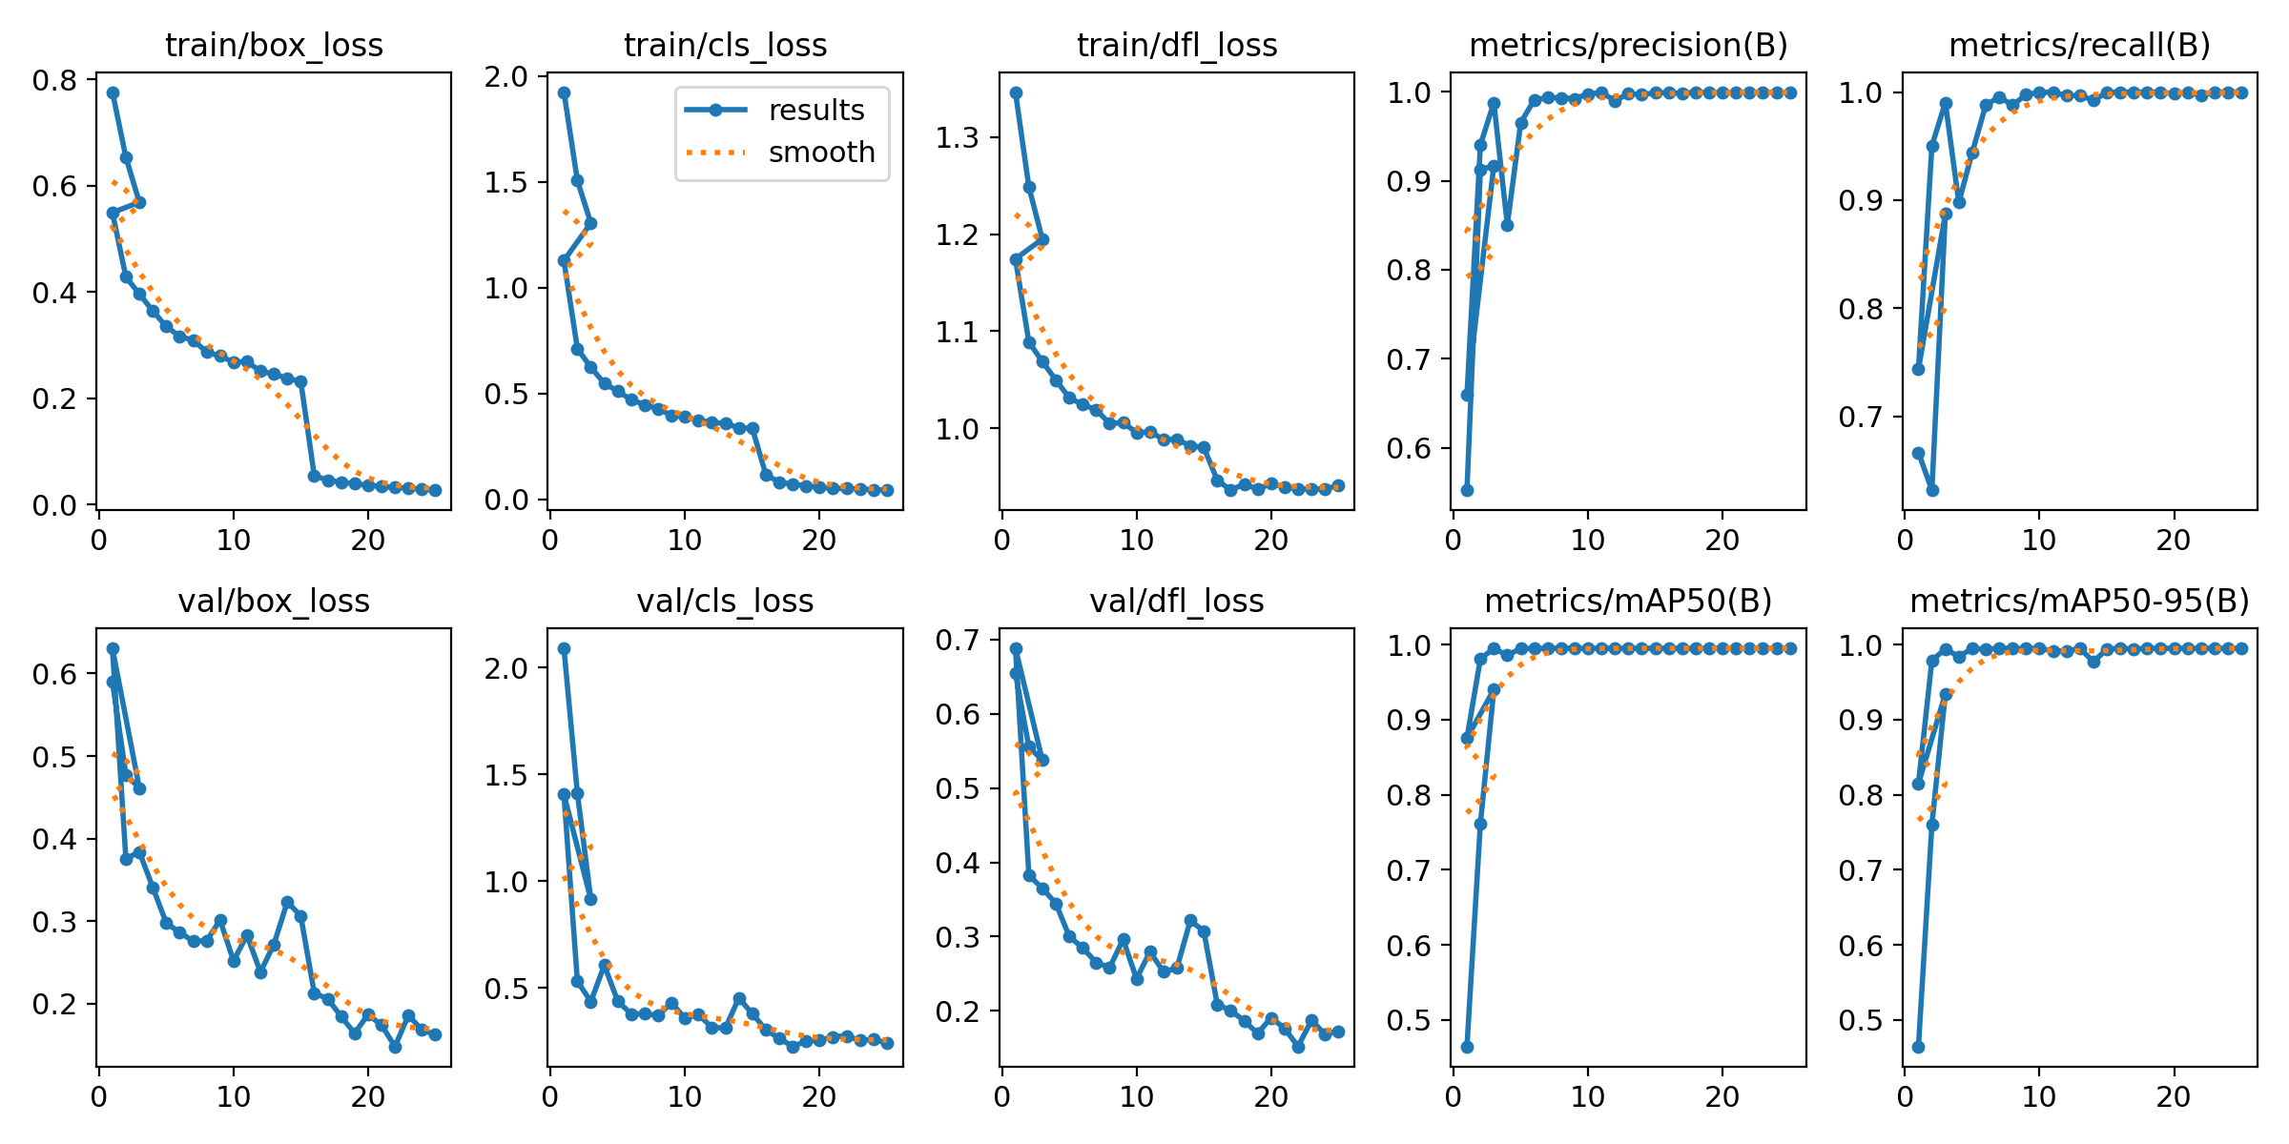
Expected Outcomes

Slide 16
Conclusion
The Grape Disease Detection System developed in this project represents a significant advancement in agricultural technology, particularly in grapevine disease management.
Through the use of the YOLOv8 model for object detection, the system is capable of classifying grape diseases into different categories such as ESCA, Leaf Blight, and Healthy vines.
The model’s ability to discern between these categories allows for precise diagnosis, providing farmers with valuable insights to take corrective actions in a timely manner.
Automating disease detection has several advantages over traditional methods. Farmers often rely on labor-intensive visual inspections to identify grapevine diseases, which can be time-consuming, inconsistent, and prone to human error.
The system ensures that grapevine diseases are identified at an early stage, which can prevent the spread of infections and allow for targeted treatment.

Slide 17
Github Link
Github Link
https://github.com/issu2009/GRAPE-LEAF-DISEASE-PREDICTION-AND-MANAGEMENT-SYSTEM

Slide 18
References
A. Surampalli, K. Gemini, R. Velpula, S. Suchitra, S.G. Sophia, and B. Pavithra. ” Tomato leaf disease detection using deep learning techniques.” In 2020 5th International Conference on Communication and Electronics Systems (ICCES), pp. 979-983. IEEE, 2020.
D. Das, M. Singh, S.S. Mohanty and S. Chakravarty, “Leaf disease detection using support vector machine.” In 2020 International Conference on Communication and Signal Process- ing (ICCSP), pp. 1036-1040. IEEE, 2020.
K.M. Sudar, P. Nagaraj, B. Prakash, M.M. Reddy, M. M. Naidu, H. Kumar, Development of Tomato Leaf Disease Prediction System to the Farmers by using Artificial Intelligent Network.” In 2022 6th International Conference on Intelligent Computing and Control Systems (ICICCS), pp. 955-961. IEEE, 2022.
Rakesh, S., and Indiramma, M. (2022, December). Explainable AI for Crop disease detection. In 2022 4th International Conference on Advances in Computing, Communication Control and Networking (ICAC3N) pp. 1601-1608. IEEE.

Slide 19

Project work mapping with SDG

Slide 20
Project work mapping with SDG
The project “Price Parity and Procurement Efficiency: A Comparative Study of GeM and Commercial E-Marketplaces” aligns most closely with the following Sustainable Development Goals (SDG):
Decent Work and Economic Growth (SDG8):Promotes inclusive economic growth by improving market access and procurement efficiency.
Industry, Innovation, and Infrastructure (SDG9):Supports innovation through digital technologies and resilient e-commerce infrastructure.
Reduced Inequalities (SDG10):Enhances market transparency and access for diverse buyers, including SMEs and underserved regions.
Responsible Consumption and Production (SDG12):Encourages informed purchasing decisions that promote sustainable consumption patterns.
Climate Action (SDG13):Helps reduce environmental impact by optimizing procurement and logistics processes.
Partnerships for the Goals (SDG17):Fosters collaboration between government, private sector, and technology providers for sustainable development.

Slide 21
Thank You

