Slide 1





Detecting Hidden Mechanisms of Abuse-Related Injury in Children:
Structured Topic Modeling of Clinical Death Reviews and Legal Opinions
Triangulating Multidisciplinary Child Fatality Reviews with Factual and Procedural Narratives from Case Law
Investigating Spatial Structures in Urban Environments (ISSUES) Lab Members: Gia E. Barboza-Salerno, Henriikka Weir, Malcolm McCarthy, Karla Shockley, Amy Watson-Grace, Keith Warren, Esenia Cassidy, Olivia McLucas, with Scottye Cash & Suzanne Perkins
Notes:
Good morning, and thank you all for being here, etc. and introduce the team and topic
The lab focuses on translating big data on the physical and social environment for legal and policy analysis to minimize violence-related harm including child abuse and neglect in vulnerable populations including children

Slide 2
THE CORE IDEA
Integrating Child Abuse & Neglect Case Narratives
The core idea(s)? (1) No single surveillance system sees the whole picture. (2) Machine learning analyses and natural language processing can capture important mechanisms that surveillance systems routinely miss. (3) Integrating clinical death reviews with legal case narratives recovers abuse-related mechanisms, including head injury and TBI, that structured codes routinely obscure.
STUDY 1
STUDY 2
Colorado CFRT Death Reviews
CourtListener Case Law
Multidisciplinary child fatality & near-fatality reviews
Factual & procedural narratives from appellate opinions
Clinical + administrative narratives
Caregiver behavior, household context, injury mechanism, diagnosis
What were the circumstances surrounding a fatal, nonfatal, or egregious CAN incident
Legal narratives of adjudicated cases
Injury mechanism, location, perpetrator, long-term consequences
How harm and its sequelae are documented over time
2
Notes:
The core idea is that machine learning analyses and natural language processing can capture important mechanisms of abuse and neglect, including injuries that surveillance systems routinely miss: the mechanisms of abuse-related traumatic brain injury in children.
Because no single administrative system captures the full picture of a maltreatment event, we triangulate two very different accounts: multidisciplinary child fatality reviews on one side, and appellate legal opinions on the other.
Both systems rely heavily on unstructured narrative text, and we analyze both with the same modeling pipeline.
Study 1 draws on Colorado Child Fatality Review Team reports — the multidisciplinary reviews conducted after a fatal, near-fatal, or egregious incident.
Study 2 draws on CourtListener, a database of appellate opinions in which the same kinds of injuries are described in factual and procedural narratives.
The two sources provide different facets of a single problem, both revealing important preventive mechanisms: the death reviews capture caregiver behavior and household context; the opinions capture how harm and its long-term sequelae are documented and adjudicated over time.

Slide 3
MACHINE LEARNING
Supervised vs. Unsupervised Learning
SUPERVISED
UNSUPERVISED
Learns from labeled examples
Discovers latent structure
Learns from examples where the correct outcome is already known. The goal is prediction— classifying or estimating an outcome for new cases.
No labeled outcome is supplied. The model finds structure in the data itself. The goal is description — grouping or summarizing, not predicting.
Examples. Regression, random forests, gradient boosting, support vector machines
Examples. k-means & hierarchical clustering, principal component analysis, topic models.
In this study. A BART zero-shot classifier independently checks the GPT-extracted consequence categories.
In this study. Topic models recover latent themes from narrative text without pre-labeled categories.
Where STM fits. Structured Topic Modeling is unsupervised — it recovers themes from patterns of word co-occurrence. The covariates we add (incident year, judicial ruling) shape how prevalent a topic is, but they supply no labels, so the model stays unsupervised. Validation is where a supervised model is useful: a BART zero-shot classifier serves as an independent, supervised-style check on the topics STM produced.
Notes:
This slide situates our method within a machine learning framework.
Supervised learning learns from examples where we already know the answer. Its goal is prediction: classification or regression on new cases. Common examples include logistic regression, random forests, and gradient-boosted trees.
Unsupervised learning has no labeled outcome; the model discovers latent structure in the data itself, and its goal is description rather than prediction — clustering, dimension reduction, or latent themes. Examples include k-means, principal components analysis, and the topic-model family, LDA and STM.
Our core method, Structured Topic Modeling, is unsupervised: we never tell it what the themes are; it recovers them from patterns of word co-occurrence. The covariates we add — incident year, judicial ruling — shape how prevalent a topic is, but they do not supply labels, so the model remains unsupervised.
The one place a supervised model enters is validation, where we use a BART zero-shot classifier as an independent check.

Slide 4
STRUCTURED TOPIC MODELS
What Are Structured Topic Models?
Topic modeling identifies latent themes across a collection of documents. In probabilistic models (LDA, STM):
Each document is a mixture of topics — not assigned to a single one
Each topic is a distribution of words that repeatedly co-occur
Words associate with topics through recurring co-occurrence patterns
STM extends LDA by letting document-level covariates shape topic prevalence (Roberts et al., 2014, 2019).
In this study
Documents
ED-style death-review narratives & court opinions
Topics
Recurring patterns of injury mechanism, behavior, setting, consequence
Words
The language clinicians, courts & social workers use to describe injury
Example: concussion, fracture, orbital, dizziness cluster into a “craniofacial trauma” topic.
7
Notes:
Topic modeling identifies common themes across a large collection of documents.
In probabilistic models such as LDA and STM, each document is represented as a mixture of topics, and each topic is a mixture of words:
A document can contain several different topics
Each topic is represented by words that tend to appear together
The model finds recurring patterns of words across documents
Researchers examine these words and interpret and label the topics
Example: Concussion, fracture, orbital, dizziness may cluster into the topic we label ‘craniofacial trauma’
A single word does not define a topic. Topics are identified by patterns of words that occur together.
Structured Topic Modeling, or STM, extends LDA in one important way: it lets document-level covariates shape topic prevalence, so we can ask whether a theme has increased or decreased over time or differs by judicial ruling.
In this study, the documents are the death-review narratives and the court opinions; the topics are recurring patterns of injury mechanism, behavior, setting, and consequence; and the words are the actual language clinicians and courts use.

Slide 5
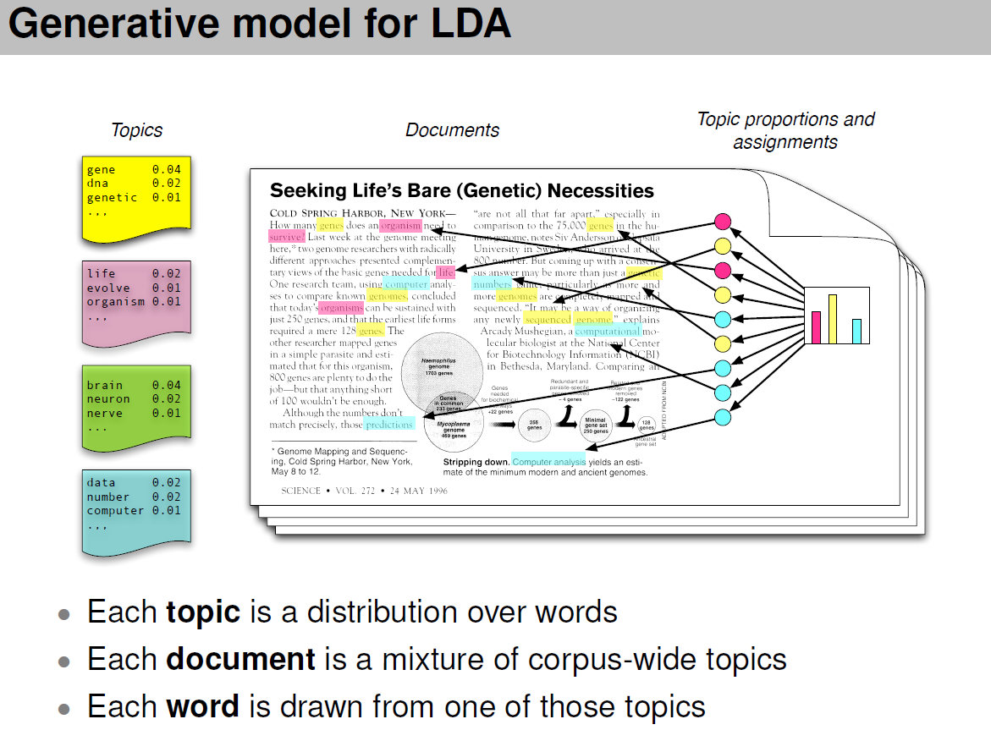
Generative Model for Topic Models
Each color represents a different topic made up of words that tend to occur together.
The highlighted words show which topic each word is associated with based on its color.
Multiple colors appear in the same document because a document can contain several topics.
The bar chart summarizes the colors: taller bars mean that topic makes up a larger proportion of the document.
A generative model starts with the words we observe in the documents and works backward to identify the topics that likely produced those patterns of words.
Notes:
Topic models are generative.
A generative model describes the underlying process that could have produced the documents.
o make this concrete: in our study, the DOCUMENTS are either Fatality reviews (Study 1) or court opinions (Study 2).
The TOPICS are recurring patterns in injury mechanism, behavior, setting, and long-term consequences.
The WORDS are the actual language that clinicians and courts use to describe the DV incident and its circumstances.

Slide 6
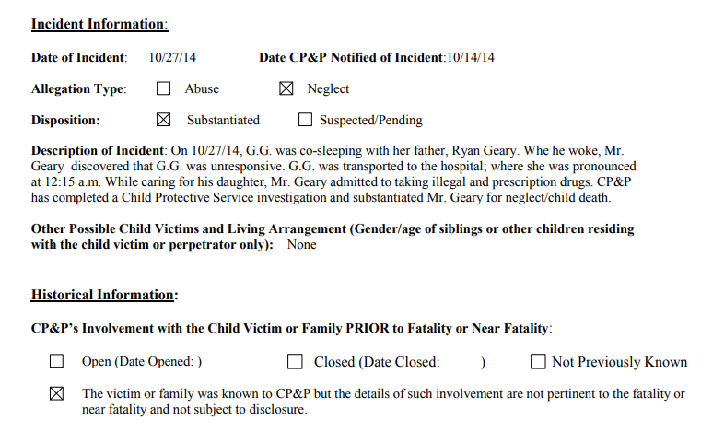
Motivation for Topic Modeling of Narrative Text
It’s relatively easy to give answers to well-specified questions using existing data sources and standard statistical analysis
Latent class analysis: risk profiles of early child adversity
Spatial models: clustering of gun violence near schools
Parallel process models: co-occurrence of psychological symptoms over time
When there is no structure to the data and the problem is not well-specified standard analyses don’t work
Unstructured data makes up 80-90% of all data produced by organizations (Holzinger, Stocker et al., 2013) including police reports, court documents and human service organizations
What patterns exist in complaints filed in protection from abuse orders?
What patterns exist in child fatality reports?
Machine learning algorithms such as text mining and topic modeling can help given meaning to narrative, unstructured text
6

Slide 7
Background
Our previous work

Slide 8
MOTIVATION
The Discovery of Latent Themes
Existing systems can miss or misclassify child maltreatment
Narratives capture context that structured data miss
Legal and medical definitions and coding practices vary across systems
Machine learning can analyze cases consistently at scale, reducing reliance on human coding and identifying patterns existing categories may miss.
Question: Can machine learning use narrative data to identify recurring patterns of child maltreatment more consistently than existing classifications?
80–90%
of maltreatment deaths missed by death certificates
55–76%
undercount in CPS records
80–90%
of organizational data is unstructured narrative text
Batra et al., 2024; Schnitzer et al., 2008; Holzinger, Stocker et al., 2013
3
Notes:
Can we use narrative data to identify recurring patterns of child maltreatment that existing classifications may miss?

Slide 9
BACKGROUND
What Our Prior Work Establishes
Head trauma is common following exposure to violence
Head trauma is socially patterned
58% of violence-related ED visits involve craniofacial trauma
Craniofacial injury predicts lasting emotional & physical symptoms, especially with loss of consciousness (80–90%)
Survivors of IPV spend nearly twice as much on brain-injury-linked care
Head-injury rates are ~5× higher among females
Violence-related TBI patients are more likely to be female, younger, non-Hispanic Black, and to have pre-injury substance use
TBI history is associated with >3× the odds of near-fatal overdose
Community engagement, motor function, and education predict long-term productive reintegration
4
Notes:
Traumatic Brain Injury Model Systems
National Wellbeing Survey
Medical Expenditure Panel Survey
National Victimization Survey

Slide 10
WHAT WE ASK
Aims & Research Questions
RQ1
Can large language models transform unstructured child fatality narratives into standardized semantic features — caregiver behavior, injury mechanism, setting, diagnosis?
RQ2
What latent themes emerge, and what typology of risk and incident circumstances do they suggest?
RQ3
Do the recovered themes reveal recurring patterns of head and neck trauma consistent with abuse-related injury?
RQ4
How does the prevalence of these themes shift across incident years (2020–2025)?
5
Notes:
Four research questions structure the work. First, can large language models convert unstructured child-fatality narratives into standardized semantic features — caregiver behavior, injury mechanism, setting, and diagnosis? Second, what latent themes emerge, and what typology of risk and incident circumstances do they imply? Third — and central to our argument — do the recovered themes reveal recurring patterns of head and neck trauma consistent with abuse? And fourth, how does the prevalence of these themes shift across incident years, from 2020 to 2025? Notice the progression: extraction, then discovery, then a substantive test about head injury, then change over time. The results section is organized to answer them in exactly that order.

Slide 11
PRELIMINARIES
Key Definitions in Colorado
Child fatality
Near fatality
Egregious
§ 26-1-139(1),(3),(5)
§ 26-1-139(2)(b)
§ 26-1-139(1)(a)
A death involving suspected abuse or neglect — including when unexplained, inconsistent with reported history, or possibly non-accidental.
A physician determines that a child is in a serious, critical, or life-threatening condition from an injury caused by suspected abuse or neglect.
A fatality or near fatality involving significant violence, torture, cruel restraints, or other aggravated circumstances.
Key distinction. A near-fatality requires a physician’s determination of medical severity plus suspected maltreatment; a “suspicious” fatality/near fatality adds a more-likely-than-not causation threshold.
6
Notes:
Before the method, three statutory definitions from Colorado law, because they define our sampling frame. A child fatality is a death involving suspected abuse or neglect — including deaths that are unexplained or inconsistent with the reported history. A near-fatality requires a physician's determination that a child is in serious, critical, or life-threatening condition from suspected maltreatment. An egregious case involves aggravating circumstances — significant violence, torture, or cruel restraint. The key distinction is that near-fatality hinges on a medical-severity judgment, whereas a 'suspicious' designation adds a more-likely-than-not causation threshold. Note too that violence here is defined relationally — an abusive act between family or household members — not by location. These categories determine which cases enter the review system, and therefore which enter our corpus.

Slide 12
UNIFIED METHODOLOGY
One AI + STM Pipeline, Two Text Corpora
A Single Pipeline Based on Text Narratives
Notes:
Everything from here to the results rests on a single pipeline, applied to both corpora.
The only steps that differ between the two studies are the covariate we model and the validation we can perform — and I'll flag those differences as we reach them.

Slide 13
COMPARE & CONTRAST
Fatality Reports versus Court Opinions
 | Study 1: CFRT Death Reviews | Study 2: CourtListener Case Law
Source | Colorado Child Fatality Review Team reports | Appellate opinions retrieved from CourtListener
Documents | 223 child-level narrative records | 751 opinions → 335 confirmed cases from Ohio
Text | Two free-text fields per report | Facts + procedural history
Extraction | GPT-4o-mini semantic and geographic features | GPT-4o-mini structured fields (9 variables)
STM models | Risk & Contributing Factors; Circumstance | Injury Mechanism; Long-Term Consequences
Covariate | Incident year (temporal prevalence) | Judicial ruling (affirmed / reversed)
Validation | Cross-checked vs. regex extraction | BART zero-shot + repeat-run reliability
9
Notes:
Study 1 is Colorado CFRT reports — two hundred twenty-three child-level narrative records across one hundred eighty-seven incidents. Study 2 is CourtListener — seven hundred fifty-one opinions, of which three hundred thirty-five confirmed cases are modeled.
Both are extracted with the same model, GPT-4o-mini; both are then modeled with STM in two fields each.
The covariate is incident year in Study 1 and judicial ruling in Study 2, and validation differs — regex cross-checking for the reviews, and a BART zero-shot classifier plus repeat-run reliability for the opinions. BART zero-shot classification uses a pretrained language model to assign text to researcher-defined categories without requiring labeled training examples.

Slide 14
Data Collection & LLM-Based Structured Extraction
Data Collection and Preparation
751 court opinions/223 fatality reviews stored as full-text .txt files
Each opinion read into R, cleaned
Code prioritizes the factual narrative and procedural history — the sections most relevant to injury circumstances and judicial decision-making
LLM-Based Structured Extraction (GPT-4o-mini)
For each narrative, the model extracted:
Case type (criminal, civil, family, appeal)
Legal outcome (summary of case resolution)
Judicial ruling (affirmed, reversed, etc.)
Domestic violence confirmation
Long-term consequences of injuries to the survivor/decedent
Injury mechanism (how the injury occurred, if any)
Injury location (body region affected)
Perpetrator relationship
Victim type (child, adult, intimate partner)
This step transforms narrative text into analyzable variables while preserving case-level meaning.

Slide 15
METHODOLOGY
Standardized Fields Extracted by the LLM
Study 1 · Death reviews
Study 2 · Court opinions
Caregiver behavior
Case type & ruling
Who was present, and what actions were undertaken
Criminal/civil /family /appeal; affirmed, reversed
Injury mechanism & location
Injury mechanism & location
Impact, ingestion, asphyxia, firearm, vehicle
How harm occurred; body region affected
Setting
Perpetrator & victim
Household context, sleep surface, supervision
Relationship; child, adult, intimate partner
Diagnosis
Long-term consequences
Head trauma, fractures, toxicology, cause of death
Documented sequelae for the survivor/decedent
Why it matters for TBI: the same diagnosis code can describe an accidental fall or an inflicted head injury — only the narrative distinguishes them.
12
Notes:
This slide makes concrete what the model actually pulls out, and the parallel structure between the two sources is deliberate. From the death reviews: caregiver behavior — who was present and the explanation offered; injury mechanism and location; setting, including sleep surface and supervision; and diagnosis. From the opinions: case type and ruling; injury mechanism and location; perpetrator and victim relationship; and documented long-term consequences.
Again, the same diagnosis code can describe an accidental fall or an inflicted head injury — only the narrative distinguishes the circumstances, actors, and actions behind the injury. That is exactly the information structured surveillance discards.

Slide 16
METHODOLOGY
The AI Extraction Pipeline
1
2
3
4
Narrative extraction
LLM semantic extraction
Integration
Topic modeling (STM)
→
→
→
PDF reports parsed with pdftools; regex isolates narrative fields from the fixed administrative template.
GPT-4o-mini converts free text into standardized fields: caregiver behavior, injury mechanism, setting, diagnosis.
Semantic features merged with structured injury variables — age, sex, incident type, prior DHS involvement, county.
Latent themes recovered with year (or ruling) as a covariate; labeled via FREX words and exemplar excerpts.
Validity check: we cross-checked extraction fields against regular-expression extraction whenever both methods returned a value. FREX balances frequency + exclusivity to help us understand what makes a topic distinctive.
11
Notes:
Step one, narrative extraction: the PDF reports are parsed, and regular expressions isolate the free-text fields from the fixed administrative template.
Step two: GPT-4o-mini reads that free text and converts it into standardized fields: caregiver behavior, injury mechanism, setting, and diagnosis.
Step three: those semantic features are merged with structured injury variables — age, sex, incident type, prior DHS involvement, county.
Step four: STM recovers the latent themes, using year or ruling as the covariate, and labels each topic with FREX words and representative excerpts.
TO address validity of the topics: the extracted fields were cross-checked against regular-expression extraction wherever both methods returned a value, so the model's output is not taken on faith.

Slide 17
METHODOLOGY
Text Preprocessing & Corpus
This stage requires substantial cleaning and text pre-processing
Text lowercased; punctuation, numbers, and standard English stop words removed (textProcessor, tidytext).
Domain stop list removed administrative & template terms (child, county, department, fatality, egregious) and near-universal role nouns (mother, father).
Retained discriminating content words: domestic, violence, substance, custody, maternal, paternal.
Bigrams/trigrams keep words together to ensure context (e.g., head injury, strangulation injury).
13
Notes:
A brief but important technical note: preprocessing choices shape which topics emerge. Text was lowercased and stripped of punctuation, numbers, and standard stop words. Critically, we built a domain stop list that removed administrative and template terms — child, county, department, fatality, egregious — and near-universal role nouns like mother and father, so those wouldn't dominate; but we deliberately retained discriminating content words such as domestic, violence, substance, custody, maternal, and paternal.
Bigrams and trigrams were detected in the legal text— head injury, strangulation injury— we did not stem, and terms appearing in fewer than three documents were dropped.
The table shows the consequence: the circumstances field carries a far larger vocabulary — nearly two thousand eight hundred terms — consistent with its role describing varied injury mechanisms and clinical findings.

Slide 18
METHODOLOGY
Structured Topic Modeling
Model
Interpretation
Fields modeled separately; each narrative is a mixture of topics, preserving how strongly each appears per case.
Incident year (Study 1) or judicial ruling (Study 2) included as a prevalence covariate.
Topics characterized by highest-probability and FREX words — balancing frequency and exclusivity.
STM tests whether topic prevalence differs by covariate — e.g., injury-mechanism topics by legal outcome.
STM recovers recurring patterns in narrative text while preserving variation in how strongly each topic appears across individual cases.
14
Notes:
This slide states how the model was fit and interpreted. Each field was modeled separately, and each narrative is represented as a mixture of topics — we preserve how strongly each theme appears in each case rather than forcing a single label. Incident year or judicial ruling enters as a prevalence covariate. Topics are characterized by both highest-probability and FREX words, the latter balancing frequency against exclusivity, so the label reflects what is distinctive about a topic. Interpretation was not automated: for each topic, the three most representative narratives were read, and two reviewers assigned a plain-language label and description. And because STM carries the covariate, we can formally test whether a topic's prevalence differs — for instance, whether injury-mechanism topics vary by legal outcome. The upshot: the model recovers recurring patterns while preserving case-level variation.

Slide 19
METHODOLOGY
Model Selection & Validation
searchK evaluated K = 3–15 for every field, judging four diagnostics simultaneously (Weston et al., 2023):
Exclusivity
Semantic coherence
Variational lower bound
Residual dispersion
Are defining words unique to each topic? ↑ higher
Do top words co-occur within documents? ↑ higher
Overall model fit ↑ higher
Unexplained structure ↓ lower
Selected solutions ranged from 13 to 15 topics. Risk & Contributing Factors K=14; Circumstances K=15; Injury Mechanism K=13; Long-Term Consequences K=14 — all stable across K solutions.
Validation
Reliability — GPT-4o-mini re-run 3× on 30 cases (temp 0.5); 6 of 9 fields ≥ 80%. Convergent validity — independent BART zero-shot NLI across 12 consequence categories; strong GPT–BART agreement for most outcomes.
15
Notes:
How did we choose the number of topics, K? We ran searchK across K equals three through fifteen for every field, judging four diagnostics at once: exclusivity and semantic coherence — both higher-is-better; the variational lower bound, a measure of overall fit; and residual dispersion, where lower indicates less unexplained structure. We combined them into a single standardized composite and selected the solutions that optimized it — fourteen and fifteen topics for the two CFRT fields, thirteen and fourteen for the two case-law fields, all stable across neighboring values of K.
We gauged reliability by re-running GPT-4o-mini three times on thirty cases, with six of nine fields exceeding eighty percent agreement, and gauged convergent validity using an independent BART zero-shot classifier across twelve consequence categories. Agreement was strong for most outcomes.

Slide 20
STUDY 1 · RESULTS
Colorado Child Fatality Reviews
What multidisciplinary death-review narratives reveal about the risk context and injury circumstances of severe and fatal child maltreatment.
Notes:
We turn to the first set of results — the Colorado child fatality reviews — and what the death-review narratives reveal about the risk context and the injury circumstances of severe and fatal child maltreatment.

Slide 21
COLORADO CFRT, 2019–2025
Sample Characteristics
Characteristic | Full (N=917) | Subsample (N=223)
Male | 503 (54.9%) | 123 (55.2%)
Female | 414 (45.1%) | 100 (44.8%)
Age, yrs: M (SD) | 3.67 (4.82) | 4.19 (4.81)
Age, yrs: Median | 1.17 | 1.83
Fatal | 384 (41.9%) | 72 (32.3%)
Egregious | 321 (35.0%) | 94 (42.2%)
Near fatal | 212 (23.1%) | 57 (25.6%)
Prior DHS involvement | 589 (64.2%) | 223 (100%)
Investigation substantiated | 637 (69.5%) | 223 (100%)
Cases by year | Full | Subsample
2019 | 6 | 1
2020 | 146 | 50
2021 | 148 | 51
2022 | 129 | 50
2023 | 189 | 42
2024 | 146 | 21
2025 (partial) | 153 | 8
Unique incidents | — | 187
AI drug/alcohol flag | — | 182 (81.6%)
The narrative subsample skews toward younger, system-involved children — 100% with prior DHS involvement and a substantiated finding.
17
Notes:
The full file has 917 records; the narrative subsample has 223.
The median age in the subsample is under two years, and the cases weigh heavily toward fatal and egregious outcomes.
One hundred percent had prior DHS involvement and a substantiated finding, versus about sixty-four and seventy percent in the full file.
The AI-derived drug-or-alcohol flag appears in about eighty-two percent of the subsample — a descriptive corpus feature I'll caveat later.

Slide 22
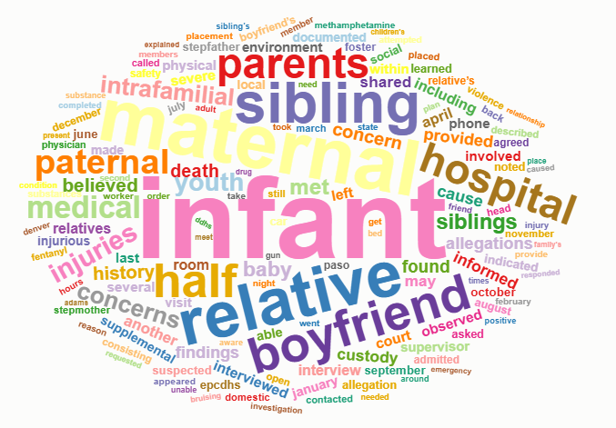
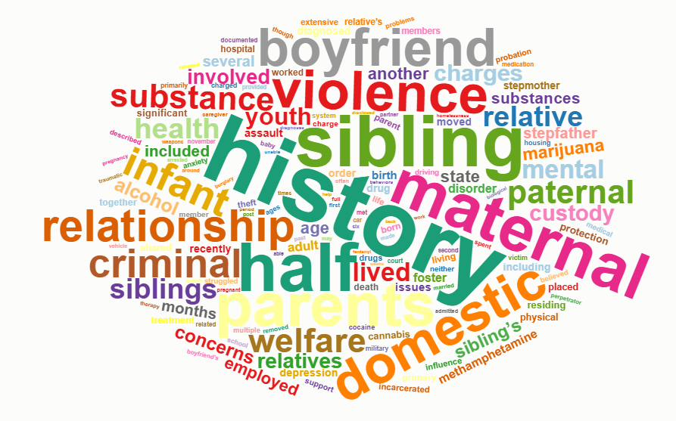
LANGUAGE OF FATALITY, NEAR FATALITY, AND EGREGIOUS ABUSE
What the Narratives Say
Circumstances of Incident
Risk & Contributing Factors
Interpretation. The risk field is dominated by relational and household structure (boyfriend, sibling, domestic, violence, maternal, custody); the circumstances field carries the clinical and mechanism vocabulary. The pairing links who was in the home to how the injury occurred.
18
Notes:
The risk field tells us who was in the home, while the circumstances field tells us how the injury occurred.

Slide 23
NARRATIVE TYPOLOGY
Top Themes Ranked by Prevalence
Risk & Contributing Factors (K = 14)
Circumstances of Incident (K = 15)
Theme | Prev.
Parental Mental Health (Depression, Anxiety, PTSD) | .161
Domestic Violence + Parental Criminal/Substance History | .113
Maternal-Relative Caregiving Amid DV/Incarceration | .091
Infant Cases with Prior Sibling Loss or Removal | .090
Paternal Household — Criminal Justice/Substance Use | .083
Theme | Prev.
Abusive Head Trauma & Unexplained Skeletal Injuries | .113
Accidental Drug Ingestion / Overdose | .099
DV Homicide — Kinship Placement Referrals | .085
Sudden/Unexplained Infant Death | .083
DV Homicide — Custody Proceedings for Survivors | .075
Household composition & caregiver history on the left; injury mechanism & clinical presentation on the right. The leading circumstances theme is an abusive head-trauma pattern.
19
Notes:
Here are the leading themes from both fields, ranked by prevalence. On the risk side, the dominant themes are parental mental health — depression, anxiety, PTSD, followed by domestic violence combined with parental criminal or substance history, and caregiving by maternal relatives amid DV or incarceration.
On the circumstances side, the single leading theme is abusive head trauma and unexplained skeletal injuries, followed by accidental drug ingestion and DV-homicide-related themes.

Slide 24
STUDY 1 · K = 14
Risk & Contributing Factors — Topics
Topic label | Prev. | Top FREX words | Yr
8 Parental Mental Health (Depression, Anxiety, PTSD) | .161 | depression, disorder, anxiety, diagnosed
2 Domestic Violence + Parental Criminal/Substance Hx | .113 | cocaine, dui, charge, parole, aggressor
9 Maternal-Relative Caregiving Amid DV/Incarceration | .091 | maternal, half-siblings, relatives | ▲
6 Infant Cases with Prior Sibling Loss or Removal | .090 | infant, born, sexual, providers, paternal | ▲
13 Paternal Household — Criminal Justice/Substance | .083 | heritage, escape, burglary, prison
3 Mother's Boyfriend — Physical Abuse | .079 | boyfriend, developmentally, juvenile | ▼
4 Intergenerational Child-Welfare Involvement | .071 | childs, adult, life, system, little
1 Half-Siblings Split Across Households / Foster Care | .059 | half, foster, infants, siblings | ▼
10 Older Youth in Non-Parental/State Custody | .052 | youth, youths, legal, male, food
11 Immigration/International Family Background | .049 | united, visa, followed, divorce, country | ▲
7 Stepfather Household — DV & Criminal Justice | .045 | stepfather, stepsibling, employment | ▼
5 Multigenerational Household with Substance Use | .040 | cousin, aunt, cousins, uncle, cannabis | ▲
14 Blended-Family Custody & Visitation Arrangements | .036 | stepmother, middle, youngest, visited | ▼
12 Accidental/Vehicle-Related Injury Risk | .032 | accident, hospital, vehicle, placement
Prev. = mean document-topic γ. Yr = year trend (▲ increasing / ▼ declining): all trends shown are statistically significant.
20
Notes:
This is the full fourteen-topic solution for the risk field; I'll highlight structure rather than read every row.
Prevalence is the mean document-topic proportion, and the right-hand column marks whether a theme is rising or falling across incident years, with significance.
The dominant themes are parental mental health and the domestic-violence-plus-substance cluster. The temporal column is where the movement is: immigration and international family background is rising most strongly, alongside several unsafe caregiving configurations, while the mother's-boyfriend physical-abuse theme and half-sibling household splitting are declining.

Slide 25
STUDY 1 · K = 15
Circumstances of Incident — Topics
Topic label | Prev. | Top FREX words | Yr
4 Abusive Head Trauma & Unexplained Skeletal Injuries | .113 | infant, brain, skeletal, explanation
15 Accidental Drug Ingestion / Overdose | .099 | fentanyl, methadone, narcan, pills
7 DV Homicide — Kinship Placement Referrals | .085 | paternal, relatives, duplicate, adams
3 Sudden/Unexplained Infant Death | .083 | baby, babys, coroner, deceased, autopsy
2 DV Homicide — Custody Proceedings for Survivors | .075 | court-involved, opened, legal, kinship
1 Family Notification After Parental Murder-Suicide | .074 | informed, member, permanency, partner
11 Stepfather — Firearm Access & Medical Neglect | .069 | stepfather, gun, third, old
12 Unsafe Sleep Environment / Co-Sleeping Infant Death | .068 | half-sibling, grandmother, co-sleeping | ▲
14 Chronic Medical Conditions / Hospital Care | .064 | guardian, neighboring, supervisor
5 Severe Domestic Violence / Captivity & Assault | .055 | youngest, counts, stepmother, dog, friends | ▼
13 Motor Vehicle Accidents | .052 | aunt, accident, driving, cousin, car
8 Mother's Boyfriend — Physical Abuse (Burns/Hitting) | .045 | boyfriends, burns, hands, middle
6 Youth Suicide / Suicidal Ideation | .043 | youths, youth, adult, suicide, suicidal
10 Twin/Multiple-Birth Infants with Healing Fractures | .039 | twin, fracture, fractures, healing, rib
9 Unsupervised Children / Shooting Near the Home | .037 | younger, window, fired, belongings, older
Leading circumstance is an abusive head-trauma / skeletal-injury pattern; unsafe-sleep infant death (▲**) is the only theme to rise significantly.
21
Notes:
The fifteen-topic circumstances solution, and the ordering reinforces the central finding. Abusive head trauma and unexplained skeletal injuries sits at the top, at point one-one-three, with FREX terms infant, brain, skeletal,.
Below it are accidental drug ingestion, sudden unexplained infant death, and several DV-homicide and household themes. On the temporal column, only one theme rises significantly — unsafe sleep and co-sleeping infant death — which I'll flag again shortly.
The substantive point is that this is a data-driven model, given only narrative text, that surfaces an abusive head trauma theme as the most prevalent circumstance of severe and fatal maltreatment.

Slide 26
STUDY 1 · CIRCUMSTANCES
Abuse-Related Head Injury & TBI Themes
Narrative themes identify both direct evidence of brain, head, and neck injury and contextual patterns that may signal injuries not captured by structured diagnoses or codes.
Theme | Prev. | What the narratives describe
Abusive Head Trauma & Unexplained Skeletal Injuries | .113 | Serious head trauma, subdural bleeding, and unexplained or multiple fractures, often with injury histories inconsistent with the medical findings
Sudden/Unexplained Infant Death | .083 | Infants found unresponsive or unexpectedly deceased, with medical, autopsy, coroner, and investigative findings used to determine the circumstances of death
Severe Domestic Violence / Captivity & Assault | .055 | Severe or repeated physical violence involving assault, restraint or confinement, weapons, or other aggravated circumstances
Mother's Boyfriend — Physical Abuse (Burns/Hitting) | .045 | Physical abuse involving a caregiver or caregiver’s partner, including hitting, burns, and injuries disclosed by children or identified during investigation
Twin/Multiple-Birth Infants with Healing Fractures | .039 | Infant injury cases involving twins or multiple births and multiple fractures, including fractures at different stages of healing
22

Slide 27
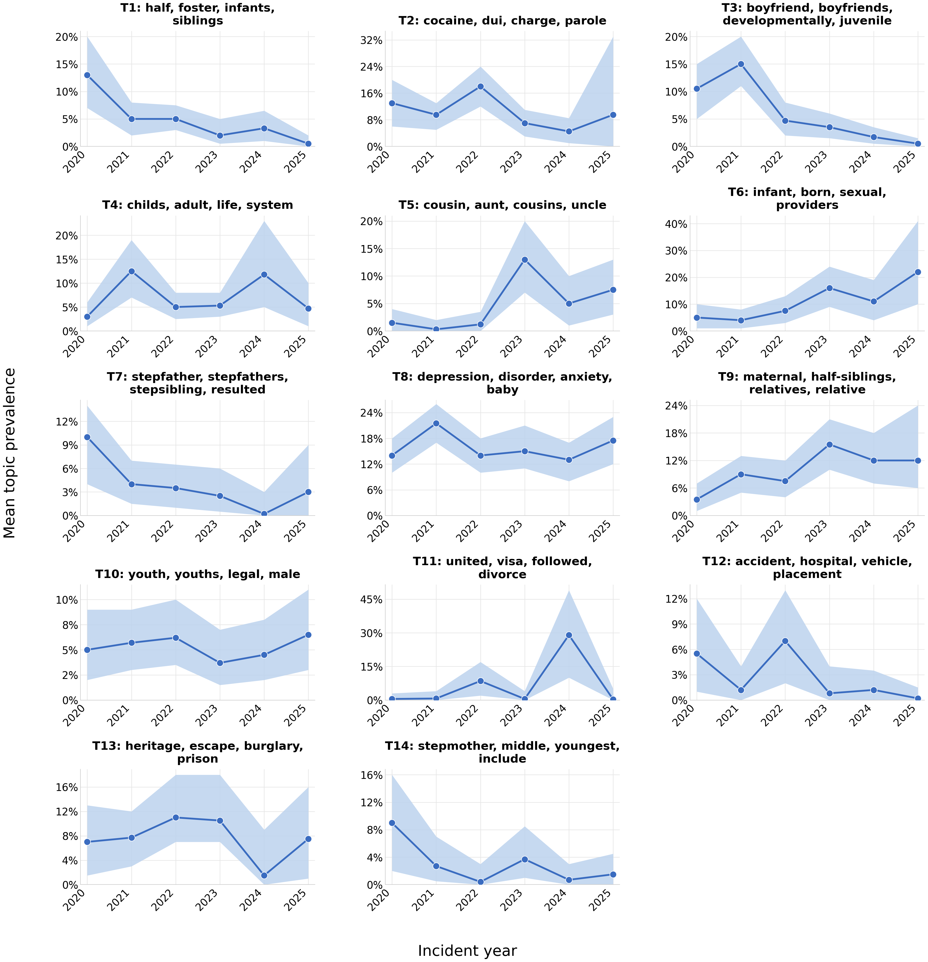
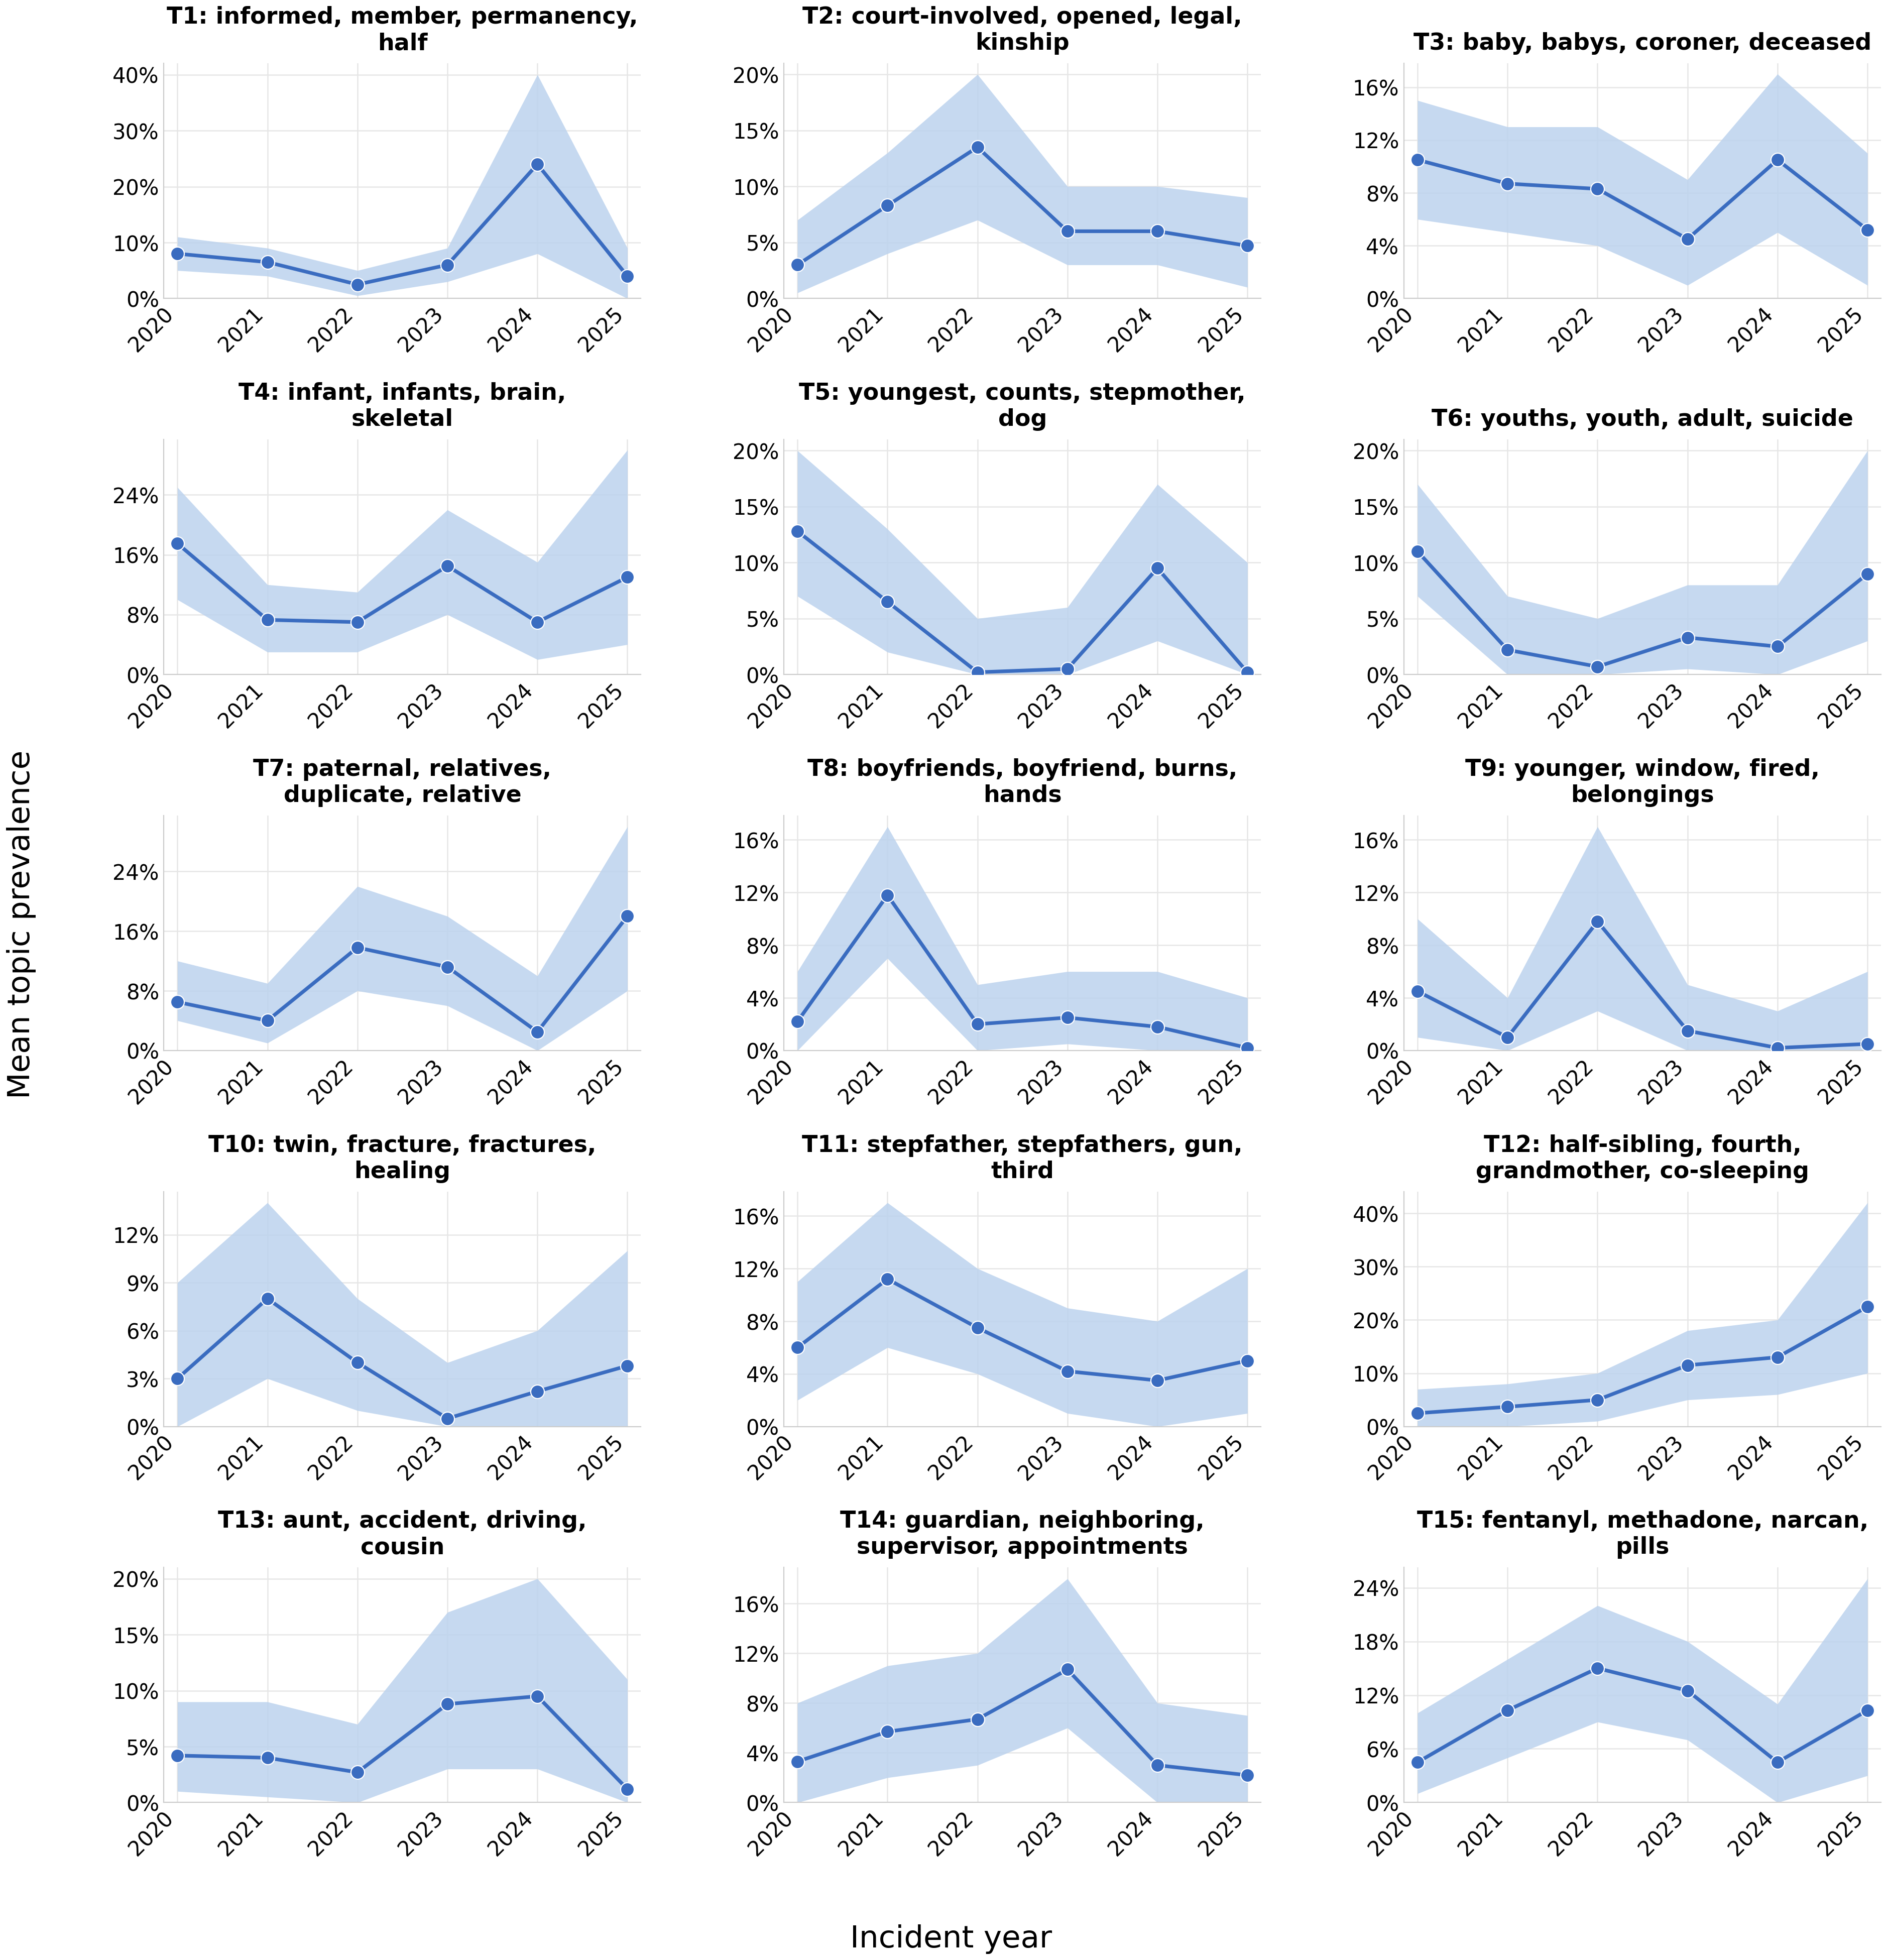
STUDY 1 · 2019–2025
Topic Prevalence by Incident Year
Circumstances of Incident
Risk & Contributing Factors
Increased significantly
Immigration/International Family Background (0.035***)
Unsafe Sleep / Co-Sleeping Infant Death (0.030**)
Infant Cases w/ Prior Sibling Loss or Removal (0.026*)
Multigenerational Household w/ Substance Use (0.025**)
Maternal-Relative Caregiving Amid DV (0.021*)
Declined
Mother's Boyfriend — Physical Abuse (−0.027**)
Half-Siblings Split Across Households (−0.021**)
Severe DV / Captivity & Assault (−0.021†)
Stepfather Household — DV & CJ (−0.018*)
Blended-Family Custody & Visitation (−0.015†)
23
Notes:
Now the temporal dimension, which is what STM's covariate structure buys us. The two panels plot topic prevalence by incident year for each field, and the lists summarize what moves significantly. Rising: immigration and international family background — the strongest effect — unsafe sleep and co-sleeping infant death, infant cases with prior sibling loss, multigenerational substance use, and maternal-relative caregiving. Declining: the mother's-boyfriend physical-abuse theme, half-sibling household splitting, severe DV with captivity, stepfather households with DV and criminal justice, and blended-family custody arrangements. I'd caution against over-reading any single trajectory given the sample size, but the directionality is coherent and, for prevention, actionable — the rising themes point to where attention may be shifting.

Slide 28
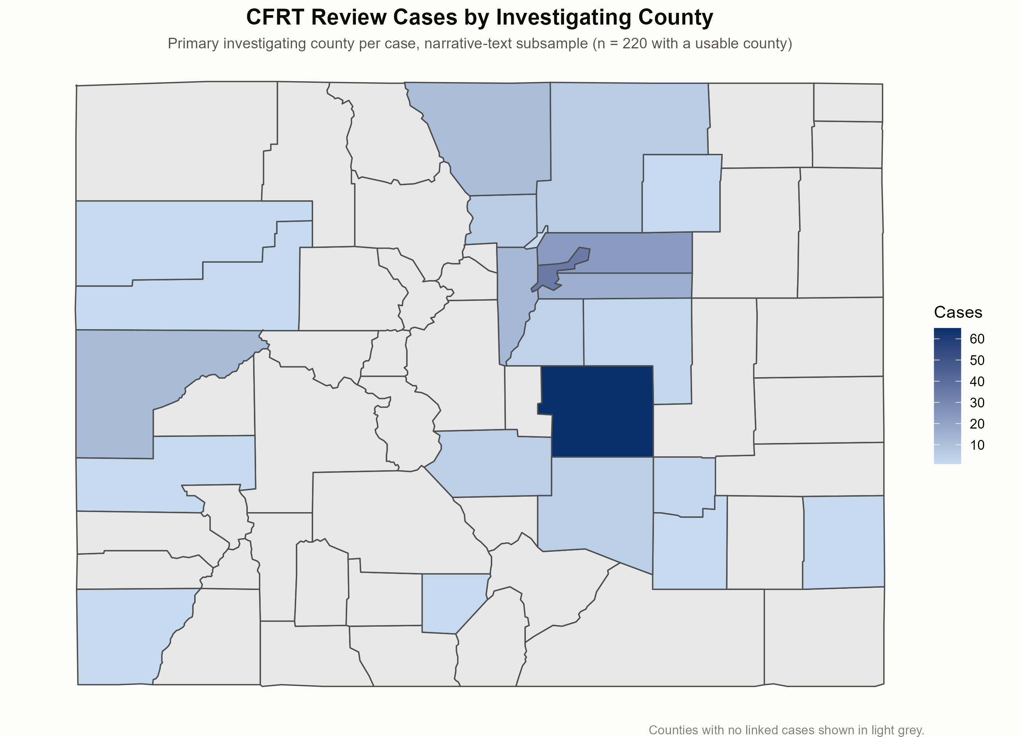
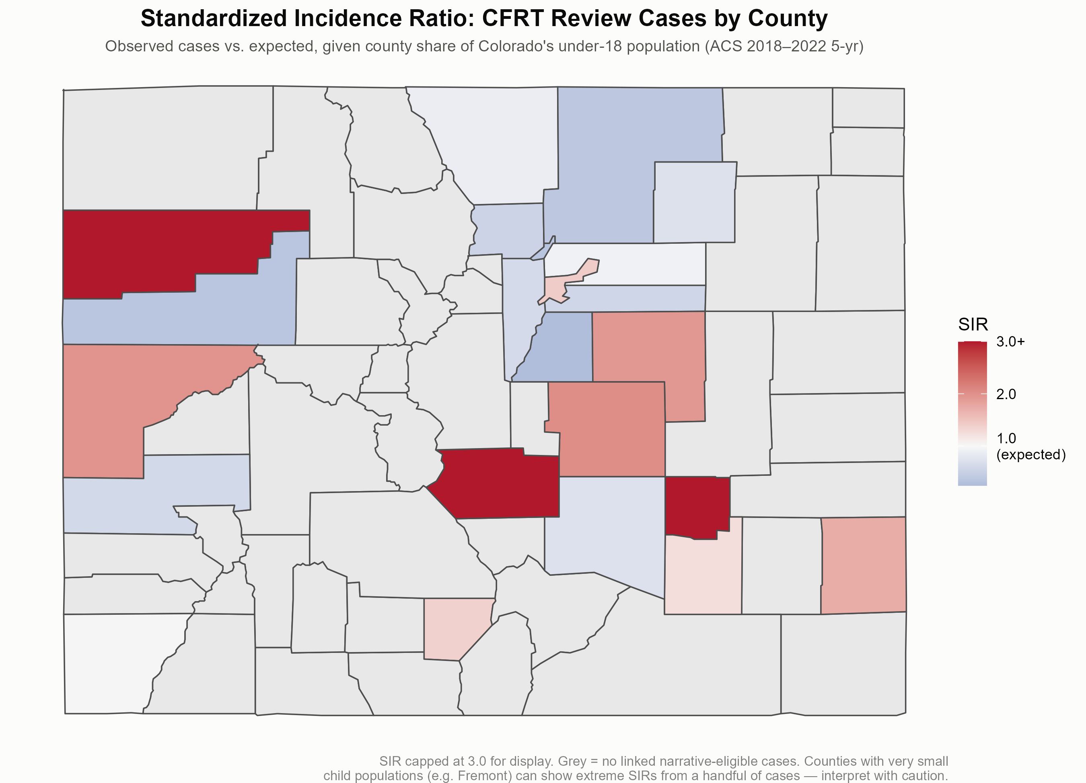
STUDY 1 · GEOGRAPHIC DISTRIBUTION OF FATALITY, NEAR FATALITY & EGREGIOUS ABUSE
Where Cases Concentrate
Cases by investigating county
Standardized Incidence Ratio (SIR)
El Paso, Denver & Adams account for 55.9% of geocoded cases. Adjusting for child population, El Paso has ~2× the expected cases (SIR = 2.03) and Denver exceeds expectation (1.41); smaller counties show excesses (Fremont 3.39, Mesa 1.97) while affluent suburbs fall well below (Douglas 0.24, Boulder 0.54, Arapahoe 0.57).
24
Notes:
Two maps give the geographic distribution. On the left, raw counts by investigating county; on the right, the standardized incidence ratio, which adjusts for the child population so we compare like with like. Three counties — El Paso, Denver, and Adams — account for nearly fifty-six percent of geocoded cases. But adjustment changes the interpretation: El Paso runs at roughly twice its expected rate, Denver above expectation, and several smaller counties show pronounced excesses — Fremont at 3.39, Mesa at 1.97 — while affluent suburbs fall well below one: Douglas at 0.24, Boulder at 0.54. So the burden is not simply where the population is; it is patterned, echoing the deprivation gradient from the prior-work slide. I'll note in limitations that SIRs are unstable for the smallest counties.

Slide 29
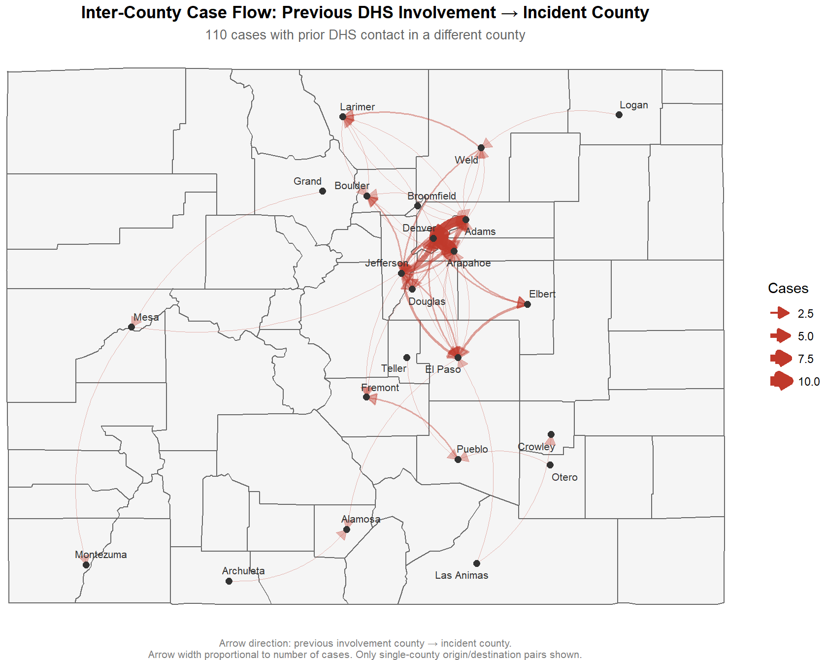
PRIOR DHS INVOLVEMENT → INCIDENT
Inter-County Case Flow
Cross-county movement concentrated among four adjacent Front Range counties — Adams, Arapahoe, Denver, Jefferson.
Most common paths: Adams→Denver and Arapahoe→Denver.
A few long-distance flows originated in rural southern and southwestern counties, raising service-continuity concerns.
These movement histories are recoverable only from the narrative text.
25
Notes:
This flow diagram traces movement between the county of prior DHS involvement and the county of the incident. Most movement concentrates among four adjacent Front Range counties — Adams, Arapahoe, Denver, and Jefferson — with Adams-to-Denver and Arapahoe-to-Denver the most common paths, ten cases each. A smaller number of long-distance flows originate in rural southern and southwestern counties, which raises genuine service-continuity concerns when a family crosses jurisdictions between prior contact and the fatal or near-fatal event. The methodological point to underline: these movement histories are recoverable only from the narrative text — they simply do not exist as a structured field. That completes Study 1.

Slide 30
STUDY 2 · RESULTS
Legal Narratives from Case Law
Appellate opinions surface how abuse-related craniofacial injury, its mechanisms, and its long-term consequences in children are documented — and preserved — in the legal record.
Notes:
We now turn to the second source — appellate case law — which lets us see how abuse-related craniofacial injury, its mechanisms, and its long-term consequences in children are documented, and durably preserved, in the legal record.

Slide 31
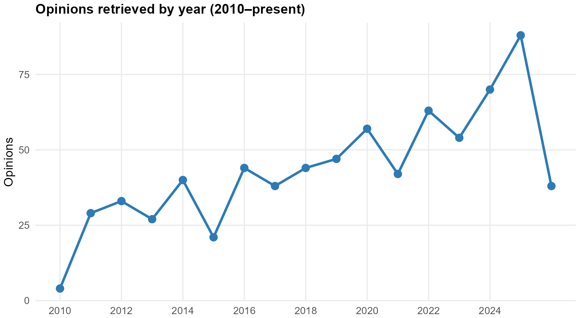
STUDY 2 · COURTLISTENER
Corpus & Retrieval
751 full-text opinions → GPT-4o-mini structured extraction of 9 fields per case.
Confirmed cases carried to STM: Injury Mechanism (K=13) and Long-Term Consequences (K=14).
A consistent upward trend from 2015–2020 (~21 to ~56 opinions).
27
Notes:
The Study 2 corpus, and how it accrues over time. Seven hundred fifty-one full-text opinions were retrieved and passed through the same nine-field GPT extraction; confirmed cases proceed to two STM models — injury mechanism at thirteen topics and long-term consequences at fourteen. The time trend rises steadily, from about twenty-one to fifty-six opinions between 2015 and 2020 — partly a reflection of what reaches appellate review and gets published. The example grounds what these records contain: In re A.M., a child born at twenty-four weeks with cerebral palsy and spastic quadriplegia, a dislodged tracheostomy tube, a ruptured eardrum, water poured on the child, with domestic violence between the parents flagged by the hospital. That level of clinical and behavioral detail is exactly what the legal narrative preserves.

Slide 32
STUDY 2 · COURTLISTENER
Corpus & Retrieval
FACTS AND PROCEDURAL HISTORY {¶2} D.M. and P.M. are the biological parents of A.M., born in November 2020. A.M. was born at 24-weeks and placed in the NICU at Akron Children's Hospital. A.M. was diagnosed with spastic quadriplegia and cerebral palsy. ACH reported multiple issues including the child's trach tube kept coming dislodged, the child's bed was saturated with cold water, her feeds were being interfered with, and the child suffered a ruptured eardrum with no explanation. The hospital was also concerned about domestic violence between Mother and Father. {¶4} Mother stated she accidentally knocked a cup of cold water on the child. Mother allegedly later admitted she intentionally poured water on the child at other times. Mother stated she had a traumatic brain injury and blacked out at times.
FACTS AND PROCEDURAL HISTORY {¶ 2} Greene County Children’s Services (GCCS) became involved with the family in 2020. After C.W.R. was injured when an unsecured door in the family home fell on him, causing a head injury, and Mother and Father had positive drug screens and/or made admissions of drug use, GCCS obtained interim custody of all three children. The children were adjudicated dependent on September 10, 2020. GCCS was subsequently granted temporary custody of the children, pending the parents’ substantial completion of their case plan objectives, with the goal of reunifying the children with their parents. On January 14, 2022, this court affirmed the judgment of the trial court granting temporary custody of the children to GCCS. ... Mother seemed “hypomanic” when she talked…. eviction proceedings had been commenced against them… stayed at two different hotels … Mother and Father “were going through a separation” and “were starting divorce…” … wanted to live in a home “without yelling and screaming.”
27

Slide 33
STUDY 2 · K = 13
Injury Mechanism Topics
# | Topic label | Prev. | Top terms
3 | Physical Assault (Multi-Mechanism) | .145 | physical, altercation, punching, hitting, choking
6 | Blunt Force — Head & Upper Body | .100 | head, kicked, back, striking, shot, violent
8 | Punching & Facial Trauma | .097 | face, fist, closed, eye, several, punched
10 | Attempted Harm & Threat-Based | .084 | attempted, argument, incidents, caused, harm
4 | Repeated & Escalating Assault | .083 | struck, repeatedly, pushed, strangled, slapped
9 | Blunt Force Trauma | .083 | trauma, force, blunt, throat, abusive, multiple
11 | Throwing, Slamming, Environmental | .082 | grabbed, wall, threw, slammed, ground, floor
7 | Strangulation + Weapon-Based | .079 | strangulation, beaten, dragged, hammer, fractures
5 | Severe Injury & Trauma | .064 | punched, brain, skull, death, fracture, ground
13 | Weapon Use / Extreme Violence | .054 | neck, knife, vehicle, belt, threatened, hammer
12 | Child-Involved Assault & Falls | .053 | hit, fall, hair, father, bed, ground, mother
2 | Strangulation & Loss of Consciousness | .050 | choked, consciousness, perpetrator, firearm, face
1 | Firearm-Related Assault | .026 | causing, gunshot, head, face, struck, door
Blunt / physical force to the head and face dominates. Child-Involved Assault & Falls (Topic 12) is a structurally distinct pattern.
28
Notes:
The thirteen-topic injury-mechanism solution for the opinions. Read down the prevalence column and the story is blunt force to the head and face: physical assault, multi-mechanism, is most prevalent at point one-four-five; blunt force to the head and upper body at point one-zero-zero; punching and facial trauma at point zero-nine-seven. Below those sit escalating-assault, throwing-and-slamming, and strangulation themes. I want to flag two topics specifically, because they recur in the synthesis: Topic 12, child-involved assault and falls, which is structurally distinct — the language of children, beds, falls, and hair; and Topic 2, strangulation with loss of consciousness. These two carry most of the child-relevant and highest-lethality signal, and we'll return to both.

Slide 34
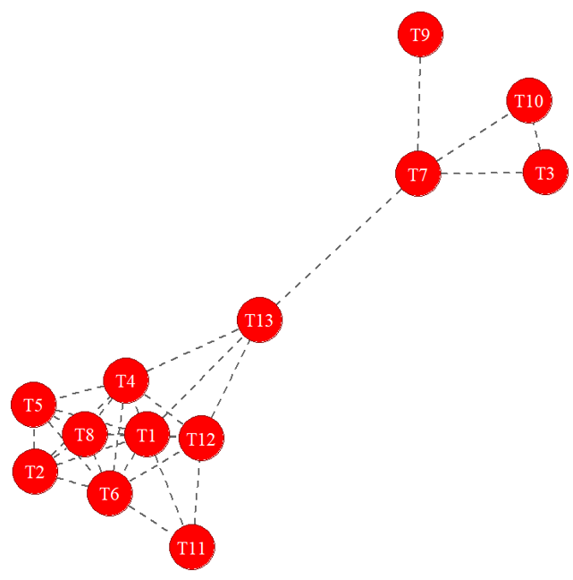
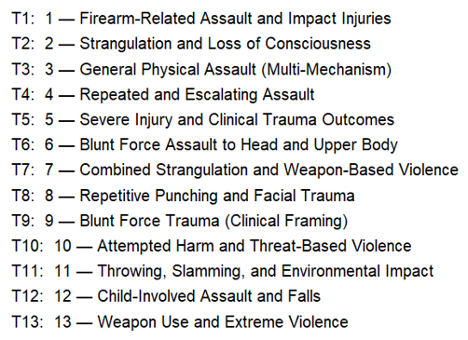
STUDY 2 · K = 13
Injury-Mechanism Topic Correlations
A smaller cluster that captures strangulation, weapons, and more severe or threat-based violence.
Validated with findThoughts()
Topic 13 (weapon use/extreme violence) helps connect the two groups
Topic 12 · Child-Involved Assault & Falls
“Grabbed M.S. by the hair and tossed her on the bed, leading to a fall where she hit her head on a bookshelf.”
“S.E. fell off the bed and hit her head on a toy.”
Topic 2 · Strangulation & Loss of Consciousness
“Struck the victim in the face and choked her, causing her to lose consciousness multiple times.”
Two clusters connect through T7 (strangulation + weapon) and T13 (weapon/extreme violence); T11 & T13 link to Child-Involved Assault (T12) — a recurring escalation pattern.
29
Notes:
This slide does two things. The network on the left shows how the mechanism topics correlate — which themes tend to co-occur within the same opinions — and the labeled key identifies each node. Two clusters connect through the strangulation-plus-weapon and the weapon-slash-extreme-violence topics; and, importantly, the throwing-and-slamming and extreme-violence topics link into child-involved assault — a recurring escalation pattern rather than isolated events. On the right are representative excerpts pulled with findThoughts, which is how we validated that the labels mean what we claim. For child-involved assault: a child grabbed by the hair and thrown, hitting her head on a bookshelf; a child falling from a bed onto a toy. For strangulation: a victim struck and choked into repeated loss of consciousness. The quotations confirm the topics are coherent, not artifacts of the model.

Slide 35
STUDY 2 · K = 14
Long-Term Consequence Topics
Topic label | Prev. | Top terms
10 PTSD and Psychological Trauma | .113 | disorder, stress, anxiety, post-traumatic, ptsd
3 Acute Severe Head and Skeletal Trauma | .100 | concussion, fracture, skull, orbital, tooth
4 Ongoing Head Injury and Functional Impairment | .096 | head, required, still, difficulty, facial, stitches
1 Surgical and Structural Fracture Injuries | .085 | requiring, surgery, fractured, nose, ribs
7 Brain Injury and Cognitive Damage Risk | .077 | brain, cognitive, potential, damage, skull, leading
6 Delayed Physical Injury and Tissue Damage | .073 | damage, two, three, fractures, incident, nasal
8 Fatal and Life-Threatening Outcomes | .072 | suffered, death, swelling, severe, bruising
5 Persistent Pain, Vision, and Memory Problems | .071 | pain, experienced, vision, significant, swelling
9 Minor to Moderate Lasting Physical Injury | .067 | permanent, bruising, tooth, swelling, concussion
11 Vision Loss and Severe Physical Impairment | .062 | loss, eye, left, blood, significant, memory
13 Chronic Medical Care and Severe Disability | .056 | due, ongoing, care, multiple, severe, surgeries
2 Long-Term Cognitive and Psychological Impairment | .052 | memory, serious, impairment, psychological, long-term
12 Developmental and Long-Term Disability | .046 | issues, long-term, surgeries, therapy, severe
14 Complex Traumatic Brain Injury & Systemic Effects | .030 | traumatic, leading, physical, brain, potential
Psychological trauma is the single most prevalent consequence topic; head, skull and brain-injury topics recur throughout.
30
Notes:
The fourteen-topic long-term-consequence solution, and here the leading theme is telling: PTSD and psychological trauma is the single most prevalent consequence topic, at point one-one-three. But look at what follows — acute severe head and skeletal trauma, ongoing head injury and functional impairment, brain injury and cognitive-damage risk, complex traumatic brain injury and systemic effects. Head, skull, and brain-injury themes recur throughout the ranking. So the legal record independently documents the same two burdens the death reviews imply — a psychological toll and a neurological one — which is precisely the cross-source corroboration this study is built to produce.

Slide 36
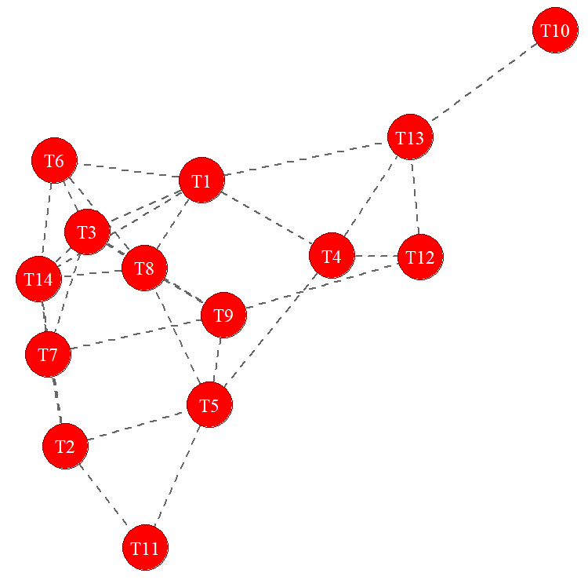
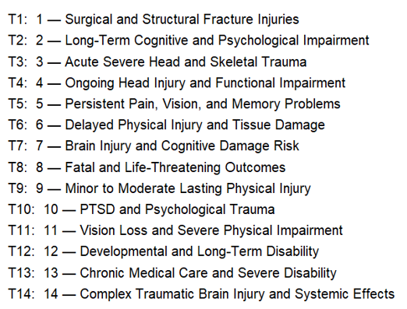
STUDY 2 · DOCUMENTED CONSEQUENCES
Craniofacial Long-Term Burden
The network shows how narratives connect initial injuries with subsequent consequences, including functional, developmental, and cognitive effects.
Acute head and skeletal trauma connects with brain injury, severe outcomes, and cognitive and physical impairment.
PTSD and psychological trauma (T10) is more distinct, connecting to the larger network through severe disability.
Together, the narratives reveal a continuum from acute bodily injury to longer-term brain and functional consequences
Acute trauma is linked with brain injury, severe outcomes, and longer-term impairment
Long-term consequences documented in the legal record following abuse-related craniofacial injury.
31
Notes:
This slide quantifies the documented long-term burden following craniofacial injury, tallied from the opinions, with the correlation network for these consequence topics on the right. Neurological or TBI outcomes appear in twenty-two percent of cases; psychological or PTSD outcomes in sixteen percent; visual impairment in over thirteen percent; then vascular or hemorrhagic, surgical, and — notably — endocrine or pituitary involvement in a small but clinically striking share.
These are serious, multi-system sequelae, recorded in a legal document, for injuries a diagnostic code would render as a single acute event.

Slide 37
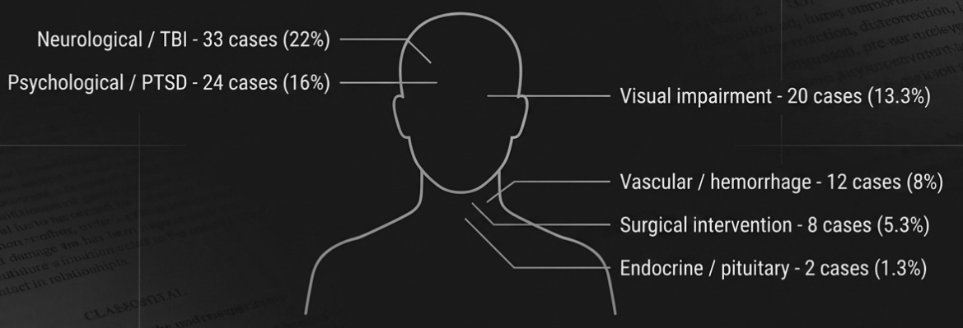
Long-term Consequences of Craniofacial-Related Injuries

Slide 38
STUDY 2 · CHILD VICTIMS
Documented Outcomes in Children
Opinion | Perpetrator | Injury site | Documented consequences
#11277309 | unknown | skull | Ongoing neurological care required; diagnosed with PTSD
#10168612 | parent | ear | Spastic quadriplegia & cerebral palsy; requires full-time care
#10580720 | unknown | neck, arm, skull, lung | Skull fracture impacted pituitary gland → diabetes insipidus
#11307256 | stepfather | head | Concussion; stress hives; began wetting the bed
Why this matters. Court records document cerebral palsy, pituitary damage, and neurological sequelae in children perhaps years before any clinical follow-up study would reach these survivors.
33
Notes:
To make the consequences concrete rather than aggregate, four child cases drawn from the opinions. A skull injury with ongoing neurological care and a PTSD diagnosis; the cerebral-palsy and spastic-quadriplegia case requiring full-time care; a skull fracture that impacted the pituitary gland, producing diabetes insipidus; and a stepfather-inflicted head injury followed by concussion, stress hives, and bed-wetting. The reason this matters, stated on the slide, is a genuine strength of the case-law source: these records document cerebral palsy, pituitary damage, and neurological sequelae in children years before any clinical follow-up study would ever reach these survivors.

Slide 39
STUDY 2 · RELIABILITY & CONVERGENT VALIDITY
Validation of LLM Extraction
Convergent validity — BART zero-shot NLI
Reliability — repeat-run agreement
Consequence | GPT | BART
Vision loss | 11.5% | 10.3%
TBI / brain | 40.0% | 30.1%
Psychological | 16.8% | 20.7%
Death | 12.4% | 21.3%
Field | Score
DV confirmed | 93.3%
Long-term consequences | 90.3%
Injury mechanism | 83.3%
Case type | 76.7%
Victim type | 76.7%
Injury location | 75.7%
Perpetrator relationship | 73.3%
Legal outcome | 67.9%
Ruling | 60.0%
Strong agreement for most categories; death & vision loss likely undercounted by GPT (conservative attribution).
The fields most central to the analysis — DV confirmed (93%), injury mechanism (83%), long-term consequences (90%) — all clear the 80% threshold.
32
Notes:
This is where we test whether to trust the extraction using supervised ML.
On the left, convergent validity: for four consequence categories we compare the GPT-derived rate against an independent BART zero-shot classifier. Agreement is close for vision loss and reasonable for TBI and psychological outcomes; where they diverge — death and vision loss — GPT reads lower.
On the right, reliability from re-running the extraction: the fields most central to our analysis all clear the eighty-percent threshold — DV confirmed at ninety-three, long-term consequences at ninety, injury mechanism at eighty-three. The fields that fall short — legal outcome and ruling — are more interpretive.

Slide 40
INTEGRATED FINDINGS
Two Sources Determine a Conceptual Framework
Where the death-review and case-law pipelines converge — and why triangulating them is the strongest approach to detecting abuse-related child head injury.
Notes:
With both studies on the table, this final section is the payoff — where the death-review and case-law pipelines converge, and why triangulating them is stronger than relying on either alone.

Slide 41
COMPARE & CONTRAST
Novel Findings and Convergence With Prior Research
Integrated finding | Study 1 · CFRT | Study 2 · Case law
Blunt force / craniofacial trauma is the dominant abuse injury mechanism | “Abusive Head Trauma & Unexplained Skeletal Injuries” is the leading Circumstances theme (.113) | Physical Assault (.145) & Blunt Force to Head/Upper Body (.100) dominate mechanisms
Strangulation: high-lethality, hidden at the ED visit | Captured within severe-DV / captivity & assault themes | Topic 2 (.050): soft-tissue damage documented 2–3 days post-incident
Child TBI is structurally distinct & under-surveilled | Infant / skeletal-injury themes; unsafe-sleep infant death | STM separates Child-Involved Assault (T12) from IP violence; CP & pituitary damage
Psychological burden is the dominant long-term consequence | Parental Mental Health is the leading risk theme (.161) | PTSD / Psychological Trauma is the top consequence topic (.113)
Both systems undercount — triangulation is essential | Narratives only for prior-DHS cases (100% system-involved) | Only appealed cases reach the record (85.7% affirmed)
35
Notes:
The rows point towards agreement between two entirely independent data sources. Blunt, craniofacial force is the dominant mechanism in both — the leading circumstance theme in the reviews, and the top mechanism topic in the opinions. Strangulation surfaces in both as a high-lethality pattern whose soft-tissue damage can be delayed. Child TBI emerges as structurally distinct in both — the model literally separates child-involved assault from intimate-partner violence. Psychological burden is the leading long-term signal in both.

Slide 42
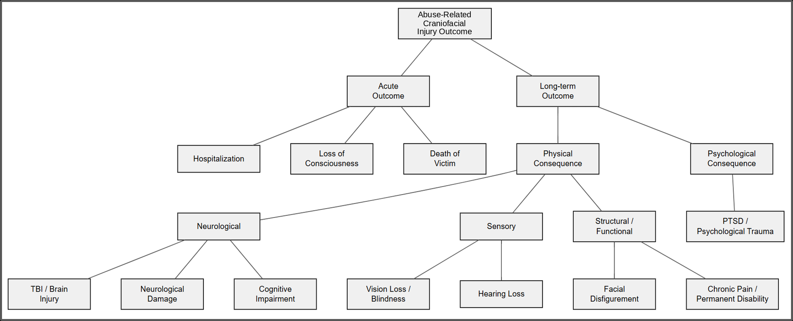
FOLLOWING ABUSE-RELATED CRANIOFACIAL INJURY IN CHILDREN
Acute & Long-Term Outcomes in Legal Narratives
Same picture from both sources. This full spectrum of acute and long-term outcomes — neurological / TBI, sensory, structural, and psychological is consistent across both the CFRT death reviews and the case-law narratives, showing that the two data sources capture the same abuse-related injury trajectory.
36
Notes:
This figure summarizes the outcome architecture — acute outcomes such as hospitalization, loss of consciousness, and death; and long-term physical and psychological consequences branching into neurological, sensory, structural, and psychological sequelae. This full spectrum recurs across both the CFRT death reviews and the case-law narratives and traces the same abuse-related injury trajectory.

Slide 43
IMPLICATIONS
What AI-Assisted Narrative Analysis Adds
Recovers hidden context
Works at scale
Caregiver behavior, injury explanations, and household circumstances that diagnoses and codes miss.
Free-text information examined across large numbers of cases and integrated with external data.
Finds recurring patterns
Improves understanding of why
Combinations of circumstances that repeat across cases, without case-by-case review.
Identifies where information, services, coordination or responses warrant closer examination.
Preserves overlap
Complements structured data
Cases carry multiple topics at once — reflecting co-occurring caregiver, household & injury factors.
Enhances — rather than replaces — administrative surveillance for prevention without assigning blame.
37
Notes:
AI-assisted narrative analysis turns information buried in free text into patterns we can examine systematically at scale. It complements existing surveillance by adding context and revealing relationships that structured codes alone may miss.

Slide 44
IMPLICATIONS
Legal, Policy & Practice Implications
Document craniofacial injury
Treat strangulation as a lethality predictor
Both sources converge on craniofacial injury as the dominant mechanism — ICD codes routinely undercount it.
Soft-tissue damage can surface 2–3 days later; clinicians and courts need training on delayed sequelae.
Recognize long-term neurological harm
Protect children as a distinct profile
Records document cerebral palsy, pituitary damage & blindness in children years before clinical follow-up.
Child-involved injury is structurally distinct in both datasets — warranting specialized clinical & legal protocols.
Screen for mechanism, not just diagnosis
Use narrative text as surveillance
Falls, environmental contact & “accidental” injury may be embedded in an abuse context.
Appellate opinions and death reviews function as injury-surveillance sources beyond structured fields.
38
Notes:
These findings directly affect how injuries are documented, screened, and followed over time. They also show why narrative information can strengthen clinical, legal, and surveillance systems by capturing mechanisms and consequences that structured diagnoses may miss.

Slide 45
SCOPE & MEASUREMENT
Limitations
Sample & scope
Method & measurement
Small narrative corpus (N = 223) reduces the reliability of topic estimation.
Not a random sample: narrative reports exist only for prior-DHS cases (100% system-involved & substantiated vs. 64.2% overall).
Findings describe system-involved fatalities and near-fatalities; Colorado's statutory process may not generalize.
LLM-extracted fields await formal validation; the drug/alcohol flag is a descriptive corpus characteristic only.
Incident year was the only prevalence covariate; child- and county-level covariates are deferred to a later phase.
Geographic analysis is descriptive; SIRs are unstable for small counties and rural areas are underrepresented.
39
Notes:
Several limitations are worth noting. First, we use this to demonstrate feasibility, and deliberately use a small corpus particularly for the case law (the fatality report data can also be expanded by using more years)
This may limit the reliability of topic estimation.
We do not have a random sample, since narrative reports exist only for prior-DHS cases, so findings describe system-involved fatalities and near-fatalities, and Colorado's statutory process may not generalize.
On method: the LLM-extracted fields still await fuller formal validation, and the drug-and-alcohol flag is a descriptive corpus characteristic, not a clinical measure; incident year was the only prevalence covariate, with child- and county-level covariates are left for future analyses;
the geographic analysis is descriptive, with SIRs unstable for small counties and rural areas underrepresented. These bound the claims, but they do not undercut the central proof of concept.

Slide 46

THANK YOU FOR ATTENDING!!
Gia E. Barboza-Salerno (Founding Director) · ISSUES Lab · The Ohio State University
Notes:
To conclude. First, AI-based analysis turned narrative case information into analyzable data — behavior, mechanism, household context, and clinical findings that structured fields do not carry. Second, topic modeling recovered coherent, interpretable patterns of risk and circumstance, including a prominent abusive-head-trauma and unexplained-skeletal-injury signal. Third, TBI and head injury emerged as a defining feature of severe and fatal maltreatment across both pipelines. And the overarching message: triangulation is the strongest approach — neither death reviews nor case law captures abuse-related child injury alone, but integrated, they identify patterns that improve our understanding of why these incidents occur, and they support prevention without assigning blame. Thank you; I'm happy to take your questions.

