Slide 1


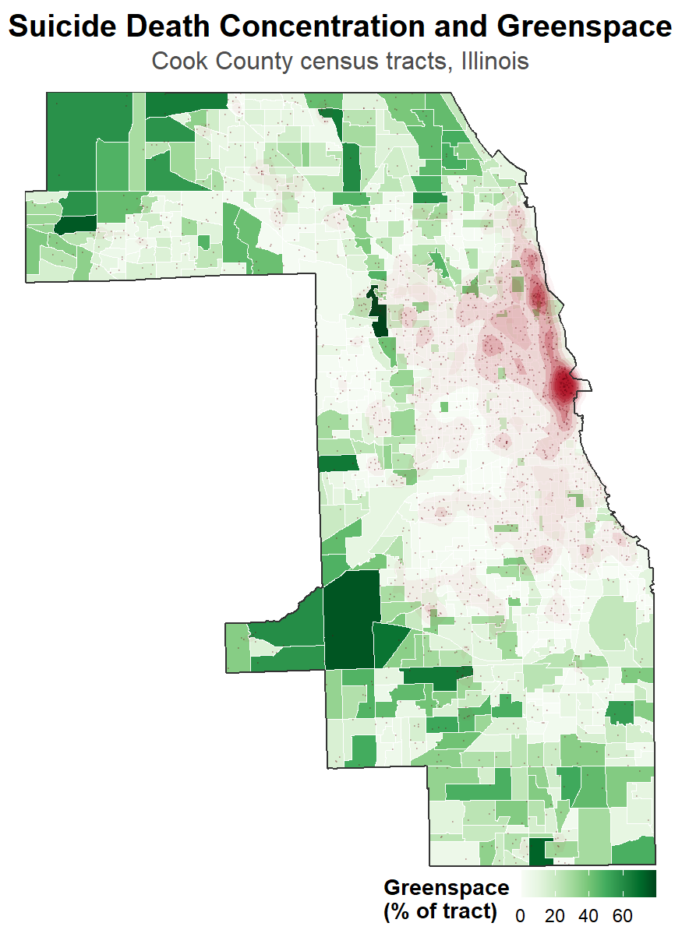
How Multiple Environmental Factors Influence Mental Health Outcomes
Malcolm McCarthy¹, Dr. Gia Barboza-Salerno^{2, 3}, Dr. Karla Shockley McCarthy⁴
¹The Ohio State University Department of Psychology, ²The Ohio State University College of Social Work, ³The Ohio State University College of Public Health, ⁴Ohio Colleges of Medicine Government Resource Center
Introduction
Depression is highly prevalent (16% of women; 10% of men) and marked by chronic mood and energy disturbances (APA, 2022; CDC, 2025). It is a documented risk factor for suicidal ideation in the DSM‑5 (APA, 2022; Porter, 2026).
Despite strong interpersonal links, geographic patterns show that high‑depression areas often do not exhibit high suicide rates (UC Boulder, 2018). Environmental factors such as land use may structurally decouple these outcomes.
This study analyzes depression and suicide at the neighborhood level to capture fine‑scale spatial variation (Lawson et al., 2018; Lee et al., 2023). Treating them as distinct outcomes allows identification of mechanistic differences (Litman, 2026; Porter, 2026).
Research Aims & Hypotheses
This study aims to: assess (1) spatial relationships between suicide and depression, (2) how green space, area deprivation, and walkability predict outcomes, and (3) how environmental interactions modify these relationships.
Expected a positive spatial association between suicide and depression, even with spillover effects (Lee et al., 2023). Hypothesized that area deprivation would uniformly worsen both outcomes (Lee et al., 2023; Vassilaki et al., 2022).
Anticipated divergent environmental effects: green space protective for depression but a risk factor for suicide, and walkability varying with urbanization and land‑use gradients (Litman, 2026; National Center for Biotechnology Information, 2023).
Spatial Data and Statistical Findings
Results
Kruskal‑Wallis tests showed significant age‑cohort differences in neighborhood exposures (Table 2). Depression and suicide exhibited a significant negative spatial co‑location (I = −0.162, z = −14.07, p < 0.001; Table 3).
In the spatial error model, higher neighborhood deprivation increased depression levels (β = 0.071, SE = 0.004, p < 0.001), while greenspace was a significant negative predictor (β = −0.014, SE = 0.005, p = 0.005).
Deprivation did not significantly predict suicide incidence (IRR = 1.0016, p = 0.202). Instead, walkability strongly increased suicide risk (IRR = 1.0644, 95 % CI [1.0381, 1.0917], p < 0.001), and greenspace slightly increased suicide incidence (IRR = 1.0109, 95 % CI [1.0066, 1.0151], p < 0.001).
Suicide locations were significantly closer to greenspace boundaries than randomized control points (W = 1,353,955, p < 0.001; Table 5).
Table 1 Demographic and Neighborhood Characteristics of Suicide Deaths and Baseline Population
Demographics | Suicide Deaths (N = 1,710) | Cook County Population (N = 5,169,517)
Mean Age (SD) | 46.81 (18.17) | N/A
Median Age [IQR] | 45.50 [31.00, 60.00] | 37.00 [33.00, 62.00]
18–24 Age Group, n (%) | 193 (11.29%) | 455,959 (8.82%)
25–45 Age Group, n (%) | 662 (38.71%) | 1,544,552 (29.88%)
45–65 Age Group, n (%) | 557 (32.57%) | 1,282,693 (24.81%)
65+ Age Group, n (%) | 298 (17.43%) | 757,688 (14.66%)
Female, n (%) | 374 (21.87%) | 2,659,831 (51.45%)
Male, n (%) | 1,334 (78.01%) | 2,509,686 (48.55%)
White, n (%) | 1,290 (75.44%) | 2,168,964 (41.96%)
Black, n (%) | 321 (18.77%) | 1,184,373 (22.91%)
Asian, n (%) | 78 (4.56%) | 382,075 (7.39%)
Am. Indian / Native, n (%) | 2 (0.12%) | 4,646 (0.09%)
Other / Multi-racial, n (%) | 19 (1.11%) | 121,027 (2.34%)
Latine / Hispanic, n (%) | 281 (16.43%) | 1,308,432 (25.31%)
Non-Latine / Non-Hispanic, n (%) | 1429 (83.57%) | 3,861,085 (74.69%)
Area Deprivation Index (ADI; Mean (SD)) | 47.02 (21.72) | 48.00 (22.96)
Walkability Index (Mean (SD)) | 13.91 (2.38) | 13.85 (2.37)
Greenspace % (NLCD; Mean (SD)) | 8.84% (14.22%) | 7.14% (12.62%)
Note. N = 1,710 for the suicide decedent sample; N = 5,169,517 for the overall Cook County population baseline. ADI = Area Deprivation Index; NLCD = National Land Cover Database; SD = Standard Deviation; IQR = Interquartile Range. Latine/Hispanic categories are mutually exclusive from non-Latine/non-Hispanic designations.
Discussion
Multivariate models showed clear mechanical differences between chronic distress and acute mortality (Depression spatial error: λ = 0.740, p < .001; Suicide negative binomial: θ = 8.608, p < .001).
Higher greenspace and walkability in Cook County reflect suburban/exurban structural patterns—older age profiles, lower social cohesion, and greater firearm access—indicating these associations are structural, not causal.
Positive suicide IRRs reflect tract‑level demographic and land‑use distributions rather than direct environmental effects on individual suicide risk.
Proximity analyses show green spaces function as physical risk environments, with the 1 km buffer illustrating how movement patterns during acute crisis reduce distance to accessible locations.
Policy Implications
Restorative Planting: Plant mature canopy trees with cleared understories to provide vegetation while minimizing visual isolation.
Defensible Space: Improve trail lighting, thin out underbrush, and increase surveillance within the 1 km buffer zone.
Resource Mapping: Map mobile crisis response teams onto identified high-risk zones for efficient deployment.
Physical Interventions: Deploy crisis-hotline signage, mobile geofencing, and emergency call boxes at trailheads.
Limitations
Ecological Design: Tract-level associations reflect spatial patterning across neighborhoods and may not represent individual-level relationships (ecological fallacy).
Data Aggregation: Treating multiple years of data as homogeneous loses temporal context.
Risk vs. Mortality: Coordinate data is based on location of death rather than location of residence or crisis onset.
Table 2 Age-Specific Disparities in Suicide and Neighborhood Environments
Category / Environmental Metric | 18–24 | 25–45 | 45–65 | 65+ | Test Statistic & Effect Size | p-value
Suicide Deaths (N = 1,710), n (%) | 193 (11.29%) | 662 (38.71%) | 557 (32.57%) | 298 (17.43%) | χ² = 335.72 (df = 3) | < .001
Neighborhood ADI (Median [IQR]) | 54.75 [33.88, 71.75] | 47.75 [30.10, 62.50] | 46.00 [30.64, 59.69] | 44.25 [29.17, 56.94] | H = 20.24, ε² = 0.0124 | < .001
Neighborhood Walkability (Median [IQR]) | 14.32 [13.05, 15.48] | 14.33 [12.98, 15.50] | 14.22 [12.67, 15.25] | 14.21 [12.46, 15.42] | H = 6.11, ε² = 0.0038 | 0.106
Neighborhood Greenspace % (Median [IQR]) | 1.08% [0.00%, 7.83%] | 1.22% [0.00%, 8.57%] | 2.76% [0.00%, 14.99%] | 2.77% [0.11%, 16.60%] | H = 23.32, ε² = 0.0143 | < .001
Methods: Data Sources
Suicide data came from the Cook County Medical Examiner archive, filtered for suicide deaths from 2022–2025 (N = 1,710) (Cook County Medical Examiner, 2026). Population‑level distress was measured using CDC PLACES 2023 estimates (CDC, 2024).
Depression was operationalized using MHLTH_CrudePrev, capturing adults reporting ≥14 days of poor mental health in the past month (CDC, 2024). Neighborhood green space was quantified using NLCD 2021 land‑cover codes (Dewitz, 2023).
SES was measured using the Area Deprivation Index (ADI), a composite of 17 socioeconomic indicators across four domains (Kind & Buckingham, 2018; University of Wisconsin, 2024). Walkability was assessed using the EPA National Walkability Index (EPA, 2021).
Methods: Statistical Analysis
All analyses were conducted at the census‑tract level using aggregated measures of greenspace, walkability, structural disadvantage, and suicide mortality. A Kruskal‑Wallis test assessed non‑parametric environmental differences across age groups (Kruskal & Wallis, 1952).
Spearman’s Rank Correlation tested the baseline aspatial relationship between distress and suicide counts (Kramer, 2023). Bivariate Moran’s I quantified localized spatial co‑location between distress and suicide (Anselin, 1995; Bivand & Wong, 2018).
A spatial error regression modeled environmental predictors of distress while accounting for spatial autocorrelation (Anselin, 2007). A non‑spatial negative binomial model with a population offset provided baseline comparison for suicide counts (Lee et al., 2023).
A point‑pattern kernel density estimate (KDE) validated tract‑level findings using continuous micro‑scale spatial analysis (Kramer, 2023; Lee et al., 2023). Residual checks confirmed that rare‑event clustering and spatial dependence did not bias inference.
Figure 1. Spatial Distribution of Suicide Death Concentration and Tract-Level Greenspace Percentage in Cook County, Illinois. Red density contours represent kernel density estimates of suicide mortality clusters relative to background canopy coverage (green).
Note. ADI = Area Deprivation Index; IQR = Interquartile Range. Higher ADI values indicate greater neighborhood socioeconomic deprivation. Neighborhood walkability scores are based on the EPA Walkability Index. Greenspace percentages represent total canopy and vegetation cover at the census tract level.
Differences across age cohorts are evaluated using a Chi-square test (χ²) for categorical counts and Kruskal-Wallis tests (H) for non-parametric continuous environmental metrics. Epsilon-squared (ε²) values represent the estimate of effect size for the non-parametric analyses. Significant p-values are highlighted relative to an alpha level of .05.
Table 4 Regression Analysis of Depression and Suicide Rates
Predictor | Baseline Model Coefficient [95% CI / SE] | p-value | Interaction Model Coefficient [95% CI / SE] | p-value
Spatial Error Model (Depression)
Intercept | 12.962 (0.472) | < .001 | 13.586 (0.955) | < .001
ADI (Deprivation) | 0.071 (0.004) | < .001 | 0.061 (0.016) | < .001
Walkability | 0.001 (0.028) | 0.984 | -0.047 (0.064) | 0.465
Greenspace % | -0.014 (0.005) | 0.005 | -0.021 (0.021) | 0.321
ADI × Walkability | — | — | 0.001 (0.001) | 0.483
ADI × Greenspace | — | — | -0.000 (0.000) | 0.646
Walkability × Greenspace | — | — | 0.001 (0.001) | 0.534
Model Fit | AIC = 5,067.6, λ = 0.740 |  | AIC = 5,072.3, λ = 0.742
Negative Binomial Model (Suicide Rates)
Intercept | 0.0001 (0.0001, 0.0002) | < .001 | 0.0001 (0.0000, 0.0003) | < .001
ADI (Deprivation) | 1.0016 (0.9991, 1.0041) | 0.202 | 1.0034 (0.9867, 1.0201) | 0.688
Walkability | 1.0644 (1.0381, 1.0917) | < .001 | 1.0718 (1.0110, 1.1362) | 0.02
Greenspace % | 1.0109 (1.0066, 1.0151) | < .001 | 1.0035 (0.9827, 1.0240) | 0.744
ADI × Walkability | — | — | 0.9998 (0.9986, 1.0009) | 0.666
ADI × Greenspace | — | — | 1.0002 (1.0000, 1.0003) | 0.071
Walkability × Greenspace | — | — | 1.0000 (0.9986, 1.0014) | 0.989
Model Fit | AIC = 3,659.9, θ = 8.608 |  | AIC = 3,661.1, θ = 8.850
Table 3 Bivariate and Spatial Associations Between Depression and Suicide
Analysis / Variable Pair | Metric | Value / Estimate [95% CI] | Test Statistic | p-value | Interpretation
Depression Prevalence × Suicide Counts | Spearman's Correlation | ρ = -0.159 [-0.206, -0.111] | S = 452,346,867 | < .001 | Significant, weak negative correlation.
Depression Prevalence × Suicide Counts | Bivariate Moran's I | I = -0.162 | z = -14.07 | < .001 | Significant negative spatial co-location.
Note. CI = Confidence Interval. Bivariate association evaluated using Spearman's rank correlation coefficient (ρ) to protect against non-normality in raw suicide counts.
Bivariate Moran's I measures the spatial co-location of tract-level depression prevalence and suicide rates, where a negative value indicates that areas with high depression prevalence are spatially contiguous to areas with lower suicide counts than expected by chance alone. The z-statistic for Moran's I is derived via a normal approximation of the randomization distribution.
Table 5 Green Space Spatial Associations and Proximity Gradients
Greenspace Analysis / Variable | Metric | Physical Context / Value | Test / Z Statistic | p-value
Bivariate Spatial Association | Greenspace × Depression (I) | -0.067 | z = -12.82 | .001 (Perm)
Bivariate Spatial Association | Greenspace × Suicide Rate (I) | 0.052 | z = 0.95 | .352 (Perm)
Proximity Metric | Median Distance: Suicide Areas | 2,154.90 meters [845.8, 4,289.6] | — | —
Proximity Metric | Median Distance: Control Points | 2,846.44 meters [599.9, 14,954.2] | — | —
Proximity Analysis | Suicide vs. Random Distance | — | W = 1,353,955 | < .001
Density Gradient Context | Risk Density Ratio inside 250m | Ratio: 1.000 (Ref: ≥ 1km) | Raw Density: 1.62e-11 | —
Density Gradient Context | Risk Density Ratio inside 500m | Ratio: 1.000 (Ref: ≥ 1km) | Raw Density: 1.62e-11 | —
Density Gradient Context | Risk Density Ratio inside 750m | Ratio: 1.000 (Ref: ≥ 1km) | Raw Density: 1.62e-11 | —
Density Gradient Context | Risk Density Reference ≥ 1000m | Baseline (1.000) | Raw Density: 1.62e-11 | —
References
Anselin, L. (1995). Local indicators of spatial association—LISA. Geographical Analysis, 27(2), 93–115.
Anselin, L. (2007). Spatial regression analysis in R: A workbook. Center for Spatially Integrated Social Science (CSISS). http://www.csiss.org/
American Psychiatric Association. (2022). Diagnostic and statistical manual of mental disorders (5th ed., text rev.).
Bivand, R. S., & Wong, D. W. (2018). Comparing implementations of global and local indicators of spatial association. Test, 27(3), 716–748.
Centers for Disease Control and Prevention. (2024). PLACES dataset. U.S. Department of Health and Human Services. https://www.cdc.gov/places
Dewitz, J. (2023). National Land Cover Database (NLCD) 2021 products. U.S. Geological Survey. https://doi.org/10.5066/P9JZ7AO3
Homer, C. G., Dewitz, J. A., Yang, L., Jin, S., Danielson, P., Xian, G., & Megown, K. (2015). Completion of the 2011 National Land Cover Database for the coterminous United States—Representing a decade of land cover change information. Photogrammetric Engineering & Remote Sensing, 81(5), 345–354.
Kind, A. J. H., & Buckingham, W. R. (2018). Making neighborhood-disadvantage metrics accessible—The Neighborhood Atlas. New England Journal of Medicine, 378(26), 2456–2458. https://doi.org/10.1056/NEJMp1802313
Kramer, M. (2023). Spatial pattern analysis of neighborhood variability. Geographical Analysis, 55(4), 431–447.
Kruskal, W. H., & Wallis, W. A. (1952). Use of ranks in one-criterion variance analysis. Journal of the American Statistical Association, 47(260), 583–621.
Larson, L. R., Barger, B., Ogletree, S., Torquati, J., Rosenberg, S., Gaither, C. J., Bartz, J. M., Gardner, A., Moody, E., & Schutte, A. (2018). Gray space and green space proximity associated with higher anxiety in youth with autism. Landscape and Urban Planning, 174, 18–29. https://doi.org/10.1016/j.healthplace.2018.07.006
Lee, S., Lee, R. J., & Scherr, S. (2023). How tree canopy cover can reduce urban suicide attempts: A geospatial analysis of the moderating role of area deprivation. Social Science & Medicine, 318, 115–128. https://doi.org/10.1016/j.landurbplan.2022.104606
Litman, T. (2026). Urban sanity: Understanding urban mental health impacts and how to create saner, happier cities. Urban Studies, 63(3), 512–527. http://www.vtpi.org/urban-sanity.pdf
Multi-Resolution Land Characteristics (MRLC) Consortium. (n.d.). NLCD land cover data. U.S. Geological Survey. https://www.mrlc.gov/data/legends/national-land-cover-database-class-legend-and-description
Porter, D. (2026). Suicidal behavior disorder: Clinical frameworks and geospatial risks. Journal of Psychiatric Practice, 32(1), 45–56.
University of Colorado Boulder. (2018). The paradox of "suicide in happy places" seems not to exist. Geospatial Health Reports, 14(2), 112–124. https://www.colorado.edu/asmagazine/2018/08/18/paradox-suicide-happy-places-seems-not-exist
Vassilaki, M., Petersen, R. C., & Vemuri, P. (2022). Area Deprivation Index as a surrogate of resilience in aging and dementia. Health Affairs, 41(8), 1124–1135. https://doi.org/10.3389/fpsyg.2022.930415
Note. SE = Standard Error; IRR = Incidence Rate Ratio; CI = Confidence Interval; AIC = Akaike Information Criterion. Spatial Error Models account for spatial Autoregressive dependencies in the error term, where λ represents the spatial autoregressive parameter. Negative Binomial models evaluate direct incidence density of suicide outcomes, where θ represents the model overdispersion parameter. All continuous environmental predictors are mean-centered prior to model entry to facilitate interaction interpretation; simple slopes are evaluated at the scale mean.
ª The Negative Binomial regression equations include an exposure offset term equal to the log-transformed total census tract population to mathematically standardize variations in underlying localized denominators.
Note. Perm = Empirical p-value derived from 999 random spatial permutations of the underlying spatial vector weights. Greenspace proximity distances are computed as the shortest Euclidean distance (in meters) from a geographic centroid to the nearest high-density vegetation boundary.
The proximity analysis comparing true suicide locations against spatially randomized control points is evaluated using a non-parametric Wilcoxon rank-sum test (W). Density gradient ratios present a relative risk perspective using the outermost buffer zone (≥ 1,000 meters) as the baseline comparison reference (1.000).

