Slide 1


Introduction to Linear Regression
January 27, 2026
Slides developed by Mine C¸ etinkaya-Rundel of OpenIntro and substantially revised by Dr. Gia Elise Barboza-Salerno.
The slides may be copied, edited, and/or shared via the CC BY-SA license. Some images may be included under fair use guidelines (educational purposes).

Slide 2
Overview
Finish Intro to R
Data Basics
Data transformations
Escape Room & Infant Mortality Example
Lab 1: Monitoring the Future
Discuss the final project
Simple linear regression (an overview)
In-class exercise
SLR mechanics in R
Review JASP file for annotative SLR explanation

Slide 3
Modeling numerical variables
In this unit we will learn to quantify the relationship between two numerical variables, as well as modeling numerical response variables using a numerical or categorical explanatory variable.

Slide 4
Model selection for continuous dependent variables
Model selection for continuous dependent variables
Outcome Variable | Are the observations independent or correlated? |  | Alternatives if the normality assumption is violated (and small sample size):
 | independent | correlated
Continuous (e.g., pain scale, cognitive function) | T-test: compares means between two independent groups ANOVA: compares means between more than two independent groups Pearson’s correlation coefficient (linear correlation): shows linear correlation between two continuous variables Linear regression: multivariate regression technique used when the outcome is continuous; gives slopes | Paired ttest: compares means between two related groups (e.g., the same subjects before and after) Repeated-measures ANOVA: compares changes over time in the means of two or more groups (repeated measurements) Mixed models/GEE modeling: multivariate regression techniques to compare changes over time between two or more groups; gives rate of change over time | Non-parametric statistics Wilcoxon sign-rank test: non-parametric alternative to the paired ttest Wilcoxon sum-rank test (=Mann-Whitney U test): non-parametric alternative to the ttest Kruskal-Wallis test: non-parametric alternative to ANOVA Spearman rank correlation coefficient: non-parametric alternative to Pearson’s correlation coefficient
See PTSD_foster_care.jasp

Slide 5
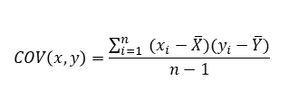
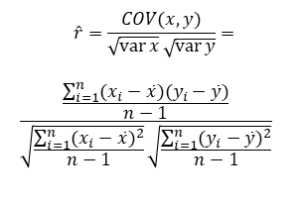
Covariance and Correlation
$$\hat{r}=\frac{COV(x,y)}{\sqrt{\operatorname{var}{x}}\sqrt{\operatorname{var}{y}}}=$$
$$\frac{\frac{\sum_{i=1}^{n}{(x_{i}−\bar{x})(y_{i}−\bar{y})}}{n−1}}{\sqrt{\frac{\sum_{i=1}^{n}{(x_{i}−\bar{x})^{2}}}{n−1}}\sqrt{\frac{\sum_{i=1}^{n}{(y_{i}−\bar{y})^{2}}}{n−1}}}$$
$$COV\left(x,y\right)=\frac{\sum_{i=1}^{n}{ (x_{i}−\overline{X})(y_{i}−\overline{Y})}}{n−1}$$
cov(X,Y) > 0 → X and Y are positively correlated
cov(X,Y) < 0 → X and Y are inversely correlated
cov(X,Y) = 0 → X and Y are independent
The estimated correlation coefficient is just the standardized covariance (do you understand what standardization is?)
It measures the relative strength of the linear relationship between two variables.

Slide 6
Quantifying the relationship
Correlation describes the strength of the linear association between two variables.
8

Slide 7
Quantifying the relationship
Correlation describes the strength of the linear association between two variables.
It takes values between -1 (perfect negative) and +1 (perfect positive).
8

Slide 8
Quantifying the relationship
Correlation describes the strength of the linear association between two variables.
It takes values between -1 (perfect negative) and +1 (perfect positive).
A value of 0 indicates no linear association.
8

Slide 9
Guessing the correlation
Which of the following is the best guess for the correlation between
% in poverty and % HS grad?
18
0.6
-0.75
-0.1
0.02
-1.5
16
14
12
10
8
6
% in poverty
80
85
% HS grad
90
9

Slide 10
Guessing the correlation
Which of the following is the best guess for the correlation between
% in poverty and % female householder, no husband present?
18
0.1
-0.6
-0.4
0.9
0.5
16
14
12
10
8
6
% in poverty
8 10 12 14 16 18
% female householder, no husband present
10

Slide 11
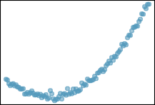
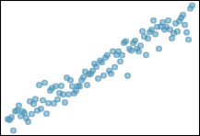
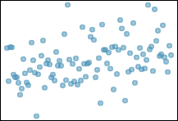
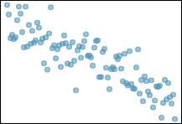
Assessing the correlation
Which of the following is has the strongest correlation, i.e. correla- tion coefficient closest to +1 or -1?
(a)
(b)
(c)
(d)
11

Slide 12
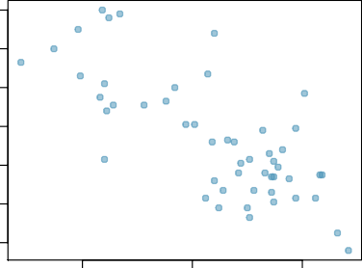
Example: Poverty vs. HS graduate rate
The scatterplot below shows the relationship between HS graduate rate in all 50 US states and DC and the % of residents who live below the poverty line (income below $23,050 for a family of 4 in 2012).
18
16
14
12
10
8
6
Response variable?
% in poverty
80
85
% HS grad
90
2

Slide 13
Example: Poverty vs. HS graduate rate
The scatterplot below shows the relationship between HS graduate rate in all 50 US states and DC and the % of residents who live below the poverty line (income below $23,050 for a family of 4 in 2012).
18
16
14
12
10
8
6
Response variable?
% in poverty
% in poverty
80
85
% HS grad
90
2

Slide 14
Example: Poverty vs. HS graduate rate
The scatterplot below shows the relationship between HS graduate rate in all 50 US states and DC and the % of residents who live below the poverty line (income below $23,050 for a family of 4 in 2012).
18
16
14
12
10
8
6
Response variable?
% in poverty
Explanatory variable?
% in poverty
80
85
% HS grad
90
2

Slide 15
Example: Poverty vs. HS graduate rate
The scatterplot below shows the relationship between HS graduate rate in all 50 US states and DC and the % of residents who live below the poverty line (income below $23,050 for a family of 4 in 2012).
18
16
14
12
10
8
6
Response variable?
% in poverty
Explanatory variable?
% HS grad
% in poverty
80
85
% HS grad
90
2

Slide 16
Poverty vs. HS graduate rate
The scatterplot below shows the relationship between HS graduate rate in all 50 US states and DC and the % of residents who live below the poverty line (income below $23,050 for a family of 4 in 2012).
18
16
14
12
10
8
6
Response variable?
% in poverty
Explanatory variable?
% HS grad
Relationship?
% in poverty
80
85
% HS grad
90
2

Slide 17
Poverty vs. HS graduate rate
The scatterplot below shows the relationship between HS graduate rate in all 50 US states and DC and the % of residents who live below the poverty line (income below $23,050 for a family of 4 in 2012).
18
16
14
12
10
8
6
Response variable?
% in poverty
Explanatory variable?
% HS grad
Relationship?
linear, negative, moderately strong
% in poverty
80
85
% HS grad
90
2

Slide 18
Model selection for continuous dependent variables
Outcome Variable | Are the observations independent or correlated? |  | Alternatives if the normality assumption is violated (and small sample size):
 | independent | correlated
Continuous (e.g. pain scale, cognitive function) | T-test: compares means between two independent groups ANOVA: compares means between more than two independent groups Pearson’s correlation coefficient (linear correlation): shows linear correlation between two continuous variables Linear regression: multivariate regression technique used when the outcome is continuous; gives slopes | Paired ttest: compares means between two related groups (e.g., the same subjects before and after) Repeated-measures ANOVA: compares changes over time in the means of two or more groups (repeated measurements) Mixed models/GEE modeling: multivariate regression techniques to compare changes over time between two or more groups; gives rate of change over time | Non-parametric statistics Wilcoxon sign-rank test: non-parametric alternative to the paired ttest Wilcoxon sum-rank test (=Mann-Whitney U test): non-parametric alternative to the ttest Kruskal-Wallis test: non-parametric alternative to ANOVA Spearman rank correlation coefficient: non-parametric alternative to Pearson’s correlation coefficient

Slide 19
Uses of Linear Regression Analysis
Regression analysis serves 3 major purposes:
Description
Prediction
Control → ceteris paribus
The several purposes of regression analysis frequently overlap in practice
Caution: this model has many assumptions that most often fail in real life. It is a model that rarely, if ever, works in our field, for reasons we will discuss later.

Slide 20
What is Simple Linear Regression (SLR)?
Simple regression analysis is a statistical tool that allows us to estimate the relationship between two variables: a dependent variable (typically labeled Y) and an independent variable (typically labeled X)
The dependent variable is the variable for which we want to make a prediction
SLR estimates a linear equation that predicts the dependent variable based on values of the independent variable (X)
While various non-linear forms may be used, linear models are the most common (and the most useless)
X
Y

Slide 21
Linear regression –Terminology
Outcome, Y
Dependent variable
Response variable
MUST be continuous (e.g., height, weight)
Is a variable measured using a Likert score continuous?
Explanatory variable (predictor), X
Independent variable
Covariate
Can be continuous or categorical (e.g., age, has PTSD, gender)

Slide 22
What is SLR Useful For?
Applications:
Predicting outcomes (e.g., predicting sales from advertising spend).
Understanding relationships (e.g., the relationship between study hours and test scores)
Quantifying the impact of one variable on another.
SLR is foundational for more complex modeling techniques.

Slide 23
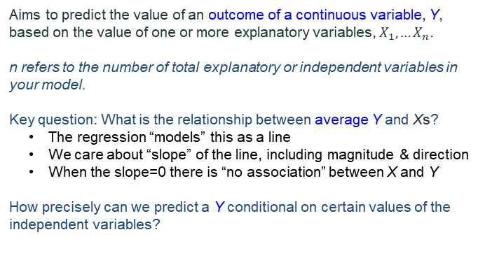
Introduction: Linear Regression
Aims to predict the value of an outcome of a continuous variable, Y, based on the value of one or more explanatory variables, $X_{1}, …X_{n}$.
n refers to the number of total explanatory or independent variables in your model.
Key question: What is the relationship between average Y and Xs?
The regression “models” this as a line
We care about “slope” of the line, including magnitude & direction
When the slope=0 there is “no association” between X and Y
How precisely can we predict a Y conditional on certain values of the independent variables?

Slide 24

Functional Form (the equation we learned)
$$Y=mX+b$$
Linear regression is merely an extension of the equation
Y
Y = dependent variable
X = independent variable
b = Y-intercept
m = slope of the line
Define b, and m
Rise
b
Run
X
Notes:
m = slope → change in Y over change in X

Slide 25
The Model
Functional Form (the equation we learned)
The model has a deterministic and a probabilistic component
According to this model, every extra square foot adds about $75 to the predicted price of a house. So, a house that is 100 square feet larger is predicted to cost about $7,500 more than a smaller otherwise similar house.
House Cost
House cost = $25,000 + 75(Size in sqft)
Housing Size | Housing Cost
0 sq. ft. | $25,000
1,000 sq. ft. | $100,000
2,500 sq. ft. | $212,500
House size
What is the expected value of the house when the size of the home is 0 square feet?
A “typical” house price comes from evaluating the regression equation at a typical value of the predictor, not from the intercept.

Slide 26

Functional Form (the equation we learned)
The model has a deterministic and a probabilistic component
A “typical” house price comes from evaluating the regression equation at a typical value of the predictor, not from the intercept.
To get the predicted price of a typical house, you would plug in the average square footage from the dataset.
For example, if the average house is 2,000 square feet, then the predicted price of a typical house would be:
House Cost
House cost = $25,000 + 75(Size in sqft)
$$25,000+75×2,000=175,000$$
House size

Slide 27


Functional Form (the equation we learned)
The model has a deterministic and a probabilistic component
However, house cost vary even among same size houses!
House Cost
+ ε
House cost = 25000 + 75 (Size)
House size
Since cost behave unpredictably, we add a random component.
What types of variables might be part of the error term?

Slide 28
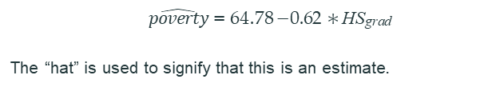
A more realistic example
The linear model for predicting poverty from high school graduation rate in the US is
$\hat{poverty}$ = 64.78 − 0.62 ∗ HS_{grad}
The “hat” is used to signify that this is an estimate.

Slide 29
Introduction: Linear Regression
The high school graduate rate in Georgia is 85.1%. What poverty level does the model predict for this state?
$\hat{poverty}$ = 64.78 − 0.62 ∗ HS_{grad}
64.78 − 0.62 ∗ 85.1 = 12.018

Slide 30
Eyeballing the line
18
(a)
(b)
(c)
(d)
Which of the follow- ing appears to be the line that best fits the linear relation- ship between % in poverty and % HS grad? Choose one.
16
% in poverty
14
12
10
8
6
80
85
% HS grad
90
Plot different values of HS grad
5

Slide 31
Residuals
Residuals are the leftovers from the model fit: Data = Fit + Residual
18
16
14
12
10
8
6
% in poverty
80
85
% HS grad
90
6

Slide 32
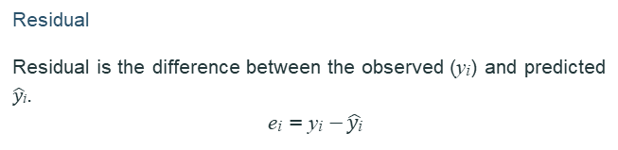
Residuals (cont.)
Residual
Residual is the difference between the observed (y_{i}) and predicted
$\hat{y\text{i}}$.
e_{i} = y_{i} − $\hat{y\text{i}}$
18
16
14
12
10
DC_{y}
_{y}^
5.44
% in poverty
−4.16
_{y}^
y
RI
8
6
80
85
% HS grad
90
7

Slide 33

Residuals (cont.)
Residual
Residual is the difference between the observed (y_{i}) and predicted
$\hat{y\text{i}}$.
e_{i} = y_{i} − $\hat{y\text{i}}$
18
16
14
12
10
DC_{y}
% living in poverty in DC is 5.44% more than predicted.
_{y}^
5.44
% in poverty
−4.16
_{y}^
y
RI
8
6
80
85
% HS grad
90
7

Slide 34
Residuals (cont.)
Residual
Residual is the difference between the observed (y_{i}) and predicted
$\hat{y\text{i}}$.
e_{i} = y_{i} − $\hat{y\text{i}}$
18
16
14
12
10
8
6
DC_{y}
% living in poverty in DC is 5.44% more than predicted.
% living in poverty in RI is 4.16% less than predicted.
_{y}^
5.44
% in poverty
−4.16
_{y}^
y
RI
80
85
90
% HS grad

Slide 35
Fitting a line by least squares regression

Slide 36

Formal statement of the model
$Y= β_{0}+β_{1}$X + ε
If the scatter plot of our sample data suggests a linear relationship between two variables i.e. we can summarize the relationship by drawing a straight line on the plot.
The values of the regression parameters β₀, and β₁ are not known. We estimate them from data.
β₀ is the intercept of Y
β₁ is the change in Y per a 1-unit increase in X
Note: the unit of increase depends on how X is measured in your data
X is a known independent variable
ε is called the error term

Slide 37
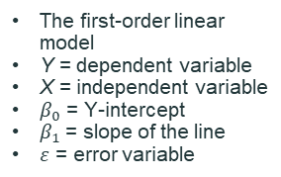

The SLR Model
$$Y=β_{0}+β_{1}X+ε$$
$β_{0}$ and $β_{1}$ are unknown population parameters; therefore, they are estimated from the data.
Y
The first-order linear model
Y = dependent variable
X = independent variable
$β_{0}$ = Y-intercept
$β_{1}$ = slope of the line
$ε$ = error variable
β₁ = Rise/Run
Rise
β₀
Run
X

Slide 38
What is Rise over Run exactly?
$$Y=β_{0}+β_{1}X+ε$$
$β_{0}$ and $β_{1}$ are unknown population parameters; therefore, they are estimated from the data.
Rise over run is the way we describe the slope of a line.
It means:
how much the outcome (Y) changes when the predictor (X) increases by one unit.
In a regression context:
Rise = change in the predicted outcome (ΔY)
Run = change in the predictor (ΔX)

Slide 39
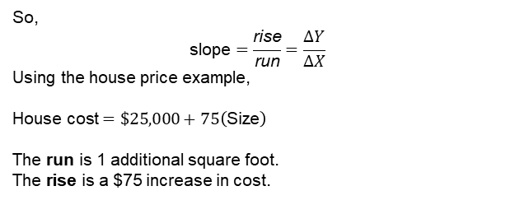
What is Rise over Run exactly?
$$Y=β_{0}+β_{1}X+ε$$
$β_{0}$ and $β_{1}$ are unknown population parameters; therefore, they are estimated from the data.
So,
$$\text{slope}=\frac{\text{rise}}{\text{run}}=\frac{ΔY}{ΔX}$$
Using the house price example,
$$\text{House} \text{cost}=\$25,000+75\left(\text{Size}\right)$$
The run is 1 additional square foot. The rise is a $75 increase in cost.

Slide 40
Estimating the model parameters?
The estimates are determined by drawing a sample from the population of interest and fitting a straight line to the data.
Y
w
w
w
w
w
w w w w
w
w w
w w
w
X
Question: What should be considered a good line?

Slide 41
The Least Squares (Regression) Line
Estimating the model parameters?
A good line is one that minimizes the sum of squared differences between the points and the line.

Slide 42
An objective measure for finding the best line
We want a line that has small residuals:
12

Slide 43
An objective measure for finding the best line
We want a line that has small residuals:
Option 1: Minimize the sum of magnitudes (absolute values) of residuals
|e₁| + |e₂| + · · · + |e_{n}|
12

Slide 44
An objective measure for finding the best line
We want a line that has small residuals:
Option 1: Minimize the sum of magnitudes (absolute values) of residuals
|e₁| + |e₂| + · · · + |e_{n}|
Option 2: Minimize the sum of squared residuals – least squares
e² + e² + · · · + e²
1 2 n
12

Slide 45
An objective measure for finding the best line
We want a line that has small residuals:
Option 1: Minimize the sum of magnitudes (absolute values) of residuals
|e₁| + |e₂| + · · · + |e_{n}|
Option 2: Minimize the sum of squared residuals – least squares
e² + e² + · · · + e²
1 2 n
Why least squares?
12

Slide 46
An objective measure for finding the best line
We want a line that has small residuals:
Option 1: Minimize the sum of magnitudes (absolute values) of residuals
|e₁| + |e₂| + · · · + |e_{n}|
Option 2: Minimize the sum of squared residuals – least squares
e² + e² + · · · + e²
1 2 n
Why least squares?
The objective function is smooth and differentiable
12

Slide 47
An objective measure for finding the best line
We want a line that has small residuals:
Option 1: Minimize the sum of magnitudes (absolute values) of residuals
|e₁| + |e₂| + · · · + |e_{n}|
Option 2: Minimize the sum of squared residuals – least squares
e² + e² + · · · + e²
1 2 n
Why least squares?
The objective function is smooth and differentiable
If the errors are normally distributed, the least squares estimators are BLUE
12

Slide 48
An objective measure for finding the best line
We want a line that has small residuals:
Option 1: Minimize the sum of magnitudes (absolute values) of residuals
|e₁| + |e₂| + · · · + |e_{n}|
Option 2: Minimize the sum of squared residuals – least squares
e² + e² + · · · + e²
1 2 n
Why least squares?
The objective function is smooth and differentiable
If the errors are normally distributed, the least squares estimators are BLUE
Squaring errors means larger errors are more heavily penalized
Handout SSE.docx
12
Notes:
We want a line that fits the data well, meaning the residuals—the vertical distances between the observed points and the line—are small overall. There are different reasonable ways to define “small.” One option is to minimize the sum of absolute residuals, which treats all errors proportionally. Another option is to minimize the sum of squared residuals, which is what least squares does.
BLUE = smallest possible variance among estimators

Slide 49
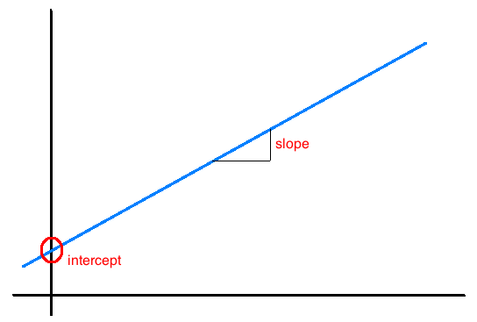
Interpretation of slope and intercept
Intercept: When x = 0, y is expected to equal the intercept.
Slope:
For each unit in x, y is expected to increase/decrease on average by the slope.
When the slope is 0, there is no relationship between X and Y
Slope = 0
When the slope = 0, every X value gives the same Y value. I.e., no matter what value X takes, the predicted value of Y stays the same
Note: These statements are not causal, unless the study is a randomized controlled experiment.

Slide 50
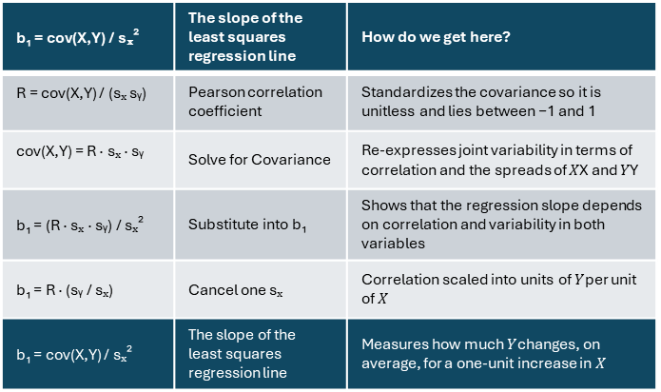
The Estimated Coefficients (Intuition)
b₁ = cov(X,Y) / sₓ² | The slope of the least squares regression line | How do we get here?
R = cov(X,Y) / (sₓ sᵧ) | Pearson correlation coefficient | Standardizes the covariance so it is unitless and lies between −1 and 1
cov(X,Y) = R · sₓ · sᵧ | Solve for Covariance | Re-expresses joint variability in terms of correlation and the spreads of 𝑋X and 𝑌Y
b₁ = (R · sₓ · sᵧ) / sₓ² | Substitute into b₁ | Shows that the regression slope depends on correlation and variability in both variables
b₁ = R · (sᵧ / sₓ) | Cancel one sₓ | Correlation scaled into units of $Y$per unit of $X$
b₁ = cov(X,Y) / sₓ² | The slope of the least squares regression line | Measures how much $Y$changes, on average, for a one-unit increase in $X$
Intuition: the slope is equal to the (correlation between X and Y) × (spread of Y / spread of X)

Slide 51
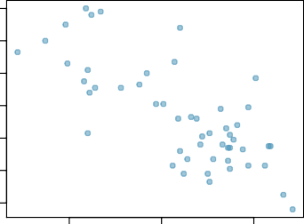
Given...
18
16
14
% HS grad
(x)
% in poverty
(y)
% in poverty
12
10
8
6
mean x¯ = 86.01
sd s_{x} = 3.73
y¯ = 11.35
s_{y} = 3.1
correlation
R = −0.75
80
85
% HS grad
90

Slide 52
Slope
Slope
The slope of the regression can be calculated as
b₁ = ^{sy} R
s_{x}
22

Slide 53
Slope
Slope
The slope of the regression can be calculated as
b₁ = ^{sy} R
s_{x}
In context...
3.1
b₁ = _{3.73} × −0.75 = −0.62
22

Slide 54
Slope
Slope
The slope of the regression can be calculated as
b₁ = ^{sy} R
s_{x}
In context...
3.1
b₁ = _{3.73} × −0.75 = −0.62
Interpretation
For each additional % point in HS graduate rate, we would expect the % living in poverty to be lower on average by 0.62% points.
22

Slide 55
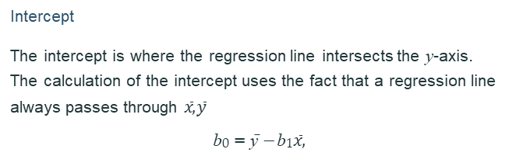
Intercept
Intercept
The intercept is where the regression line intersects the y-axis. The calculation of the intercept uses the fact that a regression line always passes through $\overline{x},$ $\overline{y}$
b₀ = y¯ − b₁$\overline{x},$
23

Slide 56

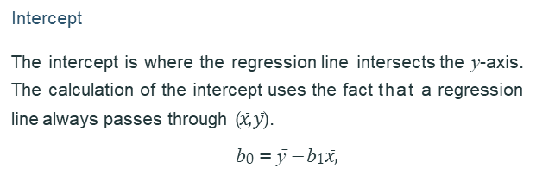
Intercept
Intercept
The intercept is where the regression line intersects the y-axis. The calculation of the intercept uses the fact that a regression line always passes through ($\overline{x},$ $\overline{y}$).
b₀ = y¯ − b₁$\overline{x},$
70
60
50
40
30
20
10
0
intercept
% in poverty
0
20
40
60
80
100
% HS grad
23

Slide 57
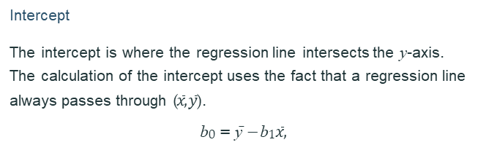
Intercept
Intercept
The intercept is where the regression line intersects the y-axis. The calculation of the intercept uses the fact that a regression line always passes through ($\overline{x},$ $\overline{y}$).
b₀ = y¯ − b₁$\overline{x},$
b₀ = 11.35 − (−0.62) × 86.01 = 64.68
70
60
50
40
30
20
10
0
intercept
% in poverty
0
20
40
60
80
100
% HS grad

Slide 58
Which of the following is the correct interpretation of the intercept?
For each % point increase in HS graduate rate, % living in poverty is expected to increase on average by 64.68%.
For each % point decrease in HS graduate rate, % living in poverty is expected to increase on average by 64.68%.
Having no HS graduates leads to 64.68% of residents living below the poverty line.
States with no HS graduates are expected on average to have 64.68% of residents living below the poverty line.
In states with no HS graduates % living in poverty is expected to increase on average by 64.68%.
24

Slide 59

More on the intercept
Since there are no states in the dataset with no HS graduates, the intercept is of no interest, not very useful, and also not reliable since the predicted value of the intercept is so far from the bulk of the data.
70
60
50
40
30
20
10
0
intercept
% in poverty
0
20
40
60
80
100
% HS grad
25

Slide 60
Regression line
% in poverty = 64.68 − 0.62 % HS grad
18
16
14
12
10
8
6
% in poverty
80
85
% HS grad
90

Slide 61
Prediction
Using the linear model to predict the value of the response variable for a given value of the explanatory variable is called prediction, simply by plugging in the value of x in the linear model equation.
There will be some uncertainty associated with the predicted value.
18
16
14
12
10
8
6
% in poverty
80
85
% HS grad
90
28

Slide 62

Extrapolation
Applying a model estimate to values outside of the realm of the original data is called extrapolation.
Sometimes the intercept might be an extrapolation.
70
60
50
40
30
20
10
0
intercept
% in poverty
0
20
40
60
80
100
% HS grad

Slide 63
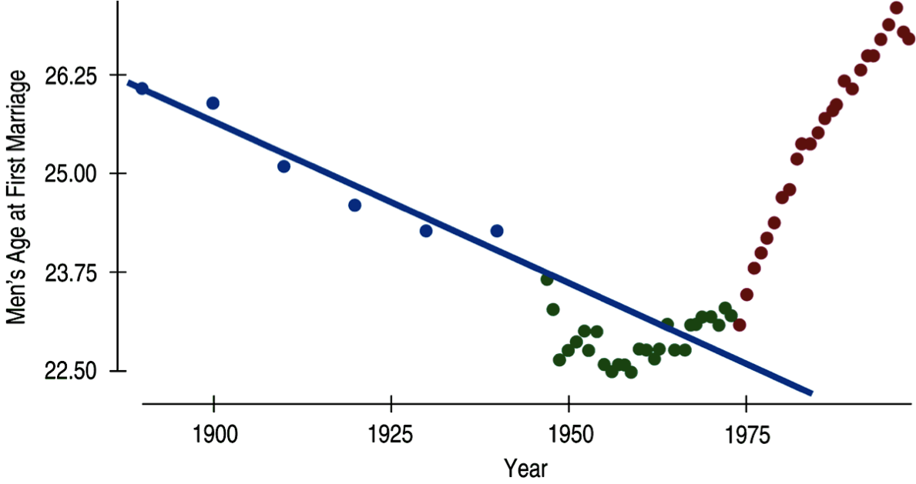
Examples of extrapolation

Slide 64
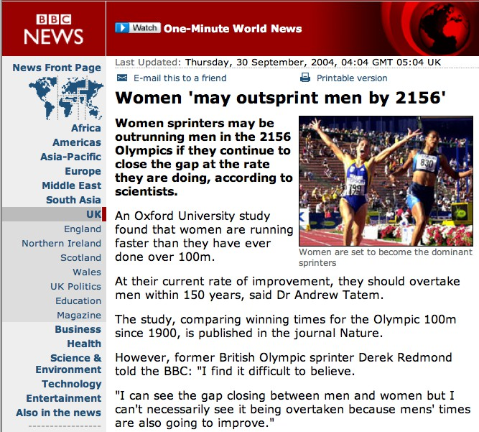
Examples of extrapolation

Slide 65
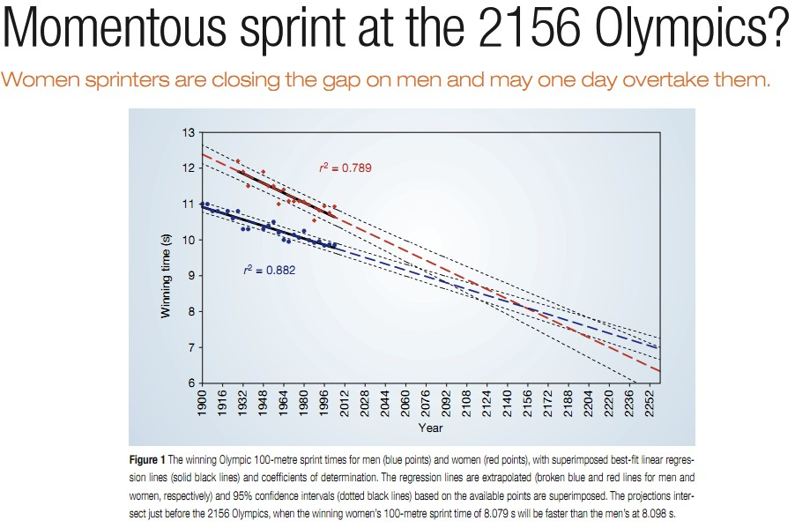
Examples of extrapolation

Slide 66
_{R}2
The strength of the fit of a linear model is most commonly evaluated using R².
33

Slide 67
_{R}2
The strength of the fit of a linear model is most commonly evaluated using R².
R² is calculated as the square of the correlation coefficient.
33

Slide 68
_{R}2
The strength of the fit of a linear model is most commonly evaluated using R².
R² is calculated as the square of the correlation coefficient.
It tells us what percent of variability in the response variable is explained by the model.
33

Slide 69
_{R}2
The strength of the fit of a linear model is most commonly evaluated using R².
R² is calculated as the square of the correlation coefficient.
It tells us what percent of variability in the response variable is explained by the model.
The remainder of the variability is explained by variables not included in the model or by inherent randomness in the data.
33

Slide 70
_{R}2
The strength of the fit of a linear model is most commonly evaluated using R².
R² is calculated as the square of the correlation coefficient.
It tells us what percent of variability in the response variable is explained by the model.
The remainder of the variability is explained by variables not included in the model or by inherent randomness in the data.
For the model we’ve been working with, R² = (−0.75)² = 0.56.
33

Slide 71

Interpretation of R²
Which of the below is the correct interpretation of R = −0.75, R² = 0.56?
56% of the variability in the % of HG graduates among the 51 states is explained by the model.
56% of the variability in the % of residents living in poverty among the 51 states is explained by the model.
56% of the time % HS graduates predict % living in poverty correctly.
75% of the variability in the % of residents living in poverty among the 51 states is explained by the model.
18
16
14
12
10
8
6
% in poverty
80 85
% HS grad
90
34

Slide 72
Exploring the relationships between self-care and well-being outcomes among child welfare professionals
Assumption | Formally Tested? | Evidence in Paper
Normality of outcomes | Partially | Skewness/kurtosis of variables
Normality of residuals | No | Not reported
Linearity | No | Not reported
Homoscedasticity | No | Not reported
Independence | No | No clustering or multilevel
Multicollinearity | No | No VIFs or diagnostics
Functional form | No | Ordinal treated as continuous
Missing data (MCAR) | Yes | Little’s test + FIML
Outliers/influence | Vague | Mentioned, not documented

