Slide 1
Factor Analysis
Week 13
March 31, 2025

Slide 2
What is Factor analysis (FA)?
FA is a tool for analyzing the structure of the interrelationships among a large number of variables by defining sets of variables that are highly interrelated
Social workers use different measures to capture different underlying constructs (?)
To be representative of the underlying construct, the variables should ‘cluster’ together around that construct
The construct is called a latent variable and is represented by a ‘factor’
Note: in Latent Class Analysis (next) the latent variable is referred to as a ‘class’
The factors are assumed to represent dimensions within the data structure
The dimensions can guide the creation of new composite measures
Example: five items represent 1 latent variable called depression, or several items of neighborhood disinvestment represent ‘sustained disinvestment’ (see below)
The dimensions have meaning for what they actually represent if there is a conceptual basis for understanding the relations between the variables

Slide 3
What is a ‘latent variable’
Latent variables are unobserved (hidden) variables that are inferred from patterns in observed data
In factor analysis, latent variables (also called factors) help explain the underlying structure among a set of measured variables (like survey items or test scores)
Example: You might measure things like "feeling sad," "trouble sleeping," and "loss of interest.“
These observed variables are indicators of a latent variable like "Depression."
Latent variables are not measured directly—they are statistical constructs that help us make sense of correlated behaviors or responses
In structural equation modeling (SEM), which builds upon factor analysis, the model is typically divided into two parts:
The Measurement Model: specifies how observed variables (survey items, indicators) reflect or "load onto" latent variables (unmeasured constructs like depression, disinvestment, or social vulnerability)
The Structural Model: This shows how latent variables are related to one another—representing the causal or correlational paths between unmeasured constructs

Slide 4
Factor analysis versus Principal Components Analysis (PCA)
Underlying Assumptions
PCA - the goal is to reduce the number of observed variables into components that account for maximum variance – i.e., to summarize the data
FA – the goal is to understand the hidden structure in the data
In factor analysis, latent variables (also called factors) help explain the underlying structure among a set of measured variables (like survey items or test scores)
Assumption: the latent constructs (factors) cause the observed correlations between variables
Example: You might measure things like "feeling sad," "trouble sleeping," and "loss of interest.“
These observed variables are indicators of a latent variable like "Depression."

Slide 5
Factor analysis versus Principal Components Analysis (PCA)
PCA is not testable
Use PCA when you're interested in data reduction (e.g., building indices or simplifying predictors), and FA when you want to model the underlying structure of the data (e.g., psychological traits, constructs)
You can't really test whether you included the “right” variables in PCA—there's no underlying theory being tested.
PCA is just mathematically rotating your variables into components that capture variance—it doesn't care why the variables are related
If the goal is to estimate underlying factors and attach some meaning, then EFA should be used (Theory)
Do not use PCA

Slide 6
Example: Five indicators of an underlying latent construct we call depression
Let’s say you have 5 questions like:
"I felt sad“
"I couldn’t sleep“
"I felt tired“
"I cried often“
"I had trouble concentrating"
If you conducted a FA:
You’re assuming these 5 items are caused by an underlying factor, like depression
You believe that depression is a latent variable that explains the shared variance (covariance) between these items
Then you test whether this model fits your data (e.g., using model fit statistics). If the model fits well, you have evidence that depression is a valid latent construct
If you conducted a PCA:
PCA examines the total variance of the 5 items and finds components that best summarize the data
You simply want to mathematically combine the items into a weighted average (component) that explains as much variance as possible
There’s no underlying assumption that a real, hidden thing like “depression” exists or is driving the items. It’s just a data summary, not a testable theory

Slide 7
Intuition
PCA
It takes all the variance from all five variables — both shared and unique
Then it creates components (linear combinations of the variables) that explain as much total variance as possible
So even if one variable doesn’t share variance with others (i.e., it doesn’t correlate well), PCA still includes it — it just might load weakly on the first few components
FA
FA focuses only on the shared variance (called common variance) between variables
It assumes there’s some underlying latent factor (like depression) that’s causing the correlation
FA removes unique variance and error variance from the factor model
Example
Let’s say one item (“I felt tired”) is not very correlated with the other 4
PCA still uses it in calculating components
FA might give it a low loading or treat its variance as mostly unique/error rather than useful in explaining the latent construct
Bottom line:
PCA uses all variables and all their variance, shared or not
FA uses only the shared variance to model an underlying latent structure

Slide 8
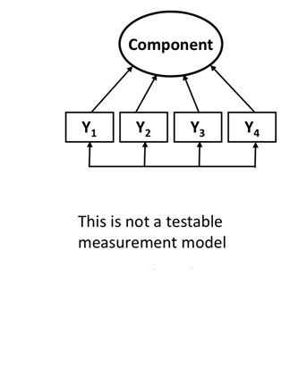
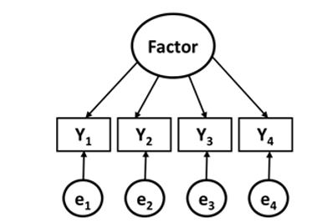
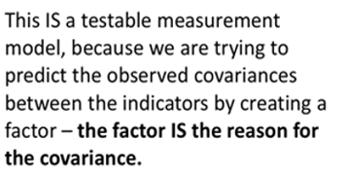
Factor analysis versus Principal Components Analysis (PCA)
In PCA, the indicators drive the component and the Ys covary in some way
Exploratory factor analysis examines all the pairwise relationships between individual variables (e.g., items on a scale) and seeks to extract latent factors from the measured variables.
In FA some underlying factors are driving the variables (plus error)

Slide 9
EFA
The main applications of factor analytic techniques are:
Data reduction. To reduce the number of variables into factors based on shared variance; and
Data classification. To detect structure (or underlying processes) in the relationships between variables, that is, to classify variables
Assumption
Variables that correlate with each other do so because they are measuring the same thing—a common domain
This is important because sometimes composite variables are used from assessments, psychological or otherwise, without concern for the process underlying that construction
RQ: What is the underlying factor structure (i.e., a latent variable) for a set of measures?
EFA is a statistical procedure that allows us to cluster variables together into constructs or ‘latent variables’
Example: Is intelligence a unitary or multidimensional construct (as in multiple forms of intelligence)?

Slide 10
Data Reduction
Reducing the number of variables
The underlying task is to find common variance and eliminate unique variance that is not of interest
It is like a reverse form of ‘partialling out’
Examples
A survey may have 100 items, but the survey was designed to measure 12 components or factors
You have 50 different variables about an individual, but some of those variables are overlapping… are they essentially measuring the same underlying (unobservable, latent) construct?

Slide 11
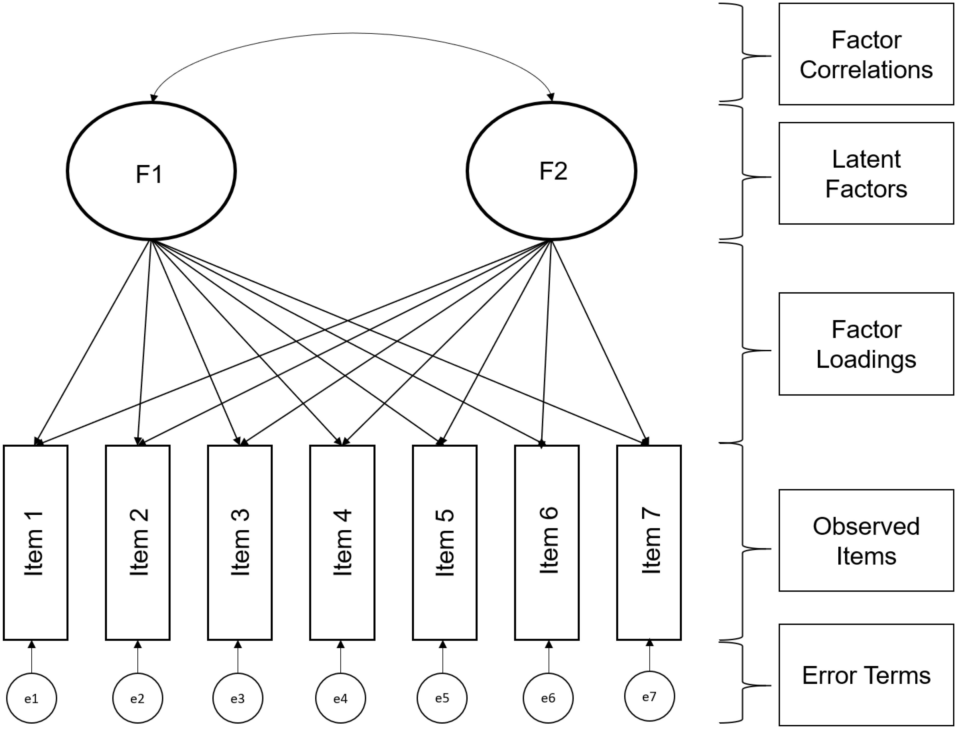
The Statistical Model
EFA does not presuppose a theoretical structure
Useful as a starting point for understanding empirical structures or identifying problems with existing scales
Correlations between items are used to infer the presence of an underlying variable (latent)
Cross loadings: One important consideration is that all items are allowed to load on any factor (compare CFA)

Slide 12
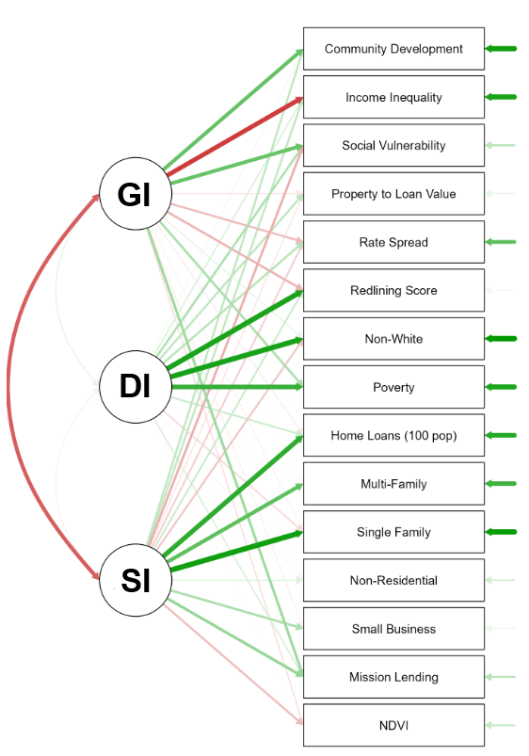
Example
Circles represent latent variables—unobserved constructs identified through factor analysis.
GI = Growing Investment
DI = Disinvestment
SI = Sustained Investment
Researchers assigned these labels based on patterns in the measured data
Boxes represent observed/measured items—real-world variables used to estimate the latent factors (e.g., "Income Inequality," "Home Loans")
Green lines show positive factor loadings:
Thicker green lines indicate stronger relationships, meaning that the item is a good indicator of the latent variable
Red lines show negative relationships or inverse loadings:
These items are negatively associated with the latent variable, meaning they represent an opposite trend or reduce the strength of that factor

Slide 13
Research Questions
How many reliable and interpretable factors/components are there in a set of variables?
How many factors/components should be extracted?
How much variance in a set of variables is accounted for by the retained factors/components?
How are the factors/components interpreted? (Note: this is subjective)

Slide 14
Illustration
Pretend we have gathered information on 9 factors that affected individual choices about whether to patronize certain stores
One question of interest is whether the items can be grouped into some more general areas of focus, i.e., how do the 9 variables group together?
Visual inspection is not helpful in revealing patterns, but factor analysis is… as shown in the next two slides

Slide 15
Correlations (what factor(s) might Cause the relationships?)
Part I Original Correlation Matrix
 | V1 | V2 | V3 | V4 | V5 | V6 | V7 | V8 | V9
V1 Price Level | 1.00
V2 Store Personnel | .427 | 1.00
V3 Return Policy | .302 | .771 | 1.00
V4 Product Availability | .470 | .497 | .427 | 1.00
V5 Product Quality | .765 | .406 | .307 | .427 | 1.00
V6 Assortment Depth | .281 | .445 | .423 | .713 | .325 | 1.00
V7 Assortment Width | .345 | .490 | .471 | .719 | .378 | .724 | 1.00
V8 In-store Service | .242 | .719 | .733 | .428 | .240 | .311 | .435 | 1.00
V9 Store Atmosphere | .372 | .737 | .774 | .479 | .326 | .429 | .466 | .710 | 1.00

Slide 16
Factor Structure
Part II Correlation Matrix After Grouping According to Factor Analysis
 | V3 | V8 | V9 | V2 | V6 | V7 | V4 | V1 | V5
V3 Return Policy | 1.00
V8 In-store Service | .773 | 1.00
V9 Store Atmosphere | .774 | .710 | 1.00
V2 Store Personnel | .771 | .719 | .737 | 1.00
V6 Assortment Depth | .423 | .311 | .429 | .445 | 1.00
V7 Assortment Width | .471 | .435 | .466 | .490 | .724 | 1.00
V4 Product Availability | .427 | .428 | .479 | .497 | .713 | .719 | 1.00
V1 Price Level | .302 | .242 | .372 | .427 | .281 | .354 | .470 | 1.00
V5 Product Quality | .307 | .240 | .326 | .406 | .325 | .378 | .427 | .765 | 1.00

Slide 17
Is factor analysis appropriate?
Conceptual issues (later)
Statistical issues (look at correlations between variables)
Ensure that the data matrix has sufficient correlations to justify the application of FA
If all correlations are low don’t use (<.30)
Look for low partial correlations → a pattern of high partial correlations means that a variable is not correlated with a large number of other variables → no factors exist in the data
Partial correlations > .7 are high
Bartlett’s test of sphericity should be significant
Kaiser-Meyer-Olkin Measure of sampling adequacy (MSA) should be high
Notes:
Before we dive into factor analysis, we need to make sure our data deserves it.
Check the correlations: Factor analysis assumes that variables share enough variance to justify summarizing them. If most correlations are below .30, it’s a sign that the variables aren’t linked strongly enough—no shared structure means no meaningful factors.
Partial correlations matter: High partial correlations (>.70) suggest that variables remain strongly correlated even after accounting for others. That implies a lack of common factors—essentially, the variables aren't playing as a team.
Bartlett’s test of sphericity: This test tells us whether our correlation matrix is significantly different from an identity matrix. A significant result means the data has enough structure to proceed. A non-significant test suggests random noise—nothing to extract.
Kaiser-Meyer-Olkin (KMO) Measure of Sampling Adequacy: This index tells us how well-suited the data is for factor analysis. Values closer to 1.0 are ideal. A rule of thumb: .80 and above = great, .60s = mediocre, below .50 = don't do it.

Slide 18
Initial factorability assessment (Summary)
Correlation coefficient values
Should be > .30
Bartlett’s test of sphericity
The null hypothesis is the variance-covariance matrix equals the identity matrix
Here we want to reject the null hypothesis because we want overlapping variance between variables to reduce them into latent factors
Anti-image correlation matrix
Kaiser-Meyer-Olkin measure of sampling adequacy (MSA)
An index of shared variance in the variables: the proportion of variance in your variables that might be “caused” by underlying factors
Compares the magnitude of the observed to partial correlation coefficients
Ranges from 0 to 1 and larger values mean more factorability (look for significance)
Notes:
To justify running factor analysis, your data needs to show enough shared variance—and we’ve got a few tools to check that.
Correlation coefficients (> .30): Think of this as the minimum level of connection we’re looking for. If variables don’t correlate at least moderately, they likely don’t share enough variance to be grouped under a latent factor.
Bartlett’s Test of Sphericity: The null hypothesis says the correlation matrix is an identity matrix—meaning variables are uncorrelated. But for factor analysis, we want overlap. So a significant result (p < .05) means we can reject the null and conclude that our variables are correlated enough to proceed. The next slide has an example of what the identity matrix looks like so you have some intuition about it.
Anti-Image Correlation Matrix: This matrix shows partial correlations, helping us identify variables that may not fit well with the rest. Large off-diagonal values here signal trouble—variables that don’t contribute to shared structure.
Kaiser-Meyer-Olkin (KMO) Measure of Sampling Adequacy: This gives us a single number summarizing how well our variables lend themselves to factor analysis. It compares the size of the observed correlations to the size of the partial correlations. Ranges from 0 to 1—higher is better. A value above .80 is considered excellent. Below .50? Not worth proceeding.

Slide 19
Identity matrix v. Covariance matrix
 | Var1 | Var2 | Var3
Var1 | 1 | 0 | 0
Var2 | 0 | 1 | 0
Var3 | 0 | 0 | 1
 | Var1 | Var2 | Var3
Var1 | 1 | 0.6 | 0.4
Var2 | 0.6 | 1 | 0.5
Var3 | 0.4 | 0.5 | 1
Notes:
Let’s talk about this matrix.
What you’re looking at is an identity matrix: all the diagonal elements are 1 (perfect correlation with themselves), and all the off-diagonal elements are 0 (no correlation with anyone else).
Translation: These variables are operating in silos. They don’t share variance, they’re not communicating, and there’s no underlying factor tying them together.
Big red flag: If your correlation matrix looks like this, don’t run factor analysis. There are no latent constructs to uncover—this is statistical isolation, not structure.
Bartlett’s test would likely be non-significant here, confirming the lack of relationship. KMO would be low, too. So the message is simple: if your data looks like this, stop here.

Slide 20
Extracting a set of factors from the correlation matrix
Recall: Variance tells us how spread out a variable’s values are around its average
When two variables are correlated, they share some of that variance. The amount they share is the squared correlation
Example: A correlation of 0.5 means 25% of the variance is shared
In FA, variables that are highly correlated are grouped together —meaning they move together and share a lot of variance
It's important to know how much of a variable’s variance is shared with others in its group (factor), and how much is unique or due to error
Total variance = Shared (common) variance + Unique variance + Error
Notes:
Let’s rewind for a second: Variance tells us how much a variable’s values spread out around the mean. But what happens when variables are correlated? They move together—and that means they’re sharing some of their variance.
When two variables correlate at .50, they share 25% of their variance—because we square the correlation to find shared variance.
In factor analysis, this shared variance is the gold we’re mining. Highly correlated variables are grouped together into factors because they fluctuate in sync—something’s linking them.
But we don’t just care about what’s shared. We also need to know what’s unique to each variable—and how much is just random noise.
So every variable’s total variance can be broken down into three pieces:
Total variance = Shared (common) variance + Unique variance + Error
Factor analysis aims to uncover the common variance—the part that tells us something meaningful is happening across multiple variables.

Slide 21
Understanding Variance in Factor Analysis
Common Variance (Shared)
The variance that is shared across variables
Explained by the underlying latent factor (e.g., depression, disinvestment)
This is what we use to group variables into factors
Example: If multiple questions ask about sadness, sleep, and energy, their shared variance may reflect the latent factor "Depression”
Unique Variance
Specific to one variable only
Not shared or explained by the factor
Still meaningful, but only pertains to that item
Example: A question about sleep may reflect not just depression, but unique aspects of sleep itself
Error Variance
Random noise or measurement inaccuracy
Unrelated to any factor or meaningful content
Notes:
When we run factor analysis, we’re asking: What part of each variable is part of something bigger? Let’s unpack what that means.
Common Variance (Shared) This is the overlap—the part of the variable that aligns with others. It’s explained by a latent factor, like depression or neighborhood disinvestment. Example: If questions about sadness, fatigue, and sleep all move together, they likely reflect the same underlying construct—say, Depression.
Unique Variance This is what makes a variable special—it’s the part not shared with others and not explained by a factor. It still matters. For instance, a sleep question may reflect depression and a uniquely personal experience with insomnia or with lack of motivation having nothing to do with depression per se.
Error Variance This is the wild card—randomness, imprecision, or noise in the data. It’s not meaningful, it’s not shared, and it’s not useful for explaining anything real. There will always be some error or noise in the data, the nice thing about statistics is that we can quantify it.
Bottom line: Factor analysis is only interested in common variance—that’s where the patterns live. Everything else? It’s either unique to that variable or just statistical noise.

Slide 22
Important concepts
Factor loadings
Correlation between a variable and a factor (How high is the correlation between two variables?)
Loading a variable to a factor
Eigenvalue
The variance explained by a factor (How much variance can be explained by the factor?)
Sum of the squared factor charges
Communalities
Variance of the variables, which is explained by all factors (How much of the variance of all variables is explained by the factor?)
Sum of the squared factor charges of a variable
Notes:
Let’s break down the key terms that tell us how well factor analysis is actually working.
Factor Loadings Think of these as correlations between a variable and a factor. They tell us how strongly a variable is associated with a latent factor. High loading? That variable belongs in the factor. It’s like asking: Does this item “belong” with the others in this group?
Eigenvalues This is the total variance explained by each factor.
When we say “total variance explained by each factor,” we’re talking about the total variance across all variables in the dataset.
So:
Eigenvalues represent how much of the total variance in all the variables is explained by a given factor.
For example, if Factor 1 has an eigenvalue of 3 in a dataset with 6 variables (each standardized, so each contributes 1 unit of variance), that means:
Factor 1 explains 3 out of 6 total units of variance—or 50% of the total variance in the dataset.
That’s why we often use eigenvalues > 1 as a cutoff: a factor should explain more variance than a single variable to be worth keeping.
Bottom line: Eigenvalues answer → How much of the story is this factor telling? Technically, it’s the sum of squared loadings for each factor. Rule of thumb: Eigenvalues > 1 are typically considered meaningful.
Communalities These tell us how much of a variable’s variance is explained by all the factors combined. It’s the sum of squared loadings for each variable across all factors. In other words: How much of this variable are we actually capturing through the factor model?

Slide 23
Communalities
These tell us how much of a variable’s variance is explained by all the factors combined
It is calculated as the sum of squared loadings for that variable across all extracted factors
Intuition: How much of this variable are we actually capturing through our factor model?
Example: Let’s say you have a variable that measures “trouble sleeping”—and it loads .60 on Factor 1 (e.g., Depression) and .30 on Factor 2 (e.g., Anxiety)
To calculate the communality for that variable:
(.60)² + (.30)² = 0.36 + 0.09 = 0.45
That means 45% of the variance in the trouble sleeping variable is explained by the two factors
The remaining 55% is either unique to that item or just noise

Slide 24
What does it mean that "communalities tell us how much of a variable’s variance is explained by all the factors combined"?
Every variable in your dataset has total variance—basically, it varies from person to person, and we want to understand why
Factor analysis is telling us that the variations are not random, but due to a few underlying patterns—called factors
If that’s true, each variable’s total variance can be partly explained by those factors
→ If a variable loads highly on one or more factors, that means the factor(s) are doing a good job of explaining that variable’s behavior—the variables are not varying randomly there is something systematic about how they are related
The communality is the total amount of that variable’s variance that can be accounted for by all the factors you've extracted—not just one factor, but all of them together
Think of it this way: If a variable has a communality of .70, it means: "70% of this variable’s variance is accounted for by the factors in the model; the remaining 30% is unique to that variable or just error
Intuition: This variable is 70% explainable by the latent structure we’ve uncovered

Slide 25
Example of Communalities
Communality = (Loading on F1)² + (Loading on F2)²
Variable | Depression (F1) | Anxiety (F2) | Communality | Interpretation
Trouble sleeping | 0.60 | 0.30 | 0.45 | 36% of variance explained by Factor 1; 9% by Factor 2
Feeling worthless | 0.70 | 0.10 | 0.50 | 49% of variance explained by Factor 1; only 1% by Factor 2
Racing thoughts | 0.20 | 0.65 | 0.45 | 4% of variance explained by Factor 1; 42% by Factor 2

Slide 26
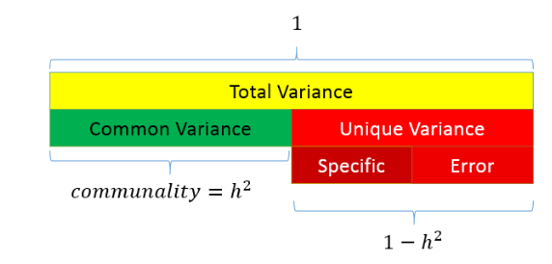
Partitioning the variance in factor analysis
Common variance is the amount of variance that is shared among the variables
Unique variance is the portion of variance that is not common
Specific
Error
Total variance = common + unique
You want communality to be high and uniqueness to be low
Ranges from 0 to 1
Higher values = the common factor
explain more of the variance of an individual
item
Notes:
The entire bar represents the total variance of a variable, which is always standardized to 1 in factor analysis.
That total variance has two parts: ✔️ Common variance (green) → variance explained by the factor(s) ❌ Unique variance (red) → variance that’s not explained by the factor model
Unique variance has two sub-parts: 🔹 Specific variance: variance unique to that variable—not shared, but still meaningful 🔹 Error variance: measurement error or randomness—basically noise
The communality is represented by h^2, which is the proportion of total variance that’s common, or:
So if a variable has a communality of 0.70, it means that 70% of its variance is explained by the factors, and the remaining 30% is unique or error.
Goal of FA: You want communalities to be high—that means your factors are doing a good job. If communalities are low, your model isn’t explaining much, and factor analysis might not be appropriate.

Slide 27
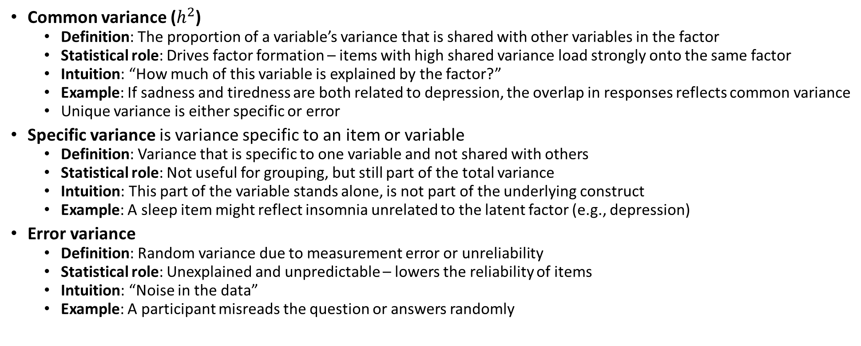
Extracting a set of factors from the correlation matrix
Common variance ($h^{2}$)
Definition: The proportion of a variable’s variance that is shared with other variables in the factor
Statistical role: Drives factor formation – items with high shared variance load strongly onto the same factor
Intuition: “How much of this variable is explained by the factor?”
Example: If sadness and tiredness are both related to depression, the overlap in responses reflects common variance
Unique variance is either specific or error
Specific variance is variance specific to an item or variable
Definition: Variance that is specific to one variable and not shared with others
Statistical role: Not useful for grouping, but still part of the total variance
Intuition: This part of the variable stands alone, is not part of the underlying construct
Example: A sleep item might reflect insomnia unrelated to the latent factor (e.g., depression)
Error variance
Definition: Random variance due to measurement error or unreliability
Statistical role: Unexplained and unpredictable – lowers the reliability of items
Intuition: “Noise in the data”
Example: A participant misreads the question or answers randomly

Slide 28
Exploratory Factor Analysis Specification Conditions & Decisions
Factor retention: once the variables are factored, we need to determine how many factors to retain
This is a “crucial decision”
Notes:
If too few factors are retained, then important information is lost and important factors may be neglected
Remember the goal is parsimony

Slide 29
Full Set of Criteria for number of factors
Note: some of these are statistical, some require common sense judgment
Selecting the factor(s)
A priori criterion (theory)
Scree plots
Kaiser’s rule (eigenvalues greater than one)
Parallel analysis
Number of variables per factor
Heterogeneity of the respondents
Notes:
This isn’t just a numbers game—some of these decisions are statistical, but others require judgment and context.
A priori criterion Sometimes, theory tells you how many factors to expect. If you're testing a validated construct (e.g., Big Five personality), you might already know what you're looking for.
Scree plot This visual shows the “elbow” where eigenvalues drop off sharply. You look for the point where the curve flattens—everything before that might be meaningful. After? Probably noise.
Kaiser’s rule Keep factors with eigenvalues > 1. Why? Because each variable contributes 1 unit of variance—so a factor should explain at least as much as a single variable to be worth keeping.
Parallel analysis A more robust method: it compares your real data to random data. If your factor explains more variance than what you'd see by chance, it's worth keeping. Gold standard in modern FA.
Number of variables per factor A factor defined by one or two variables isn’t stable. You typically want at least 3–4 strong loadings to consider a factor reliable.
Heterogeneity of respondents If your sample is diverse in key ways (age, education, context), you might find more factors. If it’s homogeneous, you may see fewer meaningful dimensions.
Bottom line: There’s no one-size-fits-all answer. Use the tools—but trust your theory and your data.

Slide 30
A priori: EFA v CFA
 | EFA (Exploratory Factor Analysis) | CFA (Confirmatory Factor Analysis)
Purpose | Discover underlying structure | Test a pre-specified factor structure
When to Use | New scale development or unclear structure | Validated constructs, theory-driven hypotheses
Model Specification | No assumptions about number or grouping of factors | User defines number of factors and item-factor relationships
Loadings | All variables can load on all factors | Loadings are restricted based on the hypothesized model
Goal | Identify how many factors and what items belong together | Assess model fit and confirm the structure
Statistical Fit Indices | Not a focus | Central (e.g., RMSEA, CFI, TLI, χ²)
Flexibility | High — lets the data “speak” | Low — strict model testing
Use Case Example | Developing a new anxiety scale | Testing if the PHQ-9 fits a one-factor model for depression

Slide 31
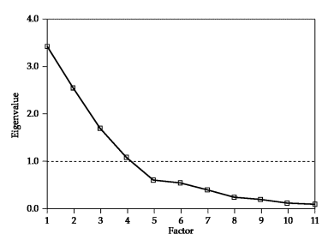
Scree plot
Look to see where the ‘elbow’ bends in the plot – that is how many factors to retain
To do this look for the clearest delineation of where the line goes from being diagonal to horizontal
Then count the number of lines
This is a matter of judgment I would look at 4, 5 and 6 and the use theory to guide
Better than Kaiser’s rule (eigenvalues greater than one)

Slide 32
Kaiser’s rule (eigenvalues greater than one)
Eigenvalues measure the amount of variance in the total sample that is accounted for by each factor
Retain only those eigenvalues that are greater than 1 and drop the rest
Why? Any value greater than one represents a factor that explains a higher-than-average amount of variance

Slide 33
Parallel Analysis** (Gold Standard)
Compare the eigenvalues from the original data to the eigenvalues generated from a Monte Carlo simulated matrix created from randomly generated data of the same sample size
Factors are retained when the i^{th} eigenvalue from the observed data is greater than the i^{th} eigenvalue from the random data
Superior to both previous methods
Software note: SPSS doesn’t provide this – do it in JASP, R (e.g., psych::fa.parallel), or Jamovi
Notes:
How it works: Parallel analysis compares your data’s eigenvalues to those generated from random data of the same sample size and number of variables. This random dataset is created using Monte Carlo simulation—basically, simulating what eigenvalues would look like if the data had no real structure.
The key idea:
A factor is retained only if the ith eigenvalue from your actual data is greater than the ith eigenvalue from the random (simulated) data.
Why it’s better: Unlike the scree plot (which is subjective) or Kaiser’s rule (which can overestimate), parallel analysis protects against chance—it helps ensure you don’t keep factors that are just statistical noise.
Software note: SPSS doesn’t include this method out of the box. But JASP, R (e.g., psych::fa.parallel), or Jamovi can run parallel analysis easily.

Slide 34
Interpreting the factors
An iterative process
Begins with estimating the factor matrix
First, the initial unrotated factor matrix is computed, containing the factor loadings
This is the first solution the software calculates
It finds factors that explain the maximum variance in the data
But: this solution is often hard to interpret, because each variable may load on multiple factors
It gives you the structure, but it's like looking at a blurry picture
Rotated factor loadings are the correlation of each variable and the factor
Rotation is a mathematical adjustment to make the factor structure more interpretable
After rotation, variables usually load more strongly on one factor, and weakly on others
This makes it easier to name the factors based on the items that group together
You typically use rotated loadings to interpret the factors

Slide 35
Example:
Imagine you're doing factor analysis on 10 survey items
Unrotated loadings might show every item loading a little on all factors (messy!)
Rotated loadings will try to "clean this up" so:
Items 1–5 load strongly on Factor 1 → You might label this "Anxiety“
Items 6–10 load strongly on Factor 2 → You might label this "Depression“
→ focus on the rotated loadings
Notes:
Factor analysis is an iterative process—we don’t stop at the first solution the software gives us.
Step 1: Initial unrotated solution The software starts by estimating the unrotated factor matrix—this is the raw set of loadings that explains the most variance possible. It’s mathematically optimal, but often messy: variables may load on multiple factors, and the structure is hard to interpret.
It’s like taking a photo that's technically “complete,” but blurry—you can’t quite make out what’s in it.
Step 2: Rotation (puts the analysis into focus) Rotation is a mathematical adjustment that helps clarify the factor structure. It doesn’t change the number of factors or the total variance explained—but it redistributes the variance across factors to make the picture clearer.
What rotation does: After rotation:
Each variable typically loads strongly on one factor and weakly on others
Factors become easier to label and interpret—because now the items grouped together actually make conceptual sense
Bottom line:
Always interpret the rotated solution. That’s the one that tells the clearest story.

Slide 36
Factor Rotation (sharpening the focus)
Rotation simply means turning the axes (factors) to a new angle to make the factor structure easier to interpret
It doesn’t change the underlying math, but helps us see which variables load clearly onto which factors
Why Rotate?
Rotation helps clarify the factor loadings, making it easier to assign meaning to each factor
It spreads the loadings out more cleanly, so that each variable “belongs” more strongly to one factor instead of multiple

Slide 37
Must rotate factors, different rotation types
When choosing a rotation method, ask yourself: Do I expect my factors to be correlated? YES
Constructs like depression and anxiety, or trauma and risk-taking, are rarely independent. Psychological, behavioral, and social variables tend to overlap
Oblique rotation (e.g., Promax, Oblimin) allows factors to correlate
Orthogonal rotation (like Varimax) forces factors to be uncorrelated
Using varimax rotation distorts underlying relationships
In most social science applications, use oblique rotation—because constructs are not independent (disinvestment example, redux).
Type | Factors Are... | Use When...
Orthogonal | Uncorrelated | You assume the factors are independent (rare).
Oblique | Correlated | More realistic for psychology/social sciences constructs that are highly interdependent

Slide 39
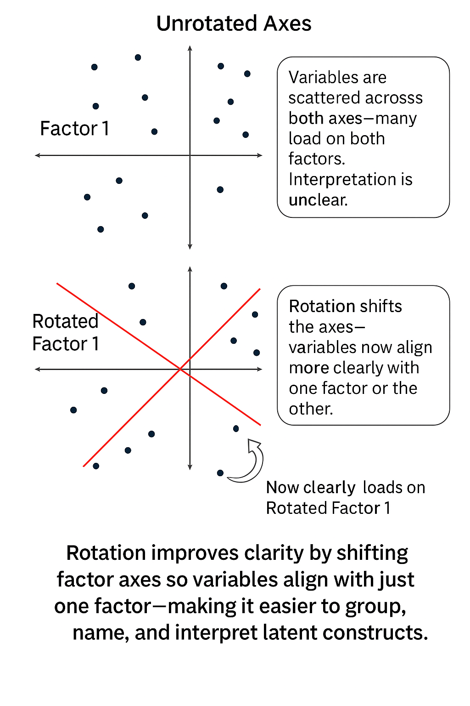
Rotation (Cont’D)
When more than one variable loads highly on a factor, the interpretation becomes difficult (as we will see)
It is a good idea to find an appropriate rotation that makes the factors more interpretable
The best way to understand this is by a scatterplot matrix of the factor loadings – the goal is to find a rotation such that each of the variables has a high loading on only one factor
Notes:
Factor analysis doesn’t stop at finding structure—it needs to make that structure interpretable. That’s where rotation comes in.
Top panel: This is the initial, unrotated factor solution. The axes (factors) are aligned to explain the maximum amount of variance, but interpretation is difficult. Many points (representing variables) are scattered across multiple quadrants—loading on more than one factor. It’s messy, and hard to tell what belongs where.
Bottom panel: After rotation, the axes have been reoriented and appear in red. Now, each variable lies closer to just one factor axis, rather than being split between both.
This creates a cleaner, more interpretable factor structure—where variables group more clearly and meaningfully, making it easier to label the factors.
The goal of rotation is simple: Help us say with confidence: “These items belong to Factor 1. Those belong to Factor 2.”
We haven’t changed the data—just the perspective. 👉 Rotation reorients the axes to make the latent structure clearer and easier to interpret.

Slide 40
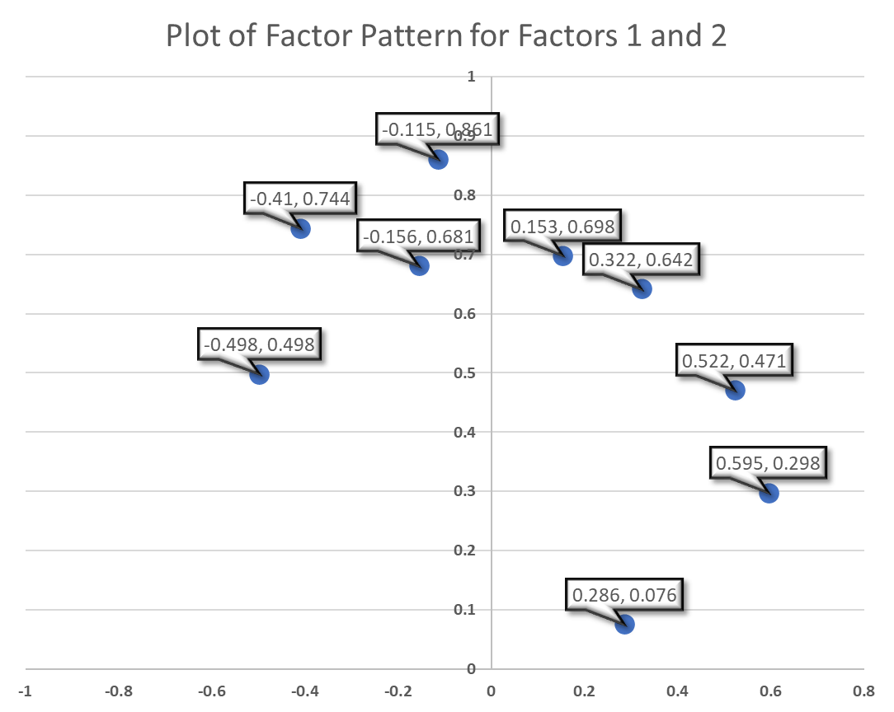
Example: Visualizing Rotation
Before rotation: Look at “Climate”—it has moderate loadings on two of three factors: 0.286, and 0.841 And “Education” is split equally between two factors: 0.498 and –0.498
This is messy. Variables are loading on multiple factors, which makes interpretation difficult
Factor
Variable | 1 | 2 | 3
Climate | 0.286 | 0.076 | 0.841
Housing | 0.698 | 0.153 | 0.084
Health | 0.744 | -0.41 | -0.02
Crime | 0.471 | 0.522 | 0.135
Transportation | 0.681 | -0.156 | -0.148
Education | 0.498 | -0.498 | -0.253
Arts | 0.861 | -0.115 | 0.011
Recreation | 0.642 | 0.322 | 0.044
Economics | 0.298 | 0.595 | -0.533
Notes:
Ideally, each variable appears in only one column
Rotation involves defining new coordinate systems so that when we rotate everything, the points fall close to the vertices (end points) of the new axes.

Slide 41
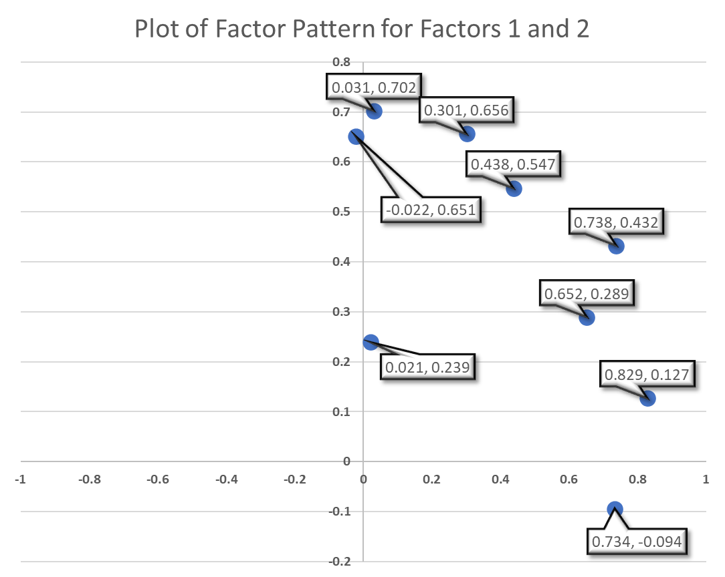
Example: Visualizing Rotation
After rotation: Now we see a clearer pattern. “Climate” loads strongly on Factor 3 (0.859) and weakly elsewhere
“Education” now loads strongly on Factor 1 (0.734), with minimal cross-loadings
Factor
Variable | 1 | 2 | 3
Climate | 0.021 | 0.239 | 0.859
Housing | 0.438 | 0.547 | 0.166
Health | 0.829 | 0.127 | 0.137
Crime | 0.031 | 0.702 | 0.139
Transportation | 0.652 | 0.289 | -0.028
Education | 0.734 | -0.094 | -0.117
Arts | 0.738 | 0.432 | 0.15
Recreation | 0.301 | 0.656 | 0.099
Economics | -0.022 | 0.651 | -0.551
Notes:
Ideally, each variable appears in only one column
Rotation involves defining new coordinate systems so that when we rotate everything, the points fall close to the vertices (end points) of the new axes.

Slide 42
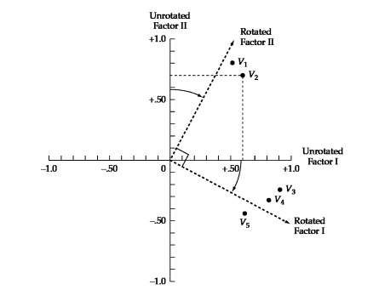
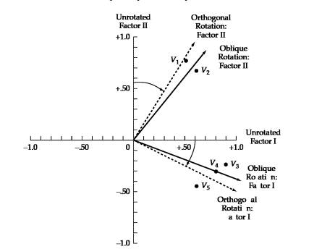
This has the effect of
making the factor loading pattern much clearer
Orthogonal rotates 90º
Comparison Between Rotated and Unrotated Factor Loadings
 | Unrotated Factor Loadings |  | Rotated Factor Loadings
Variables | I | II | I | II
V1 | .50 | .80 | .03 | .94
V2 | .60 | .70 | .16 | .90
V3 | .90 | -.25 | .95 | .24
V4 | .80 | -.30 | .84 | .15
V5 | .60 | -.50 | .76 | -.13
Oblique
Notes:
🔹 Left: Visual Comparison
Top diagram: Orthogonal Rotation
The factor axes stay at 90° angles (uncorrelated).
Variables (V1–V5) are repositioned to align better with one factor, without letting the factors correlate.
This rotation is rigid—it assumes the underlying constructs are independent.
Bottom diagram: Oblique Rotation
The axes are allowed to tilt toward each other (not necessarily 90°).
This allows the factors to correlate, which is often more realistic in social science data (e.g., depression and anxiety).
Oblique rotation gives you a more flexible, and often more accurate, picture of how variables relate to correlated constructs.
🔹 Right: Table of Loadings Before and After Rotation
Unrotated factor loadings are messy—each variable loads on both factors to some degree.
Rotated loadings (highlighted) show the improvement: Now, each variable loads strongly on one factor and weakly on the other, making interpretation straightforward.

Slide 43
Factor loadings
The factor loading provides information on the relative contribution that an individual variable makes to a factor
Should be >=.3 preferably >=.4, closer to 1 is better
The factor loading squared is the percentage of common variance of the factor that is accounted for by that variable: If a variable loads .60 on a factor, then: 36% of that variable’s variance is explained by the factor
You want each variable to have one strong loading on a single factor and near-zero on all others but in reality, cross-loadings happen—and that’s why rotation helps.
Loadings can be negative: They just mean the variable moves inversely with the factor (you can recode the item for easier interpretation)
Bipolar factors: a factor defined by positive loadings on one set of variables and negative loadings on another
Notes:
Factor loadings are the core output of factor analysis. They tell us how strongly each variable is associated with each factor—like a correlation between the item and the underlying dimension.
Magnitude matters: Loadings ≥ .30 are usually considered meaningful. ≥ .40 is better, and closer to 1.0 means a stronger contribution to that factor.
What does a loading mean? If a variable loads .60 on a factor, then:
.602=.36.60^2 = .36.602=.36 → 36% of that variable’s variance is explained by the factor This is called the communality contribution from that variable to that factor.
Ideal case (that never quite happens): You want each variable to have one strong loading on a single factor and near-zero on all others. But in the real world? Cross-loadings happen—and that’s why rotation helps.
Negative loadings are okay: They just mean the variable moves inversely with the factor. You can recode the item for easier interpretation, but it’s not wrong.
Bipolar factors: Sometimes a factor is defined by positive loadings on one set of variables and negative loadings on another. This means the factor represents a spectrum or contrast—like “introversion vs. extraversion.”

Slide 44
Judging the significance of the factors
Ensuring the practical significance
The larger the more important, using practical reasoning
+/- .30 to +/- .40 meet minimum level for interpreting factor structure
Loadings of .50 or higher are practically significant
Loadings > .70 are indicative of well-defined structure

Slide 45
Identify significant loadings and assess communalities
Once the significance of loadings has been identified, look for any variables that are not adequately accounted for by the factor solution
We do this by looking at communalities → variables with communalities less than .50 do not have sufficient explanation
If low communalities are identified, remove the variable and repeat the analysis
Then label the factors

Slide 46
Interpreting a factor matrix
Once you’ve rotated and examined the factor loadings, your goal is to name the factors—but not randomly
You need to
Find distinctive variables that load strongly on each factor
Match those variables to your theoretical or conceptual foundation
What do these items have in common? What latent idea ties them together?
Note: if you’ve used oblique rotation (which allows factors to correlate), your output includes two matrices—and they serve different purposes:
Includes both unique contributions and the shared variance due to correlations between factors
These are correlations between the variable and the factor
Use this matrix to understand overall relationships, but not to name factors
Base the factor labeling on the rotated pattern matrix

Slide 47
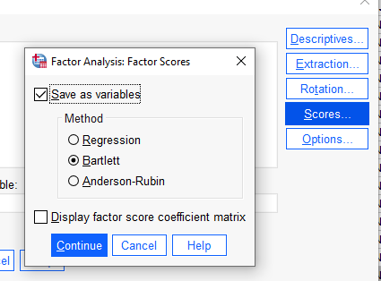
Generating factor scores: A Composite Measure
Sometimes you would like to use the factor scores as a predictor in another analysis
This can be done in SPSS
SPSS will append variables to your dataset for each factor
For oblique rotations, use regression method
This variable can be used in a different analysis
The scores are standardized, mean = 0, var = 1
Notes:
Sometimes, identifying the factors isn’t the end of the road—you may want to use them as variables in another analysis (like regression, clustering, or SEM).
Factor scores are numeric values representing how strongly each case (participant) scores on a given factor.
Think of it as: How much of Factor 1 does this person have?
SPSS makes this easy: When you extract factors, SPSS can append new variables to your dataset—one for each factor.
If using oblique rotation, select the regression method for calculating scores. This ensures the factor score estimates match the rotated structure.
The resulting variables are:
Standardized (mean = 0, variance = 1)
Ready to use as predictors or outcomes in other analyses
For example, you might create a factor score for “Neighborhood Risk” and then use it to predict rates of violence, dropout, or poor health.

Slide 48
Considerations
High communalities (approximately .8 to .9)
Low model error (which is likely evidenced in situations where communalities are high; RMSR = .00 to .06) (Preacher & MacCallum, 2002)
Factors with four or more variables with factor loadings of .60 or greater are interpretable regardless of the sample size
Solutions with lower factor loadings (.40) can still be interpreted if the number of cases is at least 200 and the number of variables per factor is larger (=> 10)

Slide 49
Assumptions
Assumption | Effect when violated
Independence | Influences standard errors and hypothesis tests
Linearity | Reduces interpretability of the FA solution
Absence of outlying cases and variables | Exerts undue influence on and distorts the FA solution
Lack of extreme multicollinearity | Reduces ability to separate effects of variables
Multivariate normality | Minimal effect except when MLE is used and when samples size is small
10 observations per variable/n >= 200
Homogeneity of the sample** | Failure to consider groupings
Notes:
Factor analysis isn’t overly fragile, but it does rest on a few key assumptions. When these are violated, your solution can become unstable or misleading.
Let’s walk through the list:
Independence: We assume observations (cases) are not dependent on one another.
Violations affect standard errors and hypothesis tests, making them less trustworthy.
Linearity: FA models shared variance, so we need linear relationships among variables.
If non-linear patterns are present, interpretability suffers—you might miss the true structure.
No extreme outliers: Outliers can dominate the solution, pulling factors in odd directions.
Always check distributions.
No extreme multicollinearity: Some correlation is good (that’s the point of FA), but extreme multicollinearity makes it hard to tell variables apart.
Multivariate normality (bolded for a reason): This is not essential unless you're using Maximum Likelihood Estimation (MLE) or have small sample sizes.
With large samples and PCA, you can relax this assumption.
Sample size: Rule of thumb: at least 10 observations per variable, with n ≥ 200 for stability.
More cases = more reliable factors.
Homogeneity of the sample: If you’re pooling across very different subgroups, your factor structure may get muddled.
Consider whether stratification or group-specific analyses are warranted.

Slide 50
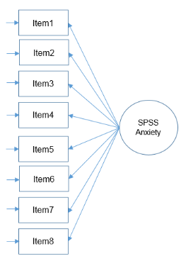
Example: Statistics anxiety
Statistics makes me cry
My friends will think I’m stupid for not being able to cope with SPSS
Standard deviations excite me
I dream that Pearson is attacking me with correlation coefficients
I don’t understand statistics
I have little experience of computers
All computers hate me
I have never been good at mathematics
Stats Anxiety
Question: What constitutes the systematic error for item 3, i.e., explanations for variation in this item that are not related to stats anxiety?
Notes:
When we talk about systematic error in factor analysis, we mean consistent variation in an item’s responses that is not related to the construct we’re trying to measure.
Let’s say this item is part of a Statistics Anxiety Scale. The goal is to capture how anxious someone feels about statistics—not their personality, interests, or professional identity.
Variance related to statistics anxiety is the good kind of systematic variance—called common variance. That’s what factor analysis is trying to detect and group with other similar items.
But Item 3 might also pick up other sources of variance that are consistent across respondents—but not part of stats anxiety. These are systematic error.
👇 What might cause systematic error in this item?
If someone responds strongly agree to “Standard deviations excite me,” it could reflect:
✅ They’re not anxious about statistics → Relevant, reflects low stats anxiety
❌ They genuinely love statistics → Enthusiasm or interest, not anxiety
❌ They want to sound smart → Social desirability, not true feelings
❌ They come from a math-heavy field → Disciplinary bias, not psychological response
Those last three are systematic sources of variance that distort the item, because they reflect traits or motivations other than the one you’re trying to measure.
This kind of variance is consistent, but not theoretically relevant to the factor being measured—it adds distortion.
Random Error for Item 3
This is the pure noise, the stuff we can’t explain:
Misclicking on a Likert scale
Misunderstanding what “standard deviation” means
Sarcastic or joking responses (hello, stats humor)
Day-to-day mood variation
This part adds variance that doesn’t relate to anything else in the dataset, and reduces reliability.
Bonus: Why This Item Might Be a Problem
Because it’s funny and clever, yes—but also:
It might not behave the same across people depending on their background in stats, field of study, or sense of humor
It could have low communality (i.e., it doesn't load strongly on any factor)
If you ran a factor analysis, this item might show high uniqueness and low loading—meaning it adds more confusion than clarity

Slide 51
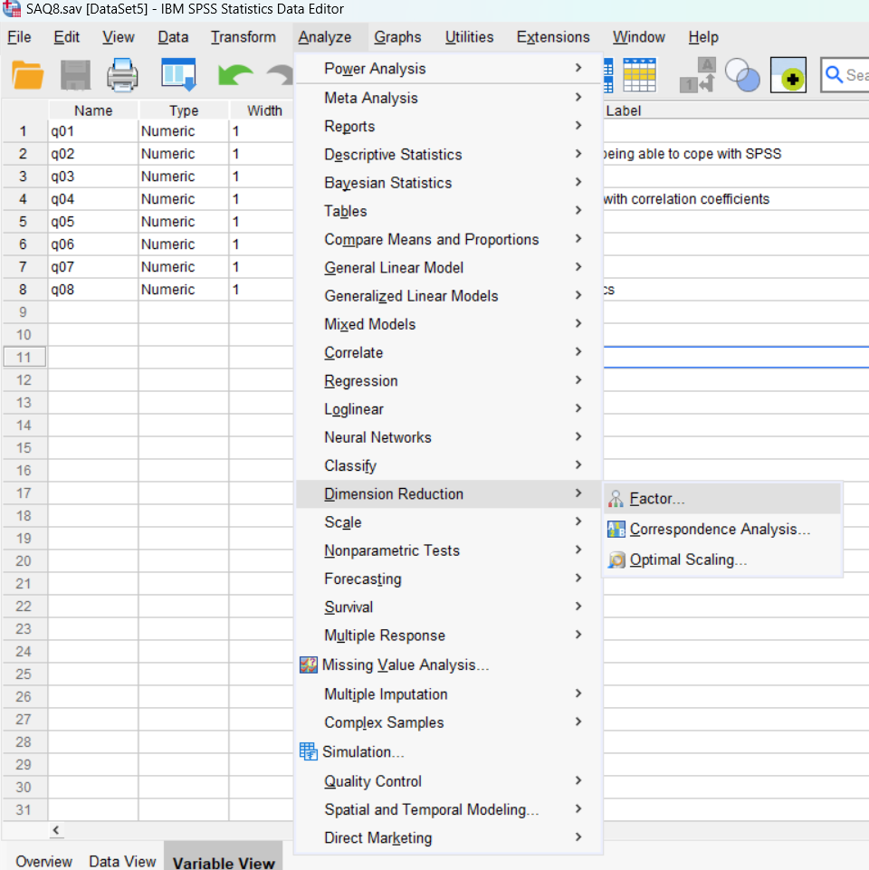

Slide 52
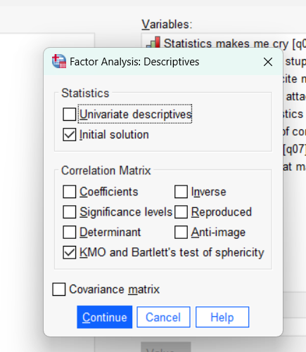
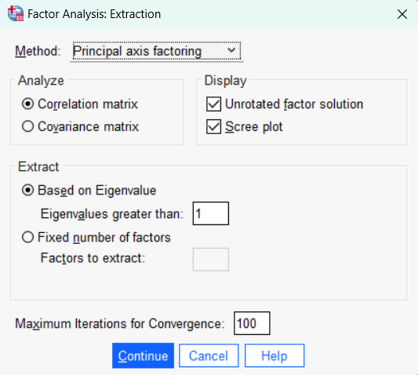
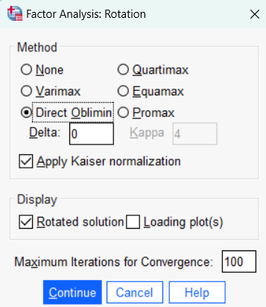



Slide 53
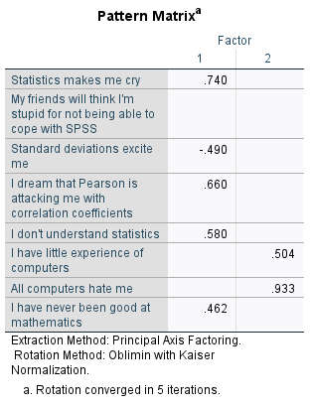
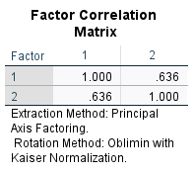
Note: there is other output including
the structure matrix and factor matrix.
The structure matrix shows the
zero-order correlations between each
item and each factor. It includes both
unique and shared variance. The factor matrix
is the unrotated solution. Ignore both.
Notes:
This shows the unique contribution of each factor to each item, controlling for overlap with the other factor.
| Use this matrix to name and interpret your factors.
Factor 1 (Statistical Fear or Anxiety):
"Statistics makes me cry" (.740)
"Pearson is attacking me" (.660)
"I don't understand statistics" (.580)
"Never been good at math" (.462)
"Standard deviations excite me" loads negatively (–.490), which fits with the idea that excitement is the opposite of fear.
Factor 2 (Computer Helplessness or Tech Aversion):
"All computers hate me" → .933
"Little experience of computers" → .504
Some items that didn’t load clearly on either factor (like "My friends will think I’m stupid") are missing here, because their loadings were too low.
Bottom line: This is the clearest structure. It helps us say:
Factor 1 = Statistical Fear; Factor 2 = Tech Helplessness

Slide 54
Cross Cultural Invariance Testing
Most questionnaires were developed in a Western context
But how do we know that the questionnaire measures the same thing across different groups?
Invariance across groups: does the test measure the latent variable in the same way across groups?

Slide 55
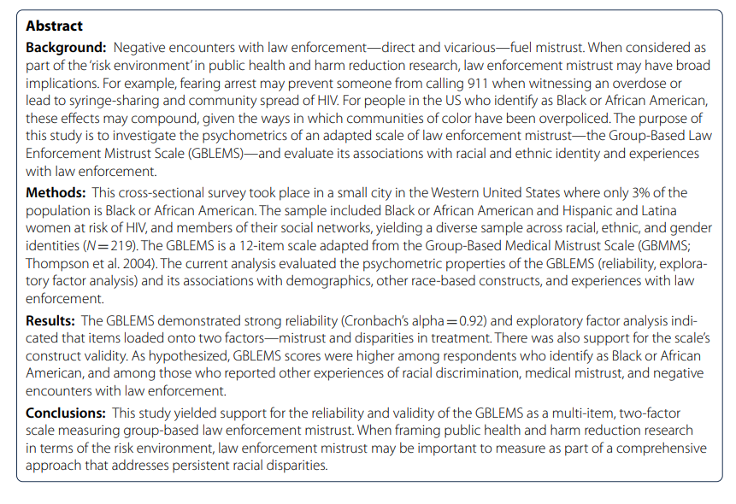
Johnson, L. M., Devereux, P. G., & Wagner, K. D. (2022). The group-based law enforcement mistrust scale: psychometric properties of an adapted scale and implications for public health and harm reduction research. Harm Reduction Journal, 19(1), 1-13.

Slide 56
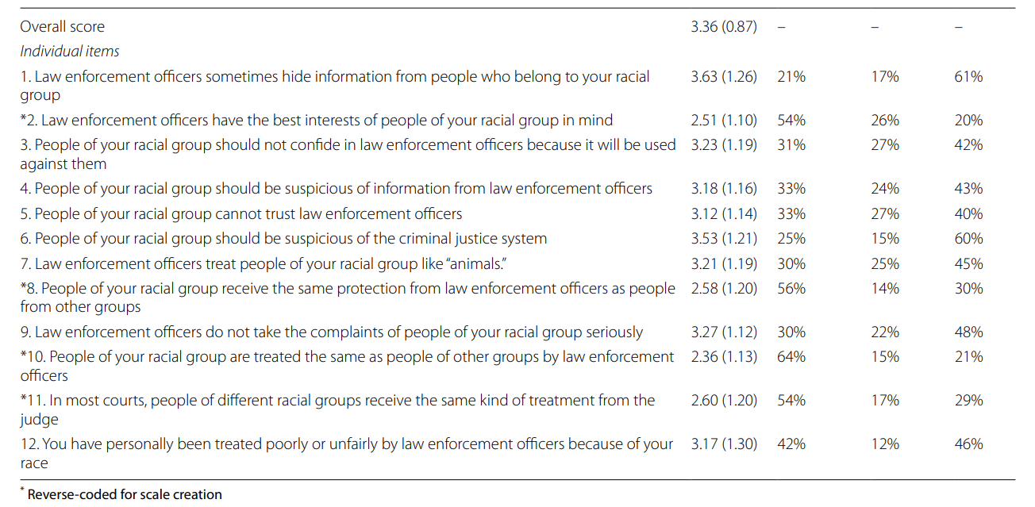
Disagree
Neutral
Agree

Slide 57
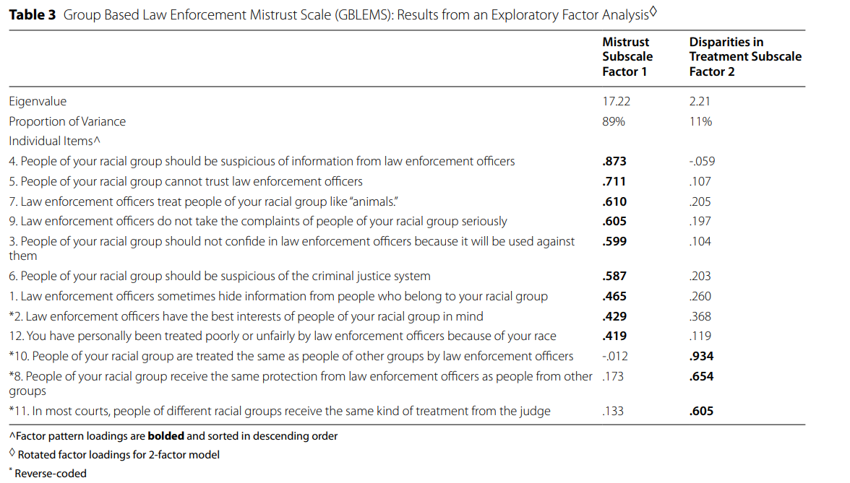
Notes:
Table 3 reports the results of an exploratory factor analysis (EFA) using oblique (promax) rotation in SAS:
This table displays the results from an EFA conducted on 12 items measuring perceptions of law enforcement mistrust. The analysis revealed two factors, which the authors interpret as:
Factor 1: Mistrust Subscale Reflecting generalized suspicion, distrust, and fear of law enforcement
Factor 2: Disparities in Treatment Subscale Reflecting perceptions of unequal treatment across racial groups in the criminal justice system
Each item’s rotated factor loadings are reported across both factors. Bolded values represent the primary factor on which each item loads.
Proportion of Variance:
Factor 1 explains 89% of the shared variance
Factor 2 explains 11% This indicates that the vast majority of the shared variance in the items is captured by the Mistrust factor.
Factor loadings can be interpreted like standardized regression coefficients—they show the strength and direction of the association between each item and the underlying factor. Values above .40 are typically considered meaningful.
Factor 1: Mistrust Subscale
This factor captures generalized distrust and suspicion toward law enforcement. Items that load most strongly include:
Item 4: “People of your racial group should be suspicious of information from law enforcement officers” → .873
(If you want to have a deeper understanding of the regression coefficient explanation, here it is
A 1 standard deviation increase in the latent factor of Mistrust is associated with a .873 standard deviation increase in endorsement of Item 4, controlling for the effects of other factors.)
Item 5: “People of your racial group cannot trust law enforcement officers” → .711
Item 7: “Law enforcement officers treat people of your racial group like ‘animals’” → .610
These items express broad beliefs about dishonesty, abuse, and hostility from law enforcement toward members of the respondent's racial group.
Factor 2: Disparities in Treatment Subscale
This factor captures beliefs about unequal treatment by law enforcement and the justice system. Items that load most strongly include:
Item 10: “People of your racial group are treated the same as people of other groups by law enforcement” → .934 (reverse-coded)
Item 8: “People of your racial group receive the same protection from law enforcement officers as people from other groups” → .654 (reverse-coded)
Item 11: “In most courts, people of different racial groups receive the same kind of treatment from the judge” → .605 (reverse-coded)
These items assess perceived fairness or equity in treatment, and because they are reverse-coded, higher agreement actually reflects lower perceived fairness, aligning with greater perceived disparity.
Notes on Specific Items
Items 1, 2, and 12 load modestly on both factors and may reflect conceptual overlap or mixed item content:
Item 2: “Law Enforcement Officers have the best interests of people of your racial group in mind” → .429 on Factor 1, .368 on Factor 2
These items may tap into both generalized mistrust and perceived fairness, which complicates clean interpretation.
Item 10 has a very high loading on Factor 2 (.934) and near-zero on Factor 1 (–.012), suggesting it is a clear anchor for the Disparities subscale.

Slide 58
Factor Analysis in SPSS
Factor analysis in spss.doc
We will use data from the Program for the International Assessment of Adult Competencies (PIAAC) located here Data - PIAAC, the OECD's programme of assessment and analysis of adult skills
The subsetted spss file is called sub_prgusap1_2017.sav

Slide 59
In class assignment
In class assignment.doc
We are going to explore the racial identity scale using data from Generations: A Study of the Life and Health of LGB People in a Changing Society, United States, 2016-2019 (ICPSR 37166)
The file is ‘life and health of lgbt people study.sav’

Slide 60
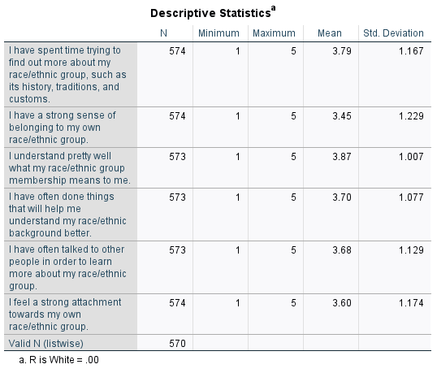
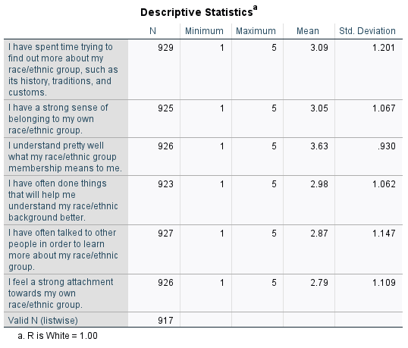

Slide 61
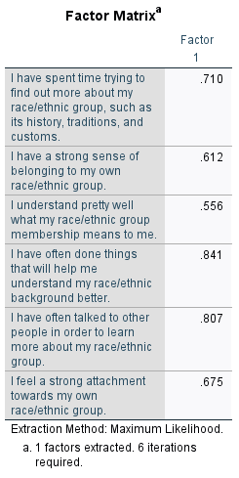

Slide 62
Use the saved factor scale in analyses
Let’s test differences across race
Let’s examine how the factor predicts depressive symptoms, controlling for family social support

