Slide 1
Week 4: February 3, 2026
Simple Linear Regression
Introduction to Multiple Linear Regression
Hypothesis Testing and Decomposition of Effects

Slide 2
Data application
Reimagine data using effective storytelling
Are there differences in infant mortality by race?
ATUS + CPS data

Slide 3
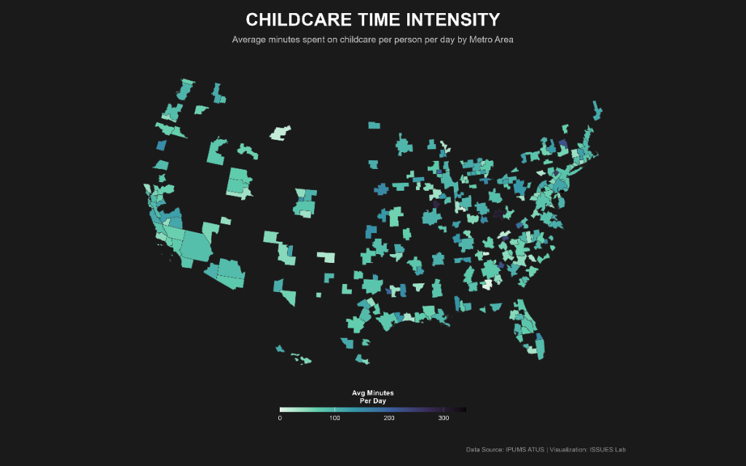
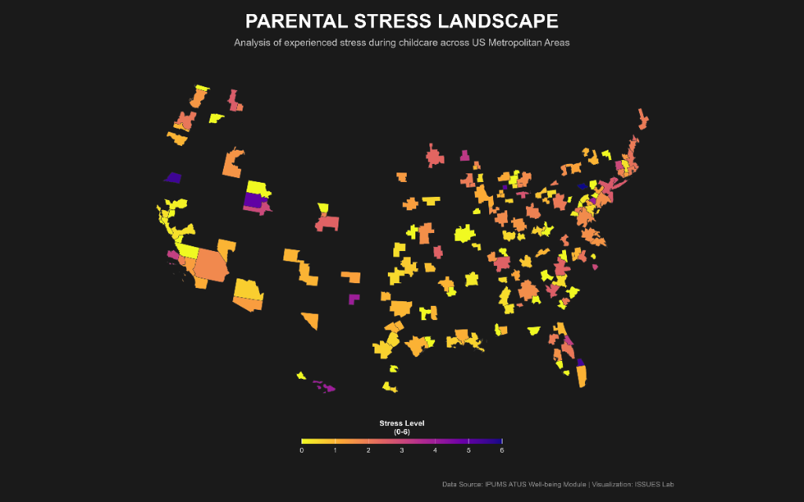

Slide 4
What model do I choose? Basic Statistical Analysis
Outcome Variable | Are the observations independent or correlated? |  | Alternatives if the normality assumption is violated (and small sample size):
 | independent | correlated
Continuous (e.g. pain scale, cognitive function) | T-test: compares means between two independent groups ANOVA: compares means between more than two independent groups Pearson’s correlation coefficient (linear correlation): shows linear correlation between two continuous variables Linear regression: multivariate regression technique used when the outcome is continuous; gives slopes | Paired ttest: compares means between two related groups (e.g., the same subjects before and after) Repeated-measures ANOVA: compares changes over time in the means of two or more groups (repeated measurements) Mixed models/GEE modeling: multivariate regression techniques to compare changes over time between two or more groups; gives rate of change over time | Non-parametric statistics Wilcoxon sign-rank test: non-parametric alternative to the paired ttest Wilcoxon sum-rank test (=Mann-Whitney U test): non-parametric alternative to the ttest Kruskal-Wallis test: non-parametric alternative to ANOVA Spearman rank correlation coefficient: non-parametric alternative to Pearson’s correlation coefficient

Slide 5
Linear regression –Terminology
Outcome, Y
Dependent variable
Response variable
Consequent
Explanatory variable, X
Independent variable
Predictor
Covariate
Control
Exposure
Antecedent

Slide 6
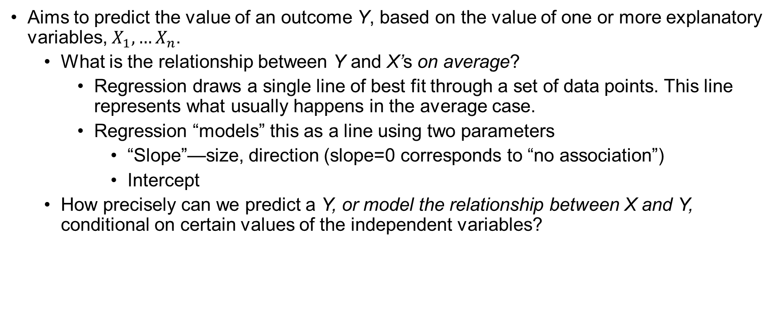
Introduction Simple Linear Regression
Aims to predict the value of an outcome Y, based on the value of one or more explanatory variables, $X_{1}, …X_{n}$.
What is the relationship between Y and X’s on average?
Regression draws a single line of best fit through a set of data points. This line represents what usually happens in the average case.
Regression “models” this as a line using two parameters
“Slope”—size, direction (slope=0 corresponds to “no association”)
Intercept
How precisely can we predict a Y, or model the relationship between X and Y, conditional on certain values of the independent variables?

Slide 7
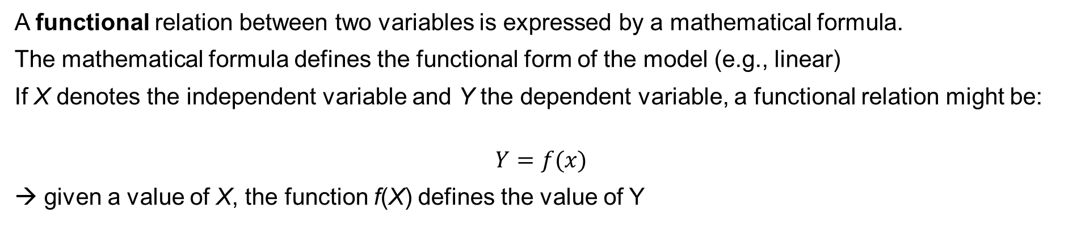
The functional form
A functional relation between two variables is expressed by a mathematical formula.
The mathematical formula defines the functional form of the model (e.g., linear)
If X denotes the independent variable and Y the dependent variable, a functional relation might be:
$$Y=f(x)$$
→ given a value of X, the function f(X) defines the value of Y
Notes:
-- the slope is known not estimated
-- there is no variability around the line, there is no probability distribution for the mean of Y
-- all points fall on the line with no error

Slide 8
Let's look at a pure functional relation. The rule is simple f(X) = X²
X = 2, Y = ?
Is there any debate? Is there any uncertainty?
No. In a pure functional relationship, if you know X, you know Y perfectly, 100% of the time. It is Deterministic.

Slide 9
A deterministic relation means there is no random error (or "noise"), if you know the input, you can calculate the output with 100% accuracy, every single time.
Based on the data above, there is a perfectly deterministic relation between ACEs and Test Score. In the table, we see that Test Score is determined entirely by the ACEs variable.
Test Score = 200 X ACEs
Age | ACEs | Test Score
5 | 7 | 1400
10 | 1 | 200
20 | 3 | 600
Why is this "Deterministic" vs. "Stochastic"?
In a standard regression (stochastic), we include an error term to represent the "messiness" of real life.

Slide 10
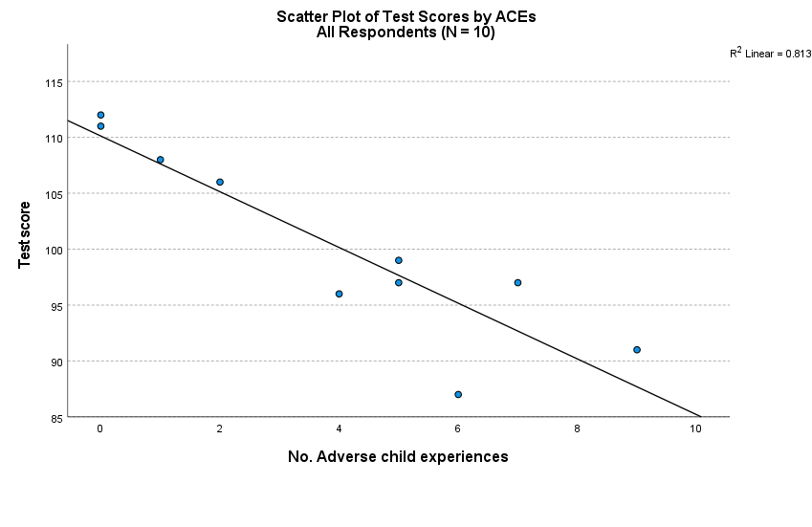
Statistical relationship between 2 Variables
A stochastic relation, unlike a deterministic relation, is not a perfect one
The observations for a statistical relation do not fall directly on the curve of the relationship
Y = f(X) + error
Notes:
Note that most of the points do not fall directly on the line of statistical relationship.
This scattering of points around the line represents variation in test scores that is not associated with ACEs and that is usually considered to be of a random nature.

Slide 11
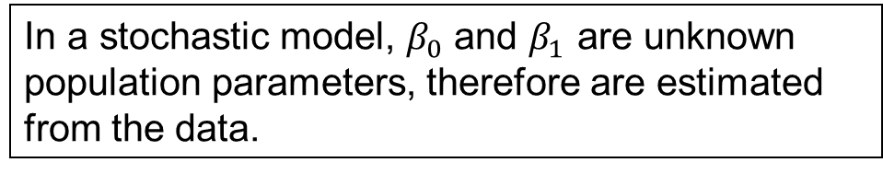

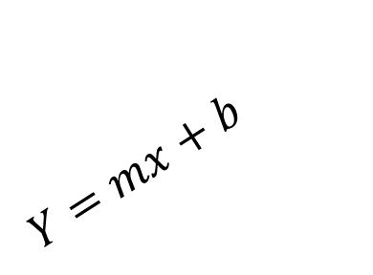

$$Y=β_{0}+β_{1}X+ε$$
$\text{In} \text{a} \text{stochastic} \text{model}\text{, }β_{0}$ and $β_{1}$ are unknown population parameters, therefore are estimated from the data.
$$Y=mx+b$$
Y
The first-order linear model
Y = dependent variable
X = independent variable
$β_{0}$= Y-intercept
$β_{1}$ = slope of the line
$ε$/e = error variable
β₁ = Rise/Run
Rise
β₀
Run
X

Slide 12
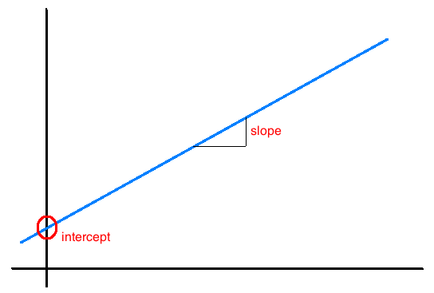
Interpretation of slope and intercept
Intercept: When X = 0, Y is expected to equal the intercept.
Slope:
For each unit in X, Y is expected to increase/decrease on average by the slope.
When the slope is 0, there is no relationship between X and Y
Slope = 0
When the slope = 0, every X value gives the same Y value. I.e., no matter what value X takes, the predicted value of Y stays the same
Note: These statements are not causal, unless the study is a randomized controlled experiment.

Slide 13






The full model
The model you are to use for SLR (which will be extended to the multivariate case) is:
b₁ > 0 ⇒ Positive Association
b₁ < 0 ⇒ Negative Association
b₁ = 0 ⇒ No Association
$$Y_{i}=β_{0}+β_{1}X_{i}+ε_{i}$$
$$Y_{i}$$
The observed response for the ith trial (or row of data)
$$X_{i}$$
A known constant, the level of the predictor in the ith trial
$β_{0}$, $β_{1}$
Unknown regression parameters
$$ε_{i}$$
Error term, independently and normally distributed, N(0, $σ^{2}$)
$$i$$
The index for the total number of cases in your data, i = 1, … N
Notes:
Independent means the outcome of any one trial has no effect on the error term for any other trial
The regression is simple, linear in the parameters and linear in the predictor
Explanatory and Response Variables are Numeric
Relationship between the mean of the response variable and the level of the explanatory variable assumed to be approximately linear (straight line)

Slide 14
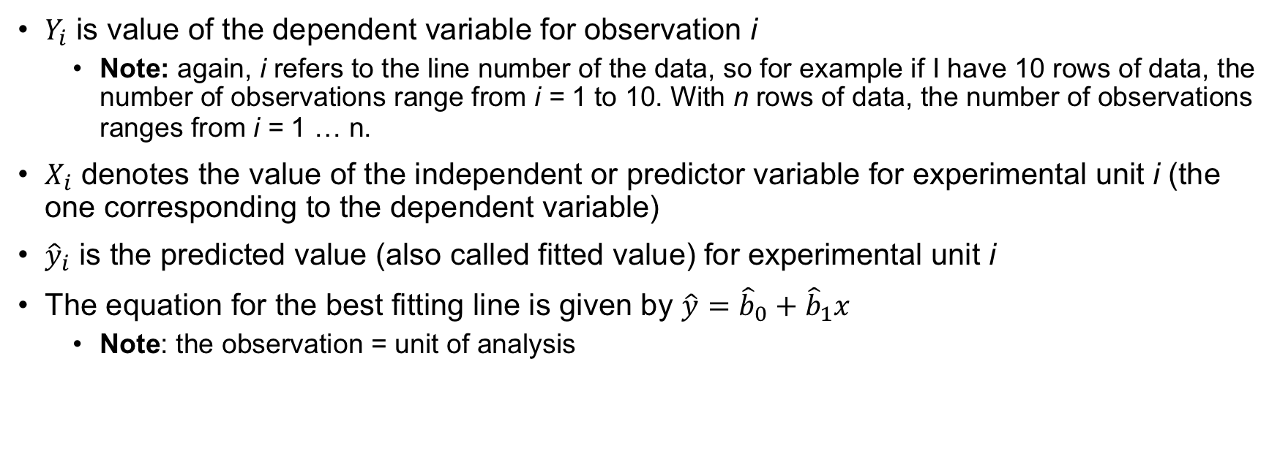
Notation
$Y_{i}$ is value of the dependent variable for observation i
Note: again, i refers to the line number of the data, so for example if I have 10 rows of data, the number of observations range from i = 1 to 10. With n rows of data, the number of observations ranges from i = 1 … n.
$X_{i}$ denotes the value of the independent or predictor variable for experimental unit i (the one corresponding to the dependent variable)
${\hat{y}}_{i}$ is the predicted value (also called fitted value) for experimental unit i
The equation for the best fitting line is given by $\hat{y}={\hat{b}}_{0}+{\hat{b}}_{1}x$
Note: the observation = unit of analysis

Slide 15
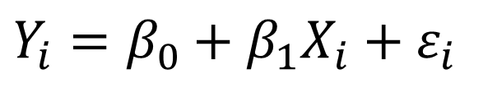
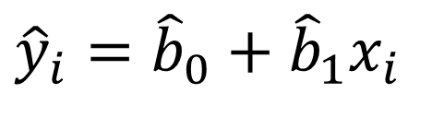
Simple Linear Regression
Assumption: a linear relationship between X & Y exists
Observed Y values can be expressed as:
Use data to estimate that linear relationship with a straight line:
$$Y_{i}=β_{0}+β_{1}X_{i}+ε_{i}$$
Deviation from the line
The straight line (average)
$${\hat{y}}_{i}={\hat{b}}_{0}+{\hat{b}}_{1}x_{i}$$

Slide 16

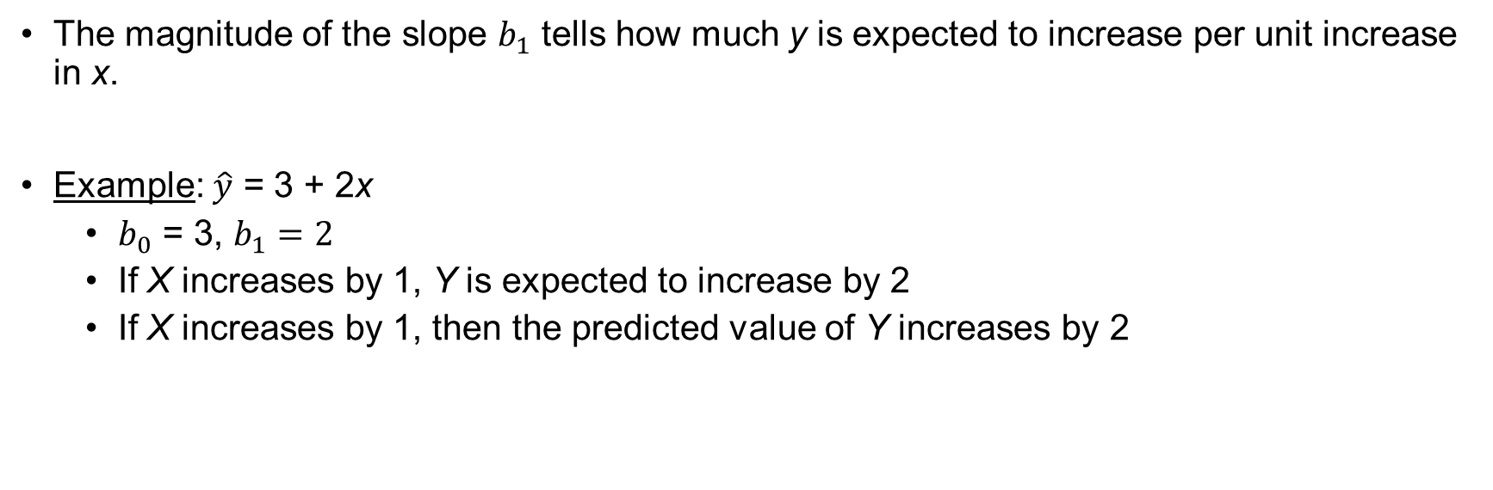
Interpretation of Regression Equation
$$\hat{y}={\hat{b}}_{0}+{\hat{b}}_{1}x$$
The magnitude of the slope $b_{1}$ tells how much y is expected to increase per unit increase in x.
Example: $\hat{y}$ = 3 + 2x
$b_{0}$ = 3, $b_{1}=2$
If X increases by 1, Y is expected to increase by 2
If X increases by 1, then the predicted value of Y increases by 2

Slide 17
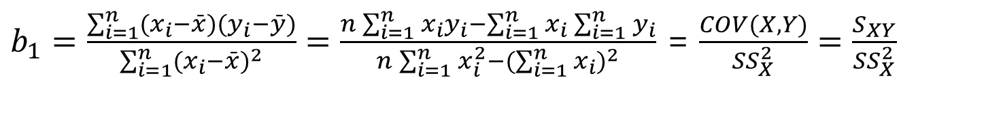

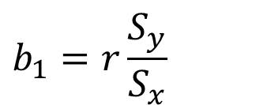

BLUE: Best Linear Unbiased Estimators**
Mathematically, we obtain estimating formulas:
or
$b_{1}=\frac{\sum_{i=1}^{n}{(x_{i}−\bar{x})(y_{i}−\bar{y})}}{\sum_{i=1}^{n}{(x_{i}−\bar{x})^{2}}}=\frac{n\sum_{i=1}^{n}{x_{i}y_{i}−\sum_{i=1}^{n}{x_{i}\sum_{i=1}^{n}{y_{i}}}}}{n\sum_{i=1}^{n}{x_{i}^{2}−(\sum_{i=1}^{n}{x_{i})^{2}}}}$ = $\frac{COV(X,Y)}{{SS}_{X}^{2}}=\frac{S_{XY}}{{SS}_{X}^{2}}$
$$b_{1}=r\frac{S_{y}}{S_{x}}$$
$$b_{0}=\bar{y}−b_{1}\bar{x}$$
The regression equation that estimates the first order linear model is:
$$\hat{y}={\hat{b}}_{0}+{\hat{b}}_{1}x$$
Notes:
This ratio compares how much X and Y move together (covariance) versus how much X moves on its own (variance)—telling us how steep the slope needs to be.
The slope is just the correlation coefficient standardized by the spread of Y relative to the spread of X.“
The line must pass through the average of the data ($\bar{x}, \bar{y}$), so the intercept is just where the line lands if we start back at zero
Final prediction

Slide 18
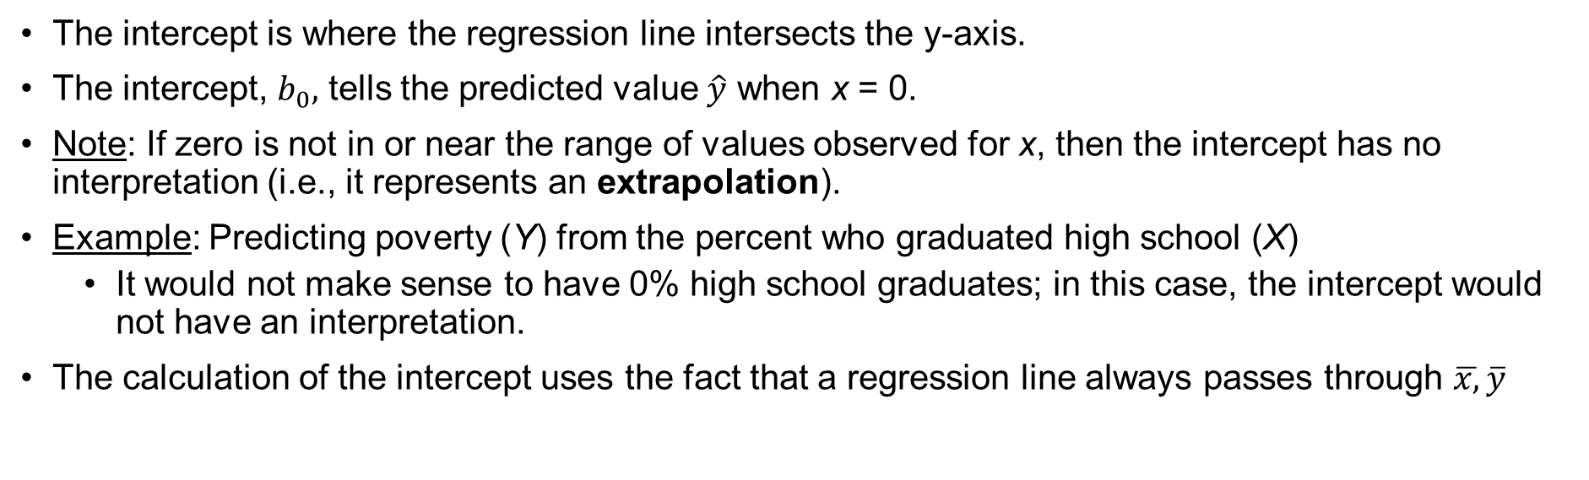

The Intercept
The intercept is where the regression line intersects the y-axis.
The intercept, $b_{0},$ tells the predicted value $\hat{y}$ when x = 0.
Note: If zero is not in or near the range of values observed for x, then the intercept has no interpretation (i.e., it represents an extrapolation).
Example: Predicting poverty (Y) from the percent who graduated high school (X)
It would not make sense to have 0% high school graduates; in this case, the intercept would not have an interpretation.
The calculation of the intercept uses the fact that a regression line always passes through $\overline{x,}\overline{y}$
$${\hat{b}}_{0}=\overline{y}−{\hat{b}}_{1}\overline{x}$$
Notes:
18

Slide 19
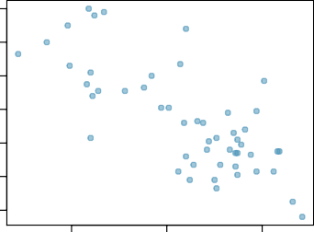
Given...
18
16
14
% HS grad
(x)
% in poverty
(y)
% in poverty
12
10
8
6
mean x¯ = 86.01
sd s_{x} = 3.73
y¯ = 11.35
s_{y} = 3.1
correlation
R = −0.75
80
85
% HS grad
90

Slide 20


Intercept
b₀ = 11.35 − (−0.62) × 86.01 = 64.68
70
60
50
40
30
20
10
0
intercept
Since the dataset contains no states with no HS graduates, the intercept is not informative, not very useful, and not reliable, as its predicted value is far from the bulk of the data.
% in poverty
0
20
40
60
80
100
% HS grad
The linear model for predicting poverty from high school graduation rate in the US is
$$\hat{poverty}=64.68 −0.62 HSgrad$$
The “hat” is used to signify that this is an estimate.

Slide 21
Slope
The slope of the regression can be calculated as
b₁ = ^{sy} R
s_{x}
In context...
3.1
b₁ = _{3.73} × −0.75 = −0.62
Interpretation
For each additional % point in HS graduate rate, we would expect the % living in poverty to be lower on average by 0.62% points.
22

Slide 22
Prediction
Using the linear model to predict the value of the response variable for a given value of the explanatory variable is called prediction, simply by plugging in the value of x in the linear model equation.
There will be some uncertainty associated with the predicted value.
% in poverty = 64.68 − 0.62 % HS grad
18
16
14
12
10
8
6
% in poverty
80
85
% HS grad
90

Slide 23
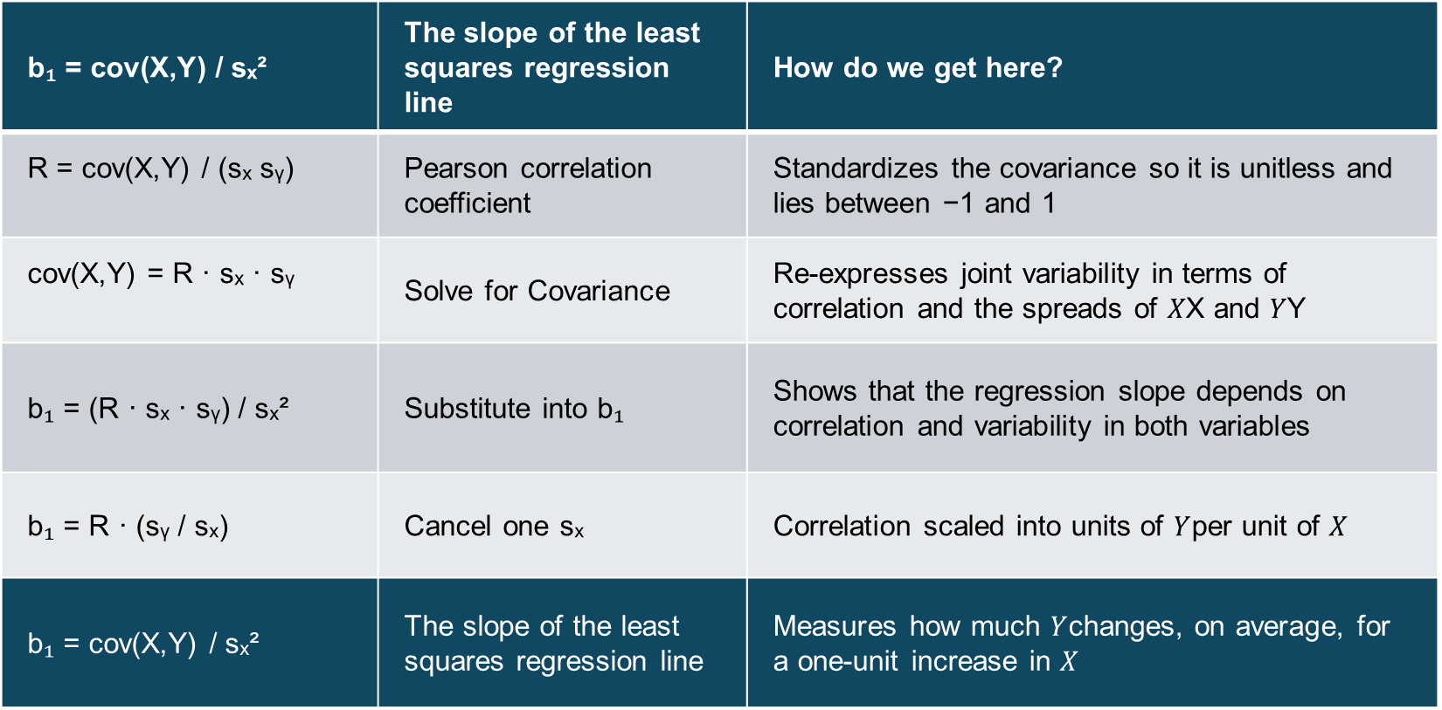
The Estimated Coefficients (Intuition)
b₁ = cov(X,Y) / sₓ² | The slope of the least squares regression line | How do we get here?
R = cov(X,Y) / (sₓ sᵧ) | Pearson correlation coefficient | Standardizes the covariance so it is unitless and lies between −1 and 1
cov(X,Y) = R · sₓ · sᵧ | Solve for Covariance | Re-expresses joint variability in terms of correlation and the spreads of 𝑋X and 𝑌Y
b₁ = (R · sₓ · sᵧ) / sₓ² | Substitute into b₁ | Shows that the regression slope depends on correlation and variability in both variables
b₁ = R · (sᵧ / sₓ) | Cancel one sₓ | Correlation scaled into units of $Y$per unit of $X$
b₁ = cov(X,Y) / sₓ² | The slope of the least squares regression line | Measures how much $Y$changes, on average, for a one-unit increase in $X$
Intuition: the slope is equal to the (correlation between X and Y) × (spread of Y / spread of X)

Slide 24
Which of the following is the correct interpretation of the intercept?
For each % point increase in HS graduate rate, % living in poverty is expected to increase on average by 64.68%.
For each % point decrease in HS graduate rate, % living in poverty is expected to increase on average by 64.68%.
Having no HS graduates leads to 64.68% of residents living below the poverty line.
States with no HS graduates are expected on average to have 64.68% of residents living below the poverty line.
In states with no HS graduates % living in poverty is expected to increase on average by 64.68%.
24

Slide 25
The Least Squares Regression Slope Where should we draw the line
A good line is one that minimizes the sum of squared differences between the points and the line.

Slide 26
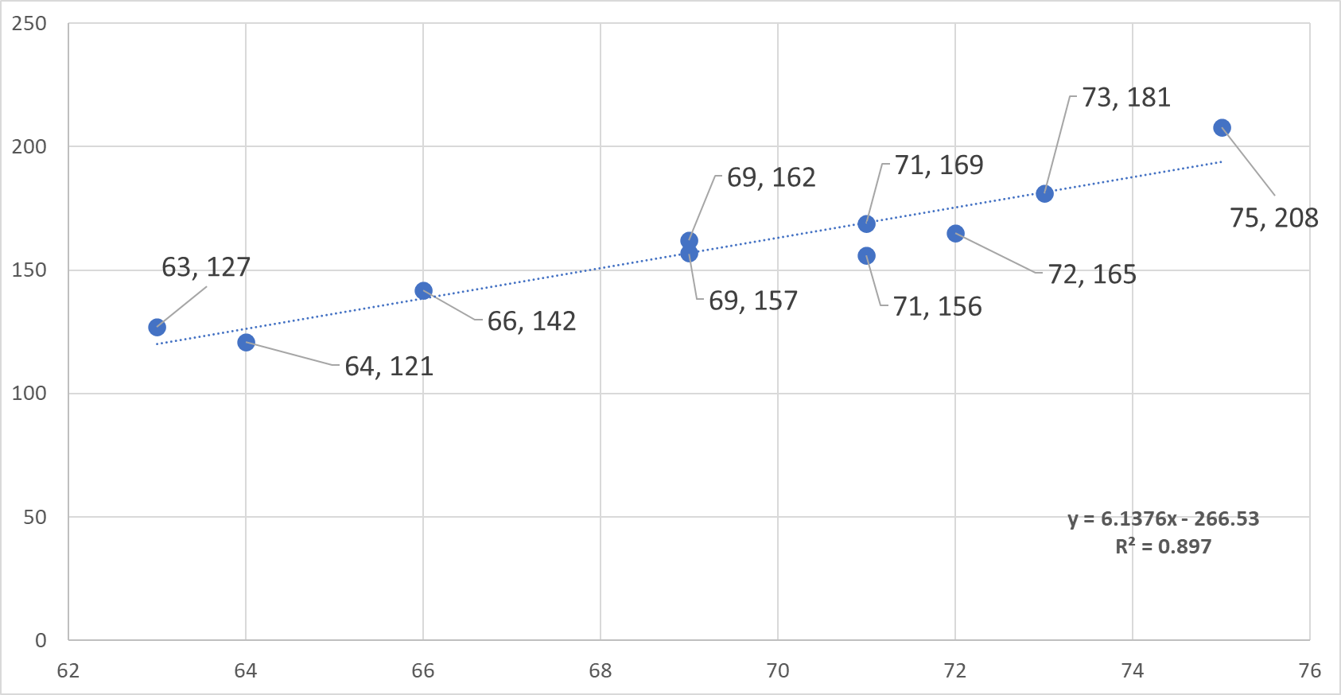
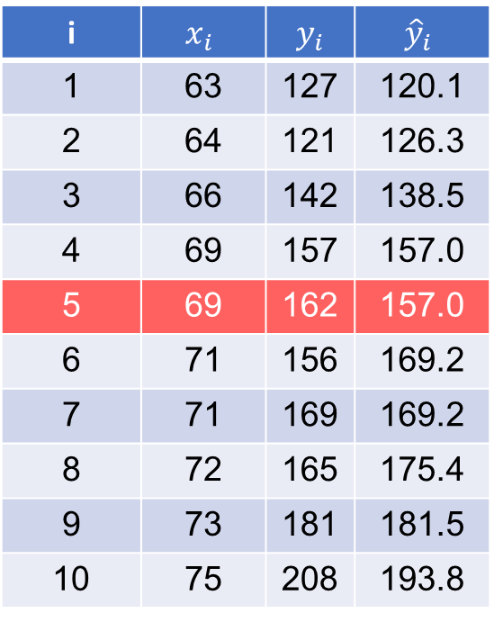
More about the best fitting line: minimizing the sum of squared errors
If we did know the value for observation 5 the equation line would predict it to be 157. The actual value for
observation 5 is 162, hence the prediction error is 162 – 157 = 5. What is the general equation for the error?
i | $$x_{i}$$ | $y_{i}$ | $${\hat{y}}_{i}$$
1 | 63 | 127 | 120.1
2 | 64 | 121 | 126.3
3 | 66 | 142 | 138.5
4 | 69 | 157 | 157.0
5 | 69 | 162 | 157.0
6 | 71 | 156 | 169.2
7 | 71 | 169 | 169.2
8 | 72 | 165 | 175.4
9 | 73 | 181 | 181.5
10 | 75 | 208 | 193.8
Note: begin to practice visualizing data, you should be able to make this chart in excel, jasp or spss

Slide 27
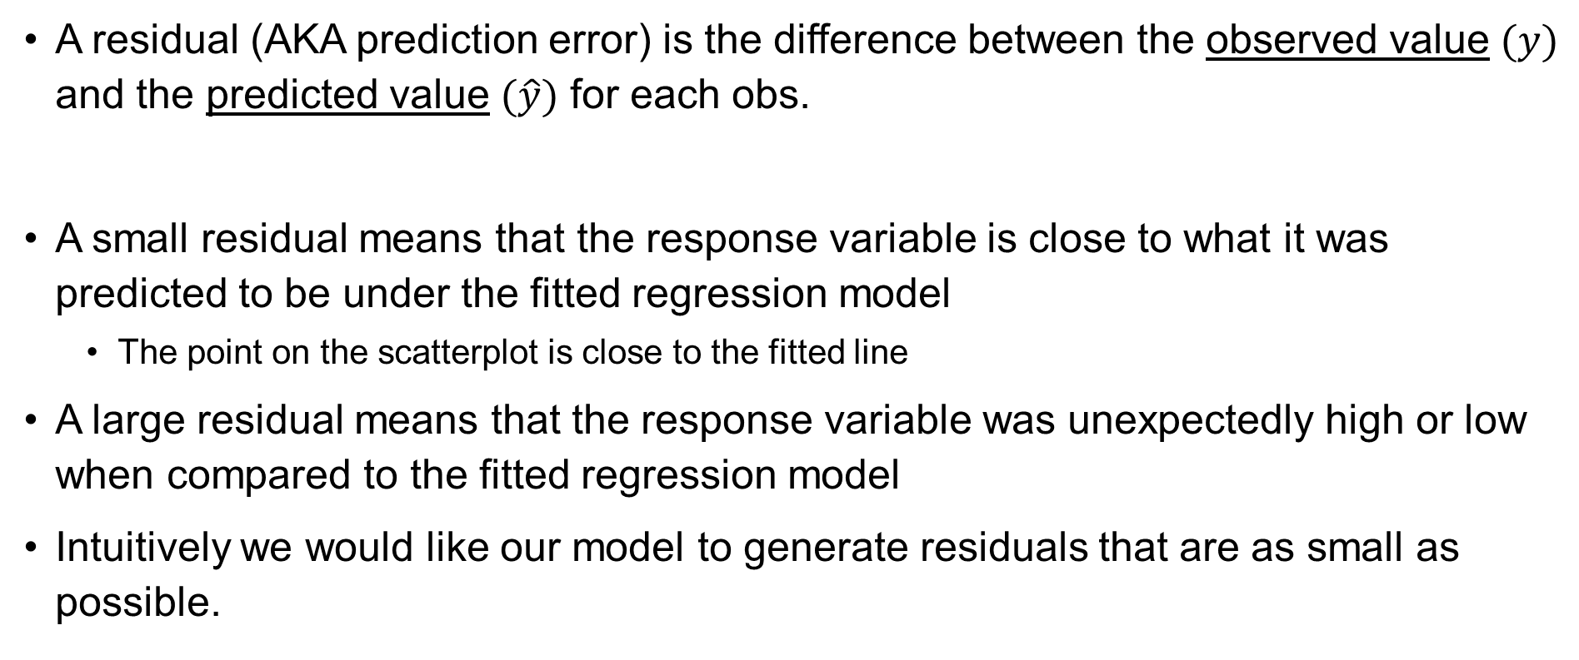
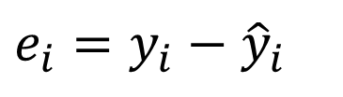
Residuals of Linear Model
A residual (AKA prediction error) is the difference between the observed value $(y)$ and the predicted value $(\hat{y})$ for each obs.
A small residual means that the response variable is close to what it was predicted to be under the fitted regression model
The point on the scatterplot is close to the fitted line
A large residual means that the response variable was unexpectedly high or low when compared to the fitted regression model
Intuitively we would like our model to generate residuals that are as small as possible.
$$e_{i}=y_{i}−{\hat{y}}_{i}$$
Notes:
27

Slide 28


An objective measure for finding the best line
We want a line that has small residuals:
Option 1: Minimize the sum of magnitudes (absolute values) of residuals
Option 2: Minimize the sum of squared residuals – least squares
Why least squares?
The objective function is smooth and differentiable
If the errors are normally distributed, the least squares estimators are BLUE
Squaring errors means larger errors are more heavily penalized
$\left|e_{1}\right|+$ $\left|e_{2}\right|+…. +\left|e_{n}\right|$
$$e_{1}^{2}+e_{2}^{2}+ …+e_{n}^{2}$$
Handout SSE.docx
12
Notes:
We want a line that fits the data well, meaning the residuals—the vertical distances between the observed points and the line—are small overall. There are different reasonable ways to define “small.” One option is to minimize the sum of absolute residuals, which treats all errors proportionally. Another option is to minimize the sum of squared residuals, which is what least squares does.
BLUE = smallest possible variance among estimators

Slide 29
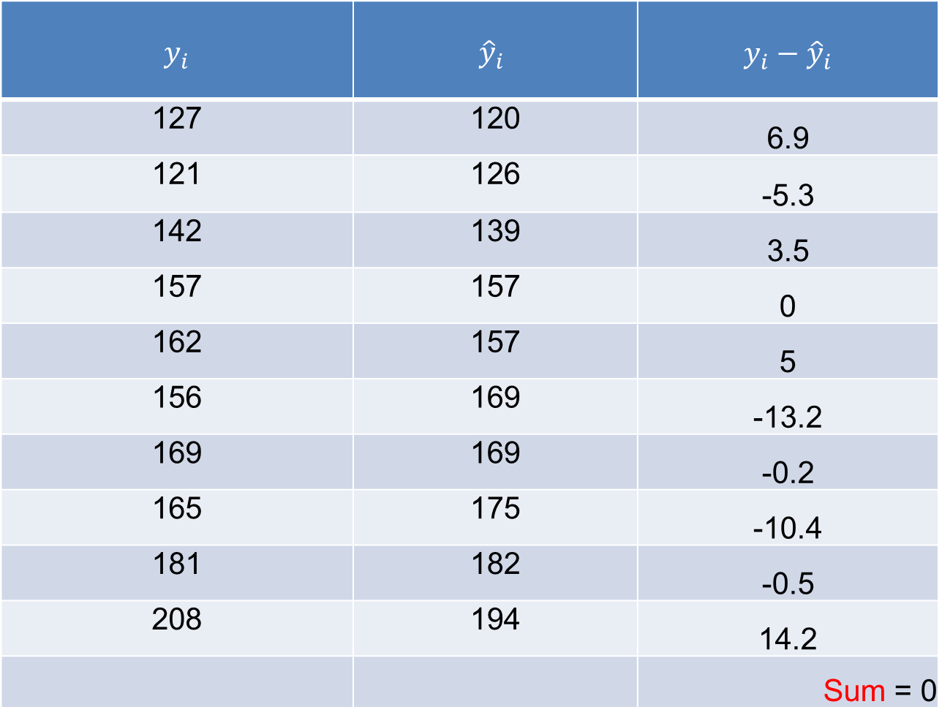
$y_{i}$ | $${\hat{y}}_{i}$$ | $$y_{i}−{\hat{y}}_{i}$$
127 | 120 | 6.9
121 | 126 | -5.3
142 | 139 | 3.5
157 | 157 | 0
162 | 157 | 5
156 | 169 | -13.2
169 | 169 | -0.2
165 | 175 | -10.4
181 | 182 | -0.5
208 | 194 | 14.2
 |  | Sum = 0

Slide 30
Sum of squared differences =
(2 - 1)² +
(4 - 2)² +
(1.5 - 3)² +
(3.2 - 4)² = 6.89
Sum of squared differences =
(2 -2.5)² +
(4 - 2.5)² +
(1.5 - 2.5)² +
(3.2 - 2.5)² = 3.99
4
(2,4)
w
3
w
(4,3.2)
The smaller the sum of
squared differences
the better the “fit” of the
line to the data (?)
2.5
2
w
(1,2)
(3,1.5)
w
1
1
2
3
4
We want to draw a line that represents the data trend.
Squared Error: We square the errors so negative and positive values don't cancel each other out.
Sum of Squared Errors (SSE): We add them all up to get a single "score" for the line.
Regression algorithms mathematically test "every possible line.“
The "Best Fit Line" is the one line in the universe that produces the smallest possible SSE.
Notes:
"If you look at the chart, we have four data points (the pink diamonds). We are trying to find a model—a line—that explains where these points are.
We technically have two contestants here:
** The Black Line:** This is a sloped trend line. When we calculate the distance from each point to this line, square those distances, and add them up, we get a total error 'score' of 6.89.
The Orange Line: This represents the average (or mean) of the Y values. It's a flat line. When we do the same calculation for this line, the score is only 3.99.
In this specific comparison, the flat orange line actually 'wins' because it has a smaller sum of squared errors. It is 'closer' to the data points overall than the black line is.
In Linear Regression, our computer's job is to minimize this number. It adjusts the slope and intercept continuously until it finds the mathematical minimum for the Sum of Squared Errors. The line with the lowest possible score is what we call the 'Best Fit Line.'"

Slide 31


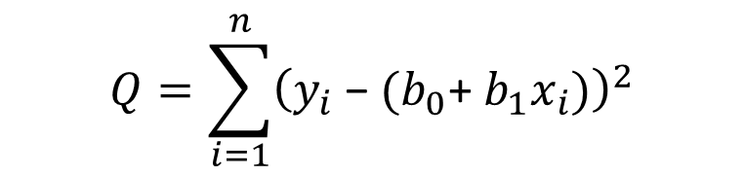
Method of Least Squares
To find "good" estimators of the regression parameters $β_{0}$ and $β_{1}$, we employ the method of least squares.
The method of least squares considers the deviation of Yi from its expected value
In particular, the method of least squares requires that we consider the sum of the n squared deviations.
This criterion is denoted by Q:
$$Q=\sum_{i=1}^{n}{{\left(y_{i}\text{ − }{\hat{y}}_{i}\right)}^{2}}$$
$$Q=\sum_{i=1}^{n}{{\left(y_{i}\text{ − }(b_{0}\text{+ }b_{1}x_{i})\right)}^{2}}$$

Slide 32

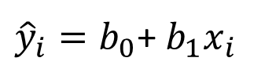
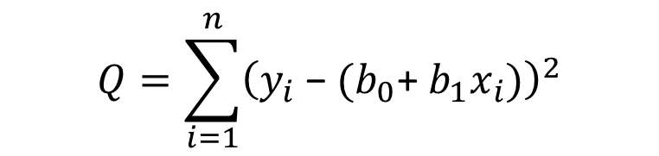

More about the best-fitting line
To minimize the SSE, we find the values for $b_{0}$, $b_{1}$ which make the sum of the squared prediction errors the smallest they can be. So, we find these values so that the following equation is minimized
Since
$$Q=\sum_{i=1}^{n}{{\left(y_{i}\text{ − }{\hat{y}}_{i}\right)}^{2}}$$
${\hat{y}}_{i}=b_{0}$+ $b_{1}x_{i}$
$$Q=\sum_{i=1}^{n}{{\left(y_{i}\text{ − }(b_{0}\text{+ }b_{1}x_{i})\right)}^{2}}$$
$$e_{i}=y_{i}\text{ − }{\hat{y}}_{i}$$

Slide 33
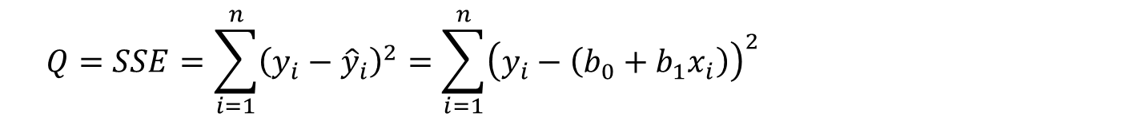
Least Squares Estimation of b₀, b₁
b₀ → Mean response when X = 0 (y-intercept)
b₁ → Change in mean response when X increases by 1 unit (slope)
b₀, b₁ are unknown parameters
b₀+b₁X → Mean response when explanatory variable takes on the value X
Goal: Choose values (estimates) that minimize the sum of squared errors (SSE) of observed values to the straight-line:
$$Q=SSE=\sum_{i=1}^{n}{{\left(y_{i}−{\hat{y}}_{i}\right)}^{2}}=\sum_{i=1}^{n}{{\left(y_{i}−\left(b_{0}+b_{1}x_{i}\right)\right)}^{2}}$$

Slide 34
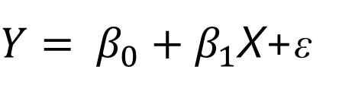

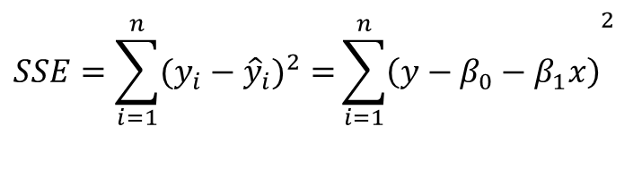
Intuition
We will write a population regression line based on sample data as
The method of least squares chooses the values for $β_{0}$ and $β_{1}$ to minimize the sum of squared errors
$Y= β_{0}+β_{1}$X+ε
$$SSE=\sum_{i=1}^{n}{(y_{i}−{\hat{y}}_{i})^{2}=}{\sum_{i=1}^{n}{\left(y−β_{0}−β_{1}x\right)}}^{2}$$

Slide 35
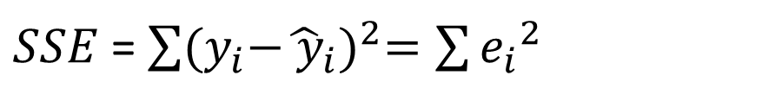
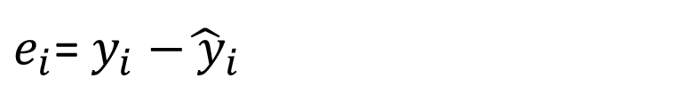
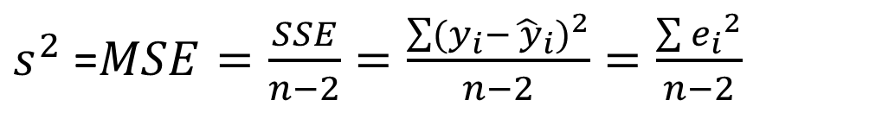
Regression Model
The deviation of an observation is calculated around its estimated mean, hence the deviations are the residuals
$e_{i}$= $y_{i}{−\hat{ y}}_{i}$
$SSE$=$\sum{{(y_{i}{−\hat{ y}}_{i})}^{2}=\sum{{e_{i}}^{2}}}$
Residual sum of squares
$s^{2}$ =$MSE=\frac{SSE}{n−2}=\frac{\sum{{(y_{i}{−\hat{ y}}_{i})}^{2}}}{n−2}=\frac{\sum{{e_{i}}^{2}}}{n−2}$
Mean square error

Slide 36

Summary
In general, when we use ${\hat{y}}_{i}=b_{0}$+ $b_{1}x_{i}$ to predict the actual response $y_{i}$ we make a prediction, or residual error, equal to
$e_{i}=y_{i}$ - ${\hat{y}}_{i}$
The best fitting line makes all prediction errors as small as possible
The best fitting line minimizes the sum of the squared prediction errors → the least squares criterion
Note: why do we need to square the prediction errors?
Prediction error for data point i

Slide 37

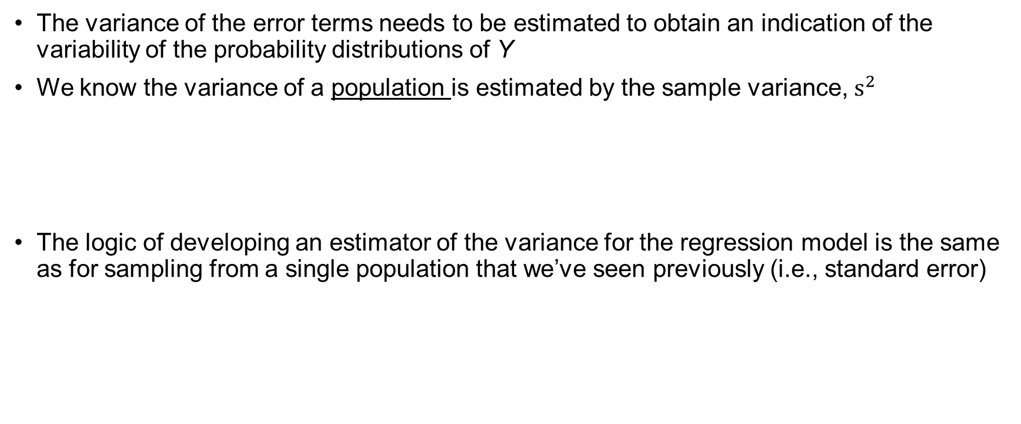
Estimation of Error Terms Variance, $σ^{2}$
The variance of the error terms needs to be estimated to obtain an indication of the variability of the probability distributions of Y
We know the variance of a population is estimated by the sample variance, $s^{2}$
The logic of developing an estimator of the variance for the regression model is the same as for sampling from a single population that we’ve seen previously (i.e., standard error)
Sum of squares
$$s^{2}=\frac{\sum{{(y_{i}−\hat{y_{i}})}^{2}}}{n−1}$$
Mean square
df

Slide 38
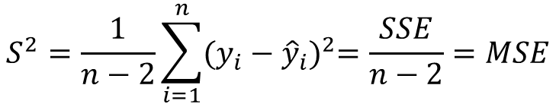

The variance of deviations
The variance of the deviation ($e_{i}$) is denoted $σ^{2}$ and is estimated using the average squared residual! This should look VERY familiar to you.
$$S^{2}=\frac{1}{n−2}\sum_{i=1}^{n}{{(y_{i}−{\hat{y}}_{i})}^{2}=\frac{SSE}{n−2}=MSE}$$
Note: to make inferences about the model parameters (i.e., hypothesis test) we also need to assume that the deviations $e_{i}$ are normally distributed

Slide 39
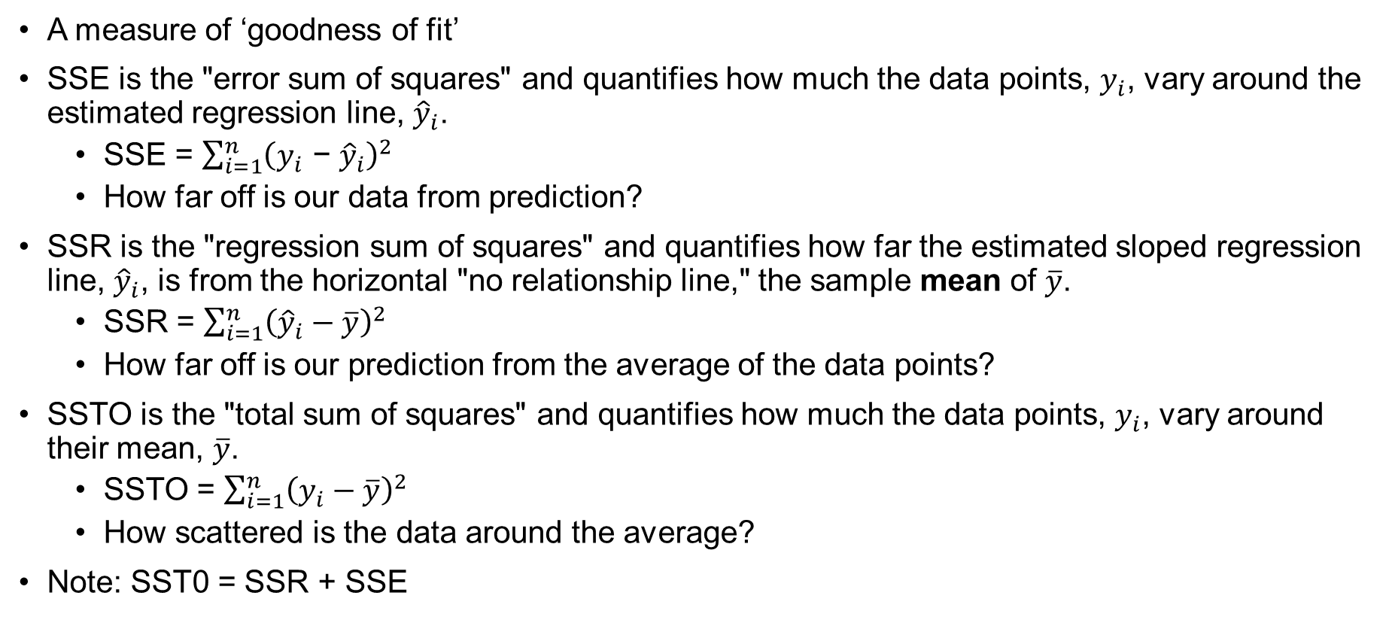
Analysis of Variance for SLR
A measure of ‘goodness of fit’
SSE is the "error sum of squares" and quantifies how much the data points, $y_{i}$, vary around the estimated regression line, ${\hat{y}}_{i}$.
SSE = $\sum_{i=1}^{n}{{\left(y_{i}\text{ − }{\hat{y}}_{i}\right)}^{2}}$
How far off is our data from prediction?
SSR is the "regression sum of squares" and quantifies how far the estimated sloped regression line, ${\hat{y}}_{i}$, is from the horizontal "no relationship line," the sample mean of $\overline{y}$.
SSR = $\sum_{i=1}^{n}{{\left({\hat{y}}_{i}−\overline{y}\right)}^{2}}$
How far off is our prediction from the average of the data points?
SSTO is the "total sum of squares" and quantifies how much the data points, $y_{i}$, vary around their mean, $\overline{y}$.
SSTO = $\sum_{i=1}^{n}{{\left(y_{i}−\overline{y}\right)}^{2}}$
How scattered is the data around the average?
Note: SST0 = SSR + SSE

Slide 40

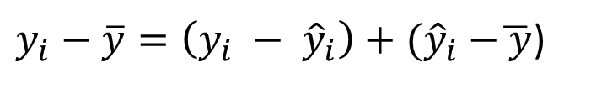
Analysis of Variance in Regression
Goal: partition the total variation in Y into variation “explained” by X and random variation
The total variation in an observed response about its mean can be written as a sum of two parts – (a) its deviation from the fitted value plus (b) the deviation of the fitted value from the mean response
$y_{i}−\overline{y}=\left(y_{i} − {\hat{y}}_{i}\right)+{(\hat{y}}_{i} −\overline{ y}$)
$${(y_{i}−\overline{y})}^{2}={\left(y_{i} − {\hat{y}}_{i}\right)}^{2}+{{(\hat{y}}_{i} −\overline{ y}\text{)}}^{2}$$
SST
SSE
SSR
We partition the total variability of the data into two components: the part our model accounts for (SSR) and the part it misses (SSE).

Slide 41

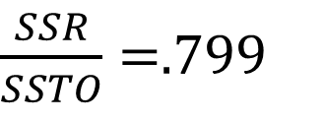
The Coefficient of Determination $R^{2}$
Question: how much of the total variation in the response Y is due to the regression of Y on X as opposed to random error?
EXAMPLE: SSE = 1708.5; SSR = 6679.3; SSTO = 8487.8
We can see that most of the total variation (SSTO) is accounted for by the regression (SSR). That is,
$R^{2}=\frac{SSR}{SSTO}→$ $1 − \frac{SSE}{SSTO}$
Explained
Not Explained
$\frac{SSR}{SSTO}=$.799

Slide 42
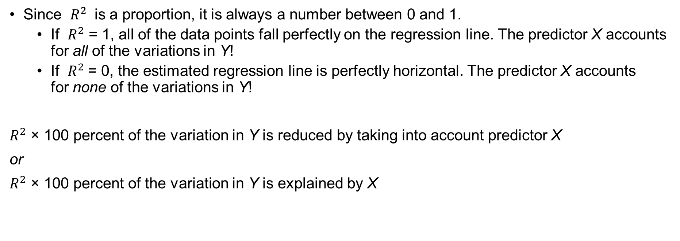
Interpretation $R^{2}$
Since $R^{2}$ is a proportion, it is always a number between 0 and 1.
If $R^{2}$ = 1, all of the data points fall perfectly on the regression line. The predictor X accounts for all of the variations in Y!
If $R^{2}$= 0, the estimated regression line is perfectly horizontal. The predictor X accounts for none of the variations in Y!
$R^{2}$ × 100 percent of the variation in Y is reduced by taking into account predictor X
or
$R^{2}$ × 100 percent of the variation in Y is explained by X

Slide 43
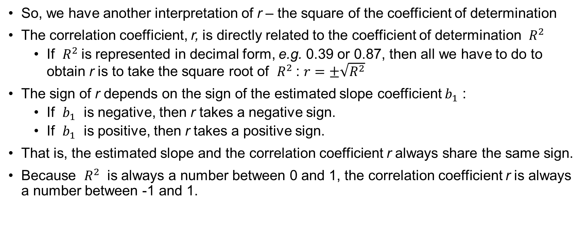
Pearson Correlation, r & $R^{2}$!!
So, we have another interpretation of r – the square of the coefficient of determination
The correlation coefficient, r, is directly related to the coefficient of determination $R^{2}$
If $R^{2}$is represented in decimal form, e.g. 0.39 or 0.87, then all we have to do to obtain r is to take the square root of $R^{2}$: $r=±\sqrt{R^{2}}$
The sign of r depends on the sign of the estimated slope coefficient $b_{1}$ :
If $b_{1}$ is negative, then r takes a negative sign.
If $b_{1}$ is positive, then r takes a positive sign.
That is, the estimated slope and the correlation coefficient r always share the same sign.
Because $R^{2}$ is always a number between 0 and 1, the correlation coefficient r is always a number between -1 and 1.

Slide 44



Note: with $R^{2}$ and SST we can calculate
and
$$SSR= R^{2}SST$$
$$SSE= {(1 −R}^{2})SST$$

Slide 45
_{The Coefficient of Variation}
The strength of the fit of a linear model is most commonly evaluated using R².
R² is calculated as the square of the correlation coefficient.
It tells us what percent of variability in the response variable is explained by the model.
The remainder of the variability is explained by variables not included in the model or by inherent randomness in the data.
For example, if R² = (−0.75)² then R = 0.56.
33

Slide 46
Interpretation of R²
Which of the below is the correct interpretation of R = −0.75, R² = 0.56?
56% of the variability in the % of HG graduates among the 51 states is explained by the model.
56% of the variability in the % of residents living in poverty among the 51 states is explained by the model.
56% of the time % HS graduates predict % living in poverty correctly.
75% of the variability in the % of residents living in poverty among the 51 states is explained by the model.
34

Slide 47


What do the regression parameters estimate?
Solid line = sample
Dotted line = population
$μ_{Y}=E\left(Y\right)=β_{0}$+ $β_{1}X$
$$\hat{y}={\hat{b}}_{0}+{\hat{b}}_{1}x$$
Notes:
We take a sample of children because we cannot collect data on the population
Every time we take a sample we will get a different line, different estimates
Ultimately we want to learn about the population parameters and we will do so by looking at the sample estimates for the intercept and slope
Of course, this is where our error comes in

Slide 48
Estimating the Coefficients
The coefficients are determined by
Drawing a sample from the population of interest,
Calculating sample statistics.
Estimating a straight line that cuts into the data.
Question: What should be considered a good line?
Y
w
w
w
w
w
w w w w
w
w w
w w
w
X

Slide 49
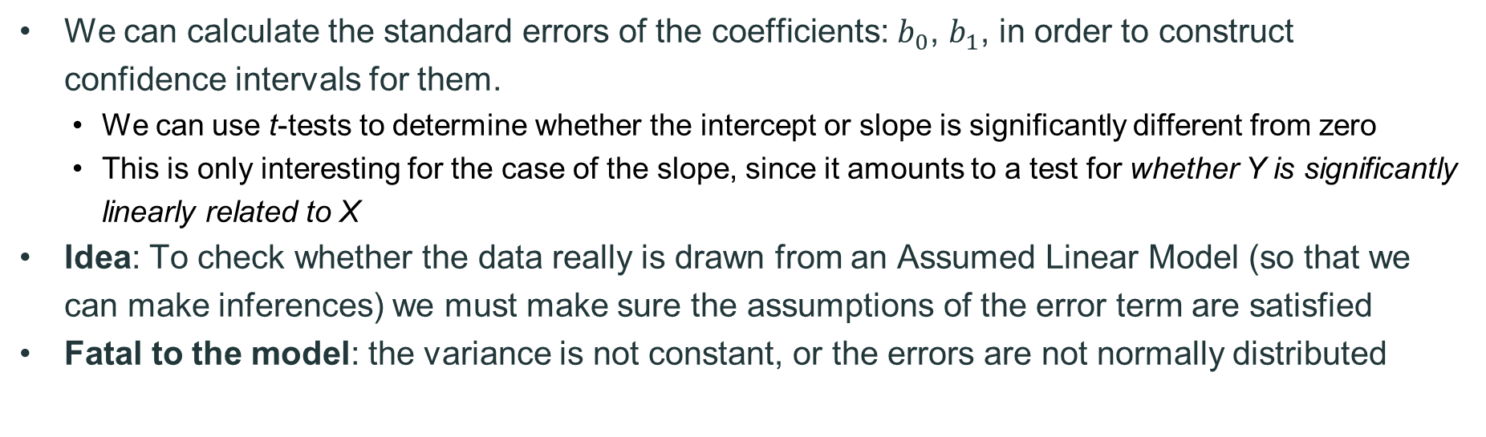
Sampling Distributions & Inference
We can calculate the standard errors of the coefficients: $b_{0}$, $b_{1}$, in order to construct confidence intervals for them.
We can use t-tests to determine whether the intercept or slope is significantly different from zero
This is only interesting for the case of the slope, since it amounts to a test for whether Y is significantly linearly related to X
Idea: To check whether the data really is drawn from an Assumed Linear Model (so that we can make inferences) we must make sure the assumptions of the error term are satisfied
Fatal to the model: the variance is not constant, or the errors are not normally distributed

Slide 50

Inference from Regression
We want to use our regression equation to make predictions for our dependent variable based on the linear combination of independent variables. We need to make assumptions about the data!
We imagined that in the population, the values of Y really are generated from the linear probabilistic model
where ε is an error term normally distributed with mean 0 and variance σ²
For our linear regression inference, we will always assume ε has a normal distribution, N(0, σ²)
$$y=β_{0}+β_{1}x+ε$$

Slide 51
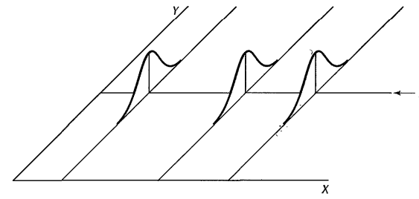
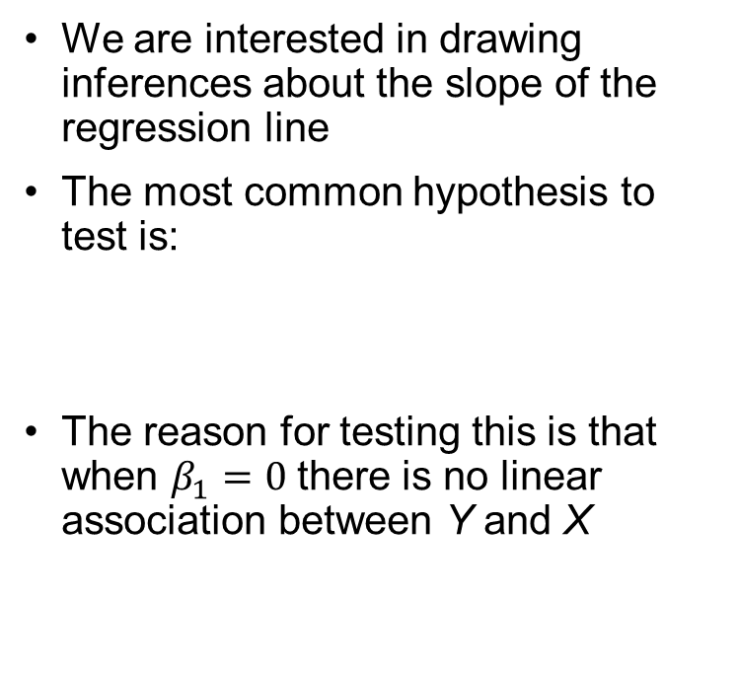



Inferences for point estimates
We are interested in drawing inferences about the slope of the regression line
The most common hypothesis to test is:
The reason for testing this is that when $β_{1}=0$there is no linear association between Y and X
$$β_{0}$$
$$H_{0}:β_{1}=0 vs.H_{0}:β_{1}≠0$$
Mean(Y$)=β_{0}+0X$ = $β_{0}$
Notes:
The probability distributions of Y are identical when the slope is 0 → there is no relationship between X and Y

Slide 52

Hypothesis testing of coefficients
We follow standard hypothesis testing for the slope parameters in a linear regression model
First, specify the null and alternative
$H_{o}: β_{1}$= 0
$H_{1}: β_{1}≠$0
Second, calculate the test statistic
$t^{∗}=\frac{b_{1}−β_{1}}{{\sqrt{MSE}}/{\sqrt{{(x_{i}−\overline{x})}^{2}}}}=\frac{b_{1}−β_{1}}{se(b_{1})}$
Calculate the p-value**
The p-value is determined by referring to a t-distribution with n – 2 df**
Decision: If p-value < $α$ reject $H_{o}$

Slide 53

Confidence intervals as hypothesis testing
It is also useful to look at the confidence interval for $β_{1}$
As always, the CI is the sample estimate $± ($t-multiplier x standard error)
$b_{1}±t_{\left(α/2, n−2\right)}×se$($b_{1}$) → $b_{1}±1.96×se$($b_{1}$)
The CI provides the following information:
It gives us a range of values that is likely to contain the true unknown value of $β_{1}$ → we are 95% certain that the true population parameter lies within the confidence interval; and
It gives us the answer to whether there is a significant relationship between X and Y → if 0 lies in the confidence interval then we know to not reject the null hypothesis. Why?

Slide 54


Critical: Inference, Error and Associations
We do not reject the null hypothesis${, H}_{o}:β_{1}$= 0
We do reject the null hypothesis${, H}_{1}:β_{1}≠ \text{0}$
But
We committed a Type II error (did not reject the null, but should have)
There really is not much of a linear relationship between x and y
There is a relationship between x and y — it is just not linear
But
We committed a Type I error (rejected the null but should not have)
The relationship between x and y is indeed linear.
A linear function fits the data, okay, but a curved ("curvilinear") function would fit the data even better (i.e., the model is mis- specified)

Slide 55

Variable definitions in the school admissions dataset: admissions.csv == admissions.jasp
…
JASP file: Predicting Math SAT scores

Slide 56
What you already know…Descriptive Statistics & Relationships
Note: the correlation between SAT math
score and SAT verbal score is .464.
Descriptive Statistics
 | Valid | Mean | Std. Deviation | Minimum | Maximum
SAT_math | 864 | 588.958 | 68.607 | 420.000 | 800.000
SAT_verbal | 864 | 564.688 | 69.000 | 370.000 | 800.000
HS_class_size | 707 | 315.704 | 177.768 | 25.000 | 906.000
Pearson's Correlations
 |  |  | Pearson's r | p
SAT_math | - | SAT_verbal | 0.464 | < .001
SAT_math | - | HS_class_size | 0.176 | < .001
SAT_verbal | - | HS_class_size | 0.045 | .240

Slide 57

Visualizing the distribution and joint distribution of SAT verbal and math scores

Slide 58




Slide 59
Model Summary - SAT_math
 |  |  |  |  | Durbin-Watson
Model | R | R² | Adjusted R² | RMSE | Autocorrelation | Statistic | p
M₀ | 0.000 | 0.000 | 0.000 | 68.607 | 0.003 | 1.993 | .920
M₁ | 0.464 | 0.215 | 0.214 | 60.824 | 0.030 | 1.939 | .372
Note. M₁ includes SAT_verbal
The independent variables are moderately to highly correlated with the dependent variable r = .476
22.7% of the variation in MATH SAT scores is explained by the independent variables (Class size and Verbal SAT). This means about 87% remains unexplained (an indication that there are variables omitted from the model that are important
to explain MATH SAT scores)
ANOVA
Model |  | Sum of Squares | df | Mean Square | F | p
M₁ | Regression | 873004.744 | 1 | 873004.744 | 235.973 | < .001
 | Residual | 3.189×10⁺⁶ | 862 | 3699.603
 | Total | 4.062×10⁺⁶ | 863
Note. M₁ includes SAT_verbal
Note. The intercept model is omitted, as no meaningful information can be shown.
Small p-value → the model is
significant

Slide 60
What’s new …
Durbin-Watson = 2 meaning
the error term may be independent
Model Summary - SAT_math
 |  |  |  |  | Durbin-Watson
Model | R | R² | Adjusted R² | RMSE | Auto-correlation | Statistic | p
M₀ | 0.000 | 0.000 | 0.000 | 68.607 | 0.003 | 1.993 | .920
M₁ | 0.464 | 0.215 | 0.214 | 60.824 | 0.030 | 1.939 | .372
Note. M₁ includes SAT_verbal
The more predictors you have in the model the lower the sum of squared residuals, the higher R², indicating the better prediction
The Adjusted R2 accounts for the number of parameters in the model (incurs a penalty for each additional variable)
Notes:
Use the Durbin-Watson statistic to test for the presence of autocorrelation in the errors of a regression model. Autocorrelation means that the errors of adjacent observations are correlated. If the errors are correlated, then least-squares regression can underestimate the standard error of the coefficients. Underestimated standard errors can make your predictors seem to be significant when they are not.
Durbin Watson ranges from 0-4, a statistic around 2 is what you are looing for…

Slide 61

ANOVA
Model |  | Sum of Squares | df | Mean Square | F | p
M₁ | Regression | 873004.744 | 1 | 873004.744 | 235.973 | < .001
 | Residual | 3.189×10⁺⁶ | 862 | 3699.603
 | Total | 4.062×10⁺⁶ | 863
Note. M₁ includes SAT_verbal
Note. The intercept model is omitted, as no meaningful information can be shown.
Small p-value → the model is significant
$H_{o}: β_{1}$ = 0
$$H_{1}:{ β}_{1} ≠\text{0}$$
We conclude that at least one of the slopes is not equal to 0

Slide 62
Coefficients
Model |  | Unstandardized | Standard Error | Standardized | t | p
M₀ | (Intercept) | 588.958 | 2.334 |  | 252.333 | < .001
M₁ | (Intercept) | 328.665 | 17.071 |  | 19.253 | < .001
 | SAT_verbal | 0.461 | 0.030 | 0.464 | 15.361 | < .001
How to Read the Story in the Numbers
When we look at a regression table like this, we are really looking at a competition between two ways of predicting the future: Model 0 (The Blind Guess) and Model 1 (The Informed Prediction).
Let's assume the dependent variable (the thing we are trying to predict) is something like Final Exam Score or SAT Math Score.

Slide 63
Coefficients
Model |  | Unstandardized | Standard Error | Standardized | t | p
M₀ | (Intercept) | 588.958 | 2.334 |  | 252.333 | < .001
M₁ | (Intercept) | 328.665 | 17.071 |  | 19.253 | < .001
 | SAT_verbal | 0.461 | 0.030 | 0.464 | 15.361 | < .001
1. Model M₀: The "Blind Guess" (Baseline)
Imagine I ask you to predict a random student's score, but I tell you absolutely nothing about them. What represents your best guess? The Average.
Intercept (588.958): This is simply the average score of everyone in the dataset.
Intuition: "If I know nothing else, I expect a student to score about 589."
Context: Because there are no other predictors in this model, the "intercept" holds all the information—it's just the mean.

Slide 64
Coefficients
Model |  | Unstandardized | Standard Error | Standardized | t | p
M₀ | (Intercept) | 588.958 | 2.334 |  | 252.333 | < .001
M₁ | (Intercept) | 328.665 | 17.071 |  | 19.253 | < .001
 | SAT_verbal | 0.461 | 0.030 | 0.464 | 15.361 | < .001
2. Model M₁: Now, I give you a hint to better inform your prediction: I tell you the student's SAT Verbal score. We can now adjust our prediction instead of just guessing the average.
Intercept (328.665): This represents the baseline variance that SAT Verbal doesn't account for. The intercept is the predicted score if a student got a zero on the SAT Verbal (which is impossible, but it anchors the math line).
SAT_verbal (0.461) [Unstandardized Coefficient]: This is like the exchange rate, or rate of change. Intuition: "For every 1 point increase in SAT Verbal, we expect the Final Score to go up by 0.46 points.“
Example: A student who scores 10 points higher on Verbal is predicted to score about 4.6 points higher on the Final.
Standardized (0.464): This removes the units of measurement, allowing us to talk about "strength" in general.
Intuition: Since it is 0.46 (on a scale typically from -1 to 1), it is a moderately strong positive predictor.

Slide 65
Coefficients
Model |  | Unstandardized | Standard Error | Standardized | t | p
M₀ | (Intercept) | 588.958 | 2.334 |  | 252.333 | < .001
M₁ | (Intercept) | 328.665 | 17.071 |  | 19.253 | < .001
 | SAT_verbal | 0.461 | 0.030 | 0.464 | 15.361 | < .001
3. The "Trust" Metrics (Errors & Significance) How confident should we be in these numbers?
Standard Error (0.030): This is the "Give or Take" amount.
Intuition: We calculated the effect is 0.461, but in reality, it might wobble a bit. Small standard errors mean our estimate is very precise.
p-value (< .001):
Intuition: If there was actually zero relationship between Verbal scores and the Final score, finding this result would be a one-in-a-thousand miracle. Since miracles are rare, we conclude the relationship is real.

Slide 66

Visualizing the marginal effects plot
The table tells you "How much", but the visual tells you "In what shape".
There are three common scenarios that a visual graph can reveal…

Slide 67

Visualizing your data
The U-Turn (Non-Linearity):
Scenario: Maybe test scores go up as anxiety goes up, but then crash when anxiety gets too high.
The Table: Averages it out to a "flat" line (Coefficient $≈$ 0), hiding the critical U-shape.
The Visual: Shows the curve immediately.
The Context Trap (Clusters):
Scenario: You might have two distinct groups (e.g., Science Majors vs. Art Majors).
The Table: Gives you one line that fits nobody well—it just splits the difference.
The Visual: Shows two distinct clusters of dots, suggesting you actually need two lines (variables), not one.
The “Micheal Jordan" Effect (Outliers):
Scenario: MJ made millions of dollars at UNC.
The Table: Linear regression is extremely weak against outliers. One data point can pull the whole line up, giving you a coefficient that represents no one except the extreme deviation (note: this could also be a coding error).
The Visual: You immediately see one dot way off in the corner and realize "Wait, that's wrong."

Slide 68
Examples: SLR mechanics
A full working example of how to do SLR in R using the admissions dataset → https://issues-osu.github.io/statsii-spring2026/admissions_SLR_example.html
Gapminder data visualization example to demonstrate how descriptive charts and statistics can help uncover the nuances in your data for modeling purposes → https://issues-osu.github.io/statsii-spring2026/gapminder-dv-example.html

Slide 69

Extrapolation
Applying a model estimate to values outside of the realm of the original data is called extrapolation.
Sometimes the intercept might be an extrapolation.
70
60
50
40
30
20
10
0
intercept
% in poverty
0
20
40
60
80
100
% HS grad

Slide 70

Examples of extrapolation

Slide 71

Examples of extrapolation

Slide 72

Examples of extrapolation

Slide 73
In class assignment
BRFSS in-class assignment: Intro to SLR using R – Statistics for Social Work
SLR annotated file in JASP: https://issues-osu.github.io/statsii-spring2026/slides/SLR_files/brfss_aces_subset.jasp

Slide 74
Exploring the relationships between self-care and well-being outcomes among child welfare professionals
Assumption | Formally Tested? | Evidence in Paper
Normality of outcomes | Partially | Skewness/kurtosis of variables
Normality of residuals | No | Not reported
Linearity | No | Not reported
Homoscedasticity | No | Not reported
Independence | No | No clustering or multilevel
Multicollinearity | No | No VIFs or diagnostics
Functional form | No | Ordinal treated as continuous
Missing data (MCAR) | Yes | Little’s test + FIML
Outliers/influence | Vague | Mentioned, not documented

