Slide 1
Factor Analysis
Week 13
April 14, 2026

Slide 2
What is Factor analysis (FA)?
FA is a tool for analyzing the structure of the interrelationships among a large number of variables by defining sets of variables that are highly interrelated
Researchers and clinicians use different measures to capture different underlying constructs (?)
To be representative of the underlying construct, the variables should ‘cluster’ together around that construct
The construct is called a latent variable and is represented by a ‘factor’
Note: in Latent Class Analysis (next) the latent variable is referred to as a ‘class,’ profile or typology
The factors are assumed to represent dimensions within the data structure
The dimensions can guide the creation of new composite measures called latent variables

Slide 3
Types of FA
Exploratory Factor Analysis (EFA)
To discover the factor structure of a construct and examine its reliability. It is data-driven.
Confirmatory Factor Analysis (CFA)
To confirm the fit of the hypothesized factor structure to the observed (sample) data. It is theory-driven.
For use with Hair, Black, Babin and Anderson, Multivariate Data Analysis 8e © 2018 Cengage Learning EMEA

Slide 4
What is EFA?
Exploratory Factor Analysis (EFA)
Examines the interrelationships among a large number of variables and then attempts to explain them in terms of their common underlying dimensions.
These common underlying dimensions are referred to as factors or components.
EFA is
A summarization and data reduction technique;
No independent and dependent variables;
Models interdependence in which all variables are considered simultaneously.
It is the first multivariate method we have looked at this semester!
For use with Hair, Black, Babin and Anderson, Multivariate Data Analysis 8e © 2018 Cengage Learning EMEA

Slide 5
What is a ‘latent variable’
Latent variables are unobserved (hidden) variables that are inferred from patterns in observed data. How can a variable be unobserved?
Example: You might measure things like "feeling sad," "trouble sleeping," and "loss of interest.“
These observed variables are indicators of a latent variable like "Depression."
Latent variables are not measured directly—they are statistical constructs that help us make sense of correlated behaviors or responses
In factor analysis, latent variables (also called factors) help explain the underlying structure among a set of measured variables (like survey items or test scores)
In structural equation modeling (SEM), the model is typically divided into two parts:
The Measurement Model: specifies how observed variables (survey items, indicators) are correlated with or "load onto" latent variables (unmeasured constructs like depression, disinvestment, or social vulnerability)
The Structural Model: This shows how latent variables are related to one another—representing the causal or correlational paths between unmeasured constructs

Slide 6
EFA versus Principal Components Analysis (PCA)
Principal Component Analysis (PCA) is a data reduction tool.
It transforms your observed variables into a smaller set of components that capture as much variance as possible. It does not assume any underlying structure and does not model latent constructs. Because of this, PCA is not testable in a theoretical sense. i.e., you are not evaluating whether variables reflect a meaningful underlying concept, only summarizing them mathematically.
Factor Analysis (FA) is a theory-driven measurement model.
It assumes that latent variables (factors) exist and that these unobserved constructs cause the correlations among observed variables. FA allows you to test whether your variables reflect an underlying structure, making it appropriate when you want to interpret factors as meaningful constructs (e.g., depression, stress, social cohesion).

Slide 7
Example
PCA summarizes variance; FA explains covariance through latent constructs.
Goal
PCA → Reduce variables
FA → Identify underlying constructs
Assumption
PCA → No model of underlying cause
FA → Latent factors generate observed relationships
Interpretation
PCA → Components are mathematical combinations (no inherent meaning)
FA → Factors are interpretable constructs (theoretically meaningful)
Testability
PCA → Not testable (no hypothesis about structure)
FA → Testable (fit, loadings, structure can be evaluated)
If you observe: Feeling sad, Trouble sleeping, Loss of interest
PCA: Combines them into a component that explains shared variance
“These variables move together”
FA: Models a latent factor (e.g., Depression) causing them
“These variables reflect an underlying construct”

Slide 8
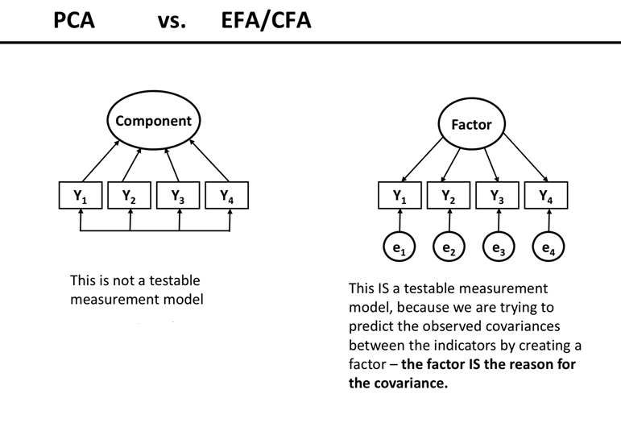
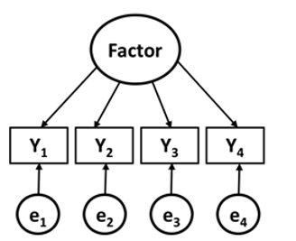
EFA versus Principal Components Analysis (PCA)
In factor analysis, the arrows go from the latent factor to the observed variables. This means the factor is assumed to cause the responses we observe. The shared variation among the Y’s is explained by a common underlying construct. “People score high on all these items because they have high levels of the latent trait (e.g., depression).”
In PCA, the arrows go the opposite direction—from the observed variables to the component. That means the component is constructed from the variables, not causing them. The component is just a summary of the variables—it doesn’t explain why they are related. These variables move together, so we combine them into a single score
This is a NOT a testable model. It is not a measurement model, and there is no hypothesis about the underlying structure.
This is a testable model. It can be evaluated for factor loadings, model fit, interpretability
Notes:
The Factor is unobserved (latent)
The $Y_{1},Y_{2},Y_{3},Y_{4}$are observed indicators
Each $e_{1},e_{2},e_{3},e_{4}$is measurement error / uniqueness
The Component is just a weighted combination of $Y_{1}$–$Y_{4}$ There is no error term modeled separately There is no latent construct being tested

Slide 9
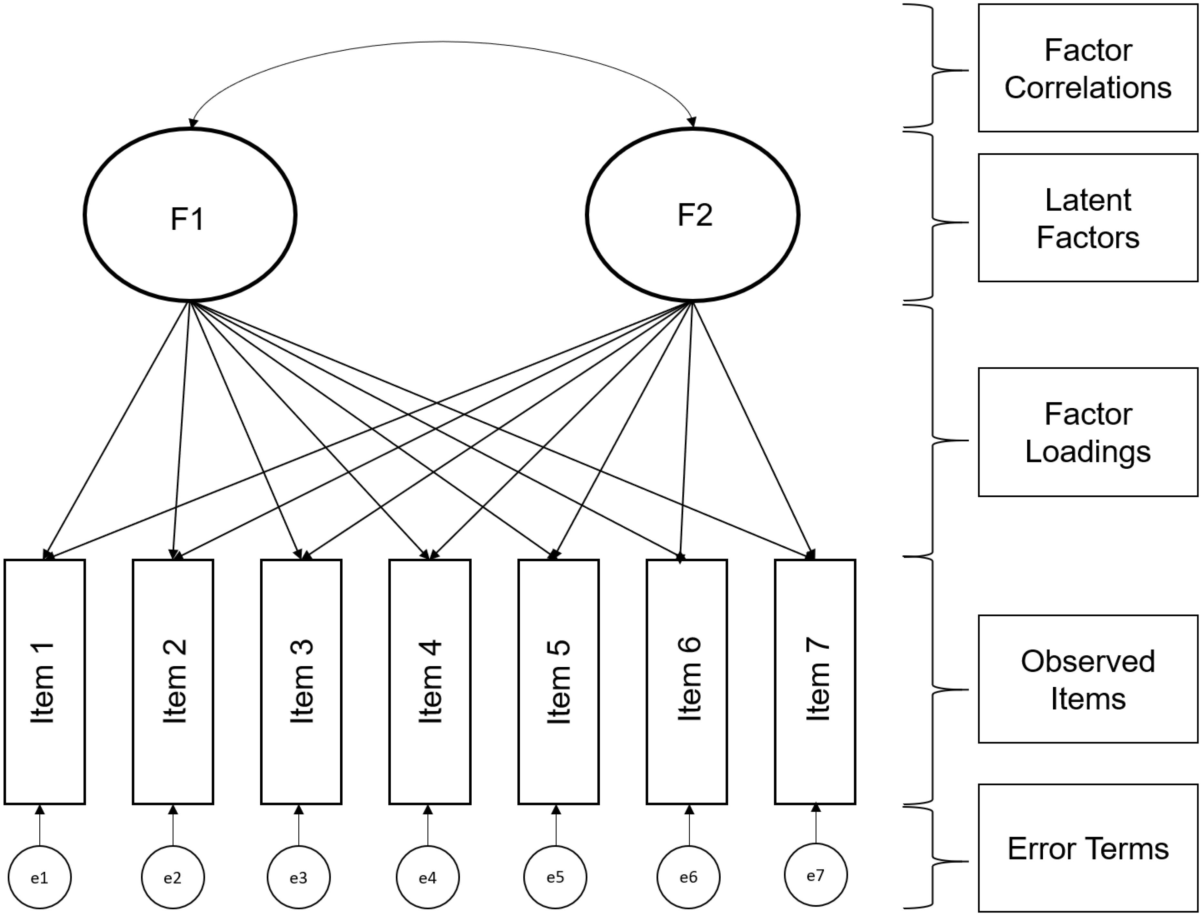
EFA: A Measurement Model
EFA does not presuppose a theoretical structure
Useful as a starting point for understanding empirical structures or identifying problems with existing scales
Correlations between items are used to infer the presence of an underlying variable (latent)
Cross loadings: One important consideration is that all items are allowed to load on any factor (compare CFA)

Slide 10
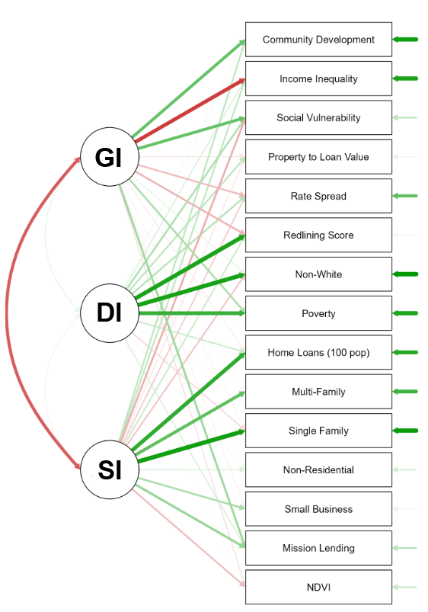
Example
Circles represent latent variables—unobserved constructs identified through factor analysis.
GI = Growing Investment
DI = Disinvestment
SI = Sustained Investment
We assigned these labels based on patterns in the measured data
Boxes represent observed/measured items—real-world variables used to estimate the latent factors (e.g., "Income Inequality," "Home Loans")
Green lines show positive factor loadings:
Thicker green lines indicate stronger relationships, meaning that the item is a good indicator of the latent variable
Red lines show negative relationships or inverse loadings:
These items are negatively associated with the latent variable, meaning they represent an opposite trend or reduce the strength of that factor
Notes:
This is a multi-factor measurement model where three latent constructs, growing investment, disinvestment and Sustained investment, are used to explain patterns of correlation across observed neighborhood-level indicators (e.g., redlining score, social vulnerability, lending practices). These are manifest variables that reflect the underlying latent constructs

Slide 11
Example: Five indicators of an underlying latent construct we call depression
Let’s say you have 5 questions like:
"I felt sad“
"I couldn’t sleep“
"I felt tired“
"I cried often“
"I had trouble concentrating"
If you conducted a FA:
You’re assuming these 5 items are caused by an underlying factor, like ?
You believe that this factor explains the shared variance (covariance) between these items
Then you test whether this model fits your data (e.g., using model fit statistics). If the model fits well, you have evidence that ? is a valid latent construct
If you conducted a PCA:
PCA examines the total variance of the 5 items and finds components that best summarize the data
You simply want to mathematically combine the items into a weighted average (component) that explains as much variance as possible
There’s no underlying assumption that a real, hidden thing like “depression” exists or is driving the items. It’s just a data summary, not a testable theory
Notes:
“This is a multi-factor measurement model where three latent constructs—GI, DI, and SI—are used to explain patterns of correlation across observed neighborhood-level indicators.”

Slide 12
Intuition
PCA
It takes all the variance from all five variables — both shared and unique
Then it creates components (linear combinations of the variables) that explain as much total variance as possible
So even if one variable doesn’t share variance with others (i.e., it doesn’t correlate well), PCA still includes it — it just might load weakly on the first few components
FA
FA focuses only on the shared variance (called common variance) between variables
It assumes there’s some underlying latent factor (like depression) that’s causing the correlation
FA removes unique variance and error variance from the factor model
Example
Let’s say one item (“I felt tired”) is not very correlated with the other 4
PCA still uses it in calculating components
FA might give it a low loading or treat its variance as mostly unique/error rather than useful in explaining the latent construct
Bottom line:
PCA uses all variables and all their variance, shared or not
FA uses only the shared variance to model an underlying latent structure

Slide 13
EFA
The main applications of factor analytic techniques are:
Data reduction. To reduce the number of variables into factors based on shared variance; and
Data classification. To detect structure (or underlying processes) in the relationships between variables, that is, to classify variables
Assumption
Variables that correlate with each other do so because they are measuring the same thing →a common domain
This is important because sometimes composite variables are used from assessments, psychological or otherwise, without concern for the process underlying that construction
RQ: What is the underlying factor structure (i.e., a latent variable) for a set of measures?
EFA is a statistical procedure that allows us to cluster variables together into constructs or ‘latent variables’
Example: Is intelligence a unitary or multidimensional construct (as in multiple forms of intelligence)?

Slide 14
Illustration
Situation: Pretend we have gathered information on 9 factors that affected individual choices about whether to patronize certain stores. We collect information on nine store image elements, including measures of the product offering, store personnel, price levels, and in-store service and experiences.
Why factor analysis? A retailer would like to know whether consumers think in more general evaluative dimensions rather than in just the specific items
Research Plan: One question of interest is whether the items can be grouped into some more general areas of focus, i.e., how do the 9 variables group together?
Visual inspection is not helpful in revealing patterns, but factor analysis is… as shown in the next two slides

Slide 15
Correlations (what factor(s) might cause the relationships?)
Part I Original Correlation Matrix
 | V1 | V2 | V3 | V4 | V5 | V6 | V7 | V8 | V9
V1 Price Level | 1.00
V2 Store Personnel | .427 | 1.00
V3 Return Policy | .302 | .771 | 1.00
V4 Product Availability | .470 | .497 | .427 | 1.00
V5 Product Quality | .765 | .406 | .307 | .427 | 1.00
V6 Assortment Depth | .281 | .445 | .423 | .713 | .325 | 1.00
V7 Assortment Width | .345 | .490 | .471 | .719 | .378 | .724 | 1.00
V8 In-store Service | .242 | .719 | .733 | .428 | .240 | .311 | .435 | 1.00
V9 Store Atmosphere | .372 | .737 | .774 | .479 | .326 | .429 | .466 | .710 | 1.00

Slide 16
Factor Structure
Part II Correlation Matrix After Grouping According to Factor Analysis
 | V3 | V8 | V9 | V2 | V6 | V7 | V4 | V1 | V5
V3 Return Policy | 1.00
V8 In-store Service | .773 | 1.00
V9 Store Atmosphere | .774 | .710 | 1.00
V2 Store Personnel | .771 | .719 | .737 | 1.00
V6 Assortment Depth | .423 | .311 | .429 | .445 | 1.00
V7 Assortment Width | .471 | .435 | .466 | .490 | .724 | 1.00
V4 Product Availability | .427 | .428 | .479 | .497 | .713 | .719 | 1.00
V1 Price Level | .302 | .242 | .372 | .427 | .281 | .354 | .470 | 1.00
V5 Product Quality | .307 | .240 | .326 | .406 | .325 | .378 | .427 | .765 | 1.00
Results: Shaded areas represent variables likely to be grouped together by exploratory factor analysis.

Slide 17
Interpreting the Factor Analysis Results
Variables Factors
V₃ Return Policy
V₈ In-store Service
In-store Experience
V₉ Store Atmosphere
V₂ Store Personnel
V₆ Assortment Depth
V₇ Assortment Width
Product Offerings
V₄ Product Availability
V₁ Price Level
Value
V₅ Product Quality
For use with Hair, Black, Babin and Anderson, Multivariate Data Analysis 8e © 2018 Cengage Learning EMEA

Slide 18
Exploratory Factor Analysis Decision Process
Stage 1: Objectives of Exploratory Factor Analysis (EFA)
Stage 2: Designing an Exploratory Factor Analysis
Stage 3: Assumptions in Exploratory Factor Analysis
Stage 4: Deriving Factors and Assessing Overall Fit
Stage 5: Interpreting the Factors
Stage 6: Validation of Exploratory Factor Analysis
Stage 7: Additional uses of Exploratory Factor Analysis Results
For use with Hair, Black, Babin and Anderson, Multivariate Data Analysis 8e © 2018 Cengage Learning EMEA

Slide 19
Stage 1: Objectives of Exploratory Factor Analysis
Specifying the Unit of Analysis
Achieving Data Summarization Versus Data Reduction
Variable Selection
Using Factor Analysis with Other Multivariate Techniques
For use with Hair, Black, Babin and Anderson, Multivariate Data Analysis 8e © 2018 Cengage Learning EMEA

Slide 20
EFA Unit of Analysis and Objectives
Unit of Analysis
Variables, not rows or cases (same as we’ve done)
Data Summarization versus Data Reduction
Data summarization – defining structure through underlying dimensions that, when interpreted and understood, describe the data in a much smaller number of concepts than the original individual variables. The basis for scale development.
Data reduction – extends the process of data summarization by deriving an empirical value (factor score or summated scale) for each dimension (factor) and then substituting this value for the original variable values in subsequent analysis.
For use with Hair, Black, Babin and Anderson, Multivariate Data Analysis 8e © 2018 Cengage Learning EMEA

Slide 21
Data Reduction
Reducing the number of variables
The underlying task is to find common variance and eliminate unique variance that is not of interest
It is like a reverse form of ‘partialling out’
Examples
A survey may have 100 items, but the survey was designed to measure 12 components or factors
You have 50 different variables about an individual, but some of those variables are overlapping… are they essentially measuring the same underlying (unobservable, latent) construct?

Slide 22
Variable Selection and Use with Other Techniques
Three Elements in variable selection
Variable specification – researcher must specifically designate variables to be analyzed.
Factors – EFA always generates factors, researcher has the responsibility to evaluate the usefulness and validity of the factors.
Factors require multiple variables – EFA must have at least two correlated variables to form a factor. Thus, it is OK for variables to NOT BE included in a specified factor. They are omitted because no other correlated variables were included in the analysis.
Using Factor Analysis with Other Multivariate Techniques
Factors may identify concepts more useful than individual variables.
Factors help mitigate the impact of multicollinearity on the interpretation of correlated variables.
For use with Hair, Black, Babin and Anderson, Multivariate Data Analysis 8e © 2018 Cengage Learning EMEA

Slide 23
Stage 2: Designing an Exploratory Factor Analysis
Variable Selection and Measurement Issues
Sample Size
Correlations among Variables or Respondents
For use with Hair, Black, Babin and Anderson, Multivariate Data Analysis 8e © 2018 Cengage Learning EMEA

Slide 24
EFA Research Design
Factor analysis is performed most often only on continuous variables
If your data are categorical, Latent Class Analysis can provide insight into underlying latent variables.
If a study is being designed to reveal factor structure, strive to have at least five variables for each proposed factor.
For sample size:
The sample must have more observations than variables.
Larger samples are strongly recommended (at least 100 observations).
Maximize the number of observations per variable, with a minimum of five and hopefully at least ten observations per variable.
Correlation matrix is most often performed, although a similarity/distance matrix is also an option.
For use with Hair, Black, Babin and Anderson, Multivariate Data Analysis 8e © 2018 Cengage Learning EMEA
Notes:
Example: If you have 20 variables → you need more than 20 people otherwise, the correlation matrix can’t even be properly estimated. But this alone is NOT enough.

Slide 25
Stage 3: Assumptions in Factor Analysis
Conceptual Issues
Statistical Issues
For use with Hair, Black, Babin and Anderson, Multivariate Data Analysis 8e © 2018 Cengage Learning EMEA

Slide 26
Assumptions of EFA
Conceptual
Before the factor analysis is performed, there must be a strong conceptual foundation to support the assumption that a structure does exist.
Assume a homogeneity of sub-sample factor solutions (or do multigroup analysi)
For use with Hair, Black, Babin and Anderson, Multivariate Data Analysis 8e © 2018 Cengage Learning EMEA

Slide 27
Assumptions of EFA
Statistical issues (look at correlations between variables)
Ensure that the data matrix has sufficient correlations to justify the application of FA
If all correlations are low don’t use (<.30)
Look for low partial correlations → a pattern of high partial correlations means that a variable is not correlated with a large number of other variables → no factors exist in the data
Partial correlations > .7 are high
Bartlett’s test of sphericity should be significant
Kaiser-Meyer-Olkin Measure of sampling adequacy (MSA) should be high
Notes:
Before we dive into factor analysis, we need to make sure our data deserves it.
Check the correlations: Factor analysis assumes that variables share enough variance to justify summarizing them. If most correlations are below .30, it’s a sign that the variables aren’t linked strongly enough—no shared structure means no meaningful factors.
Partial correlations matter: High partial correlations (>.70) suggest that variables remain strongly correlated even after accounting for others. That implies a lack of common factors—essentially, the variables aren't playing as a team.
Bartlett’s test of sphericity: This test tells us whether our correlation matrix is significantly different from an identity matrix. A significant result means the data has enough structure to proceed. A non-significant test suggests random noise—nothing to extract.
Kaiser-Meyer-Olkin (KMO) Measure of Sampling Adequacy: This index tells us how well-suited the data is for factor analysis. Values closer to 1.0 are ideal. A rule of thumb: .80 and above = great, .60s = mediocre, below .50 = don't do it.

Slide 28
Assumptions of EFA
Statistical Issues addressing Multicollinearity
A statistically significant Bartlett’s test of sphericity (sig. < .05) indicates that sufficient correlations exist among the variables to proceed with an exploratory factor analysis.
Another good diagnostic test is the MSA (measure of sampling adequacy).
Measured by the Kaiser-Meyer-Olkin (KMO) statistic, which indicates if a set of variables is likely to identify a good factor solution based on correlations/partial correlations.
KMO statistic exists for each individual variable and an overall value that can vary from 0 to 1.0.
KMO value must exceed .50 for both the overall test and each individual variable. Variables with values less than .50 should be omitted from the factor analysis one at a time, with the smallest one being omitted each time, until both overall and all individual values are above .50
For use with Hair, Black, Babin and Anderson, Multivariate Data Analysis 8e © 2018 Cengage Learning EMEA

Slide 29
Identity matrix v. Covariance matrix
 | Var1 | Var2 | Var3
Var1 | 1 | 0 | 0
Var2 | 0 | 1 | 0
Var3 | 0 | 0 | 1
 | Var1 | Var2 | Var3
Var1 | 1 | 0.6 | 0.4
Var2 | 0.6 | 1 | 0.5
Var3 | 0.4 | 0.5 | 1
Notes:
Let’s talk about this matrix.
What you’re looking at is an identity matrix: all the diagonal elements are 1 (perfect correlation with themselves), and all the off-diagonal elements are 0 (no correlation with anyone else).
Translation: These variables are operating in silos. They don’t share variance, they’re not communicating, and there’s no underlying factor tying them together.
Big red flag: If your correlation matrix looks like this, don’t run factor analysis. There are no latent constructs to uncover—this is statistical isolation, not structure.
Bartlett’s test would likely be non-significant here, confirming the lack of relationship. KMO would be low, too. So the message is simple: if your data looks like this, stop here.

Slide 30
Initial factorability assessment (summary)
Correlation coefficient values
Should be >= .30
Bartlett’s test of sphericity
The null hypothesis is the variance-covariance matrix equals the identity matrix
Here we want to reject the null hypothesis because we want overlapping variance between variables to reduce them into latent factors
Anti-image correlation matrix
Kaiser-Meyer-Olkin measure of sampling adequacy (MSA)
An index of shared variance in the variables: the proportion of variance in your variables that might be “caused” by underlying factors
Compares the magnitude of the observed to partial correlation coefficients
Ranges from 0 to 1 and larger values mean more factorability (look for significance)
Notes:
To justify running factor analysis, your data needs to show enough shared variance—and we’ve got a few tools to check that.
Correlation coefficients (> .30): Think of this as the minimum level of connection we’re looking for. If variables don’t correlate at least moderately, they likely don’t share enough variance to be grouped under a latent factor.
Bartlett’s Test of Sphericity: The null hypothesis says the correlation matrix is an identity matrix—meaning variables are uncorrelated. But for factor analysis, we want overlap. So a significant result (p < .05) means we can reject the null and conclude that our variables are correlated enough to proceed. The next slide has an example of what the identity matrix looks like so you have some intuition about it.
Anti-Image Correlation Matrix: This matrix shows partial correlations, helping us identify variables that may not fit well with the rest. Large off-diagonal values here signal trouble—variables that don’t contribute to shared structure.
Kaiser-Meyer-Olkin (KMO) Measure of Sampling Adequacy: This gives us a single number summarizing how well our variables lend themselves to factor analysis. It compares the size of the observed correlations to the size of the partial correlations. Ranges from 0 to 1—higher is better. A value above .80 is considered excellent. Below .50? Not worth proceeding.

Slide 31
Stage 4: Deriving Factors and Assessing Overall Fit
Selecting the factor extraction method – common vs. component analysis.
Stopping Rules: Criteria for the Number of Factors to Extract.
Alternatives to Principal Components and Common Factor Analysis.
For use with Hair, Black, Babin and Anderson, Multivariate Data Analysis 8e © 2018 Cengage Learning EMEA

Slide 32
Key Questions
How many reliable and interpretable factors/components are there in a set of variables?
How many factors/components should be extracted?
How much variance in a set of variables is accounted for by the retained factors/components?
How are the factors/components interpreted? (Note: this is subjective)

Slide 33
Extracting a set of factors from the correlation matrix
Recall: Variance tells us how spread out a variable’s values are around its average
When two variables are correlated, they share some of that variance. The amount they share is the squared correlation
Example: A correlation of 0.5 means 25% of the variance is shared
In FA, variables that are highly correlated are grouped together —meaning they move together and share a lot of variance
It's important to know how much of a variable’s variance is shared with others in its group (factor), and how much is unique or due to error
Total variance = Shared (common) variance + Unique variance + Error
Notes:
Let’s rewind for a second: Variance tells us how much a variable’s values spread out around the mean. But what happens when variables are correlated? They move together—and that means they’re sharing some of their variance.
When two variables correlate at .50, they share 25% of their variance—because we square the correlation to find shared variance.
In factor analysis, this shared variance is the gold we’re mining. Highly correlated variables are grouped together into factors because they fluctuate in sync—something’s linking them.
But we don’t just care about what’s shared. We also need to know what’s unique to each variable—and how much is just random noise.
So every variable’s total variance can be broken down into three pieces:
Total variance = Shared (common) variance + Unique variance + Error
Factor analysis aims to uncover the common variance—the part that tells us something meaningful is happening across multiple variables.

Slide 34
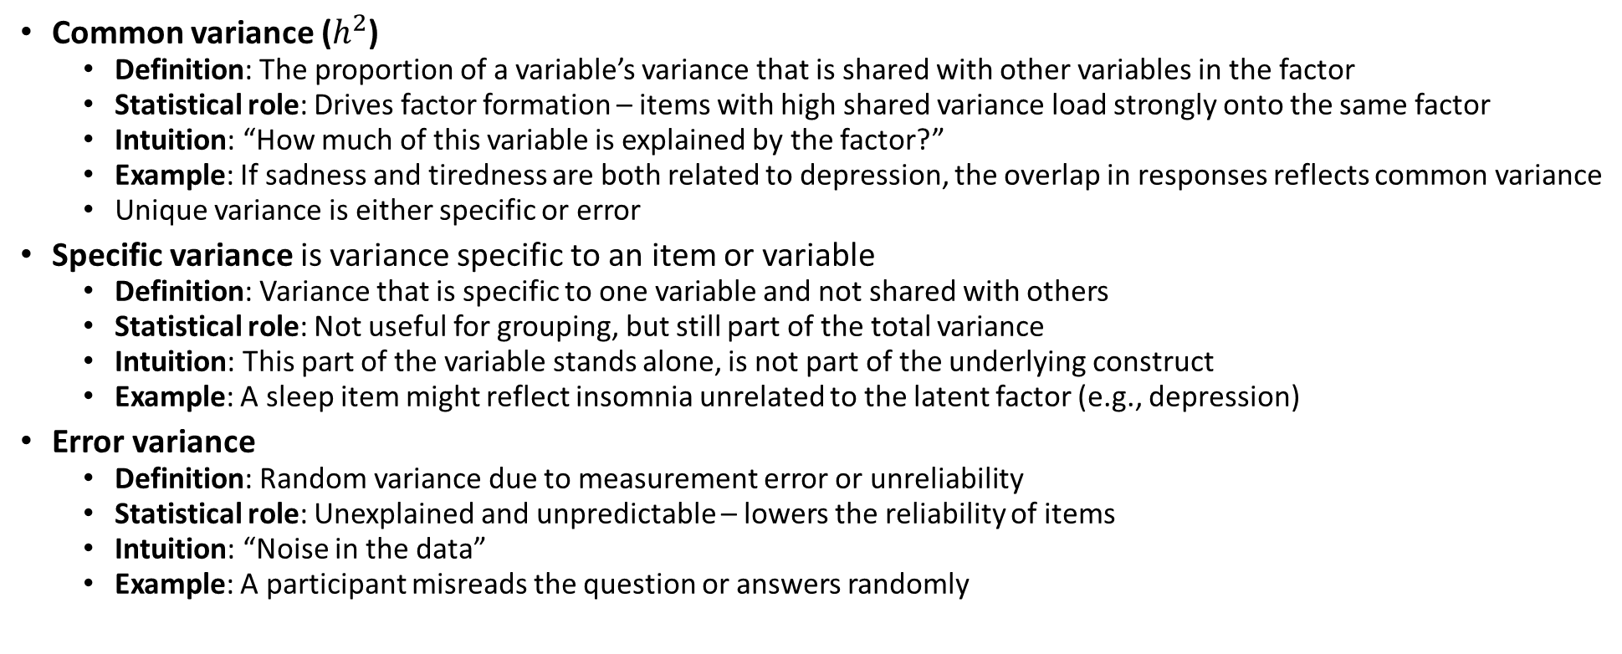
Extracting a set of factors from the correlation matrix
Common variance ($h^{2}$)
Definition: The proportion of a variable’s variance that is shared with other variables in the factor
Statistical role: Drives factor formation – items with high shared variance load strongly onto the same factor
Intuition: “How much of this variable is explained by the factor?”
Example: If sadness and tiredness are both related to depression, the overlap in responses reflects common variance
Unique variance is either specific or error
Specific variance is variance specific to an item or variable
Definition: Variance that is specific to one variable and not shared with others
Statistical role: Not useful for grouping, but still part of the total variance
Intuition: This part of the variable stands alone, is not part of the underlying construct
Example: A sleep item might reflect insomnia unrelated to the latent factor (e.g., depression)
Error variance
Definition: Random variance due to measurement error or unreliability
Statistical role: Unexplained and unpredictable – lowers the reliability of items
Intuition: “Noise in the data”
Example: A participant misreads the question or answers randomly
Notes:
When we run factor analysis, we’re asking: What part of each variable is part of something bigger? Let’s unpack what that means.
Common Variance (Shared) This is the overlap—the part of the variable that aligns with others. It’s explained by a latent factor, like depression or neighborhood disinvestment. Example: If questions about sadness, fatigue, and sleep all move together, they likely reflect the same underlying construct—say, Depression.
Unique Variance This is what makes a variable special—it’s the part not shared with others and not explained by a factor. It still matters. For instance, a sleep question may reflect depression and a uniquely personal experience with insomnia or with lack of motivation having nothing to do with depression per se.
Error Variance This israndomness, imprecision, or noise in the data. It’s not meaningful, it’s not shared, and it’s not useful for explaining anything real. There will always be some error or noise in the data, the nice thing about statistics is that we can quantify it.
Bottom line: Factor analysis is only interested in common variance—that’s where the patterns live. Everything else? It’s either unique to that variable or just statistical noise.

Slide 35
Selecting the factor extraction method
Partitioning the Variance
Common variance
Variable communality is the estimate of its shared, or common, variance among the variables as represented by the derived factors.
Variance of a variable that is shared with all other variables in the analysis.
Results from the variable’s correlations with all other variables in the analysis.
Unique variance – composed of Specific and Error variance
Specific variance – cannot be explained by the correlations to the other variables but reflects the unique characteristics of that variable apart from the other variables in the analysis.
Error variance – due to unreliability in the data-gathering process, measurement error, or a random component in the measured phenomenon.
For use with Hair, Black, Babin and Anderson, Multivariate Data Analysis 8e © 2018 Cengage Learning EMEA

Slide 36
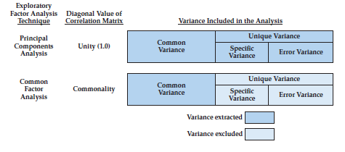
How do they differ?
Extraction Method Determines the Types of Variance
Carried into the Factor Matrix
For use with Hair, Black, Babin and Anderson, Multivariate Data Analysis 8e © 2018 Cengage Learning EMEA
Notes:
In PCA, the diagonal is fixed at 1, meaning all variance is analyzed, whereas in factor analysis, the diagonal is replaced with communalities so that only shared variance is used to estimate latent factors.

Slide 37
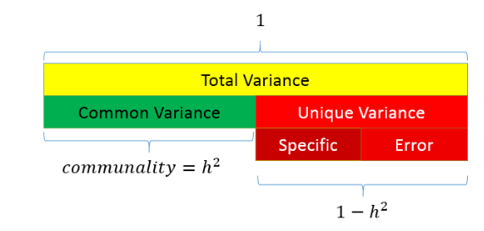
Partitioning the variance in factor analysis
Common variance is the amount of variance that is shared among the variables
Unique variance is the portion of variance that is not common
Specific
Error
Total variance = common + unique
You want communality to be high and uniqueness to be low
Ranges from 0 to 1
Higher values = the common factor
explain more of the variance of an individual
item
Notes:
The entire bar represents the total variance of a variable, which is always standardized to 1 in factor analysis.
That total variance has two parts: ✔️ Common variance (green) → variance explained by the factor(s) ❌ Unique variance (red) → variance that’s not explained by the factor model
Unique variance has two sub-parts: 🔹 Specific variance: variance unique to that variable—not shared, but still meaningful 🔹 Error variance: measurement error or randomness—basically noise
The communality is represented by h^2, which is the proportion of total variance that’s common, or:
So if a variable has a communality of 0.70, it means that 70% of its variance is explained by the factors, and the remaining 30% is unique or error.
Goal of FA: You want communalities to be high—that means your factors are doing a good job. If communalities are low, your model isn’t explaining much, and factor analysis might not be appropriate.

Slide 38
Important concepts
Factor loadings
Correlation between a variable and a factor (How high is the correlation between two variables?)
Loading a variable to a factor
Eigenvalue
The variance explained by a factor (How much variance can be explained by the factor?)
Sum of the squared factor charges
Communalities
Variance of the variables, which is explained by all factors (How much of the variance of all variables is explained by the factor?)
Sum of the squared factor charges of a variable
Notes:
Let’s break down the key terms that tell us how well factor analysis is actually working.
Factor Loadings Think of these as correlations between a variable and a factor. They tell us how strongly a variable is associated with a latent factor. High loading? That variable belongs in the factor. It’s like asking: Does this item “belong” with the others in this group?
Eigenvalues This is the total variance explained by each factor.
When we say “total variance explained by each factor,” we’re talking about the total variance across all variables in the dataset.
So:
Eigenvalues represent how much of the total variance in all the variables is explained by a given factor.
For example, if Factor 1 has an eigenvalue of 3 in a dataset with 6 variables (each standardized, so each contributes 1 unit of variance), that means:
Factor 1 explains 3 out of 6 total units of variance—or 50% of the total variance in the dataset.
That’s why we often use eigenvalues > 1 as a cutoff: a factor should explain more variance than a single variable to be worth keeping.
Bottom line: Eigenvalues answer → How much of the story is this factor telling? Technically, it’s the sum of squared loadings for each factor. Rule of thumb: Eigenvalues > 1 are typically considered meaningful.
Communalities These tell us how much of a variable’s variance is explained by all the factors combined. It’s the sum of squared loadings for each variable across all factors. In other words: How much of this variable are we actually capturing through the factor model?

Slide 39
Communalities
These tell us how much of a variable’s variance is explained by all the factors combined
It is calculated as the sum of squared loadings for that variable across all extracted factors
Intuition: How much of this variable are we actually capturing through our factor model?
Example: Let’s say you have a variable that measures “trouble sleeping”—and it loads .60 on Factor 1 (e.g., Depression) and .30 on Factor 2 (e.g., Anxiety)
To calculate the communality for that variable:
(.60)² + (.30)² = 0.36 + 0.09 = 0.45
That means 45% of the variance in the trouble sleeping variable is explained by the two factors
The remaining 55% is either unique to that item or just noise

Slide 40
Example of Communalities
Communality = (Loading on F1)² + (Loading on F2)²
Variable | Depression (F1) | Anxiety (F2) | Communality | Interpretation
Trouble sleeping | 0.60 | 0.30 | 0.45 | 36% of variance explained by Factor 1; 9% by Factor 2
Feeling worthless | 0.70 | 0.10 | 0.50 | 49% of variance explained by Factor 1; only 1% by Factor 2
Racing thoughts | 0.20 | 0.65 | 0.45 | 4% of variance explained by Factor 1; 42% by Factor 2

Slide 41
Exploratory Factor Analysis Specification Conditions & Decisions
Factor retention: once the variables are factored, we need to determine how many factors to retain
This is a “crucial decision”
Notes:
If too few factors are retained, then important information is lost and important factors may be neglected
Remember the goal is parsimony

Slide 42
Rules of Thumb – Choosing Factor Models and Number of Factors
A decision on the number of retained factors should be based on several considerations:
Use several stopping criteria to determine the initial number of factors to retain.
Factors With Eigenvalues greater than 1.0.
A pre-determined number based on research objectives and/or prior research.
Enough factors for a specified percentage of variance explained (e.g., usually 60%).
Factors shown by the scree test to have substantial amounts of common variance (i.e, before inflection point).
Factors which have eigenvalues greater than factors from randomly-generated data.
Factors above the threshold established by parallel analysis.
More factors when there is heterogeneity among sample subgroups.
Consideration of several alternative solutions (one more and one less factor than the initial solution) to ensure the best structure is identified.
For use with Hair, Black, Babin and Anderson, Multivariate Data Analysis 8e © 2018 Cengage Learning EMEA

Slide 43
Full Set of Criteria for determining the number of factors
Note: some of these are statistical, some require common sense judgment
Selecting the factor(s)
A priori criterion (theory)
Scree plots
Kaiser’s rule (eigenvalues greater than one)
Parallel analysis
Number of variables per factor
Heterogeneity of the respondents
Notes:
This isn’t just a numbers game—some of these decisions are statistical, but others require judgment and context.
A priori criterion Sometimes, theory tells you how many factors to expect. If you're testing a validated construct (e.g., Big Five personality), you might already know what you're looking for.
Scree plot This visual shows the “elbow” where eigenvalues drop off sharply. You look for the point where the curve flattens—everything before that might be meaningful. After? Probably noise.
Kaiser’s rule Keep factors with eigenvalues > 1. Why? Because each variable contributes 1 unit of variance—so a factor should explain at least as much as a single variable to be worth keeping.
Parallel analysis A more robust method: it compares your real data to random data. If your factor explains more variance than what you'd see by chance, it's worth keeping. Gold standard in modern FA.
Number of variables per factor A factor defined by one or two variables isn’t stable. You typically want at least 3–4 strong loadings to consider a factor reliable.
Heterogeneity of respondents If your sample is diverse in key ways (age, education, context), you might find more factors. If it’s homogeneous, you may see fewer meaningful dimensions.
Bottom line: There’s no one-size-fits-all answer. Use the tools—but trust your theory and your data.

Slide 44
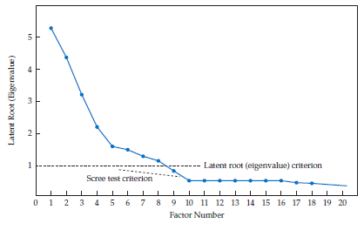
Stopping Rules: Criteria for the Number of Factors to Extract
Scree Test Criterion
Identify the optimum number of factors that can be extracted before the amount of unique variance begins to dominate the common variance structure.
Plot of latent root (eigenvalues) defines “elbow,” the point at which the curve first begins to straighten out.
Considered to represent those factors containing more unique rather than common variance.
Most researchers do not include the elbow, but rather retain all of the preceding factors.
The factor explains as much variance as one original variable
For use with Hair, Black, Babin and Anderson, Multivariate Data Analysis 8e © 2018 Cengage Learning EMEA
Notes:
Say you have 10 variables:
Total variance in the dataset = 10 units (because each variable = 1)
Now suppose:
Factor 1 eigenvalue = 4 → explains 4/10 = 40% of total variance
Why we compare to “1”
Because:
1 = variance of one variable
So:
Eigenvalue > 1 → factor is worth keeping ✅
Eigenvalue < 1 → weaker than a single variable ❌

Slide 45
Kaiser’s rule (eigenvalues greater than one)
Eigenvalues measure the amount of variance in the total sample that is accounted for by each factor
Retain only those eigenvalues that are greater than 1 and drop the rest
Why? Any value greater than one represents a factor that explains a higher-than-average amount of variance

Slide 46
Stopping Rules: Criteria for the Number of Factors to Extract
Parallel Analysis
Empirical measure based on the specific characteristics (i.e., number of variables and sample size) of the dataset being analyzed.
Procedure
Generate a large number (e.g., 500 or 1000) simulated datasets with random values for the same number of variables and sample size.
Apply factor analysis to each dataset.
Calculate average eigenvalue across datasets for each factor(i.e., first, second, . . . )
Compare the eigenvalues for the original data and retain all factors that are greater than the average eigenvalues from random datasets
Variants of this rule suggest taking the upper bound (95th percentile) of the simulated eigenvalues.
Applicable equally well to principal components or common factor methods
For use with Hair, Black, Babin and Anderson, Multivariate Data Analysis 8e © 2018 Cengage Learning EMEA

Slide 47
Parallel Analysis** (Gold Standard)
Compare the eigenvalues from the original data to the eigenvalues generated from a Monte Carlo simulated matrix created from randomly generated data of the same sample size
Factors are retained when the i^{th} eigenvalue from the observed data is greater than the i^{th} eigenvalue from the random data
Superior to both previous methods
Software note: SPSS doesn’t provide this – do it in JASP, R (e.g., psych::fa.parallel), or Jamovi
Notes:
How it works: Parallel analysis compares your data’s eigenvalues to those generated from random data of the same sample size and number of variables. This random dataset is created using Monte Carlo simulation—basically, simulating what eigenvalues would look like if the data had no real structure.
The key idea:
A factor is retained only if the ith eigenvalue from your actual data is greater than the ith eigenvalue from the random (simulated) data.
Why it’s better: Unlike the scree plot (which is subjective) or Kaiser’s rule (which can overestimate), parallel analysis protects against chance—it helps ensure you don’t keep factors that are just statistical noise.
Software note: SPSS doesn’t include this method out of the box. But JASP, R (e.g., psych::fa.parallel), or Jamovi can run parallel analysis easily.

Slide 48
Step 5: Interpreting the Factors
The Three Processes of Factor Interpretation
Factor Extraction
Rotation of Factors
Judging the Significance of Factor Loadings
Interpreting a Factor Matrix
For use with Hair, Black, Babin and Anderson, Multivariate Data Analysis 8e © 2018 Cengage Learning EMEA

Slide 49
The Three Processes of Factor Interpretation
Estimate the Factor matrix
Compute unrotated factor loadings – correlation of variable and factor.
If used strictly for data reduction, the process can stop here.
Factor Rotation
Employ a rotational method to achieve simpler and theoretically more meaningful factor solutions.
In most cases, rotation of the factors improves the interpretation by reducing some of the ambiguities that often accompany initial unrotated factor solutions.
Factor Interpretation and Re-specification
Evaluate the (rotated) factor loadings for each variable in order to determine that variable’s role and contribution in determining the factor structure.
Re-specification involves eliminating variables or extract different number of factors.
For use with Hair, Black, Babin and Anderson, Multivariate Data Analysis 8e © 2018 Cengage Learning EMEA

Slide 50
Rotation of Factors
Procedure
The reference axes of the factors are turned about the origin until some other position has been reached. Loadings of each variable remain fixed relative to other loadings.
Impact
The ultimate effect of rotating the factor matrix is to redistribute the variance from earlier factors to later ones to achieve a simpler, theoretically more meaningful factor pattern.
Alternative Methods
Orthogonal rotation – simplest approach which maintains orthogonality of factors.
Most common method – VARIMAX.
Oblique rotation – allows for correlation among rotated factors.
For use with Hair, Black, Babin and Anderson, Multivariate Data Analysis 8e © 2018 Cengage Learning EMEA

Slide 51
Factor Rotation (sharpening the results)
Rotation simply means turning the axes (factors) to a new angle to make the factor structure easier to interpret
It doesn’t change the underlying math, but helps us see which variables load clearly onto which factors
Why Rotate?
Rotation helps clarify the factor loadings, making it easier to assign meaning to each factor
It spreads the loadings out more cleanly, so that each variable “belongs” more strongly to one factor instead of multiple

Slide 52
Interpreting the factors
An iterative process
Begins with estimating the factor matrix
First, the initial unrotated factor matrix is computed, containing the factor loadings
This is the first solution the software calculates
It finds factors that explain the maximum variance in the data
But: this solution is often hard to interpret, because each variable may load on multiple factors
It gives you the structure, but it's like looking at a blurry picture
Rotated factor loadings are the correlation of each variable and the factor
Rotation is a mathematical adjustment to make the factor structure more interpretable
After rotation, variables usually load more strongly on one factor, and weakly on others
This makes it easier to name the factors based on the items that group together
You typically use rotated loadings to interpret the factors

Slide 53
Example:
Imagine you're doing factor analysis on 10 survey items
Unrotated loadings might show every item loading a little on all factors (messy!)
Rotated loadings will try to "clean this up" so:
Items 1–5 load strongly on Factor 1 → You might label this "Anxiety“
Items 6–10 load strongly on Factor 2 → You might label this "Depression“
→ focus on the rotated loadings
Notes:
Factor analysis is an iterative process—we don’t stop at the first solution the software gives us.
Step 1: Initial unrotated solution The software starts by estimating the unrotated factor matrix—this is the raw set of loadings that explains the most variance possible. It’s mathematically optimal, but often messy: variables may load on multiple factors, and the structure is hard to interpret.
It’s like taking a photo that's technically “complete,” but blurry—you can’t quite make out what’s in it.
Step 2: Rotation (puts the analysis into focus) Rotation is a mathematical adjustment that helps clarify the factor structure. It doesn’t change the number of factors or the total variance explained—but it redistributes the variance across factors to make the picture clearer.
What rotation does: After rotation:
Each variable typically loads strongly on one factor and weakly on others
Factors become easier to label and interpret—because now the items grouped together actually make conceptual sense
Bottom line:
Always interpret the rotated solution. That’s the one that tells the clearest story.

Slide 54
Must rotate factors, different rotation types
When choosing a rotation method, ask yourself: Do I expect my factors to be correlated? YES
Constructs like depression and anxiety, or trauma and risk-taking, are rarely independent. Psychological, behavioral, and social variables tend to overlap
Oblique rotation (e.g., Promax, Oblimin) allows factors to correlate
Orthogonal rotation (like Varimax) forces factors to be uncorrelated
Using varimax rotation distorts underlying relationships
In most social science applications, use oblique rotation—because constructs are not independent (disinvestment example, redux).
Type | Factors Are... | Use When...
Orthogonal | Uncorrelated | You assume the factors are independent (rare).
Oblique | Correlated | More realistic for psychology/social sciences constructs that are highly interdependent

Slide 55
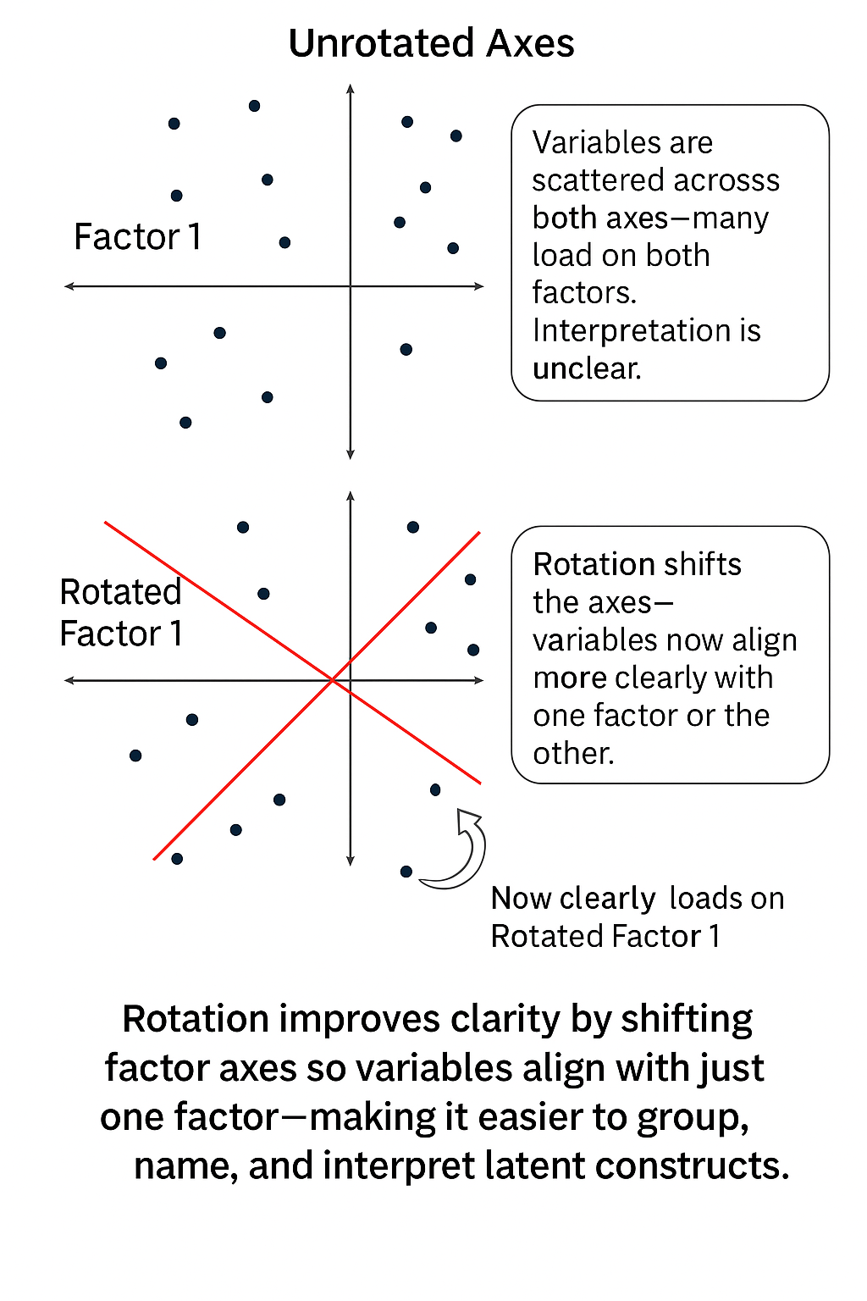
Rotation (Cont’D)
When more than one variable loads highly on a factor, the interpretation becomes difficult (as we will see)
It is a good idea to find an appropriate rotation that makes the factors more interpretable
The best way to understand this is by a scatterplot matrix of the factor loadings – the goal is to find a rotation such that each of the variables has a high loading on only one factor
Notes:
Factor analysis doesn’t stop at finding structure—it needs to make that structure interpretable. That’s where rotation comes in.
Top panel: This is the initial, unrotated factor solution. The axes (factors) are aligned to explain the maximum amount of variance, but interpretation is difficult. Many points (representing variables) are scattered across multiple quadrants—loading on more than one factor. It’s messy, and hard to tell what belongs where.
Bottom panel: After rotation, the axes have been reoriented and appear in red. Now, each variable lies closer to just one factor axis, rather than being split between both.
This creates a cleaner, more interpretable factor structure—where variables group more clearly and meaningfully, making it easier to label the factors.
The goal of rotation is simple: Help us say with confidence: “These items belong to Factor 1. Those belong to Factor 2.”
We haven’t changed the data—just the perspective. 👉 Rotation reorients the axes to make the latent structure clearer and easier to interpret.

Slide 56
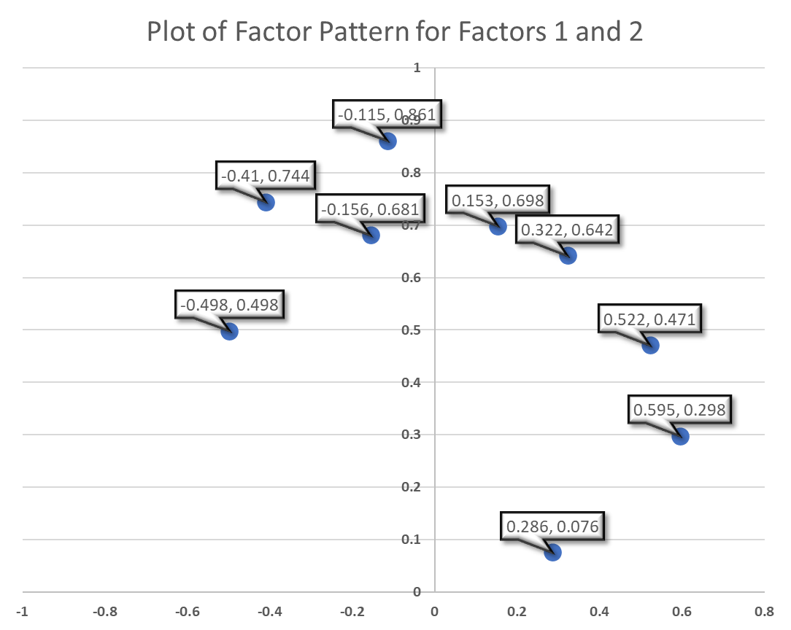
Example: Visualizing Rotation
Before rotation: Look at “Climate”—it has moderate loadings on two of three factors: 0.286, and 0.841 And “Education” is split equally between two factors: 0.498 and –0.498
This is messy. Variables are loading on multiple factors, which makes interpretation difficult
Factor
Variable | 1 | 2 | 3
Climate | 0.286 | 0.076 | 0.841
Housing | 0.698 | 0.153 | 0.084
Health | 0.744 | -0.41 | -0.02
Crime | 0.471 | 0.522 | 0.135
Transportation | 0.681 | -0.156 | -0.148
Education | 0.498 | -0.498 | -0.253
Arts | 0.861 | -0.115 | 0.011
Recreation | 0.642 | 0.322 | 0.044
Economics | 0.298 | 0.595 | -0.533
Notes:
Ideally, each variable appears in only one column
Rotation involves defining new coordinate systems so that when we rotate everything, the points fall close to the vertices (end points) of the new axes.

Slide 57
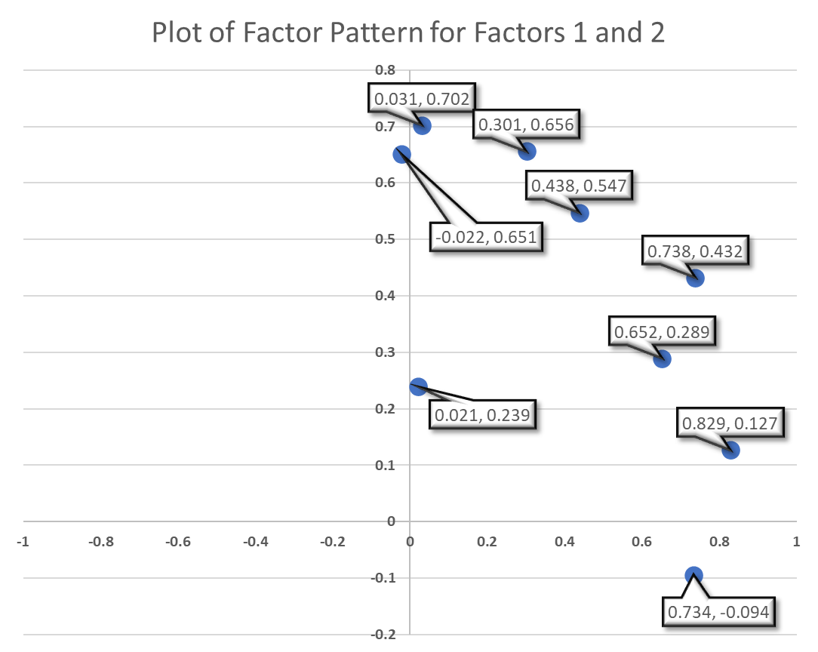
Example: Visualizing Rotation
After rotation: Now we see a clearer pattern. “Climate” loads strongly on Factor 3 (0.859) and weakly elsewhere
“Education” now loads strongly on Factor 1 (0.734), with minimal cross-loadings
Factor
Variable | 1 | 2 | 3
Climate | 0.021 | 0.239 | 0.859
Housing | 0.438 | 0.547 | 0.166
Health | 0.829 | 0.127 | 0.137
Crime | 0.031 | 0.702 | 0.139
Transportation | 0.652 | 0.289 | -0.028
Education | 0.734 | -0.094 | -0.117
Arts | 0.738 | 0.432 | 0.15
Recreation | 0.301 | 0.656 | 0.099
Economics | -0.022 | 0.651 | -0.551
Notes:
Ideally, each variable appears in only one column
Rotation involves defining new coordinate systems so that when we rotate everything, the points fall close to the vertices (end points) of the new axes.

Slide 58
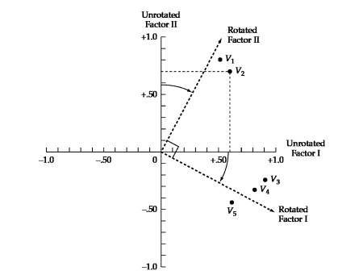
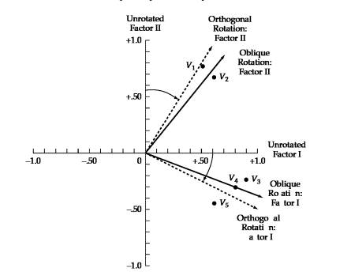
This has the effect of
making the factor loading pattern much clearer
Orthogonal rotates 90º
Comparison Between Rotated and Unrotated Factor Loadings
 | Unrotated Factor Loadings |  | Rotated Factor Loadings
Variables | I | II | I | II
V1 | .50 | .80 | .03 | .94
V2 | .60 | .70 | .16 | .90
V3 | .90 | -.25 | .95 | .24
V4 | .80 | -.30 | .84 | .15
V5 | .60 | -.50 | .76 | -.13
Oblique
Notes:
🔹 Left: Visual Comparison
Top diagram: Orthogonal Rotation
The factor axes stay at 90° angles (uncorrelated).
Variables (V1–V5) are repositioned to align better with one factor, without letting the factors correlate.
This rotation is rigid—it assumes the underlying constructs are independent.
Bottom diagram: Oblique Rotation
The axes are allowed to tilt toward each other (not necessarily 90°).
This allows the factors to correlate, which is often more realistic in social science data (e.g., depression and anxiety).
Oblique rotation gives you a more flexible, and often more accurate, picture of how variables relate to correlated constructs.
🔹 Right: Table of Loadings Before and After Rotation
Unrotated factor loadings are messy—each variable loads on both factors to some degree.
Rotated loadings (highlighted) show the improvement: Now, each variable loads strongly on one factor and weakly on the other, making interpretation straightforward.

Slide 59
Interpreting a Factor Matrix
Interpretation needed when factors used beyond solely data reduction
The objective is a simple structure, characterized by two principles:
Each variable has a high/significant loading on one factor only, and
Each factor has high/significant loadings for only a subset of items.
Five-step process
Examine the factor matrix of loadings.
Identify the significant loading(s) for each variable.
Assess the communalities of the variables.
Respecify the factor model if needed.
Label the factors.
For use with Hair, Black, Babin and Anderson, Multivariate Data Analysis 8e © 2018 Cengage Learning EMEA

Slide 60
Factor loadings
The factor loading provides information on the relative contribution that an individual variable makes to a factor
Should be >=.3 preferably >=.4, closer to 1 is better
The larger the more important, using practical reasoning
+/- .30 to +/- .40 meet minimum level for interpreting factor structure
Loadings of .50 or higher are practically significant
Loadings > .70 are indicative of well-defined structure
Recall: The factor loading squared is the percentage of common variance of the factor that is accounted for by that variable: If a variable loads .60 on a factor, then: 36% of that variable’s variance is explained by the factor
You want each variable to have one strong loading on a single factor and near-zero on all others but in reality, cross-loadings happen (even after rotation, but it helps).
Loadings can be negative: They just mean the variable moves inversely with the factor (you can recode the item for easier interpretation)
Bipolar factors: a factor defined by positive loadings on one set of variables and negative loadings on another
Notes:
Factor loadings are the core output of factor analysis. They tell us how strongly each variable is associated with each factor—like a correlation between the item and the underlying dimension.
Magnitude matters: Loadings ≥ .30 are usually considered meaningful. ≥ .40 is better, and closer to 1.0 means a stronger contribution to that factor.
What does a loading mean? If a variable loads .60 on a factor, then:
.602=.36.60^2 = .36.602=.36 → 36% of that variable’s variance is explained by the factor This is called the communality contribution from that variable to that factor.
Ideal case (that never quite happens): You want each variable to have one strong loading on a single factor and near-zero on all others. But in the real world? Cross-loadings happen—and that’s why rotation helps.
Negative loadings are okay: They just mean the variable moves inversely with the factor. You can recode the item for easier interpretation, but it’s not wrong.
Bipolar factors: Sometimes a factor is defined by positive loadings on one set of variables and negative loadings on another. This means the factor represents a spectrum or contrast—like “introversion vs. extraversion.”

Slide 61
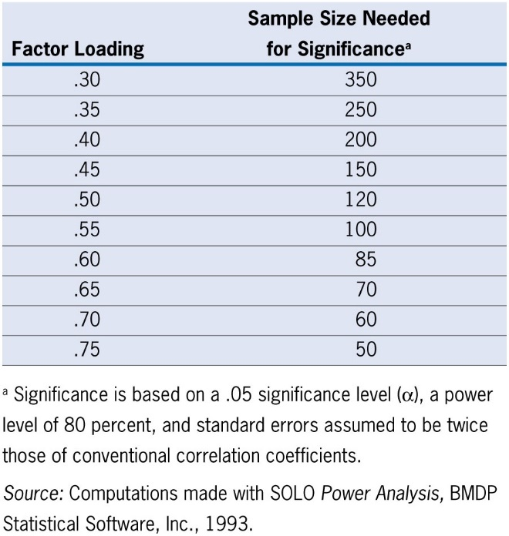
Judging the Significance of Factor Loadings
Practical Significance For Assessing Structure
Equivalent to zero: less than +/- .10
Minimal Level: in the range of +/- .30 to +/- .40
Practically Significant: values of +/- .50 or greater
Well-defined structure: exceeding +/- .70
Factor Structure
With big samples, even small loadings are reliable.
When you extract more factors, you need stronger loadings to clearly assign variables to the correct factor.
Statistical Significance
Ensuring adequate statistical power, significant loadings can be identified by sample size.
For use with Hair, Black, Babin and Anderson, Multivariate Data Analysis 8e © 2018 Cengage Learning EMEA

Slide 62
Identify significant loadings and assess communalities
Once the significance of loadings has been identified, look for any variables that are not adequately accounted for by the factor solution
We do this by looking at communalities → variables with communalities less than .50 do not have sufficient explanation
If low communalities are identified, remove the variable and repeat the analysis
Then label the factors

Slide 63
Interpreting a factor matrix
Once you’ve rotated and examined the factor loadings, your goal is to name the factors—but not randomly
You need to
Find distinctive variables that load strongly on each factor
Match those variables to your theoretical or conceptual foundation
What do these items have in common? What latent idea ties them together?
Note: if you’ve used oblique rotation (which allows factors to correlate), your output includes two matrices—and they serve different purposes:
Includes both unique contributions and the shared variance due to correlations between factors
These are correlations between the variable and the factor
Use this matrix to understand overall relationships, but not to name factors
Base the factor labeling on the rotated pattern matrix

Slide 64
Step 1: Examine the factor matrix of loadings
Starting Point:
Factor matrix has loadings of every variable on every factor extracted.
Examine each variable for the highest loading/significant loading on a factor.
Cross-loading – when a variable has a significant loading on more than one factor.
Two Principles to Assist in Identifying Cross-loadings
Compare variances, Not Loadings.
Variance (i.e., squared loading) is ultimate objective of factor analysis, so use that measure.
Compare ratios of variances.
Relative magnitude expressed as the ratio of two variances (larger variance / smaller variance) which “scales” the variance difference to the size of the two variances.
For use with Hair, Black, Babin and Anderson, Multivariate Data Analysis 8e © 2018 Cengage Learning EMEA

Slide 65
Process For Identifying Cross-Loadings
Identify potential cross-loadings
Both loadings for a variable must be above the threshold for significance (e.g., .30 or .40).
Compute the ratio of the squared loadings
Square each of the loadings and then compute the ratio of the larger loading to the smaller loading → This is what I was telling you Mason, about LCA.
Designate the pair of loadings as follows based on the ratio:
Between 1.0 and 1.5 — problematic cross-loading and the variable with smaller loading a strong candidate for elimination to achieve simple structure.
Between 1.5 and 2.0 — potential cross-loading, with deletion of a variable based on interpretability of resulting factors.
Greater than 2.0 — ignorable cross-loading, where smaller loading, while significant, can be ignored for purposes of interpretation.

Slide 66
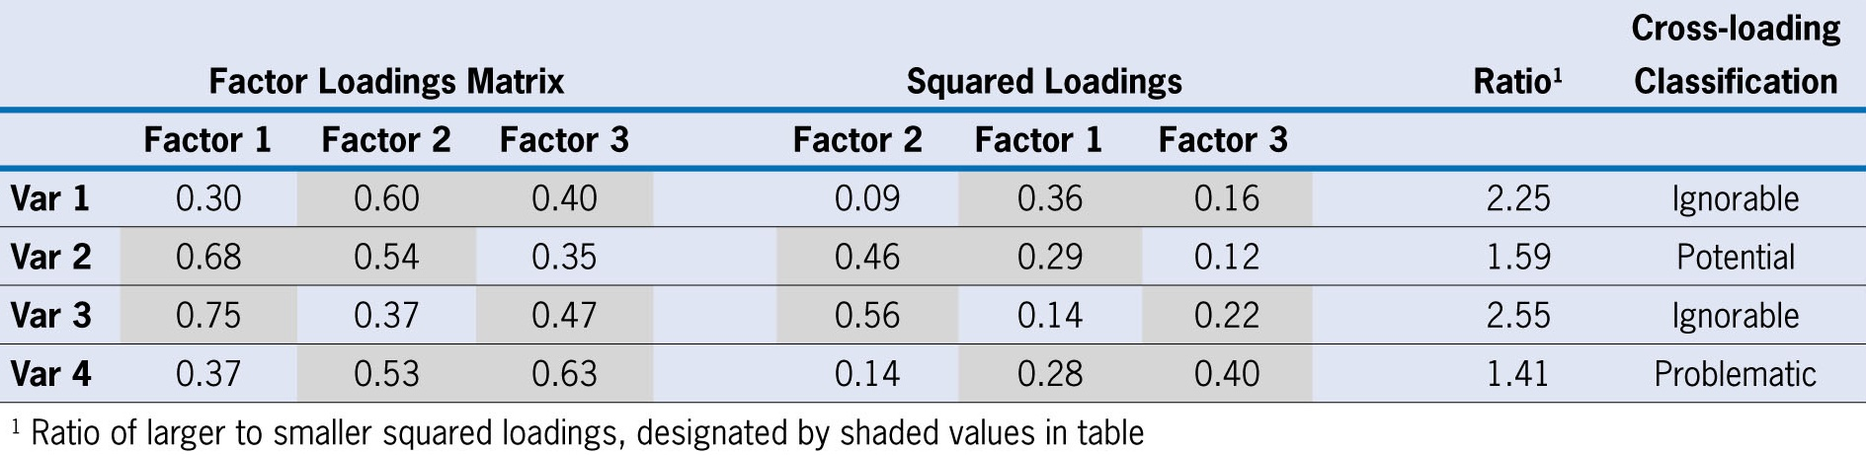
Example for Identifying Cross-Loadings
For use with Hair, Black, Babin and Anderson, Multivariate Data Analysis 8e © 2018 Cengage Learning EMEA

Slide 67
Step 3: Assess the Communalities of the Variables
Communality
Represents the amount of variance accounted for by the factor solution for each variable.
Calculated as the sum of the squared loadings across all retained factors.
Use as an Evaluative Measure
View the communalities to assess whether the variables meet acceptable levels of explanation.
For example, a researcher may specify that at least one-half of the variance of each variable must be taken into account. Using this guideline, the researcher would identify all variables with communalities less than .50 as not having sufficient explanation.
For use with Hair, Black, Babin and Anderson, Multivariate Data Analysis 8e © 2018 Cengage Learning EMEA

Slide 68
Step 4: Re-specify the Factor Model if Needed
Three conditions indicating possible respecification
a variable has no significant loadings.
even with a significant loading, a variable’s communality is deemed too low.
a variable has a cross-loading.
If respecification is needed, several options are available . . .
Ignore the problematic variable.
Deletion of variables from the analysis.
Use a different rotational approach.
Extract a different number of factors.
Change the method of extraction.
For use with Hair, Black, Babin and Anderson, Multivariate Data Analysis 8e © 2018 Cengage Learning EMEA

Slide 69
Step 5: Label the Factors
Objective:
Assign some meaning to the pattern of factor loadings.
Variables with higher loadings are considered more important and have greater influence on the name or label selected to represent a factor.
Considerations
The signs are interpreted just as with any other correlation coefficients. For each factor, like signs mean the variables are positively related, and opposite signs mean the variables are negatively related.
The label is intuitively developed by the researcher based on its appropriateness for representing the underlying dimensions of a particular factor.
For use with Hair, Black, Babin and Anderson, Multivariate Data Analysis 8e © 2018 Cengage Learning EMEA

Slide 70
Rules of Thumb – Interpreting The Factors
An optimal structure exists when all variables have high loadings only on a single factor.
Variables that cross-load (load highly on two or more factors) are usually deleted unless theoretically justified or the objective is strictly data reduction.
Variables should generally have communalities of greater than .50 to be retained in the analysis.
Respecification of a factor analysis can include options such as:
deleting a variable(s),
changing rotation methods, and/or
increasing or decreasing the number of factors.
For use with Hair, Black, Babin and Anderson, Multivariate Data Analysis 8e © 2018 Cengage Learning EMEA

Slide 71
Considerations
High communalities (approximately .8 to .9)
Low model error (which is likely evidenced in situations where communalities are high; RMSR = .00 to .06) (Preacher & MacCallum, 2002)
Factors with four or more variables with factor loadings of .60 or greater are interpretable regardless of the sample size
Solutions with lower factor loadings (.40) can still be interpreted if the number of cases is at least 200 and the number of variables per factor is larger (=> 10)

Slide 72
Assumptions
Assumption | Effect when violated
Independence | Influences standard errors and hypothesis tests
Linearity | Reduces interpretability of the FA solution
Absence of outlying cases and variables | Exerts undue influence on and distorts the FA solution
Lack of extreme multicollinearity | Reduces ability to separate effects of variables
Multivariate normality | Minimal effect except when MLE is used and when samples size is small
10 observations per variable/n >= 200
Homogeneity of the sample** | Failure to consider groupings
Notes:
Factor analysis isn’t overly fragile, but it does rest on a few key assumptions. When these are violated, your solution can become unstable or misleading.
Let’s walk through the list:
Independence: We assume observations (cases) are not dependent on one another.
Violations affect standard errors and hypothesis tests, making them less trustworthy.
Linearity: FA models shared variance, so we need linear relationships among variables.
If non-linear patterns are present, interpretability suffers—you might miss the true structure.
No extreme outliers: Outliers can dominate the solution, pulling factors in odd directions.
Always check distributions.
No extreme multicollinearity: Some correlation is good (that’s the point of FA), but extreme multicollinearity makes it hard to tell variables apart.
Multivariate normality (bolded for a reason): This is not essential unless you're using Maximum Likelihood Estimation (MLE) or have small sample sizes.
With large samples and PCA, you can relax this assumption.
Sample size: Rule of thumb: at least 10 observations per variable, with n ≥ 200 for stability.
More cases = more reliable factors.
Homogeneity of the sample: If you’re pooling across very different subgroups, your factor structure may get muddled.
Consider whether stratification or group-specific analyses are warranted.

Slide 73
A priori: EFA v CFA
 | EFA (Exploratory Factor Analysis) | CFA (Confirmatory Factor Analysis)
Purpose | Discover underlying structure | Test a pre-specified factor structure
When to Use | New scale development or unclear structure | Validated constructs, theory-driven hypotheses
Model Specification | No assumptions about number or grouping of factors | User defines number of factors and item-factor relationships
Loadings | All variables can load on all factors | Loadings are restricted based on the hypothesized model
Goal | Identify how many factors and what items belong together | Assess model fit and confirm the structure
Statistical Fit Indices | Not a focus | Central (e.g., RMSEA, CFI, TLI, χ²)
Flexibility | High — lets the data “speak” | Low — strict model testing
Use Case Example | Developing a new anxiety scale | Testing if the PHQ-9 fits a one-factor model for depression

