Slide 1
EFA and LCA
Part 2

Slide 2
Statistical Modeling Context
 |  |  | Outcome/Dependent Variable
 |  |  | Continuous | Categorical
Predictor Variables | Observed | Continuous | Regression | Logistic
 |  | Including moderation & mediation
 |  | Categorical | MANOVA/Regression | Non-parametric (e.g. chi-square)
 | Latent | Continuous | Factor Analysis | Item Response Theory
 |  | Categorical | Latent Profile Analysis | Latent Class Analysis
Finite Mixture Models

Slide 3
SEM: Why 'Family of Procedures'?
SEM is AKA analysis of covariance structure, covariance structure modeling, and causal modeling
Note: the design of the study allows for causal inference, not the SEM framework per se
SEM is an umbrella for many related methods:
• Path Analysis — chains of regression equations among observed variables
◦ Example: Does stress predict sleep quality, which then predicts academic performance?
• Exploratory Factor Analysis (EFA) — tests whether items measure the right construct
◦ Example: Do my 8 anxiety items all load onto one 'anxiety' factor?
• Latent Class Analysis (LCA) — identifies unobserved subgroups of individuals based on similar response patterns across categorical indicators
◦ Example: Are there distinct classes of adolescents based on patterns of substance use, depression symptoms,
and delinquent behavior?

Slide 4
Which Method Do I Use?
Observed vs Latent predictors:
• Observed = something you directly measured (age, income, a test score)
• Latent = something you infer from multiple items (anxiety, intelligence, frailty)
Continuous vs Categorical outcomes:
• Continuous outcome → Regression (observed predictors) or Factor Analysis (latent predictors)
• Categorical outcome → Logistic regression (observed) or LCA (latent)
EXAMPLE
You have 10 survey items about depression and want to know if there are distinct 'types' of depressed people → Latent Categorical predictor, Categorical grouping outcome → use LCA.
You want to predict GPA from study habits (measured directly) → Observed continuous predictor, continuous outcome → Regression.

Slide 5
Why Does the Distinction Between Observed and Latent Matter?
Observed variables have MEASUREMENT ERROR baked in.
When you ask someone 'How anxious are you on a scale of 1–10?', that single item is imprecise. People interpret scales differently. They may not accurately report their feelings.
Latent variables model the UNDERLYING TRUE CONSTRUCT.
If you ask 10 questions about anxiety symptoms, the shared variance across those items is a better estimate of 'true anxiety' than any single item.
ANALOGY
Think of measuring someone's height. One measurement with a ruler = observed (has error). The average of 20 measurements = closer to the latent true height. The class of SEM formally models this.
SEM methods use measurement models to separate true signal from random error, which makes estimates more accurate than simple regression.

Slide 6
SEM ≠ Causation
A common misconception: 'I used SEM therefore I proved causation.'
This is WRONG. SEM (like regression) only shows that variables are statistically related in a way consistent with your model. It cannot rule out other explanations.
What DOES allow causal inference?
• Randomized controlled experiments (gold standard)
• Strong quasi-experimental designs (regression discontinuity, difference-in-differences)
• Longitudinal data where cause precedes effect in time
EXAMPLE
You find that anxiety → depression in your SEM. But maybe both are caused by a third variable (childhood trauma) you didn't measure. That's confounding — SEM alone cannot rule it out.
SEM tests whether your hypothesized structure is consistent with the data, not whether that structure is the only possible explanation.

Slide 7
Some notation
V
Observed Variables are denoted by a box
Latent Variables or Factors are denoted by a circle
Error variance in the observed Vs
Disturbances in Fs (unexplained variances – variance not explained by the model)
F
Directional: Hypothesized structural/causal effect
Non-Directional: Hypothesized non-structural/non-causal variation
Notes:
Single-headed arrow (→): Directional / hypothesized causal
• Means: Variable A is hypothesized to PREDICT or CAUSE Variable B
• Example: Stress → Anxiety (stress predicts anxiety)
• Direction matters: the researcher decides which way the arrow points based on THEORY, not statistics
Double-headed arrow (↔): Non-directional / correlation
• Means: A and B are related, but we make NO claim about which causes which
• Example: Anxiety ↔ Depression (they co-occur, but we're not claiming one causes the other)
• Used for correlated predictors, correlated errors, or correlated latent factors

Slide 8
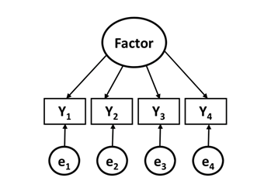
EFA: Arrows Go FROM Factor TO Items
This is one of the most important conceptual points in factor analysis:
In regression: observed predictors → outcome (arrows point from measured variables to outcome)
In factor analysis: latent factor → observed items (arrows point FROM the hidden factor TO the items)
Why does direction matter?
• The latent construct (anxiety, intelligence, frailty) is hypothesized to CAUSE the item responses (just like hours studying “causes” good test performance in OLS)
• When you feel more anxious, that's why you say 'yes' to items like 'I worry constantly'
CONTRAST WITH FORMATIVE INDICATORS
Sometimes items CAUSE the construct (called formative indicators). Example: SES is caused by income + education + occupation — not the other way around. These need different modeling approaches.
Standard EFA/CFA assumes reflective indicators: the factor causes the item responses. Always think about which direction makes theoretical sense.

Slide 9
EFA: What Does 'Factors Drive Variables' Actually Mean?
Core idea of factor analysis:
We assume there is a HIDDEN (latent) variable that is the real cause of why several observed items correlate with each other.
CLASSIC EXAMPLE: Intelligence
Students who score high on a math test also tend to score high on a verbal test, a spatial reasoning test, and a logic test. Why?
Factor analysis says: these tests correlate because they all tap into an underlying 'g' factor (general intelligence). 'g' is not directly observed — it's inferred from the pattern of correlations.
The factor model:
Score on Math Test = (loading × g-factor) + unique error
Score on Verbal Test = (loading × g-factor) + unique error
Score on Logic Test = (loading × g-factor) + unique error
The 'loading' tells you how strongly each test reflects the underlying factor. Higher loading = better indicator.

Slide 10
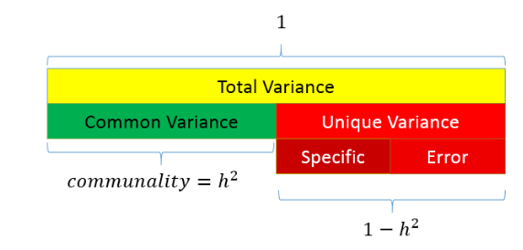
Exploratory Factor Analysis Specification Conditions & Decisions
Notes:
Principal Components
Analyzes the variance not the covariance (i.e., communality)
JASP gives the unique variance in the output

Slide 11
EFA: Key Decisions You Must Make
1. How many factors to retain?
• Scree plot: plot eigenvalues, look for the 'elbow' — retain factors before the bend
• Kaiser criterion: retain factors with eigenvalue > 1 (rule of thumb, often retains too many)
• Parallel analysis: compare your eigenvalues to those from random data — gold standard
• Theory: how many factors make substantive sense given what you know?
2. Which extraction method?
• Maximum Likelihood (ML): best if data are normally distributed, gives fit statistics
• Principal Axis Factoring (PAF): more robust if normality is questionable
3. Which rotation method?
• Orthogonal (e.g., Varimax): assumes factors are UNCORRELATED — rarely true in social science
• Oblique (e.g., Oblimin, Promax): allows factors to correlate — usually preferred
PRACTICAL ADVICE
In social/behavioral science, factors almost always correlate (anxiety and depression co-occur). Use oblique rotation unless you have strong theoretical reasons to assume independence.

Slide 12
EFA: What Does a Factor Loading Table Look Like?
Example: 8-item stress questionnaire, 2-factor oblique EFA
How to interpret:
• Items 1–4 load strongly on Factor 1 → label this 'Work Overload'
• Items 5–8 load strongly on Factor 2 → label this 'Physiological Tension'
• Cross-loadings (> .30 on both factors) indicate items are ambiguous — review them
• The factor correlation matrix tells you how related the two factors are
Item | Factor 1 | Factor 2
I feel overwhelmed at work | 0.82 | 0.08
My workload is unmanageable | 0.79 | 0.11
I can't keep up with demands | 0.74 | -0.05
I have too many responsibilities | 0.71 | 0.14
I feel tense and anxious | 0.09 | 0.76
My muscles feel tight | 0.12 | 0.73
I have trouble sleeping due to worry | 0.15 | 0.68
I feel on edge | -0.03 | 0.71

Slide 13
A good latent variable?
• Convergent validity: items that should measure the same thing DO correlate strongly
◦ Example: all anxiety items intercorrelate at r > .40
• Discriminant validity: the latent variable is distinct from other constructs
◦ Example: anxiety factor and depression factor are related but not identical (r ~ .50, not .95)
• Clear factor loadings: items load strongly on their intended factor (ideally > .50)
◦ Items with loadings < .30 are weak indicators — consider removing them
• Adequate sample size: at minimum 5–10 participants per item, ideally 200+ total
CRONBACH'S ALPHA NOTE
You may see Cronbach's alpha reported alongside EFA. Alpha measures internal consistency (do items correlate?). However, alpha does NOT confirm unidimensionality — that requires factor analysis. You can have high alpha with multiple factors!

Slide 14
EFA vs LCA: Same Goal, Different Approach
Both EFA and LCA reduce complexity. But they do it differently:
Feature EFA LCA
─────────────────────────────────────────────────────────────────────────
Type of latent variable Continuous factor Categorical class
Grouping unit Variables People
Output Factor scores (continuous) Class membership (discrete)
Assumes Everyone is on a continuum People fall into distinct groups
Use case 'What dimensions exist?' 'What types of people exist?'
ANALOGY
EFA says: 'People vary from low to high on Anxiety.' (a dimension)
LCA says: 'There are three types: the Worriers, the Situationally Anxious, and the Non-Anxious.' (categories)
Neither is 'right' or 'wrong' — the choice depends on whether you believe the underlying structure is truly continuous or truly categorical. Both provide more parsimonious ways to view relationships among indicators as the number of latent variables is less than the number of observed variables

Slide 15
LCA is a special case of a mixture model
A mixture model is a probabilistic model for representing the presence of subpopulations within an overall population ← Modeling a “mixture” of sub-groups within a population
No requirement that an observed data set should identify the sub-population to which an individual observation belongs
Assumes
“Finite” number of homogeneous categories
The population is a mixture of qualitatively different groups of individuals
Groups can be identified based on similarities in response patterns
Notes:
In statistics,

Slide 16
LCA is a special case of a mixture model
LCA RQ: Can we identify subgroups of individuals who fit various ‘profiles’
Imagine you're looking at a histogram of depression scores:
If you see ONE smooth bell curve → probably a single homogeneous population.
If you see a BIMODAL distribution (two humps) → the data may be a MIXTURE of two groups: one group with low depression and one with high depression.
A mixture model formally decomposes this distribution into its components. It estimates:
• How many components (classes) explain the distribution best?
• What does each component look like?
• What proportion of the sample belongs to each component?

Slide 17
Latent Class Analysis: The Core Idea
LCA asks: Are there hidden subgroups in the population?
Instead of assuming everyone varies continuously on some dimension (like EFA does), LCA assumes the population is a MIXTURE of qualitatively distinct groups.
EXAMPLE: ACEs Research
You measure 10 types of Adverse Childhood Experiences (abuse, neglect, household challentes, etc.) in 1,000 adults. Instead of summing them up, LCA might reveal:
• Class 1 (50%): Low ACEs across all types — mostly unexposed
• Class 2 (30%): High on household challenge items only — difficult home environment
• Class 3 (15%): High on abuse and neglect items — direct maltreatment
• Class 4 (5%): High on all ACE types — pervasive adversity
Each class has a distinct PROFILE of ACE exposure. This is richer than just an ACE score — it tells you what TYPE of adversity people experienced.
Note: ACEs should not be clustered into different classes, theoretically. Why?

Slide 18
LCA vs Cluster Analysis: What's the Difference?
Both find groups in data. But they're different in important ways:
Feature LCA (Model-Based) Cluster Analysis (Algorithm-Based)
─────────────────────────────────────────────────────────────────────────────────────
Why prefer LCA?
• LCA gives you a formal statistical model you can compare and test
• You can include covariates to predict class membership
• Class assignment is probabilistic — people have a probability of being in each class
• You can formally test 'Is a 3-class model better than a 2-class model?'
Foundation | Formal statistical model | Distance/similarity algorithm
Fit testing | Yes — BIC, LMR, chi-square | No formal fit tests
Handles item types | Categorical and continuous | Usually continuous
Class uncertainty | Formally modeled | Not modeled
Replicability | Generally better | Can vary with starting values
Probabilistic | Yes — soft class assignment | No — hard assignment

Slide 19
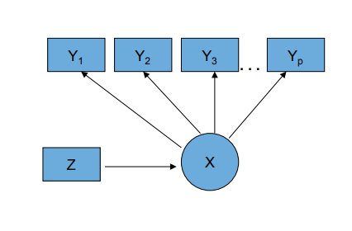
The Latent Class Model
Observed Categorical Items (Y’s)
Categorical Latent Class Variable (C)
Continuous or Categorical Covariates (Z)
C
Notes:
Note: the only difference between the Latent Class and Latent Profile models is that the profile models have continuous Y’s and we are not estimating conditional class probabilities we are estimating conditional means of continuous variables

Slide 20
The Three Components of an LCA Model
LCA estimates three types of parameters:
• 1. Class prevalences: What proportion of the population belongs to each class?
◦ Example: 40% in Class 1 (e.g., Low Aces), 35% in Class 2, 20% in Class 3, 5% in Class 4
◦ Note: these must sum to 1
• 2. Item-response probabilities: Within each class, what's the probability of endorsing each item?
◦ Example: P(Neglect = Yes | Class 1) = .95, P(Neglect = Yes | Class 2) = .42, P(Neglect = Yes | Class 3) = .08
• 3. Posterior class probabilities: Given this person's response pattern, what's the probability they're in each class?
◦ Example: Person who said Yes to all items: P(Class 1) = .89, P(Class 2) = .09, P(Class 3) = .02
LCA assigns people PROBABILISTICALLY (soft classification). A person might be 89% likely to be in Class 1 and 11% likely to be in Class 2. This uncertainty is formally modeled.
'Modal class assignment' (assigning to the most likely class) is used for descriptive purposes but loses information about uncertainty — DO NOT USE.

Slide 21
LCA in Practice: What Can It Answer?
LCA is useful whenever you want to identify TYPES of people rather than dimensions:
• What types of bullying victims are there? (cyber-only, physical-only, poly-victims)
• What profiles of sexual risk-taking exist in adolescents?
• What types of trauma exposure do children experience?
• What types of Stressful Life Experiences do women experience during pregnancy?
Longitudinal extensions:
• Latent Transition Analysis (LTA): Are people in the same class at two time points? Who transitions between classes?
◦ Example: What proportion of 'pre-frail' older adults transition to 'frail' over 2 years?
• Growth Mixture Modeling (GMM): The classes are growth trajectories – What profiles characterize depressive symptoms across developmental age?
MULTILEVEL EXTENSION
Multilevel LCA handles clustered data — e.g., students nested within schools. The classes exist at the student level, but you can also look for school-level classes.

Slide 22
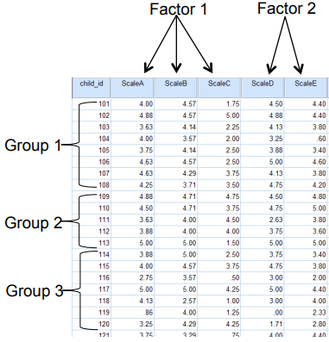
Person-centered v. Variable-centered analysis
LCA is a person-centered approach
Variable centered
Correlations/covariances are of interest
Structure among columns (e.g., factor)
Person-centered
Structure among rows is of interest
Seeks to group individuals based on shared characteristics
Goal: identify qualitatively distinct groups
Notes:
Variable centered seeks to estimate relationships between variables (e.g. correlations) are of interest
Person centered seeks to understand how variables combine across individuals → groupings of indiviauals

Slide 23
Person-Centered Analysis: Why It Matters Clinically
Variable-centered: 'Which variables predict outcomes?'
Result: 'High stress AND low social support predict depression.’ → Three variables are somehow associated.
Limitation: Treats all high-stress, low-support people as the same. Ignores who these people actually are.
Person-centered: 'What types of people exist?'
Result: (Putting people into categories)
Type 1 = high stress + low support + high baseline depression (25% of sample).
Type 2 = high stress + high support + resilient (35%).
Insight: People in Type 1 need intensive intervention. People in Type 2 may just need social support bolstering.
CLINICAL EXAMPLE
Variable-centered: anxiety predicts treatment dropout (OR = 1.4, p < .01).
Person-centered: There's a 'high-anxiety, avoidant, low-motivation' subtype that drives most dropouts. The other anxious patients stay in treatment. This tells us who needs extra retention effort.
Neither approach is universally better, it depends on the question you are asking.

Slide 24
Quick examples
The Frailty construct in aging research
Latent: status or degree of syndrome
Manifest: criteria (as derived from the literature)
Weight loss above threshold
Low energy expenditure
Low walking speed
Weakness beyond threshold
Exhaustion
RQ?
Notes:
Recall: we discussed briefly that latent classes can differ substantively or ‘by degree’
This has no equivalent in FA

Slide 25
What is frailty among older adults?
How would you interpret and label these classes?
Criterion/Item | 3-Class Model
 | Class 1 | Class 2 | Class 3
Weight Loss | .072 | .11 | .54
Weakness | .029 | .26 | .77
Slowness | .004 | .45 | .85
Low Physical Activity | .000 | .28 | .70
Exhaustion | .027 | .16 | .56
Class prevalence (%) | 39.2 | 53.6 | 7.2
Bandeen-Roche et al., J Gerontol, 2006
Notes:
These researchers found 3 classes best described the frailty concept
First thing to note is that these classes differ by degree (?)

Slide 26
Interpreting an LCA Probability Table: Step-by-Step
When you see an LCA output table, here is how to read it:
Each COLUMN is a class. Each ROW is an indicator item. The cell value is:
P(item = Yes | Class c) → the probability of saying Yes to that item IF you're in that class
What makes a class interpretable:
• High probabilities (> .60) on some items indicate the class 'endorses' those items
• Low probabilities (< .20) on some items indicate the class 'rejects' those items
• Look for the PATTERN across rows for each column — that's the class profile
FROM THE FRAILTY DATA
Class 3 has probabilities: .54, .77, .85, .70, .56 across the 5 frailty criteria.
All are > .50 → this class endorses ALL frailty criteria → label: 'Frail'
Class 1 has probabilities: .07, .03, .00, .00, .03 → almost zero on everything → label: 'Not Frail'
The class PREVALENCE (bottom row) tells you how common each group is in the population.

Slide 27
LCA Example: Frailty in Older Adults (Detailed)
Data: Community sample of older adults, 5 binary frailty criteria
Criterion Overall Rate
────────────────────────────────────────────
Weight loss > 5% in the past year 18.2%
Weakness (grip strength) 22.1%
Slowness (walking speed) 17.6%
Low physical activity 21.4%
Self-reported exhaustion 21.0%
3-Class LCA Solution (Bandeen-Roche et al., 2006):
Class Size Interpretation
─────────────────────────────────────────────────────────────────────
Class 1 (Not Frail) 39.2% Very low probability of ALL criteria
Class 2 (Pre-frail) 53.6% Moderate prob on slowness & low activity
Class 3 (Frail) 7.2% High probability of ALL criteria
Key insight: The frailty SYNDROME only applies to Class 3 — not just anyone who checks one or two boxes. LCA identifies the co-occurring pattern that defines frailty.

Slide 28
Understanding Conditional Independence in LCA
Local (Conditional) Independence Assumption:
Within each class, knowing a person's response to one item gives NO additional information about their response to another item.
Why do items correlate at all then?
Because of class membership! Items correlate because they're all influenced by the latent class variable. Once you 'control for' class, the correlations disappear.
CONCRETE EXAMPLE
Frailty items (weakness, slowness, low activity) all correlate in the full sample. WHY? Because the 'Frail' class has high rates on ALL of them.
But within the 'Frail' class: knowing someone has weakness doesn't tell you much extra about their slowness — the class membership already explains it.
What if the assumption is violated?
• Bivariate residuals will be large (> 3.84) for problematic item pairs
• Fix: add more classes, combine the correlated items, or use a special model for dependent items
• In JAMOVI/snowLatent: check the 'Bivariate residuals' output table

Slide 29
What Does 'Homogeneity Within Classes' Actually Mean?
A good LCA class is homogeneous — people within a class are similar to each other and different from people in other classes.
Two ways to measure this:
• Entropy: global measure of classification accuracy
◦ Ranges 0–1. Entropy = 1 means perfect classification. Entropy > 0.80 is generally good.
◦ Formula: based on how peaked the posterior probabilities are for each person
• Average posterior class probabilities (AvePP):
◦ For each class, average the posterior probability of its assigned members
◦ AvePP > 0.70 for assigned members suggests acceptable separation
EXAMPLE: HIGH ENTROPY
Class 1: AvePP = 0.94, Class 2: AvePP = 0.88, Class 3: AvePP = 0.91 → Clean separation, classes are well-defined.
EXAMPLE: LOW ENTROPY
Class 1: AvePP = 0.52, Class 2: AvePP = 0.48 → Classes barely distinguish people; most people have nearly 50/50 posterior probabilities. This model may not be meaningful.

Slide 30
Motivating Example: Patterns & Classes
 | Class 1 | Class 2
CRT (Y1)
Yes P(Y1=1|C) | 0.96 | 0.23
No P(Y1=2|C) | 0.04 | 0.77
CGT (Y2)
Yes P(Y2=1|C) | 0.74 | 0.04
No P(Y2=2|C) | 0.26 | 0.96
CCT (Y3)
Yes P(Y3=1|C) | 0.92 | 0.24
No P(Y3=2|C) | 0.08 | 0.76
Class % | 0.6205 | 0.3795
Y1: CRT | Y2: CGT | Y3: CCT | Observed Frequency | Observed proportion n/N
Yes | Yes | Yes | 696 | .406
Yes | Yes | No | 68 | .040
Yes | No | Yes | 275 | .161
Yes | No | No | 130 | .076
No | Yes | Yes | 34 | .020
No | Yes | No | 19 | .011
No | No | Yes | 125 | .073
No | No | No | 366 | .214
Single Class
Y1: CRT should be taught in schools? (Y/N)
Y2: CGT should be taught in schools? (Y/N)
Y3: CCT should be taught in schools? (Y/N)
Two Classes
Notes:
Notice: we call the ‘yes’ responses the probability of endorsement
Notice: the probability of Yes + the probability of No MUST EQUAL TO ONE
Typically we only present the endorsement probabilities because if we know the Pr(Yes) then the Pr(No) is = 1 – Pr(Yes)
See this in the chart on the right

Slide 31
Understanding Response Patterns in LCA
With K binary items, there are 2^K possible response patterns.
3 items → 2³ = 8 patterns
7 items → 2⁷ = 128 patterns
10 items → 2¹⁰ = 1024 patterns
Why this matters:
LCA estimates class probabilities to reproduce the OBSERVED FREQUENCIES of each pattern. A good model makes implied frequencies ≈ observed frequencies.
With 3 binary items (CRT, CGT, CCT), there are 8 possible response patterns.
Most common: Yes/Yes/Yes (696 people = 40.6% of sample)
Least common: No/Yes/No (19 people = 1.1% of sample)

Slide 32
Two key model assumptions (summary)
1. MIXTURE ASSUMPTION
There is a latent categorical variable (NOT MANIFEST VARIABLE) that consists of a finite number of types of people, i.e. classes
2. LOCAL INDEPENDENCE ASSUMPTION
Within classes, responses are independent
Notes:
This means there are no correlations between variables WITHIN classes because we have accounted for the underlying “cause” that is producing those relationships
Let’s think of PTSD items and illustrate these assumptions:
The mixture assumption means that we can identify subgroups of persons with different levels of PTSD indicators such as startle response, avoidance behaviors, etc. This implies that PTSD is NOT a unidimensional concept.
The local independence assumption means that the class specific relationships between PTSD indicators are independent once we identify the class
Let’s say we identify a class of people with high scores on avoidance of people’ and ‘avoidance of places’– this assumption means that are highly likely to avoid people and places these two variables are no longer related – the underlying latent construct is the cause of these indicators – we might label it as ‘Avoidance’…
Neither of these may be reasonable assumptions but they can be tested by our models.

Slide 33
Testing Whether the Assumptions Hold (Summary)
Assumption 1 — Mixture: Is the categorical structure justified?
• Compare 1-class to 2-class model using BIC and LMR test
• If 2-class is significantly better than 1-class: evidence that multiple groups exist
• If 1-class fits well: data may be homogeneous — use regression instead of LCA
Assumption 2 — Local Independence: Are items correlated within classes?
• Check bivariate residuals (BVR) for all item pairs in your chosen model
• BVR > 3.84 indicates a significant violation — those two items correlate beyond what class explains
WHAT TO DO IF LOCAL INDEPENDENCE IS VIOLATED
• Option 1: Add more classes — maybe the solution needs finer distinctions
• Option 2: Remove one of the correlated items if they're measuring the same thing
• Option 3: Combine correlated items into a composite before running LCA
• Option 4: Use a special 'residual covariance' LCA model (advanced)
Always report whether you checked and whether it held — reviewers will ask.

Slide 34
Evaluating Model Fit/Selecting the # of classes
a priori theory
Chi-Square goodness of fit
Classification error
Information Statistics – AIC, BIC, others
Lo-Mendell-Rubin (LMR) – (normal Y)
Bootstrapped Likelihood Ratio Test

Slide 35
Comparing Models: A Decision Framework
When should you prefer a k-class model over a (k-1)-class model?
• 1. BIC/aBIC/AIC improves (decreases) with the addition of a class
• 2. LMR or BLRT test is significant (p < .05): the k-class model fits significantly better**
• 3. The new class is large enough to be meaningful (> 5% of sample)
• 4. The new class has a distinct, interpretable profile
• 5. Class separation is adequate (entropy > .80 for assigned members)
When to STOP adding classes:
• BIC starts increasing again (adding classes is hurting parsimony more than it helps fit)
• New classes are very small (< 5%) and hard to interpret
• Classes only differ on one or two items — not meaningfully distinct
• LMR/BLRT no longer significant
RULE OF THUMB
In practice: run 1 through 5+ class models, compare BIC in a table, plot the elbow, check the LMR, then choose the model that is both statistically supported AND theoretically interpretable. Statistics inform — they don't decide.

Slide 36
Entropy
Similar to our classification ‘error’ table from chi-square and logistic regression
Measures classification error
Ranges between 0 – 1 (1 = perfect classification)

Slide 37
Entropy: A Worked Example
Entropy formula (conceptual): based on how certain the model is about each person's class.
Entropy = 1 − [average uncertainty across all people and classes]
Three scenarios:
• Person A: P(C1) = 0.97, P(C2) = 0.02, P(C3) = 0.01 → near certain → HIGH ENTROPY contribution
• Person B: P(C1) = 0.50, P(C2) = 0.48, P(C3) = 0.02 → very uncertain → LOW ENTROPY contribution
• Person C: P(C1) = 0.33, P(C2) = 0.33, P(C3) = 0.33 → maximally uncertain → ZERO ENTROPY contribution
Interpreting entropy for your model:
Entropy = 0.85 → 85% of maximum possible certainty → 'Good' separation
Entropy = 0.65 → Classes overlap a lot → Classes may not be distinct enough
Entropy = 0.40 → Most people have similar probabilities for all classes → Rethink the model
PRACTICAL NOTE
Entropy is reported but should NOT be the primary basis for selecting the number of classes. A low-entropy 3-class model can still be preferred if BIC supports it and the classes are theoretically meaningful. Entropy is technically not a ‘fit statistic’

Slide 38
Information Criterion Statistics
AIC: -2LL + 2s
BIC = -2LL + s*log(N)
where s = # of parameters, N = sample size
Here, as in all SEM models, smaller values are better
BIC is typically preferred
In LVM, the BIC statistic is the gold standard

Slide 39
BIC and AIC: Intuition and Formulas
Information criteria balance FIT vs PARSIMONY.
AIC = −2 × log-likelihood + 2 × (number of parameters)
BIC = −2 × log-likelihood + ln(N) × (number of parameters)
Interpretation:
• −2LL: How well does the model fit? Smaller (more negative) = better fit
• Penalty term: How complex is the model? More parameters = larger penalty
• Adding a class improves fit (−2LL decreases) but also adds parameters (penalty increases)
• The best model has the LOWEST BIC/AIC — it's the best trade-off
Why BIC is preferred in LCA:
• AIC tends to OVERFIT — it selects too many classes in large samples
• BIC's penalty grows with sample size, making it more conservative
• Simulation studies show BIC more accurately recovers the true number of classes

Slide 40
AIC and BIC: The Elbow Plot
One practical way to choose the number of classes: the elbow plot.
Plot AIC (or BIC) on the y-axis, number of classes on the x-axis.
Typical pattern:
• Fit improves sharply as you go from 1 → 2 → 3 classes
• Improvement flattens out after some point — the 'elbow'
• After the elbow, adding classes gives diminishing returns

Slide 41
Model fit Comparisons
 | L2 | BIC | AIC | df | P-value
1-C
2-C
3-C
4-C
5-C
6-C
Note: Can make elbow plot of AIC/BIC etc to show lowest value

Slide 42
Selecting Classes: Putting All Criteria Together
Use ALL of these, in combination:
When criteria conflict: prioritize BIC, bootstrap fit, and interpretability. Never choose a model purely on statistics — theoretical coherence is essential.
Criterion | What it tells you | How to use it
BIC | Overall parsimony-corrected fit | Pick lowest
AIC | Less penalized fit | Secondary check
G² p-value | Overall fit test | Want p > .05
Bootstrap p | Reliable fit test for sparse tables | Want p > .05
LMR test | Is k better than k−1? | Want p < .05
BLRT | Bootstrapped LMR (more reliable) | Want p < .05
Entropy | Classification quality | Want > .80
AvePP | Class separation | Want > .70 per class
Class size | Are classes large enough? | Want > 5% of N
Interpretability | Do classes make theoretical sense? | Always

Slide 43
Example
Are there distinct latent classes of complementary and integrative health (CIH) practice engagement among U.S. adults, and do these classes differ by BMI, GLP-1 medication use, race/ethnicity, self-rated health, and usual source of care?
Variable | Label | Values |  |  | Notes
Manifest indicators (binary LCA items)
CIH_MUSART | Past 3 months, practiced music/art for health | 0 = No, 1 = Yes | 0 = No, 1 = Yes | 12.0% Yes (unweighted); intended for exploratory/benchmarking use
CIH_QIGONG | Past 12 months, practiced Qi Gong for health | 0 = No, 1 = Yes | 0 = No, 1 = Yes | 1.4% Yes (unweighted)
CIH_TAICHI | Past 12 months, practiced Tai Chi for health | 0 = No, 1 = Yes | 0 = No, 1 = Yes | 2.4% Yes (unweighted)
CIH_ACUPUN | Past 12 months, saw acupuncture practitioner | 0 = No, 1 = Yes | 0 = No, 1 = Yes | 3.5% Yes (unweighted)
CIH_REIKI | Past 12 months, saw energy healing/Reiki practitioner | 0 = No, 1 = Yes | 0 = No, 1 = Yes | 2.3% Yes (unweighted)
CIH_HOMEO | Past 12 months, saw homeopathy practitioner | 0 = No, 1 = Yes | 0 = No, 1 = Yes | 3.7% Yes (unweighted)
CIH_HLTH12M | Past 12 months, saw traditional healer (e.g., curandero, shaman, Native American healer) | 0 = No, 1 = Yes | 0 = No, 1 = Yes | 1.9% Yes (unweighted)
Round 7 Datasets and Documentation | Rapid Surveys System | CDC

Slide 44
Latent class model fit indices (1 to 8 classes)
Classes | LL | AIC | BIC | saBIC | Entropy | Npar | Selected
1 | −8358.58 | 16731.15 | 16779.93 | 16757.68 | — | 7
2 | −7653.39 | 15336.77 | 15441.30 | 15393.63 | 0.913 | 15
3 | −7635.07 | 15316.14 | 15476.41 | 15403.32 | 0.487 | 23
4 | −7555.77 | 15173.54 | 15389.56 | 15291.05 | 0.895 | 31 | BIC, saBIC
5 | −7543.27 | 15164.55 | 15436.31 | 15312.37 | 0.826 | 39 | AIC
6 | −7545.92 | 15185.85 | 15513.35 | 15364.00 | 0.814 | 47
7 | −7540.36 | 15190.72 | 15573.97 | 15399.19 | 0.831 | 55
8 | −7537.89 | 15201.78 | 15640.78 | 15440.58 | 0.793 | 63

Slide 45
Item-response probabilities: Pr(Yes) for each CIH indicator by latent class (NOTE: when in doubt interpret by comparing the response probabilities to the ‘typical respondent’ i.e., the average value for the sample).
CIH indicator | Class 1 Movement/Arts (3.4%, n = 182) | Class 2 Comprehensive (0.8%, n = 52) | Class 3 Mind-Body (3.4%, n = 176) | Class 4 Non-Users (92.4%, n = 7,440)
Music or art for health | 0.376 | 0.628 | 0.340 | 0.100
Qigong | 0.239 | 0.732 | 0.000 | 0.000
Tai chi | 0.556 | 0.660 | 0.029 | 0.001
Acupuncture | 0.076 | 0.668 | 0.297 | 0.019
Reiki | 0.060 | 0.680 | 0.376 | 0.003
Homeopathy | 0.034 | 0.643 | 0.382 | 0.019
Traditional practitioner (e.g., Ayurvedic, Shaman, Medicine Man) | 0.020 | 0.636 | 0.195 | 0.006

Slide 46
Prediction
We are interested in how the covariate predicts membership in a latent class

Slide 47
Predictor | Class 1: Movement/Arts OR (95% CI) | Class 2: Comprehensive OR (95% CI) | Class 3: Mind-Body OR (95% CI)
Usual care type (ref = Doctor/health center)
No usual place | 0.617 (0.033, 11.652) | 0.456 (0.036, 5.742) | 0.382 (0.022, 6.515)
Urgent care* | 0.216* (0.08, 0.583) | 0.268* (0.128, 0.562) | 0.215* (0.091, 0.509)
Hospital ER | 0.473 (0.115, 1.940) | 0.249* (0.077, 0.803) | 0.441 (0.122, 1.597)
VA medical center | 1.786 (0.288, 11.085) | 0.461 (0.083, 2.564) | 0.531 (0.083, 3.404)
Other | 0.475 (0.040, 5.666) | 0.179 (0.021, 1.522) | 0.501 (0.052, 4.826)
Race/ethnicity (ref = White)
Black | 0.494 (0.191, 1.283) | 0.295* (0.132, 0.663) | 0.446 (0.184, 1.079)
Hispanic | 0.697 (0.204, 2.382) | 0.586 (0.200, 1.718) | 1.156 (0.377, 3.546)
Other | 0.480 (0.190, 1.210) | 0.315* (0.143, 0.695) | 0.274* (0.112, 0.668)
GLP-1 medication type (ref = No GLP-1, no diabetes)
GLP-1, likely weight loss | 0.063 (0.004, 1.012) | 0.440 (0.110, 1.769) | 0.572 (0.126, 2.588)
GLP-1, prediabetes* | 0.101* (0.018, 0.547) | 0.128* (0.042, 0.395) | 0.288 (0.082, 1.012)
GLP-1, active diabetes* | 0.077* (0.026, 0.226) | 0.083* (0.039, 0.180) | 0.092* (0.036, 0.231)
Diabetes, no GLP-1 | 0.509 (0.052, 4.978) | 0.959 (0.121, 7.572) | 1.295 (0.156, 10.764)
Continuous/ordinal covariates
BMI category (1–6) | 0.958 (0.711, 1.290) | 1.067 (0.825, 1.380) | 0.938 (0.711, 1.236)
Self-rated health (1–5)* | 2.219* (1.464, 3.364) | 2.042* (1.415, 2.949) | 2.251* (1.522, 3.328)

Slide 48
Predicting Class Membership: The Distal Outcome Approach
Two types of external variables in LCA:
• Covariates: variables that PREDICT class membership (entered before or simultaneously)
◦ Example: gender, age, income predicting which political participation class you're in
• Distal outcomes: variables we examine AFTER establishing class membership
◦ Example: class membership predicts later voting behavior, health outcomes, civic engagement
The correct order:
1. Find the best class solution (without covariates)
2. Add covariates to predict class membership (multinomial logistic regression)
3. Examine distal outcomes by class (compare means or proportions across classes)
COMMON MISTAKE TO AVOID
Do NOT include the distal outcome as an indicator in the LCA model. The classes should be defined by the core indicators, not by the variable you want to predict. Mixing them biases both the class solution and the prediction.

Slide 49
Future reference

Slide 50
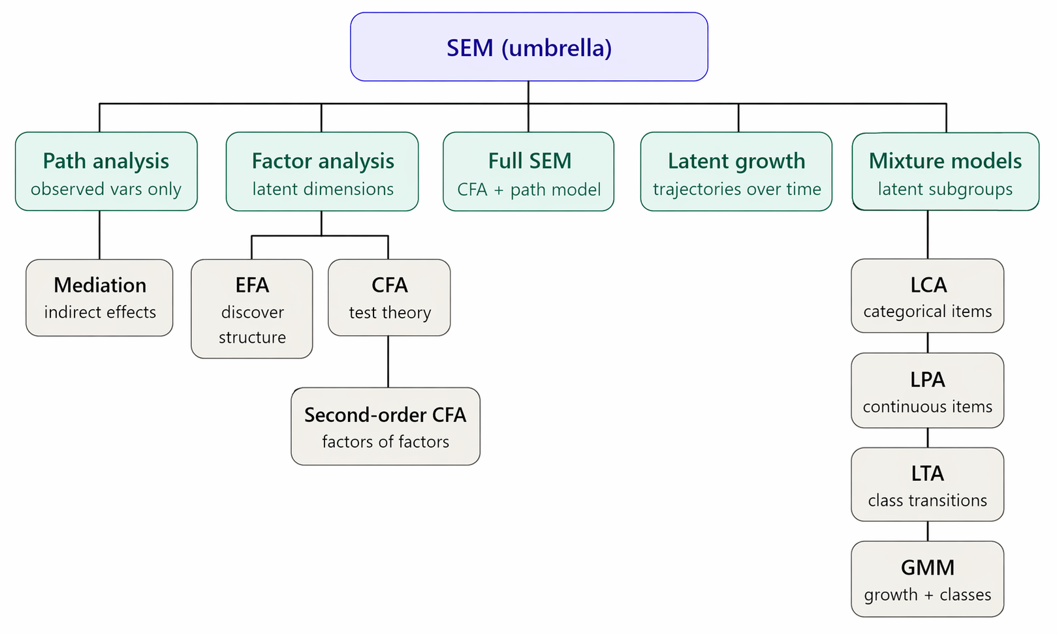
Complete Concept Map: SEM, EFA, CFA, LCA, GMM
How all methods in this deck relate to each other:
All of these can be combined — e.g., GMM uses growth curve + mixture; Second-order growth curves use CFA + growth modeling. The flexibility is the point of SEM as a framework.

Slide 51
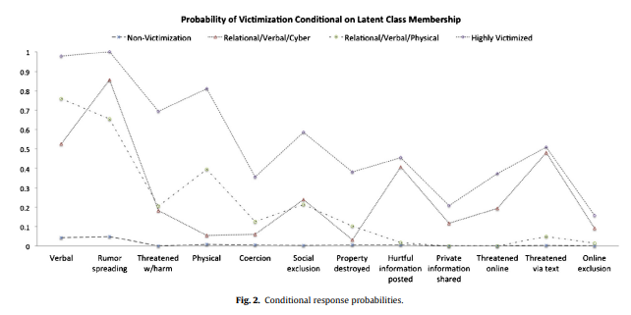
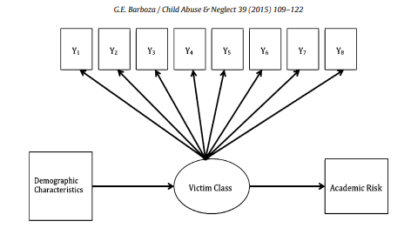
Latent Class Mixture models
RQ: LCA is good to construct typologies
How do families experience ACEs?
How do children experience F2F and cyber-bullying?

Slide 52
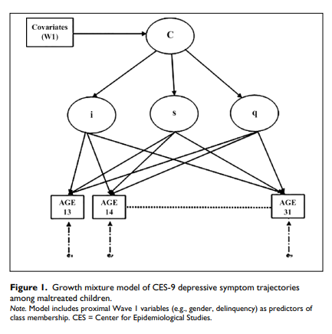
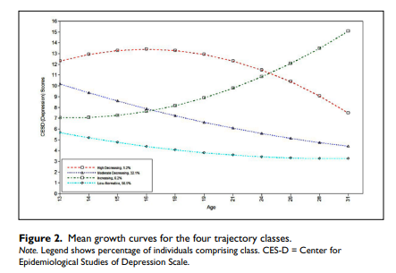
Growth mixture modeling
RQ: How does depression manifest developmentally?
Example: Do all people follow the same trajectory?

Slide 53
Growth Mixture Modeling: Building Intuition
Question: Does everyone follow the same trajectory over time?
A standard latent growth model assumes ONE average trajectory for everyone. GMM relaxes this — it allows for MULTIPLE distinct trajectories.
EXAMPLE: Depression Trajectories After Divorce
You track depression monthly for 2 years in 500 recently divorced adults. A standard growth model might show: on average, depression decreases over time.
But GMM might reveal:
• Class 1 (60%): Recovery group — high initial depression, steady decline to normal
• Class 2 (25%): Resilient group — low depression throughout, minimal change
• Class 3 (15%): Chronic group — high and stable depression, never recovers
The average trajectory hides the chronic group! They look like they'll recover 'on average,' but they never do. GMM reveals this important subgroup.
This is called 'heterogeneity in trajectories' — the population is not homogeneous.

Slide 54
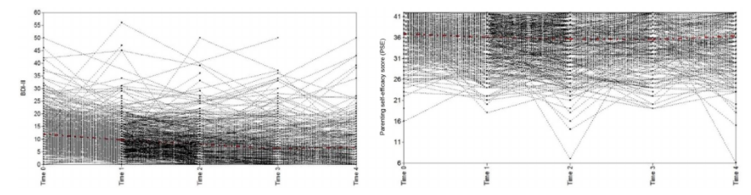
Growth Mixture Modeling
Goals were to explore
Potential heterogeneity in dual trajectories of PSE and depressive symptoms among first-time postpartum mothers and
Whether the dual trajectory classes are differentially associated with poor outcomes in early childhood
Barboza, G. E., & Schiamberg, L. (2021). Dual trajectories of parenting self‐efficacy and depressive symptoms in new, postpartum mothers and socioemotional adjustment in early childhood: A growth mixture model. Infant mental health journal, 42(5), 636-654.

Slide 55
Reading a GMM Study: What to Look For
Barboza & Schiamberg 2021:
• What outcomes were modeled? (e.g., PSE and depressive symptoms)
• What time points were included? (e.g., 1 month, 3 months, 6 months postpartum)
• How many classes did they find, and what are the trajectory shapes?
• What are the class prevalences? (e.g., 60% in Class 1)
• How did they validate the classes? (predictive validity, external outcomes)
WHAT DUAL TRAJECTORY MEANS
A 'dual trajectory' model simultaneously estimates two growth curves (PSE and depression) and finds classes that reflect combinations of both trajectories.
For example: Class 1 might have HIGH PSE that stays high + LOW depression that stays low. Class 3 might have LOW PSE that declines further + HIGH depression that worsens. These are 'joint' patterns across both outcomes simultaneously.
This is more informative than looking at each outcome separately — it captures how the two developmental processes co-occur.

Slide 56
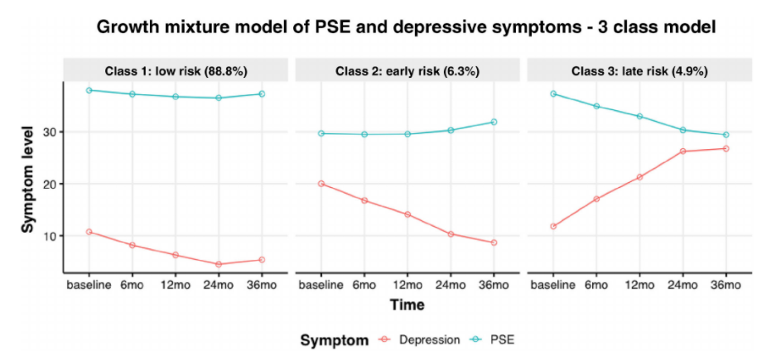
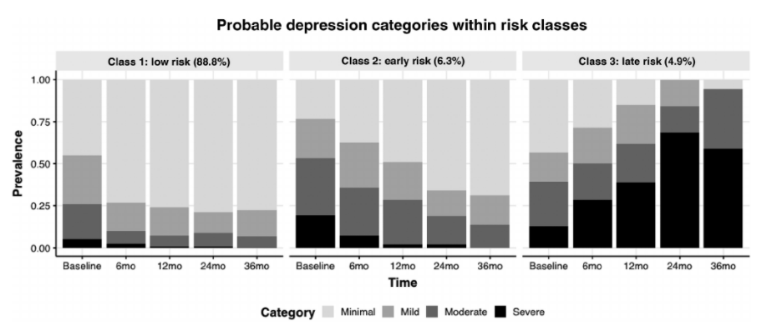
Growth Mixture Modeling
Three classes of dual trajectories found
Predictive validity established as low-risk classes had very low levels of moderate to severe depression compared to the high-risk classes
Barboza, G. E., & Schiamberg, L. (2021). Dual trajectories of parenting self‐efficacy and depressive symptoms in new, postpartum mothers and socioemotional adjustment in early childhood: A growth mixture model. Infant mental health journal, 42(5), 636-654.

Slide 57
Interpreting GMM Classes: The Labeling Step
After finding classes, you must NAME them. This requires judgment:
Step 1: Look at the trajectory shape for each class
• Is the intercept (starting point) high or low?
• Is the slope positive (increasing), negative (decreasing), or flat?
• Is there a quadratic component (curve that accelerates or decelerates)?
Step 2: Label based on the profile
• 'High-stable' = high starting point, slope near zero
• 'Low-recovering' = high start, negative slope, levels off
• 'Resilient' = low throughout
BARBOZA & SCHIAMBERG 2021
found 3 classes based on dual PSE + depression trajectories:
• Class 1 = 'Low-risk': High PSE, low depression — healthy adaptive mothers
• Class 2 = 'Moderate-risk': Moderate PSE, moderate depression — some difficulty
• Class 3 = 'High-risk': Low PSE, high depression — struggling mothers
Notes:
Naming is done by the researchers based on the trajectory patterns — it is a substantive interpretation, not automatic.

Slide 58
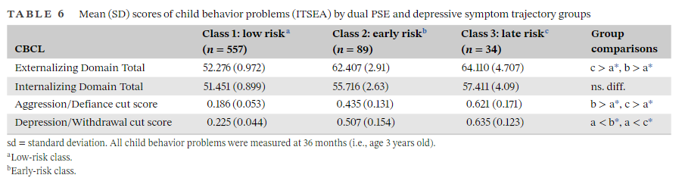
Growth Mixture Modeling
Subgroup analysis showed that children of mothers in the low-risk class showed significantly fewer total externalizing problem behaviors compared with the higher risk classes

Slide 59
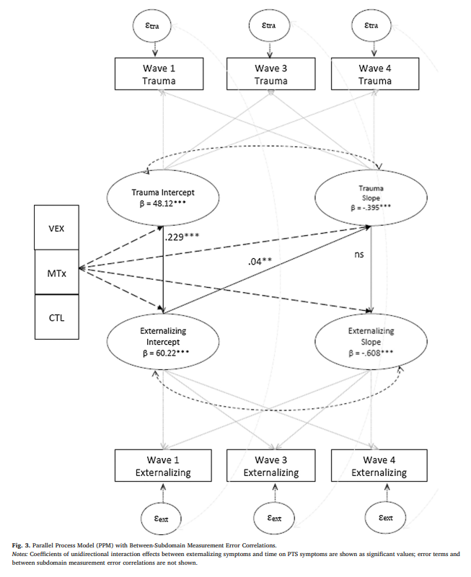
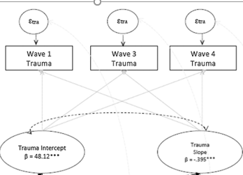
Latent growth models
Example of latent growth curve model of PTS
Example parallel process model that explores how growth in one symptom affects growth in another

Slide 60
Latent Growth Curve Models: What Are We Modeling?
A latent growth curve model (LGCM) captures two things about change over time:
• Intercept: where does the person START? (their baseline level)
• Slope: how fast do they CHANGE over time? (growth rate)
• Quadratic: does the rate of change itself change? (curved trajectory)
These are treated as LATENT VARIABLES — each person has their own true starting point and growth rate, which we estimate from their observed scores across time points.
EXAMPLE: PTSD Symptoms After Trauma
You measure PTSD at 1 month, 3 months, 6 months, and 12 months after a traumatic event.
• Intercept factor: each person's true PTSD level at 1 month
• Slope factor: each person's rate of PTSD decrease (or increase) over 12 months
People differ in BOTH their starting level (some start high, some low) and their trajectory (some recover fast, some slowly, some get worse). The model estimates means AND variances of both.
You can then ask: what predicts higher starting points? What predicts faster recovery?

Slide 61
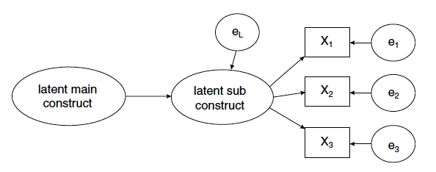
Second order CFA
The first order latent factor explains a higher order latent factor

Slide 62
Second-Order CFA: Factors That Explain Factors
Sometimes factors themselves are explained by a higher-order factor:
CLASSIC EXAMPLE: Intelligence
First-order factors from a cognitive test battery:
• Factor 1: Verbal Ability (vocabulary, reading comprehension, verbal analogies)
• Factor 2: Spatial Ability (mental rotation, pattern recognition, visual memory)
• Factor 3: Numerical Ability (arithmetic, algebra, number series)
These three factors themselves CORRELATE with each other. Why? Because there's a higher-order 'g' (general intelligence) factor explaining the correlations among them.
In second-order CFA:
• First-order: items → Verbal, Spatial, Numerical factors
• Second-order: Verbal, Spatial, Numerical → General Intelligence 'g'
When to use it:
• When you have multiple correlated factors and a theoretical reason to believe they share a common cause
• When you want to test hierarchical theories of a construct

Slide 63
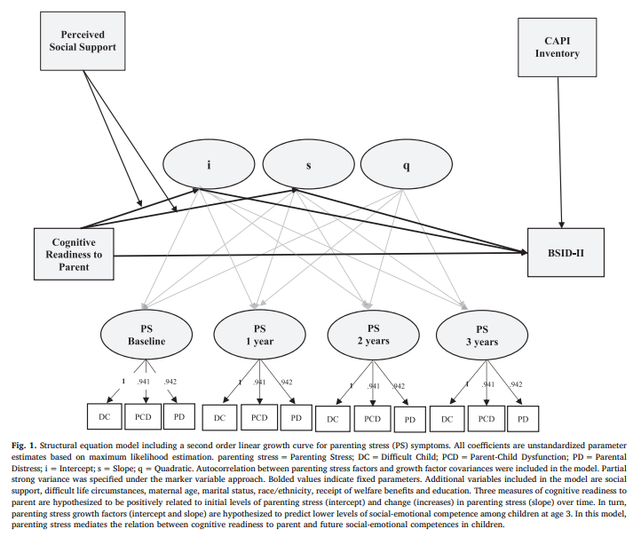
Second order growth curve model
Here is a growth curve model with intercept, slope and quadratic
The growth is believed to mediate the relationship between ‘readiness to parent’ and child behavior
PS is comprised of three subscales
Perceived SS moderates the relationship between readiness to parent and growth in PS

Slide 64
Complex SEM Models: Putting It All Together
Advanced SEM models can combine multiple features simultaneously:
• Latent growth + mediation: Does trajectory of skill X mediate the effect of intervention Y on outcome Z?
• Latent growth + moderation: Does social support moderate the slope of depression recovery?
• Multi-group SEM: Does the same model hold for males and females? For different cultures?
• Parallel processes: Do changes in one variable over time relate to changes in another variable?
THE SLIDE 18 MODEL EXPLAINED
The model shown has:
• A growth curve for Parenting Skills (PS) with intercept, slope, and quadratic term
• PS is measured by 3 subscales (observed indicators)
• 'Readiness to parent' predicts the PS growth trajectory
• The PS trajectory mediates the effect of readiness on child behavior outcomes
• Perceived social support MODERATES (changes) the relationship between readiness and growth in PS
This is a full 'moderated mediation with growth' model — one of the most complex SEM applications.

Slide 65
Running EFA in JAMOVI: Quick Guide
JAMOVI makes EFA accessible. Here are the key steps:
• 1. Open your data file in JAMOVI
• 2. Go to: Factor → Exploratory Factor Analysis
• 3. Move your items into the 'Variables' box
Key settings to check:
• Extraction method: Maximum Likelihood (if normal) or Principal Axis Factoring
• Rotation: Oblimin (oblique) for most social science data
• Number of factors: try Parallel Analysis first, then compare to Scree plot
• Minimum loading to display: set to .30 or .40 to suppress weak loadings
Key output to interpret:
• Factor Loadings table: which items load on which factors?
• Uniquenesses: high uniqueness (> .80) means the item isn't well-explained by any factor
• Factor correlations: how much do your factors correlate?
• Model fit: CFI > .95, RMSEA < .06 suggest good fit (if using ML extraction)
For LCA in JAMOVI: install 'snowLatent' package from the JAMOVI library.

