Slide 1
Risk Ratios, Odds Ratios, and Logistic Regression
February 24, 2026

Slide 2
Measures of Risk
In social science we estimate all types of different things:
The among of drug use in a population; by type and frequency
The “risk” of developing a mental health problem or some other outcome following a violent victimization
The risks and benefits of a proposed treatment
This requires an understanding of:
Measures of frequency
Proportions and odds
Prevalence and incidence rates
Risk (absolute and relative) (e.g., the risk of something happening (or not) v the risk of one thing in relation to another)

Slide 3
Four Primary Risk Measures
Prevalence
Incidence
Relative Risk
Odds Ratios

Slide 4
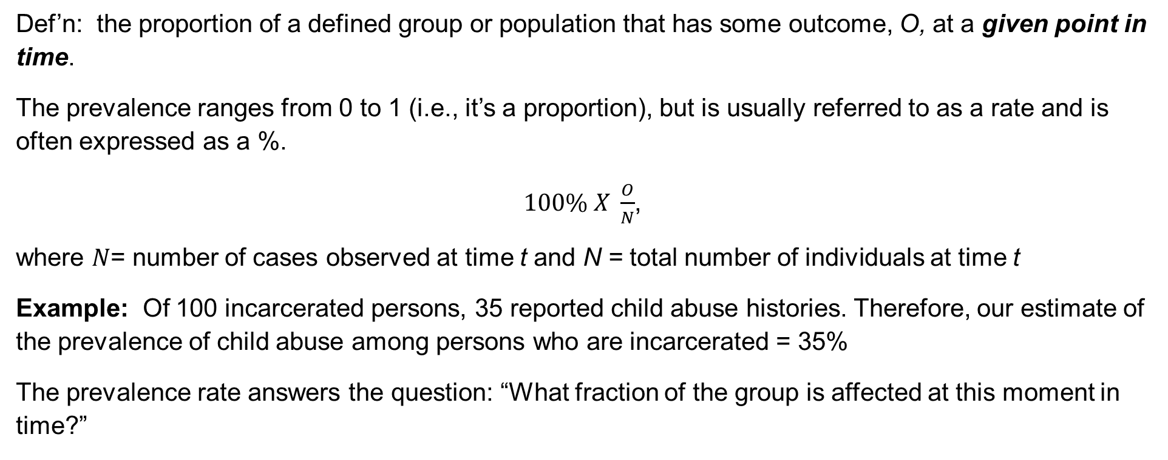
Prevalence
Def’n: the proportion of a defined group or population that has some outcome, O, at a given point in time.
The prevalence ranges from 0 to 1 (i.e., it’s a proportion), but is usually referred to as a rate and is often expressed as a %.
$100\% X \frac{O}{N}$,
where $N$= number of cases observed at time t and N = total number of individuals at time t
Example: Of 100 incarcerated persons, 35 reported child abuse histories. Therefore, our estimate of the prevalence of child abuse among persons who are incarcerated = 35%
The prevalence rate answers the question: “What fraction of the group is affected at this moment in time?”
Notes:
Prevalence measures how many people currently have a condition at a given time. It includes both new and existing cases.

Slide 5
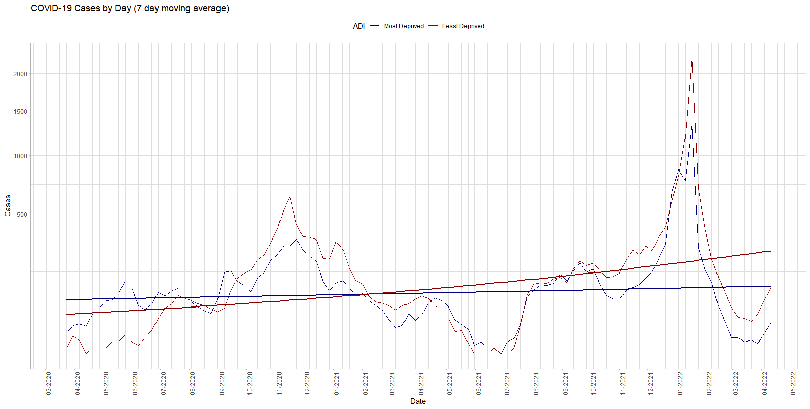
Incidence
Epidemiological definition:
A special type of proportion that includes a specific time-period and population-at-risk
Numerator = the number of newly affected individuals occurring over a specified time-period (here on a particular day)
Denominator = the total population-at-risk over the same time-period
Standardization constant: per 10,000 persons
Crude daily incidence rate per 10,000 population (7-Day Moving Average)
Blue areas represent most deprived 20% of neighborhoods
Red areas represent least deprived 20% of neighborhoods
Notes:
Incidence measures new cases that develop during a specific time period.

Slide 6
Quantifying Risk and Interpreting Risk
Information on the effect of a potential risk factor or beneficial treatment can be presented in several different ways:
Relative Risk (RR)
Odds Ratio (OR)
Percent decrease or increase in odds
The way risk information is presented and interpreted can have a profound effect on decision-making processes with implications for policy and treatment outcomes

Slide 7
Quantifying Risk (or Benefit) Presentation and Interpretation of Information on Risk
We might also think of these as measures of association.
Measures of association quantify the potential relationship between “exposure” and “outcome” among two groups.
Recall there are two types of association (+) and (-)
The two main measures are Relative Risk (RR) and Odds Ratio (OR)

Slide 8
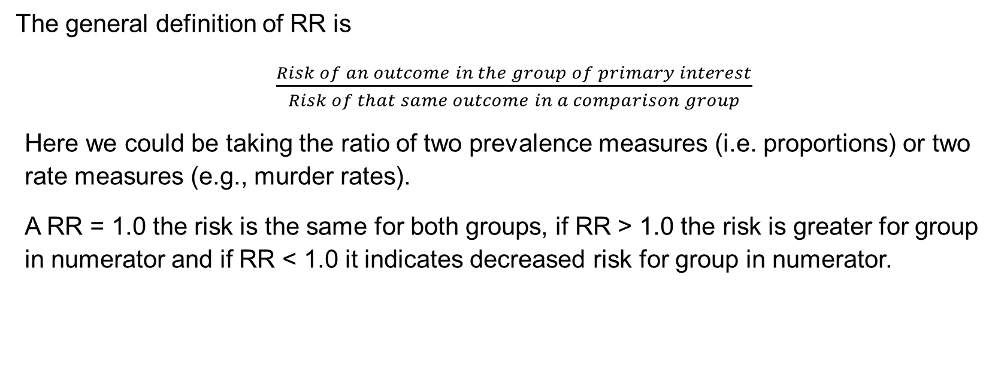
Relative Risk, Risk Ratio, or Rate Ratio (RR)
The general definition of RR is
$\frac{Risk of an outcome in the group of primary interest}{Risk of that same outcome in a comparison group}$
Here we could be taking the ratio of two prevalence measures (i.e. proportions) or two rate measures (e.g., murder rates).
A RR = 1.0 the risk is the same for both groups, if RR > 1.0 the risk is greater for group in numerator and if RR < 1.0 it indicates decreased risk for group in numerator.

Slide 9
Example: PTSD among foster youth by physical abuse
 | Developed PTSD?
Abused? | Yes | No
Physically Abused | 28 | 129 | 157
Not Physically Abused | 4 | 133 | 137
 | 32 | 262 | Total = 294
Row marginals
The row marginal answers the question: Among foster youth who were physically abused, what percentage developed PTSD? 28/157
Column marginals
Note: this is NOT the same as the probability of being abused AND having PTSD (28/294)
The column marginal answers the question: Among foster youth who developed PTSD, what percentage were physically abused? 28/32

Slide 10

 | Developed PTSD?
Abused? | Yes | No
Physically Abused | 28 | 129 | 157
Not Physically Abused | 4 | 133 | 137
 | 32 | 262 | Total = 294
What is the risk ratio (RR) of developing PTSD among foster youth who were physically abused compared to those who were not?
What percentage of physically abused developed PTSD? This is also the ‘risk’
28/157 = 17.8%
What percentage of those not physically abused developed PTSD? This is also the ‘risk’
4/137 = 2.9%
$$RR= \frac{17.8}{2.9}=6.1$$
XXXXX were XXXXX times more likely to develop PTSD compared to XXXXX

Slide 11
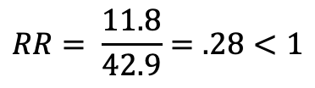
Your Turn: COVID-19 in a sample of individuals who received the Pfizer Vaccine
 | Developed Coronavirus?
Vaccinated? | Yes | No
Yes | 18 | 134 | 152
No | 3 | 4 | 7
 |  |  | Total = 159
What is the relative risk of developing COVID-19 among individuals who have been vaccinated (compared to those
who have not?
$$RR= \frac{11.8}{42.9}=.28<1$$
What is the outcome we are looking for?
What percent of vaccinated persons developed corona?
The risk of developing COVID-19 among those
who are vaccinated by the Pfizer vaccine is .28
times that of those who are not
What percent of unvaccinated persons developed corona?
Compute and interpret the relative risk…
Notes:
The outcome is developing coronavirus
Percent of vaccinated developing corona = 18/(18+134) = 18/152 = .118 or 11.8%
Percent of unvaccinated developing coron = 3/(3+4) = 3/7 = .429 = 42.9%

Slide 12

Relationship between prevalence, probability and odds
Let p = the probability of some outcome, then
Odds for that outcome is defined as $ODDS=$ $\frac{p}{(1 −p)}$

Slide 13
Interpretation
Three possibilities
If Odds are < 1 then the odds are “lower”
If Odds are > 1 then odds are higher
If Odds = 1 then the odds are the same
Note: the Null Hypothesis for the exponentiated logit coefficients in a logistic regression analysis is that the ODDS ratio = 1, why?

Slide 14
Example
Example: In North Carolina the probability of a pre-term birth is .1136. Compute and interpret:
The odds that a woman will have a pre-term birth; and
The odds that a woman will not have a pre-term birth.

Slide 15
Solution
Odds for pre-term birth = (.𝟏𝟏𝟑𝟔)/(𝟏−.𝟏𝟏𝟑𝟔)=(.𝟏𝟏𝟑𝟔)/(.𝟖𝟖𝟔𝟒)=.𝟏𝟐𝟖𝟐
Here .1282 < 1, the odds of pre-term birth are lower than full-term births
Odds for full-term birth = (.𝟖𝟖𝟔𝟒)/(𝟏−.𝟖𝟖𝟔𝟒)=(.𝟖𝟖𝟔𝟒)/(.𝟏𝟏𝟑𝟔)=𝟕.𝟖𝟎𝟑
Let’s say that the odds of a full-term birth are 7.803 as we calculated. If we had the following 95% confidence interval for this estimate can you tell me if the estimate is statistically significant?
𝟕.𝟖𝟎𝟑 (6.879 – 8.342)

Slide 16

Relationship between probability and odds
Let odds = the ODDS that some outcome will occur, then
The probability for that outcome is defined as
$p= \frac{ODDS of the outcome}{(1+ODDS of the outcome)}=$ $\frac{ODDS}{(1+ODDS)}$
Intuition: The odds of a child being substantiated for neglect are 3:4 after being reported for maltreatment.
The odds are 3 to 4 substantiated versus not substantiated therefore the probability of a substantiation is
3 out of 4 or .75 (following our rules of probability)

Slide 17

Example
Example: At OSU, the ODDS that a student will graduate are twice as high compared to those who do not graduate. Compute the probability that a randomly selected person will graduate from OSU:
$p= \frac{ODDS of the outcome}{(1+ODDS of the outcome)}=$ $\frac{2}{(1+2)}=\frac{2}{3}$
The odds are 2 to 1 (2:1) graduating versus not graduating therefore the probability of graduating is
2 out of 3 or .667 (following our rules of probability)

Slide 18
Intuition
Probability | Odds
0.80 | 4
0.67 | 2
0.60 | 1.5
0.50 | 1.0
0.40 | 0.67
0.33 | 0.5
0.25 | 0.33
0.20 | 0.25
0.10 | 0.11
0.05 | 0.053
0.01 | 0.0101
Probability and odds are more alike the lower the probability of the outcome, p = P (outcome)
Check these for yourself, by hand

Slide 19
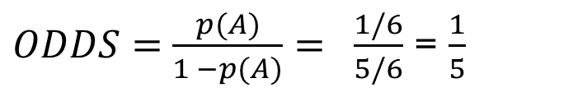
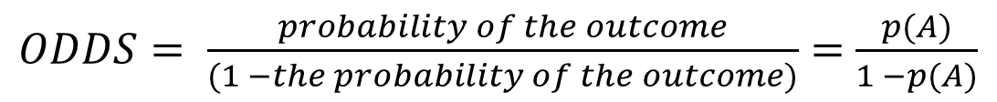
Computing Odds
Recall the odds of an event or outcome, A, is defined as
$ODDS= \frac{probability of the outcome}{(1 −the probability of the outcome)}=$ $\frac{p(A)}{1 −p(A)}$
For example, suppose we roll a single (fair) die, compute the odds of rolling a 3:
Let A – we observe a “3” after 1 roll of a fair die
What is the P(A)? 1/6
What is 1 - P(A)? 5/6
Compute
Interpret: The odds of getting a “3” are 1 in 5 (intuitive) and the odds of not getting a “3” are 5 in 1
$ODDS=$ $\frac{p(A)}{1 −p(A)}= \frac{1/6}{5/6}$ = $\frac{1}{5}$

Slide 20

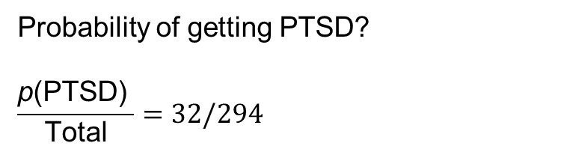
Example
To compute the odds we need to introduce the idea of conditional probability
Different questions can be asked….
 | Developed PTSD?
Abused? | Yes | No
Physically Abused | 28 | 129 | 157
Not Physically Abused | 4 | 133 | 137
 | 32 | 262 | Total = 294
Outcome
Probability of getting PTSD?
$$\frac{\text{p}\text{(}\text{PTSD}\text{) }}{\text{Total}}=32/294$$
Probability of getting PTSD conditional
on experiencing abuse?
$\frac{\text{p}\text{(}\text{PTSD}\text{| }\text{Abused}\text{) }}{\text{Abuse} \text{total}}=28/$157
“Risk factor”
Column marginals

Slide 21
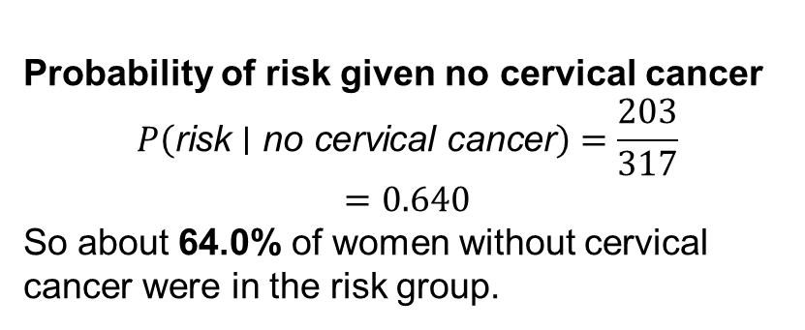
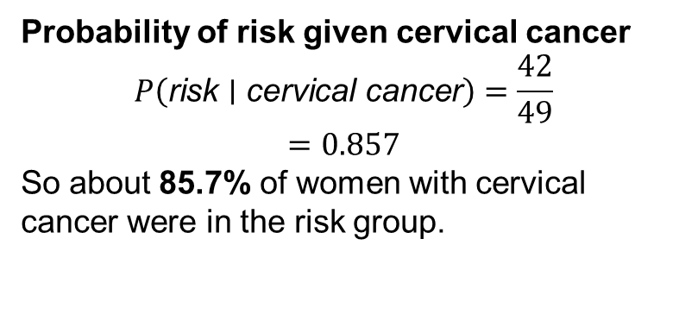
Compute the odds ratio of 1st preg. before (or at) age 25
What is P(risk|cervical cancer) & is P(risk|No cervical cancer) ?
Here, risk corresponds to Age at first pregnancy < 25.
Risk group = Age < 25
Non-risk group = Age > 25
Age at 1st Pregnancy | Cervical Cancer | No Cervical Cancer | Total
Age < 25 (risk) | 42 | 203 | 245
Age > 25 | 7 | 114 | 121
Total | 49 | 317 | 366
Probability of risk given no cervical cancer
$$P\left(\text{risk}∣\text{no} \text{cervical} \text{cancer}\right)=\frac{203}{317}$$
$$=0.640$$
So about 64.0% of women without cervical cancer were in the risk group.
Probability of risk given cervical cancer
$$P\left(\text{risk}∣\text{cervical} \text{cancer}\right)=\frac{42}{49}$$
$$=0.857$$
So about 85.7% of women with cervical cancer were in the risk group.

Slide 22
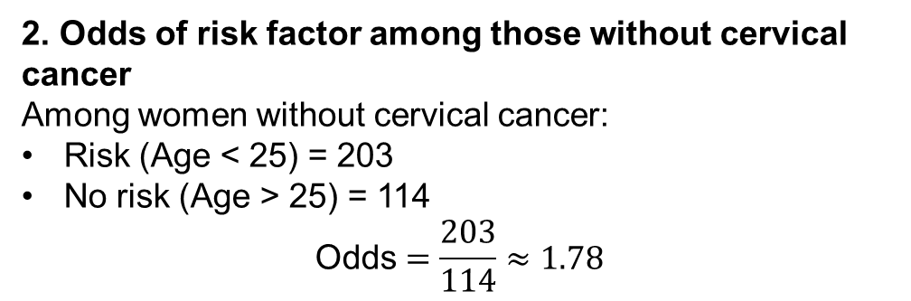
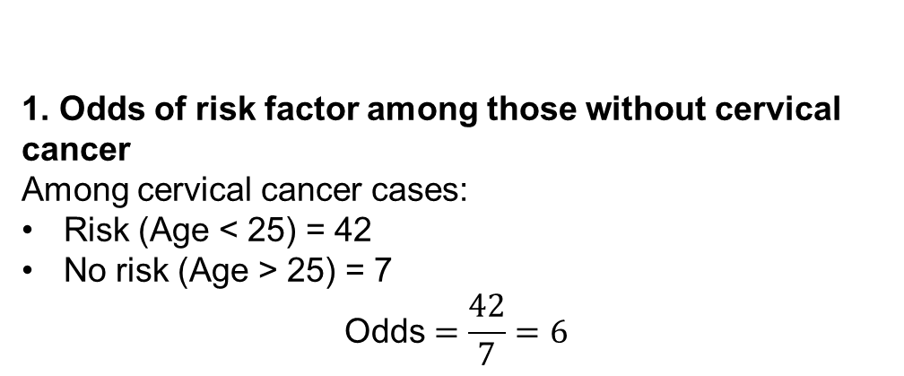
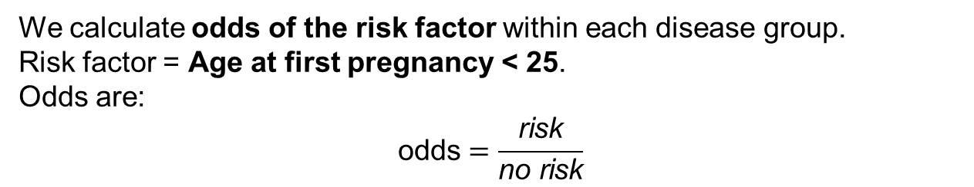
What are the odds for the risk factor amongst the cervical cancer? Amongst no cervical cancer?
We calculate odds of the risk factor within each disease group.
Risk factor = Age at first pregnancy < 25.
Odds are:
$$\text{odds}=\frac{\text{risk}}{\text{no} \text{risk}}$$
1. Odds of risk factor among those without cervical cancer
Among cervical cancer cases:
Risk (Age < 25) = 42
No risk (Age > 25) = 7
$$\text{Odds}=\frac{42}{7}=6$$
2. Odds of risk factor among those without cervical cancer
Among women without cervical cancer:
Risk (Age < 25) = 203
No risk (Age > 25) = 114
$$\text{Odds}=\frac{203}{114}≈1.78$$

Slide 23
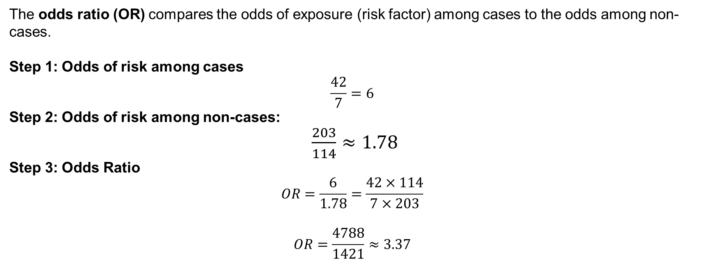
Age at 1st Pregnancy | Cervical Cancer | No Cervical Cancer
Age < 25 (risk) | 42 | 203
Age > 25 (no risk) | 7 | 114
The odds ratio (OR) compares the odds of exposure (risk factor) among cases to the odds among non-cases.
Step 1: Odds of risk among cases
$$\frac{42}{7}=6$$
Step 2: Odds of risk among non-cases:
$\frac{203}{114}≈1.78$
Step 3: Odds Ratio
$$OR=\frac{6}{1.78}=\frac{42×114}{7×203}$$
$$OR=\frac{4788}{1421}≈3.37$$

Slide 24
Easy Formula to use
Again, the question is: compute the odds ratio of having a 1st preg. before (or at) age 25 among women who have cervical cancer and those who do not
Risk Factor Status | Case | Control
Risk Factor Present | a | b
Risk Factor Absent | c | d
a x d
OR = _____
b x c

Slide 25
Easy Formula to use
a x d
OR = _____
b x c
Again, the question is: compute the odds ratio of having a child before (or at) age 25 among women who have cervical cancer and those who do not
Age at 1st Pregnancy | Cancer | No Cancer
Age <= 25 | a = 42 | b = 7
Age > 25 | c = 203 | d = 114
42 x 114
OR = _____
7 x 203
4902 x 1421 = 3.4!

Slide 26
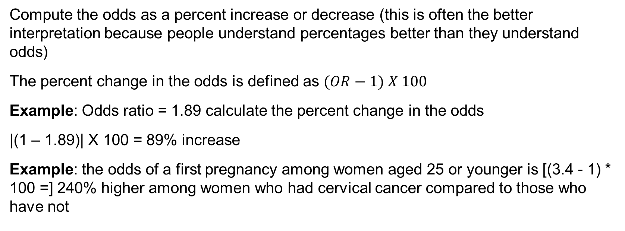
Other interpretations
Compute the odds as a percent increase or decrease (this is often the better interpretation because people understand percentages better than they understand odds)
The percent change in the odds is defined as $(OR−1) X 100$
Example: Odds ratio = 1.89 calculate the percent change in the odds
|(1 – 1.89)| X 100 = 89% increase
Example: the odds of a first pregnancy among women aged 25 or younger is [(3.4 - 1) * 100 =] 240% higher among women who had cervical cancer compared to those who have not

Slide 27
Logistic Regression

Slide 28
Introduction
Logistic regression is used when the dependent variable is qualitative (e.g., Yes/No)
Recall
A qualitative variable (also known as categorical) is not numerical, and its values fit into categories. It is also divided into two types:
Nominal: no ordering is possible or implied in the categories (for example sex at birth);
Ordinal: an order is implied in the categories (for example the health status, such as poor/reasonable/good, a Likert scale)
A binary variable, also known as dichotomous, is a special case of a qualitative nominal variable when there are only two categories.

Slide 29
Research Questions & Methodological Approaches
Medicine
Estimate the risk factors associated with a disease or a harmful condition
Predict the risk of developing a disease based on a patient’s medical history
Determine the most “important” biological factors associated with a specific disease or condition
Economics/Business
Estimate a debtor’s likelihood to default on a loan based on creditworthiness
Model a customer’s propensity to buy a certain product or service given a demographic profile
Psychology/Social Work
Estimate the probability of developing PTSD following trauma
Political Science
A question I examined ad nauseum in graduate school: What predicts voting behavior?

Slide 30
What is a Generalized Linear Model (GLM)?
A Generalized Linear Model (GLM) is a flexible extension of ordinary linear regression that allows us to model outcomes that:
Are not normally distributed
Are not continuous
Have non-constant variance
Are bounded (e.g., probabilities between 0 and 1)

Slide 31
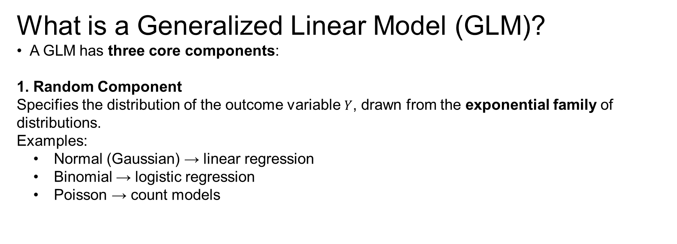
What is a Generalized Linear Model (GLM)?
A GLM has three core components:
1. Random Component
Specifies the distribution of the outcome variable $Y$, drawn from the exponential family of distributions.
Examples:
Normal (Gaussian) → linear regression
Binomial → logistic regression
Poisson → count models

Slide 32
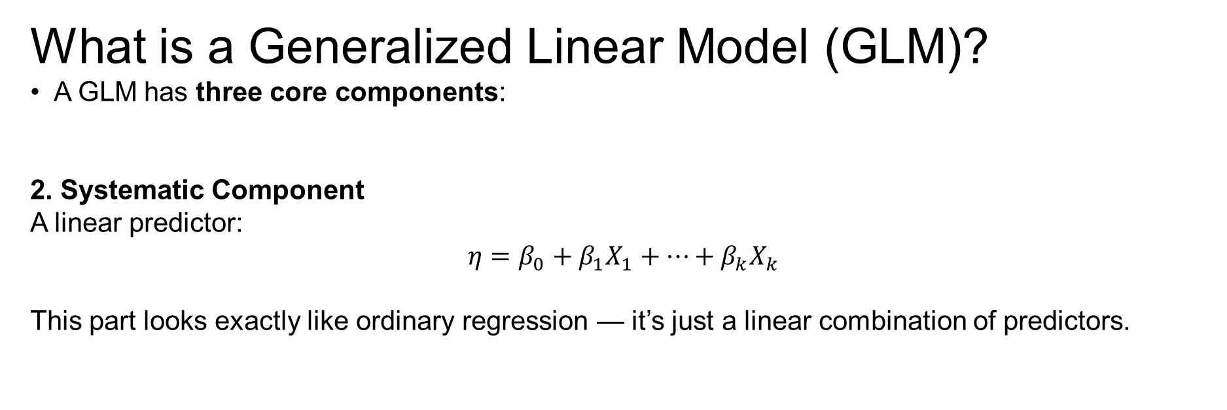
What is a Generalized Linear Model (GLM)?
A GLM has three core components:
2. Systematic Component
A linear predictor:
$$η=β_{0}+β_{1}X_{1}+⋯+β_{k}X_{k}$$
This part looks exactly like ordinary regression — it’s just a linear combination of predictors.

Slide 33
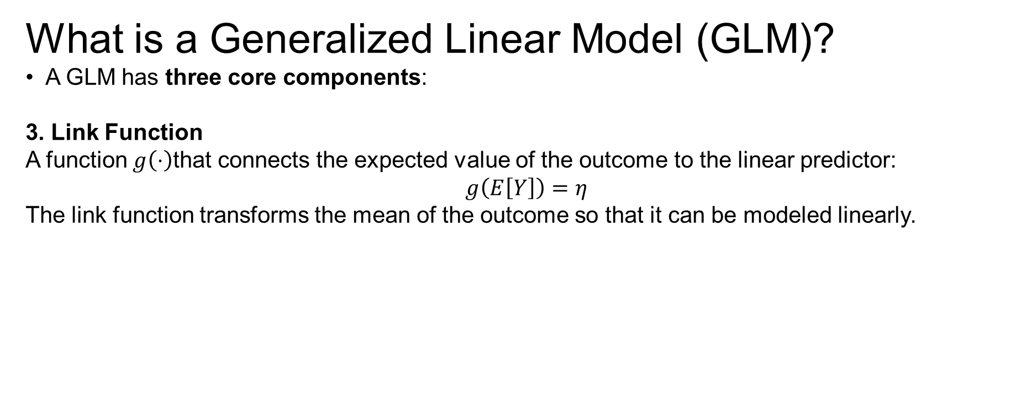
What is a Generalized Linear Model (GLM)?
A GLM has three core components:
3. Link Function
A function $g\left(⋅\right)$that connects the expected value of the outcome to the linear predictor:
$$g\left(E\left[Y\right]\right)=η$$
The link function transforms the mean of the outcome so that it can be modeled linearly.

Slide 34
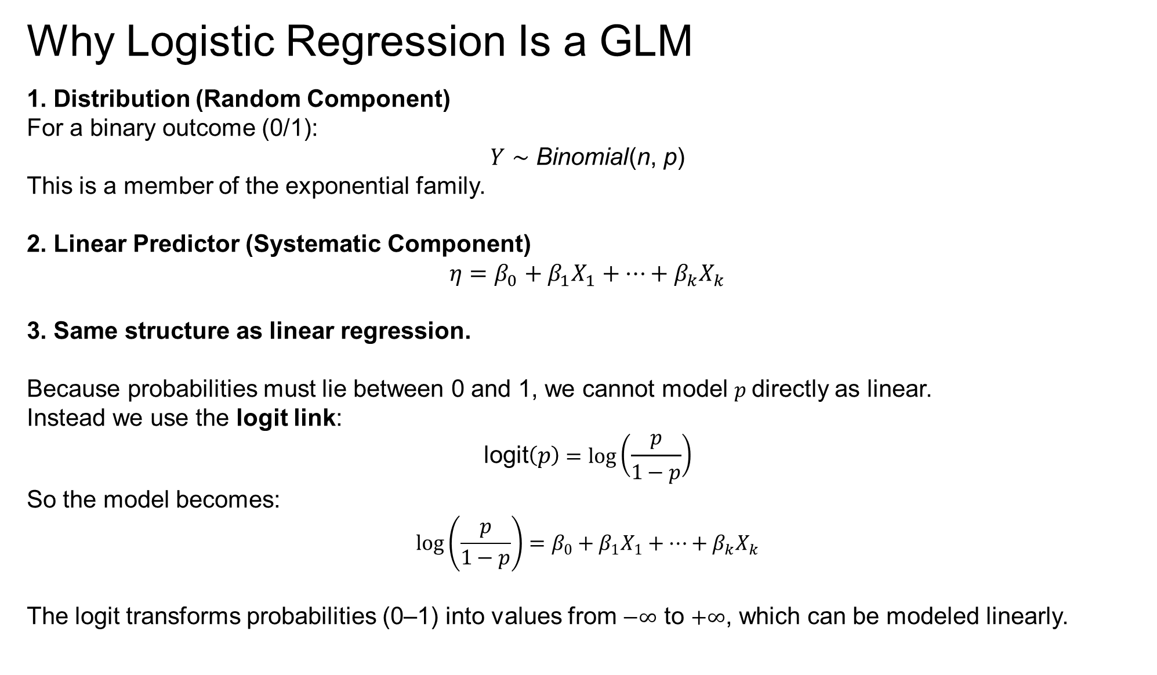
Why Logistic Regression Is a GLM
1. Distribution (Random Component)
For a binary outcome (0/1):
$Y∼\text{Binomial}$(n, p)
This is a member of the exponential family.
2. Linear Predictor (Systematic Component)
$$η=β_{0}+β_{1}X_{1}+⋯+β_{k}X_{k}$$
3. Same structure as linear regression.
Because probabilities must lie between 0 and 1, we cannot model $p$directly as linear.
Instead we use the logit link:
$$\text{logit}\left(p\right)=\log\left(\frac{p}{1−p}\right)$$
So the model becomes:
$$\log\left(\frac{p}{1−p}\right)=β_{0}+β_{1}X_{1}+⋯+β_{k}X_{k}$$
The logit transforms probabilities (0–1) into values from $−∞$ to $+∞$, which can be modeled linearly.

Slide 35
Generalized Linear Models
Categorical regressions (i.e., of the logistic family) (and Poisson regression) are both part of a broader type of model called generalized linear models (abbreviated as GLM).
Two categories: Binary logistic regression is used when the goal is to estimate the relationship between a binary dependent variable (= two outcomes), and one or more independent variables (of any type)
More than two categories: Multinomial logistic regression is used when the goal is to estimate the relationship between a nominal dependent variable with three or more unordered outcomes, and one or more independent variables (of any type).
More than two ordered categories: Ordinal logistic regression is used when the goal is to estimate the relationship between an ordinal dependent variable with three or more ordered outcomes, and one or more independent variables (of any type).

Slide 36
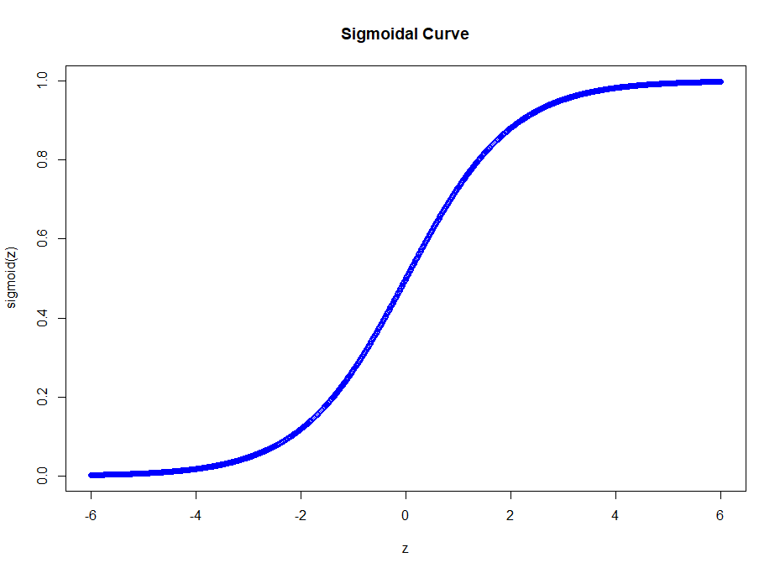
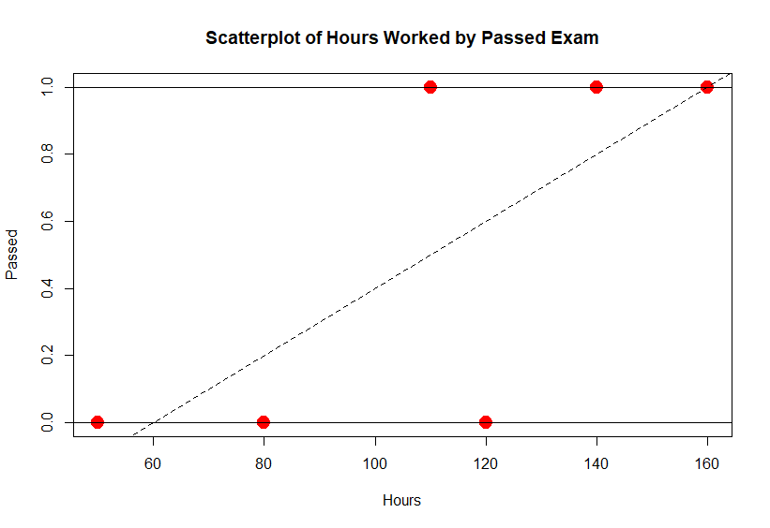

The sigmoidal function models the probability that Y = 1 conditional on X (i.e., values falling along the x-axis); using the logit function ensures that the Y values will be between 0 and 1 for all values of X (i.e., no matter the range of X)
Linear vs. Logistic Regression
Notes:
Logistic
The model is nonlinear (aka sigmoidal)

Slide 37
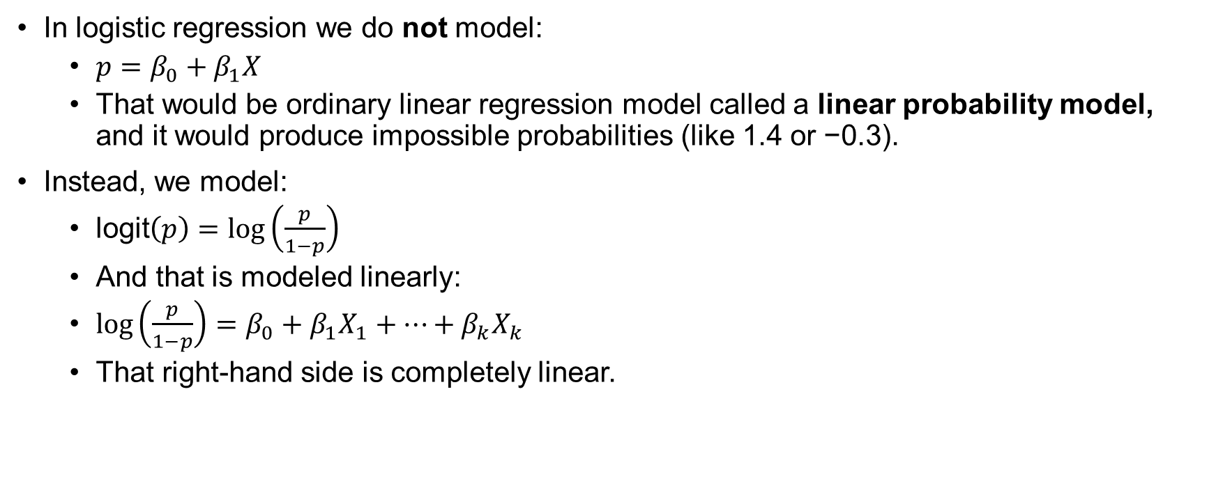
How is that model linear?
In logistic regression we do not model:
$p=β_{0}+β_{1}X$
That would be ordinary linear regression model called a linear probability model, and it would produce impossible probabilities (like 1.4 or −0.3).
Instead, we model:
$\text{l}\text{ogit}\left(p\right)=\log\left(\frac{p}{1−p}\right)$
And that is modeled linearly:
$\log\left(\frac{p}{1−p}\right)=β_{0}+β_{1}X_{1}+⋯+β_{k}X_{k}$
That right-hand side is completely linear.

Slide 38
Univariate versus multivariate logistic regression
Univariate binary logistic regression includes one independent variable
Multivariate binary logistic regression includes two or more independent variables
Variables can be quantitative or qualitative

Slide 39
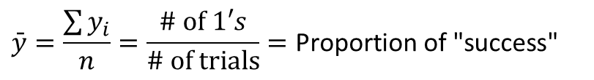
Mechanics of Logistic Regression
A regression where the dependent variable is measured 0/1 (pass/fail; vote/didn’t vote, etc.) (i.e., the dependent variable is a dummy variable)
In ordinary regression the model predicts the mean of Y for any combination of predictors
Goal of logistic regression: Predict the “true” proportion of success, p, at any value of the predictor.
What’s the “mean” of a 0/1 indicator variable?
$$\bar{y}=\frac{\sum{y_{i}}}{n}=\frac{\# \text{of} 1′s}{\# \text{of} \text{trials}}=\text{Proportion} \text{of}\text{ "}\text{success}\text{"}$$
p = Proportion of “Success”

Slide 40
From Odds to Probability and Back Again
Binary logistic regression models the probability that Y = 1.
For example, if we think that 60 on a test is passing, we can recode the passing variable as follows: Y = 1 if the student passed, and 0 otherwise, we are modeling the likelihood that the student passes or not (conditional on the independent variables in the model)
This likelihood will be framed as a probability

Slide 41
Mechanics of Logistic Regression
Logit of Y equation interpretation: For each one-unit change in the independent variable, the log odds of Y increases (decreases) by the beta coefficient
Problem: nobody knows what log odds are!
Exponentiate the logit (Y) (i.e., the outcome of the logistic regression equation), to convert it back to the odds
Interpret the independent variables as affecting the odds (rather than log odds) of the outcome
Convert odds to probability: Probability values close to one indicate increased likelihood of occurrence
Much more intuitive

Slide 42
Recall the relation between odds and probability
Odds and logit (or log odds)
Odds = the ratio of the probability of the dependent variable’s two outcomes
Taking the log odds of Y creates a linear relationship between X and the probability of Y (Pampel, 2000)
$$Y=β_{0}+β_{1}X_{1}+β_{2}X_{2}+...+β_{m}X_{m}$$
$$\ln\left[\frac{P(Y=1)}{1−P(Y=1)}\right]=Logit(Y)=β_{0}+β_{1}X_{1}+β_{2}X_{2}+...+β_{m}X_{m}$$

Slide 43
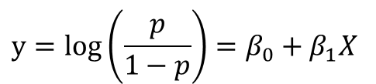
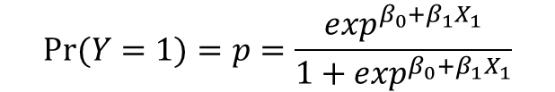
Equivalent forms of the logistic regression model
Y = Binary response
X = Quantitative predictor
Logit form
Probability form
$$y=log\left(\frac{p}{1−p}\right)=β_{0}+β_{1}X$$
$$Pr⁡(Y=1)=p=\frac{\exp^{β_{0}+β_{1}X_{1}}}{1+\exp^{β_{0}+β_{1}X_{1}}}$$
This is natural log (aka “ln”)
p = proportion of 1’s (yes, success) at any X
Log Odds
Probability
Notes:
where π (0≤π≤1) is the probability of an event happening (success) and denoted π=P(success). We find the estimates for β0, β1, …, βp, using the maximum likelihood method. This method is one of several methods used in statistics to estimate parameters of a mathematical model. The goal of the estimator is to estimate the parameters β0, β1, …, βp which maximize the log likelihood function.

Slide 44

Recall the model
Y = $\left\{\begin{aligned}0 \\ 1\end{aligned}\right.$
$$p\left(X\right)=P[Y=1|X=x]=\frac{\exp^{(β_{0}+β_{1}X)}}{1+\exp^{(β_{0}+β_{1}X)}}$$
If the condition is false
If the condition is true
Our goal is to estimate the unknown parameters, ${\hat{β}}_{0}$, ${\hat{β}}_{1}$

Slide 45




Review Algebra
Properties of exponents
Properties of logarithms
$$e^{x}×e^{y}=e^{x}+e^{y}$$
$e^{x+y}=e^{x}$ + $e^{y}$
$${ln⁡(e}^{x}) =x$$
$$e^{ln⁡(x)}=x$$
$$e^{0}=1$$

Slide 46



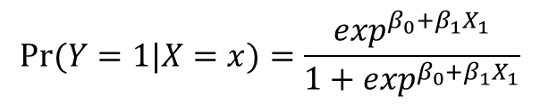

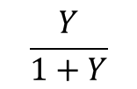

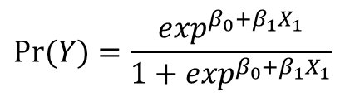


Mathematical Snapshot
$$Logit(Y)=β_{0}+β_{1}X_{1}+β_{2}X_{2}+...+β_{m}X_{m}$$
$β_{0}, β_{1}$ is interpreted as “log odds of Y”
$$Logit(Y)=β_{0}+β_{1}X_{1}$$
Take the exponent of each side
$$\exp^{Logit(Y)}=\exp^{β_{0}+β_{1}X_{1}}$$
This follows because
$$e^{ln⁡(x)}=x$$
$$Y=\exp^{β_{0}+β_{1}X_{1}}$$
$\exp\left(β_{0}\right), exp⁡(β_{1})$is interpreted as the “odds of Y”
$$Pr⁡(Y)=\frac{\exp^{β_{0}+β_{1}X_{1}}}{1+\exp^{β_{0}+β_{1}X_{1}}}$$
$$\frac{Odds}{1+Odds}$$
$$\frac{Y}{1+Y}$$
is a probability
This follows because
so that
$$Pr⁡(Y=1|X=x)=\frac{\exp^{β_{0}+β_{1}X_{1}}}{1+\exp^{β_{0}+β_{1}X_{1}}}$$
This is interpreted as a ‘conditional’ probability

Slide 47
Model fit
Overall logistic regression model determines the extent to which the predicted values accurately represent the observed values (Xie, Pendergast, & Clarke, 2008)
Change in log likelihood
Hosmer and Lemeshow goodness-of-fit test
Pseudo-variance explained
Predicted group membership
Significance tests: Beta coefficients
Each logistic regression coefficient determines if the individual coefficients are statistically significantly different from zero

Slide 48
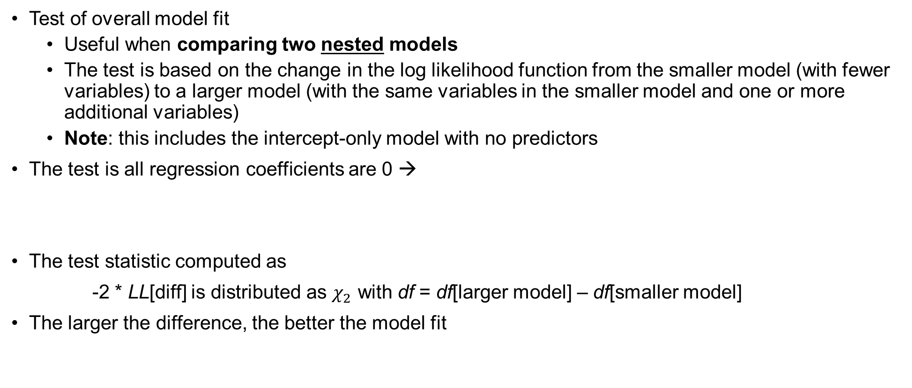


Change in Log Likelihood test for model fit (1)
Test of overall model fit
Useful when comparing two nested models
The test is based on the change in the log likelihood function from the smaller model (with fewer variables) to a larger model (with the same variables in the smaller model and one or more additional variables)
Note: this includes the intercept-only model with no predictors
The test is all regression coefficients are 0 →
The test statistic computed as
-2 * LL[diff] is distributed as $χ_{2}$ with df = df[larger model] – df[smaller model]
The larger the difference, the better the model fit
$H_{0}:β_{1}=β_{2}…$ $β_{m}=0$
$$H_{1}:at least one β ≠0$$

Slide 49
Terminology for Predicted Group Membership table (1)
Sensitivity is the probability that the dependent variable was coded as a “1” and our model predicted a “1” i.e., it was classified correctly
The percentage of correct predictions of the cases that are coded as 1 for the dependent variable
Example: You have the disease and we said you did
Specificity is the probability that a case-coded dependent variable was coded as a “0” and our model predicted a “0” i.e., it was classified correctly
The percentage of correct predictions of the cases that are coded as 0 for the dependent variable
Example: You don’t have the disease and we said you didn’t
This should sound really familiar

Slide 50
Terminology for Predicted Group Membership table (2)
False positive rate is the probability that a case coded as 0 for the dependent variable (aka ‘negative’) is classified incorrectly.
In other words, this is the percentage of cases in error where the dependent variable is predicted to be 1 (i.e., disease), but in fact the observed value is 0 (i.e., no disease)
Example: you have the disease, but you don’t
False negative rate is the probability that a case coded as 1 for the dependent variable (aka ‘positive’) is classified incorrectly.
In other words, this is the percentage of cases in error where the dependent variable is predicted to be 0 (i.e., unprepared), but in fact the observed value is 1 (i.e., prepared)
Example: you don’t have the disease, but you we said you did

Slide 51
Predicted Group Membership for determining model fit (2)
If the predicted probability is above a cutoff (usually .5) assign 1, otherwise 0
A crosstab table of predicted to observed probabilities provides the frequency and percentage of cases correctly classified
A perfect model produces 100% correctly classified cases
A model that classifies no better than chance would provide 50% correctly classified cases.

Slide 52
Binary Logistic Regression in JASP
Use the file gpa-college-enroll.JASP/gpa-college-enroll.sav
Analyze → Regression → Binary Logistic
In this example we have
Y = college enrollment
X₁ = undergraduate GPA

Slide 53
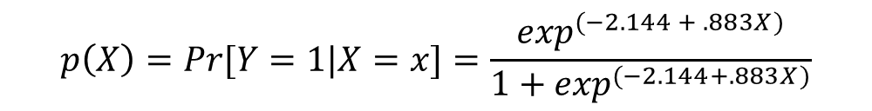

Focus on the results first
Coefficients
 |  |  |  |  |  | Wald Test
Model |  | Estimate | Standard Error | Odds Ratio | z | Wald Statistic | df | p
M₀ | (Intercept) | 0.405 | 0.645 | 1.500 | 0.628 | 0.395 | 1 | .530
M₁ | (Intercept) | -2.144 | 2.416 | 0.117 | -0.888 | 0.788 | 1 | .375
 | gpa | 0.883 | 0.821 | 2.419 | 1.076 | 1.157 | 1 | .282
Note. enroll level '1' coded as class 1.
$$logit\left(Y\right)=−2.144+.833GPA$$
$$p\left(X\right)=Pr[Y=1|X=x]=\frac{\exp^{(−2.144 + .883X)}}{1+\exp^{(−2.144+.883X)}}$$
Probability of enrolling in
college ‘conditional on’ values
of one’s grade point average
The Wald test is the test statistic for the logistic regression model
The sig. is the p-value
EXP(B) is the odds ratio – the interpretation is: the odds of enrolling in college are about 2.42 times greater for each one unit increase in undergraduate gpa, but the result is not statistically significant

Slide 54

Computing probabilities
The most useful part of logistic regression is the ability to predict the conditional probability of Y given values of the independent variables
For example: what is the probability of college enrollment given that your gpa is 1.0, 2.0, 3.0 and 4.0?
$$Pr⁡(Y=1)=p=\frac{e^{β_{0}+β_{1}X_{1}}}{1+e^{β_{0}+β_{1}X_{1}}}$$
$Pr⁡(Y=1|X=1)=\frac{e^{−2.144+.883(1)}}{1+e^{−2.144+.883(1)}}$ =$\frac{e^{−2.144+.883}}{1+e^{−2.144+.883}}$= $\frac{e^{−1.261}}{1+e^{−1.261}}$= $\frac{.283371}{1+.283371}$=.221
$Pr⁡(Y=1|X=2)=\frac{e^{−2.144+.883(2)}}{1+e^{−2.144+.883(2)}}$ =$\frac{e^{−2.144+1.766}}{1+e^{−2.144+1.766}}$= $\frac{e^{−.378}}{1+e^{−.378}}$= $\frac{.283371}{1+.283371}$=.407

Slide 55
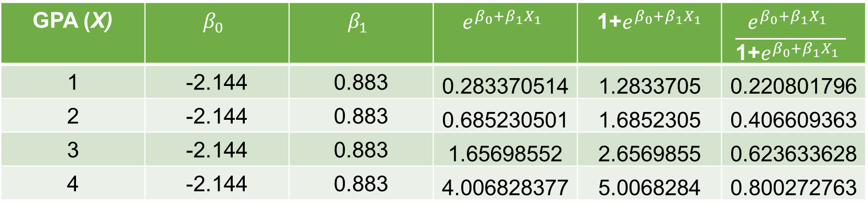
Table of predicted probabilities
GPA (X) | $$β_{0}$$ | $$β_{1}$$ | $$e^{β_{0}+β_{1}X_{1}}$$ | 1+$e^{β_{0}+β_{1}X_{1}}$ | $$\frac{e^{β_{0}+β_{1}X_{1}} }{\text{1}\text{+}e^{β_{0}+β_{1}X_{1}} }$$
1 | -2.144 | 0.883 | 0.283370514 | 1.2833705 | 0.220801796
2 | -2.144 | 0.883 | 0.685230501 | 1.6852305 | 0.406609363
3 | -2.144 | 0.883 | 1.65698552 | 2.6569855 | 0.623633628
4 | -2.144 | 0.883 | 4.006828377 | 5.0068284 | 0.800272763
See excel file gpa_college_enrollment_example.xlsx

Slide 56
Model Summary & Classification
The classification table is provided. Here we correctly classify 60% of enrollments, better than chance (not much better)
Using the 50% cutoff, when the observed Y was the student did not enroll in college, we predicted enrollment correctly 1/2 of the time
Similarly, using the same cutoff, when the student did enroll, we were correct 4 of 6 times (2/3)
Confusion matrix
 | Predicted
Observed | 0 | 1 | % Correct
0 | 2 | 2 | 50.000
1 | 2 | 4 | 66.667
Overall % Correct |  |  | 60.000
Note. The cut-off value is set to 0.5
Specificity
Sensitivity
(2 + 4)/(2+2+2+4) = 60%
Notes:
Specificity is the percentage of correct predictions of the cases that are coded as 0 for the dependent variable 50
sensitivity is the percentage of correct predictions of the cases that are coded as 1 for the dependent variable 66.7
false negative rate the percentage of cases in error where the dependent variable is predicted to be 0 50
false positive rate the percentage of cases in error where the dependent variable is predicted to be 1 33.3

Slide 57
More on classifications and correctly predicted observations
Your observed outcome in logistic regression can ONLY be 0 or 1
The predicted probabilities from the model can take on all possible values between 0 and 1
So, for a given observation, the predicted probability from the model may have been 0.51 (51% probability of success), but your observation was actually a 0 (not a success)
By default, SPSS uses a classification of 50/50 → if the probability is .51 or greater, the case is coded as “1” (i.e., a success) and if it is <= .50 it’s coded as “0” (i.e., a fail)
The next slide shows how we can add the probabilities and classifications to our dataset for additional intuition

Slide 58
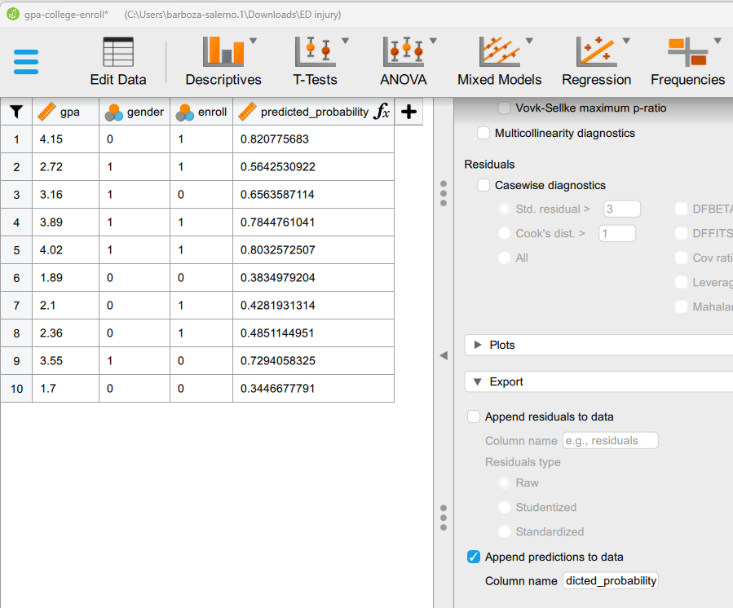

Slide 59
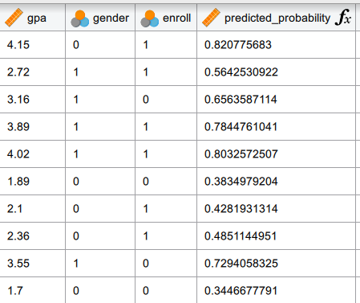

Slide 60
Improving classification
We can change the default value from .5 to something else
Example: Let’s change the default to .4 and see how this ‘improves’ our classification

Slide 61
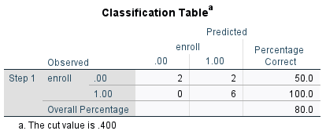
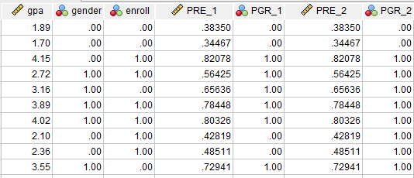
Default = .5
Default = .4
When we changed
the default value from .5
to .4, what changed?

Slide 62
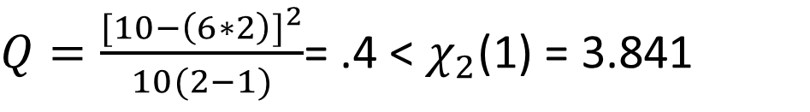
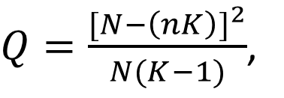
You may want to report…
Is the 60% correctly predicted rate better than chance (i.e., 50%)
You can report Press’s Q, which is distributed as
$Q=\frac{{[N−\left(nK\right)]}^{2}}{N(K−1)}$,
N is the total sample size,
n represents the number of cases that were correctly classified
K equals the number of groups
$Q=\frac{{[10−\left(6∗2\right)]}^{2}}{10(2−1)}$= .4 < $χ_{2}$(1) = 3.841
In this case, the results are no better than chance

Slide 63
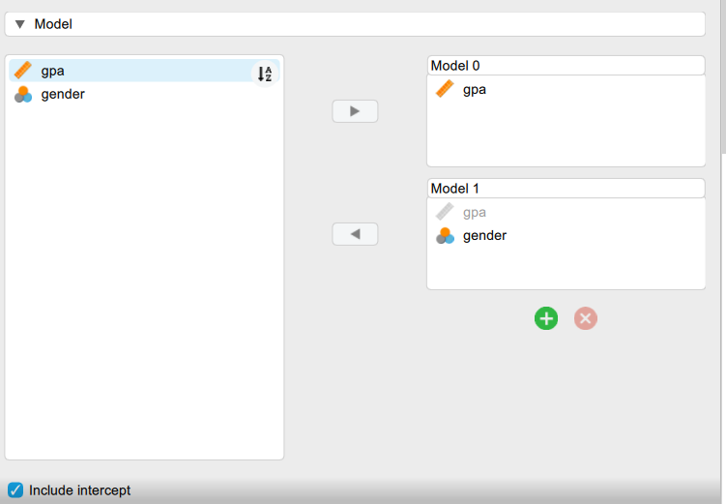
Does the addition of gender improve the model fit?
$χ^{2}(1)$= 2(${LL}_{m2}−{LL}_{m1})=−(10.936−12.169)=1.233$
m2 = model with additional predictors, it is also called the unrestricted model
m1 = model with fewer predictors, it is nested in m2, it is also called the restricted model
There is one parameter difference between the models, and one degree of freedom
The critical value is greater than the calculated statistic and hence there is no statistically significant difference between these models!
Model Summary - enroll
Model | Deviance | AIC | BIC | df | ΔΧ² | p | McFadden R² | Nagelkerke R² | Tjur R² | Cox & Snell R²
M₀ | 12.169 | 16.169 | 16.775 | 8 |  |  | 0.000 | 0.000 | 0.119 | 0.000
M₁ | 10.936 | 16.936 | 17.843 | 7 | 1.234 | .267 | 0.101 | 0.165 | 0.217 | 0.116
Note. M₀ includes gpa
Note. M₁ includes gpa, gender

Slide 64
Log-Likelihood
Model Summary - enroll
Model | Deviance | AIC | BIC | df | ΔΧ² | p | McFadden R² | Nagelkerke R² | Tjur R² | Cox & Snell R²
M₀ | 13.460 | 15.460 | 15.763 | 9 |  |  | 0.000 |  | 0.000
M₁ | 12.169 | 16.169 | 16.775 | 8 | 1.291 | .256 | 0.096 | 0.164 | 0.119 | 0.121
Note. M₁ includes gpa
The model summary information is provided only as a method of comparison
Let’s compare this model with a model that includes student gender (next slide)

Slide 65
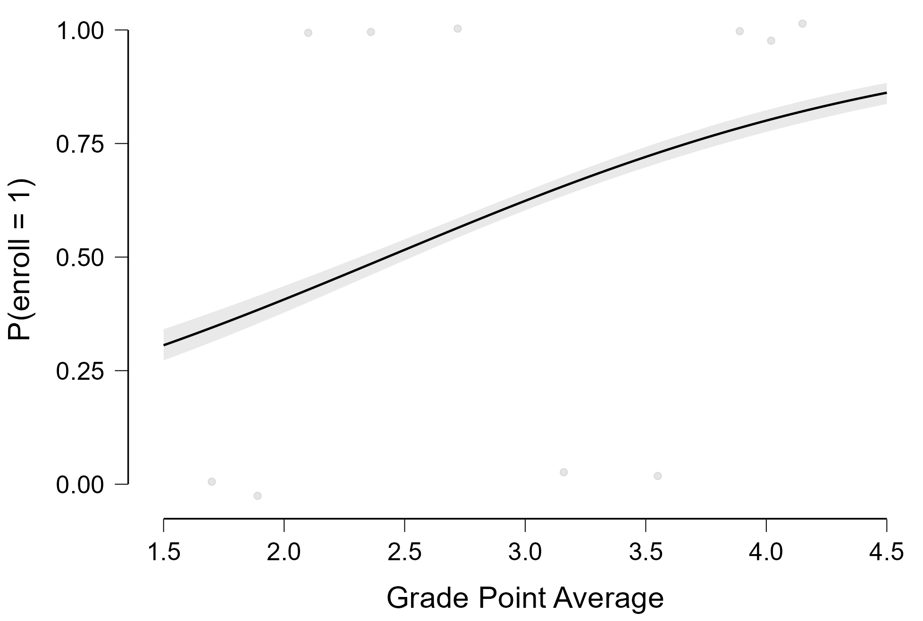
Probability of enrolling in college conditional on high school gpa
As gpa increases the probability of enrolling increases
The probability is about .30 for a gpa = 1.5 but increases to about .9 for a gpa = 4.5

Slide 66


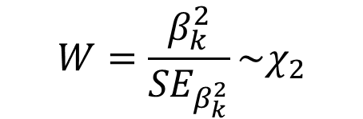
Test of Significance of the Logistic Regression Coefficients
The second test in logistic regression is the test of the statistical significance of each regression coefficient, b_{k}
The test statistic is called a Wald test computed as
$$H_{0}:β_{k}=0$$
$$H_{1}:β_{k}≠0$$
$$W=\frac{β_{k}^{2}}{{SE}_{β_{k}^{2}}}\sim χ_{2}$$

Slide 67
What Logistic Regression Is and How It Works: Assumptions
Noncollinearity
Linearity
Independence of errors
Values of X are fixed
Conditions
Nonzero cell counts
Nonseparation of data
Lack of influential points
Sufficient sample size

Slide 68
Let’s do this in JASP
Unsheltered-demographic-survey.jasp

Slide 69
Your turn
Open the SPSS file passing.sav
The data has three made-up variables:
Passed a statistics test
Hours of study
Gender (1 = male, 0 = female)
Run a binary logistic regression of passed on hours
Write out the regression equation
Predict the probability of passing for 0, 50, 100, 150,200 and 250 hours of studying
Add gender into the model and interpret the coefficient in terms of odds and percent change in odds
Does adding gender improve the model fit?
Compute the probability of passing for males and females for 100 study hours

Slide 70
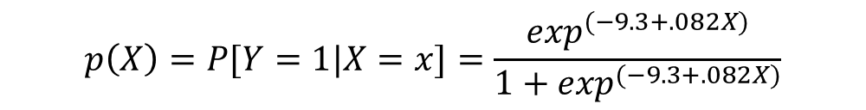

Model & Interpretation
$$logit\left(Y\right)=−9.3+.082X$$
$$p\left(X\right)=P[Y=1|X=x]=\frac{\exp^{(−9.3+.082X)}}{1+\exp^{(−9.3+.082X)}}$$
Check: What is the Probability of passing when hours = X
Note: exp(.082) = 1.085
Table 1. Predicted probability of Passing Conditional on Hours Studying | Table 1. Predicted probability of Passing Conditional on Hours Studying
X | 0 | 50 | 100 | 150 | 200 | 250
P(Y|x=X) | 0.0055 | 0.0603 | 0.4286 | 0.6298 | 0.8975 | 0.9783
Each additional hour spent working increases the odds of passing by [exp(.082)-1 *100] percent
Each additional hour spent working increases the odds of passing by about 8.5 percent
The odds of passing are 1.085 times higher for each additional hour spent studying

Slide 71
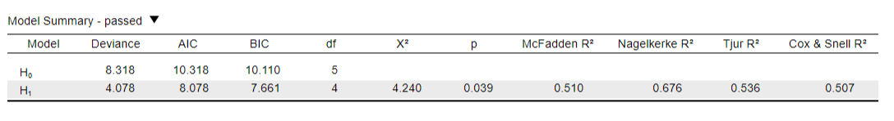
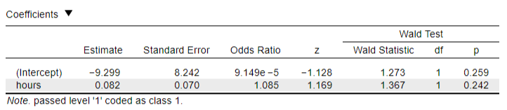
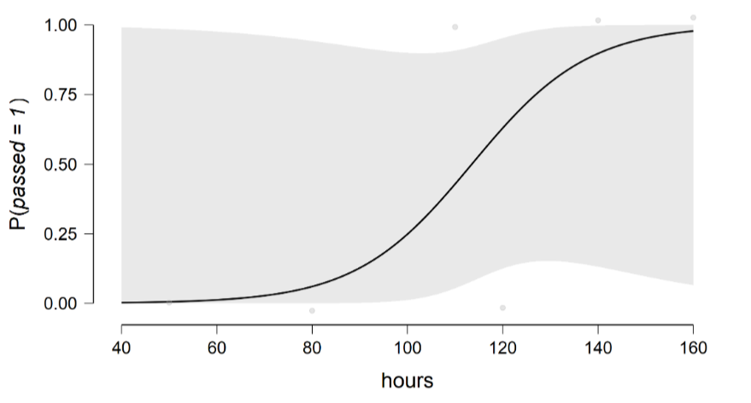
Jasp Output

Slide 72
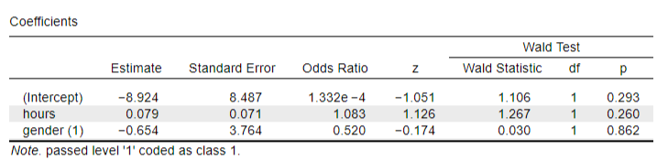
Let’s add a binary variable, gender, to the equation
The odds of passing for males are [exp(-.654)-1 *100] percent lower compared to females
The odds of passing for males are 48.01% lower compared to females
The odds of passing are .5100 (exp(-.654)) times lower for males compared to females
The file probability of passing by gender.xlsx has the probability of passing for males and females given 100
hours of study time

Slide 73


$$logit\left(Y\right)=−2.144+.833GPA$$
$$p\left(X\right)=Pr[Y=1|X=x]=\frac{\exp^{(−2.144 + .883X)}}{1+\exp^{(−2.144+.883X)}}$$
Probability of enrolling in
college ‘conditional on’ values
of one’s grade point average
Coefficients
 |  |  |  |  |  |  |  | Wald Test
 |  | Estimate |  | Standard Error |  | z |  | Wald Statistic |  | df |  | p
(Intercept) |  | -2.144 |  | 2.416 |  | -0.888 |  | 0.788 |  | 1 |  | 0.375
gpa |  | 0.883 |  | 0.821 |  | 1.076 |  | 1.157 |  | 1 |  | 0.282
Note. enroll level '1' coded as class 1.
The Wald test is the test statistic for the logistic regression model
The sig. is the p-value
EXP(B) is the odds ratio – the interpretation is: the odds of enrolling in college are about 2.5 times greater for each one unit increase in undergraduate gpa, but the result is not statistically significant

Slide 74
Your turn
Open the file passing.JASP in JASP
The data has three made-up variables:
Passed a statistics test
Hours of study
Gender (1 = male, 0 = female)
Run a binary logistic regression of passed on hours
Write out the regression equation
Predict the probability of passing for 0, 50, 100, 150,200 and 250 hours of studying
Add gender into the model and interpret the coefficient in terms of odds and percent change in odds
Does adding gender improve the model fit?
Compute the probability of passing for males and females for 100 study hours

Slide 75


Model & Interpretation
$$logit\left(Y\right)=−9.3+.082X$$
$$p\left(X\right)=P[Y=1|X=x]=\frac{\exp^{(−9.3+.082X)}}{1+\exp^{(−9.3+.082X)}}$$
Check: What is the Probability of passing when hours = X
Note: exp(.082) = 1.085
Table 1. Predicted probability of Passing Conditional on Hours Studying | Table 1. Predicted probability of Passing Conditional on Hours Studying
X | 0 | 50 | 100 | 150 | 200 | 250
P(Y|x=X) | 0.0055 | 0.0603 | 0.4286 | 0.6298 | 0.8975 | 0.9783
Each additional hour spent working increases the odds of passing by [exp(.082)-1 *100] percent
Each additional hour spent working increases the odds of passing by about 8.5 percent
The odds of passing are 1.085 times higher for each additional hour spent studying

Slide 76
Script 1: Logistic Regression: Application of Logistic Regression using R on website

