Slide 1
Regression Mechanics
Dummy Variables, Quadratic Terms + Other Extensions

Slide 2
Medical Expenditure Panel Survey (Katie’s Study?)
Goal: To examine the relationship between food insecurity and mental/physical health and healthcare utilization, with a specific focus on the unique burden faced by older adults (ages 65+).
Survey Weights: The analysis utilizes the complex survey weight (SDOHWT21F) and accounts for the cluster (VARPSU) and strata (VARSTR) design of the survey.
Population Estimates: By applying these weights, the results shift from being simple descriptions of the 14,000+ people in our data to representative population estimates for the entire U.S. civilian noninstitutionalized population.
Significance: This ensures that our results are representative of the entire U.S. civilian noninstitutionalized population in 2021.

Slide 3
Medical Expenditure Panel Survey
Research Questions
Direct Association: To what extent is food insecurity directly associated with poorer mental and physical health scores, independent of socio-economic and clinical controls?
Moderation (Age): Does age (65+) moderate the relationship between food insecurity and health? (i.e., is the health "penalty" significantly different for seniors?)
Direct Effect (Utilization): What is the direct effect of food insecurity on the probability/frequency of Emergency Department visits and total expenditures?
Moderation (Buffer Effect): Does the difference in public health insurance systems (Medicare for seniors vs. Medicaid for younger adults) moderate the relationship between food insecurity and emergency department visits?

Slide 4
Category | Variable(s) | Description
Dependent | VPCS42 / VMCS42 | Physical and Mental Health Component Summary scores.
 | ERTOT21 / TOTEXP21 | Total ED visits and healthcare expenditures.
Main Predictors | food_insecure | Binary indicator (combined Worry / No food available).
 | older_adult | Recoded indicator for individuals aged 65+.
Controls | any_chronic_cond | Aggregated indicator of 8 major conditions (Diabetes, Stroke, etc.).
 | poverty_cont | Continuous poverty level (percentage).
 | insurance_type | Refined: Private, Medicare (65+), Medicaid (<65), Uninsured.

Slide 5
Results
While younger adults lose 2.5 points due to food insecurity, seniors lose 4.8 points. Food-insecure seniors have the lowest physical health in the study (41.6).
Older adults who are food secure report the best mental health in the study (54.4). However, food insecurity wipes out this "senior advantage" entirely, dropping them to 48.1, lower than food-secure younger adults.
Health declines are less likely to result in an Emergency Department visit among seniors with Medicare than among younger adults without access to a safety net.

Slide 6
Group | Odds Ratio (OR) | Explanation of Effect Size
Age < 65 | 1.80x | Younger adults who are food insecure are 80% more likely to end up in the ER.
Age >= 65 | 1.27x | Older persons who are food insecure are 27% more likely to end up in the ER.
The Buffer effect of Medicare | 0.70x | Medicare/social safety nets cut the link between hunger and the ER by 30%.

Slide 7
Visualization

Slide 8
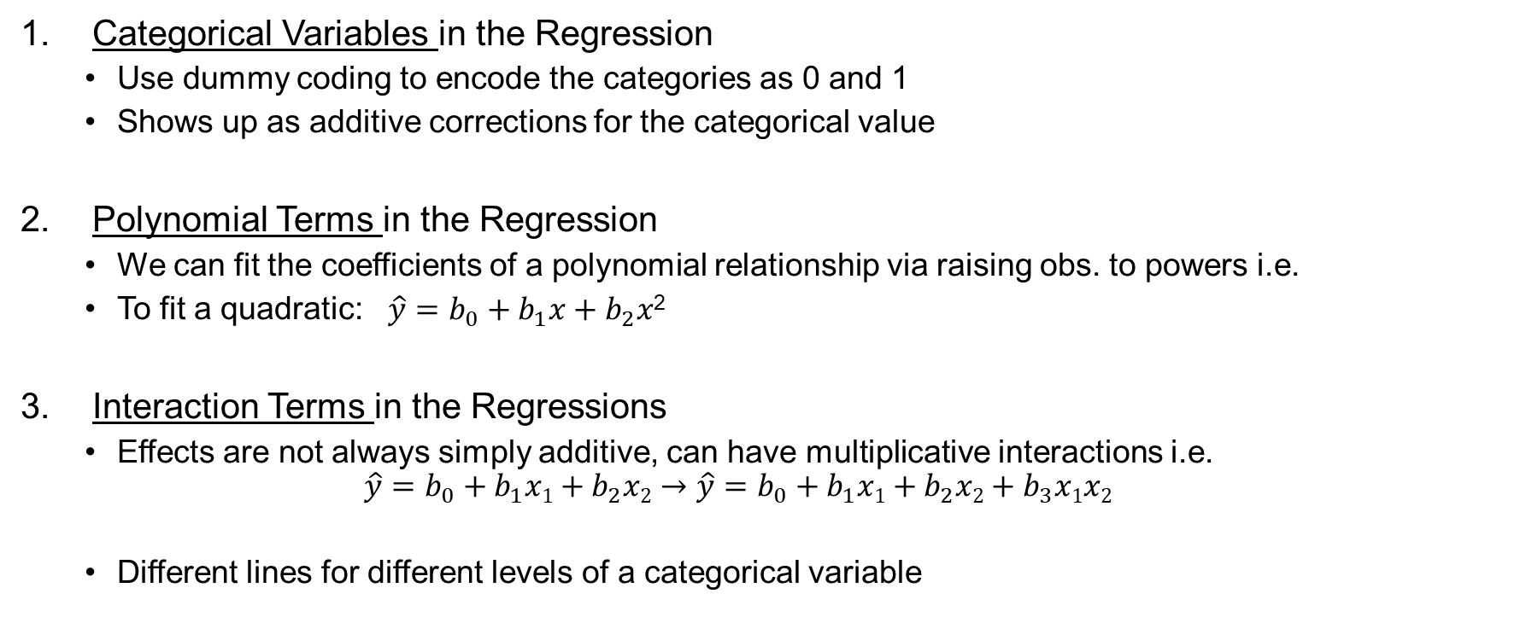
Advanced Topic: Heterogeneous Variable Types
Categorical Variables in the Regression
Use dummy coding to encode the categories as 0 and 1
Shows up as additive corrections for the categorical value
Polynomial Terms in the Regression
We can fit the coefficients of a polynomial relationship via raising obs. to powers i.e.
To fit a quadratic: $\hat{y}=b_{0}+b_{1}x+b_{2}x$²
Interaction Terms in the Regressions
Effects are not always simply additive, can have multiplicative interactions i.e.
$$\hat{y}=b_{0}+b_{1}x1+b_{2}x2→\hat{y}=b_{0}+b_{1}x1+b_{2}x2+b_{3}x1x2$$
Different lines for different levels of a categorical variable
New variable, simply the square of the x
New variable, product of x₁ and x₂

Slide 9
Categorical Variables
Thus far, we’ve seen regressions characterized by:
Numeric response (Y) variable
Example: SAT Verbal Score
Numeric explanatory (X) variable(s)
Example: SAT Math Score, ACT Score, Class Rank
Idea: Explanatory variables are not just limited to numeric variables! We can incorporate categorical and higher-order variables into the regression equation with (almost) no additional work.

Slide 10
Categorical Variables: Dummy Variables
A dummy variable is a numeric variable used in regression models to represent categories. Instead of using terms like male/female or insured/uninsured, we encode categories as numeric values so statistical models can use them.
A dummy variable takes only two values: 0 = category not present and 1 = category present.
Example: Gender If we code:
Male = 0
Female = 1
Then the dummy variable equals 1 for females and 0 for males.
A dummy variable allows categorical group differences to be included in regression models, with one group serving as the reference category

Slide 11
Models with Dummy Variables
Some models have both numeric and categorical explanatory variables (e.g., gender or race)
Numeric variables can go directly into the model, but categorical variables must first be converted into numbers so the model can estimate differences between groups. This is done using dummy variables.
If a categorical variable has k levels, we need to create k-1 dummy variables that take on the values 1 if the level of interest is present and 0 otherwise.
One category is intentionally left out and becomes the baseline (reference) group, where all dummy variables equal 0.
The baseline level of the categorical variable for which all k-1 dummy variables are set to 0
This avoids a problem called perfect multicollinearity, where including all k categories would create redundant information and make the model impossible to estimate
In the regression, each dummy variable coefficient represents how much the mean outcome for that category differs from the baseline group, after accounting for all other variables in the model.
The coefficient tells you how that group compares to the reference category, holding numeric predictors constant.
The baseline group serves as the comparison point, and each dummy coefficient shows how much higher or lower the outcome is for each other category relative to that group.

Slide 12
Interpreting Dummy Variables
Can add categorical variables to the regression model, but first need to create dummy codes
If k categories, you only need k-1 dummy variables
Other category acts as the reference group; absorbed into intercept
Each dummy variable acts as an indicator of whether the observation is in that category
Each dummy coefficient can be interpreted as the average difference in Y between the dummy category and the reference group.
Specifically, the dummy coefficients are the linear correction in the model for that level relative to the reference group.
issues-osu.github.io/statsii-spring2026/static/johfre-freese-2021-reconsidering-the-reference-category.pdf

Slide 13
Reconsidering the Reference Category
Social scientists often present modeling results from categorical explanatory variables, such as gender, race, and marital status, as coefficients representing contrasts to a “reference” group. Although choosing the reference category may seem arbitrary, the authors argue that it is an intrinsically meaningful act that affects the interpretability of results. Reference category selection foregrounds some contrasts over others. Also, selecting a culturally dominant group as the reference can subtly reify the notion that dominant groups are the most “normal.” The authors find that three of four recently published tables in Demography and American Sociological Review that include race or gender explanatory variables use dominant groups (i.e., male or white) as the reference group. Furthermore, the tables rarely state what the reference is: only half of tables with race variables and one-fifth of tables with gender variables explicitly specify the reference category; the rest leave it up to the reader to check the methods section or simply guess. As an alternative to this apparently standard practice, the authors suggest guidelines for intentionally and responsibly choosing a reference category. The authors then discuss alternative ways to convey results from categorical explanatory variables that avoid the problems of reference categories entirely.

Slide 14

Categorical Variables and Dummies
Idea: Use a binary (0/1) variable to identify different groups i.e. X_{i} = 1 if observation is of the category and X_{i} = 0 otherwise.
The binary categorical variable acts as an additive correction term.
Suppose x₂ is binary with coeff. ${\hat{β}}_{2}$.
Then the model is: $\hat{y} ={\hat{β}}_{0}+{\hat{β}}_{1}x1$+ ${\hat{β}}_{2}$ $x2$ which splits into:
$\hat{y}\left|\text{(}\text{x}\text{2} \text{=} \text{0)} ={\hat{β}}_{0}+{\hat{β}}_{1}x1 \hat{y}\right|\text{(}\text{x}\text{2} \text{=} \text{1}\text{)} ={\hat{β}}_{0}+{\hat{β}}_{1}x1$+ ${\hat{β}}_{2}$
Additive Correction

Slide 15
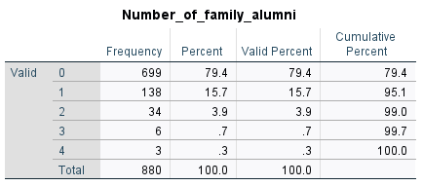
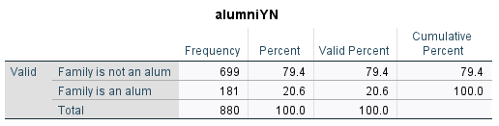
Example: Recoding dummy variables
Use the school admissions data variable for whether a student is an alum and recode it as a simple binary variable (Y/N).
Label the groups with no alum family 0, else 1
The “0” group is called the reference group, no additive correction present here
We will use it in a multiple linear regression where the “slope” for the binary categorical variable we create will represent the difference in the intercepts between of the two groups

Slide 16
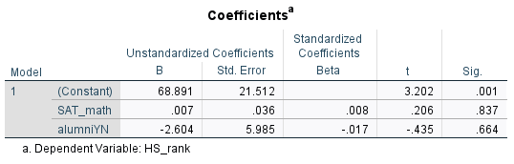
Example
Run a multiple linear regression of HS class rank on Math SAT score and the dummy variable coding the effect of having a family member as an alum (=1) or not (=0)
With only two groups,
the dummy variable represents
the average difference in HS rank between students who have family members that are an alumni and those who do not.
Note: this is not really any different, an increase in X means going from 0 to 1
Interpretation: the estimated difference in HS rank between students who have family that are alumns and those who do not is -2.604. Students who have one or more family members who are alums have a HS rank that is 2.604 points lower, on average, holding SAT score constant at its mean.
Regression Equation:
Rank = 68.89 + .007*SAT_math – 2.6*(IF ALUM)

Slide 17

The correction
Then the model is: $\hat{y} ={\hat{β}}_{0}+{\hat{β}}_{1}x1$+ ${\hat{β}}_{2}$ $x2$ which splits into:
$\hat{y}\left|\text{(}\text{x}\text{2}\text{=0)} ={\hat{β}}_{0}+{\hat{β}}_{1}x1 \hat{y}\right|\text{(}\text{x}\text{2}\text{=}\text{1}\text{)} ={\hat{β}}_{0}+{\hat{β}}_{1}x1$+ ${\hat{β}}_{2}$
Regression Equation:
Rank = 68.89 + .007*SAT_math – 2.6*(IF ALUM)
Regression Equation:
Rank|Alum = 0: 68.89 + .007*SAT_math
Regression Equation:
Rank|Alum = 1: = 68.89 + .007*SAT_math – 2.6*(1)

Slide 18
SAT Math | Family is Alumni | Predicted Class Rank
100 | 0 | 69.59
100 | 1 | 66.99
500 | 0 | 72.39
500 | 1 | 69.79

Slide 19
Creating ‘Fast Dummies’ in R
1. No more dummy variables! R automatically creates k−1 dummy variables.
data$race <- factor(data$race)
model <- lm(y ~ race + age + income, data = data)
2. FastDummies package
library(fastDummies)
data_dum <- fastDummies::dummy_cols(
data,
select_columns = "race",
remove_first_dummy = TRUE, # avoids multicollinearity
remove_selected_columns = TRUE)
Creates columns like:
race_Black race_White race_Hispanic ...
Fast Dummies – Statistics for Social Work

Slide 20
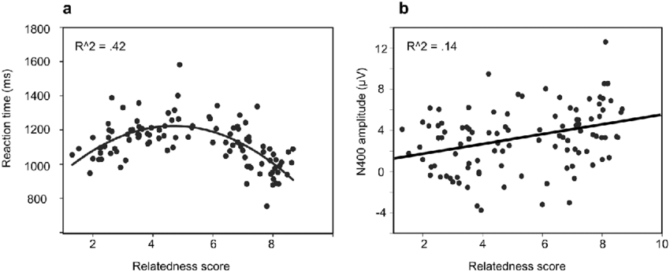

Quadratic Terms
Problem: What if, before running our multiple linear regression we look at paired scatter plots and observe that the relationship between independent and response is not simply a straight line?
One Solution: Use X² to model a curvilinear relationship:
$\hat{y}={\hat{β}}_{0}+{\hat{β}}_{1}x1+{\hat{β}}_{2}x1$²
x₁² is treated as another predictor, data is generated by simply squaring the features value for each observation!
(Barely) Linear Scatterplot
Rel.
Nonlinear Scatterplot Rel.

Slide 21
Quadratic Terms
A quadratic term is an interaction of a variable with itself, sometimes we suspect these relationships even without seeing the scatter plot.
Example: Modeling the effect of increasing the distance from Pitt on sat score might also be dependent on the current distance from Pitt, thus requiring a quadratic term
Warning: Adding quadratic terms increases the number of variables in your model like anything else, and thus hurts the models R² unless this relationship is strongly present
It’s also an easy way to overfit your data, can lead to bizarre predictions!

Slide 22
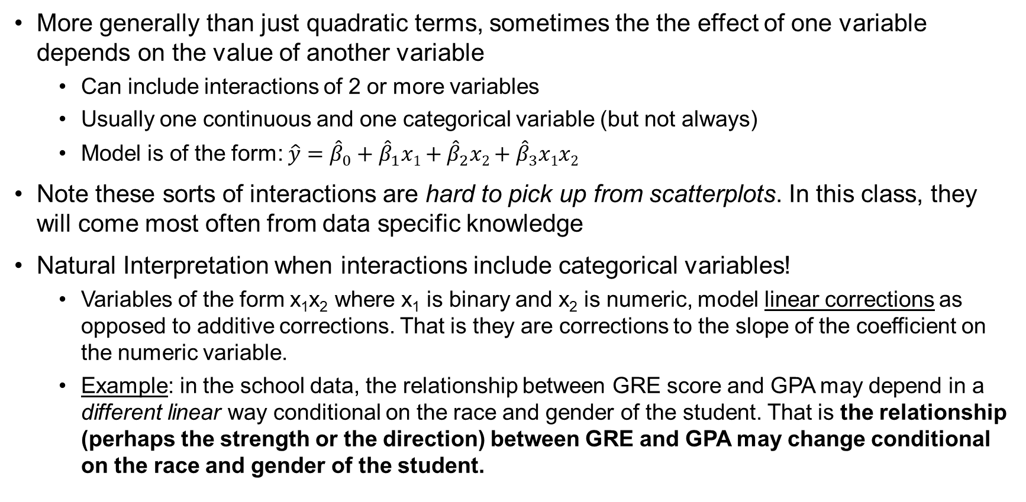
Interaction Terms
More generally than just quadratic terms, sometimes the the effect of one variable depends on the value of another variable
Can include interactions of 2 or more variables
Usually one continuous and one categorical variable (but not always)
Model is of the form: $\hat{y}={\hat{β}}_{0}+{\hat{β}}_{1}x1+{\hat{β}}_{2}x2+{\hat{β}}_{3}x1x2$
Note these sorts of interactions are hard to pick up from scatterplots. In this class, they will come most often from data specific knowledge
Natural Interpretation when interactions include categorical variables!
Variables of the form x₁x₂ where x₁ is binary and x₂ is numeric, model linear corrections as opposed to additive corrections. That is they are corrections to the slope of the coefficient on the numeric variable.
Example: in the school data, the relationship between GRE score and GPA may depend in a different linear way conditional on the race and gender of the student. That is the relationship (perhaps the strength or the direction) between GRE and GPA may change conditional on the race and gender of the student.

Slide 23
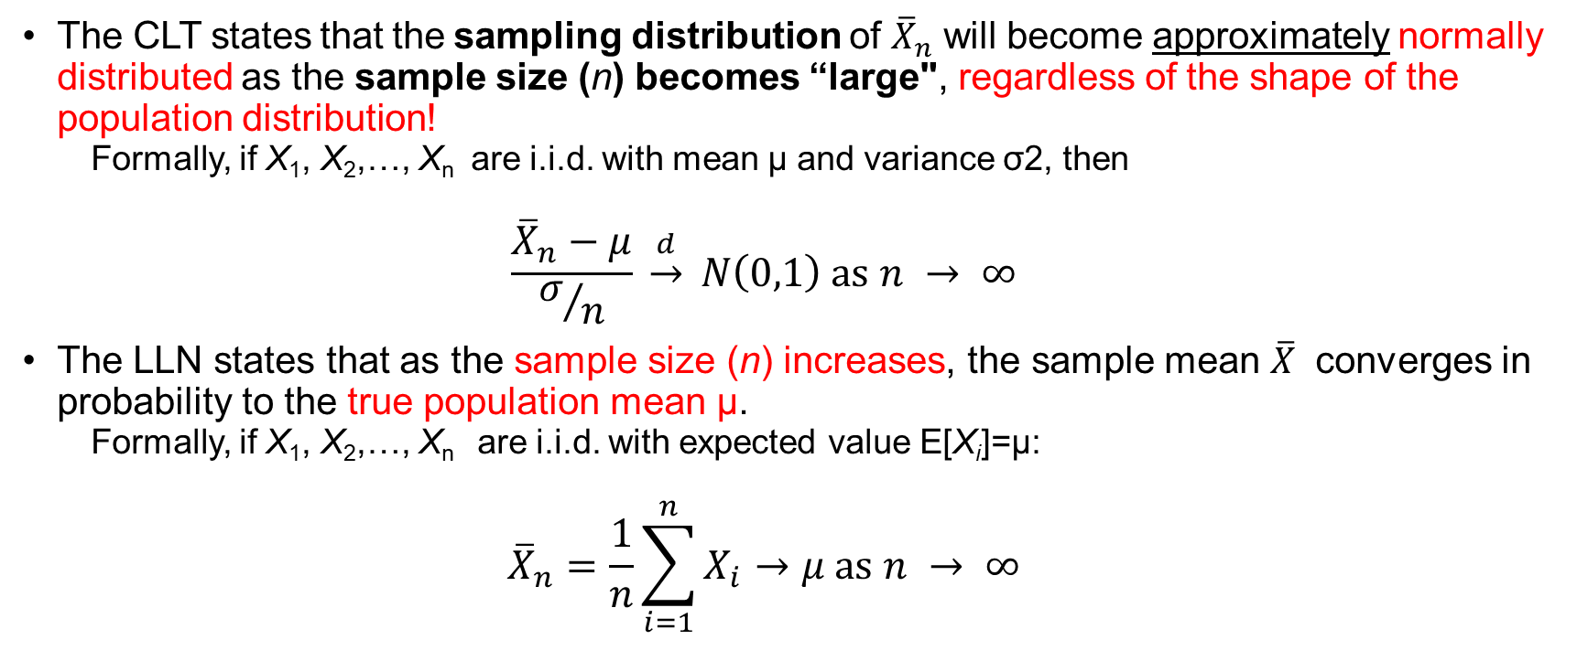
Central Limit Theorem (CLT) & the Law of Large Numbers (LLN)
The CLT states that the sampling distribution of ${\overline{X}}_{n}$ will become approximately normally distributed as the sample size (n) becomes “large", regardless of the shape of the population distribution!
Formally, if X₁, X₂,…, X_{n​} ​ are i.i.d. with mean μ and variance σ2, then
$$\frac{{\overline{X}}_{n}−μ}{σ/n} \underset{→}{d} Ν\left(0,1\right) as n → ∞$$
The LLN states that as the sample size (n) increases, the sample mean $\overline{X}$ converges in probability to the true population mean μ.
Formally, if X₁, X₂,…, X_{n​} ​ ​ are i.i.d. with expected value E[X_{i}]=μ:
$${\overline{X}}_{n}=\frac{1}{n}\sum_{i=1}^{n}{X_{i}}→μ as n → ∞$$
CLT makes averages normal, not data normal.

Slide 24
Central Limit Theorem (CLT)
The CLT tells us that the distribution of the sample mean is centered around the true mean
The variance of the sample mean decreases as n increases
With normality approximation of the sampling distribution, we can perform interval estimation around the population mean
The Central Limit Theorem (CLT) has profound implications for confidence intervals and sampling distributions in statistics

Slide 25
Implications for Sampling Distributions
The CLT states that, for a sufficiently large sample size, the sampling distribution of the sample mean will be approximately normal, regardless of the shape of the population distribution.
This allows us to make statistical inferences even when the original population distribution is skewed, bimodal, or non-normal.
The larger the sample size, the closer the sampling distribution will be to normality.

Slide 26
Implications for Confidence Intervals
Confidence intervals (CIs) rely on the assumption that the sampling distribution of the mean is normal
Because of the CLT, we can use the normal distribution (Z-distribution, t-distribution) to compute confidence intervals for population parameters, even if the underlying population is non-normal
As sample size increases:
The standard error (𝜎/𝑛) decreases, leading to narrower confidence intervals (greater precision)
The sampling distribution becomes more normal, making parametric inference more reliable

Slide 27
Practical Considerations
Small Sample Sizes (𝑛<30): If the population is normal, the sampling distribution is also normal, and confidence intervals can be computed using the t-distribution
Large Sample Sizes (𝑛≥30): The CLT ensures that the sampling distribution is approximately normal, even if the population is not (?)
Skewed or Heavy-Tailed Distributions: A larger sample size is needed (e.g., 𝑛≥50 or more) for the CLT to take effect
We don’t need data to be normal; we need the sampling distribution to be normal. With large samples, CLT handles this. With small samples, normality assumptions matter.

Slide 28
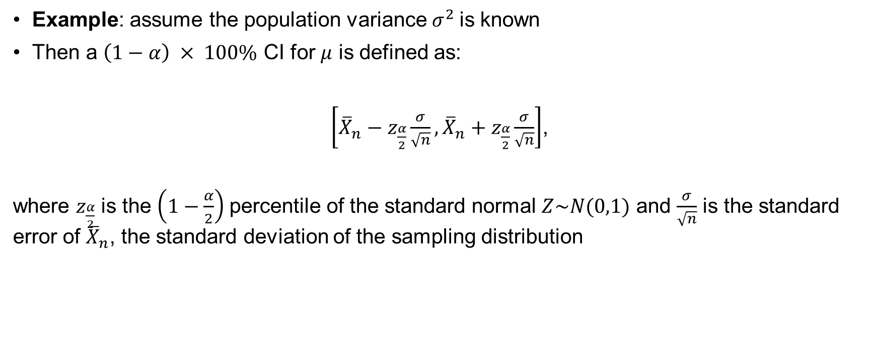
Constructing Confidence Intervals (CIs) for $μ$
Example: assume the population variance $σ^{2}$is known
Then a $\left(1−α\right) × 100\%$ CI for $μ$ is defined as:
$\left[{\overline{X}}_{n}−z_{\frac{α}{2}}\frac{σ}{\sqrt{n}},{\overline{X}}_{n}+z_{\frac{α}{2}}\frac{σ}{\sqrt{n}}\right]$,
where $z_{\frac{α}{2}}$ is the $\left(1−\frac{α}{2}\right)$percentile of the standard normal $Z\sim N(0,1)$ and $\frac{σ}{\sqrt{n}}$ is the standard error of ${\overline{X}}_{n}$, the standard deviation of the sampling distribution

Slide 29
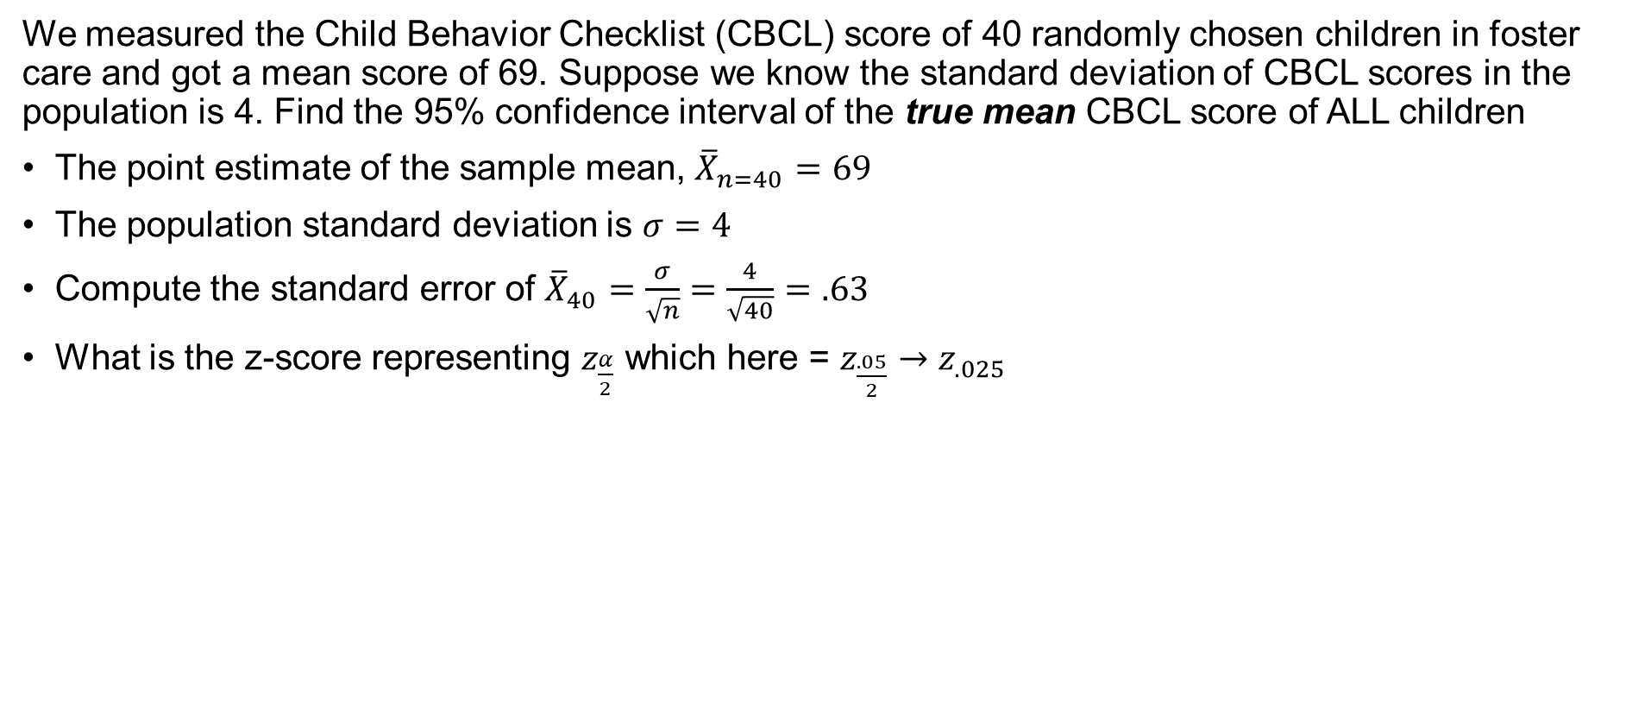
Example
We measured the Child Behavior Checklist (CBCL) score of 40 randomly chosen children in foster care and got a mean score of 69. Suppose we know the standard deviation of CBCL scores in the population is 4. Find the 95% confidence interval of the true mean CBCL score of ALL children
The point estimate of the sample mean, ${\overline{X}}_{n=40}=69$
The population standard deviation is $σ=4$
Compute the standard error of ${\overline{X}}_{40}=\frac{σ}{\sqrt{n}}=\frac{4}{\sqrt{40}}=.63$
What is the z-score representing $z_{\frac{α}{2}}$ which here = $z_{\frac{.05}{2}}{→z}_{.025}$
$$\left[{\overline{X}}_{n}−z_{\frac{α}{2}}\frac{σ}{\sqrt{n}},{\overline{X}}_{n}+z_{\frac{α}{2}}\frac{σ}{\sqrt{n}}\right]$$
$$\left[69−1.96(.63),69+1.96(.63) \right]$$
$$\left[67.77, 70.23\right]$$
Reflects the uncertainty of our estimate

Slide 30
How do we interpret the CI?
In general, If we were to take many random samples then (1 −𝛼 )% of these confidence intervals will contain the true population mean, 𝜇
[67.77, 70.23] (?)
This means that we are 95% confident that the true population mean lies in the interval [67.77, 70.23]
Recall: there is a relationship between the confidence interval and hypothesis testing
Any value outside the confidence interval is in our rejection region
So, the confidence interval represents the outermost limits of statistical significance
A CBCL score of 65 is too unlikely to occur by chance and is significantly different from the population mean of 69
What about a score of 70?

Slide 31
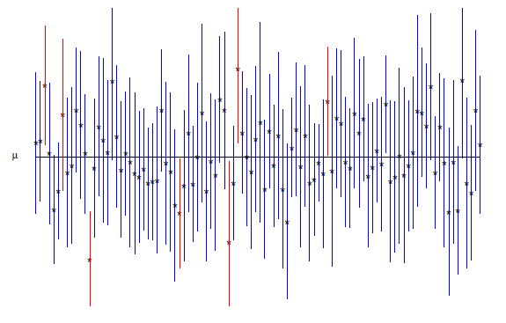
Conceptual Understanding of CIs
The vertical lines (error bars) represent confidence intervals around the estimated means.
The small dots at the center of each line are the point estimates (e.g., means or effect sizes).
The red lines are significantly above the mean, the blue lines overlap
The blue lines indicate estimates that contain the reference value (μ).
The red lines indicate confidence intervals that do not include μ, suggesting statistical significance

Slide 32

Central Limit Theorem (CLT) - Redux
The sampling distribution of ${\overline{X}}_{n}$ will become approximately normally distributed as the sample size (n) becomes “large", regardless of the shape of the population distribution!

Slide 33
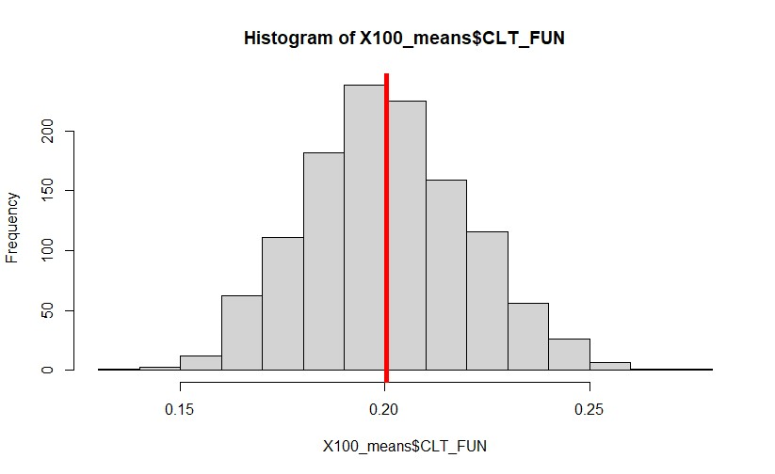
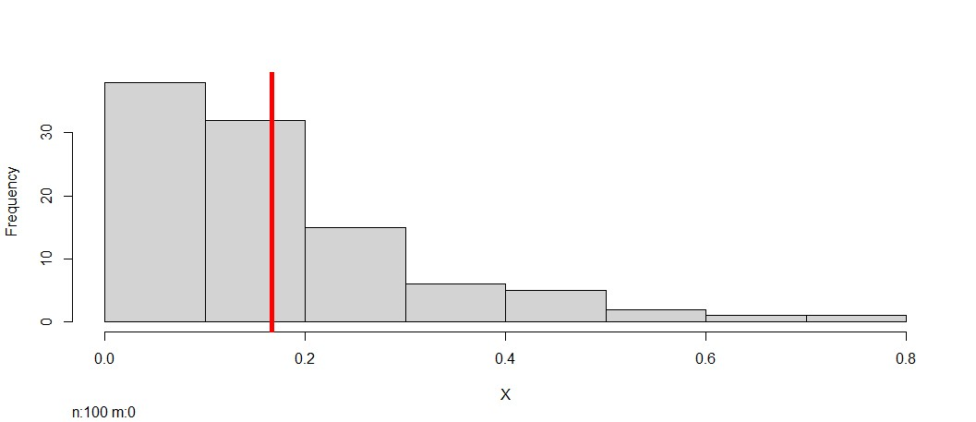
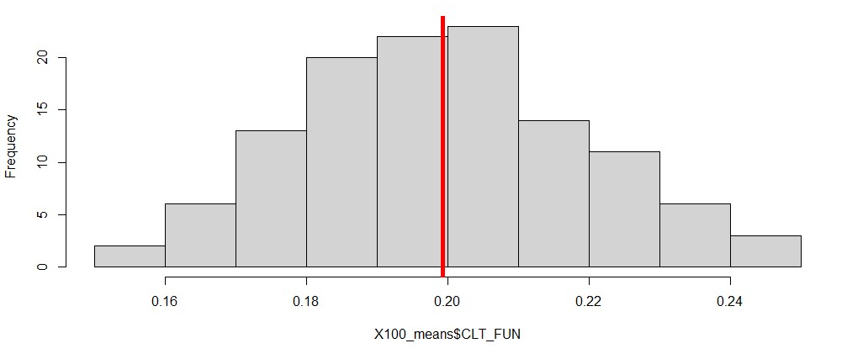
From exponential to normal?
See my R code called clt_fun.R
I took n = 100 observations from an exponential distribution with mean = .20 and plotted it (to the left)
Then I repeated this process 120 times (took 120 samples of n = 100 observations) and plotted the mean of each sample – according to the CLT this plot of the means should look normal ☺
Mean of 120 samples of n = 100 observations from
an exponential distribution
Exponential Distribution (n = 100 observations)
Try increasing the number of samples from 120 to 1200

Slide 34

“Sharpton took to X/Twitter to call out the jury selection process after only four Black people were selected as possible jurors for the New Yorker’s case, writing: “It has been brought to my attention by the [his civil rights organisation] National Action Network’s Los Angeles office that out of 106 people called to potentially sit as jurors in A$AP Rocky’s trial in Los Angeles, there are only four Black people.”
Al Sharpton says "ridiculous" jury selection process may "deprive A$AP Rocky of a fair trial"

Slide 35
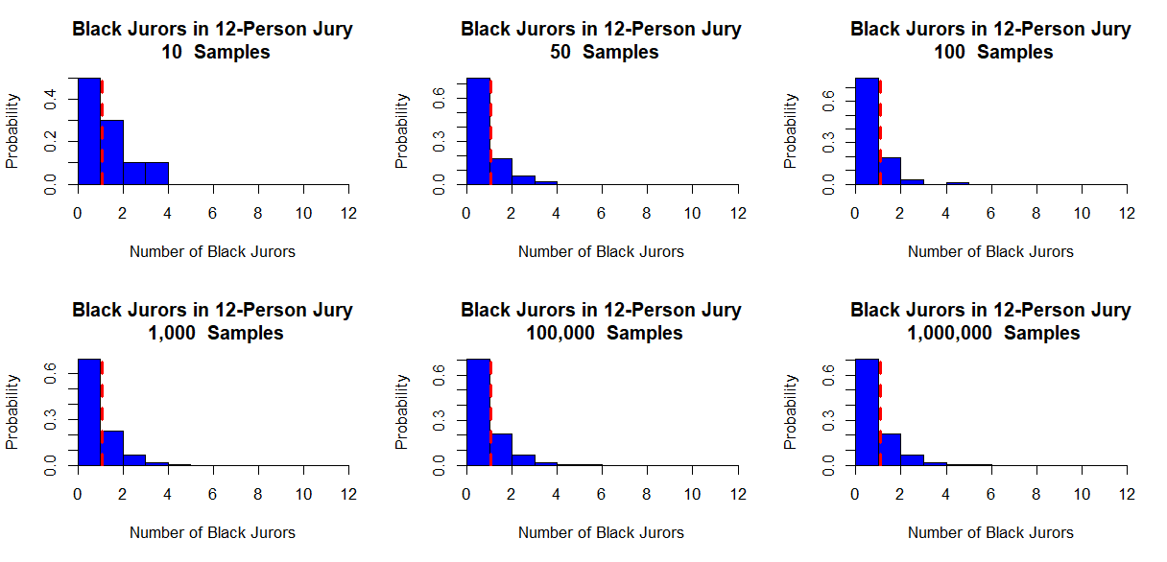
Why is the distribution not converging to normal?
See my write-up on A$AP Rocky
Notes:
The distribution is not converging because I am plotting the distribution of counts in a small jury (n = 12), not the distribution of averages across large samples.
This distribution is actually binomial, not normal, and since jury size stays fixed at 12, it remains skewed even when you simulate many juries. Increasing the number of simulations just makes the histogram smoother; it doesn’t change the underlying shape.

Slide 36
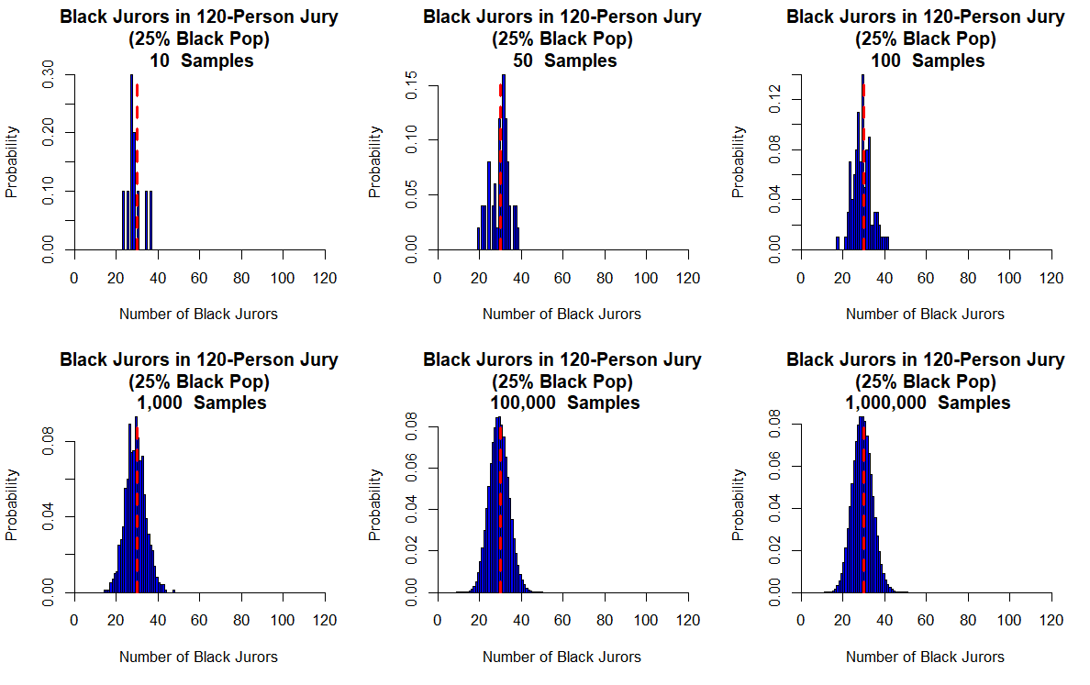
Low precision
Low confidence
Higher precision
More confidence
Notes:
Now each sample contains many more people, so:
• sampling variability shrinks • results cluster around the expected value • the distribution looks much more normal.
Now CLT conditions begin to apply because the sample size per draw is large.

