Slide 2
Overview
Simple linear regression (an overview)
What multiple linear regression is and how it works
  Characteristics
  Sample size
  Power
  Effect Size
  Assumptions
Mathematical introduction snapshot
Code and examples posted to CANVAS for W3

Slide 3
Model selection for continuous dependent variables
Outcome Variable | Are the observations independent or correlated? |  | Alternatives if the normality assumption is violated (and small sample size):
 | independent | correlated
Continuous (e.g. pain scale, cognitive function) | T-test: compares means between two independent groups ANOVA: compares means between more than two independent groups Pearson’s correlation coefficient (linear correlation): shows linear correlation between two continuous variables Linear regression: multivariate regression technique used when the outcome is continuous; gives slopes | Paired ttest: compares means between two related groups (e.g., the same subjects before and after) Repeated-measures ANOVA: compares changes over time in the means of two or more groups (repeated measurements) Mixed models/GEE modeling: multivariate regression techniques to compare changes over time between two or more groups; gives rate of change over time | Non-parametric statistics Wilcoxon sign-rank test: non-parametric alternative to the paired ttest Wilcoxon sum-rank test (=Mann-Whitney U test): non-parametric alternative to the ttest Kruskal-Wallis test: non-parametric alternative to ANOVA Spearman rank correlation coefficient: non-parametric alternative to Pearson’s correlation coefficient
See PTSD_foster_care.jasp

Slide 4
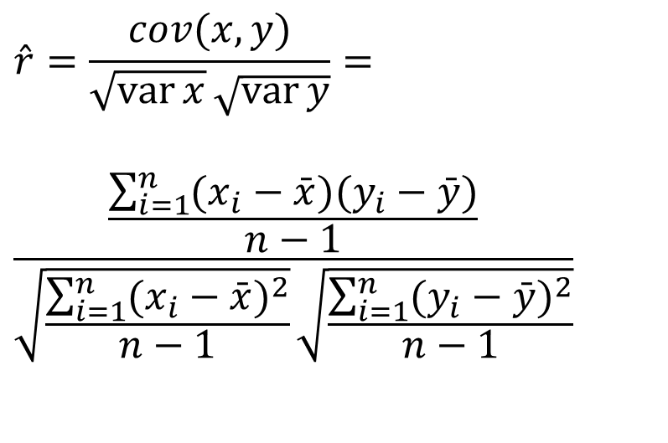
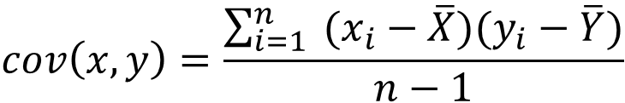
Covariance and Correlation
$$\hat{r}=\frac{cov(x,y)}{\sqrt{\operatorname{var}{x}}\sqrt{\operatorname{var}{y}}}=$$
$$\frac{\frac{\sum_{i=1}^{n}{(x_{i}−\bar{x})(y_{i}−\bar{y})}}{n−1}}{\sqrt{\frac{\sum_{i=1}^{n}{(x_{i}−\bar{x})^{2}}}{n−1}}\sqrt{\frac{\sum_{i=1}^{n}{(y_{i}−\bar{y})^{2}}}{n−1}}}$$
$$cov\left(x,y\right)=\frac{\sum_{i=1}^{n}{ (x_{i}−\overline{X})(y_{i}−\overline{Y})}}{n−1}$$
cov(X,Y) > 0 → X and Y are positively correlated
cov(X,Y) < 0 → X and Y are inversely correlated
cov(X,Y) = 0 → X and Y are independent
Standardized covariance (recall standardization)
Measures the relative strength of the linear relationship between two variables
Unit-less

Slide 5
Scatter Plots of Data with Various Correlation Coefficients
Y
Y
Y
X
X
X
r = -1
r = -.6
r = 0
Y
Y
Y
X
X
X
r = +1
r = +.3
r = 0

Slide 6
Linear Correlation
Linear relationships
Curvilinear relationships
Y
Y
X
X
Y
Y
X
X

Slide 7
Linear Correlation
Strong relationships
Weak relationships
Y
Y
X
X
Y
Y
X
X

Slide 8
Model selection for continuous dependent variables
Outcome Variable | Are the observations independent or correlated? |  | Alternatives if the normality assumption is violated (and small sample size):
 | independent | correlated
Continuous (e.g. pain scale, cognitive function) | T-test: compares means between two independent groups ANOVA: compares means between more than two independent groups Pearson’s correlation coefficient (linear correlation): shows linear correlation between two continuous variables Linear regression: multivariate regression technique used when the outcome is continuous; gives slopes | Paired ttest: compares means between two related groups (e.g., the same subjects before and after) Repeated-measures ANOVA: compares changes over time in the means of two or more groups (repeated measurements) Mixed models/GEE modeling: multivariate regression techniques to compare changes over time between two or more groups; gives rate of change over time | Non-parametric statistics Wilcoxon sign-rank test: non-parametric alternative to the paired ttest Wilcoxon sum-rank test (=Mann-Whitney U test): non-parametric alternative to the ttest Kruskal-Wallis test: non-parametric alternative to ANOVA Spearman rank correlation coefficient: non-parametric alternative to Pearson’s correlation coefficient
See PTSD_foster_care.jasp

Slide 9
Uses of Regression Analysis
Regression analysis serves 3 major purposes:
    Description
    Prediction
    Control → ceteris paribus
The several purposes of regression analysis frequently overlap in practice

Slide 10
Mechanics
Simple regression analysis is a statistical tool that gives us the ability to estimate the relationship between a dependent variable (usually called y) and an independent variable (usually called x).
  The dependent variable is the variable for which we want to make a prediction
  While various non-linear forms may be used, simple linear regression models are the most common (and the most useless)

Slide 11
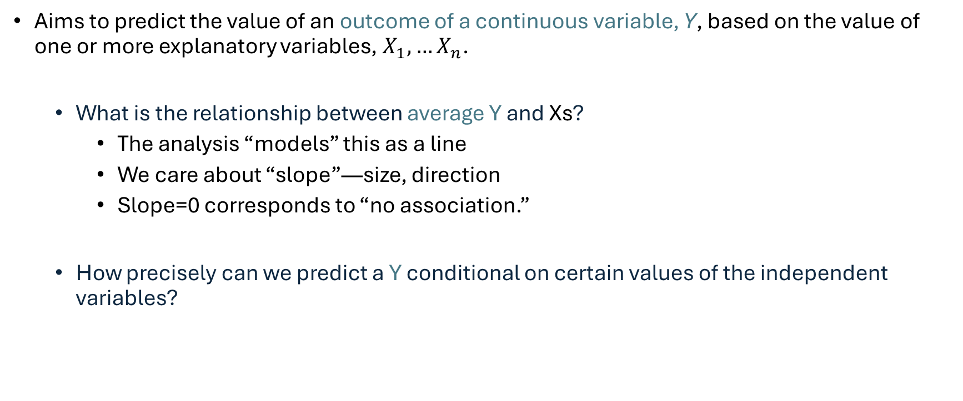
Introduction: Linear Regression
Aims to predict the value of an outcome of a continuous variable, Y, based on the value of one or more explanatory variables, $X_{1}, …X_{n}$.
  What is the relationship between average Y and Xs?
    The analysis “models” this as a line
    We care about “slope”—size, direction
    Slope=0 corresponds to “no association.”
  How precisely can we predict a Y conditional on certain values of the independent variables?

Slide 13
Linear regression –Terminology
Outcome, Y
  Dependent variable
  Response variable
Explanatory variable (predictor), X
  Independent variable
  Covariate

Slide 14

Functional Form
Y
The first order linear model
  Y = dependent variable
  X = independent variable
  b = Y-intercept
  m = slope of the line
  Define b, and m
$$Y=mX+b$$
Rise
b
Run
X
Notes:
m = slope → change in Y over change in X

Slide 15
The Model
Housing Size | Housing Cost
0 sq. ft. | $25,000
1,000 sq. ft. | $100,000
2,500 sq. ft. | $212,500
The model has a deterministic and a probabilistic components
House Cost
Building a house costs about
$75 per square foot.
House cost = 25000 + 75(Size)
Most lots sell
for $25,000
House size
What is the expected value of the house when the house size is 0?

Slide 16


However, house cost vary even among same size houses!
House cost = 25000 + 75 (Size)
+ ε
House Cost
Most lots sell for $25,000
What types of variables might be part of the error term?
Since cost behave unpredictably, we add a random component.
House size

Slide 17
β₀ and β₁ are unknown population parameters, therefore are estimated from the data.
The first order linear model
  Y = dependent variable
  X = independent variable
  β₀ = Y-intercept
  β₁ = slope of the line
  ε = error variable
Y
β₁ = Rise/Run
Rise
β₀
Run
X

Slide 18
Estimating the model parameters
The estimates are determined by
  drawing a sample from the population of interest,
  calculating sample statistics.
  producing a straight line that cuts through the data.
Y
w
w
w
w
w
w w w w
w
w w
w w
w
X
Question: What should be considered a good line?

Slide 19
The Least Squares (Regression) Line
A good line is one that minimizes the sum of squared differences between the points and the line.

Slide 20
Sum of squared differences =
(2 - 1)² +
(4 - 2)² +
(1.5 - 3)² +
(3.2 - 4)² = 6.89
Sum of squared differences =
(2 -2.5)² +
(4 - 2.5)² +
(1.5 - 2.5)² +
(3.2 - 2.5)² = 3.99
4
(2,4)
w
3
w
(4,3.2)
The smaller the sum of
squared differences
the better the fit of the
line to the data.
2.5
2
w
(1,2)
(3,1.5)
w
1
1
2
3
4

Slide 21
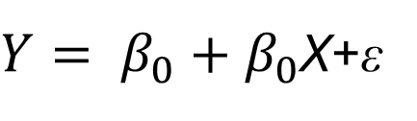
Formal statement of the model
If the scatter plot of our sample data suggests a linear relationship between two variables i.e. we can summarize the relationship by drawing a straight line on the plot.
The values of the regression parameters β₀, and β₁ are not known. We estimate them from data.
  β₀ indicates the intercept of Y
  β₁ indicates the change in the mean response in Y per unit increase in X
X is a known independent variable
Deviations ε are independent N(o, σ²)
Least squares method give us the “best” estimated line for our set of sample data.
$Y= β_{0}+β_{0}$X+ε

Slide 22
The Estimated Coefficients
To calculate the estimates of the line coefficients, that minimize the differences between the data points and the line, use the formulas:
The regression equation that estimates the equation of the first order linear model is:

