Slide 2
Multicollinearity
As the number of predictors increases, multiple regression modeling can become very complicated
Multicollinearity is when the predictors in the regression equation are correlated with each other
Example:
  Suppose you use both educational attainment and job type as independent variables to predict income
  Note educational attainment and job type are highly correlated with each other! Thus having both educational attainment and job type in your multiple regression equation may only slightly improve the R² over an equation with just educational attainment
  Might conclude that job type is highly influential on income, while educational attainment is unimportant (or vice versa) which is not true!
This happened in our paper for SSRW when we included an index of redlining, concentrated disadvantage and concentrated affluence in the model
Note that while there is substantial overlap between variables theoretically, they are quite distinguishable
  The opposite of concentrated disadvantage is not concentrated advantage
  Use theory to guide the model building!!!!!

Slide 3
What to do if you find multicollinearity?
If two variables are highly correlated, it is probably not a good idea to use both in the regression equation. Why?
  Many correlated variables hurts the Adjusted R²
  We generally prefer smaller models
  Smaller models are much easier to interpret
  Multiple regression models describe the effect of one variable on another after partialling out the effects of all other variables in the model
    Regarding MC, this means that if two variables are highly correlated, once one of them is partialled out, there is much less variation left in the other variable for the model to “explain”
    Check the partial correlation coefficients and zero order coefficients before including variables!

Slide 4
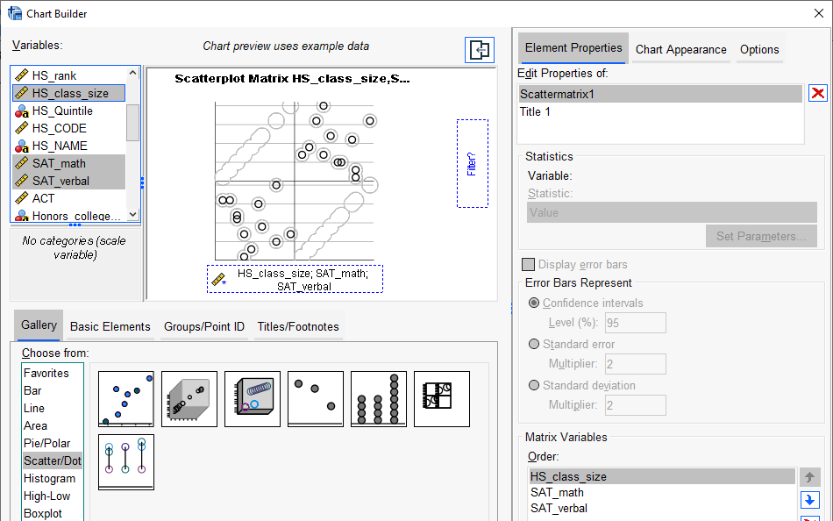
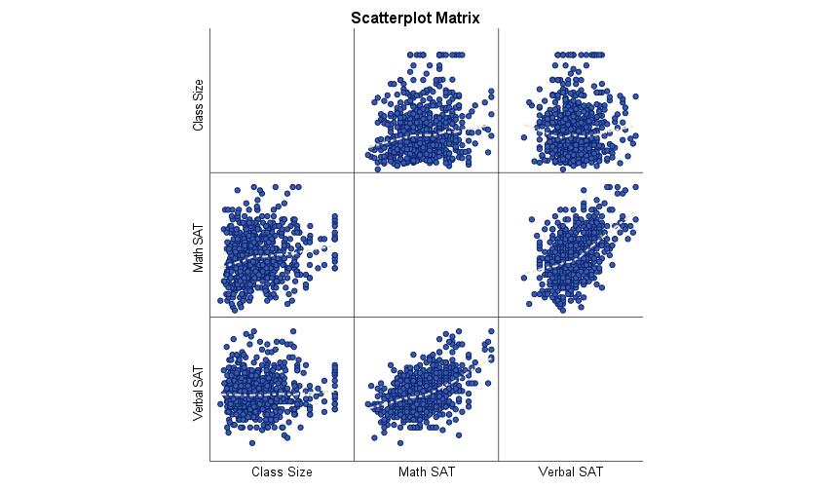
How to check for multicollinearity?
GPA data.sav
Scatterplots, Scatterplot Matrix
  A scatterplot matrix is a matrix of scatterplots, one plot for each pair of variables.
  Note: To read it, pick a plot in the matrix. Look in the column for the X variable and the row for the Y variable
Graph → Chart Builder → Scatter/Dot (drag variables into chart area)

Slide 5
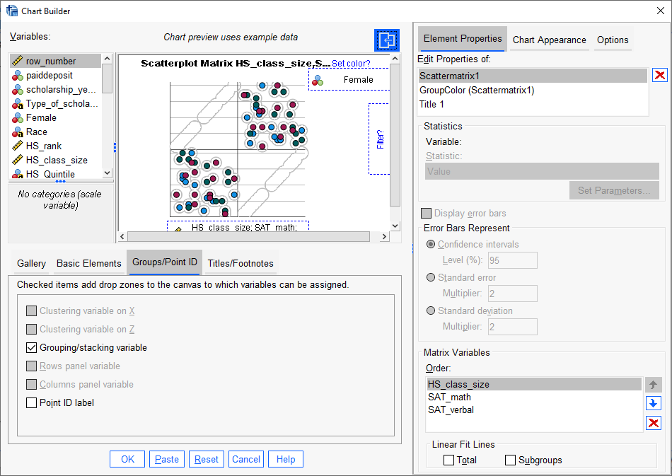
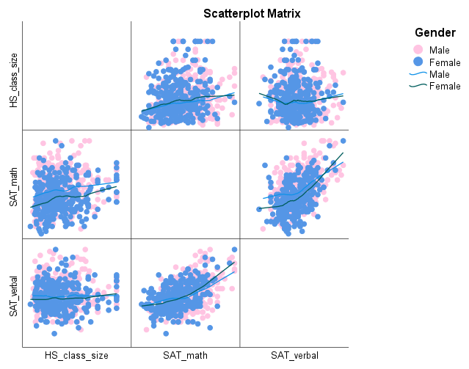
Scatterplots by Grouping Variable
Can color code a scatterplot by a categorical variable to get a sense of how the distribution of variables is heterogeneous across groups

Slide 6
Your turn
Can I predict your graduate GPA based on your undergraduate GPA & score on the GRE
GPA data.sav
Process
  First, look at descriptive statistics
  Second, calculate the zero order and partial correlations between the variables
  Third, calculate b2 using formula
  Fourth, run regression analysis
  Fifth, interpret coefficients
  Sixth, evaluate overall model for assumptions and fit

Slide 7
GRE-GPA Example Data
Student | GRE-Total (X₁) | Undergraduate GPA (X₂) | Graduate GPA(Y)
1 | 145 | 3.2 | 4.0
2 | 120 | 3.7 | 3.9
3 | 125 | 3.6 | 3.8
4 | 130 | 2.9 | 3.7
5 | 110 | 3.5 | 3.6
6 | 100 | 3.3 | 3.5
7 | 95 | 3.0 | 3.4
8 | 115 | 2.7 | 3.3
9 | 105 | 3.1 | 3.2
10 | 90 | 2.8 | 3.1
11 | 105 | 2.4 | 3.0

Slide 8
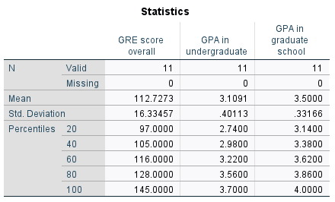
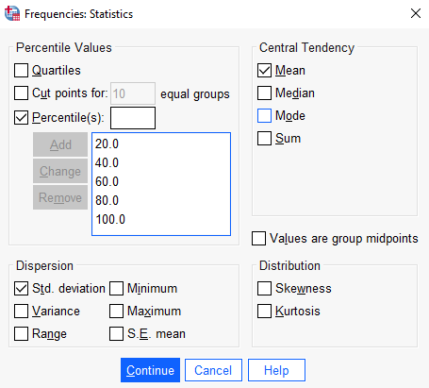
$$b_{1}=\frac{(r_{Y.X1}−r_{Y.X2}r_{12})s_{Y}}{(1−r_{12}^{2})s_{X1}}$$
Y = GPA in graduate school
X1 = GRE score
X2 = Undergraduate GPA
$$b_{1}=\frac{(r_{Y.X1}−r_{Y.X2}r_{12})s_{Y}}{(1−r_{12}^{2})s_{X1}}=\frac{\left(r_{Y.X1}−r_{Y.X2}r_{12}\right).3312}{\left(1−r_{12}^{2}\right).4011}$$

Slide 9
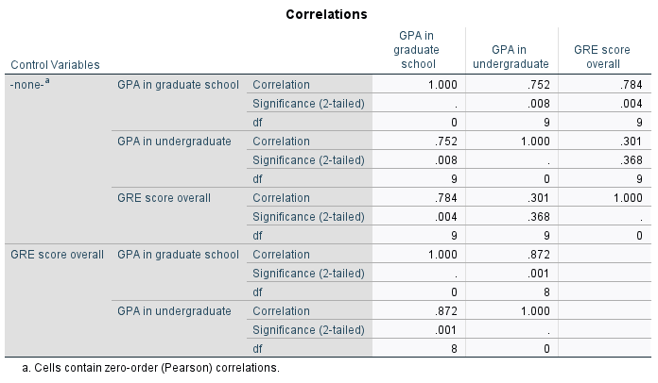
Zero order (the Pearson
you already know)
Partial correlation (the correlation after one variable has been partialed out)
$$r_{Y.X1}=.784$$
The correlation between GRE and Graduate GPA
$$r_{Y.X2}=.752$$
The correlation between GRE and Undergrad GPA
$$r_{12}=.301$$
The partial correlation between GRE and Undergraduate GPA
$$b_{1}=\frac{(r_{Y1}−r_{Y2}r_{12})s_{Y}}{(1−r_{12}^{2})s_{X1}}=\frac{[.784−(.752)(.301)].332}{(1−.301^{2})16.33}$$
$$b_{2}=\frac{(r_{Y.X2}−r_{Y.X1}r_{12})s_{Y}}{(1−r_{12}^{2})s_{X2}}=\frac{[.7516−(.784)(.301)].332}{(1−.301^{2}).401}$$

Slide 10
Sample Partial Slope and Intercept
$$b_{1}=\frac{(r_{Y1}−r_{Y2}r_{12})s_{Y}}{(1−r_{12}^{2})s_{X1}}=\frac{[.7845−(.7516)(.3011)].3317}{(1−.3011^{2})16.3346}=.0125$$
$$b_{2}=\frac{(r_{Y.X2}−r_{Y.X1}r_{12})s_{Y}}{(1−r_{12}^{2})s_{X2}}=\frac{[.7516−(.7845)(.3011)].3317}{(1−.3011^{2}).4011}=.4687$$
$$b_{0}=\bar{Y}−b_{1}{\bar{X}}_{1}−b_{2}{\bar{X}}_{2}=3.5000−(.0125)(112.7273)−(.4687)(3.1091)=.6337$$

Slide 11
Sample Multiple Linear Regression Model
Y_{i} = $b_{0}$+ $b_{1}X_{1}+b_{2}X_{2}$+ e_{i}
$\hat{Y\text{i}}$= .6337 + .0125 X₁ + .4687 X₂ + e_{i}
If your score on the GRETOT was 130 and your UGPA was 3.5, then your predicted score on the GGPA would be computed as:
  $\hat{Y\text{i}}$ = .0125 (130) + .4687 (3.5000) + .6337 = 3.8992

Slide 12
Overall F Test Statistic
$$F=\frac{SS_{reg}/df_{reg}}{SS_{res}/df_{res}}=\frac{0.9998/2}{.1002/8}=39.9122$$
The null: all slopes equal 0
The critical value, at the .05 level of significance, is _{.05} F _{2,8} = 4.46
Test statistic exceeds the critical value, so we reject H₀ and conclude that all of the partial slopes are not equal to zero at the .05 level of significance

Slide 13
Re-visiting Multicollinearity (summary)
One of the assumptions of the linear regression model is that there is no exact linear relationship among the regressors
  Perfect collinearity: A perfect linear relationship between the two variables exists.
  Imperfect collinearity: The regressors are highly (but not perfectly) collinear
Why care?
  Even though some regression coefficients are statistically insignificant, the R2 value may be very high.
  One may conclude (misleadingly) that the true values of these coefficients are not different from zero

Slide 14
Variance Inflation Factor
$$Y_{i}=β_{0}+β_{1}X_{1i}+β_{2}X_{2i}+u_{i}$$
$$VIF=\frac{1}{1−r_{12}^{2}}$$
VIF is a measure of the degree to which the variance of the OLS estimator is inflated because of collinearity.

Slide 15
Clues that MC is a problem
High R² but few significant t ratios
High pair-wise correlations among explanatory variables or regressors
High partial correlation coefficients
High Variance Inflation Factor (VIF) and low Tolerance Factor (TOL, the inverse of VIF)

Slide 16
What should we do if we detect multicollinearity?
Nothing, for we often have no control over the data and our model is driven by theory
Redefine the model by excluding variables may attenuate the problem, provided we do not omit relevant variables
Principal components analysis (this is something we will cover later)

Slide 17
What to do if you find multicollinearity?
If two variables are highly correlated, it is probably not a good idea to use both in the regression equation. Why?
  Many correlated variables hurts the Adjusted R²
  We generally prefer smaller models
  Smaller models are much easier to interpret
  Multiple regression models describe the effect of one variable on another after partialling out the effects of all other variables in the model
    - Regarding MC, this means that if two variables are highly correlated, once one of them is partialled out, there is much less variation left in the other variable for the model to “explain”

Slide 18
Multicollinearity
As the number of predictors increases, multiple regression modeling can become very complicated
Multicollinearity is when the predictors in the regression equation are correlated with each other
Example:
  Suppose you use both educational attainment and job type as independent variables to predict income.
  Note educational attainment and job type are highly correlated with each other! Thus having both educational attainment and job type in your multiple regression equation may only slightly improve the R² over an equation with just educational attainment
  Might conclude that job type is highly influential on income, while educational attainment is unimportant (or vice versa) which is not true!
  This happened in our paper for SSRW when we included an index of redlining, concentrated disadvantage and concentrated affluence in the model
  Note that while there is substantial overlap between variables theoretically, they are quite distinguishable
    The opposite of concentrated disadvantage is not concentrated advantage
    Use theory to guide the model building!!!!!

Slide 19
How to check for multicollinearity?
Scatterplots, Scatterplot Matrix
  A scatterplot matrix is a matrix of scatterplots, one plot for each pair of variables.
  Note: To read it, pick a plot in the matrix. Look in the column for the X variable and the row for the Y variable
Graph → Chart Builder → Scatter/Dot (drag variables into chart area)

Slide 20
Scatterplots by Grouping Variable
Can color code a scatterplot by a categorical variable to get a sense of how the distribution of variables is heterogeneous across groups

Slide 21
Sampling Distributions & Inference
We can calculate the standard errors of the coefficients: $b_{0}$, $b_{1}$, in order to construct confidence intervals for them.
We can use t-tests to determine whether the intercept or slope is significantly different from zero
  This is only interesting for the case of the slope, since it amounts to a test for whether Y is significantly linearly related to X
Idea: To check whether the data really is drawn from an Assumed Linear Model (so that we can make inferences) we must make sure the assumptions of the error term are satisfied
  Fatal to the model: the variance is not constant, or the errors are not normally distributed

Slide 22
Four testable model assumptions
$$y=β_{0}+β_{1}x+ε$$
Linearity: Linear association between the dependent variable and the independent variable
  The mean values of response variables fall on a straight line as a function of the explanatory variable
Normality: Normality of the distribution of errors i.e. normality of the residuals (pp plot, qqplot of residuals is diagonal)
Independence: Independence of the errors around the regression line between the actual and predicted values of the response variable

Slide 23
Four testable model assumptions
$$y=β_{0}+β_{1}x+ε$$
Constant variance: Equal variance of the distribution of the response variable for each level of the independent variable. (homoscedasticity, the violation is called heteroskedasticity)
  The spread of the response around the straight line is same for all levels of explanatory variable
  Errors have constant variance
equal variance
non-linear (curvilinear)
increasing variance
time trend
Notes:
Three primary types of violations common in our research

Slide 24
Checking the Assumptions
We must check to see whether these assumptions are reasonable or not.
If the assumptions hold then our assumed model is correct:
  Linearity → Use Residuals vs. Fitted plot
  Independence → Use Durbin-Watson test (we did not cover last lecture)
  Normality → Use Normal Q-Q plot
  Equal Variance → Use Residuals vs. Fitted plot

Slide 25
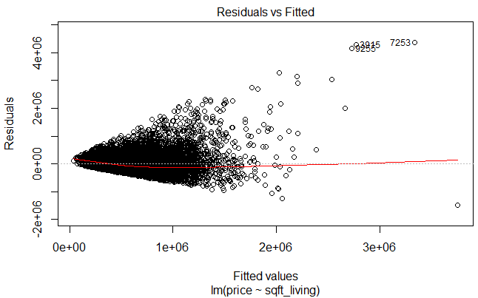
Fitted Values vs. Residuals
Looking for equal variance & linearity
Not looking for
  Curvilinear
  Non-constant variance
  Outliers
  Time trends

Slide 26
Checking for independence
Use Durbin Watson test statistic (simple)
The question is whether the residuals from the regression model are autocorrelated
  Autocorrelation is the degree to which the error term of one observation is related to the error term of a different observation
The null hypothesis: the residuals are independent
  Large p-value indicates the residuals are not correlated (GOOD)
  Small p-value indicates the residuals are correlated (BAD)
  ?
Notes:
This is VERY common when testing model diagnostics oftentimes you DO NOT want to reject the null

Slide 27
Checking for independence
The DW statistic ranges from zero to four, with a value of 2.0 indicating zero autocorrelation
  Values below 2.0 mean there is positive autocorrelation and above 2.0 indicates negative autocorrelation
  Ideally, the DW should be between 1 and 3
  SPSS gives the statistic only, JASP gives the value, the statistic and the p-value

Slide 28
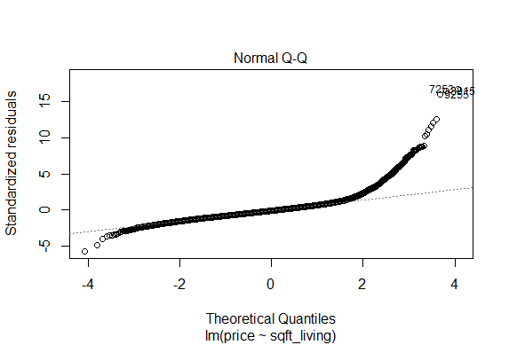
Normal Probability Plot
Looking for points to fall along dashed line (normal distribution)

Slide 29
Note
Explanatory or Predictor variables do not have to be normally distributed
The residuals must be normally distributed
  The variability in Y that is left over after we accounted for X should follow a normal distribution

Slide 30
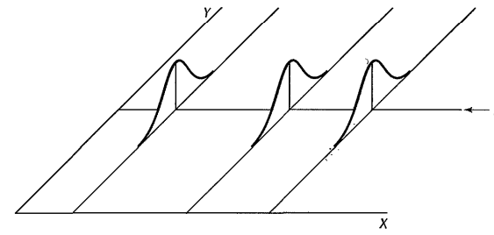
Inferences for point estimates
We are interested in drawing inferences about the slope of the regression line
The most common hypothesis to test is:
The reason for testing this is that when $β_{1}=0$there is no linear association between Y and X
$$β_{0}$$
$$H_{0}:β_{1}=0 vs.H_{0}:β_{1}≠0$$
Mean(Y$)=β_{0}+0X$ = $β_{0}$
Notes:
The probability distributions of Y are identical when the slope is 0 → there is no relationship between X and Y

Slide 31

Hypothesis testing of coefficients
We follow standard hypothesis testing for the slope parameters in a linear regression model
First, specify the null and alternative
  $H_{o}: β_{1}$= 0
  $H_{1}: β_{1}≠$0
Second, calculate the test statistic
  $t^{∗}=\frac{b_{1}−β_{1}}{{\sqrt{MSE}}/{\sqrt{{(x_{i}−\overline{x})}^{2}}}}=\frac{b_{1}−β_{1}}{se(b_{1})}$
Calculate the p-value**
  The p-value is determined by referring to a t-distribution with n – 2 df**
Decision: If p-value < $α$ reject $H_{o}$, OR
if t* > t(1- $α$/2, t-2) reject the null

Slide 32
Inferences for Confidence Intervals
$\frac{b_{1}−β_{1}}{se(b_{1})}$ follows t-distribution with n -2 degrees of freedom
Because of the symmetry of the t-distribution around its mean 0 it follows that
  $b_{1}±t_{\left(α/2, n−2\right)}×se$($b_{1}$) → $b_{1}±1.96×se$($b_{1}$)
$se$($b_{1}$) $={\sqrt{MSE}}/{\sqrt{{(x_{i}−\overline{x})}^{2}}}$

Slide 33
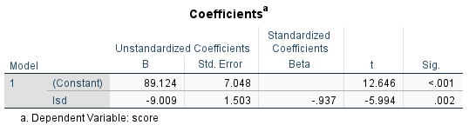
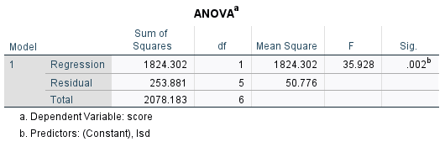
Example -Pharmacodynamics of LSD
  $H_{o}: β_{1}$= 0 vs $H_{1}: β_{1}≠$0
n = 7; ${ b}_{1}$= -9.01; $s=\sqrt{50.72}=7.12;$ Sxx – 22.475; se($b_{1}$) = 7.12/22.475 = 1.50
Testing
  t* = -9.01 / 1.50 ~= -5.994 → p = .002 → reject Null
  Note, the t equals the Z only when N is large

Slide 34
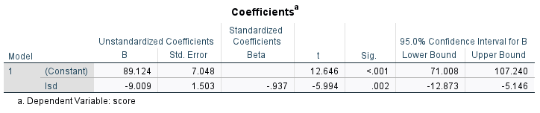
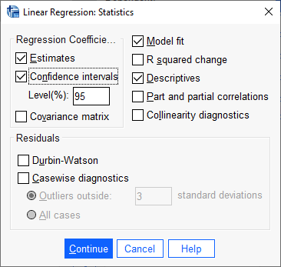
Example -Pharmacodynamics of LSD
n = 7
$b_{1}$=-9.01
se($b_{1}$) = 7.12/22.475 = 1.50
95% CI
  -9.01 $±$ 2.57(1.50) → -9.01$±3.86$ → (-12.87, -5.15)
  From this confidence interval, do you reject the Null?

Slide 35
Correlation & Regression
Measures the strength of the linear association between two variables
Is between -1 and 1
Takes on the same sign as the slope estimate from the linear regression
Population Parameter - r
Pearson’s Correlation Coefficient:
$$r=\frac{SS_{xy}}{\sqrt{SS_{x}SS_{y}}}$$
$$r_{ }^{2}$$ | Estimated Size of the Effect
Close to .01 | Small
Close to .09 | Moderate
Close to .25 | Large

Slide 36
Correlation & Regression
If data are non-normal (e.g., categorical or contain outliers), Spearman’s coefficient of correlation can be computed based on the ranks of the x and y values
Test of H₀:r = 0 is equivalent to test of H₀:b₁=0
Coefficient of Determination (r²) - Proportion of variation in y “explained” by the regression on x
$$r_{ }^{2}={\left(r\right)}^{2}=R^{2}$$
$R^{2}=\frac{SSR}{SSTO}→$ $1 − \frac{SSR}{SSTO}$
Note! I made a mistake last
week here
Explained
Not Explained

Slide 37
Example
$$S_{xx}=22.475 S_{xy}=−202.487 S_{yy}=2078.183 SSE=253.89$$
$$r=\frac{−202.487}{\sqrt{(22.475)(2078.183)}}=−0.94$$
$$R^{2}=\frac{2078.183−253.89}{2078.183}=0.88=(−0.94)^{2}$$
$R^{2}×100$ =
% of variation in the dependent variable explained by the independent variable(s) in the mode

Slide 38
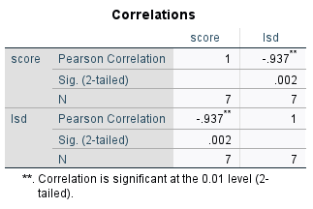
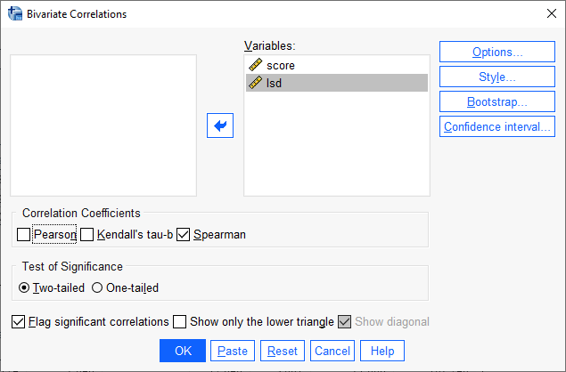
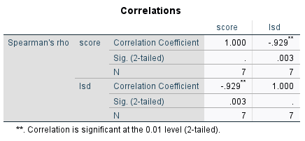
Example

Slide 39
Analysis of Variance in Regression
Goal: partition the total variation in Y into variation “explained” by X and random variation
The total variation in an observed response about its mean can be written as a sum of two parts – (a) its deviation from the fitted value plus (b) the deviation of the fitted value from the mean response
$y_{i}−\overline{y}=\left(y_{i} − {\hat{y}}_{i}\right)+{(\hat{y}}_{i} −\overline{ y}$)
$${(y_{i}−\overline{y})}^{2}={\left(y_{i} − {\hat{y}}_{i}\right)}^{2}+{{(\hat{y}}_{i} −\overline{ y}\text{)}}^{2}$$
SST
SSE
SSR

Slide 40
ANOVA F-test
Analysis of Variance F-test
Tests the significance of the overall model including ALL independent variables
For SLR, the F-test is the same as the t-test for b1
F = t²
Source of Variation | Sum of Squares | Degrees of Freedom | Mean Square | F
Model | SSR | 1 | MSR = SSR/1 | F = MSR/MSE
Error | SSE | n-2 | MSE = SSE/(n-2)
Total | S_{yy} | n-1

Slide 41
ANOVA F-test for SLR
Analysis of Variance F-test
  $H_{o}: β_{1}$= 0
  $H_{1}: β_{1}≠$0
F* = $\frac{MSR}{MSE}$ > $F_{α, df=1, n−2}$→ reject null
Source of Variation | Sum of Squares | Degrees of Freedom | Mean Square | F
Model | SSR | 1 | MSR = SSR/1 | F = MSR/MSE
Error | SSE | n-2 | MSE = SSE/(n-2)
Total | S_{yy} | n-1

Slide 42
Example - Pharmacodynamics of LSD
Total Sum of squares:
Error Sum of squares:
Model Sum of Squares:

Slide 43
Example - Pharmacodynamics of LSD
Source of Variation | Sum of Squares | Degrees of Freedom | Mean Square | F
Model | 1824.293 | 1 | 1824.293 | 35.93
Error | 253.890 | 5 | 50.778
Total | 2078.183 | 6
Analysis of Variance - F-test
H₀: all betas equal 0 vs H_{A}: at least one beta is 0
H₀: β₁ = 0 vs H_{A}: β₁ ≠ 0
$F=\frac{MSR}{MSE}=35.928>F_{α, df=1, n−2}$ = 6.61→
Reject Null

Slide 44
Estimation of Error Terms Variance, $σ^{2}$
The variance of the error terms needs to be estimated to obtain an indication of the variability of the probability distributions of Y
We know the variance of a single population is estimated by the sample variance, $s^{2}$
The logic of developing an estimator of the variance for the regression model is the same as for sampling from a single population
$$s^{2}=\frac{\sum{{(Y_{i}−\overline{Y})}^{2}}}{n−1}$$
Sum of squares
Mean square
df

Slide 45
Fitted Values & Residuals
Fitted values for the sample cases are obtained by substituting the appropriate X values into the estimated regression function. For the fourth sample case, we have Xi = 4.69. Hence, the fitted value is:
The residual is the difference between the observed value Yi and the fitted value ${\hat{Y}}_{i}$. The residual is denoted by $e_{i}$and is defined as
For the case above
Score (Y) | LSD Conc (X)
78.93 | 1.17
58.20 | 2.97
67.47 | 3.26
37.47 | 4.69
45.65 | 5.83
32.92 | 6.00
29.97 | 6.41
350.61 | 30.33
$Score=89.125 −9.009(4.69$)=46.87279
$e_{i}$= $Y_{i}{−\hat{ Y}}_{i}$
$e_{1}$= $Y_{1}{−\hat{ Y}}_{1}=37.47$- 46.87 = -9.4

Slide 46
Residuals of Linear Model
A residual (AKA prediction error) is the difference between the observed value $(y)$ and the predicted value $(\hat{y})$ for each obs.
A small residual means that the response variable is close to what it was predicted to be under the fitted regression model
  The point on the scatterplot is close to the fitted line
A large residual means that the response variable was unexpectedly high or low when compared to the fitted regression model
Intuitively we would like our model to generate residuals that are as small as possible.
$$e_{i}=y_{i}−{\hat{y}}_{i}$$
Notes:
46

Slide 47
Regression Model
The deviation of an observation is calculated around its estimated mean, hence the deviations are the residuals
$e_{i}$= $Y_{i}{−\hat{ Y}}_{i}$
$SSE$=$\sum{{(Y_{i}{−\hat{ Y}}_{i})}^{2}=\sum{{e_{i}}^{2}}}$
Residual sum of squares
$s^{2}$ =$MSE=\frac{SSE}{n−2}=\frac{\sum{{(Y_{i}{−\hat{ Y}}_{i})}^{2}}}{n−2}=\frac{\sum{{e_{i}}^{2}}}{n−2}$
Mean square error

Slide 48
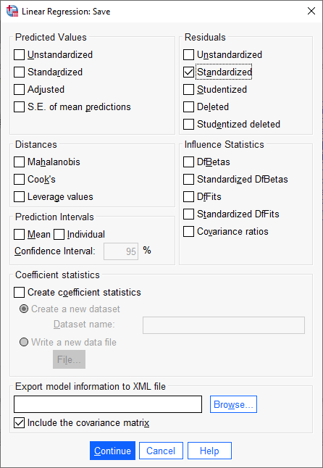
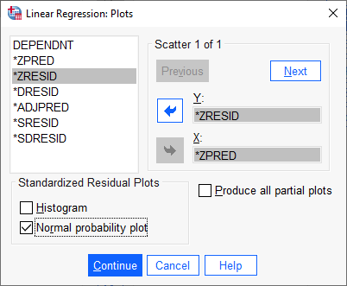
Example: Compute diagnostic tests for linearity, normality and homoskedasticity of error term

Slide 49
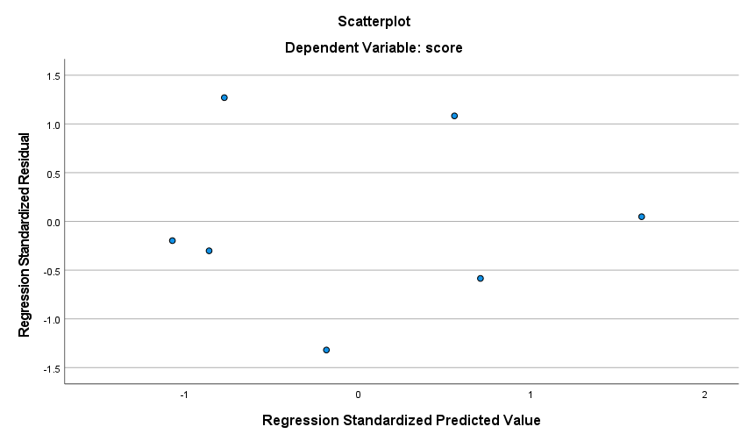
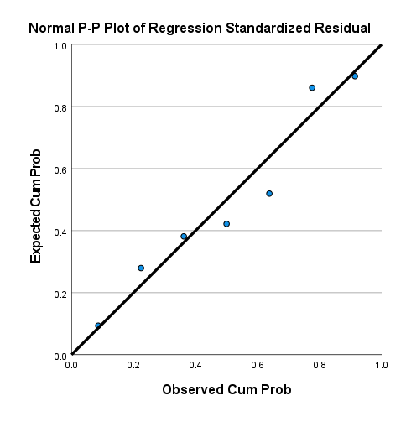
Example: Diagnostics
Terrible plots!

Slide 50
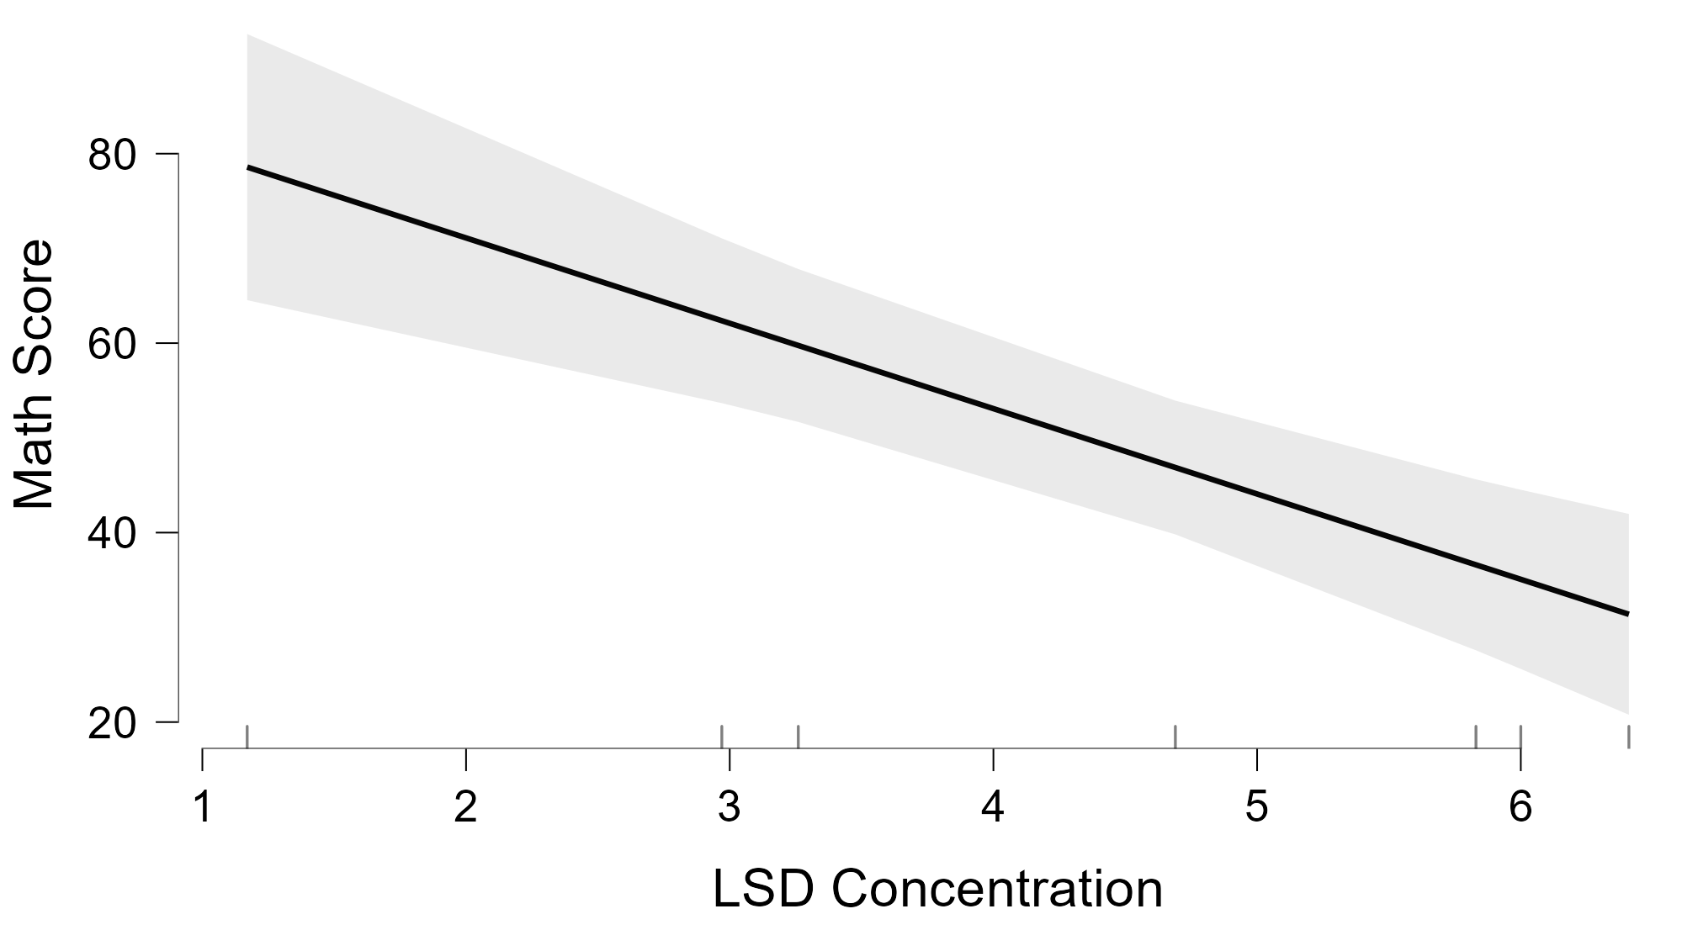
Example: Let’s do this over again using JASP
JASP allows me to annotate the output
JASP has much nicer graphics
JASP allows you to do the analysis in the same screen

Slide 51
Your turn
Use SPSS or JASP and perform a SLR on

Slide 52

More diagnostics
An outlier is a data point whose response y does not follow the general trend of the rest of the data
A data point has high leverage if it has "extreme" predictor x values
  With a single predictor, an extreme x value is simply one that is particularly high or low.
  With multiple predictors, extreme x values may be particularly high or low for one or more predictors
Notes:
or may be "unusual" combinations of predictor values (e.g., with two predictors that are positively correlated, an unusual combination of predictor values might be a high value of one predictor paired with a low value of the other predictor).

Slide 53
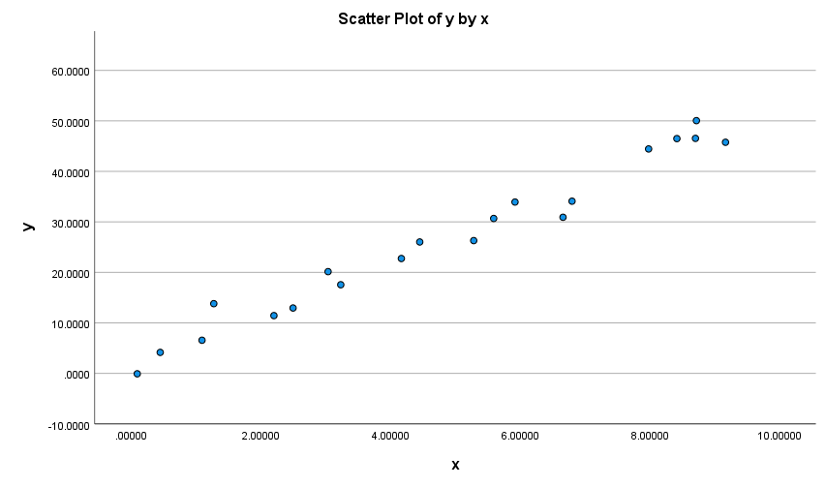

Outliers and unusual values
Does anything look unusual or different about plot A?
Does anything look unusual or different about plot B?
A
B
Notes:
However, this point does not have an extreme x value, so it does not have high leverage. Is the red data point influential? An easy way to determine if the data point is influential is to find the best fitting line twice — once with the red data point included and once with the red data point excluded.

Slide 54
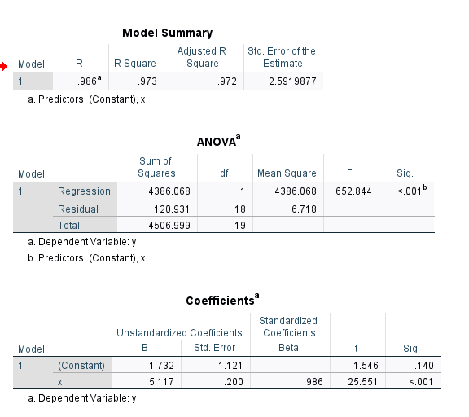
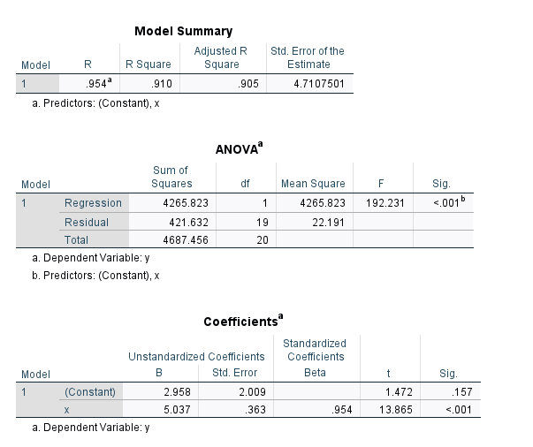
Regression output
Compare the two regressions, any differences?
Notes:
The R² value has decreased slightly, but the relationship between y and x would still be deemed strong.
The standard error of b₁, which is used in calculating our confidence interval for β₁, is larger when the red data point is included, thereby increasing the width of our confidence interval. You may recall that the standard error of b₁ depends on the mean squared error MSE, which quantifies the difference between the observed and predicted responses. It is because the red data point is an outlier — in the y direction — that the standard error of b₁ increases, not because the data point is influential in any way.
In each case, the P-value for testing H₀: β₁ = 0 is less than 0.001. In either case, we can conclude that there is sufficient evidence at the 0.05 level to conclude that, in the population, x is related to y.

Slide 55
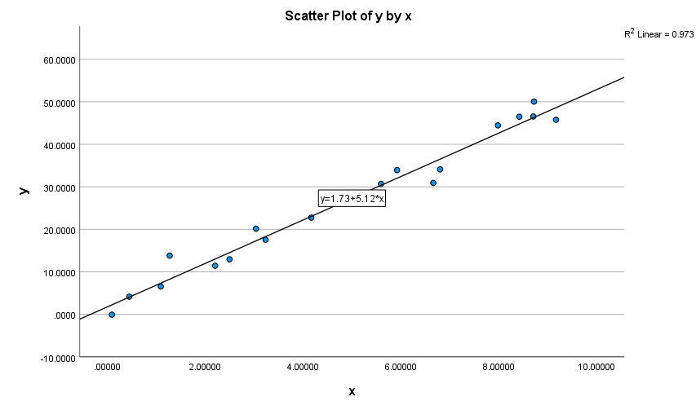
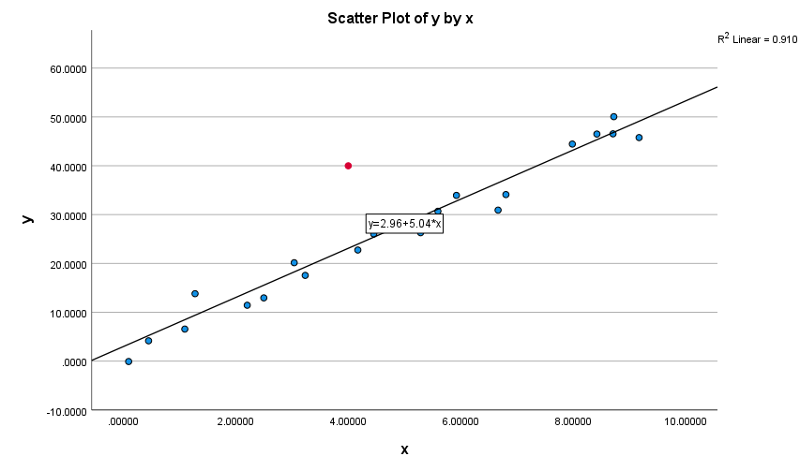

Slide 56
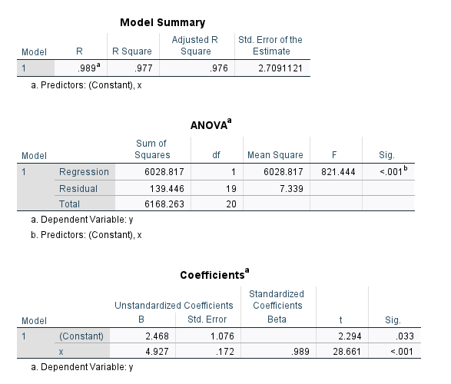
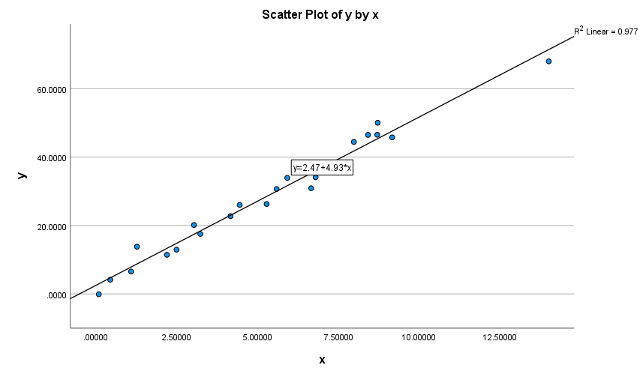
Notes:
The R² value has hardly changed at all, increasing only slightly from 97.3% to 97.7%. In either case, the relationship between y and x is deemed strong.
The standard error of b₁ is about the same in each case — 0.172 when the red data point is included, and 0.200 when the red data point is excluded. Therefore, the width of the confidence intervals for β₁ would largely remain unaffected by the existence of the red data point. You might take note that this is because the data point is not an outlier heavily impacting MSE.
In each case, the P-value for testing H₀: β₁ = 0 is less than 0.001. In either case, we can conclude that there is sufficient evidence at the 0.05 level to conclude that, in the population, x is related to y.

Slide 57
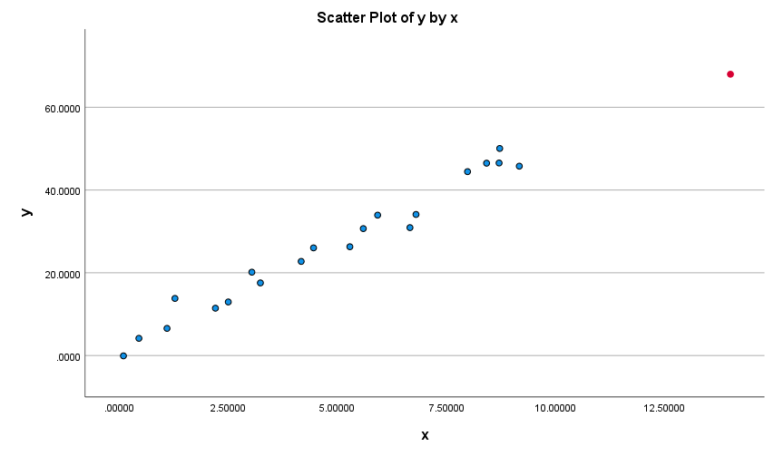
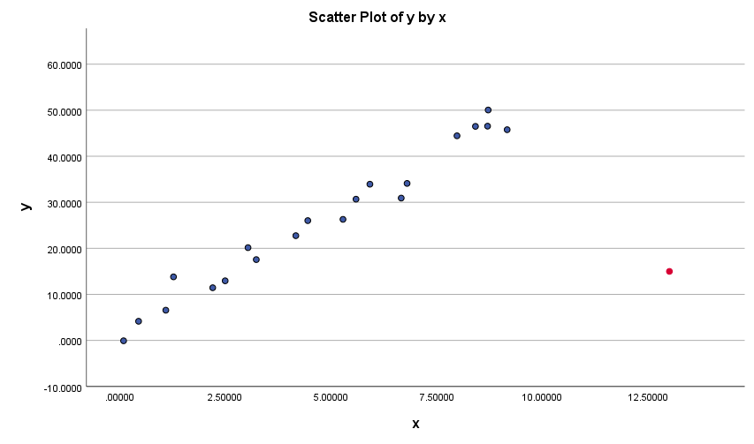
Unusual values and influential points
Does anything look unusual or different about plot A?
Does anything look unusual or different about plot B?
A
B

Slide 58
Identifying data points whose x values are extreme
The leverage merely quantifies the potential for a data point to exert strong influence on the regression analysis.
The leverage depends only on the predictor values.
Whether the data point is influential or not also depends on the observed value of the response yi
All we need to do is determine when a leverage value should be considered large. A common rule is to flag any observation whose leverage value, hii, is more than 3 times larger than the mean leverage value

Slide 59
Leverage
$$\overline{h}=\sum_{i=1}^{n}{\frac{k+1}{n}}$$
That is, if:
$$h_{ii}>3\left(\frac{k+1}{n}\right)$$
then flag the observations as "Unusual X" or "X denotes an observation whose X value gives it potentially large influence" or "X denotes an observation whose X value gives it large leverage").

Slide 60
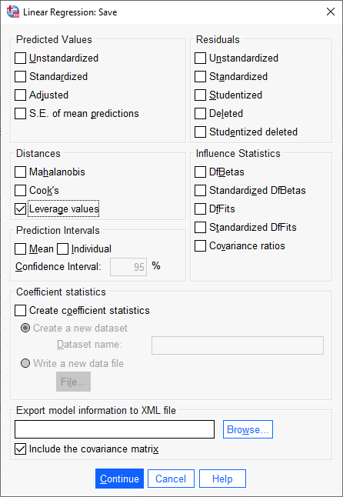
Example
You perform a SLR with n = 21 cases. What is the leverage cutoff value that gives you some reason to be concerned?
k = 2, n = 21
$h_{ii}>3\left(\frac{2+1}{21}\right)$=.286

Slide 61
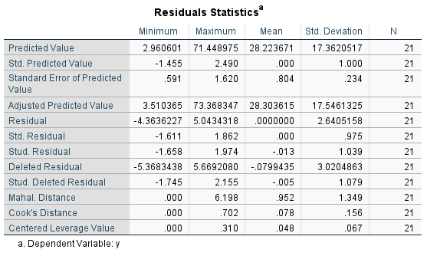
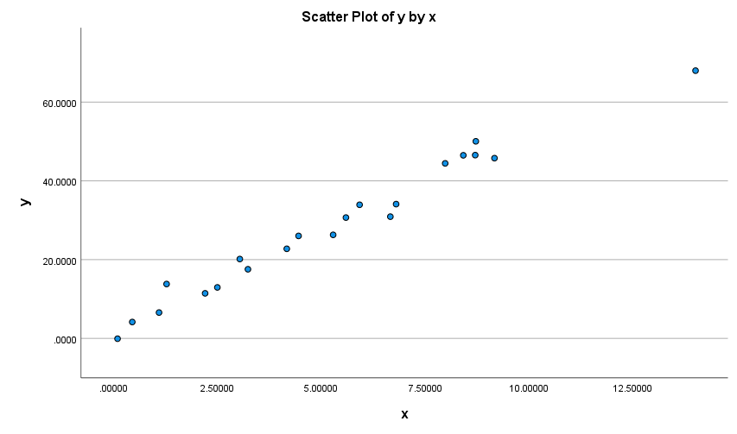

Slide 62
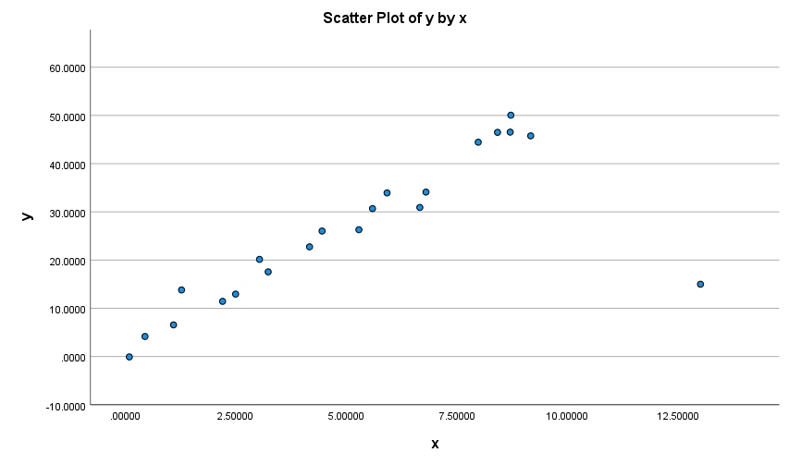
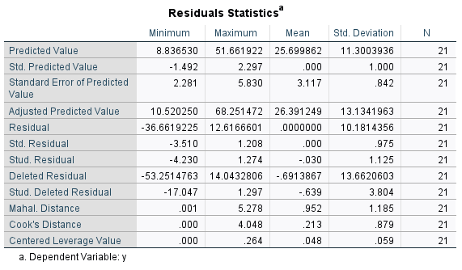

Slide 63
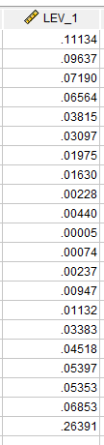
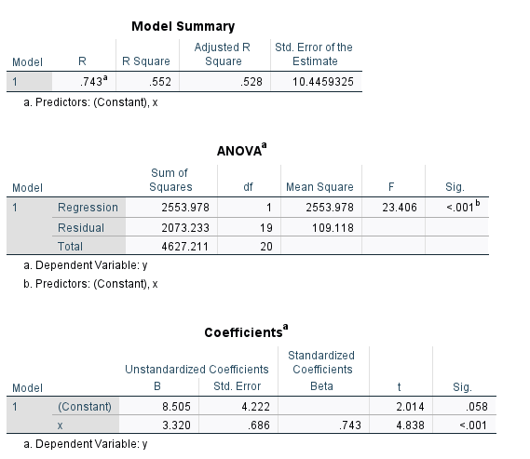
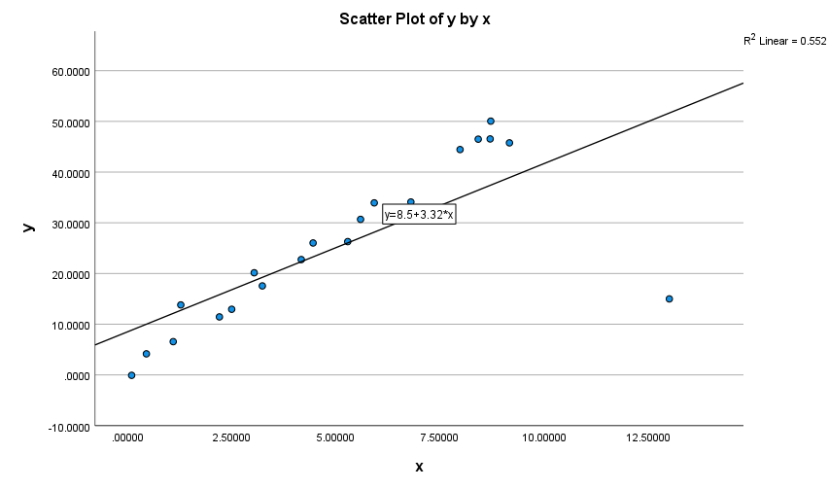
Notes:
The R² value has decreased substantially from 97.32% to 55.19%. If we include the red data point, we conclude that the relationship between y and x is only moderately strong, whereas if we exclude the red data point, we conclude that the relationship between y and x is very strong.
The standard error of b₁ is almost 3.5 times larger when the red data point is included — increasing from 0.200 to 0.686. This increase would have a substantial effect on the width of our confidence interval for β₁. Again, the increase is because the red data point is an outlier — in the y direction.
In each case, the P-value for testing H₀: β₁ = 0 is less than 0.001. In both cases, we can conclude that there is sufficient evidence at the 0.05 level to conclude that, in the population, x is related to y. Note, however, that the t-statistic decreases dramatically from 25.55 to 4.84 upon inclusion of the red data point.

Slide 64
Multicollinearity
As the number of predictors increases, multiple regression modeling can become very complicated
Multicollinearity is when the predictors in the regression equation are correlated with each other
Example:
  Suppose you use both educational attainment and job type as independent variables to predict income.
  Note educational attainment and job type are highly correlated with each other! Thus having both educational attainment and job type in your multiple regression equation may only slightly improve the R² over an equation with just educational attainment
  Might conclude that job type is highly influential on income, while educational attainment is unimportant (or vice versa) which is not true!
  This happened in our paper for SSRW when we included an index of redlining, concentrated disadvantage and concentrated affluence in the model
  Note that while there is substantial overlap between variables theoretically, they are quite distinguishable
    The opposite of concentrated disadvantage is not concentrated advantage
    Use theory to guide the model building!!!!!

Slide 65
What to do if you find multicollinearity?
If two variables are highly correlated, it is probably not a good idea to use both in the regression equation. Why?
  Many correlated variables hurts the Adjusted R²
  We generally prefer smaller models
  Smaller models are much easier to interpret
  Multiple regression models describe the effect of one variable on another after partialling out the effects of all other variables in the model
    Regarding MC, this means that if two variables are highly correlated, once one of them is partialled out, there is much less variation left in the other variable for the model to “explain”
    Check the partial correlation coefficients and zero order coefficients before including variables!

Slide 66
How to check for multicollinearity?
Scatterplots, Scatterplot Matrix
  A scatterplot matrix is a matrix of scatterplots, one plot for each pair of variables.
  Note: To read it, pick a plot in the matrix. Look in the column for the X variable and the row for the Y variable
Graph → Chart Builder → Scatter/Dot (drag variables into chart area)

Slide 67
Scatterplots by Grouping Variable
Can color code a scatterplot by a categorical variable to get a sense of how the distribution of variables is heterogeneous across groups

Slide 68
Your turn
Can I predict your graduate GPA based on your undergraduate GPA & score on the GRE
GPA data.sav
Process
  First, look at descriptive statistics
  Second, calculate the zero order and partial correlations between the variables
  Third, calculate b2 using formula
  Fourth, run regression analysis
  Fifth, interpret coefficients
  Sixth, evaluate overall model for assumptions and fit

Slide 69
GRE-GPA Example Data
Student | GRE-Total (X₁) | Undergraduate GPA (X₂) | Graduate GPA(Y)
1 | 145 | 3.2 | 4.0
2 | 120 | 3.7 | 3.9
3 | 125 | 3.6 | 3.8
4 | 130 | 2.9 | 3.7
5 | 110 | 3.5 | 3.6
6 | 100 | 3.3 | 3.5
7 | 95 | 3.0 | 3.4
8 | 115 | 2.7 | 3.3
9 | 105 | 3.1 | 3.2
10 | 90 | 2.8 | 3.1
11 | 105 | 2.4 | 3.0

Slide 70
$$b_{1}=\frac{(r_{Y.X1}−r_{Y.X2}r_{12})s_{Y}}{(1−r_{12}^{2})s_{X1}}$$
Y = GPA in graduate school
X1 = GRE score
X2 = Undergraduate GPA
$$b_{1}=\frac{(r_{Y.X1}−r_{Y.X2}r_{12})s_{Y}}{(1−r_{12}^{2})s_{X1}}=\frac{\left(r_{Y.X1}−r_{Y.X2}r_{12}\right).3312}{\left(1−r_{12}^{2}\right).4011}$$

Slide 71
Zero order (the Pearson
you already know)
Partial correlation (the correlation after one variable has been partialed out)
$$r_{Y.X1}=.784$$
The correlation between GRE and Graduate GPA
$$r_{Y.X2}=.752$$
The correlation between GRE and Undergrad GPA
$$r_{12}=.301$$
The partial correlation between GRE and Undergraduate GPA
$$b_{1}=\frac{(r_{Y1}−r_{Y2}r_{12})s_{Y}}{(1−r_{12}^{2})s_{X1}}=\frac{[.784−(.752)(.301)].332}{(1−.301^{2})16.33}$$
$$b_{2}=\frac{(r_{Y.X2}−r_{Y.X1}r_{12})s_{Y}}{(1−r_{12}^{2})s_{X2}}=\frac{[.7516−(.784)(.301)].332}{(1−.301^{2}).401}$$

Slide 72
Sample Partial Slope and Intercept
$$b_{1}=\frac{(r_{Y1}−r_{Y2}r_{12})s_{Y}}{(1−r_{12}^{2})s_{X1}}=\frac{[.7845−(.7516)(.3011)].3317}{(1−.3011^{2})16.3346}=.0125$$
$$b_{2}=\frac{(r_{Y.X2}−r_{Y.X1}r_{12})s_{Y}}{(1−r_{12}^{2})s_{X2}}=\frac{[.7516−(.7845)(.3011)].3317}{(1−.3011^{2}).4011}=.4687$$
$$b_{0}=\bar{Y}−b_{1}{\bar{X}}_{1}−b_{2}{\bar{X}}_{2}=3.5000−(.0125)(112.7273)−(.4687)(3.1091)=.6337$$

Slide 73
Sample Multiple Linear Regression Model
Y_{i} = $b_{0}$+ $b_{1}X_{1}+b_{2}X_{2}$+ e_{i}
$\hat{Y\text{i}}$= .6337 + .0125 X₁ + .4687 X₂ + e_{i}
If your score on the GRETOT was 130 and your UGPA was 3.5, then your predicted score on the GGPA would be computed as:
  $\hat{Y\text{i}}$ = .0125 (130) + .4687 (3.5000) + .6337 = 3.8992

Slide 74
Overall F Test Statistic
$$F=\frac{SS_{reg}/df_{reg}}{SS_{res}/df_{res}}=\frac{0.9998/2}{.1002/8}=39.9122$$
The null: all slopes equal 0
The critical value, at the .05 level of significance, is _{.05} F _{2,8} = 4.46
Test statistic exceeds the critical value, so we reject H₀ and conclude that all of the partial slopes are not equal to zero at the .05 level of significance

Slide 75
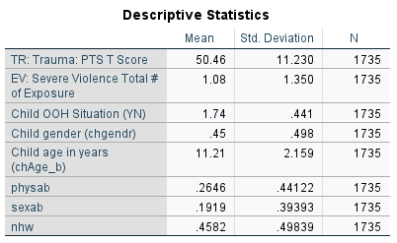
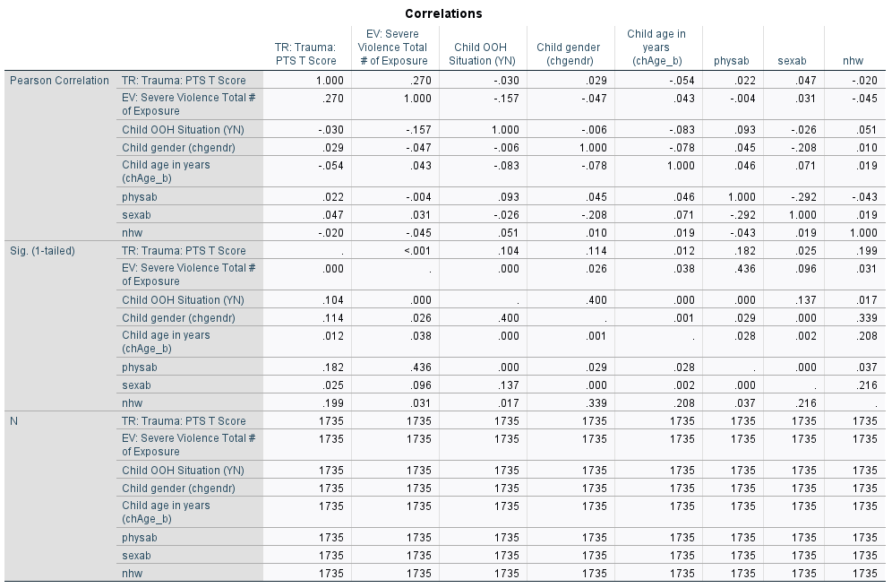

Slide 76
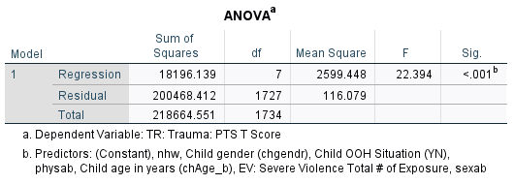
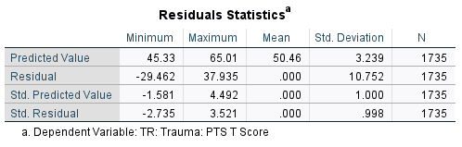
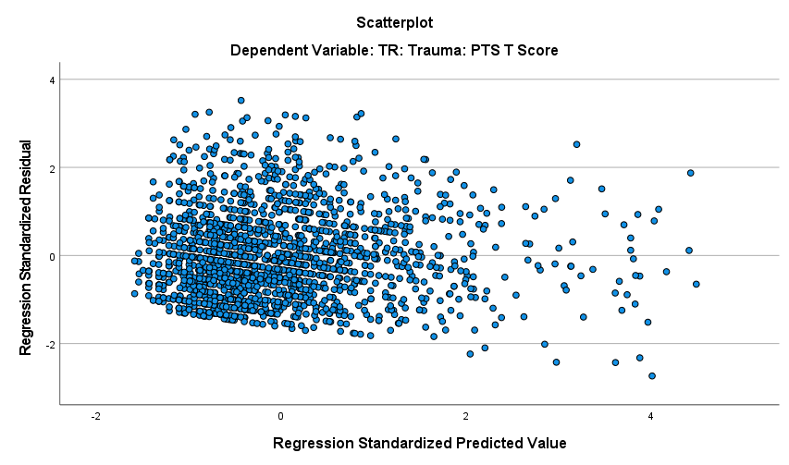
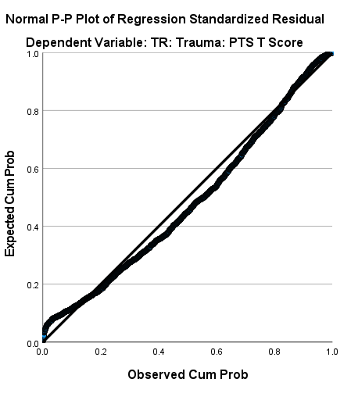
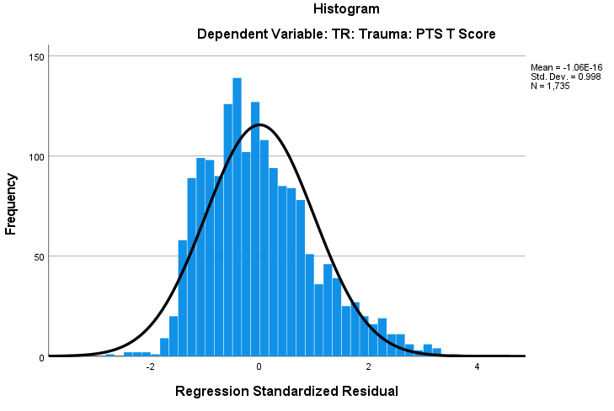

Slide 77
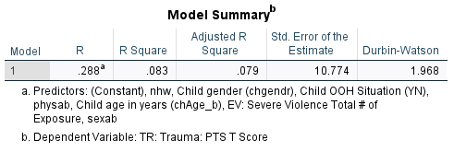
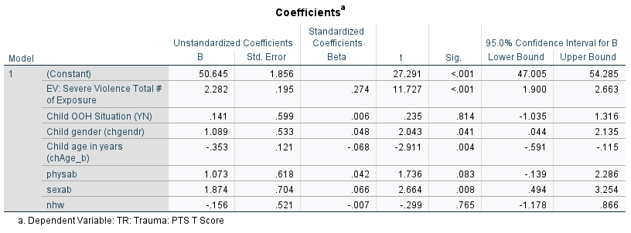
Your turn
This data is from NASCW on youth in the child welfare system
The variables are as follows:
  EV severe violence exposure
  Child is in out-of-home care (dummy, 1 = Yes, 0 = No)
  Child gender (0 = male, 1 = female)
  Child Age in Years
  Child experienced physical abuse (1 = yes, 0 = no)
  Child experienced sexual abuse (1 = yes, 0 = no)
  Child is Non-Hispanic White (1 = yes, 0 = no)

Slide 78
Other hypotheses to test
Older children with higher levels of violence exposure have more PTS symptoms compared to younger children
Children who are sexually abused with higher levels of violence exposure have more PTS symptoms compared children who have experienced other forms of abuse
How might depressive symptoms be related to PTS symptoms?
  More depressive symptoms → more PTS symptoms
  Children who have more depressive symptoms and higher levels of violence exposure have more PTS symptoms compared to children with less depressive symptoms
  Note: this is the same hypothesis as: Children who have higher levels of violence exposure and more depressive symptoms have more PTS symptoms compared to children with less violence exposure

