Slide 1

League of Nations

Slide 2
Contents
Introduction
Members
Structure
Aims
Successes and failures 1920’s
Successes and failures 1930’s
Strengths and weaknesses

Slide 3
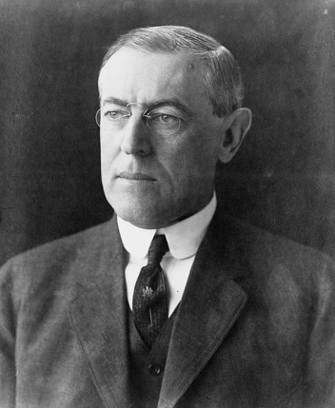
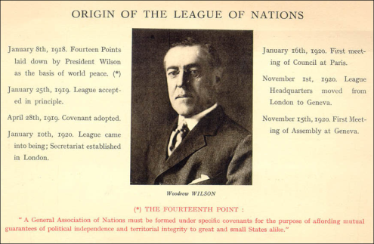
Introduction
The allies set up the League of Nations to preserve world peace and to stop future wars after the destruction caused in World War One. It was the USA’s idea and the creation of it was one of Woodrow Wilson’s fourteen points. It was set up to resolve disputes and conflicts between countries. The League of Nations required all countries to join or it would not be a success. The USA, however, refused to join. This was not good because the USA was the most powerful country and Wilson, the US President at the end of World War One, invented it, so that possibly contributed to the League failing in the end.
Isabell Long

Slide 4
Aims
The main aims of the Leagues of Nations were:
to keep the peace
to guarantee the independence of other member’s territory
to submit disputes to an independent body
to take action against an aggressor by either military or economic means
to decrease armaments

Slide 5




Council
4 permanent members
4 members to be elected by assembly
Met 4 times a year
Political problems / disputes
Decisions to be unanimous ( right to veto )
Assembly
3 members from every country
all members had equal votes
made decisions affecting world peace
Decisions to be unanimous ( right to veto )
Met annually.
Secretariat
Permanent staff
Head quarters – Geneva
Kept records of meetings and discussions.
Court of International justice
Set up in the Netherlands 1922
15 judges from various countries
Deal with international disputes
Could not force countries to accept there decisions
From 1922-39 it settled 70 cases & helped arrange 400 international agreements.
Special commissions
Deal with specific problems e.g.. Drugs commission minorities commission ect.
Much of successful work took place here.
Committees
Social economic & humanitarian matters Included health, financial and economic organisation
special comities for drug traffic, women's rights, refugees, child welfare . Eg .ILO To improve living and working conditions Agreements on working hours working conditions & the right to belong to a trade Union.

Slide 6
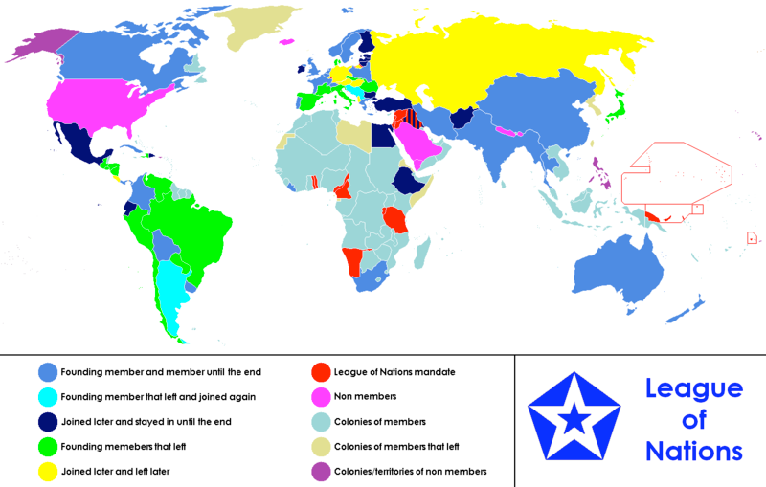
Including : England, France, Canada, Australia, India, China
Including : Argentina , Yugoslavia
Including : Mexico Egypt Ethiopia Ireland , Afghanistan Iraq Bulgaria Finland , Estonia, Ecuador
Including : brazil , Peru, Venezuela , Japan Spain , Italy , Romania

Slide 7
Strengths | Weaknesses
42 countries were members rising to 58 in 1934 Set up the council which met four to five times a year and in times of crisis Allowed the League to respond quickly to crises. Collective security made it safer and less likely for a war to break out Britain and France were the main members, helped by Italy and Japan; they were quite powerful countries. | The USA, USSR and Germany - the three greatest powers in the world - were not members. agreements of the assembly and council had to be unanimous Made it very hard to get anything done Set up the Secretariat. Too small to handle the vast work of the League If someone declared war on a country it couldn’t be stopped because of the right to veto . They did not have an army. One of the biggest weaknesses was that the League’s organisation was in a muddle. The different parts of the League were supposed to act together; but in a crisis, no-one could agree.
Both Sides Set up by the Treaty of Versailles (agreed by everybody at the conference=strength /associated with the treaty weakness)

Slide 8
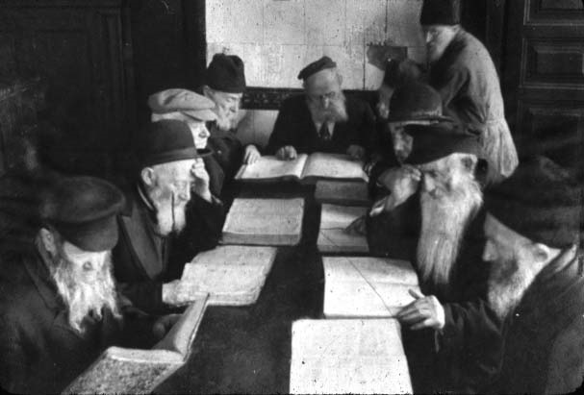
Success and failures of the league of nations (1920’s & 1930’s) Failures and successes the 1920’s Vilna: 1920 After the war Poland and Lithuania were two new states created due to the League of Nations. Vilna was made the capital of Lithuania, however a large population of the people living in the city were in fact Polish. In 1920 a private Polish army took control. Lithuania appealed for help from the League of Nations. However the League was stuck with a choice. It could see the Pole’s point of view and reasoning for invading. However, if they were to abide by the rules of the league, they should send French and British troops into Lithuania to force the poles out. In the end France didn’t want to upset Poland as they saw them as a potential ally against Germany and Britain did not want to send their troops all the way over to the other side of Europe to fight a war. In the end the League did nothing and the poles kept Vilna.

Slide 9
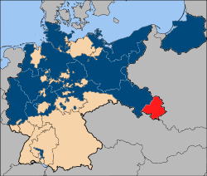
Upper Silesia 1921
Upper Silesia was an industrial region on the outskirts of Germany and Poland. It was inhabited by both German and Polish people. Both Germany and Poland wanted control of it, for its riches (iron and steel). In 1921 a vote was cast to decide on the future of the region. The French and British troops were sent to keep order at the polling booths. The industrial areas mainly voted for Germany, whereas the rural areas voted for Poland. The league therefore divided the region along these lines and the riches of the region were split between Poland and Germany. On the whole many people were dissatisfied, but the two countries did except the decision.

Slide 10


Aaland Islands 1921
Both Sweden and Finland wanted control of the Aaland Islands, which were midway between the two countries. Both countries were willing to fight over the islands. They both appealed for guidance from the league, and after studying the matter closely, the League came up with the decision that the islands should go to Finland. Sweden accepted the decision made by the league and a future war was prevented even though a large number of people living on the island were in fact Swedish and the island was closer to Sweden

Slide 11
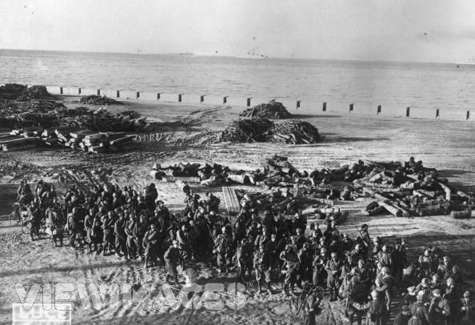
Corfu, 1923
The League of Nations had decided to put a border between Greece and Albania. An Italian General called Tellini was appointed to supervise the border. On 27th of August, while they were surveying the Greek side, they were ambushed and Tellini and his men were killed. The Italian Government was furious and blamed the Greek government for the murder. On the 29th of August the Italians demanded that Greece pay compensation and execute the murderers. However Greece, did not know who the killers were so could not execute them. On the 31st of August Mussolini bombarded and then occupied the Greek island of Corfu. By this time the Greeks had applied for help from the League. The situation was very serious, and it reminded the world of the actions that had triggered the first World War. Fortunately, the League had already begun preparing its decision. By September the 7th the League had reached a decision and condemned the Italians. It also suggested that Greece did pay compensation to Italy, and leave the money in the hands of League until Italy withdrew. On September 27th Italy, withdrew from Corfu, and began boasting of their triumph.

Slide 12
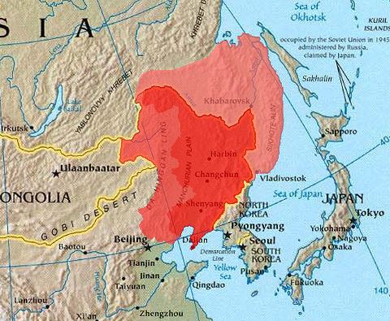
Manchuria (1)
After the 1920s Japan was not doing very well, it did not have many resources and the taxes the Chinese government imposed on their goods did not help trade. Without exports they could not afford imports that they needed. Japan had too many people in it and its army felt that they needed more living space. They already had some business interests in Manchuria. For example they ran the south Manchuria railway.
They decided to invade Manchuria to gain more space and to gain resources .
The Japanese blew up a section of the railway. Even though they wanted the land they tried to make it look like they were innocent by blaming it on China.

Slide 13
Manchuria (2)
China asked for help from the League ,but Japan argued that because China was in such a state so in order to keep the peace they went and invaded -not as an aggressor but just to settle local difficulties .
Japan was an important member of the League’s council so there was a long delay in deciding what to do causing a lot of frustration.
The League’s officials sailed round the world to see the situation for themselves and try and resolve it. They did not know what to do and it took months for the issue to be resolved. After a full year the Lytton Commission produced a detailed and balanced report. The judgment was very clear- Japan had acted unlawfully, and Manchuria should be returned to China.
However in 1933, the Japanese didn’t withdraw from China but instead announced that they wanted to invade more of China. They argued that it was in self-defense .
On February 24th the League of Nations report was approved by 42 votes. The only country that disapproved was Japan .
Japan saw this as a insult and left the League on March 27th 1933.
Isabell and Tamara

Slide 14
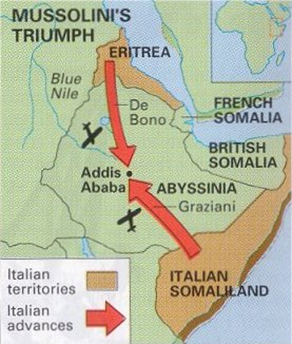
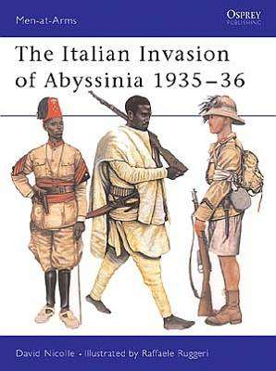
Abyssinian Crisis 1935-36 (1)
The origins of the crisis date back from the previous century. In 1896 Italian troops had tried to invade Abyssinia but had been defeated by a poorly equipped army of tribesmen. Mussolini wanted revenge for this humiliating defeat. He also had his eyes on the fertile lands and mineral wealth of Abyssinia. However, most importantly, he wanted glory and conquest. His style of leadership needed military victories and he often talked of restoring the glory of the Roman Empire.
In December 1934 there was a dispute between Italian and Ethiopian soldiers at the Wal-Wal oasis-80 km inside Abyssinia. Mussolini took this as his cue and claimed this was actually Italian territory. He demanded an apology and began preparing the Italian army for an invasion of Abyssinia. The Abyssinian emperor Haile Selassi appealed to the League for help.

Slide 15
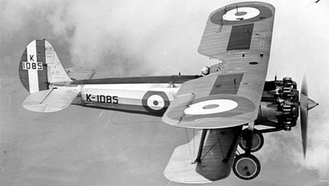
Abyssinian Crisis 1935-36 (2)
In this period Mussolini was supposedly negotiating with the League to settle the dispute, while at the same time he was shipping his army to Africa and creating a war fever among the Italian people, and preparing for a full scale invasion of Abyssinia. However the British and the French failed to take the situation seriously. They were desperate to keep a good relation with Mussolini, who seemed to be their strongest ally against Hitler. They signed an agreement with him early in 1935 known as the Stresa Pact which formalized a protest at German rearmament and commitment to stand united against Italy. As the year progressed, there was a public outcry against Italy’s behaviour. A vote was cast in Britain and the majority of the British public voted for the League using military force to defend Abyssinia. On the 4th of December, after eight months’ deliberation a committee reported to the League that neither side could be held responsible for the Wal-Wal incident. The league put forward a plan that would give Mussolini some of Abyssinia. However Mussolini rejected this. In October 1936 Mussolini’s army was ready . He launched a full scale invasion. Despite brave resistance, the Abyssinians were no match for the modern Italian army with tanks, aeroplanes, and poison gas.

Slide 16
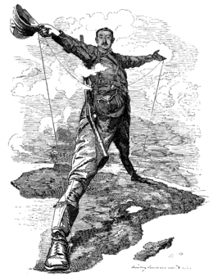
Abyssinian Crisis 1935-36 (3)
This was a definite case of a large, powerful state attacking a smaller one. The league was designed for such disputes, and unlike the Manchurian crisis was ideally situated to act. There was no doubting the seriousness of the issue either. The covenant made it clear that sanctions must be introduced against the aggressor . A committee was immediately set up to agree what sanctions to impose. Sanctions would only work if they were imposed quickly and decisively. Each week a decision was delayed would allow Mussolini to build up a stockpile of raw materials. The League imposed an immediate ban on arms, the export of Italy, tin and metals. However, the league delayed decisions for two months, over whether to ban oil to Italy. It feared that the Americans would not support the sanction . It also feared that it’s members economical interests would be further damaged. In Britain, the Cabinet was informed that 30,000 British coal miners were about to lose their jobs because the ban on coal exports to Italy.
There were both similarities with and differences from the Japanese invasion of Manchuria. Like Japan, Italy was a leading member of the League. Like Japan, Italy wanted to expand its empire by invading another country. However, unlike Manchuria, this dispute was on the League’s doorstep. Italy was a European power. It even had a border with France. Abyssinia bordered on the Anglo-Egyptian territory of Sudan and British colonies of Uganda, Kenya and British Somaliland. Unlike events in Manchuria , the League could not claim that this problem was in an inaccessible part of the world.

Slide 17
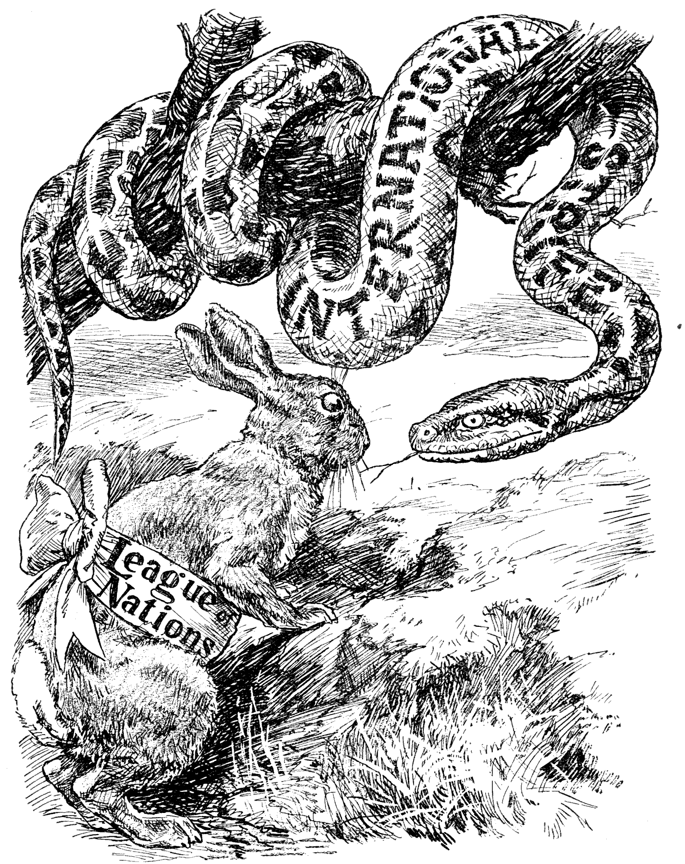
Sources
In the first picture the snake represents evil and risk of war. The rabbit represents the League of Nations. The message is that the League is not strong enough to combat the snake, the evil.

Slide 18
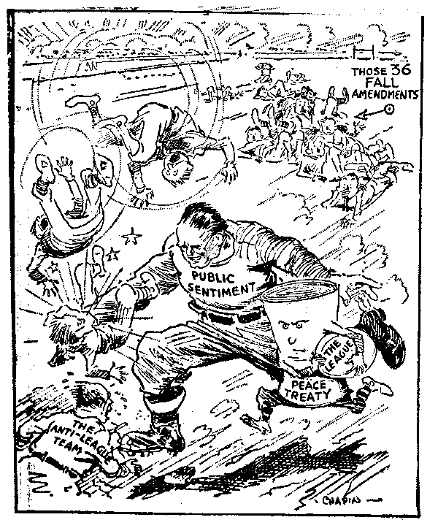
The second picture represents a rugby match where the attacker is the toughest player who represents the feelings of the public. The public like the League and are trying to guide it, but between the two there is peace treaty and people do not agree with it.

Slide 19
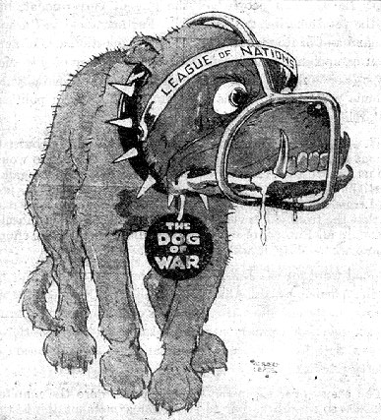
This third is a dog with a mussel . The dog is the dog of war and the mussel is the League of Nations . It signifies that the League of Nations can stop wars.

Slide 20
How did the Depression affect the League of Nations?
This great depression lasted four years and delivered a devastating blow to the American economy and also to the outside world. The overwhelming depression forced many other countries such as Italy, France, Germany etc. to want to expand their land and gain more power. The depression caused the other European countries to become more selfish and only worry about themselves and forget about the main objective of the League which was to keep peace within the world. Another factor which affected the League was that also during these years Italy and Germany were ruled by dictators therefore meaning these two countries wanted more power than any other country. Because of the depression the Italians and Germans were suffering therefore they needed a new leader who could pull the country out of the depression. These leaders were to bring about the collapse of the League.

