Slide 1
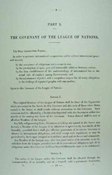
The Aims of the League of Nations
The main aims of the Leagues of Nations were :
to keep the peace
to guarantee the independence of other member’s territory
to submit disputes to an independent body
to take action against an aggressor by either military or economic means
to decrease armaments

Slide 2
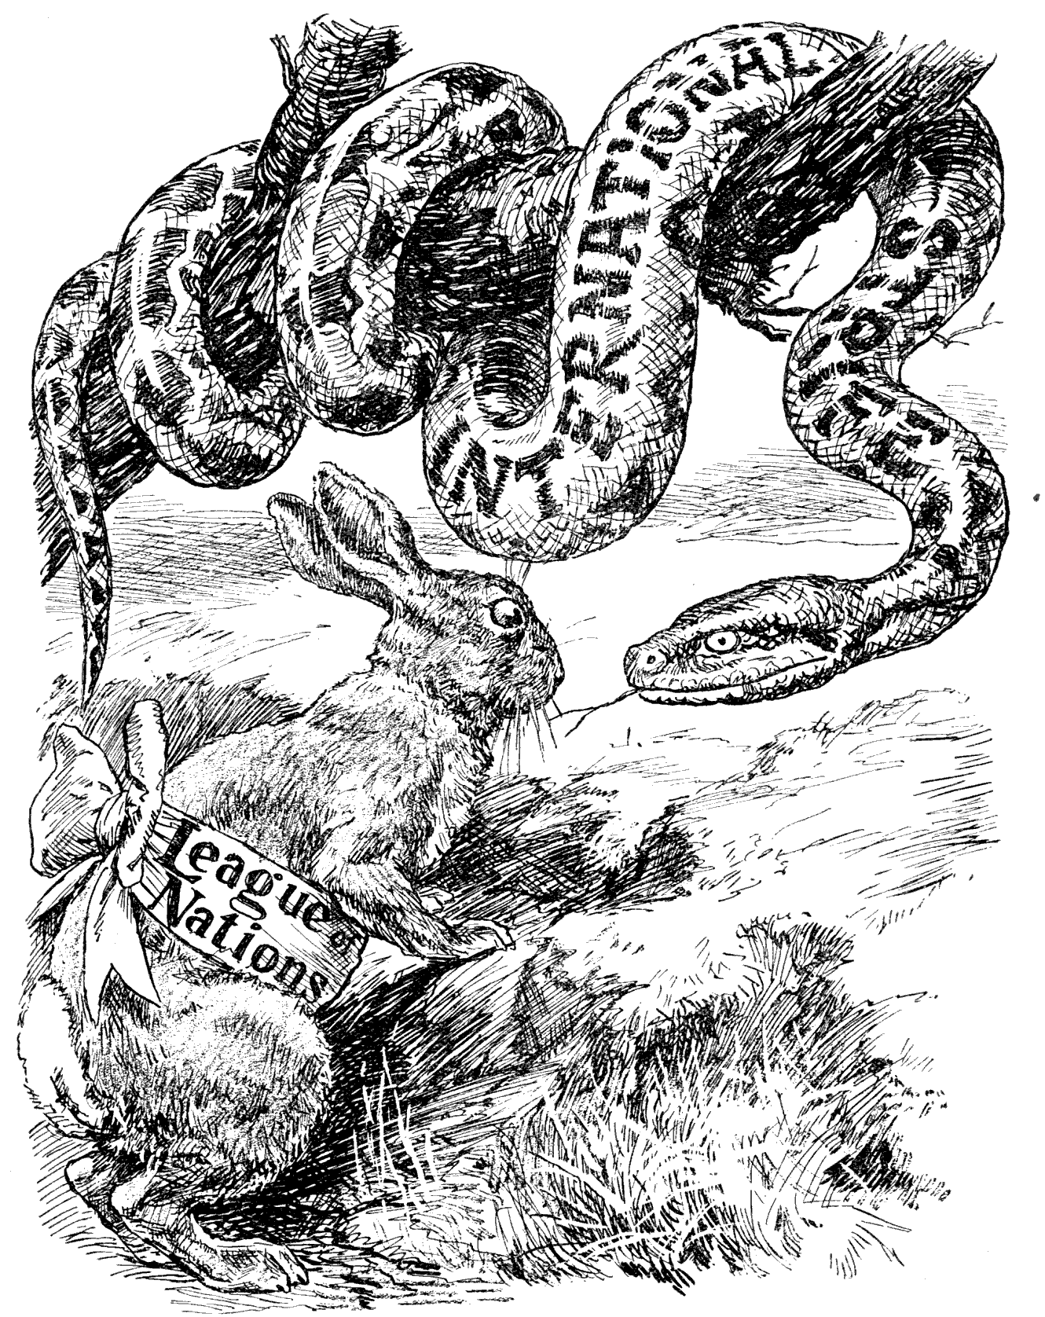
Sources
In the first picture the snake represents evil and risk of war. The rabbit represents the League of Nations. The message the rabbit sends is that they need more countries to defeat the evil.

Slide 3
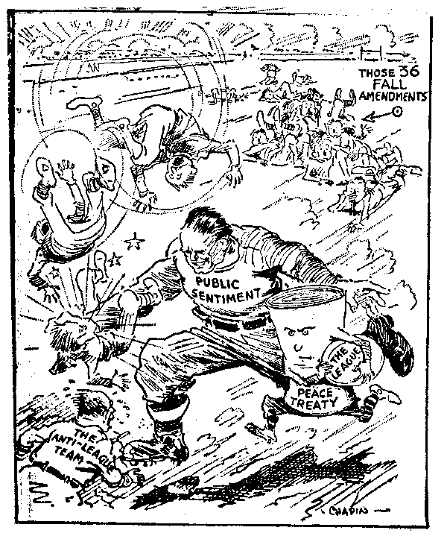
The second picture represents a rugby match where the attacker is the toughest player, that represent the public sentiment and the ball the league. Between these two there is peace threaty.

Slide 4
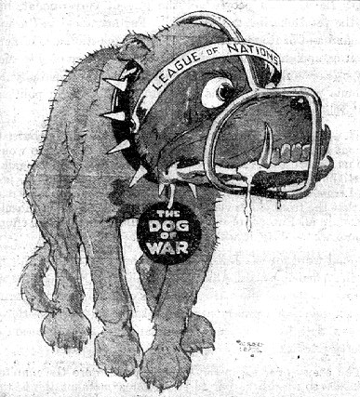
This third is a dog with a mussel . The dog is the dog of war and the mussel is the League of Nations . It signifies that the League of Nations can stop wars

