Slide 1
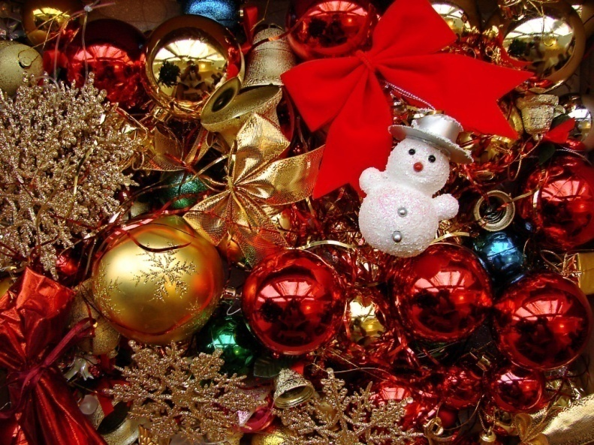
Christmas
BY ISABELL LONG
Isabell Long isabell121@gmail.com

Slide 2
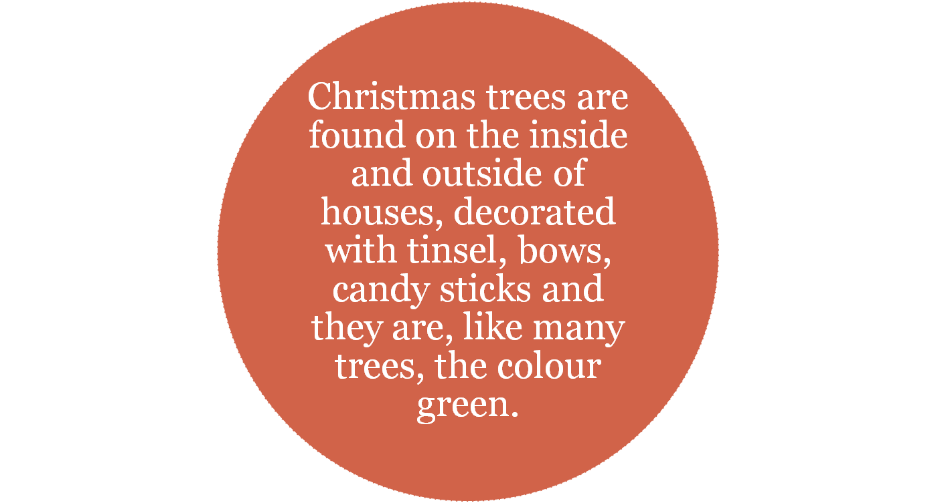


Christmas Trees
Isabell Long isabell121@gmail.com

Slide 3
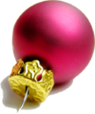
Christmas Decorations
Christmas decorations are found in the inside of houses around Christmas time.
Now, the tradition has grown to displaying these decorations (usually big, flashy , energy-wasting, light pollution causing things) outside, such as on the roof...
Isabell Long isabell121@gmail.com

Slide 4
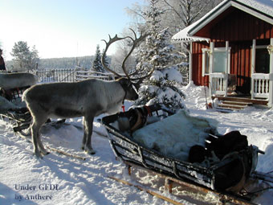
Christmas Songs
Christmas carols are sung around Christmas time, they are part of the tradition.
There are traditional Christmas carols such as ‘Silent Night’ and more modern ones like ‘Rudolf the Red Nosed Reindeer’.
Isabell Long isabell121@gmail.com

Slide 5
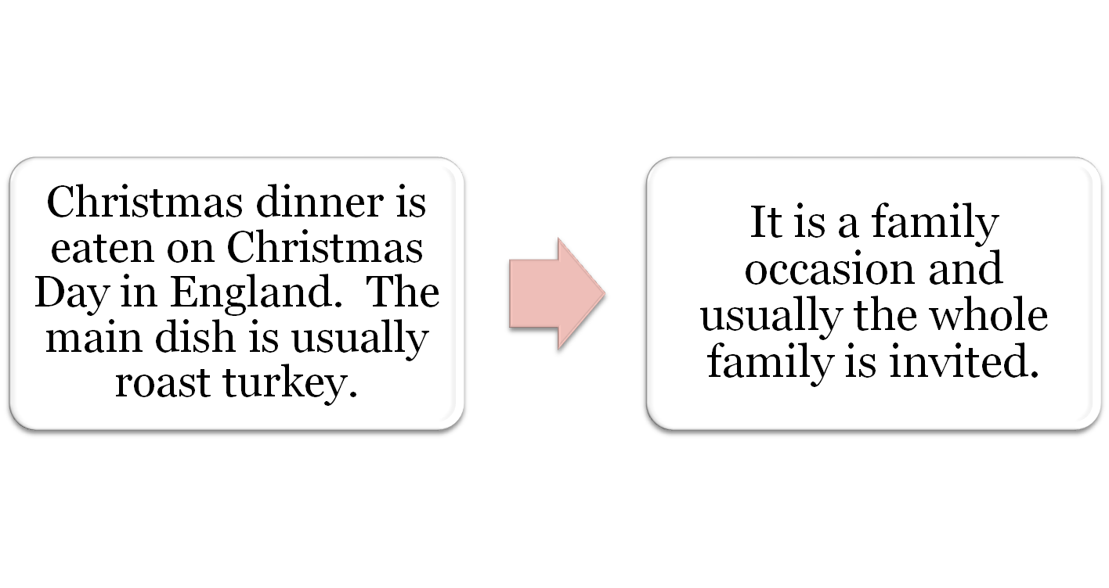
Christmas Dinner
Isabell Long isabell121@gmail.com

Slide 6
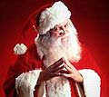
Father Christmas
Father Christmas is also known as Santa Claus.
He travels the world on 24th December every year.
He comes in the middle of the night and deposits presents in children's stockings.
He has a long white beard and wears red.
He travels using reindeer and a sleigh.
Children often put out mince pies and carrots for him and Rudolf.
Isabell Long isabell121@gmail.com

Slide 7
Different Languages
Here are some ways to say Merry Christmas in different languages:
English – Merry Christmas
French – Joyeux Noel
Spanish - Feliz Navidad
Swedish – God Jul
Dutch - Vrolijk kerstfeest
Czech - Veselé Vánoce
Isabell Long isabell121@gmail.com

Slide 8
Boxing Day
Boxing Day, in England, is the day after Christmas Day.
The left over food from Christmas Day is eaten for lunch or dinner.
There is usually plenty of food.
Families come together again to relax and eat and drink more.
Isabell Long isabell121@gmail.com

Slide 9
Source
All images from Wikimedia Commons (Wikimedia Foundation)
Isabell Long isabell121@gmail.com

