Slide 1
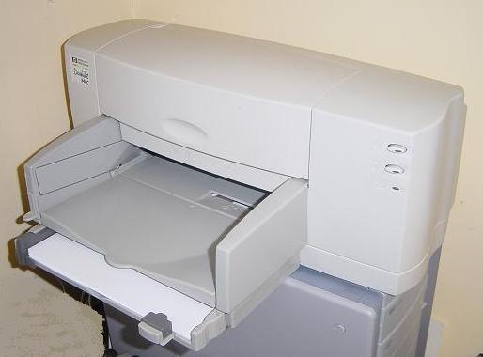
Printers of all types
Ink Jet
Laser
Thermal
And for all budgets
Budget from £99
Home office from £199
Network from £495
Notes:
All the latest printer technologies are available

Slide 2
Storage media special offers
CD-R
CD-RW
DVD-R
DVD-RW
Notes:
Sales of this products have been spectacular, as can be seen by the graph.

Slide 3
Hothouse Design for Computer Peripherals
We offer a full range of peripherals for PCs and Macs.
Notes:
I am here on behalf of the Sales department of Hothouse Design

