Slide 1
Computer Networks
By Isabell Long

Slide 2
A computer network is a collection of computers linked together so that they can communicate with each other.
A computer that is not connected to a network is called a stand-alone computer.
There are two different types of computer network:
  Local Area Network or LAN - the computers are all in the same building or in different buildings on one site permanently connected to each other with special cables.
  Wide Area Network or WAN - the computers are spread over a large geographical area not permanently connected to each other communicate using telephone lines, radio transmitters or satellite links.

Slide 3
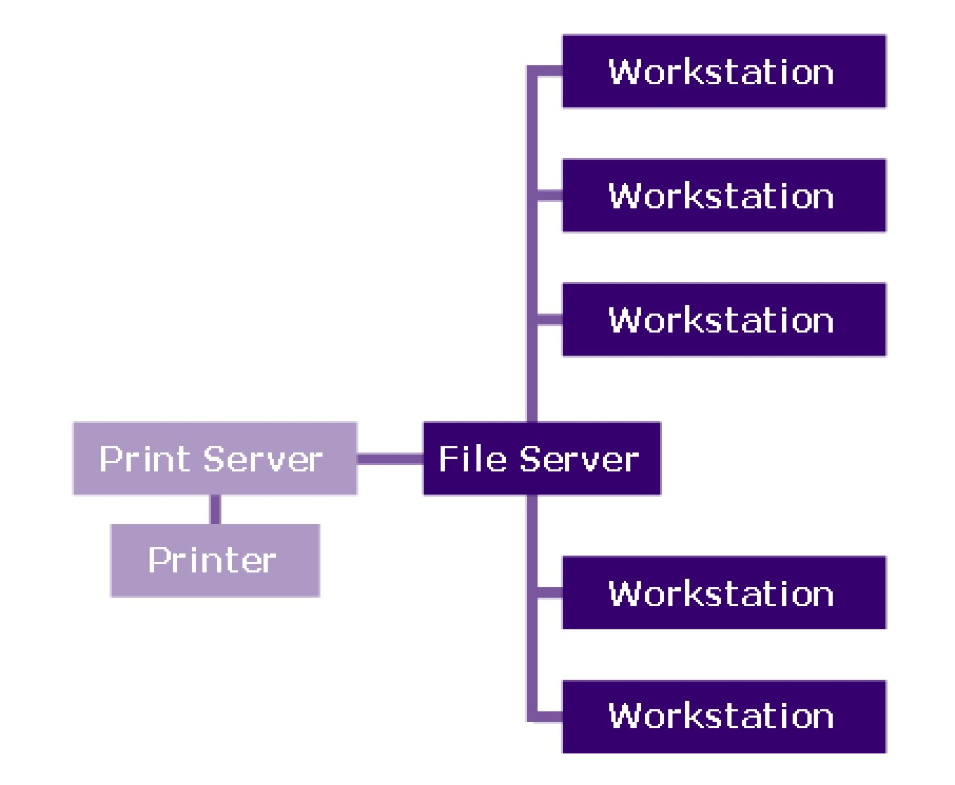
Local Area Network

Slide 4
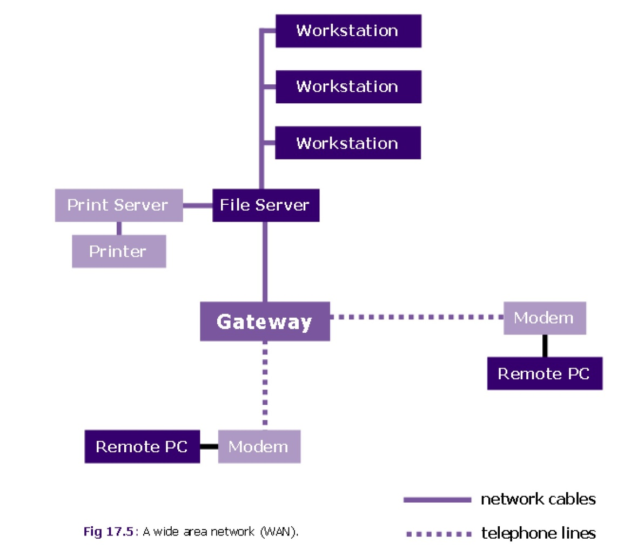
Wide Area Network

Slide 5
Network security measures are needed to protect programs and data from the threats that come from other users and hackers.
Data can be kept secure by:
  giving each network user their own user identity and password;
  reducing unauthorised access by allowing users different levels of access;
  physically restricting access to computer rooms by locking doors or providing users with entry codes or special swipe card keys.

Slide 6
The topology of a network describes the way cables are used to connect network devices like servers, workstations or printers.
In a bus topology all the computers are connected through their own cable to a single central cable - this is the simplest type of topology.

Slide 7
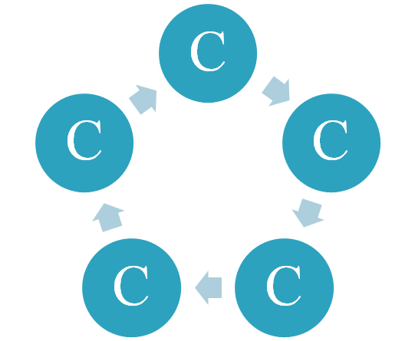
In a ring topology computers are connected to each other forming a large circle.
Data is sent around the ring until it reaches its final destination.
A problem with this topology is that if one computer fails the entire network will break down this is one reason why ring topologies are not used much anymore.

Slide 8
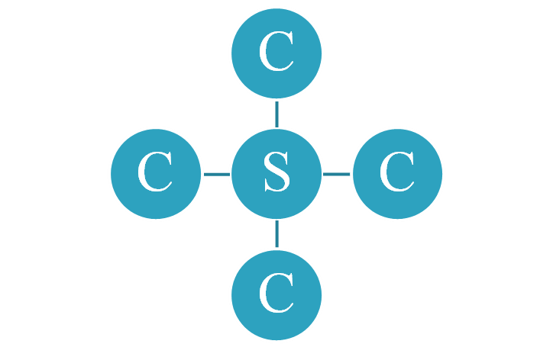
In a star topology each computer is connected directly to a central server by a dedicated cable.
This type of topology is very reliable but the cost of cabling can be quite expensive.

Slide 9
Advantages of LANs
Workstations can share peripheral devices such as printers. This is cheaper than buying a printer for every workstation;
Workstations don’t necessarily need their own hard disk or CD-ROM drives which makes them cheaper to buy than stand-alone PC’s;
Users can save their work centrally on the network’s file server. This means that they can retrieve their work from any workstation on the network. They don’t need to go back to the same workstation all the time;
Users can communicate with each other and transfer data between workstations very easily;

Slide 10
One copy of each application package such as a word processor, spreadsheet etc can be loaded onto the file server and shared by all users. When a new version comes out, it only has to be loaded onto the server instead of onto every workstation.
Disadvantages of LANs
Special security measures are needed to stop users from using programs and data that they shouldn’t have access to;
Networks are difficult to set up and must be maintained by skilled ICT Technicians;
If the file server develops a serious fault all the users are affected, rather than just one user in the case of a stand-alone machine.

