Slide 1
A spreadsheet package is a general purpose computer package that is designed to perform calculations.
A spreadsheet is a table which is divided into rows and columns.
Columns have a letter at the top and rows have a number at the side.
Lines divide rows and columns up into boxes called cells.
Cells can contain text, numbers or a formulae.
Individual cells are identified by their cell reference which normally contains a column letter and a row number.

Slide 3
A formula is used on a spreadsheet to perform a calculation using the numbers in other cells.
The result of the calculation is displayed in the cell where the formula has been entered.
A simple formula can be used to add, subtract, multiply or divide numbers.
To carry out these sorts of calculation these symbols are used in a formula:
+ to add - to subtract
* to multiply / to divide

Slide 4
Suppose you wanted to add two numbers on a spreadsheet together.
If the numbers were in cells A1 and A2 the formula that you would need to enter would be something like
= A1+A2
To make it easier to enter longer, more complicated formulae, spreadsheet packages also have special mathematical functions built-in.
Two of the most commonly used functions are used to calculate either the SUM or AVERAGE of a range of cells.

Slide 5
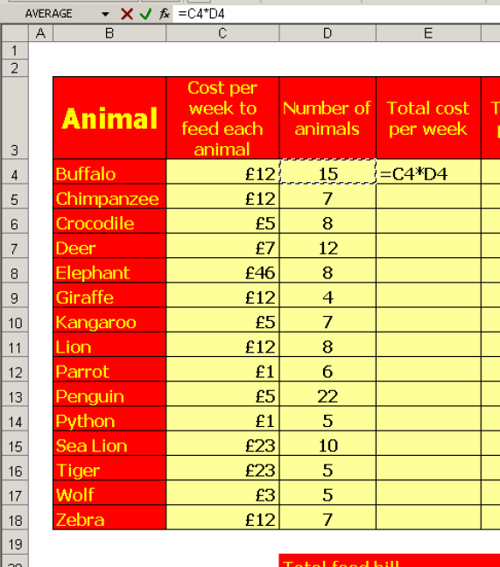
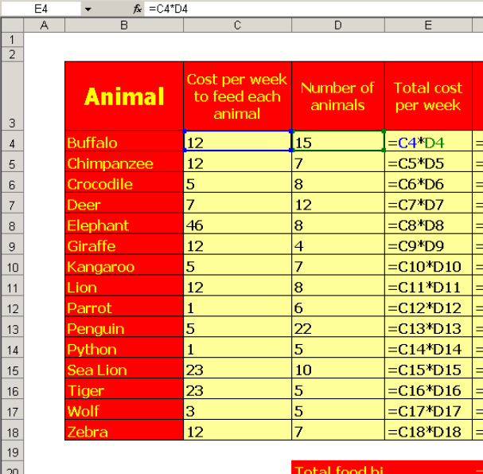
When a new spreadsheet is being set up very similar formulae are often needed in adjacent cells.
If this is the case a single formula can be copied or replicated into adjacent cells.
The spreadsheet software will automatically update the cell references in the original formula so that the new formulae refer to the correct cells.

Slide 6
Suppose, for example, that you had a formula like this:
=A1+A2+A3+A4+A5+A6+A7+A8+A9+A10
This formula would add up all of the numbers in cells A1 to A10.
Instead of typing in such a long formula, the SUM function could be used.
On most spreadsheets the formula would be something like this:
= SUM (A1: A10)

Slide 7
Spreadsheet packages have built-in formatting options which allow you to change the way a spreadsheet looks.
Some of the more commonly used formatting options are:
Changing font size and style
Decimal, currency or date formats
Making text bold, italic or underlined
Changing text alignment
Adding borders and lines
Inserting extra rows and columns
Changing column width and row height
Adding colour

Slide 8
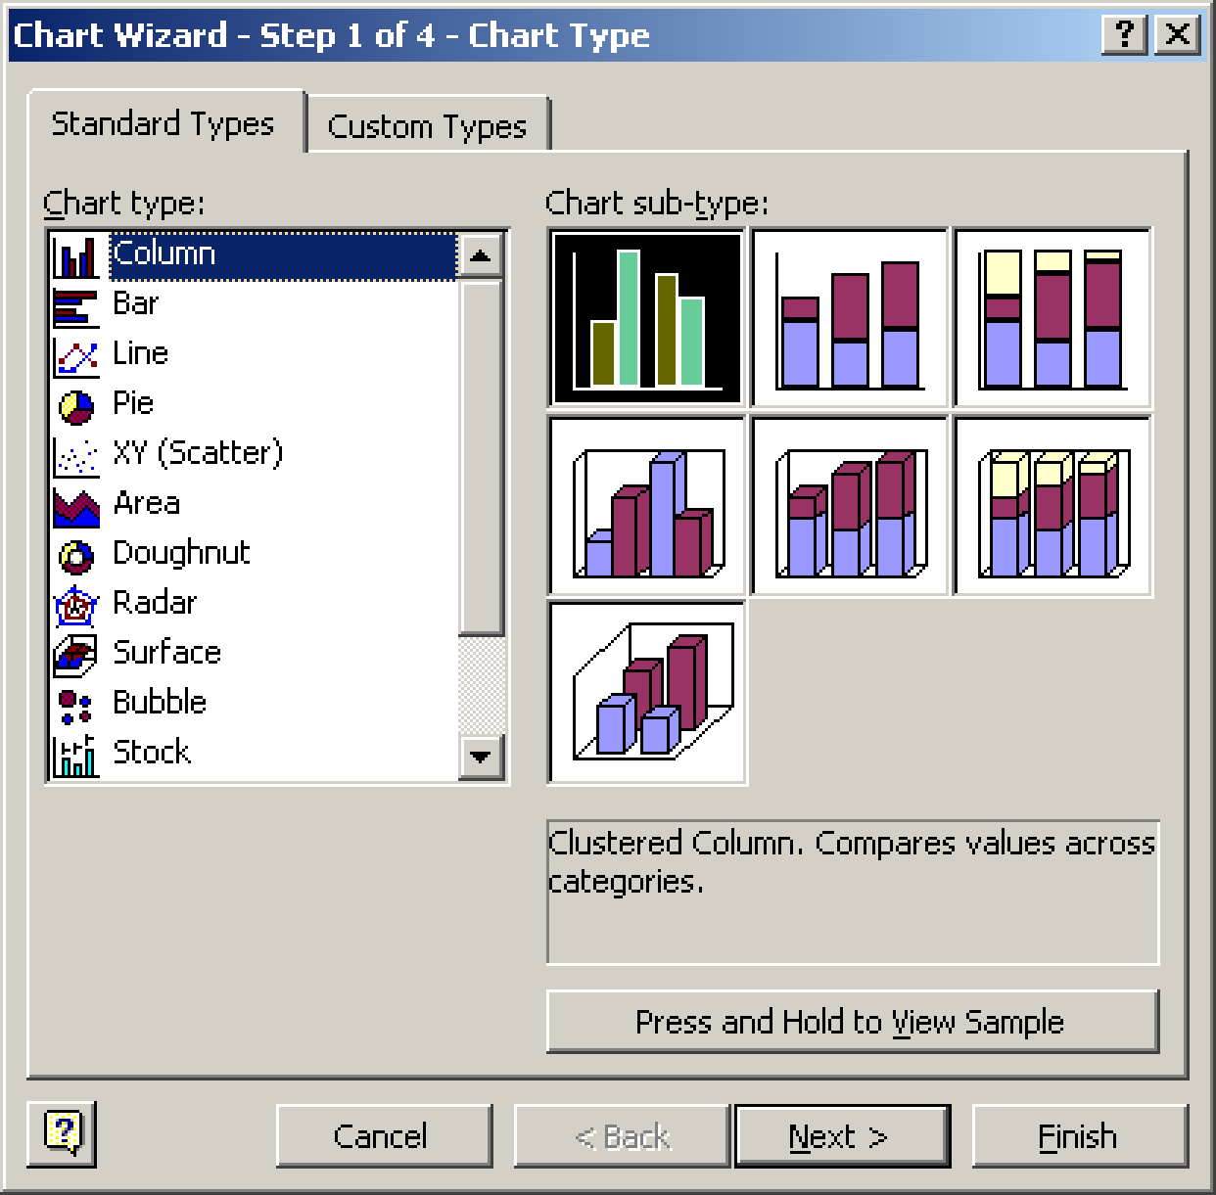
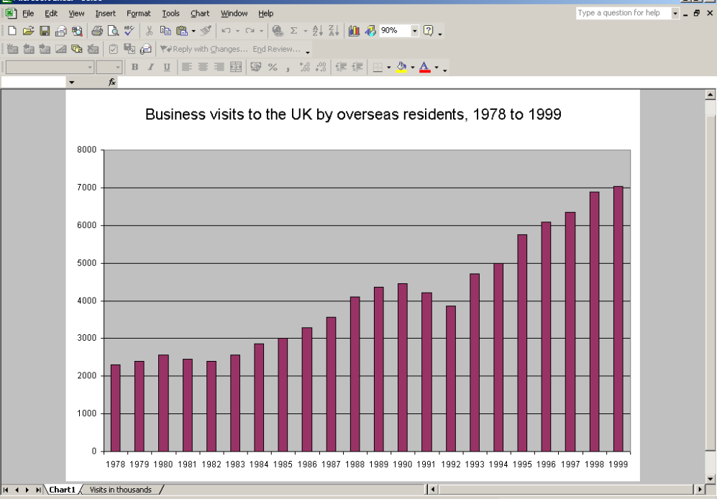

Slide 9
Most spreadsheet packages include facilities for representing information in the form of a graph or chart.
The more common types of charts and graphs that are used are bar charts, pie charts and line graphs.
A chart wizard gives step-by-step help when drawing a graph or chart.
The graph or chart is automatically drawn by the spreadsheet software. It can then be copied and pasted into other applications if required.

Slide 10
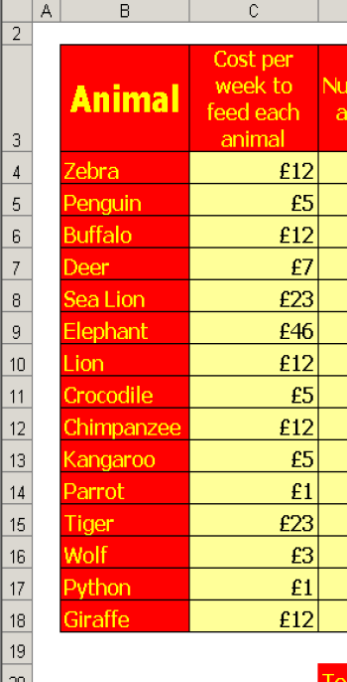
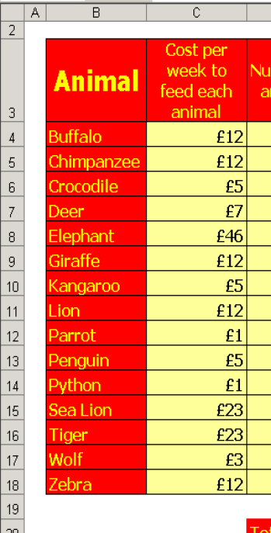
One very useful feature of spreadsheet package is the sort facility.
This allows the columns or rows of a spreadsheet to be sorted into alphabetical or numerical order of a value in a particular row or column.

