Slide 1
CSS

Slide 2
Purpose of HTML
Describes and defines content
Adds meaning to content to help search engines
Semantic Tags/Elements
Notes:
Semantic tags/elements describe is meaning to both the browser and developer

Slide 3
Homework Questions?
https://ist263-talley.github.io/spring-2020/studentone-resume.html
Notes:
Opinions on Git & GitHub
Any trouble or questions?
Collect stats on submissions…

Slide 4
Individual Project
Notes:
Opinions on Git & GitHub
Any trouble or questions?
Collect stats on submissions…

Slide 5
HTML + CSS + JS = Web page
Cornerstone technologies for the WWW
describes how the content should be rendered
the content to be rendered
makes the page interactive
Notes:
Why are they separated?
Separation MVC framework

Slide 6
CSS
Cascading Style Sheets
CSS is a stylesheet language used to describe the presentation of a document written in HTML or XML.
Allows a browser engine to paint elements of the page with specific features like colors, positioning or decorations.
Notes:
Describes to who - Browser

Slide 7
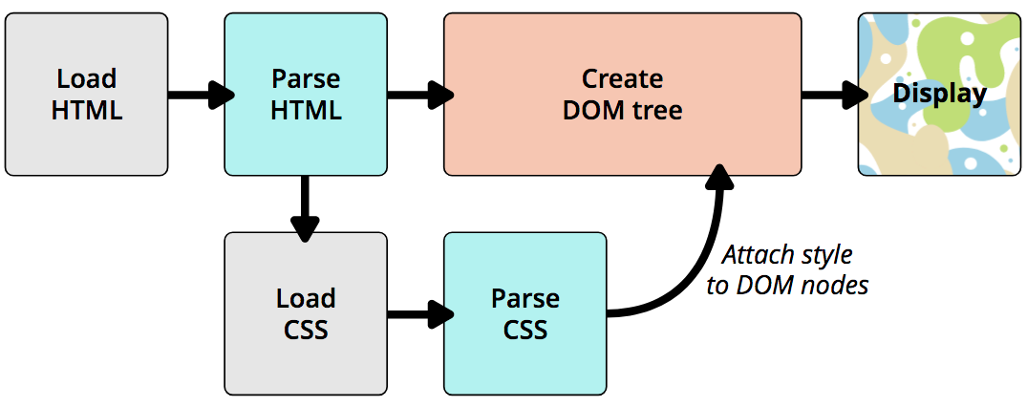
How does CSS
Affect HTML
https://developer.mozilla.org/en-US/docs/Learn/CSS/Introduction_to_CSS/How_CSS_works
Notes:
CSS does not directly affect HTML. It is used by the browser to style the HTML
previously i said browser gets the HTML and then renders it as a page.
Lets dig a little deep and add some more details to that process

Slide 8
CSS Vocabulary
h1 {
font-size: 35px;
font-weight: normal;
text-align: center;
color: #666;
}
Selector
Property
Value
CSS Declaration
CSS Ruleset or Rule
Notes:
https://developer.mozilla.org/en-US/docs/Learn/CSS/Introduction_to_CSS/Syntax
Make CSS readable

Slide 9
How to Apply CSS
External Stylesheet Defined in an external file. Included via the <link> element. Affects all pages where it is included.
Internal Stylesheet Included in the page via the <style> element. Affects only the page it is included in.
Inline Styles Included via the style attribute for a HTML element. Affects only the element.
Notes:
https://developer.mozilla.org/en-US/docs/Learn/CSS/Introduction_to_CSS/How_CSS_works
Internal
Only applies to the current page
<style> element
Inline Style
affects the single element where it is defined in the style attribute

Slide 10
Samples in Folder
week-04/01

Slide 11
Let’s try some CSS

Slide 12
Developer Tools

Slide 13
DOM
Document Object Model
Created by the browser, and has a tree-like structure
HTML Element => DOM Node

Slide 14
HTML => DOM Tree
<!doctype html>
<html lang="en">
<head>
<title>IST 263</title>
</head>
<body>
<p>Hello World !!!</p>
</body>
</html>
Notes:
Draw tree
Talk about nodes
Explain why it is called Cascading SS

Slide 15
Dom Node - Relationships
Parent, Child & Siblings
<p>
Let's use:
<span>Cascading</span>
<span>Style</span>
<span>Sheets</span>
</p>
P
├─ "Let's use:"
├─ SPAN
| └─ "Cascading"
├─ SPAN
| └─ "Style"
└─ SPAN
└─ "Sheets"
Notes:
style applied to a parent element automatically gets applied to all its children elements

Slide 16
More CSS
Next Class

