Slide 1
테스트

Slide 2
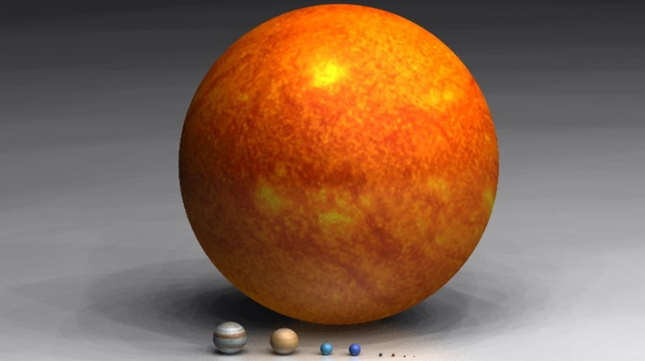

Slide 3
Title 1 | Title 2 | Title 3
Cell 1,0 | Cell 1,1 | Cell 1,2
Cell 2,0 | Cell 2,1 | Cell 2,2
Cell 3,0 | Cell 3,1 | Cell 3,2
Cell 4,0 | Cell 4,1 | Cell 4,2

