Slide 1
Project Title
Power BI Project: company Performance & Insights
AdventureWorksDW2022 Database
Presented by: [Abdullah Istanbuli]
Date: June 2025

Slide 2
Objectives
Analyze employee performance metrics
Visualize salary distribution across departments
Analyze sales and patterns related
Analyze best products and best customer segments

Slide 3
Dashboards Overview
1. Salary by Department
2. Average Salary by Birthdate
3. Sick/Vacation Hours vs Salary
4. Gender Distribution & Job Titles
5. Sales by year and by location and by banks
6. Customer sales by birth year and by income and gender
7. Best product preformance

Slide 4
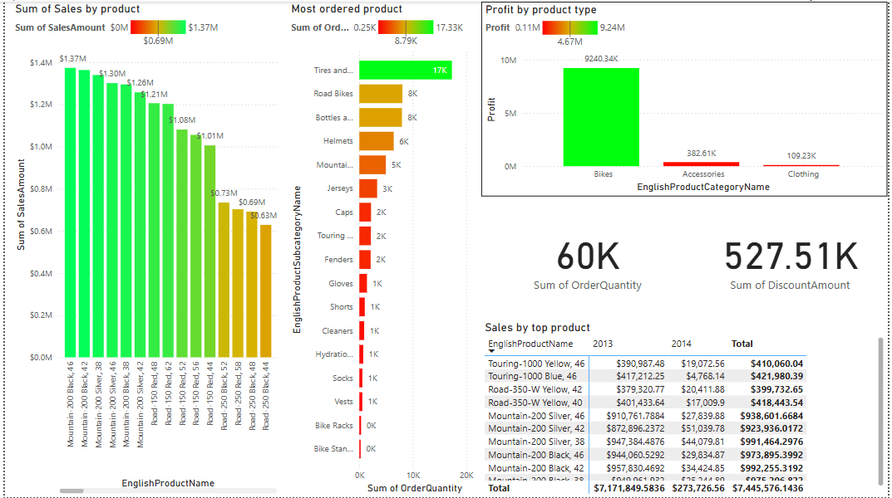
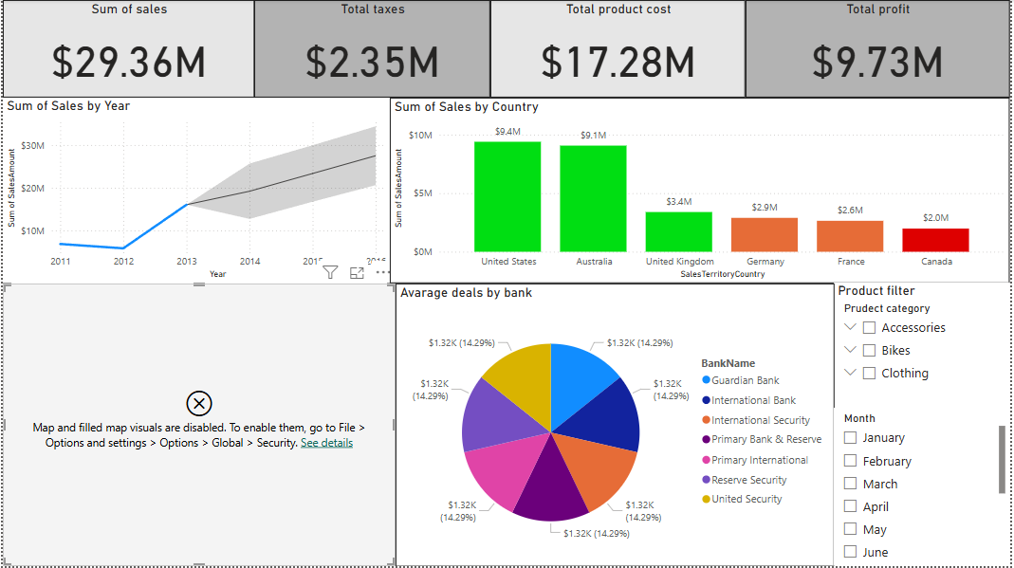
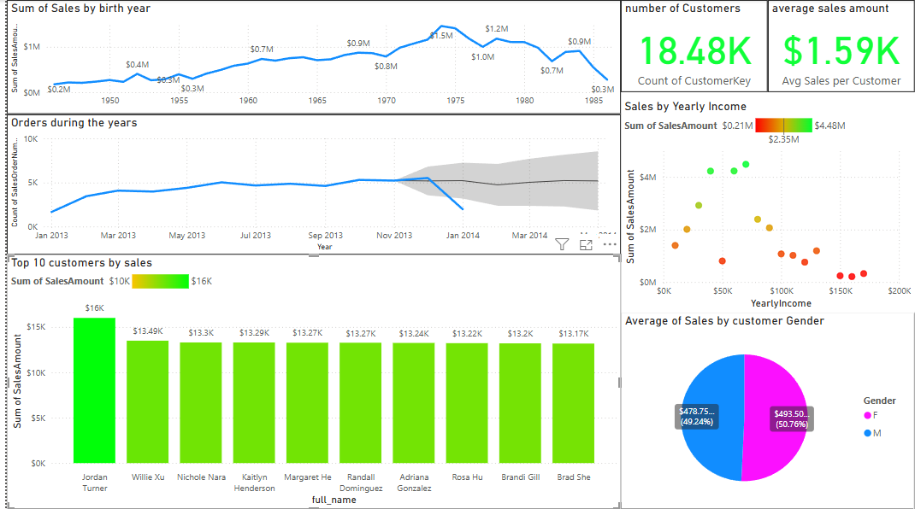
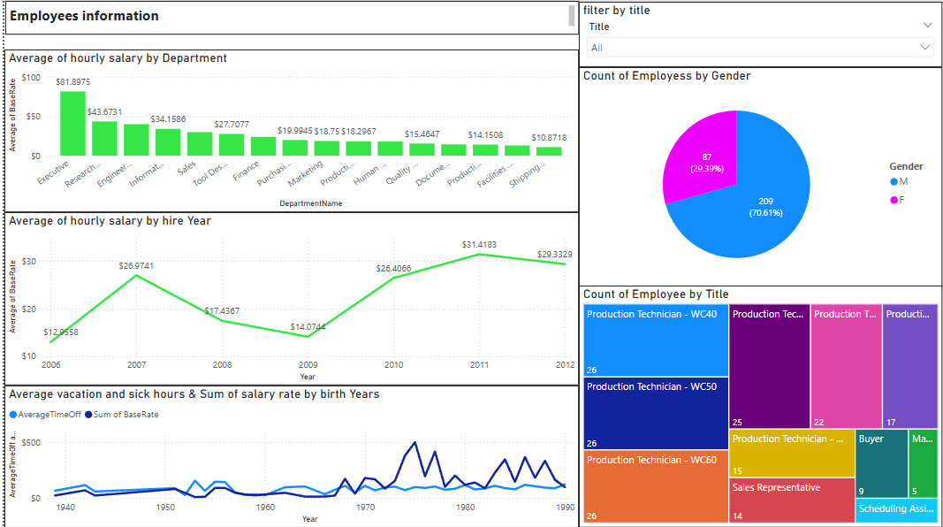

Slide 5
Most important charts in each dashboard
employees
Line chart showing salary trend by birth year
Finance and Engineering departments have highest averages
Line chart of total leave hours vs salary, no significant information has been revealed
The company are majority male employees 70%

Slide 6
Most important charts in each dashboard
sales
Pie chart showing the most business done with banks
Sales by year Line chart shows highest sales year is 2013, with forecasting
Bar chart shows the best selling countries (USA)
Filters by month and product

Slide 7
Most important charts in each dashboard
customers
Line chart showing best customers by birth year, which shows that customers born in 74 are the best buyers
sales over the years chart to show trends
Best 10 customers
Scatter plot for customers sales with their income which shows that people who make 70k are the best customers

Slide 8
Most important charts in each dashboard
product
The most sold product by (price) bar chart
Most ordered product bar chart
Profit by product type bar chart
Top product sales matrix

Slide 9
Conclusions & Recommendations
Key findings summarized: salary trends, leave patterns, and gender distribution, best customer segment, best product preformance
Recommendations:
- Adjust compensation policies for early-career employees
- Investigate leave policies to ensure fairness
Target the 70k income and born in 74 customers they make the best sales
Replace the worst sold products with new ones
- Continue monitoring with updated data

Slide 10

Thank you Abdullah Istanbuli (21110366)

