Slide 1


Topic Modelling Tutorial
Mauro Bruno, Elena Catanese, Francesco Ortame, Francesco Pugliese,
mbruno@istat.it, catanese@istat.it, ortame@istat.it, frpuglie@istat.it

Slide 2
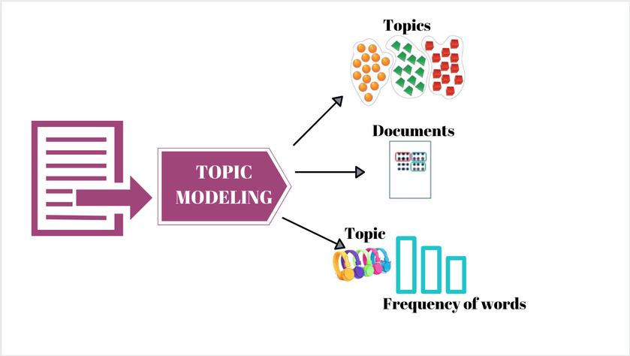
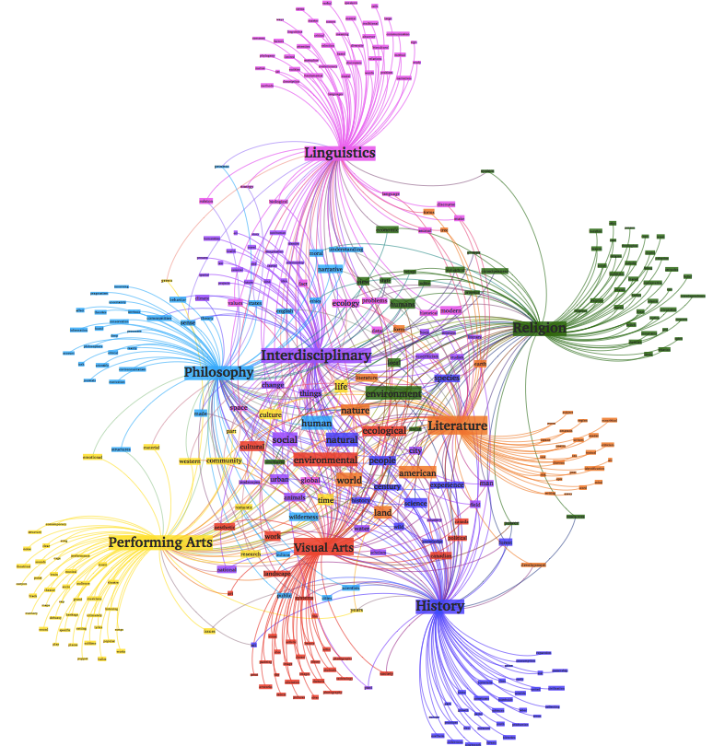
What is the Topic Modelling?
Topic modeling is a type of statistical modeling that uses unsupervised Machine Learning to identify clusters or groups of similar words within a body of text. This Text Mining method uses semantic structures in text to understand unstructured data without predefined tags or training data.
Topic modeling discovers abstract topics within a collection of documents. It is widely used in Natural Language Processing (NLP) and Text Mining to understand the themes or subjects present in large sets of unstructured text data.

Slide 3
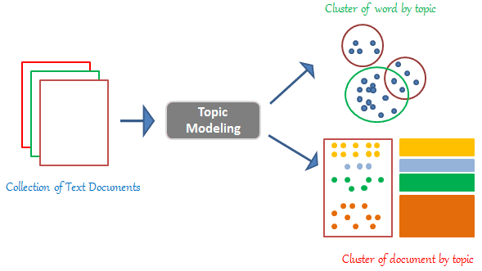
What is the Topic Modelling?
Here’s a more detailed breakdown of what topic modeling entails:
Documents and Words: The basic units of topic modeling. Documents are the individual pieces of text (e.g., articles, emails, reviews), and words are the tokens or terms within these documents.
Topics: A topic is a distribution over a fixed vocabulary. It is characterized by a set of words that frequently appear together. Each topic can be seen as a pattern of co-occurrence of words.
Latent Variables: These are the hidden patterns or topics inferred from the observed data (the words in the documents).

Slide 4
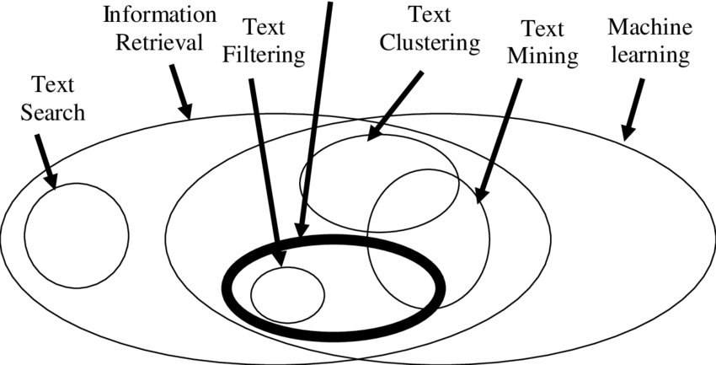
Applications of Topic Modelling
Text Categorization: Classifying documents into predefined categories based on the identified topics.
Information Retrieval: Enhancing search engines by indexing documents with topics to improve search relevance.
Recommender Systems: Suggesting articles, books, or other content based on topics of interest.
Sentiment Analysis: Understanding public sentiment by analyzing the topics discussed in social media, reviews, or feedback.

Slide 5
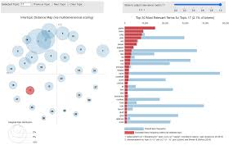
Challenges in Topic Modelling
Topic modelling is a powerful tool for extracting insights from large text corpora, enabling a deeper understanding of the underlying themes and patterns in the data.
Choosing the Number of Topics: Determining the optimal number of topics can be non-trivial and often requires experimentation.
Topic Interpretability: Ensuring the topics make sense to humans can be challenging.
Scalability: Handling large datasets efficiently, particularly in terms of computation time and memory usage.

Slide 6
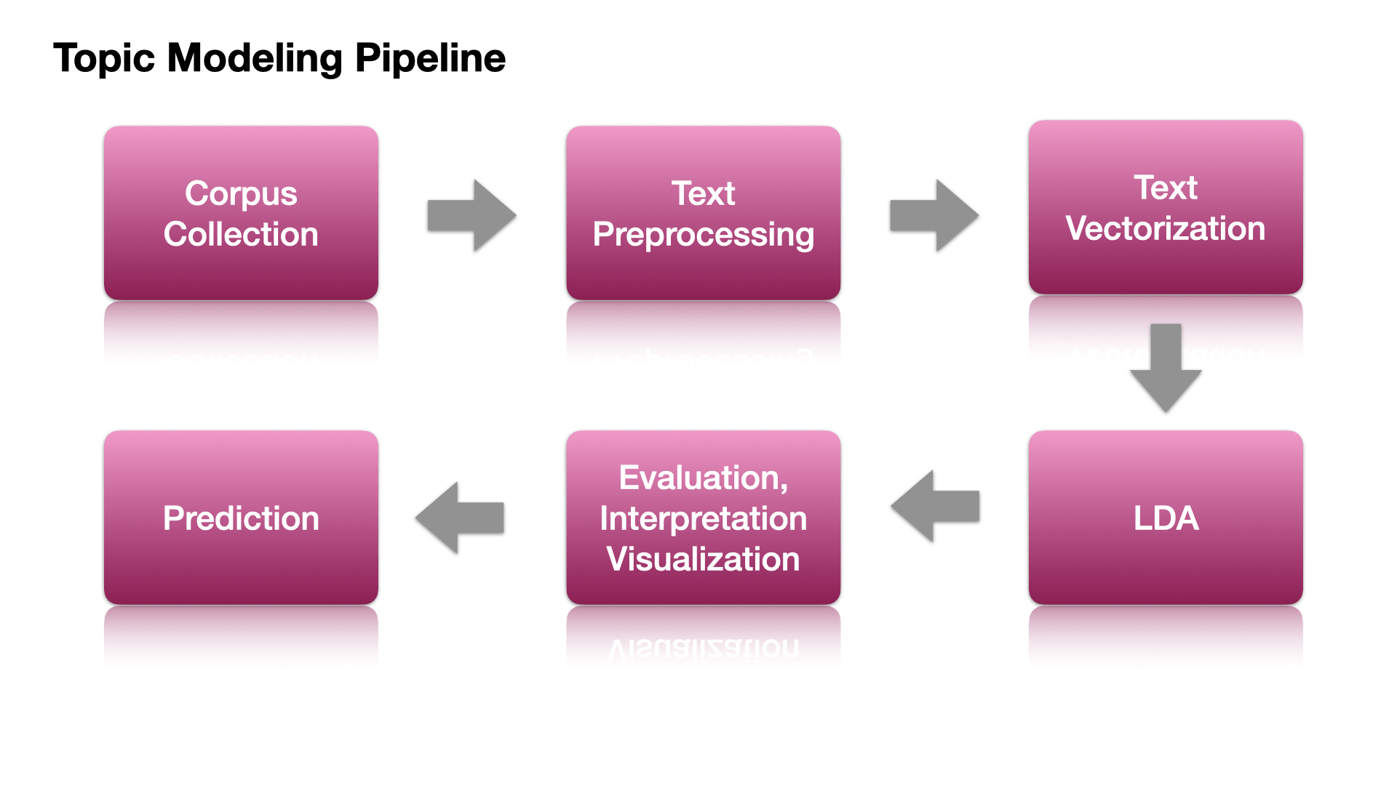
Steps in Topic Modelling
Preprocessing: Clean the text data (e.g., remove stop words, tokenize, and normalize).
Model Training: Apply a topic modeling algorithm to the preprocessed data.
Evaluation: Assess the quality of the topics using coherence scores, human judgment, or other metrics.
Interpretation: Analyze the topics and assign meaningful labels or descriptions.

Slide 7
Upsides of Topic Modelling
Preprocessing: Clean the text data (e.g., remove stop words, tokenize, and normalize).
Model Training: Apply a topic modeling algorithm to the preprocessed data.
Evaluation: Assess the quality of the topics using coherence scores, human judgment, or other metrics.
Interpretation: Analyze the topics and assign meaningful labels or descriptions.

Slide 8
Upsides of Topic Modelling
Efficient Data Organization and Summarization: Topic modeling can automatically categorize vast amounts of text data into meaningful topics, saving significant time and effort.
Insight Generation and Uncovering Hidden Patterns: Topic modeling has the ability to uncover latent themes and structures within text data that might not be immediately obvious.
Enhanced Information Retrieval: By indexing documents with topics, search engines can return more relevant results.
Content Recommendation and Personalization: Topic modeling can be used to recommend content based on the topics of interest, such as articles, books, or multimedia.
Scalability and Versatility: Its versatility allows it to be applied across various domains, such as academia, business, marketing, etc.

Slide 9
Downsides of Topic Modelling
Choosing the Number of Topics: Selecting the optimal number of topics is often arbitrary and requires trial and error.
Interpretability of Topics: The topics generated by models like LDA may not always be easily interpretable. The sets of words associated with each topic might not clearly convey a coherent theme, making it difficult to label and understand them
Vague or Mixed Topics: Sometimes the words in a topic don't form a clear, coherent idea
Human Judgment Required: Often needs human interpretation to make sense of the topics.
Scalability and Computational Cost: Training topic models on large datasets can be computationally expensive and time-consuming

Slide 10
Latent Dirichlet Allocation - LDA

Slide 11
Hierarchical Dirichlet Process - HDP

Slide 12
Non-Negative Matrix Factorization – NMF

Slide 13
Top2Vec

Slide 14
BERTopic

Slide 15
Llama2

Slide 16
BERTopic with Llama2

Slide 17
References

Slide 18
Acknowledgements
Thank You for you Attention

