Slide 1
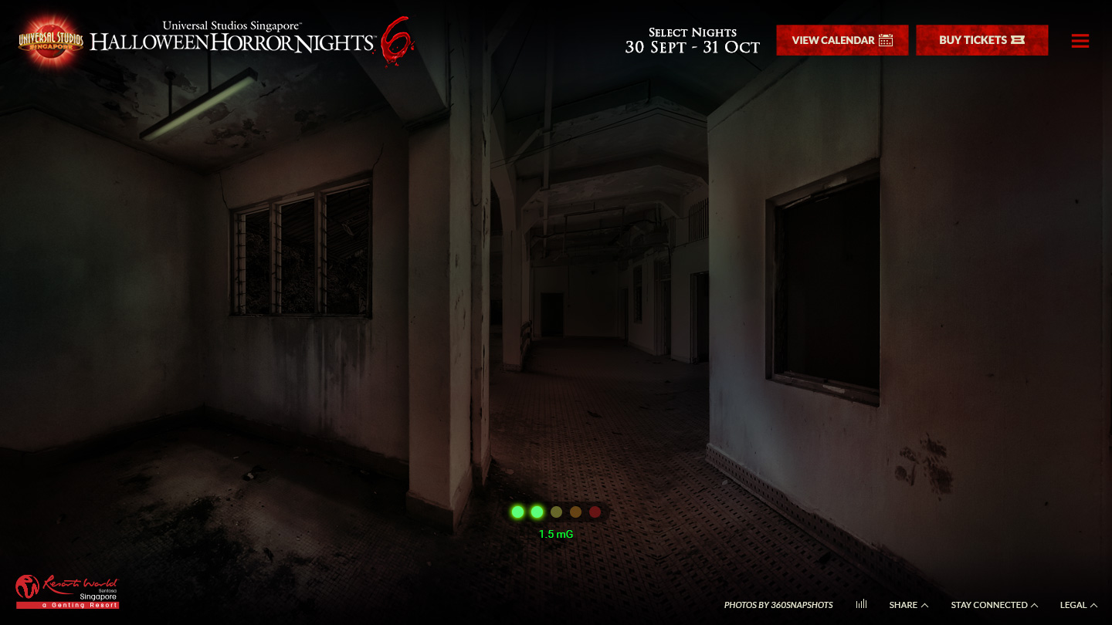
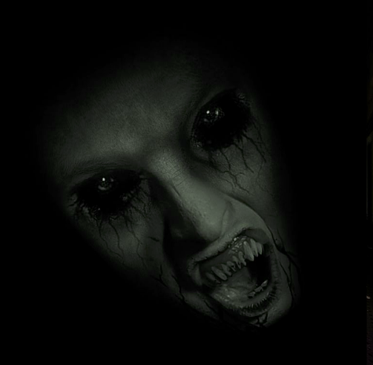
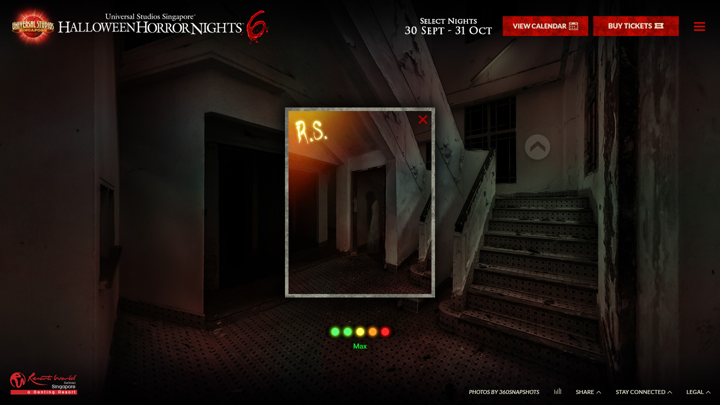
Bgm.mp3
Play on enter game
jumpscare.mp3
Play when she appear
takephoto.mp3
Play when user takes a photo
(apply to all 5 clues)

Slide 2
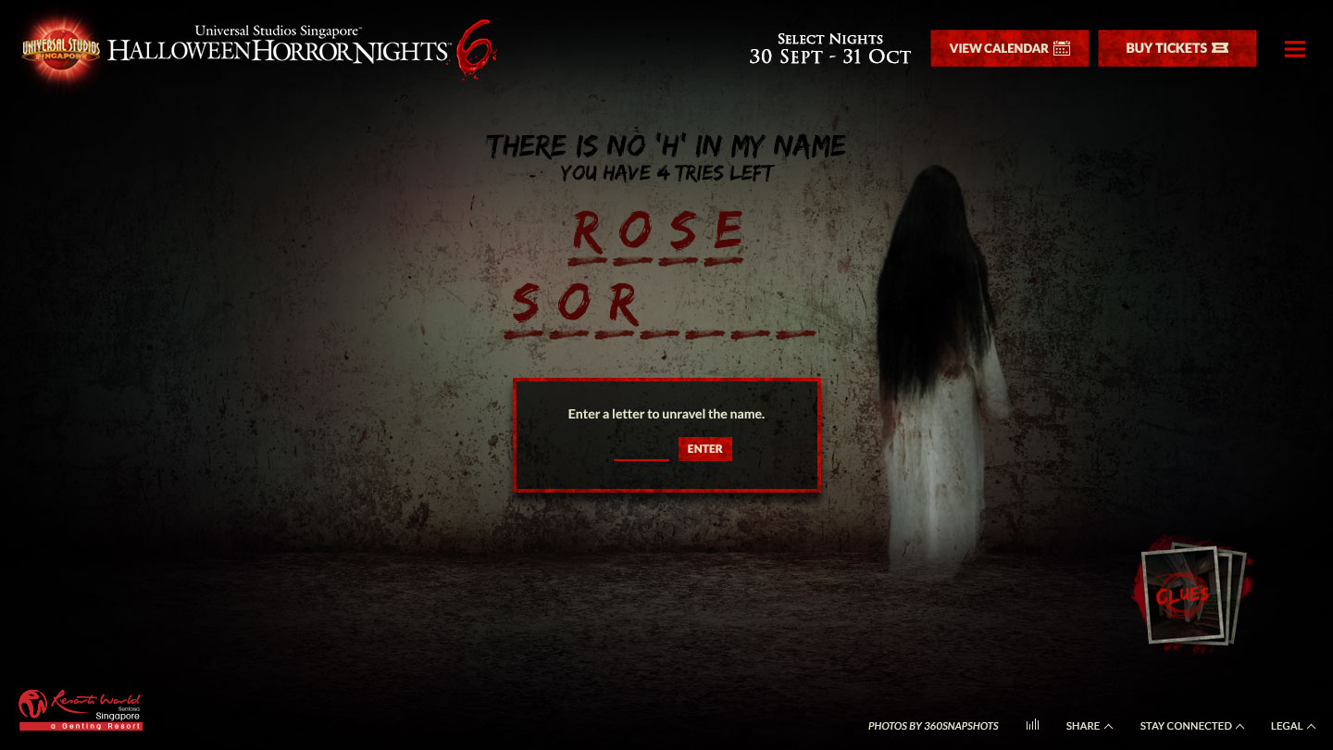
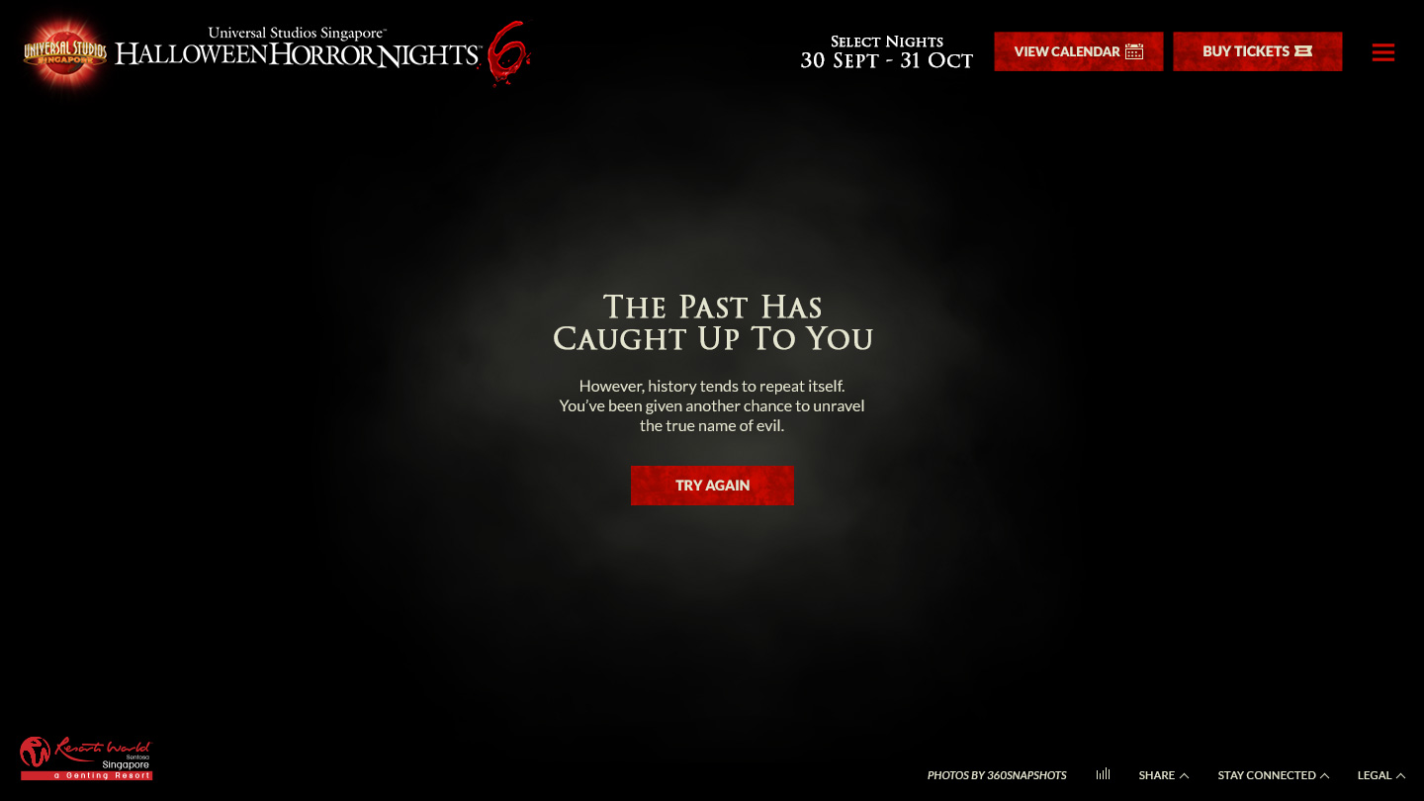
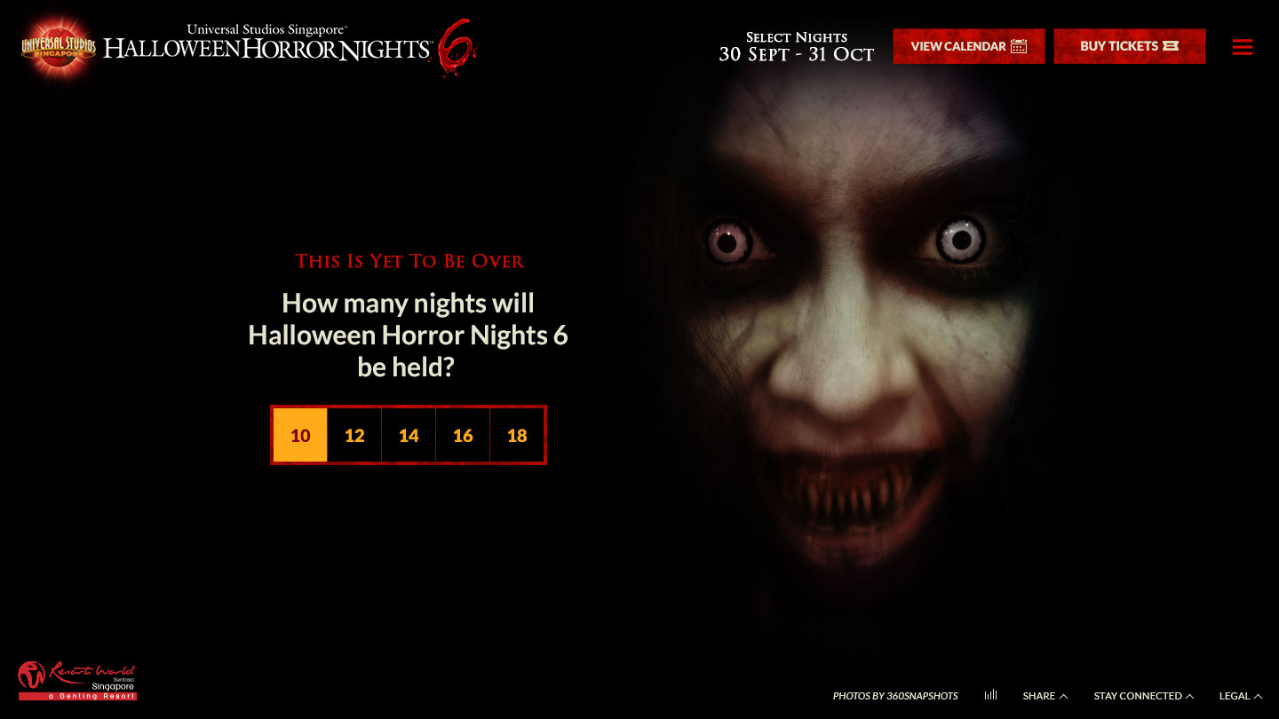
pon_appear.mp3
Play when pontianak appear for the 1st wrong answer
0016_piano_horror_alerted_d.mp3
Play when user failed the game
pon_dash.mp3
Play when pontianak dash towards user

