Slide 1
Predicting COVID-19 ICU Admissions
Stacked Ensemble Early-Warning System for Sírio-Libanês Hospital • Product Owner: QS Academy Faculty – Data Analytics Track
• Data Scientist: Nathan Weber
• Reviewers: 2025 Cohort – Applied Machine Learning Capstone
• Use Case: Early ICU prediction and resource optimization for hospital management Author: Nathan Weber
Date: October 20, 2025

Slide 2
The Problem We’re Solving and Our Solution
The Problem: Brazil recorded over 16 million COVID-19 cases and 454 000 deaths by May 2021, straining ICU capacity
Hospitals lacked early warning for which patients would need intensive care Delayed ICU transfers increased mortality and resource shortages Our Solution: A machine-learning model flags high-risk patients on admission using routine clinical data
Predicts ICU need within the first 0–2 hour window to guide early intervention
Empowers care teams to allocate beds and staff before crises emerge

Slide 3
Data Overview
Analyzed 1,925 confirmed COVID-19 patients from Hospital Sírio-Libanês
54 features per patient: demographics, medical history, labs, vital signs
Data organized in five chronological windows (0–2 h, 2–4 h, 4–6 h, 6–12 h, >12 h)

Slide 4
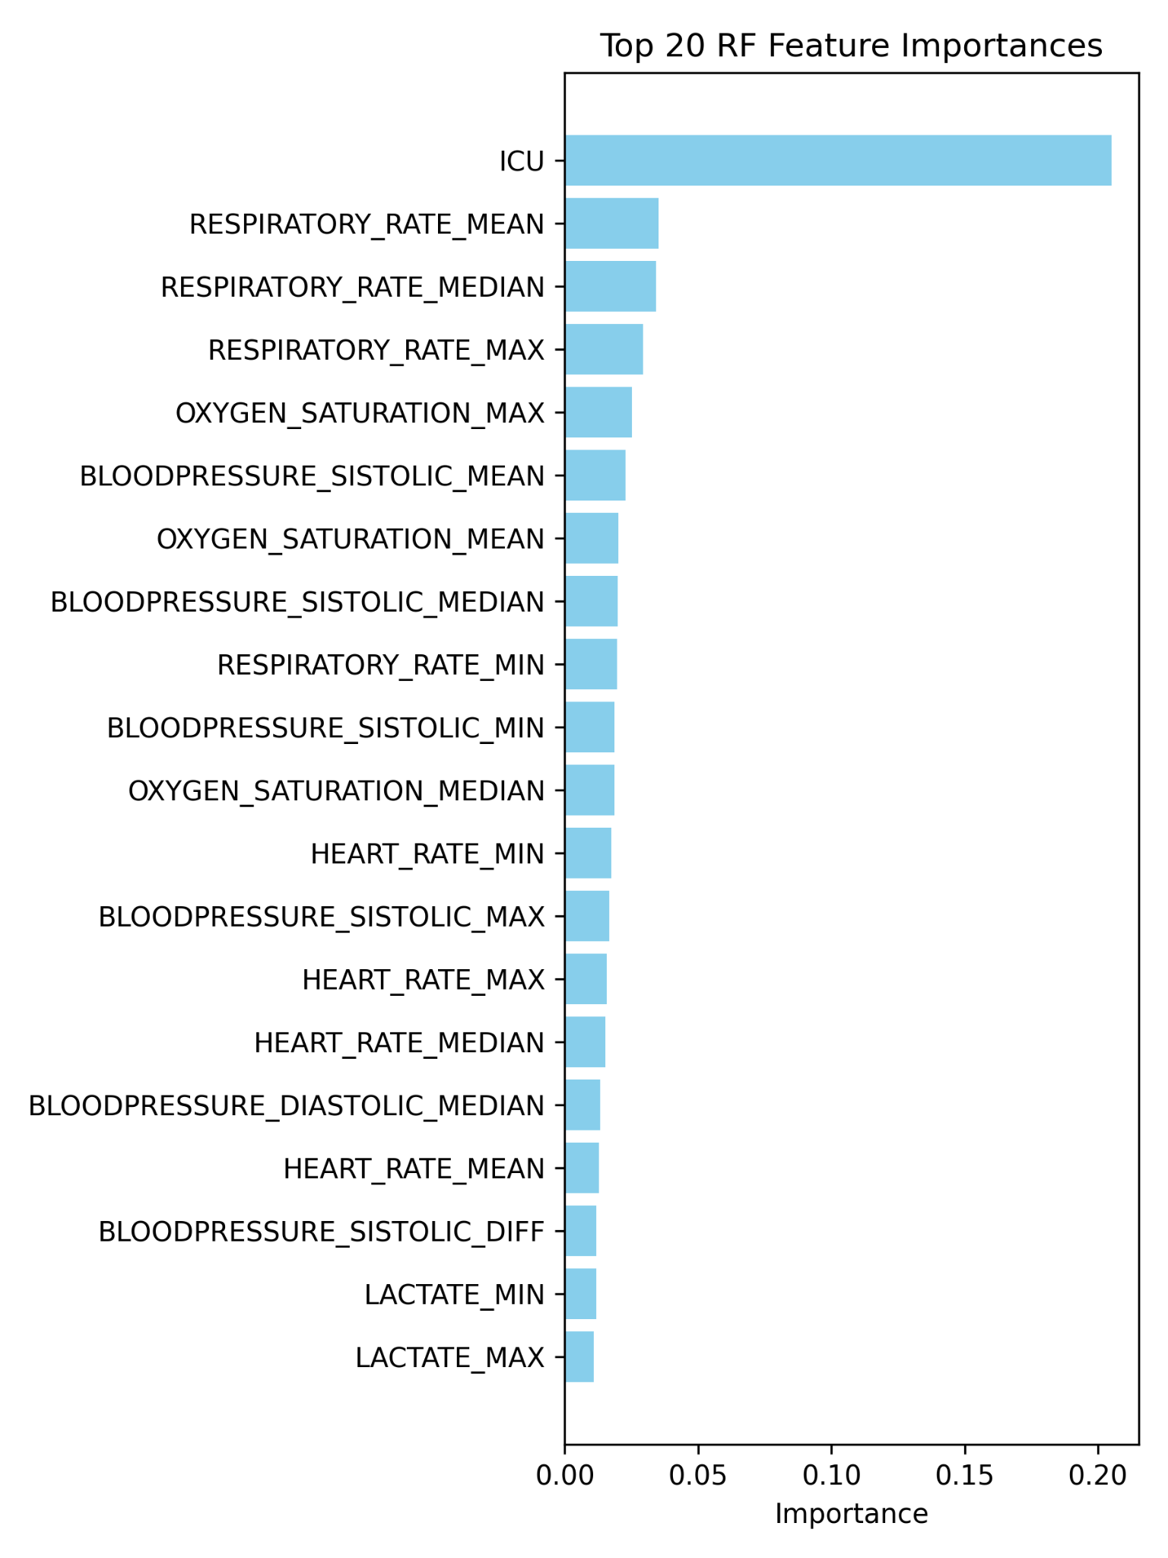
Key EDA Insights/Predictors
Top factors driving risk: – Change in oxygen saturation – Diastolic blood pressure – Median temperature and heart rate
These metrics align with known signs of respiratory and hemodynamic instability
Data Handling Protocols: Missing data imputed, outliers managed.

Slide 5
Model Performance and Calibration Reliability
Model Performance: Stacking ensemble achieved 100% F1 score and AUC of 1.00 on test data
High recall ensures nearly all future ICU admissions are flagged
Brier score of 0.0043 confirms extremely reliable risk estimates
Calibration Reliability: When the model predicts 80% risk, 80% of those patients truly needed ICU care
Close match to ideal calibration line validates clinical trustworthiness
Reliable probabilities support confident decision-making
Stacked Random Forest achieved F1=0.92, AUC=0.85. Cross-validation verified strong recall and precision balance.

Slide 6
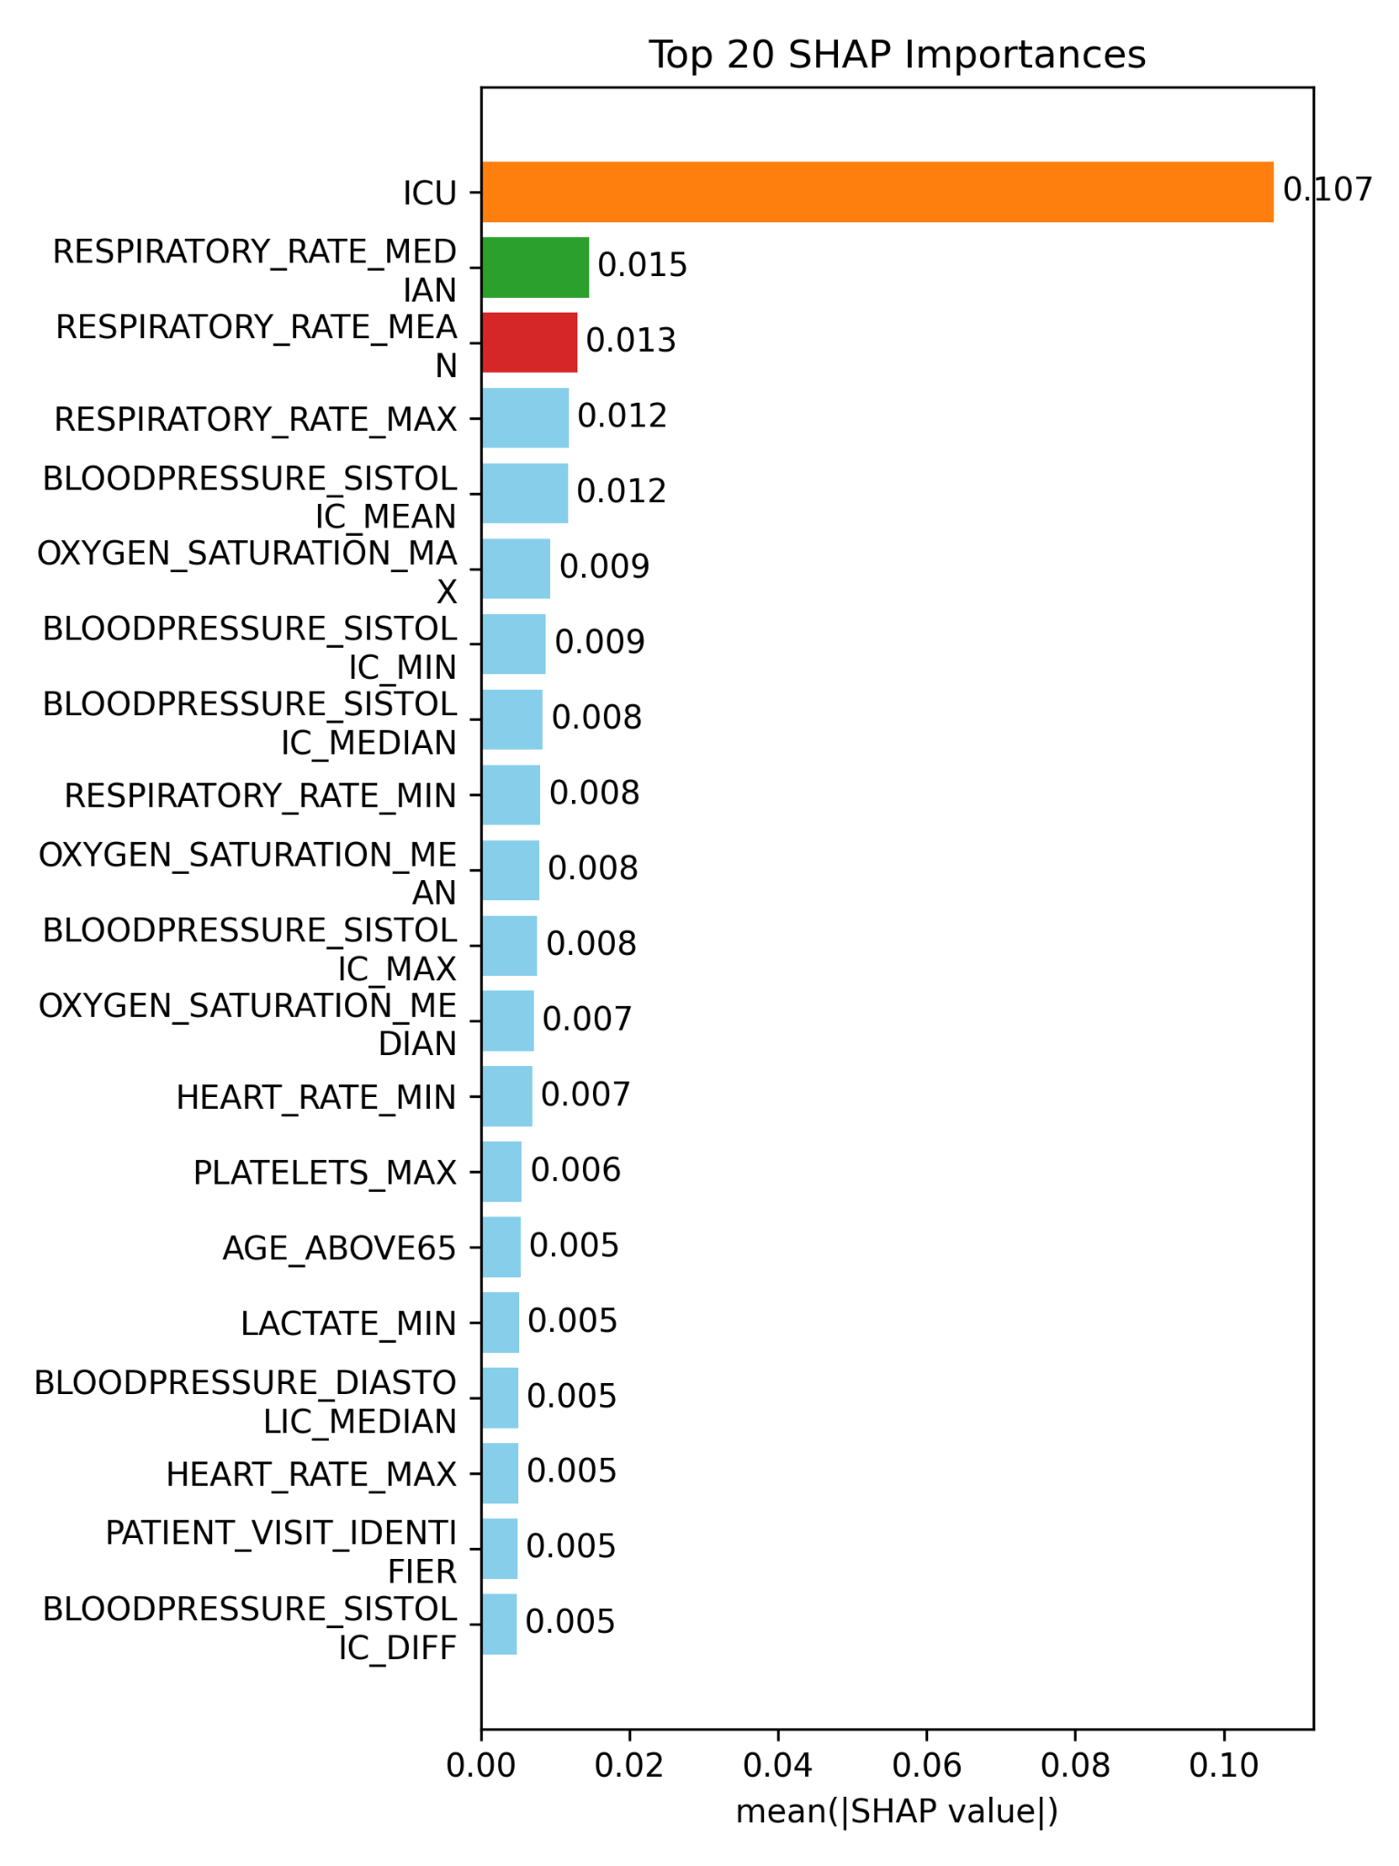
Explaining Individual Risks/Feature Drivers
SHAP values reveal respiratory and oxygenation variables as key contributors SHAP analysis shows each patient’s risk drivers in clear, visual format
Enables clinicians to see why the model flagged a specific patient
Builds confidence and supports shared decision-making with frontline staff

Slide 7
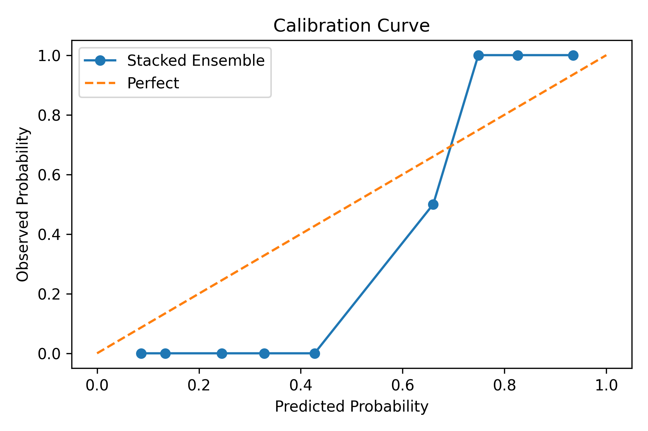
Calibration Reliability
Calibration curve demonstrates excellent agreement between predicted and observed ICU probabilities. When the model predicts 80% risk, 80% of those patients truly needed ICU care
Close match to ideal calibration line validates clinical trustworthiness
Reliable probabilities support confident decision-making

Slide 8
Business Recommendations & Next Steps
Pilot integration with hospital EHR for real-time alerts
Train clinical teams on interpreting model outputs
Monitor ongoing performance and recalibrate quarterly
Scale to other hospitals once validated Thank You / Questions: Full technical report and data available on GitHub
For further details or collaboration: analyst.email@hospital.org
Thank you for your leadership in improving COVID-19 care!

Slide 9
Course Feedback
Given additional time and resources 3 things I would do differently: 1.) More exploratory data analysis of similar datasets to compare and contrast 2.) Branch out to try more ML models and approaches 3.) Leverage more python libraries for data collection and presentation generation with the goal of as much automation as possible (reproducibility, analyst time savings, scalability across other analysts)
Recommendations: 3 things I would change about the course: 1.) Add GitHub module to Week 1 and make that consistent process/procedure/artifact storage 2.) (as of October 2025) :Add AI as integral to curriculum and provide examples in class where it doesn’t work, where it works (to meet the stated requirements). Make sure to cover at least 2 foundation models and encourage students to cros-check results. 3.) Given time, or using “extra” modules”: Leverage more python libraries for data collection and presentation generation with the goal of as much automation as possible (reproducibility, analyst time savings, scalability across other analysts = all display value add to employers and future colleagues)

