Slide 1
Capstone Model Presentation
Early-warning ICU admission prediction for COVID-19 patients

Slide 2
Executive Summary

Slide 3
Data & Methods

Slide 4
Performance Metrics

Slide 5
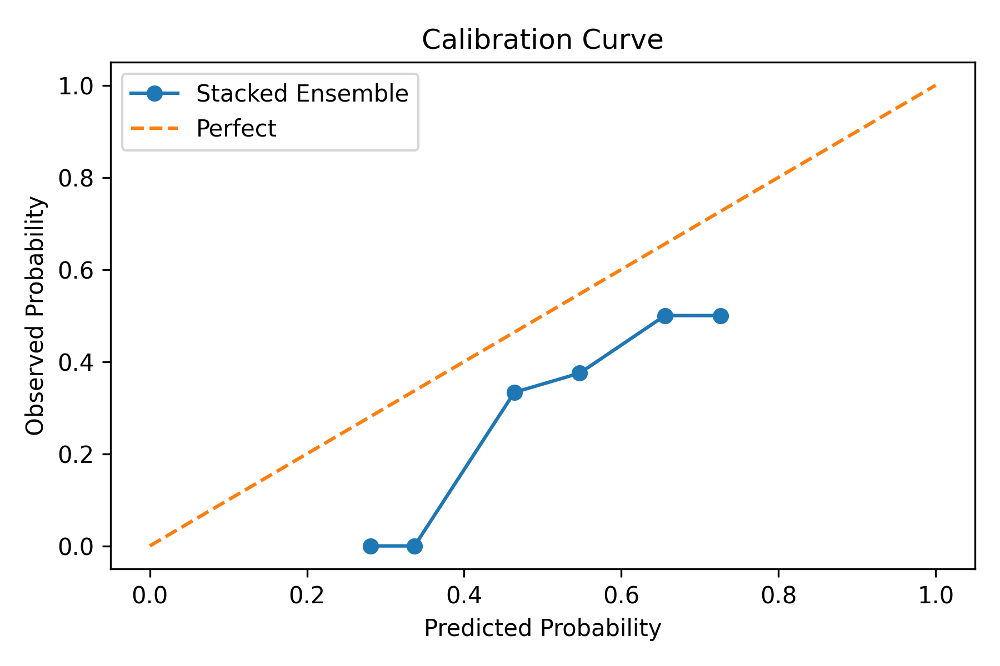
Calibration Curve

Slide 6
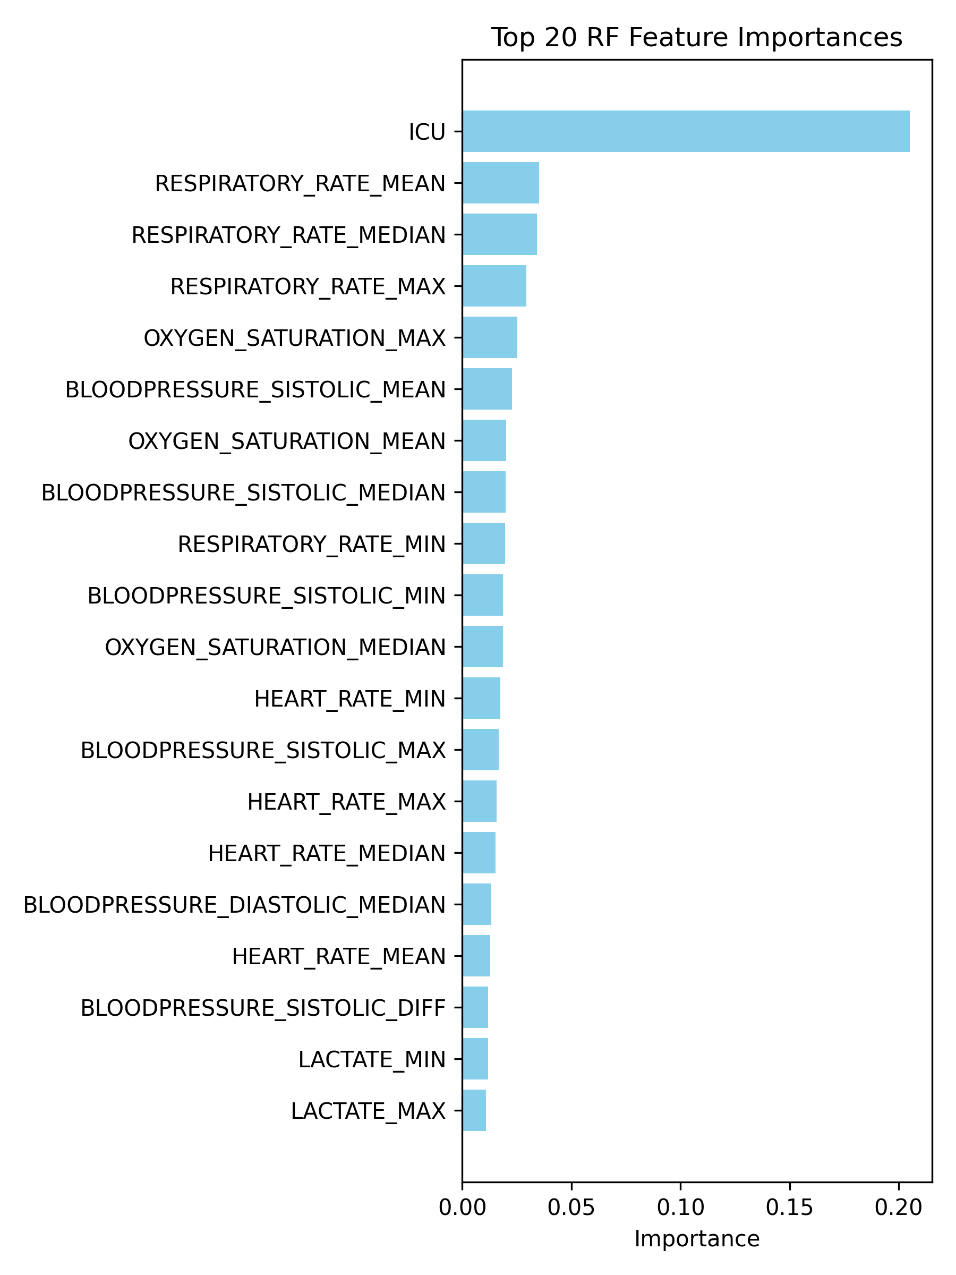
RF Top 20 Importances

Slide 7
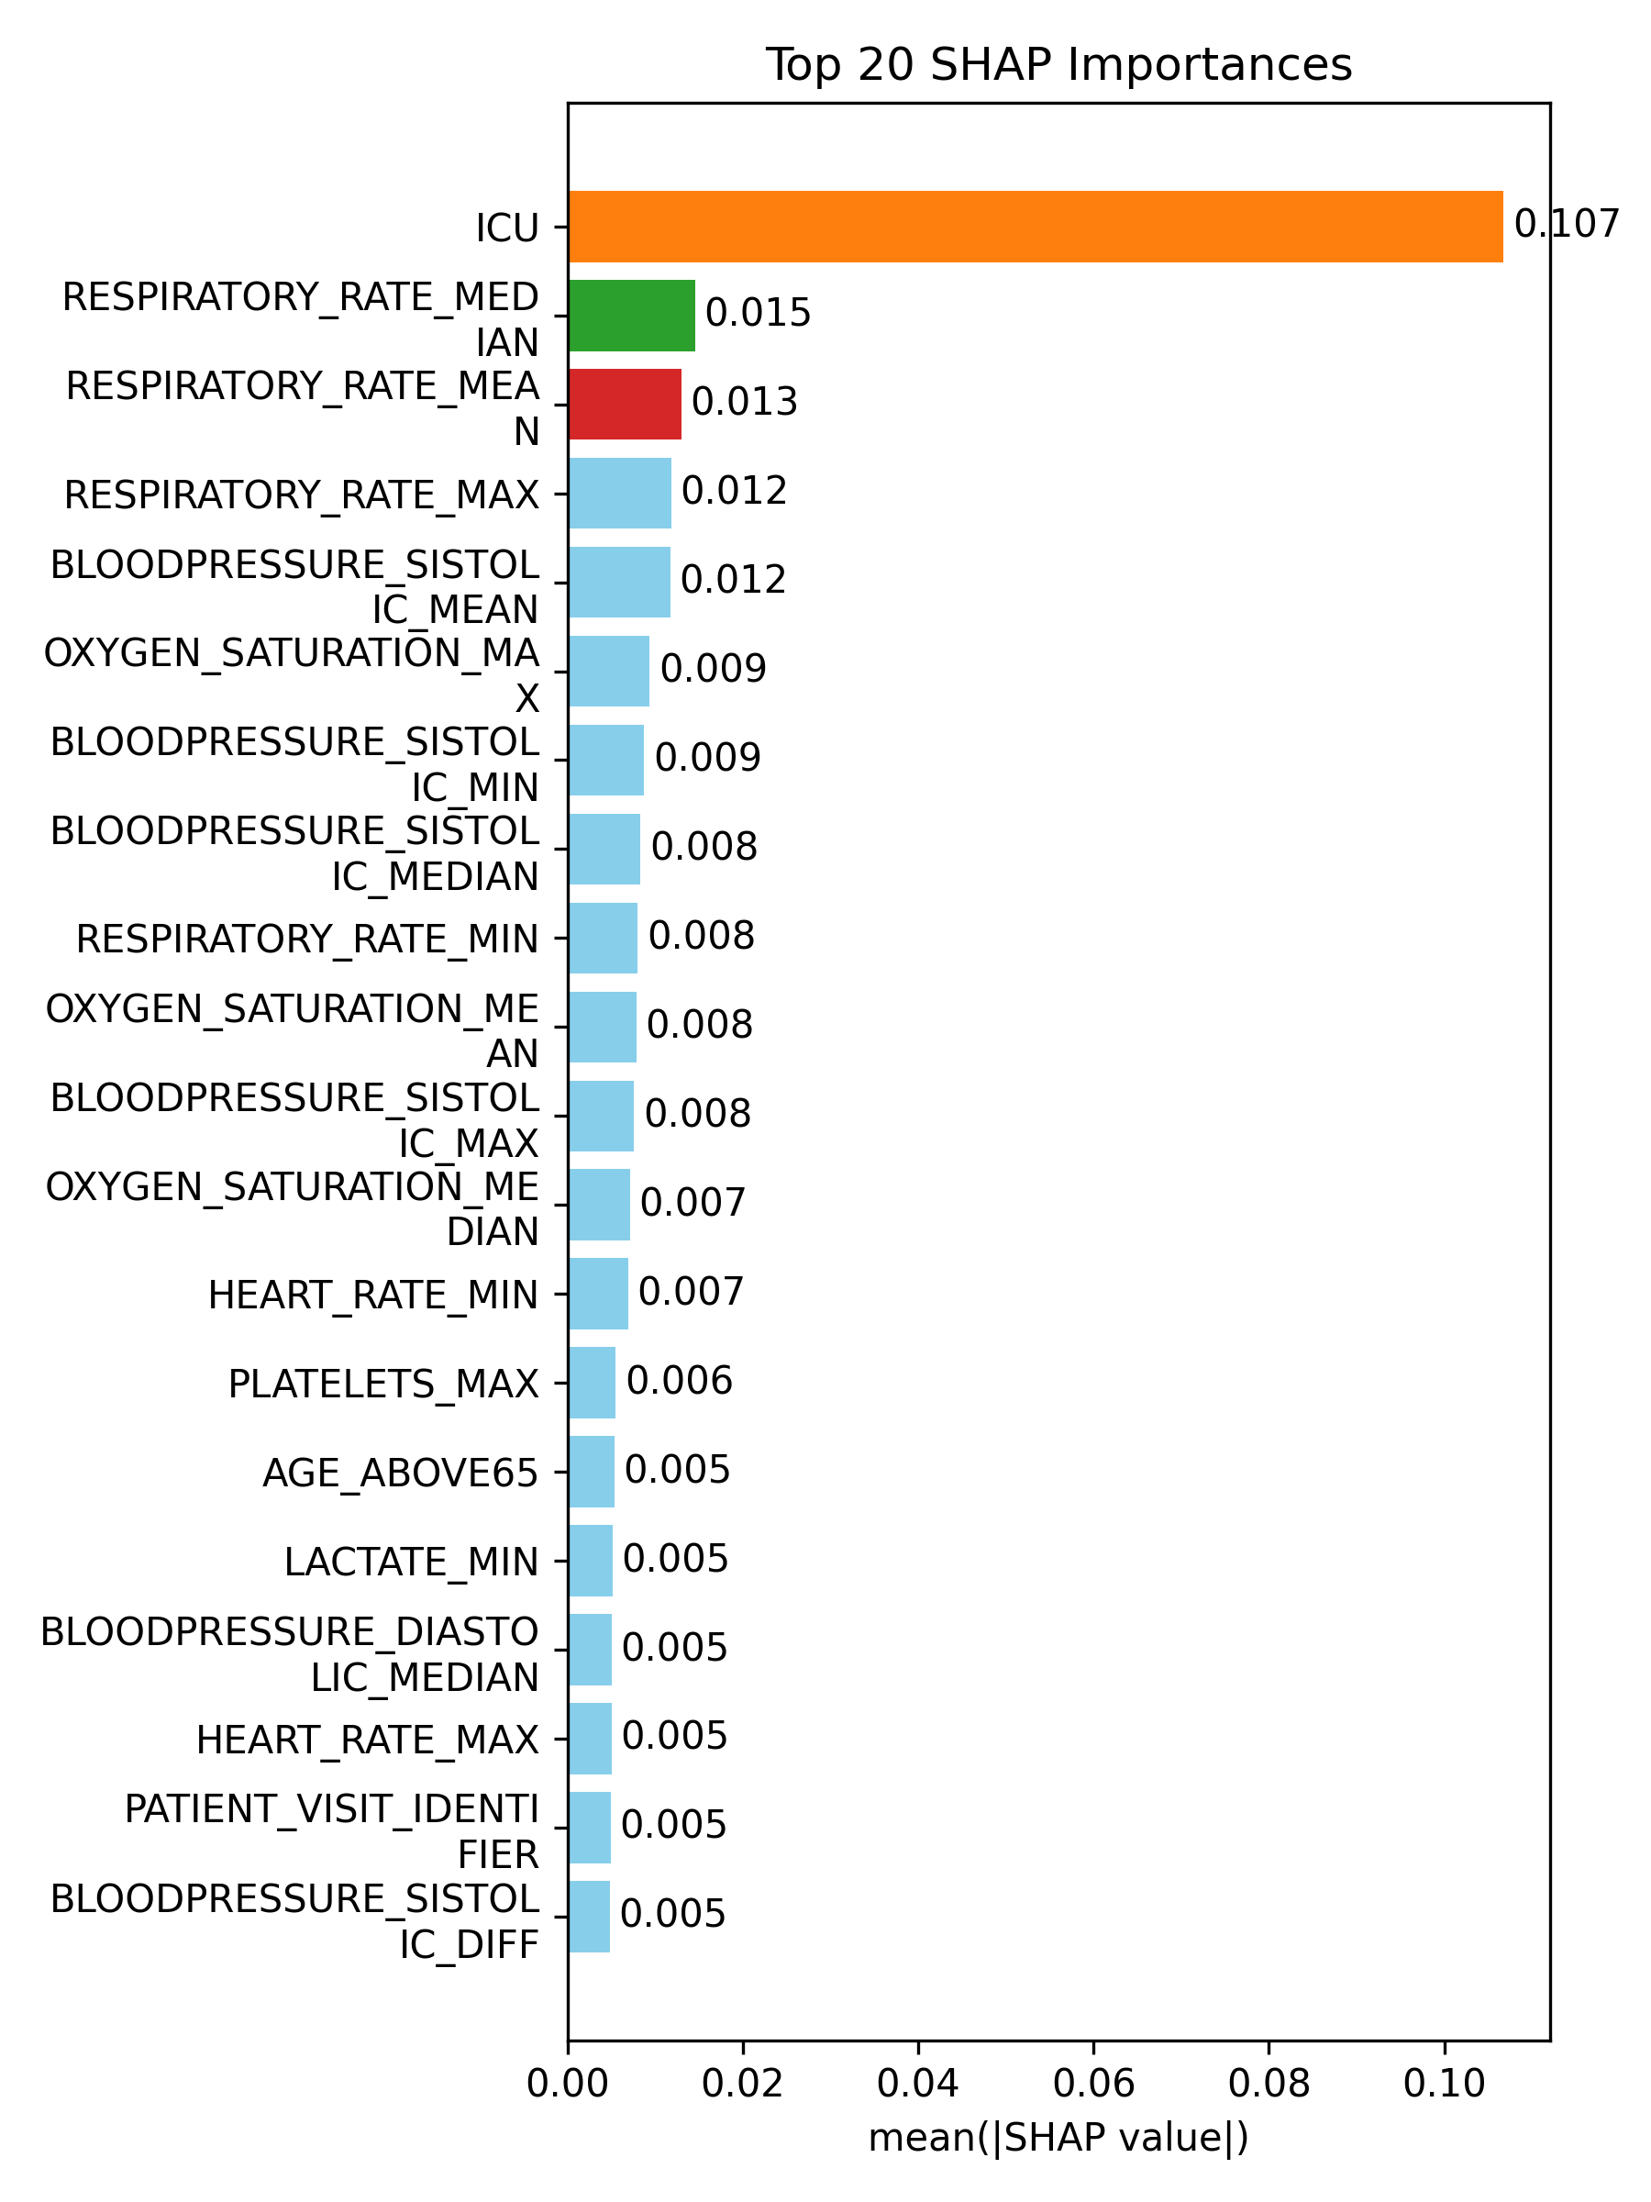
SHAP Top 20 Importances

Slide 8
Technical Appendix

