Slide 1
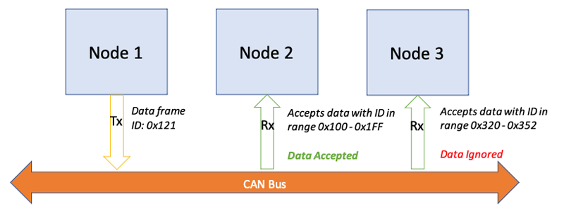

CAN protocol

Slide 2
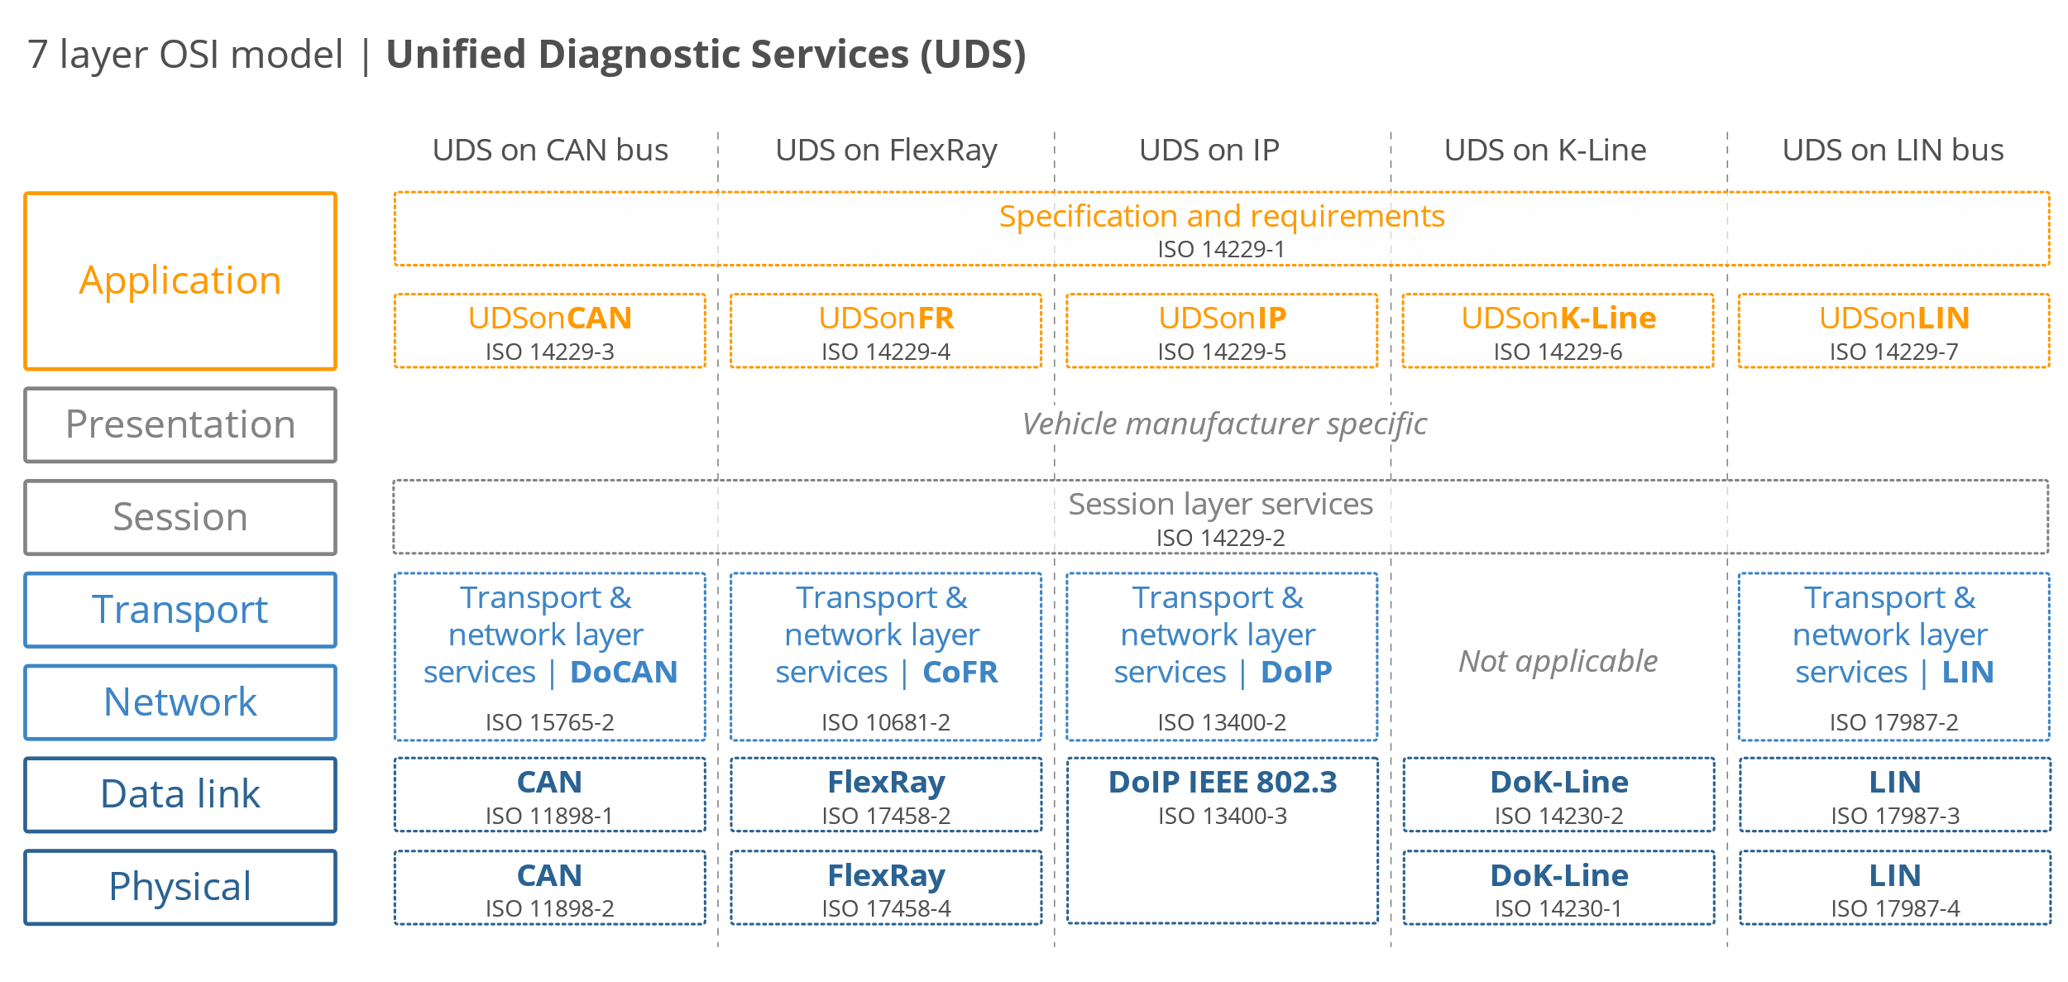
Unified Diagnostic Services

Slide 3



Positive response
Negative response

Slide 4
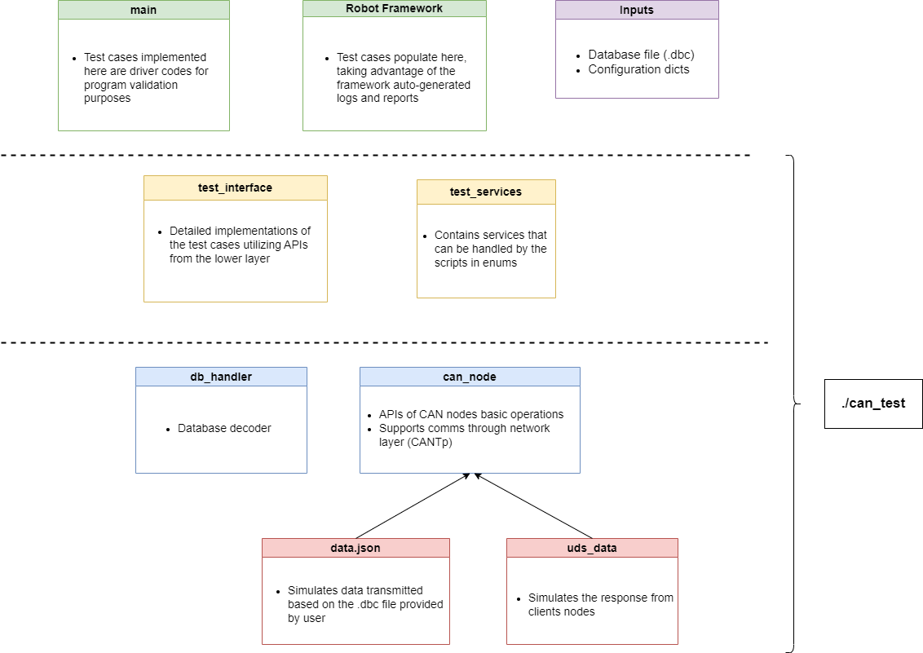
Software Architecture

