Slide 1
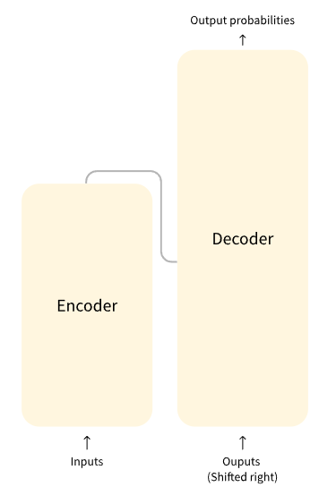
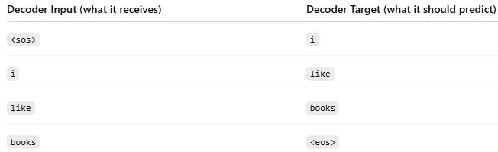
1. Architecture
KOR
Encoder (left): The encoder receives an input and builds a representation of it (its features). This means that the model is optimized to acquire understanding from the input.
Decoder (right): The decoder uses the encoder’s representation (features) along with other inputs to generate a target sequence. This means that the model is optimized for generating outputs.
["i", "like", "books"]
Decoder target (what it should predict)
["<sos>", "i", "like", "books"]
Decoder input
ENG
KOR
Refs: https://huggingface.co/learn/llm-course/en/chapter1/4

Slide 2
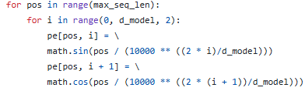
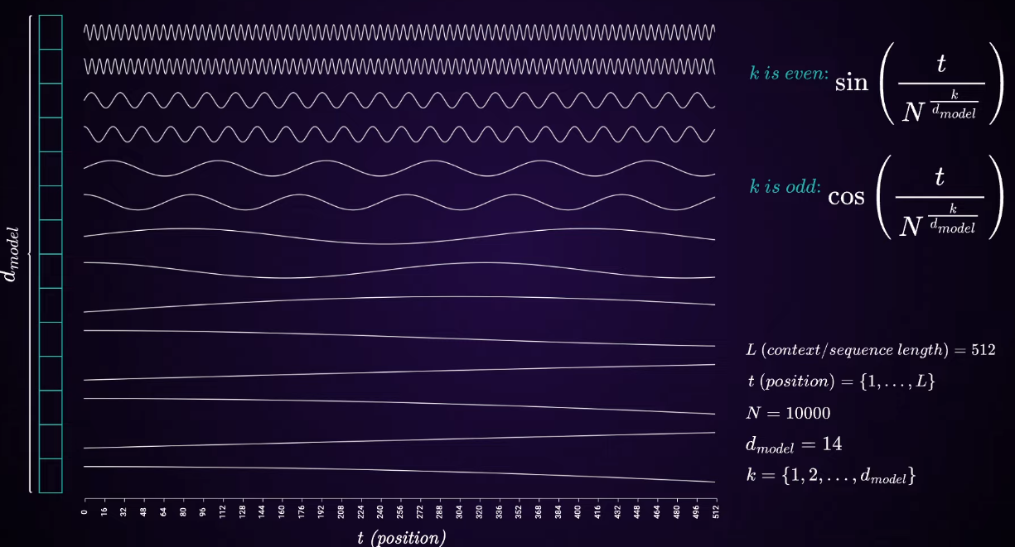

1. Architecture: Positional Encoding
Implementation
t (position)
Transformers process all tokens in parallel → must inject information about token positions into the model.
A sinusoidal positional encoding vector is created for each token
embedding space
Each encoded vector is unique in a sequence
https://github.com/SamLynnEvans/Transformer/blob/master/Embed.py
How many words per sentence
Embedding space dimension
Refs

Slide 3

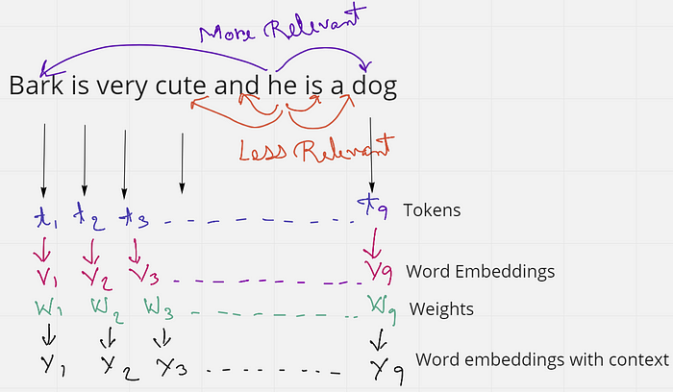
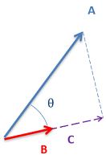
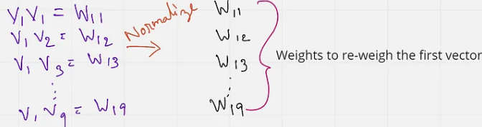
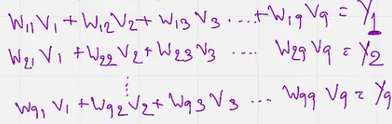
1. Architecture: Attention Layer
E.g. Consider two sentences:
The cat drank the milk because it was hungry.
The cat drank the milk because it was sweet.
Refs
(1)
(1) Idea: Add some weights (W) to the initial word embeddings (V embeddings)→ relevance between words (Y embeddings)
(2) Finding the weights:
W₁₁ → W₁₉ relationships of other words to the 1st token
Repeat the calculation for other words (W₂₁ → W₂₉, W₃₁ → W₃₉, etc.)
If two vectors point in
Roughly the same direction → their dot product will be large and (+).
Orthogonal, the dot product is zero.
Opposite directions, the result is (-).
(2)
Project A onto B (the projected vector is called A’), dot product of A * B = |A’| * |B|
Where |A’| = |A|cos(θ)
(3)
(3) New embeddings w/ context

Slide 4
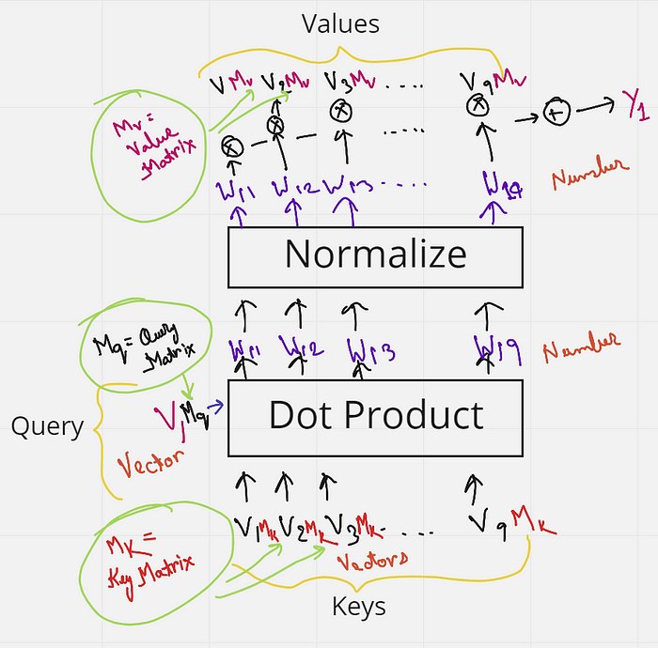
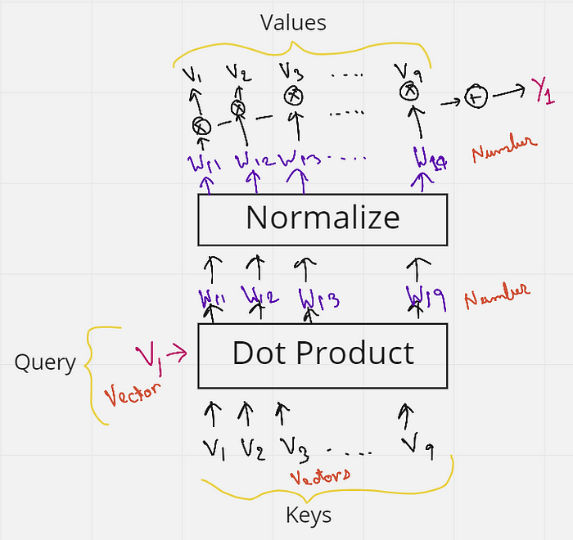
1. Architecture: Attention Layer
QUERY v₁ to other words (KEY) → results in VALUE
Adding M_{k}, M_{q}, M_{v} (trainable params)
Multiply each key from V₁ to V₉ (each of shape 1 x k), with a matrix M_{k} (Key matrix) of shape k x k.
Multiply the query vector (shape 1 x k), with a matrix M_{Q} (Query matrix) of shape k x k. (? – My deduction)
Multiply each value vector (shape 1 x k), with a matric M_{V} (Value matrix) of shape k x k. (? – My deduction)

Slide 5
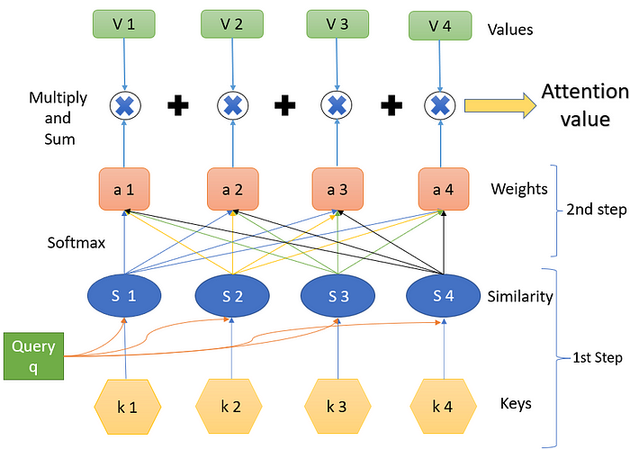
1. Architecture: Attention Layer
(3) Weighted sum:
output = attention_weights @ V
(2) Finding weights (using softmax function):
Turn the scores → probabilities (weights that sum to 1)
attention_weights = softmax(scaled_scores)
(1) Score calculations:
scores = Q @ K^{T}
scaled_scores = scores / sqrt(d_k)
where d_k is the dimension of the keys.

Slide 6
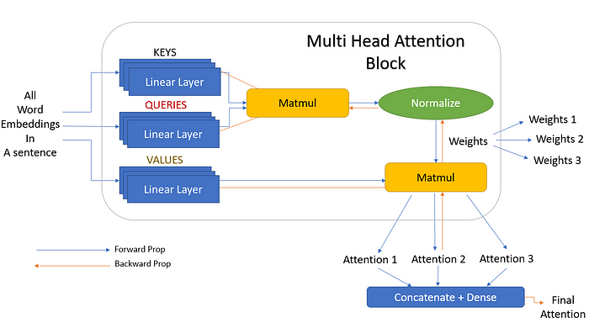
1. Architecture: Attention Layer – Multi-Head Attention
Use multiple attentions to reduce the load on one attention to find all significant words.
Increase the chances of funding relevant words easily.
Each attention block is trained in parallel and independent of one another.
E.g.
d_model = 512 (dim of input embeddings)
num_heads = 8
Each head will operate in d_k = d_model / num_heads = 64
For 8 heads operating in parallel, 8 different 64-dimensional outputs/token is given
Concatenate the outputs: 8 x 64 = 512

Slide 7

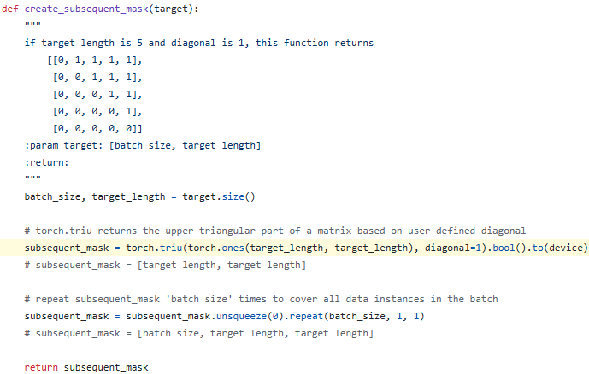
1. Architecture: Masked attention layer (decoder)
1️⃣ Masked Self-Attention (first layer in decoder):
Each token can attend only to previous tokens, including itself. It cannot see future tokens.
It’s masked so the model doesn’t cheat during training by peeking at tokens it hasn’t generated yet.
E.g. Generating “I like dogs”
Time step 0: can see ["<sos>"]
Time step 1: can see ["<sos>", "I"]
Time step 2: can see ["<sos>", "I", "like"]
Done with a triangular causal mask
Masking examples:
(1) https://github.com/SamLynnEvans/Transformer/blob/master/Batch.py#L12
(2) https://github.com/Huffon/pytorch-transformer-kor-eng/blob/93eea77b9562941813856f117aad7b2e4d3c01e8/model/ops.py#L26
Decoder Block:
Input (previous target tokens)
↓
Masked Self-Attention ← only looks at past tokens
↓
Cross-Attention (encoder-decoder) ← looks at full encoder output
↓
Feed-Forward Network
↓
Output

Slide 8
2. Plan
Tokenization & Vocab (spacy)
Multi-Head Attention
Encoder
train.py
Positional Encoding
Feedforward Layer
Decoder
Refs
https://github.com/SamLynnEvans/Transformer
https://github.com/Huffon/pytorch-transformer-kor-eng/tree/master

Slide 9
1. Tokenizer (konlpy + spacy) → Recommended
Load data from csv file
pd.DataFrame
Build vocab
Vocab
Build DataSet
torch.Dataset
Build DataLoader
I
I
0
Build Vocab
tokenizer
like
like
14
I like travelling
travelling
travelling
22
Separate sentence into meaningful chunks
numericize words

Slide 10
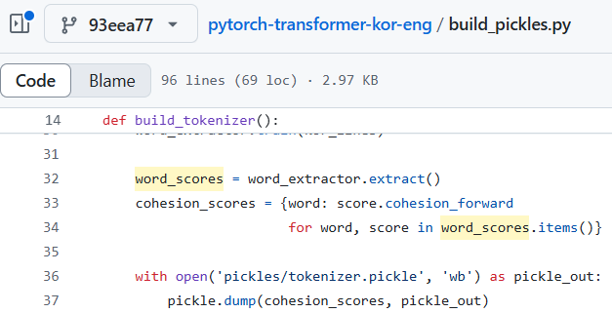
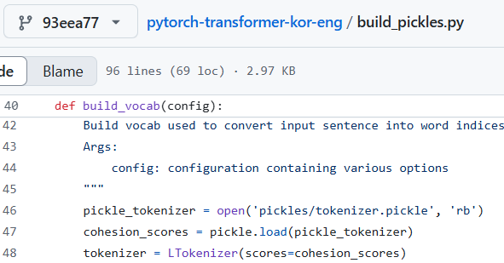
1. Tokenizer (soynlp)
WordExtractor
Objectives:
WordExtractor: Extracts meaningful words from a sentence → Builds the Lexicon.
Uses the lexicon to split sentences.
Measures how tightly the characters in the word sticks together (left to right). High value means it’s likely an actual word
Dict: (word): Scores
Tokenizer
Notes:
Possible to use spaCy for English & Korean
LTokenizer stands for Left tokenizer:
L + [R] → Left part (main word) + Right part (optional particle or suffix).
E.g.: "학생이" → "학생" (L) + "이" (R)

Slide 11
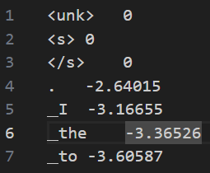
1. Tokenizer (sentencepiece)
sentencepiece has better morphological understanding:
E.g. “obviously” is tokenized into “obvious” + suffix “ly”
.vocab file
token
score
start of sequence
Higher values (less negative) = more common in the training data
end of sequence

Slide 12
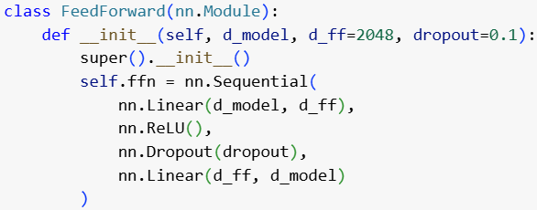
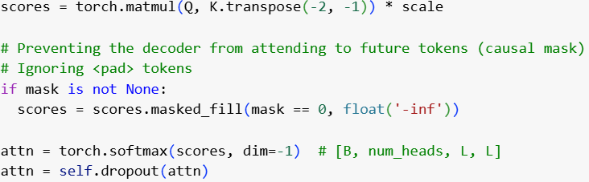
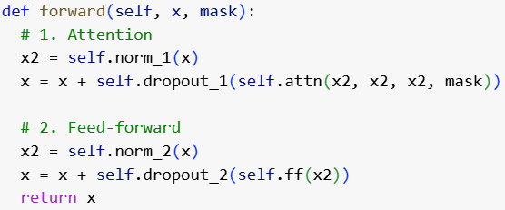
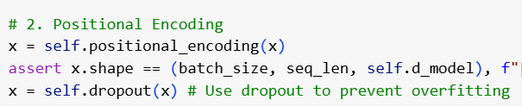
Dropout
Encoder:
Feed-forward network: After applying ReLU
Multi-head Attention: After applying softmax
After applying the attention block
After applying the feed-forward block
After Positional Encoding
(1)
(3)
(4)
(2)
(5)

Slide 13
Beam Search (01/11/2025)
A week before, I discovered that accuracy is not a useful metric for seq2seq models as words can be synonyms -> cannot represent the reference with 100% ‘happy’ can also be translated as ‘joyful’ yet those two words have different tokens
-> Use BLEU to evaluate model’s performance
Beam Search can be used to enhance the meaning of the sentence as a whole. Instead of picking words with highest probability at each timestep
Beam Search with length norm -> encourages long sentences: https://arxiv.org/pdf/1609.08144

