Slide 1
A Zero-Trust Framework for Synthetic Media Detection: Integrating C2PA Cryptographic Provenance with Computer Vision Fallback
Md. Shihab Ar Rafi
ID : 0242310005101721
Supervised by
Shahriar Shakil, Lecturer
Department of CSE
Daffodil International University
Page: 01

Slide 2
Outline
Introduction
Background Study/Literature Review
Gap Analysis
Objective and Motivation
Novelty of this Study
Datasets, Tools and Techniques
Proposed Methodology
Results & Outcomes
Q & A
Page: 02

Slide 3
Introduction
Hybrid system for detecting AI-generated (synthetic) images by combining C2PA cryptographic provenance with an independent computer-vision forensic model.
Pipeline: C2PA manifest check (Door 1) + CV forensic model (Door 2) → zero-trust decision logic → REAL / FAKE / Suspicious label.
Investigates a deeper question: can a cryptographically valid C2PA signature ever be trusted alone, or must it always be cross-checked against independent visual evidence?
Phase-I delivers a fully trained, from-scratch CV detection model (Door 2) reaching up to 95.32% validation accuracy; the C2PA module (Door 1) is designed for Phase-II.
Page: 03

Slide 4
Background Study/Literature Review
Reference | Method | Key Finding | Limitation
FerretNet (Liang et al., 2025) | Lightweight CNN exploiting local pixel dependencies | 97.1% accuracy across 20+ unseen generators, trained only on ProGAN | Doesn't incorporate provenance metadata at all
Petrzelkova & Cech (2026) | Single-generator CNN forensic detector | Near-perfect accuracy within its own training generator | Collapses on unseen generators — confirmed independently in this project
Ojha et al. (2023) | CLIP-feature real-vs-fake classification | Explains why classifiers treat “real” as a catch-all sink class | Diagnostic insight only, not a deployable detector
Golaszewski et al. (2026) | Formal security analysis of the C2PA specifications | Real camera credentials signed onto AI-generated images; revoked certs still shown valid | Doesn't propose a cross-checking mitigation system
World Privacy Forum (2026); Kaye & Dixon | Policy and technical review of the C2PA framework | A signature certifies who signed a manifest, not whether content is true | No technical framework combining CV + provenance
Page: 04

Slide 5
Gap Analysis
Pixel-based forensic detection and C2PA provenance verification are almost always studied and deployed in isolation across the literature.
CV-only detectors generalize poorly outside their training distribution — confirmed directly in this project, where Model 2 misclassified unseen-generator fakes as REAL.
C2PA signatures can be cryptographically valid yet still falsely provenanced — published attacks show fake camera credentials, altered GPS/timestamps, and stale revocation checks.
Central gap: no existing framework cross-checks a valid C2PA signature against an independent CV judgment, or reports their disagreement rate.
Page: 05

Slide 6
Objective and Motivation
Design and train, entirely from scratch with no pretrained weights, an original CNN (SimpleForensicNet) for AI-generated image detection.
Empirically test generalization across generator families and quantify the accuracy/generalization trade-off across three progressive training experiments.
Design a zero-trust hybrid decision architecture combining C2PA and CV verification, never trusting either signal blindly, and flagging disagreement between them.
Motivation: AI-generated images now pass as real in journalism, legal evidence, and public discourse — trustworthy detection needs both cryptographic and visual evidence, never just one.
Page: 06

Slide 7
Novelty of this Study
Most detection frameworks pick either provenance or pixel-forensics; this project is the first, per the reviewed literature, to combine both in a zero-trust cross-check.
Empirically demonstrated the accuracy/generalization trade-off: single-generator models score higher in-domain (95.32%, 91.82%) but fail out-of-domain entirely.
The multi-generator model trades some in-domain accuracy (87.76%) for verified generalization, correctly flagging a held-out Stable Diffusion image at 96.99% confidence.
Combines a working, from-scratch CV detector with a principled, disagreement-aware hybrid architecture ready for cryptographic integration.
Page: 07

Slide 8
Datasets, Tools and Techniques
Datasets: CIFAKE (200k images), 140k Real & Fake Faces (FFHQ + StyleGAN), Stable Diffusion Faces — all via Kaggle.
Preprocessing: resize to 256×256, normalization; Kaggle API used for direct-to-Colab download after browser uploads repeatedly failed.
Model: SimpleForensicNet — 4 Conv2D+BatchNorm+ReLU+MaxPool blocks, Global Average Pooling, Dropout(0.3), Linear+Sigmoid; 389,633 parameters.
Built and trained entirely from scratch in PyTorch — no pretrained weights used anywhere in the pipeline.
Training: Google Colab (NVIDIA T4 GPU, free tier); best checkpoint saved by validation accuracy.
Planned for Phase-II: c2patool / c2pa-python for C2PA manifest verification (Door 1).
Page: 08

Slide 9
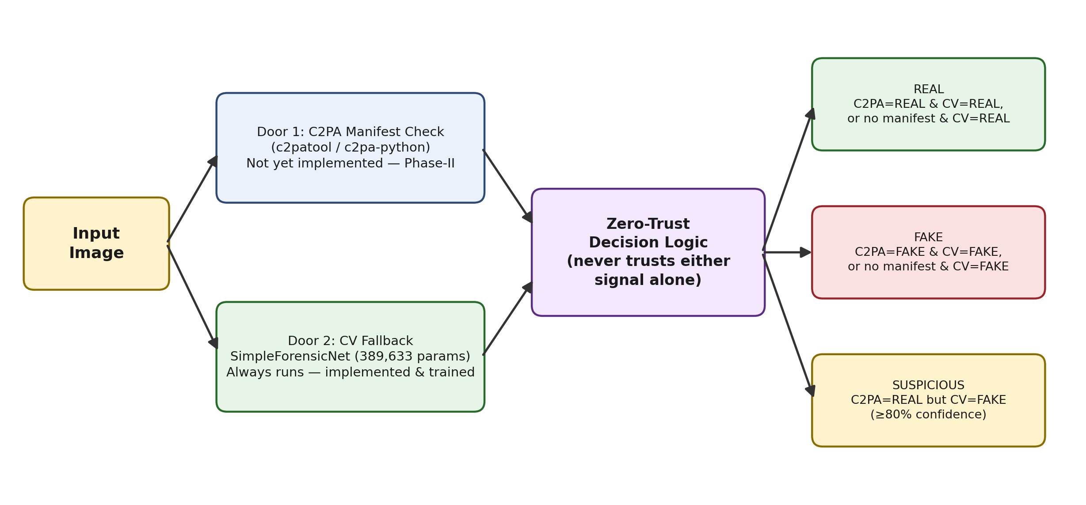
Proposed Methodology
Page: 09

Slide 10
Results & Outcomes
Phase-I Achievements:
Fully implemented, trained, and evaluated CV forensic detection pipeline (Door 2), built entirely from scratch with no pretrained weights.
Three training experiments completed: Model 1 (CIFAKE) 95.32%, Model 2 (StyleGAN faces) 91.82%, Model 3 (combined StyleGAN+SD) 87.76%.
Critical generalization failure identified in Model 2 (misclassified unseen-generator fakes) and directly resolved in Model 3 (96.99% confidence on held-out SD image).
Zero-trust hybrid decision architecture (Door 1 + Door 2 + 3-state logic) fully designed and documented.
Phase-II Plan:
Implement Door 1: a C2PA manifest reader using c2patool / c2pa-python.
Implement the full hybrid decision logic (REAL / FAKE / Suspicious) with a tuned confidence threshold.
Build paired clean vs. metadata-stripped test conditions; compare C2PA-only, CV-only, and Hybrid systems.
Complete final thesis chapters and prepare for the Phase-II defense presentation.
Page: 10

Slide 11
THANK YOU!
Page: 11

