Slide 1
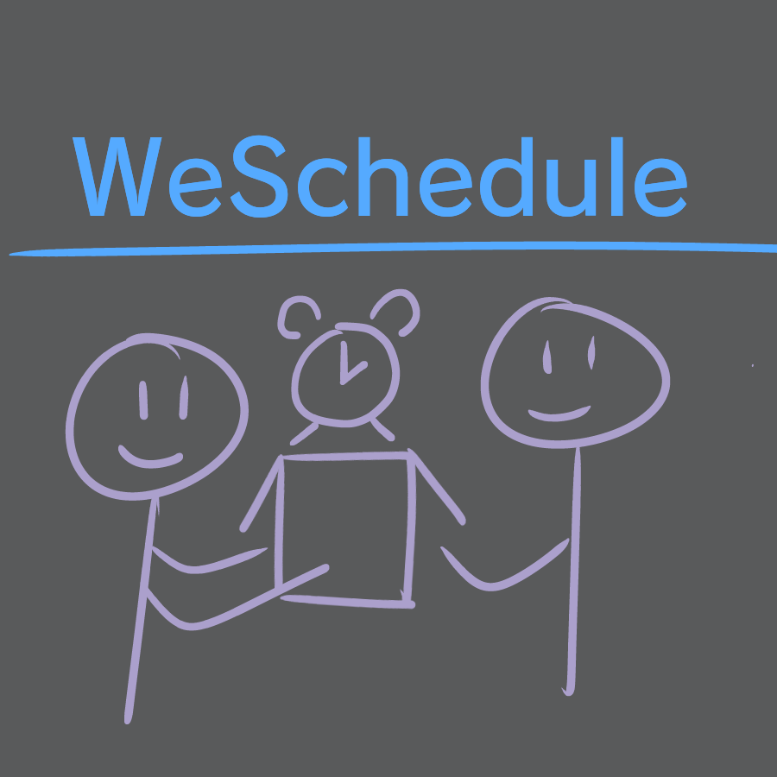
Joshua Barbee, Caleb Krauter, Tyler Robinson, Thomas Tien

Slide 2

Overview
Objective: Provide an intuitive platform for team management, enhancing collaboration and productivity in professional and social settings through efficient scheduling and communication tools.
Target audience:
Educational institutions
Professional organizations
Social groups,
Bloggers
Multilingual communities
Main features:
Personalized user accounts
Group and topic management tools
Local administrator roles
Event scheduling capabilities
Language translation feature for multilingual accessibility.

Slide 3
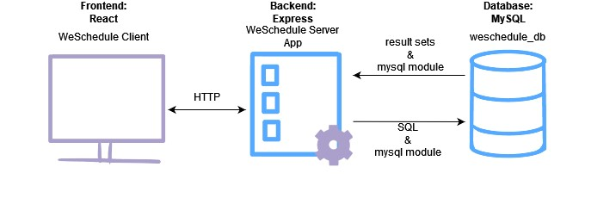
Architectural Design
Client-Side Frontend:
Uses HTML, CSS, JavaScript, and React.js for dynamic UIs, handling user interactions, data presentation, and backend communication.
Server-Side Backend: Developed with Node.js and Express.js for a robust environment, managing authentication, data processing, API services, and database interactions, with express-session for secure user sessions, and a MySQL database for storing various data types with integrity and efficiency.
API Layer: Features RESTful API for frontend-backend communication with CRUD operations, Swagger for API documentation/testing, and robust security with salted and hashed password authentication and RBAC. Supports many languages for message translation and will later have a fully translated UI.
Notes:
the high level design

Slide 4
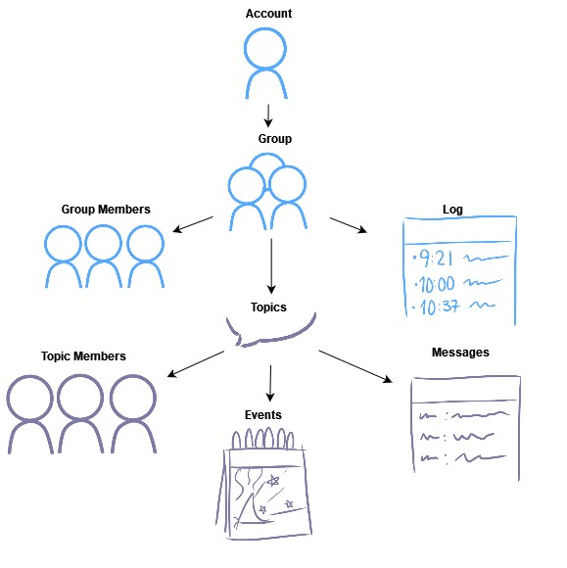
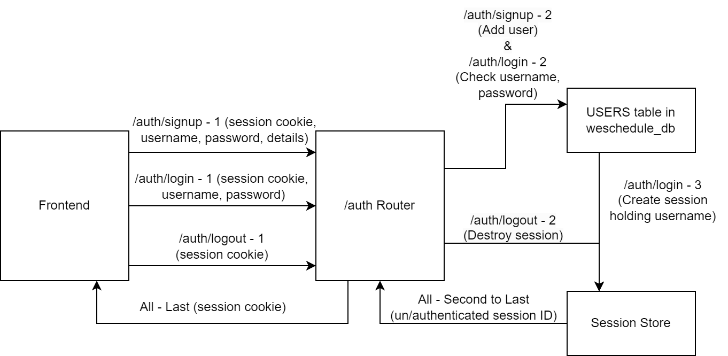
Functional Design Diagrams
Frontend Diagram
Backend Diagram (WS-1)
Notes:
ooo… diagrams

Slide 5
Web Service Composition Scenario
In WS-7: GET /groups/{gid}/topics/{topic}/messages
Fetch all messages from a specific topic in a group.
User Language Preference Check: Consults the Users Service (WS-2) to determine the current user's preferred language settings.
Translation Integration: Sends messages and retrieved language to the Language Service (WS-10) for translation based on user's preferred language, returning translated content to the client.

Slide 6
Demonstration
Frontend
Swagger API Docs

Slide 7
Future work
Challenges
Translate all UI text based on user’s preferred language
Cache translated messages to reduce Azure usage
More granular permissions
Paginated queries
Address information leakage about whether resources exist due to difference in code run times
Editing and deleting messages
Juggling tasks from other classes and the project
Learning curves with Github, Bootstrap, and React
Team availability mismatch
Unrelated repetitive blue screens

