Slide 1

FAKE NEWS DETECTION (Using Machine Learning)
By: Rajat Upreti

Slide 2

INTRODUCTION
Background:
In today's digital age, the proliferation of fake news poses a significant challenge to society. Misinformation, spread rapidly through social media and online platforms, can manipulate public opinion, undermine trust in institutions, and even incite social unrest.
Objective:
The objective of this project is to develop a robust machine learning model capable of accurately identifying fake news articles. By leveraging artificial intelligence and natural language processing techniques, we aim to combat the spread of misinformation and promote media literacy.

Slide 3
METHODOLOGY
Data Collection: News articles from a variety of sources, including reputable news outlets, social media platforms, and known fake news websites.
Data Preprocessing: Removing stop words, tokenizing the text, and vectorizing it using techniques like TF-IDF
Machine Learning Algorithms: Naive Bayes, Support Vector Machines (SVM), Random Forest, Gradient Boosting Machines (GBM), and Convolutional Neural Networks (CNN)

Slide 4
DATA COLLECTION
Source Selection: Articles from established news organizations, popular social media platforms.
Dataset should be sourced from a wide range of platforms to ensure diversity and representativeness.
Labelling Process: Domain experts were tasked with manually labeling each article as real or fake based on its content, credibility, and source.
This meticulous labeling process was essential to train the machine learning models effectively and ensure accurate classification.

Slide 5
Data Preprocessing
Stop Word Removal: Stop words are frequently occurring words like "the," "and," and "is" that carry little semantic meaning.
Tokenization: The text data was tokenized, breaking down the articles into individual words or phrases.
Vectorization: To prepare the text data for machine learning algorithms, we employed vectorization techniques such as TF-IDF (Term Frequency-Inverse Document Frequency).

Slide 6
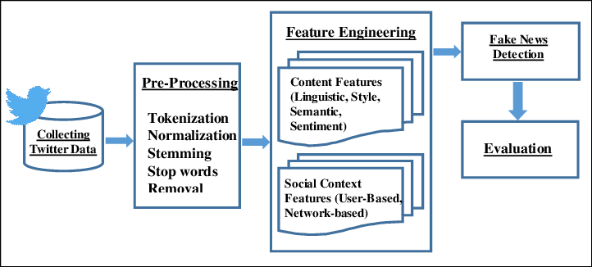

Slide 7

Machine Learning Algorithms
Naive Bayes
TF-IDF (Term Frequency-Inverse Document Frequency)
Support Vector Machines (SVM)
Random Forest
Gradient Boosting Machines (GBM)
Convolutional Neural Networks (CNN)

Slide 8
Model Evaluation
Performance Metrics: To evaluate the performance of the machine learning models, we used a range of metrics including accuracy, precision, recall, and F1-score.
Cross-Validation: We employed cross-validation techniques such as k-fold cross-validation to assess the robustness of the models and mitigate overfitting.

Slide 9
Conclusion
Based on the results, the Convolutional Neural Network (CNN) model achieved the highest overall performance in terms of accuracy, precision, recall, and F1-score. However, all algorithms demonstrated promising results in distinguishing between real and fake news articles. Further optimization and fine-tuning of the models could potentially enhance their performance even further.

Slide 10
Future Work
Ensemble Methods:Investigate ensemble learning techniques to combine the strengths of multiple machine learning algorithms for improved fake news detection.
Deep Learning Architectures:Explore advanced deep learning architectures, including recurrent neural networks (RNNs), long short-term memory (LSTM) networks, and transformer models,
Real-time Deployment

Slide 11


