Slide 1
Web Development Internship
RAJAT UPRETI 2019030 sec: f 7th semester
Made under the mentorship of
Mr. Arhan
Nova nectar services pvt. Ltd.

Slide 2
About The Company
NovaNectar Services Pvt. Ltd. is a dynamic technology company specializing in software development, web solutions, and digital services. With a strong focus on innovation and quality, NovaNectar Services Pvt. Ltd. offers a range of IT solutions, including web development, mobile app development, and custom software creation. The company is committed to empowering clients by providing tailored digital solutions that meet modern business needs and enhance online presence. At NovaNectar Services Pvt. Ltd., a team of skilled developers, designers, and IT professionals work collaboratively to deliver high-performance, user-friendly applications and websites. The company emphasizes the importance of responsive design, user experience, and scalable technology, enabling businesses to engage their customers effectively across multiple platforms.

Slide 3
Work Responsibilities
Frontend Development:
Created and styled web pages using HTML, CSS, and JavaScript to build visually appealing and responsive layouts, enhancing the user experience on various devices.
Responsive Design Implementation
Developed media queries and responsive grid layouts to ensure that website content was accessible and consistent across mobile, tablet, and desktop screens. • JavaScript Interactivity Integrated dynamic elements such as image sliders, modal pop-ups, and smooth scrolling features to improve user engagement and add functionality to the website.

Slide 4
Work Responsibilities
JavaScript Interactivity
Integrated dynamic elements such as image sliders, modal pop-ups, and smooth scrolling features to improve user engagement and add functionality to the website.
UI/UX Optimization
Worked with the design team to implement user-friendly layouts and streamline navigation flow, focusing on intuitive features like interactive buttons, icons, and menu structures.
Cross-Browser Testing and Troubleshooting
Conducted comprehensive testing across different browsers (Chrome, Firefox, Safari) to verify consistency and performance, resolving any issues identified.
Content Structuring and Organization
Organized and structured content on the website to enhance readability and ease of navigation, and made updates based on client and team feedback.

Slide 5
Work Details
1. Landing Page Design
Project Objective: To design a visually engaging and informative landing page that captures visitors' attention and provides essential information in a concise format.
2. Travel Website
Project Objective: To create an interactive and user-friendly travel website that allows users to explore destinations, view accommodation options, and plan trips.
Technical Development:
HTML & CSS: Structured and styled the page for a clean, professional look, using consistent color schemes and typography.
JavaScript: Added interactive elements like hover effects, scroll animations, and smooth transitions to enhance the user experience.
Responsive Design: Ensured compatibility across different screen sizes for accessibility on mobile, tablet, and desktop devices.

Slide 6
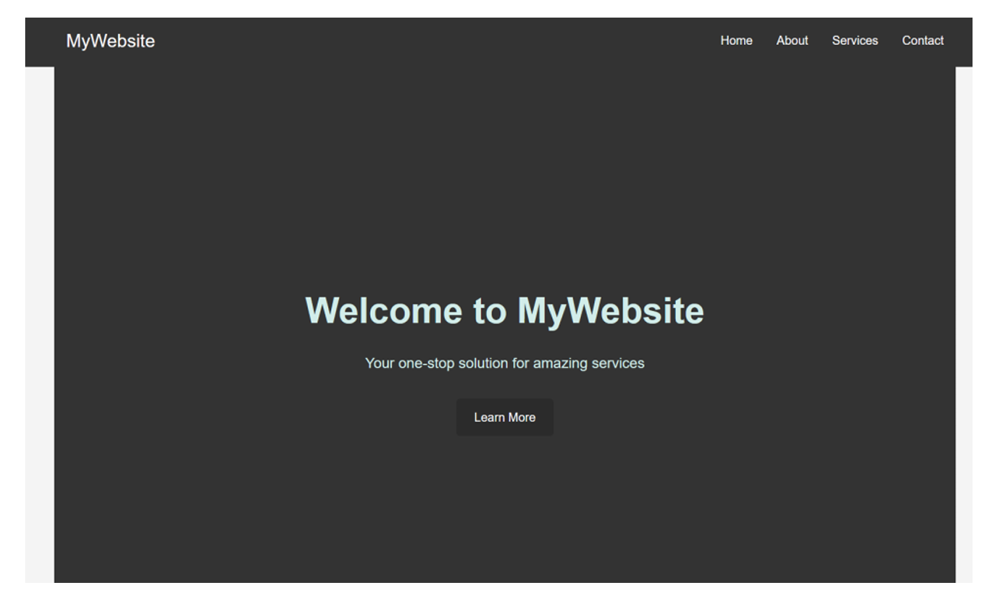
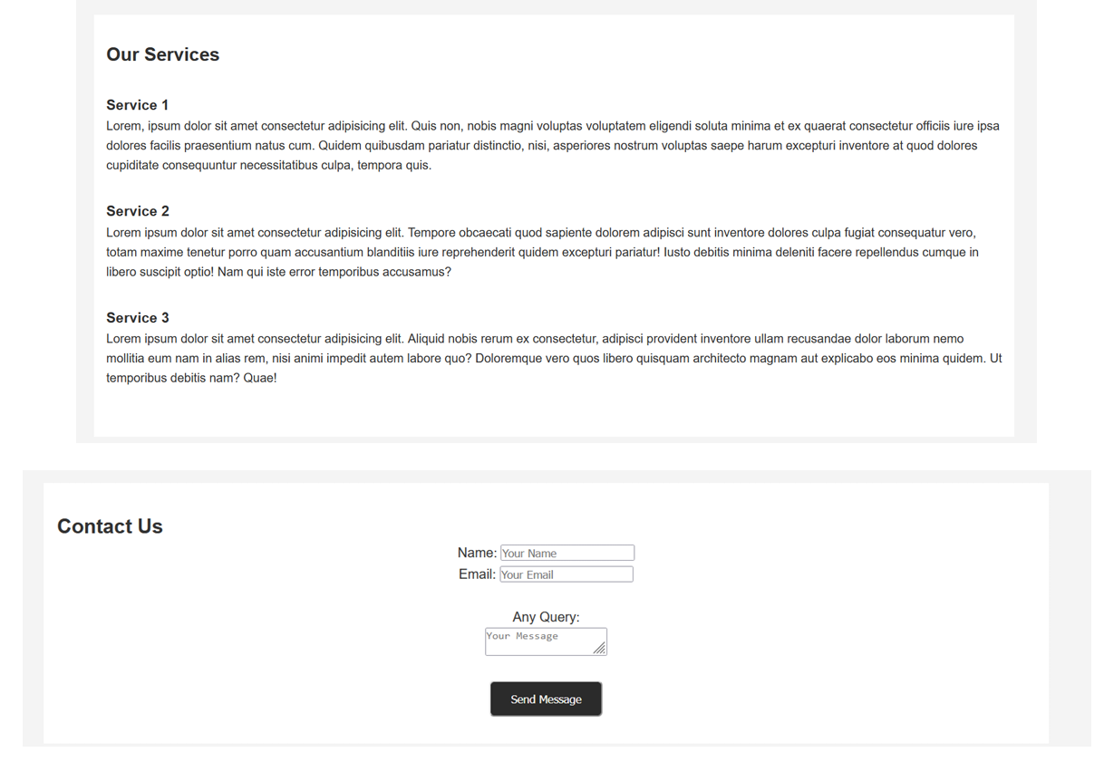

Slide 7
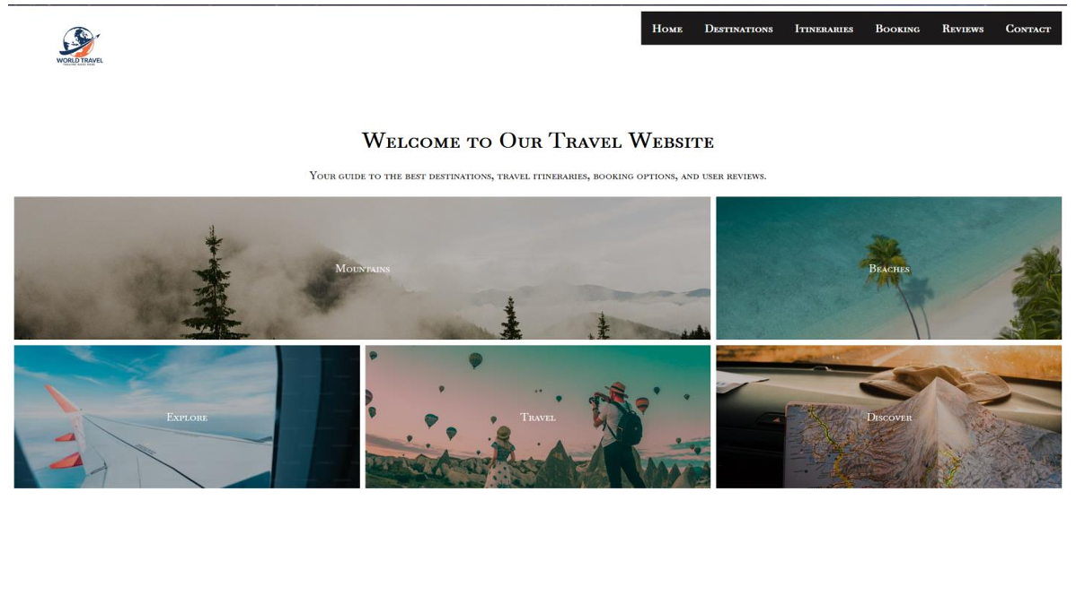
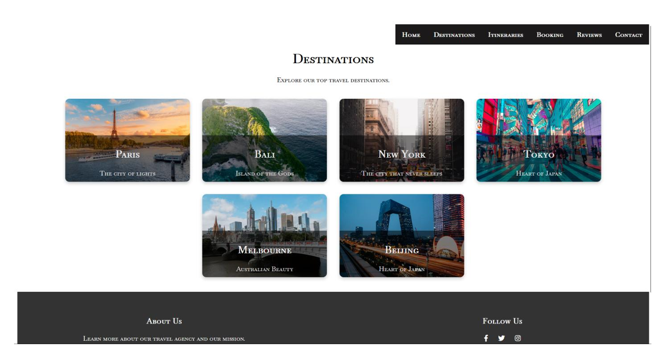

Slide 8
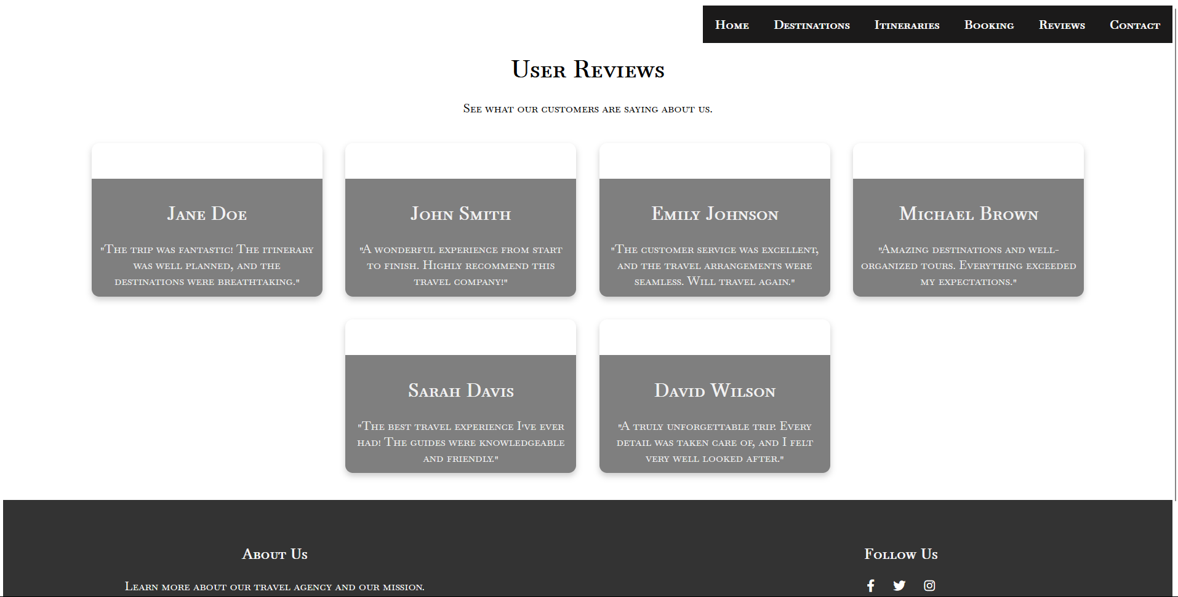
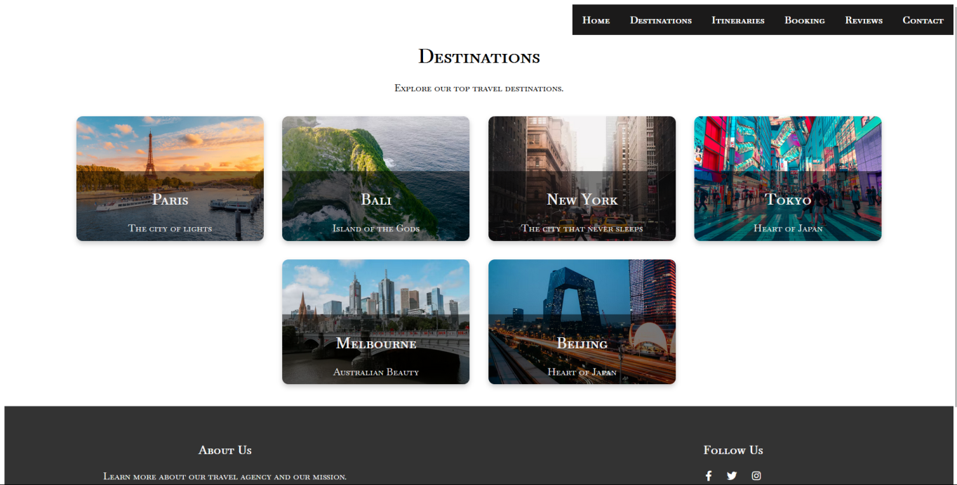

Slide 9
Skills Learned
1. Technical Skills
• Frontend Development: Gained hands-on experience with HTML, CSS, and JavaScript to structure, style, and add interactivity to web pages, creating user-friendly and visually appealing interfaces.
• Responsive Web Design: Learned to implement responsive layouts using CSS grid, flexbox, and media queries, ensuring consistent display across mobile, tablet, and desktop devices.
• JavaScript Functionality: Developed proficiency in using JavaScript for interactive elements such as image sliders, modals, and task management function, enhancing user engagement.
• User Interface (UI): Design Principles Enhanced understanding of UI design principles, focusing on intuitive navigation, button placements, and optimized layouts to improve user experience.
• Cross-Browser Testing and Debugging: Conducted testing across various browsers to ensure compatibility and consistent performance, and learned debugging techniques to resolve cross-browser issues.

Slide 10
Skills Learned
2. Professional Skills
• Problem-Solving and Debugging: Enhanced my problem-solving abilities by troubleshooting issues during development and applying effective debugging methods to resolve technical challenges.
• Project Documentation: Developed skills in maintaining comprehensive documentation, recording development processes, code explanations, and project progress to ensure clear and organized handovers.
• Collaboration and Communication: Improved my collaboration skills by working closely with team members, sharing ideas, and incorporating feedback to refine projects.
• Time Management: Learned to manage multiple tasks efficiently, setting priorities and meeting project deadlines without compromising quality. • Attention to Detail Developed a keen eye for detail by ensuring high-quality code and precise design implementations, which contributed to polished and professional final projects.

Slide 11
Conclusion
My internship experience at Nova Nectar Services Pvt. Ltd. has been instrumental in my journey as an aspiring web developer. Through practical, hands-on projects and constructive guidance, I had the opportunity to deepen my technical knowledge, sharpen my problem-solving skills, and gain exposure to industry-standard practices.
The skills and insights gained from this internship have not only bolstered my confidence but have also prepared me for future roles in the tech industry. I am grateful for the supportive environment at Nova Nectar, where I was encouraged to explore, ask questions, and collaborate with experienced professionals.

