Slide 1
Chapter 2
Instructions: Language of the Computer
Notes:
The University of Adelaide, School of Computer Science
*
Chapter 2 — Instructions: Language of the Computer
‹#›

Slide 2
Instruction Set
§2.1 Introduction
The repertoire of instructions of a computer
Different computers have different instruction sets
But with many aspects in common
Early computers had very simple instruction sets
Simplified implementation
Many modern computers also have simple instruction sets
Chapter 2 — Instructions: Language of the Computer — ‹#›
Notes:
The University of Adelaide, School of Computer Science
*
Chapter 2 — Instructions: Language of the Computer
‹#›

Slide 3
The RISC-V Instruction Set
Used as the example throughout the book
Developed at UC Berkeley as open ISA
Now managed by the RISC-V Foundation (riscv.org)
Typical of many modern ISAs
See RISC-V Reference Data tear-out card
Similar ISAs have a large share of embedded core market
Applications in consumer electronics, network/storage equipment, cameras, printers, …
Chapter 2 — Instructions: Language of the Computer — ‹#›
Notes:
The University of Adelaide, School of Computer Science
*
Chapter 2 — Instructions: Language of the Computer
‹#›

Slide 4
Arithmetic Operations
Add and subtract, three operands
Two sources and one destination
add a, b, c // a gets b + c
All arithmetic operations have this form
Design Principle 1: Simplicity favors regularity
Regularity makes implementation simpler
Simplicity enables higher performance at lower cost
§2.2 Operations of the Computer Hardware
Chapter 2 — Instructions: Language of the Computer — ‹#›
Notes:
The University of Adelaide, School of Computer Science
*
Chapter 2 — Instructions: Language of the Computer
‹#›

Slide 5
Arithmetic Example
C code:
f = (g + h) - (i + j);
Compiled RISC-V code:
add t0, g, h // temp t0 = g + h add t1, i, j // temp t1 = i + j add f, t0, t1 // f = t0 - t1
Chapter 2 — Instructions: Language of the Computer — ‹#›
Notes:
The University of Adelaide, School of Computer Science
*
Chapter 2 — Instructions: Language of the Computer
‹#›

Slide 6
Register Operands
Arithmetic instructions use register operands
RISC-V has a 32 × 64-bit register file
Use for frequently accessed data
64-bit data is called a “doubleword”
32 x 64-bit general purpose registers x0 to x31
32-bit data is called a “word”
Design Principle 2: Smaller is faster
c.f. main memory: millions of locations
§2.3 Operands of the Computer Hardware
Chapter 2 — Instructions: Language of the Computer — ‹#›
Notes:
The University of Adelaide, School of Computer Science
*
Chapter 2 — Instructions: Language of the Computer
‹#›

Slide 7
RISC-V Registers
x0: the constant value 0
x1: return address
x2: stack pointer
x3: global pointer
x4: thread pointer
x5 – x7, x28 – x31: temporaries
x8: frame pointer
x9, x18 – x27: saved registers
x10 – x11: function arguments/results
x12 – x17: function arguments
Chapter 2 — Instructions: Language of the Computer — ‹#›

Slide 8
Register Operand Example
C code:
f = (g + h) - (i + j);
f, …, j in x19, x20, …, x23
Compiled RISC-V code:
add x5, x20, x21 add x6, x22, x23 sub x19, x5, x6
Chapter 2 — Instructions: Language of the Computer — ‹#›
Notes:
The University of Adelaide, School of Computer Science
*
Chapter 2 — Instructions: Language of the Computer
‹#›

Slide 9
Memory Operands
Main memory used for composite data
Arrays, structures, dynamic data
To apply arithmetic operations
Load values from memory into registers
Store result from register to memory
Memory is byte addressed
Each address identifies an 8-bit byte
RISC-V is Little Endian
Least-significant byte at least address of a word
c.f. Big Endian: most-significant byte at least address
RISC-V does not require words to be aligned in memory
Unlike some other ISAs
Chapter 2 — Instructions: Language of the Computer — ‹#›
Notes:
The University of Adelaide, School of Computer Science
*
Chapter 2 — Instructions: Language of the Computer
‹#›

Slide 10
Memory Operand Example
C code:
A[12] = h + A[8];
h in x21, base address of A in x22
Compiled RISC-V code:
Index 8 requires offset of 64
8 bytes per doubleword
ld x9, 64(x22) add x9, x21, x9 sd x9, 96(x22)
Chapter 2 — Instructions: Language of the Computer — ‹#›
Notes:
The University of Adelaide, School of Computer Science
*
Chapter 2 — Instructions: Language of the Computer
‹#›

Slide 11
Registers vs. Memory
Registers are faster to access than memory
Operating on memory data requires loads and stores
More instructions to be executed
Compiler must use registers for variables as much as possible
Only spill to memory for less frequently used variables
Register optimization is important!
Chapter 2 — Instructions: Language of the Computer — ‹#›
Notes:
The University of Adelaide, School of Computer Science
*
Chapter 2 — Instructions: Language of the Computer
‹#›

Slide 12
Immediate Operands
Constant data specified in an instruction
addi x22, x22, 4
Make the common case fast
Small constants are common
Immediate operand avoids a load instruction
Chapter 2 — Instructions: Language of the Computer — ‹#›
Notes:
The University of Adelaide, School of Computer Science
*
Chapter 2 — Instructions: Language of the Computer
‹#›

Slide 13
Sign Extension
Representing a number using more bits
Preserve the numeric value
Replicate the sign bit to the left
c.f. unsigned values: extend with 0s
Examples: 8-bit to 16-bit
+2: 0000 0010 => 0000 0000 0000 0010
–2: 1111 1110 => 1111 1111 1111 1110
In RISC-V instruction set
lb: sign-extend loaded byte
lbu: zero-extend loaded byte
Chapter 2 — Instructions: Language of the Computer — ‹#›
Notes:
The University of Adelaide, School of Computer Science
*
Chapter 2 — Instructions: Language of the Computer
‹#›

Slide 14
Representing Instructions
Instructions are encoded in binary
Called machine code
RISC-V instructions
Encoded as 32-bit instruction words
Small number of formats encoding operation code (opcode), register numbers, …
Regularity!
§2.5 Representing Instructions in the Computer
Chapter 2 — Instructions: Language of the Computer — ‹#›
Notes:
The University of Adelaide, School of Computer Science
*
Chapter 2 — Instructions: Language of the Computer
‹#›

Slide 15
RISC-V R-format Instructions
funct7
rs2
rs1
funct3
rd
opcode
7 bits
5 bits
5 bits
3 bits
5 bits
7 bits
Instruction fields
opcode: operation code
rd: destination register number
funct3: 3-bit function code (additional opcode)
rs1: the first source register number
rs2: the second source register number
funct7: 7-bit function code (additional opcode)
Chapter 2 — Instructions: Language of the Computer — ‹#›
Notes:
The University of Adelaide, School of Computer Science
*
Chapter 2 — Instructions: Language of the Computer
‹#›

Slide 16
R-format Example
funct7
rs2
rs1
funct3
rd
opcode
7 bits
5 bits
5 bits
3 bits
5 bits
7 bits
add x9,x20,x21
0
21
20
0
9
51
0000000
10101
10100
000
01001
0110011
0000 0001 0101 1010 0000 0100 1011 0011_{two} =
015A04B3₁₆
Chapter 2 — Instructions: Language of the Computer — ‹#›
Notes:
The University of Adelaide, School of Computer Science
*
Chapter 2 — Instructions: Language of the Computer
‹#›

Slide 17
RISC-V I-format Instructions
immediate
rs1
funct3
rd
opcode
12 bits
5 bits
3 bits
5 bits
7 bits
Immediate arithmetic and load instructions
rs1: source or base address register number
immediate: constant operand, or offset added to base address
2s-complement, sign extended
Design Principle 3: Good design demands good compromises
Different formats complicate decoding, but allow 32-bit instructions uniformly
Keep formats as similar as possible
Chapter 2 — Instructions: Language of the Computer — ‹#›
Notes:
The University of Adelaide, School of Computer Science
*
Chapter 2 — Instructions: Language of the Computer
‹#›

Slide 18
RISC-V S-format Instructions
imm[11:5]
rs2
rs1
funct3
imm[4:0]
opcode
7 bits
5 bits
5 bits
3 bits
5 bits
7 bits
Different immediate format for store instructions
rs1: base address register number
rs2: source operand register number
immediate: offset added to base address
Split so that rs1 and rs2 fields always in the same place
Chapter 2 — Instructions: Language of the Computer — ‹#›
Notes:
The University of Adelaide, School of Computer Science
*
Chapter 2 — Instructions: Language of the Computer
‹#›

Slide 19
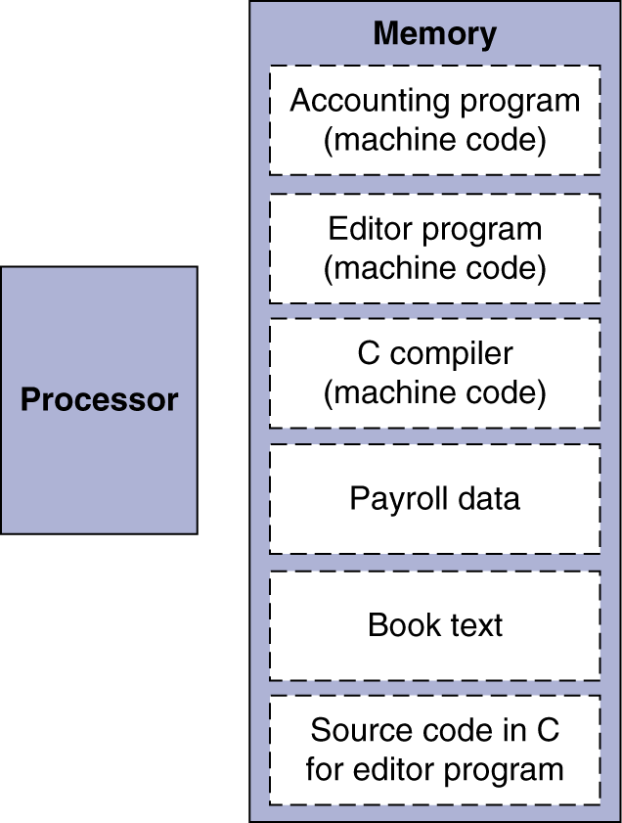
Stored Program Computers
The BIG Picture
Instructions represented in binary, just like data
Instructions and data stored in memory
Programs can operate on programs
e.g., compilers, linkers, …
Binary compatibility allows compiled programs to work on different computers
Standardized ISAs
Chapter 2 — Instructions: Language of the Computer — ‹#›
Notes:
The University of Adelaide, School of Computer Science
*
Chapter 2 — Instructions: Language of the Computer
‹#›

Slide 20
Logical Operations
Instructions for bitwise manipulation
§2.6 Logical Operations
Operation | C | Java | RISC-V
Shift left | << | << | slli
Shift right | >> | >>> | srli
Bit-by-bit AND | & | & | and, andi
Bit-by-bit OR | | | | | or, ori
Bit-by-bit XOR | ^ | ^ | xor, xori
Bit-by-bit NOT | ~ | ~
Useful for extracting and inserting groups of bits in a word
Chapter 2 — Instructions: Language of the Computer — ‹#›
Notes:
The University of Adelaide, School of Computer Science
*
Chapter 2 — Instructions: Language of the Computer
‹#›

Slide 21
Shift Operations
funct6
immed
rs1
funct3
rd
opcode
6 bits
6 bits
5 bits
3 bits
5 bits
7 bits
immed: how many positions to shift
Shift left logical
Shift left and fill with 0 bits
slli by i bits multiplies by 2^{i}
Shift right logical
Shift right and fill with 0 bits
srli by i bits divides by 2^{i} (unsigned only)
Chapter 2 — Instructions: Language of the Computer — ‹#›
Notes:
The University of Adelaide, School of Computer Science
*
Chapter 2 — Instructions: Language of the Computer
‹#›

Slide 22
AND Operations
Useful to mask bits in a word
Select some bits, clear others to 0
and x9,x10,x11
x10
00000000 00000000 00000000 00000000 00000000 00000000 00001101 11000000
x11
00000000 00000000 00000000 00000000 00000000 00000000 00111100 00000000
x9
00000000 00000000 00000000 00000000 00000000 00000000 00001100 00000000
Chapter 2 — Instructions: Language of the Computer — ‹#›
Notes:
The University of Adelaide, School of Computer Science
*
Chapter 2 — Instructions: Language of the Computer
‹#›

Slide 23
OR Operations
Useful to include bits in a word
Set some bits to 1, leave others unchanged
or x9,x10,x11
x10
00000000 00000000 00000000 00000000 00000000 00000000 00001101 11000000
x11
00000000 00000000 00000000 00000000 00000000 00000000 00111100 00000000
x9
00000000 00000000 00000000 00000000 00000000 00000000 00111101 11000000
Chapter 2 — Instructions: Language of the Computer — ‹#›
Notes:
The University of Adelaide, School of Computer Science
*
Chapter 2 — Instructions: Language of the Computer
‹#›

Slide 24
XOR Operations
Differencing operation
Set some bits to 1, leave others unchanged
xor x9,x10,x12 // NOT operation
x10
00000000 00000000 00000000 00000000 00000000 00000000 00001101 11000000
x12
11111111 11111111 11111111 11111111 11111111 11111111 11111111 11111111
x9
11111111 11111111 11111111 11111111 11111111 11111111 11110010 00111111
Chapter 2 — Instructions: Language of the Computer — ‹#›
Notes:
The University of Adelaide, School of Computer Science
*
Chapter 2 — Instructions: Language of the Computer
‹#›

Slide 25
Conditional Operations
Branch to a labeled instruction if a condition is true
Otherwise, continue sequentially
beq rs1, rs2, L1
if (rs1 == rs2) branch to instruction labeled L1
bne rs1, rs2, L1
if (rs1 != rs2) branch to instruction labeled L1
§2.7 Instructions for Making Decisions
Chapter 2 — Instructions: Language of the Computer — ‹#›
Notes:
The University of Adelaide, School of Computer Science
*
Chapter 2 — Instructions: Language of the Computer
‹#›

Slide 26
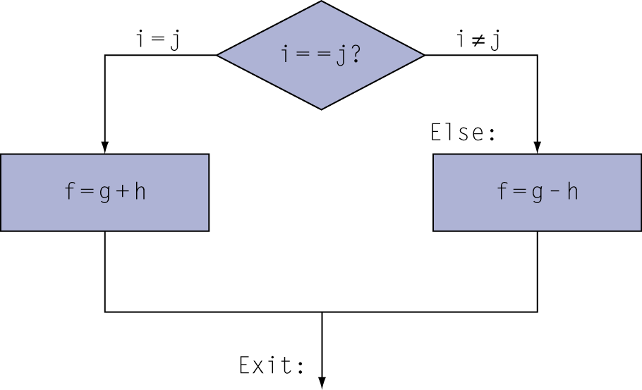
Compiling If Statements
C code:
if (i==j) f = g+h; else f = g-h;
f, g, … in x19, x20, …
Compiled RISC-V code:
bne x22, x23, Else add x19, x20, x21 beq x0,x0,Exit // unconditional Else: sub x19, x20, x21 Exit: …
Assembler calculates addresses
Chapter 2 — Instructions: Language of the Computer — ‹#›
Notes:
The University of Adelaide, School of Computer Science
*
Chapter 2 — Instructions: Language of the Computer
‹#›

Slide 27
Compiling Loop Statements
C code:
while (save[i] == k) i += 1;
i in x22, k in x24, address of save in x25
Compiled RISC-V code:
Loop: slli x10, x22, 3 add x10, x10, x25 ld x9, 0(x10) bne x9, x24, Exit
addi x22, x22, 1 beq x0, x0, Loop Exit: …
Chapter 2 — Instructions: Language of the Computer — ‹#›
Notes:
The University of Adelaide, School of Computer Science
*
Chapter 2 — Instructions: Language of the Computer
‹#›

Slide 28
Basic Blocks
A basic block is a sequence of instructions with
No embedded branches (except at end)
No branch targets (except at beginning)
A compiler identifies basic blocks for optimization
An advanced processor can accelerate execution of basic blocks
Chapter 2 — Instructions: Language of the Computer — ‹#›
Notes:
The University of Adelaide, School of Computer Science
*
Chapter 2 — Instructions: Language of the Computer
‹#›

Slide 29
More Conditional Operations
blt rs1, rs2, L1
if (rs1 < rs2) branch to instruction labeled L1
bge rs1, rs2, L1
if (rs1 >= rs2) branch to instruction labeled L1
Example
if (a > b) a += 1;
a in x22, b in x23
bge x23, x22, Exit // branch if b >= a
addi x22, x22, 1
Exit:
Chapter 2 — Instructions: Language of the Computer — ‹#›
Notes:
The University of Adelaide, School of Computer Science
*
Chapter 2 — Instructions: Language of the Computer
‹#›

Slide 30
Signed vs. Unsigned
Signed comparison: blt, bge
Unsigned comparison: bltu, bgeu
Example
x22 = 1111 1111 1111 1111 1111 1111 1111 1111
x23 = 0000 0000 0000 0000 0000 0000 0000 0001
x22 < x23 // signed
–1 < +1
x22 > x23 // unsigned
+4,294,967,295 > +1
Chapter 2 — Instructions: Language of the Computer — ‹#›
Notes:
The University of Adelaide, School of Computer Science
*
Chapter 2 — Instructions: Language of the Computer
‹#›

Slide 31
Procedure Calling
Steps required
Place parameters in registers x10 to x17
Transfer control to procedure
Acquire storage for procedure
Perform procedure’s operations
Place result in register for caller
Return to place of call (address in x1)
§2.8 Supporting Procedures in Computer Hardware
Chapter 2 — Instructions: Language of the Computer — ‹#›
Notes:
The University of Adelaide, School of Computer Science
*
Chapter 2 — Instructions: Language of the Computer
‹#›

Slide 32
Procedure Call Instructions
Procedure call: jump and link
jal x1, ProcedureLabel
Address of following instruction put in x1
Jumps to target address
Procedure return: jump and link register
jalr x0, 0(x1)
Like jal, but jumps to 0 + address in x1
Use x0 as rd (x0 cannot be changed)
Can also be used for computed jumps
e.g., for case/switch statements
Chapter 2 — Instructions: Language of the Computer — ‹#›
Notes:
The University of Adelaide, School of Computer Science
*
Chapter 2 — Instructions: Language of the Computer
‹#›

Slide 33
Leaf Procedure Example
C code:
long long int leaf_example ( long long int g, long long int h, long long int i, long long int j) { long long int f; f = (g + h) - (i + j); return f; }
Arguments g, …, j in x10, …, x13
f in x20
temporaries x5, x6
Need to save x5, x6, x20 on stack
Chapter 2 — Instructions: Language of the Computer — ‹#›
Notes:
The University of Adelaide, School of Computer Science
*
Chapter 2 — Instructions: Language of the Computer
‹#›

Slide 34
Leaf Procedure Example
RISC-V code:
leaf_example:
addi sp,sp,-24
sd x5,16(sp)
sd x6,8(sp)
sd x20,0(sp
add x5,x10,x11
add x6,x12,x1
sub x20,x5,x6
addi x10,x20,0
ld x20,0(sp)
ld x6,8(sp)
ld x5,16(sp)
addi sp,sp,24
jalr x0,0(x1)
Save x5, x6, x20 on stack
x5 = g + h
x6 = i + j
f = x5 – x6
copy f to return register
Resore x5, x6, x20 from stack
Return to caller
Chapter 2 — Instructions: Language of the Computer — ‹#›
Notes:
The University of Adelaide, School of Computer Science
*
Chapter 2 — Instructions: Language of the Computer
‹#›

Slide 35
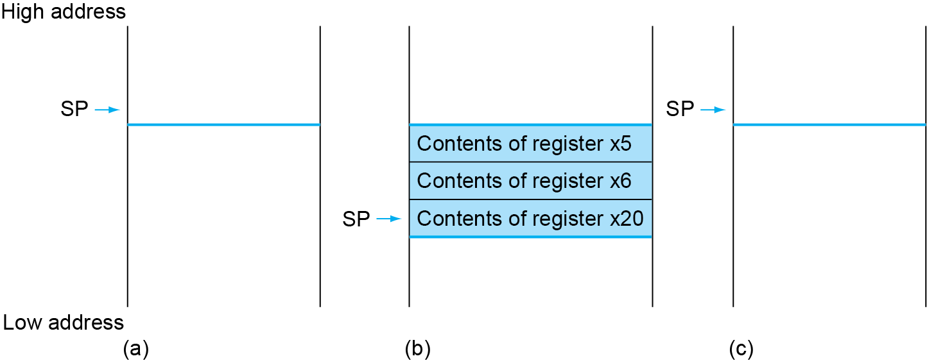
Local Data on the Stack
Chapter 2 — Instructions: Language of the Computer — ‹#›

Slide 36
Register Usage
x5 – x7, x28 – x31: temporary registers
Not preserved by the callee
x8 – x9, x18 – x27: saved registers
If used, the callee saves and restores them
Chapter 2 — Instructions: Language of the Computer — ‹#›

Slide 37
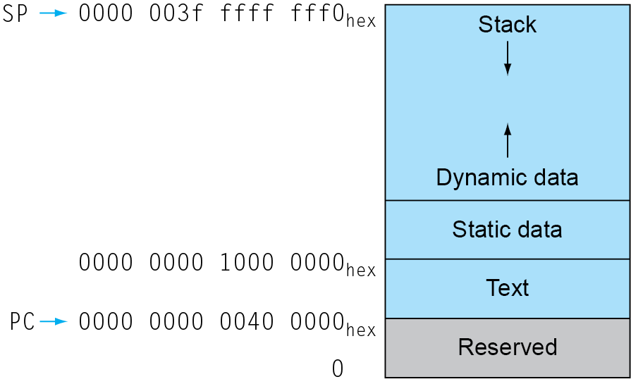
Memory Layout
Text: program code
Static data: global variables
e.g., static variables in C, constant arrays and strings
x3 (global pointer) initialized to address allowing ±offsets into this segment
Dynamic data: heap
E.g., malloc in C, new in Java
Stack: automatic storage
Chapter 2 — Instructions: Language of the Computer — ‹#›
Notes:
The University of Adelaide, School of Computer Science
*
Chapter 2 — Instructions: Language of the Computer
‹#›

Slide 38
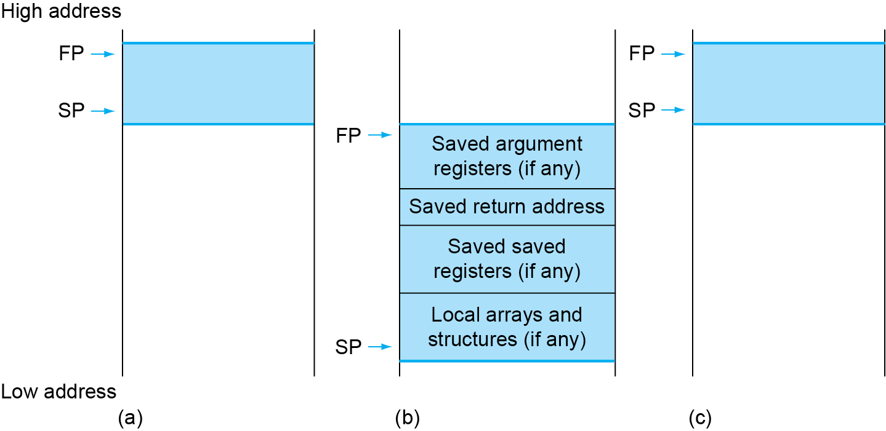
Local Data on the Stack
Local data allocated by callee
e.g., C automatic variables
Procedure frame (activation record)
Used by some compilers to manage stack storage
Chapter 2 — Instructions: Language of the Computer — ‹#›
Notes:
The University of Adelaide, School of Computer Science
*
Chapter 2 — Instructions: Language of the Computer
‹#›

Slide 39
Character Data
Byte-encoded character sets
ASCII: 128 characters
95 graphic, 33 control
Latin-1: 256 characters
ASCII, +96 more graphic characters
Unicode: 32-bit character set
Used in Java, C++ wide characters, …
Most of the world’s alphabets, plus symbols
UTF-8, UTF-16: variable-length encodings
§2.9 Communicating with People
Chapter 2 — Instructions: Language of the Computer — ‹#›
Notes:
The University of Adelaide, School of Computer Science
*
Chapter 2 — Instructions: Language of the Computer
‹#›

Slide 40
Byte/Halfword/Word Operations
RISC-V byte/halfword/word load/store
Load byte/halfword/word: Sign extend to 64 bits in rd
lb rd, offset(rs1)
lh rd, offset(rs1)
lw rd, offset(rs1)
Load byte/halfword/word unsigned: Zero extend to 64 bits in rd
lbu rd, offset(rs1)
lhu rd, offset(rs1)
lwu rd, offset(rs1)
Store byte/halfword/word: Store rightmost 8/16/32 bits
sb rs2, offset(rs1)
sh rs2, offset(rs1)
sw rs2, offset(rs1)
Chapter 2 — Instructions: Language of the Computer — ‹#›
Notes:
The University of Adelaide, School of Computer Science
*
Chapter 2 — Instructions: Language of the Computer
‹#›

Slide 41
32-bit Constants
Most constants are small
12-bit immediate is sufficient
For the occasional 32-bit constant
lui rd, constant
Copies 20-bit constant to bits [31:12] of rd
Extends bit 31 to bits [63:32]
Clears bits [11:0] of rd to 0
§2.10 RISC-V Addressing for Wide Immediates and Addresses
lui x19, 976 // 0x003D0
0000 0000 0000 0000
0000 0000 0000 0000
0000 0000 0011 1101 0000
0000 0000 0000
addi x19,x19,1280 // 0x500
0000 0000 0000 0000
0000 0000 0000 0000
0000 0000 0011 1101 0000
0101 0000 0000
Chapter 2 — Instructions: Language of the Computer — ‹#›
Notes:
The University of Adelaide, School of Computer Science
*
Chapter 2 — Instructions: Language of the Computer
‹#›

Slide 42
Branch Addressing
Branch instructions specify
Opcode, two registers, target address
Most branch targets are near branch
Forward or backward
SB format:
imm [10:5]
rs2
rs1
funct3
imm [4:1]
opcode
imm[12]
imm[11]
PC-relative addressing
Target address = PC + immediate × 2
Chapter 2 — Instructions: Language of the Computer — ‹#›
Notes:
The University of Adelaide, School of Computer Science
*
Chapter 2 — Instructions: Language of the Computer
‹#›

Slide 43
Jump Addressing
Jump and link (jal) target uses 20-bit immediate for larger range
UJ format:
imm[10:1]
imm[19:12]
rd
opcode
5 bits
7 bits
imm[20]
imm[11]
For long jumps, eg, to 32-bit absolute address
lui: load address[31:12] to temp register
jalr: add address[11:0] and jump to target
Chapter 2 — Instructions: Language of the Computer — ‹#›
Notes:
The University of Adelaide, School of Computer Science
*
Chapter 2 — Instructions: Language of the Computer
‹#›

Slide 44
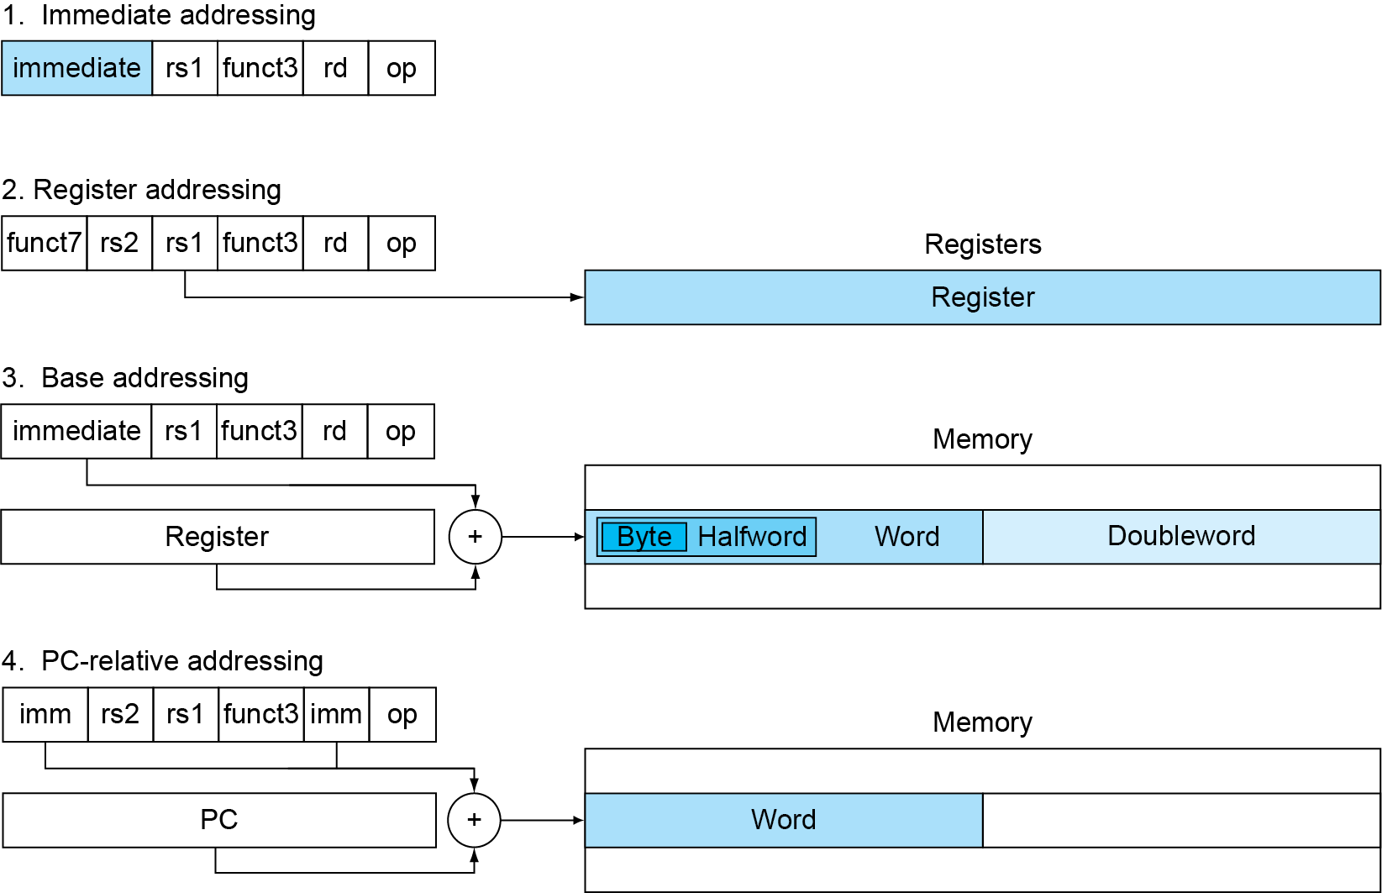
RISC-V Addressing Summary
Chapter 2 — Instructions: Language of the Computer — ‹#›

Slide 45
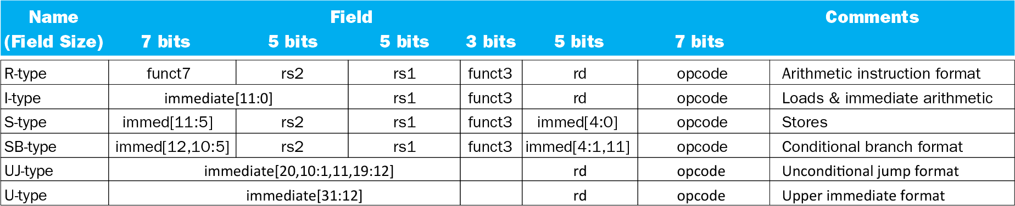
RISC-V Encoding Summary
Chapter 2 — Instructions: Language of the Computer — ‹#›

Slide 46
Lessons Learnt
Instruction count and CPI are not good performance indicators in isolation
Compiler optimizations are sensitive to the algorithm
Java/JIT compiled code is significantly faster than JVM interpreted
Comparable to optimized C in some cases
Nothing can fix a dumb algorithm!
Chapter 2 — Instructions: Language of the Computer — ‹#›
Notes:
The University of Adelaide, School of Computer Science
*
Chapter 2 — Instructions: Language of the Computer
‹#›

Slide 47
MIPS Instructions
MIPS: commercial predecessor to RISC-V
Similar basic set of instructions
32-bit instructions
32 general purpose registers, register 0 is always 0
32 floating-point registers
Memory accessed only by load/store instructions
Consistent use of addressing modes for all data sizes
Different conditional branches
For <, <=, >, >=
RISC-V: blt, bge, bltu, bgeu
MIPS: slt, sltu (set less than, result is 0 or 1)
Then use beq, bne to complete the branch
§2.16 Real Stuff: MIPS Instructions
Chapter 2 — Instructions: Language of the Computer — ‹#›
Notes:
The University of Adelaide, School of Computer Science
*
Chapter 2 — Instructions: Language of the Computer
‹#›

Slide 48
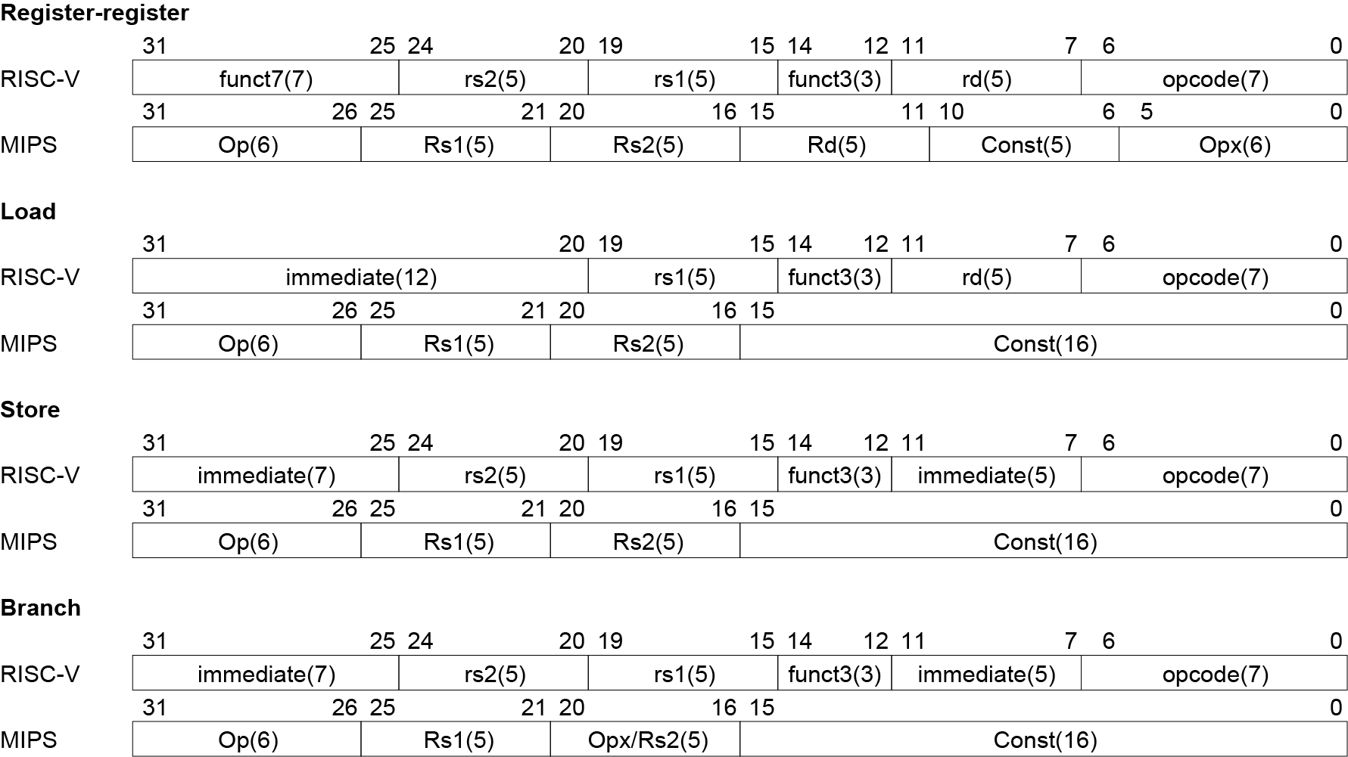
Instruction Encoding
Chapter 2 — Instructions: Language of the Computer — ‹#›
Notes:
The University of Adelaide, School of Computer Science
*
Chapter 2 — Instructions: Language of the Computer
‹#›

Slide 49
Concluding Remarks
Design principles
1. Simplicity favors regularity
2. Smaller is faster
3. Good design demands good compromises
Make the common case fast
Layers of software/hardware
Compiler, assembler, hardware
RISC-V: typical of RISC ISAs
c.f. x86
§2.23 Concluding Remarks
Chapter 2 — Instructions: Language of the Computer — ‹#›
Notes:
The University of Adelaide, School of Computer Science
*
Chapter 2 — Instructions: Language of the Computer
‹#›

