Slide 1
2.6 Natural Polymers
by Zeynep Guven
SCH4U
Istikbal Turut
Nile Academy
November, 1st 2017

Slide 2
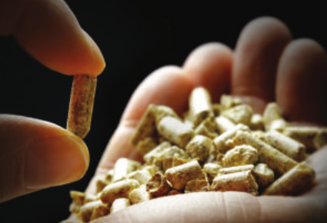
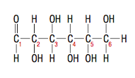
Polysaccharides
A carbohydrate, such as starch or cellulose, is a polymer of monosaccharides, or simple sugars. A monosaccharide is a ketone or aldehyde with many additional hydroxyl substituents. For example, glucose has a hexagonal structure with five hydroxyl groups.

Slide 3
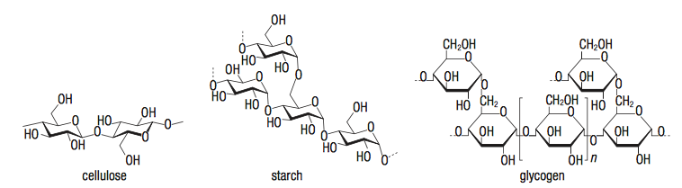
When monosaccharide rings join together, they form large polymers consisting of many monosaccharide units. Such a polymer is called a polysaccharide. The third important polysaccharide, along with cellulose and glycogen, is starch.

Slide 4
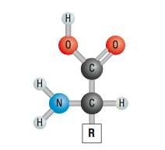
Proteins
All proteins are made of amino acids. An amino acid is an organic molecule that contains a carboxyl group (–COOH), an amino group (–NH2), and a hydrogen atom all attached to the same carbon atom.
The fourth bond on that carbon atom links to an additional group or chain of atoms, generically designated as R. The nature of this group gives each amino acid its distinct properties.

Slide 5
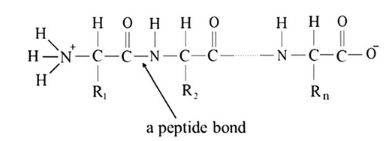
Peptide
A protein polymer is built by condensation reactions between amino acids. A peptide is two or more amino acids linked together through a condensation reaction between the amine and acid groups.

Slide 6
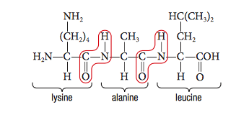
Protein Structure
For example, one possible sequence for a tripeptide (a chain of three amino acids joined by peptide bonds) containing lysine, alanine, and leucine.
The sequence of amino acids in the protein chain is called the primary structure. Bio- chemists use the convention that the terminal carboxyl group is on the right and the terminal amino group is on the left.

Slide 7
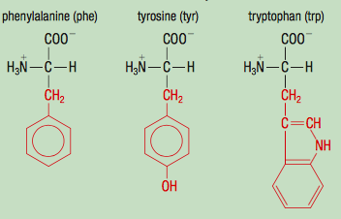
The 20 amino acids all have different side chains (R groups), shown in red.
Aromatic R Groups

Slide 8
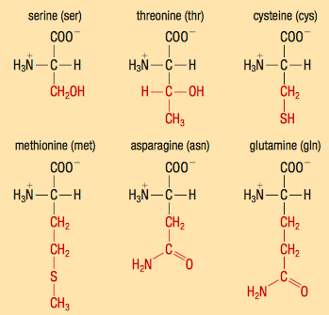
Polar, Uncharged R Groups

Slide 9
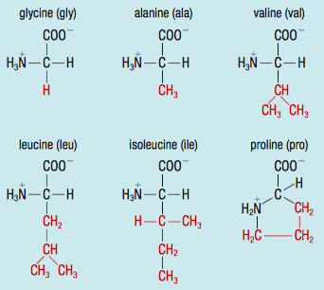
Non-polar, Aliphatic R Groups

Slide 10
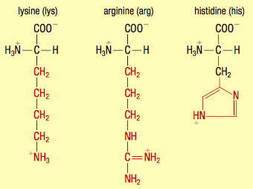
Positively Charged R Groups

Slide 11
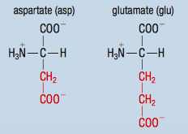
Negatively Charged R Groups

Slide 12
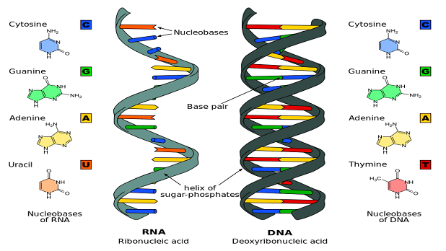
Nucleic Acids
DNA (deoxyribonucleic acid): a polymer in the cell nucleus that stores and transmits genetic information.
RNA (ribonucleic acid): a polymer in the cell cytoplasm that stores and transmits genetic information.
nucleic acid: the polymer molecules that make up DNA and RNA.

Slide 13
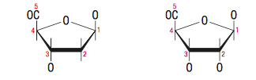
Three Parts of Nucleotides
The monomers of the nucleic acids, called nucleotides, are composed of three distinct parts:
1. a 5-carbon sugar: deoxyribose in DNA and ribose in RNA
Deoxyribose
Ribose

Slide 14
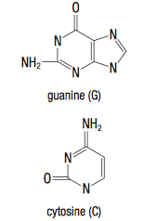
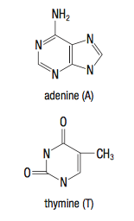
2. a nitrogen-containing organic base
The key to DNA’s functioning is its double-helical structure with complementary bases on the two strands. The bases form hydrogen bonds with each other.
The structures of cytosine and guanine make them perfect partners for hydrogen bonding, and they are always found opposite each other on the two strands of DNA.
Thymine and adenine form similar hydrogen-bonding pairs.

Slide 15
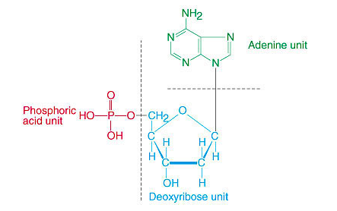
3. a phosphoric acid molecule, H3PO4

Slide 16


