Slide 1
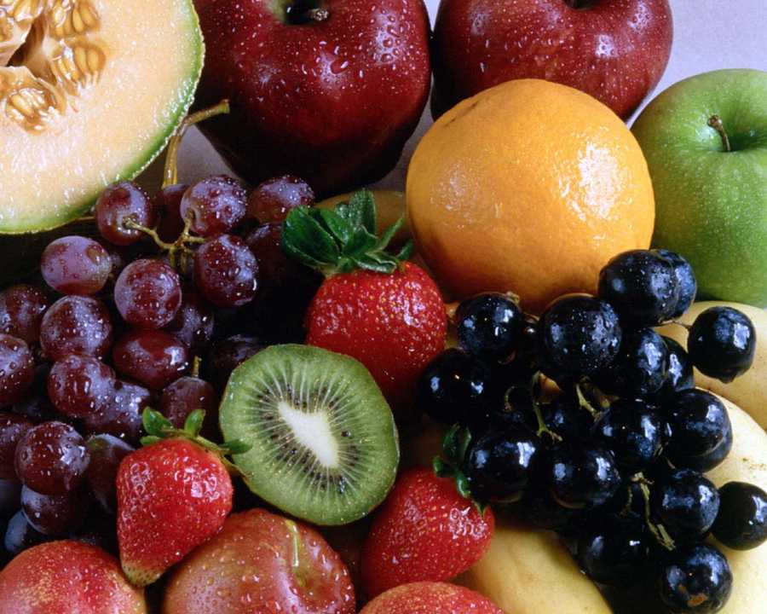
Acid–Base Equilibrium
The term acid is “acere”, in Latin language, meaning sour.
In 17th century the English chemist Robert Boyle grouped the
substances as either acids or bases.
Acids and bases are found in many fruits, vegetables and some household products, like vinegar, apple, oranges, lemons, grapes, soaps, etc.
To explain the behavior of acids and bases there are many acid-base theories.

Slide 2
In 1884, Swedish chemist Svante Arrhenius defined acids as
compounds that produce H⁺ ions in aqueous solutions, and
bases compounds that produce OH⁻ ions in aqueous solutions.
This theory was insufficient to explain the acidic or basic
properties of some substances such as SO₃ or NH₃.

Slide 3
Brønsted–Lowry theory a theory stating that an acid is a hydrogen ion (proton)
donor and a base is a hydrogen ion (proton) acceptor
hydronium ion a water molecule that has accepted a hydrogen ion, H₃O¹⁺

Slide 5
Conjugate Acid–Base Pairs
conjugate acid the substance that forms when a base, according to the Brønsted– Lowry theory, accepts a hydrogen ion (proton)
conjugate base the substance that forms when an acid loses a hydrogen ion (proton)
conjugate acid–base pair two substances related to each other by the donating and accepting of a single hydrogen ion

Slide 6
Amphiprotic (Amphoteric) Substances
amphiprotic (amphoteric) able to donate or accept a hydrogen ion (proton) and thus
act as both a Brønsted–Lowry acid and a Brønsted–Lowry base

Slide 8
acid ionization constant (Ka) the equilibrium constant for the ionization of an acid; also
called the acid dissociation constant

Slide 10
strong acid an acid that ionizes almost 100 % in water, producing hydrogen ions
weak acid an acid that only partly ionizes in water, producing hydrogen ions

Slide 11
oxyacid an acid in which the acidic hydrogen atom is attached to an oxygen atom
Sulfuric acid is a typical example of a strong oxyacid.
Many common weak acids, such as phosphoric acid, H3PO4(aq); nitrous acid, HNO2(aq); and hypochlorous acid, HClO(aq), are also oxyacids.
organic acid an acid (except carbonic acid, H2CO3(aq)) containing carbon, oxygen, and
hydrogen atoms; also called carboxylic acid

Slide 12
Strong Bases and Weak Bases
strong base a base that dissociates completely in water, producing hydroxide ions
weak base a base that only partially reacts with water to produce hydroxide ions

Slide 13
base ionization constant (Kb) the equilibrium constant for the ionization of a base; also called the base dissociation constant

Slide 15
autoionization of water the transfer of a hydrogen ion from one water molecule to another
ion-product constant for water (Kw) the equilibrium constant for the autoionization of water

Slide 17
pH the negative logarithm of the concentration of hydrogen ions in an aqueous solution
pOH the negative logarithm of the concentration of hydroxide ions in an aqueous solution

Slide 22
percentage ionization the percentage of a solute that ionizes when it dissolves in a solvent

Slide 26
monoprotic acid an acid that possesses only one ionizable (acidic) hydrogen atom
polyprotic acid an acid that possesses more than one ionizable (acidic) hydrogen atom

Slide 39
titration the addition of precise volumes of a solution in a burette to a measured volume of a sample solution; often used to determine the concentration of a substance in the sample
sample the solution being analyzed in a titration
titrant the solution in a burette during a titration
burette a calibrated tube used to deliver variable known volumes of a liquid during a titration

Slide 40
standard solution a solution whose concentration is accurately and precisely known
primary standard a highly pure and stable chemical used to determine the precise concentration of acids or bases
equivalence point the point in a titration when neutralization is complete
endpoint the point in a titration at which a sharp change in a measurable and characteristic property occurs (for example, a colour change in an acid–base indicator)

Slide 43
Example
A 0.1 M of 50 mL HCl solution is titrated with 0.1 M NaOH
solution. Calculate the pH of the final solutions in each of the
following cases and draw a curve showing pH versus volume
of NaOH added.
In the original acid solution.
After 10 mL of NaOH solution has been added.
After 49 mL of NaOH solution has been added.
After 50 mL of NaOH solution has been added.
After 60 mL of NaOH solution has been added.

Slide 49
buffer an aqueous solution containing a conjugate acid–base pair that maintains a
nearly constant pH when an acid or base is added
A buffer solution is an aqueous solution consisting of a mixture of a weak acid and its conjugate base or a weak base and its conjugate acid.
It has the property that the pH of the solution changes very little when a small amount of acid or base is added to it.
Buffer solutions are used as a means of keeping pH at a nearly constant value in a wide variety of chemical applications. Such as pH of blood, to maintain pH stability carbonic acid-bicarbonate buffer system is used.

