Slide 1
Chemical equilibrium is a state of balance in which the
rate of a forward reaction equals the rate of the reverse
reaction and the concentrations of products and reactants
remain unchanged.
H₂+I₂ 2HI
Only a very small fraction of the collisions between H₂ and I₂ result in the formation of HI.
As more HI molecules are made, they collide more often and form H₂ and I₂ by the reverse reaction.

Slide 2

chemical equilibrium the state of a reaction in which all reactants and products have reached constant concentrations in a closed system
dynamic equilibrium a balance between forward and reverse processes that are occurring simultaneously at equal rates
equilibrium position the relative concentrations of reactants and products
in a system in dynamic equilibrium
reversible reaction a chemical reaction that proceeds in both the forward and reverse directions, setting up an equilibrium in a closed system

Slide 3
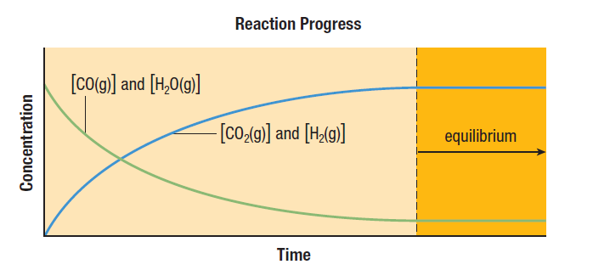

Slide 4
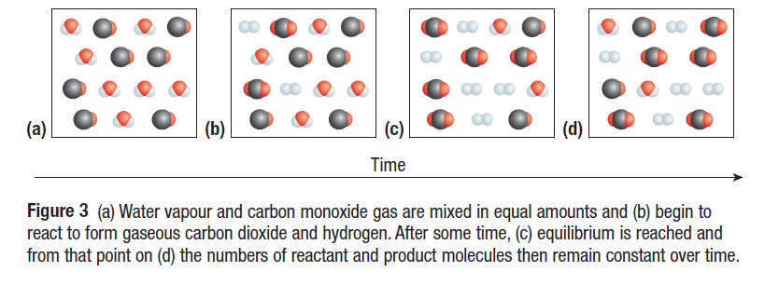

Slide 5

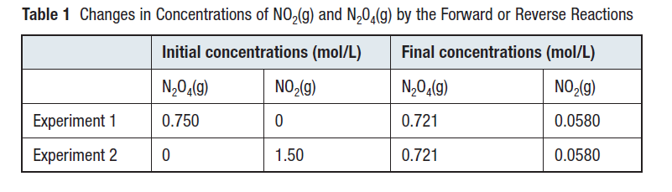
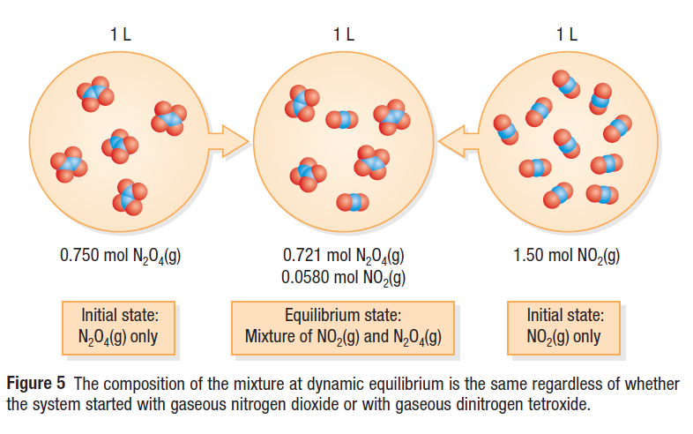

Slide 6

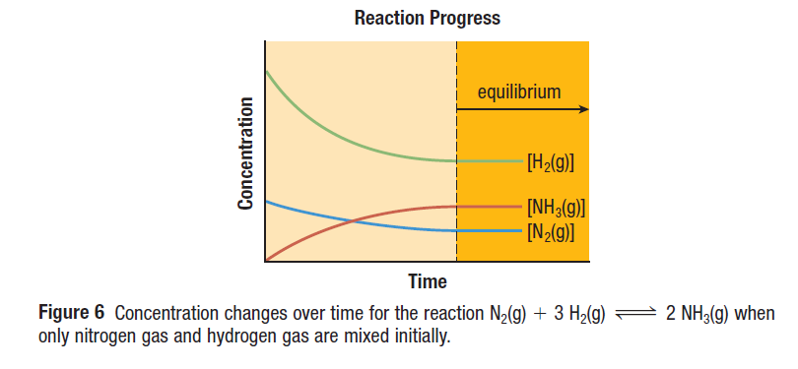

Slide 7
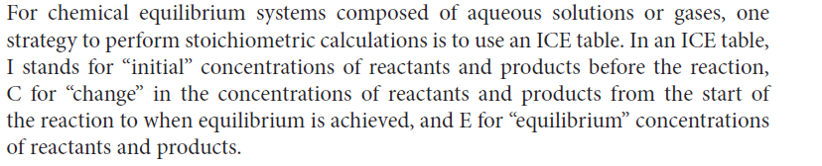
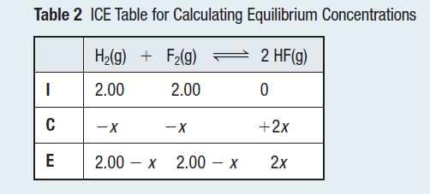

Slide 8

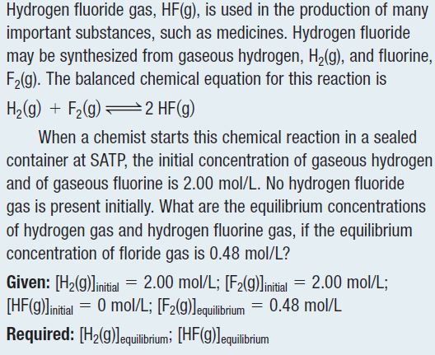

Slide 9
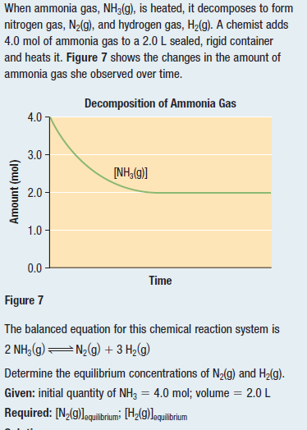

Slide 10
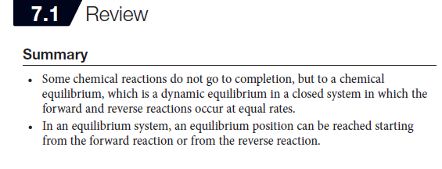

Slide 11


Equilibrium law the mathematical description of a chemical system at equilibrium Equilibrium constant (K) a constant numerical value defining the equilibrium law for a given system: units are not included when giving the value of K

Slide 12
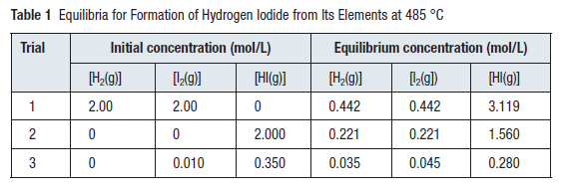
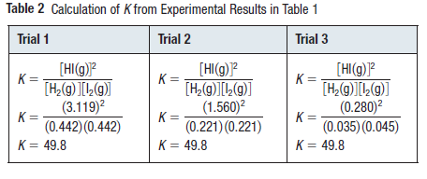

Slide 13

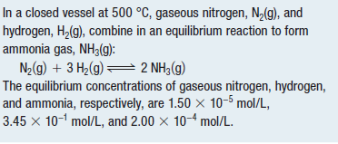


Slide 14




Slide 15


homogeneous equilibrium a chemical equilibrium system in which all reactants and products are in the same state of matter, such as the gas state
heterogeneous equilibrium a chemical equilibrium system in which the reactants and products are present in at least two different states, such as gases and solids

Slide 16

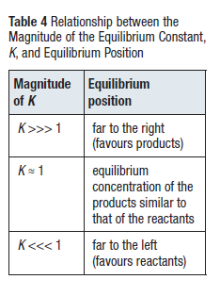



Slide 17
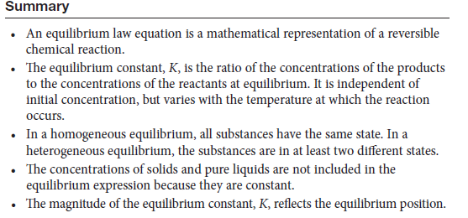

Slide 18
The Equilibrium Constant
The Many Types of Equilibrium Constants, K_{eq}
K_{c}
K_{p}
K_{sp}
K_{a}/K_{b}
K_{w}

Slide 19

Qualitative Changes in Equilibrium Systems
Le Châtelier’s principle a generalization that states that chemical systems at equilibrium shift to restore equilibrium when a change occurs that disturbs the equilibrium
When a chemical system at equilibrium is disturbed by a change in a property, the system adjusts in a way that opposes the change.
Le Châtelier’s Principle and Changes in Concentration
equilibrium shift a change in concentrations of reactants and products
in order to restore an equilibrium state

Slide 20
Factors Affecting Equilibrium
(Le Chatelier’s Principle)
1. The Effect of Concentration
For the effect of concentration there are four cases:
Following reaction is given below;
N₂(g) + 3H₂(g) ⇔ 2NH₃(g) at equilibrium at 25ºC.
a. If some N₂ or H₂ is added to reaction container, the system is disturbed and it will try to decrease this effect by moving forward, then the reaction will reestablish a new equilibrium. As a result of this, concentration of NH₃ will increase.
b. If some NH₃ is added the reaction will try to minimize this effect by moving backward. As a result concentration of both N₂ and H₂ will increase.

Slide 21
1. The Effect of Concentration
N₂(g) + 3H₂(g) ⇔ 2NH₃(g) at equilibrium at 25ºC.
c. If some N₂ or H₂ is removed, decreasing concentration, from reaction container, the system is disturbed and it will try to decrease this effect by moving backward, then the reaction will reestablish a new equilibrium. As a result of this, concentration of NH₃ will decrease.
d. If some NH₃ is removed from the reaction container the reaction will try to minimize this effect by moving forward. As a result concentration of both N₂ and H₂ will decrease.

Slide 22
Example
The following reaction at equilibrium is given, at 25ºC.
CO(g) + H₂O(g) ⇔ CO₂(g) + H₂(g).
Following changes are applied. Try to predict how the reaction
respond to the these effects.
Addition of CO gas,
Addition of H₂ gas,
Removal of H₂O gas,
Removal of CO₂ gas.

Slide 23
Solution
CO(g) + H₂O(g) ⇔ CO₂(g) + H₂(g).
The reaction shifts forward, and concentration of CO₂ and H₂ will increase and concentration of H₂O will decrease.
The reaction shifts backward, and concentration of H₂O and CO will increase and concentration of CO₂ will decrease.
The reaction shifts backward, and concentration of CO₂ and H₂ will decrease and concentration of CO will increase.
The reaction shifts forward, and concentration of CO and H₂O will decrease and concentration of H₂ will increase.

Slide 24

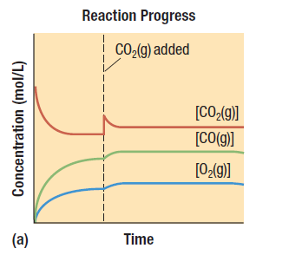
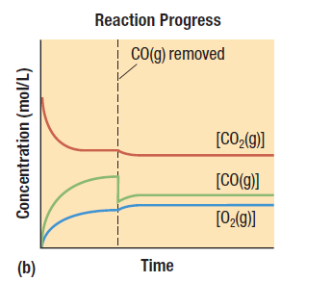
Example:
Figure 4 (a) At the dotted line, when the system was at equilibrium, more
carbon dioxide gas (reactant) was added to the system. The equilibrium responded by shifting to the right (in the direction of products). The concentration of the reactant at the new equilibrium is also higher. (b) At the dotted line, when the system was at equilibrium, carbon monoxide gas (product) was removed from the system. As in (a), the equilibrium responded by shifting to the right, converting more reactant to products.

Slide 25
Example 18
Consider the reaction:
2HI(g) ⇔ H₂(g) + I₂(g)
An equilibrium mixture was found to contain 2 mol of HI, 1 mol
of H₂ and 1 mol of I₂ in a 2-L vessel. At the same temperature
1 mol of HI is added to the vessel. Calculate the concentration
of each substance when new equilibrium is established.

Slide 26
2. Volume Changes or Effect of Pressure
Change in volume alters the concentrations of gas reactants and gas products.
According to Le Chatelier’s principle, when the volume of the system is decreased; the reaction shifts to the side having the smaller number of coefficients of gases to decrease this effect.
When the volume of the system is increased; the reaction shifts to the side having the greater number of coefficients of gases to decrease this effect.

Slide 27
2. Volume Changes or Effect of Pressure
For heterogeneous equilibrium the effect of volume is predicted by counting the number of moles of gas indicated on each side of an equation.
Change in pressure affects the equilibrium reaction conversely with respect to volume change.

Slide 28
Example:
Consider the reaction:
2NH₃(g) ⇔ 3H₂(g) + N₂(g)
Following changes are applied. Try to predict how the reaction
respond to the these effects.
Increasing volume,
Decreasing volume,
Increasing pressure.

Slide 29
Solution:
2NH₃(g) ⇔ 3H₂(g) + N₂(g)
2 mol gas reactant 4 mol gas product
The reaction shifts forward, and concentration of H₂ and N₂ will increase and that of NH₃ will decrease.
The reaction shifts backward, and concentration of H₂ and N₂ will decrease and that of NH₃ will increase.
Increasing pressure means decreasing volume. Thus it will have same effect in b.

Slide 30
Example:
Consider the reaction:
CaCO₃(s) ⇔ CO₂(g) + CaO(s)
Following changes are applied. How the reaction will the
reaction shift to reestablish equilibrium.
Increasing pressure,
Decreasing volume,
Increasing volume.

Slide 31
Solution
CaCO₃(s) ⇔ CO₂(g) + CaO(s)
0 mol gas reactant 1 mol gas product
Increasing pressure means decreasing volume. The reaction shifts backward.
The reaction shifts backward.
The reaction shifts forward.

Slide 32
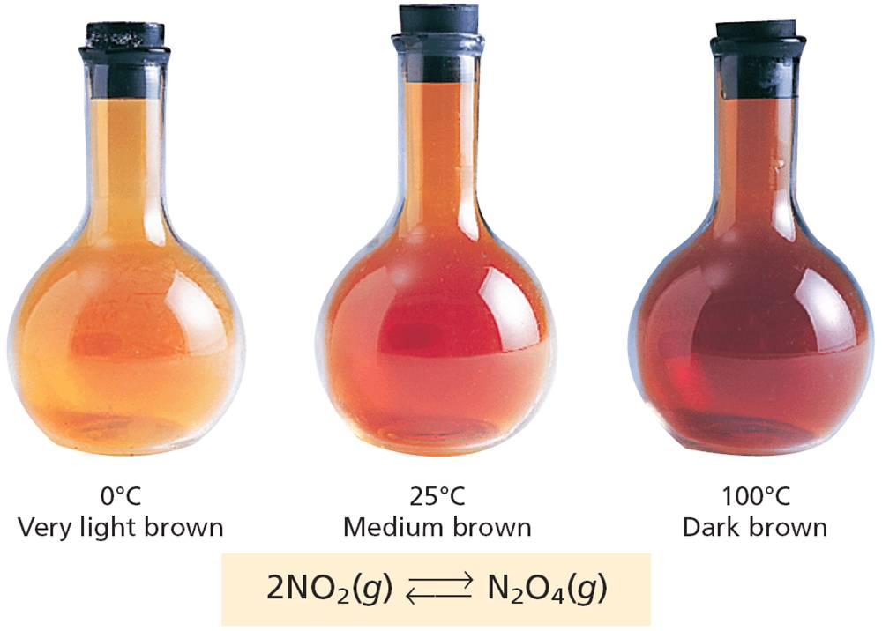
3. Effect of Temperature
Effect of temperature can be understood by knowing whether the reaction is exothermic or endothermic.
In endothermic reactions when temperature is increased the reaction will proceed to forward to eliminate effect.
In exothermic reactions when temperature is increased the reaction will move backward to minimize effect.

Slide 33
Example
Consider the reaction:
2H₂O(g) ⇔ 2H₂(g) + O₂(g) ΔH = +136.6 kcal
Following changes are applied. How the reaction will the
reaction shift to reestablish equilibrium.
Increasing temperature,
Decreasing temperature.

Slide 34
Solution
2H₂O(g) ⇔ 2H₂(g) + O₂(g) ΔH = +136.6 kcal
The reaction is endothermic.
Forward reaction needs energy to take place, if temperature is increased it will be in favor of forward reaction. The reaction will shift forward.
Reverse reaction is exothermic. If temperature is decreased it will be in favor of reverse reaction. The reaction will shift backward.

Slide 35
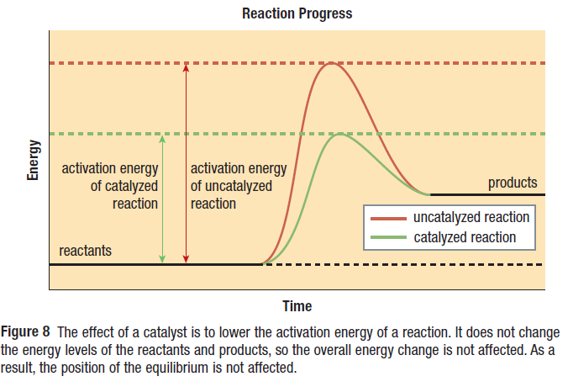
4. Effect of Catalyst
Catalyst does not effect equilibrium reactions and Kc.
They effect both forward and reverse reactions equally, therefore they cause the reactions to reach equilibrium in a shorter time.

Slide 36
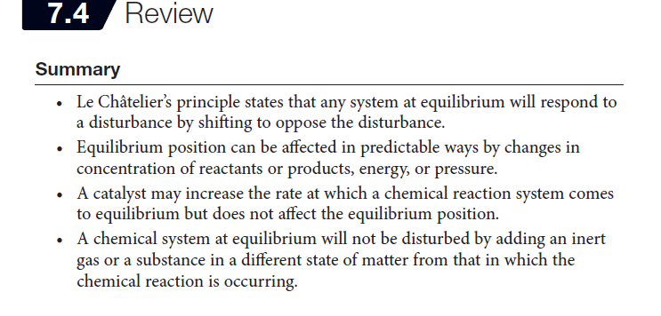

Slide 37
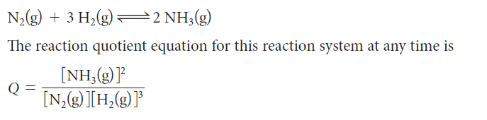
Quantitative Changes in equilibrium systems
The Reaction Quotient (Q)
reaction quotient (Q) the product of the
concentrations of the products, divided by
the product of the concentrations of the
reactants, for a chemical reaction that is
not necessarily at equilibrium
instantaneous concentrations
concentrations that occur together at a
particular instant in time in the progress
of a chemical reaction

Slide 38
The Reaction Quotient, Qc
Qc helps us predict the direction in which a reaction mixture
will proceed to reach equilibrium. Kc is determined when the
reaction is at equilibrium at constant temperature. Qc is
determined when the reaction is at non equilibrium conditions.
Qc = Kc, then the reaction is at equilibrium.
Qc>Kc , then the reverse reaction takes place to establish equilibrium.
Qc<Kc, then the forward reaction takes place to establish equilibrium.

Slide 39
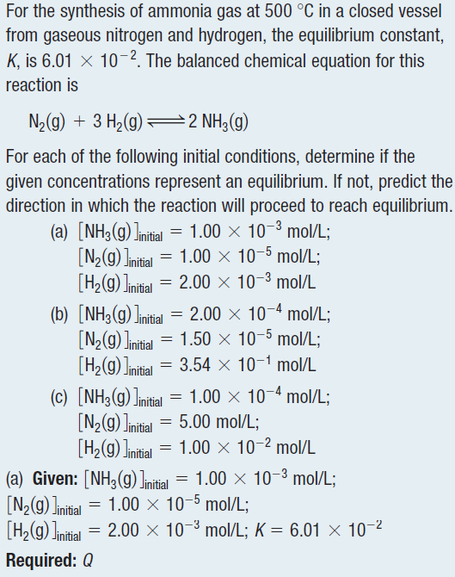

Slide 40
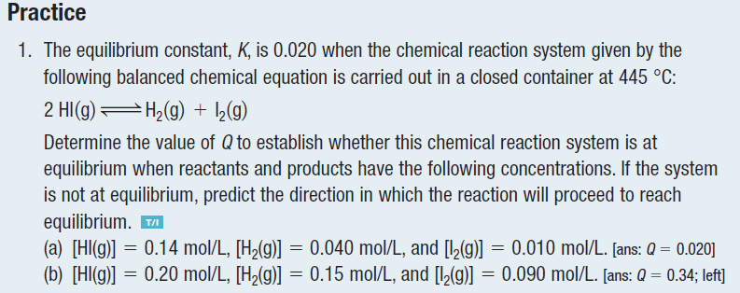

Slide 41
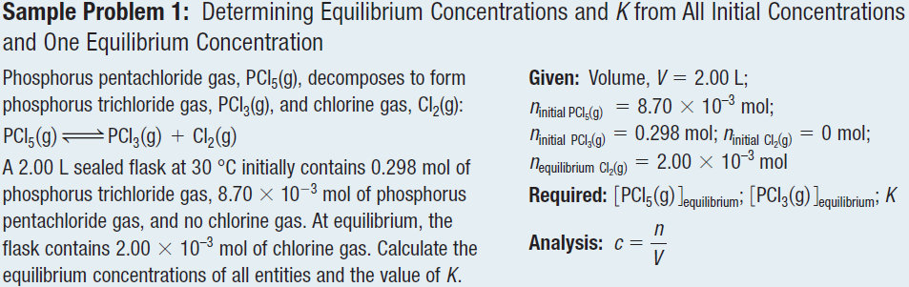

Slide 42

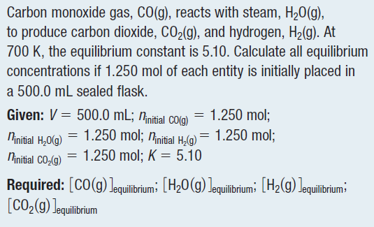

Slide 43

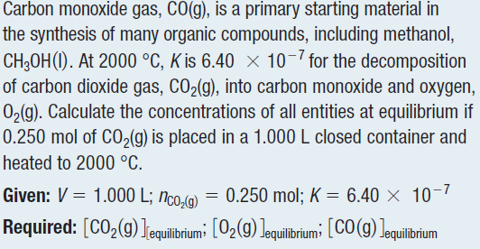

Slide 44
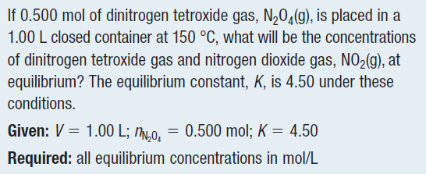

Slide 45
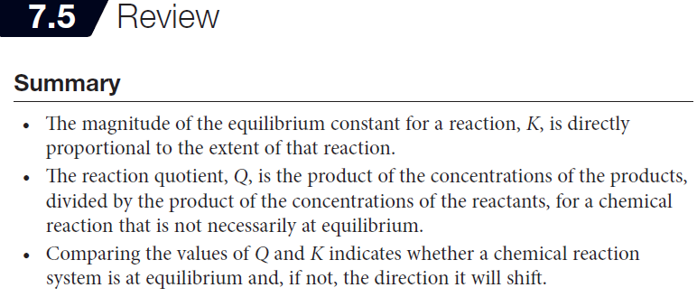

Slide 46



solubility the quantity of solute that
dissolves in a given quantity of solvent at
a particular temperature; the concentration
of a saturated solution at a particular
temperature
solubility equilibrium a dynamic
equilibrium between a solute and a solvent
in a saturated solution in a closed system
solubility product constant (Ksp) the
value obtained from the equilibrium law
applied to a saturated solution

Slide 47
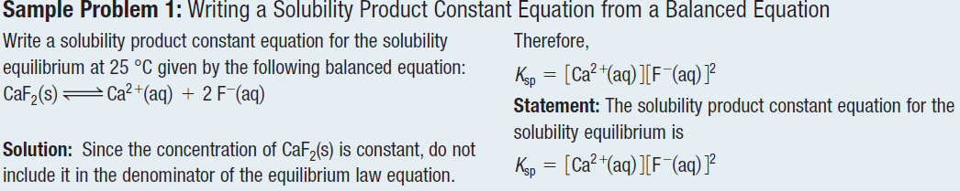
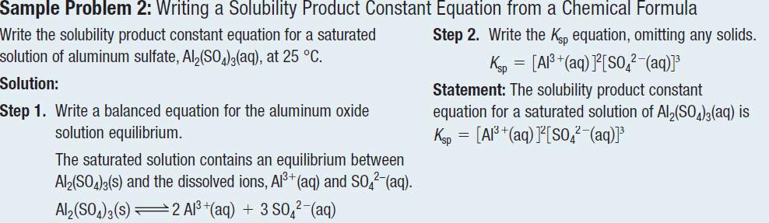

Slide 48
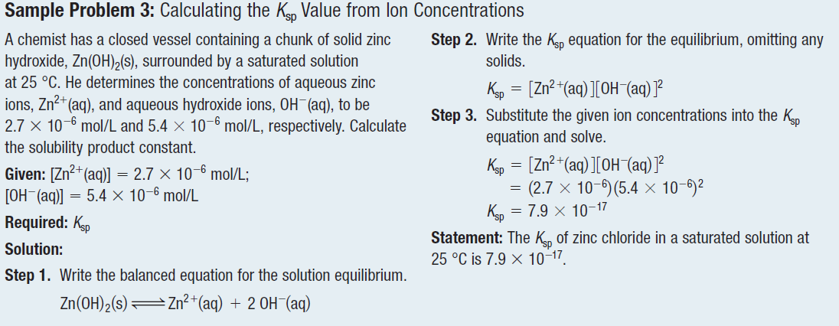

Slide 49
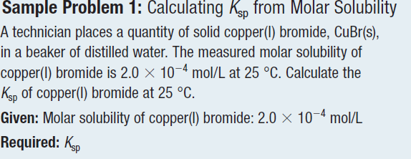
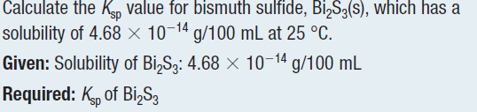

Slide 50
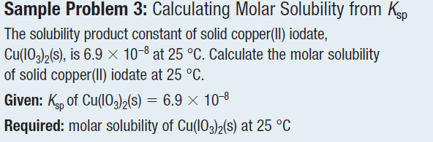

Slide 51

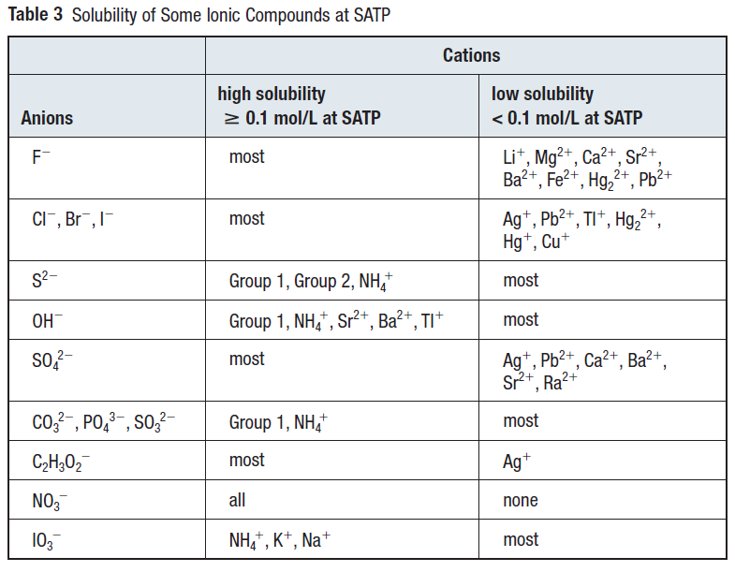

Slide 52


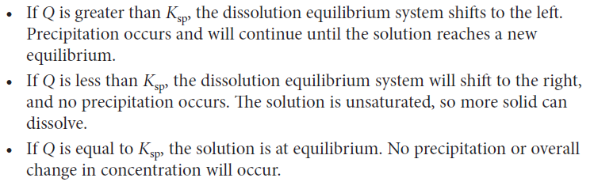
trial ion product (Q) the product of
the concentrations of ions in a specific
solution raised to powers equal to their
coefficients in the balanced chemical
equation; can be used to predict the
formation of a precipitate

Slide 53
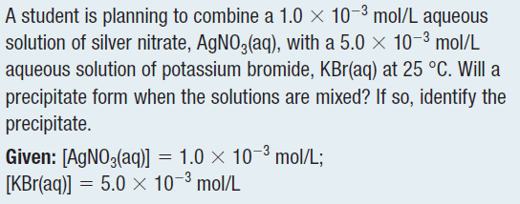
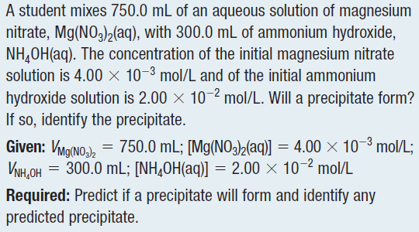

Slide 54

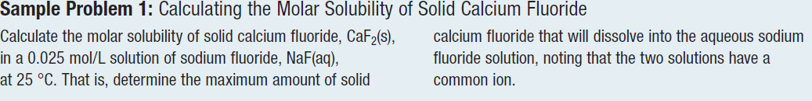
common ion effect a reduction in the solubility of an ionic compound due to the
presence of a common ion in solution

Slide 55


