Slide 1

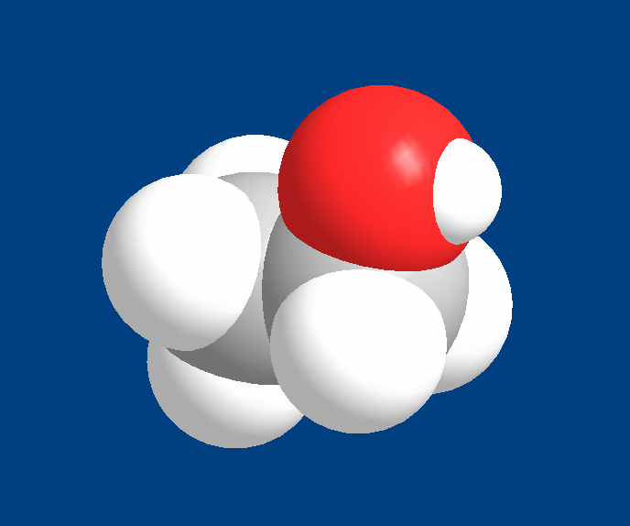


is produced in nature by
Grain alcohol
yeast
and other primitive
in a process called
organisms
fermentation

Slide 2
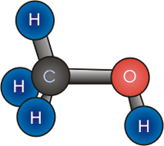
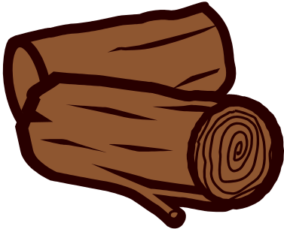
Wood alcohol
was first made from
wood

