Slide 1
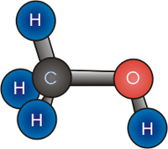

Methanol
has a slight
fruity odour

Slide 2


Methanol
is a colourless
liquid
at room
temperature

Slide 3

methanol
The density of
is less than
water

Slide 4


Methanol
is
poisonous
and if ingested can cause
blindness

Slide 5



Methanol
is a neutral
solution
and shows negative
results
tests
for all acid

