Slide 1
Gurgaon Property Market
Pricing signals, premium segments and commercial decisions
14,223 unique listings after deduplication | Prepared 05 Sep 2026

Slide 2
Executive readout
The market is segmented: location and luxury product dominate headline prices.
₹122.63 Cr
Sector 42
Costliest listing
Highest locality average
6 BHK DLF Camellias, Sector 42
₹50.24 Cr across 60 listings
₹55,989
+5%
Highest locality rate
Ready vs under-construction
Average listed rate / sqft
Average price: ₹4.15 Cr vs ₹3.96 Cr
Property market analysis | 2

Slide 3
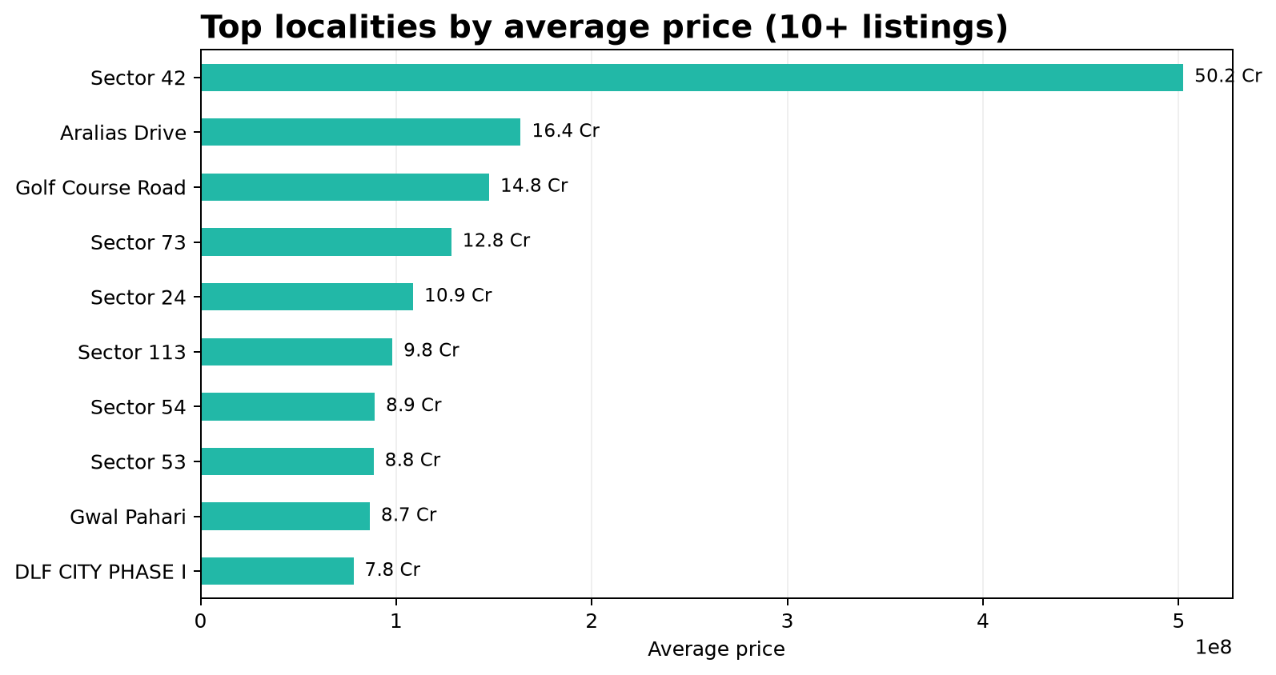
1 | The costliest flat is a clear luxury outlier
₹122.63 Cr
6 BHK Apartment in DLF Camellias
Sector 42 | 16,500 sqft | ₹74,323 listed rate / sqft
Ready to move | Not approved by RERA
Builder: Provident Capital | Company: DLF
Decision: treat luxury listings separately from mainstream benchmarking.
Property market analysis | 3

Slide 4
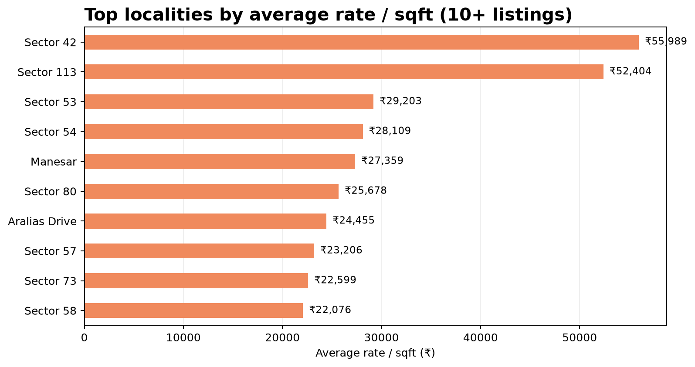
2–3 | Sector 42 leads both price and rate
Recommendation: use Sector 42 as the luxury benchmark, but require sample counts before generalizing.
Property market analysis | 4

Slide 5
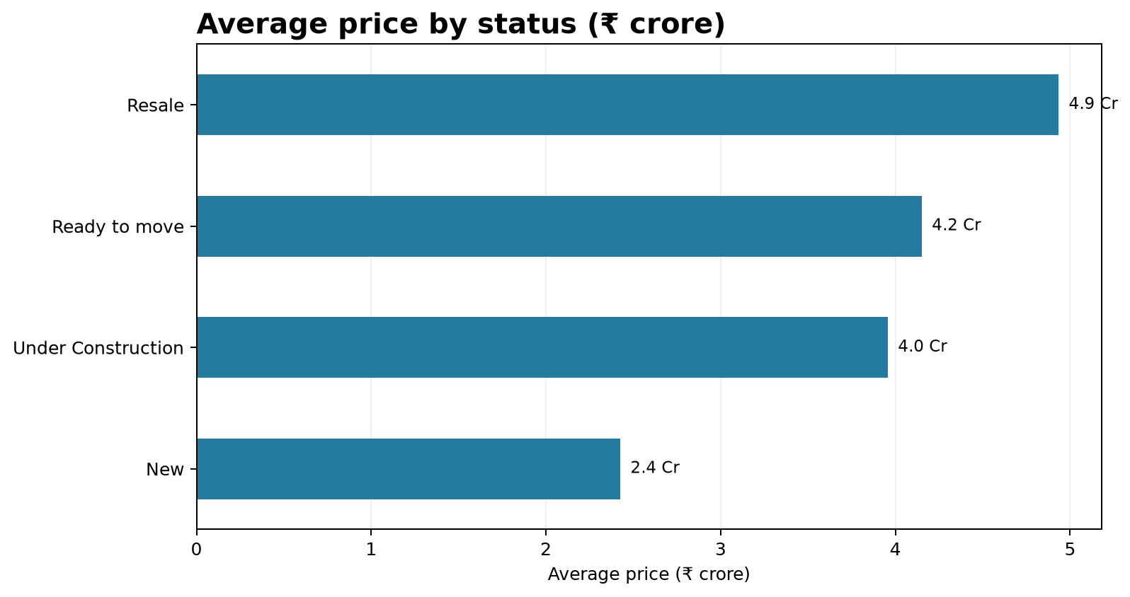
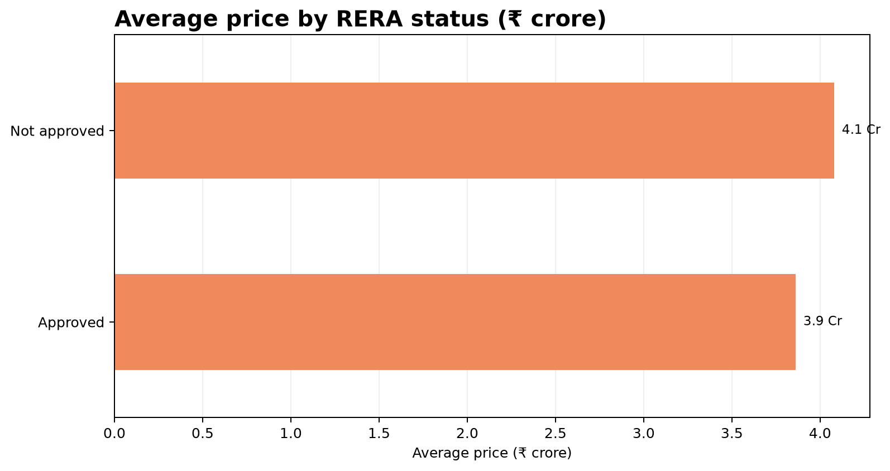
4–5 | Status shows a small ready-to-move premium; RERA does not
Ready-to-move avg: ₹4.15 Cr vs under-construction: ₹3.96 Cr (+4.9%). RERA-approved avg: ₹3.86 Cr vs not approved: ₹4.08 Cr (-5.4%).
Property market analysis | 5

Slide 6
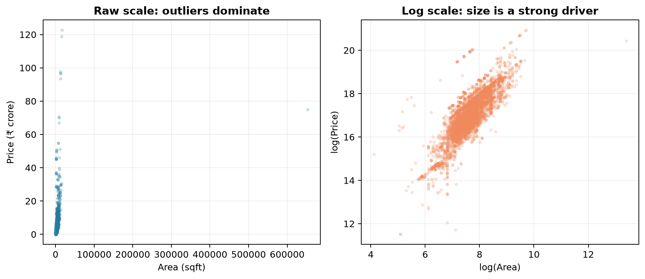
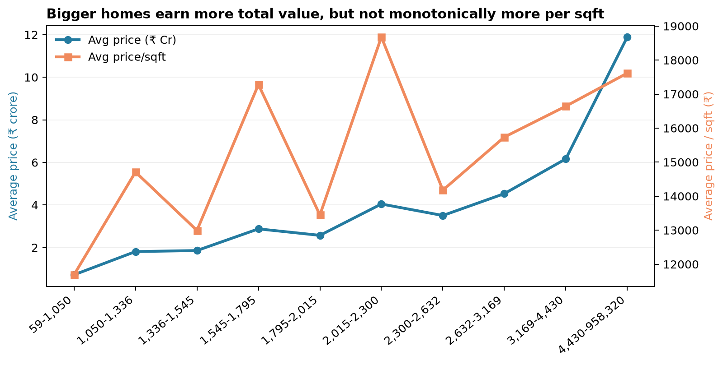
6 | Area raises total price, but the relationship is non-linear
Raw correlation: 0.197; log-scale correlation: 0.804.
The log view is more informative because ultra-large plots and luxury homes distort the raw scale.
Use area as a core pricing driver, but model location, product type and segment alongside it.
Property market analysis | 6

Slide 7
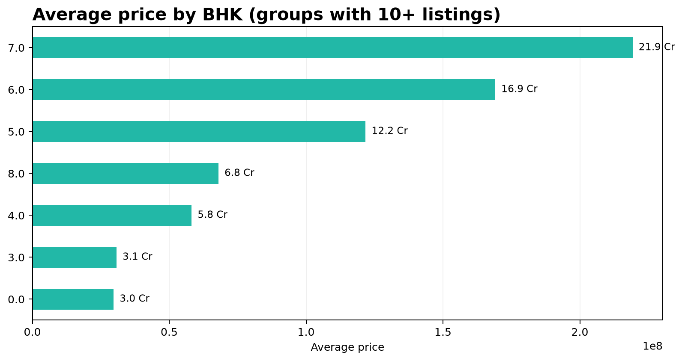
7 | Larger BHK configurations command the highest averages
7 BHK leads at ₹21.93 Cr average
7 BHK has the highest average, but only 16 listings.
6 BHK is the stronger luxury signal with 89 listings.
Decision: target 4–6 BHK premium inventory; treat 7+ BHK as a low-volume niche.
Property market analysis | 7

Slide 8
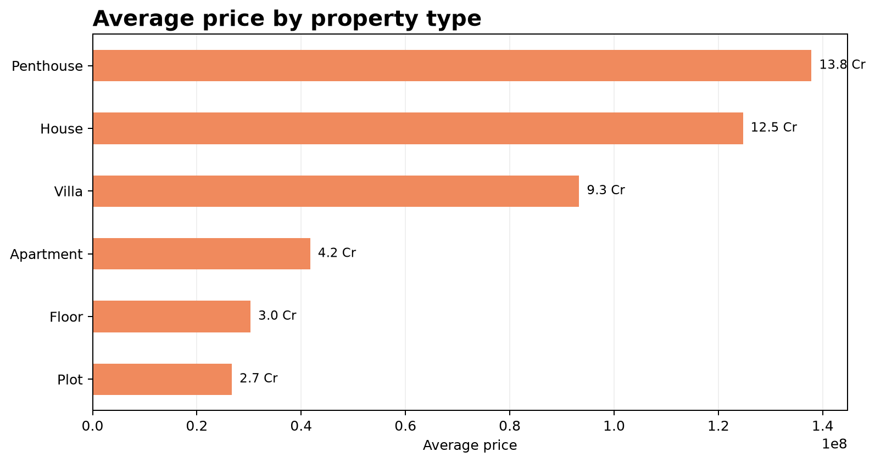
8 | Penthouse is the costliest property type; apartments drive scale
Penthouse: ₹13.78 Cr average, but only 32 listings.
Apartment: ₹4.17 Cr average across 10,894 listings.
Decision: separate premium inventory from mass-market volume in pricing and marketing dashboards.
Property market analysis | 8

Slide 9
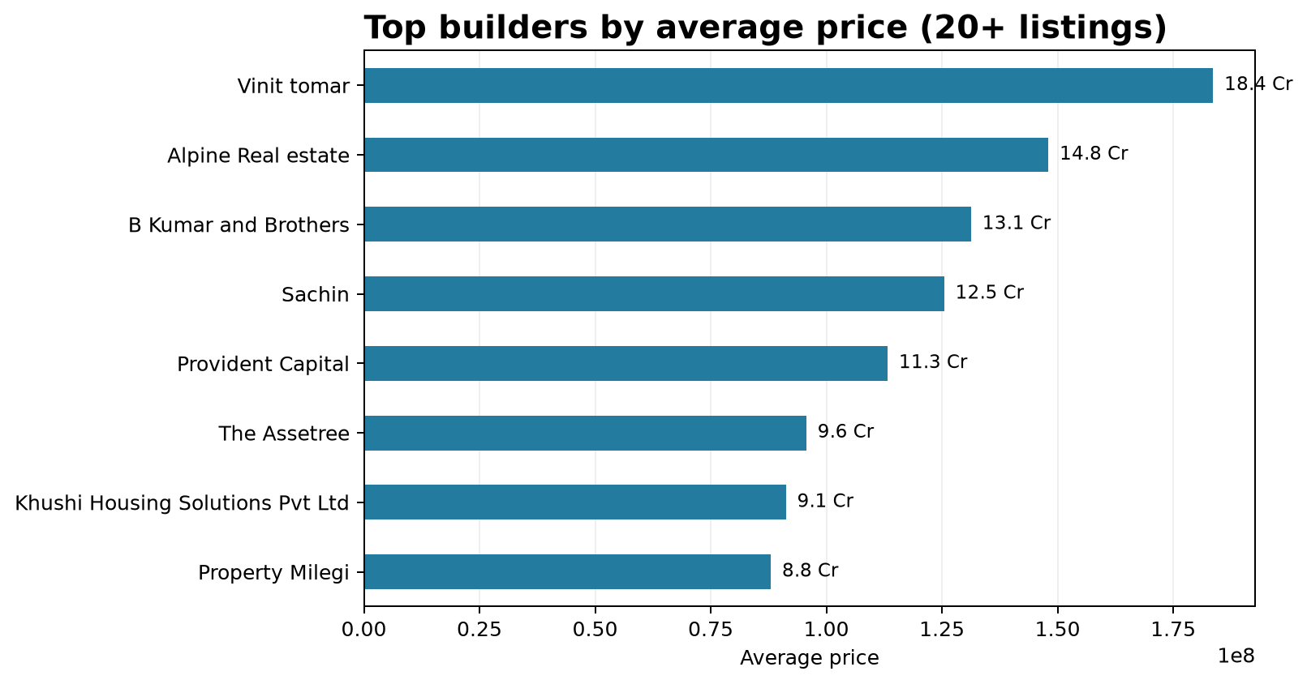
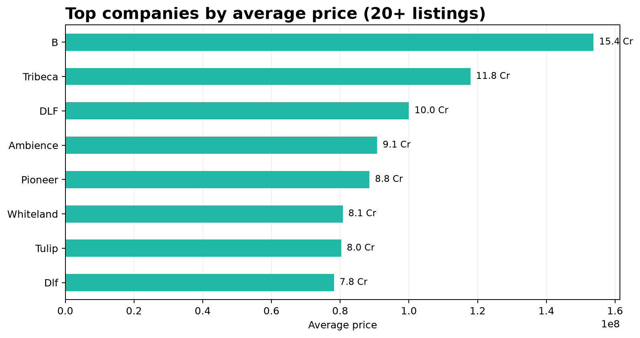
9 | Some builders and companies price higher—but mix matters
Use builder/company as a premium signal, not a causal claim: high-end inventory mix can explain much of the gap.
Property market analysis | 9

Slide 10
10 | Larger homes are not always more expensive per square foot
Answer: No
Average price / sqft rises and falls across area deciles.
Product type and location can outweigh size: premium smaller homes can command high rates.
Price on total value for portfolio decisions; use rate / sqft for apples-to-apples comparisons.
Property market analysis | 10

Slide 11
Decision playbook
Translate the data into pricing, targeting and governance actions.
1
Segment first
Separate luxury (Sector 42 / 5–7 BHK / penthouse) from mainstream inventory before benchmarking.
2
Price with multiple drivers
Use area + locality + BHK + property type + builder/company; do not rely on area alone.
3
Avoid RERA overpricing assumptions
This sample shows no positive RERA price premium; validate with like-for-like comparisons.
4
Use rate / sqft carefully
Rate is useful for comparability, but it is not a monotonic function of home size.
Bottom line: premium pricing is primarily a location-and-product story, not simply a size or RERA story.
Property market analysis | 11

Slide 12
Methodology and caveats
Source: market_data.csv; 19,515 raw rows reduced to 14,223 unique listings after exact-duplicate removal.
Price and rate fields were parsed from text; price / sqft was calculated as Price ÷ Area.
Locality, builder and company comparisons use at least 10 listings for locality and 20 for builder/company.
BHK groups with fewer than 10 listings are excluded from the ranked comparison; averages are sensitive to luxury outliers.
Associations are descriptive, not causal; a like-for-like regression or matched comparison is the next step.
Property market analysis | 12

