Slide 1
JARPEB
CVS Setup and Operation
Dr. Diomidis Spinellis
Assistant Professor
dds@aueb.gr
AUEB - Department of
Management Science and Technology

Slide 2
Setup under Windows
Download and install CVS client
  http://ftp.cvshome.org/win32/cvs-1-11-5.zip
Download ssh clients
  http://www.chiark.greenend.org.uk/~sgtatham/putty/
  plink.exe
  putty.exe
  pageant.exe
  puttygen.exe

Slide 3
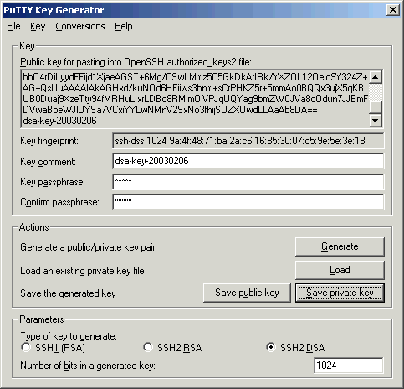
Create public keys
Run puttygen
Select ssh2 dsa
Press Generate
Enter passphrase
  Used to protect your keys
Save private key
Copy public key to clipboard

Slide 4
Copy public key to server
C:\>plink username@istlab.dmst.aueb.gr mkdir .ssh
Password:
C:\>plink username@istlab.dmst.aueb.gr cat ">.ssh/authorized_keys2"
Password:
ssh-dss AAAAB3NzaC1kc3MAAACBANyQNB3vXSOCFpQQ2KbE3VHyrdCOk92FEno8+30tZ6s8TNs2wUX/
PSjo4PxiombaQnKtNUuOQvF9Yfcy094xoKd84PN60h1k7K+731Y3h/QmGwesy3o9Y72nhbd9kxdCReV1
KGSFaMCLw8F7zlZDjq6+m2UxotxUo/olW9Ux781TAAAAFQDg7A/WEInDPS/QytKqdjzXxdPOLQAAAIA2
UXL0xOFM0VVoPkI3K+sQMuUl6yTDQk6EmVg9ZCQ3dKzcHka08Vm/BZ1ouVV38CBdJGFOL9otXHvdDSey
Fsn2IJ3/zE09isbbO4rDiLyydFFijd1XjaeAGST+6Mg/CSwLMYz5C5GkDkAtIRk/YXZOL12Oeiq9Y324
Z+AG+QsUuAAAAIAkAGHxd/kuNOd6HFiiws3bnY+sCrPHKZ5r+5mmAo0BQQx3ujX5qKBUB0Duaj9XzeTt
y94fMRHuLIxrLDBc8RMimOiVPJqUQYag9bmZWCJVa8cOdun7JJBmFDVwaBoeWJlOYSa7VCxiYYLwNMnV
2SxNo3fhijSOZXUwdLLAaAb8DA== dsa-key-20030206
^Z

Slide 5
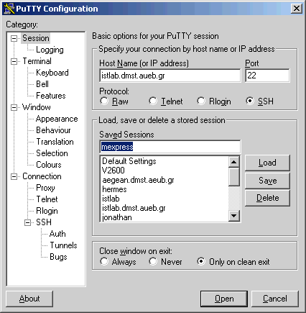
Setup ssh connection (1)
Run putty
Session details
  istlab.dmst.aueb.gr
  Protocol ssh
  Saved sessions:
    istlab

Slide 6
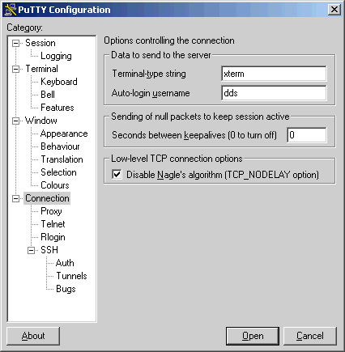
Setup ssh connection (2)
Connection
  Auto-login username
  Your user name

Slide 7
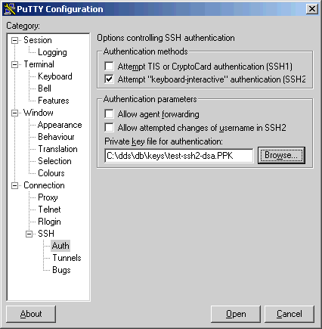
Setup ssh connection (3)
Set ssh authentica-
tion parameters
Specify the private key you saved
Finally, return to session and
save it using the istlab name
Close

Slide 8
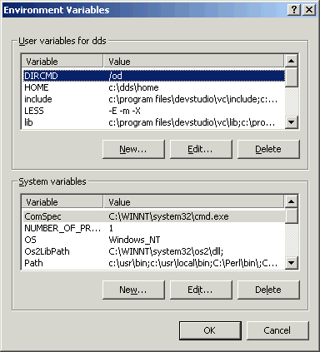
Setup environment variables
  set CVSROOT=:ext:istlab:/home/dds/cvsroot
  set CVS_RSH=C:\mypath\plink.exe
  You may specify these in:
    autoexec.bat
    Control panel –
    system properties –
    advanced
    - environment variables

Slide 9
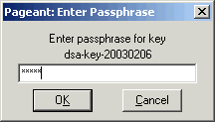
Before using CVS
Run pageant on your private key
  pageant mykey-ssh2-dsa-priv.PPK
  Enter the passphrease used to protect your private key
  This is the only password you need to enter
  You may arrange for pageant to be run from the Startup menu

Slide 10
Short CVS Tutorial
First time through:
  cvs co jarpeb
After adding a file or directory
  cvs add filename
When your changes / additions should be released
  cvs commit
To retrieve a fresh copy
  cvs update
To see a file’s history
  cvs log filename

Slide 11
Other resources
CVS plugins and graphical front ends
  http://www.loria.fr/cgi-bin/molli/wilma.cgi/rel
Documentation
  http://www.loria.fr/~molli/cvs-index.html
Home page
  http://www.cvshome.org/

