Slide 1
Java Logging Standards
Istvan Fodor

Slide 2
Overview
Terminology
Logging Architecture
Example Use Cases

Slide 3
Terminology I
Logging Level / Log Level
Levels let us control the detail of our logging. Typically 5 levels: trace, debug, info, warn, error.
Message priority increases from trace to error: for example when we set a global log level to info, we want to see info, warn and error level messages.
Slf4J example:
log.info(”Application startup finished at {}”, new Date());

Slide 4
Terminology II
Configuration
The configuration defines what log messages get logged (logger) and where (appender) and what gets ignored.
Most libraries use a file that gets read from the root of the classpath on application startup. Programmatic configuration is also possible, but not recommended, as that is a lot harder to change once the application is deployed.
Logback: logback.xml
Log4J2: log4j2.xml, log4j2.json, log4j2.yaml

Slide 5
Terminology III
Logger
Created in Java, configured in the configuration file.
On the Java side it provides the entry point for logging. On the configuration side we get to configure the output format, logging level and other features.
Appender
Defined in the configuration, works as a sink, that writes messages to a particular target (console, file, email, database, etc).
Most of the message customization is in appenders, such as format, filters, additional logged variables, etc.

Slide 6
Architecture I
Modern logging = Facade + Implementation + Configuration + Aggregator

Slide 7
Architecture II
Modern logging = Facade + Implementation + Configuration + Aggregator
Let’s consider only the first 3 for now.

Slide 8
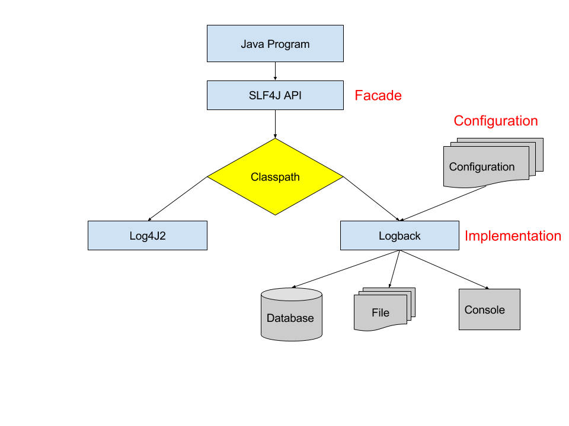
Architecture III

Slide 9

Examples

Slide 10
Examples - Setup
Clone from Github: https://github.com/istvan-fodor/logging-examples
If you look at TestLogging.java, you will see that logging features are demonstrated in individual JUnit4 test methods.
Run src/test/resources/run-docker.bat (If you don’t have Docker installed, get it here.)
Run “mvnw clean test” to see if everything works. You should see “BUILD SUCCESS”.
We will go over individual test cases.

Slide 11
Examples – How and what I
To run individual tests from command line:
mvnw clean test –Dtest=TestLogging#<test name>
Tests:
testLevels: shows different logging levels and when they get displayed
Tip: Change the level on <logger name="com.ifodor" level="INFO" /> to TRACE
testBigObject: shows why you should use substitution instead of concatenation and why you should avoid toString() in log message parameters
testMdc: demonstrates Mapped Diagnostic Contexts. Observe the log messages (callerId = ?)

Slide 12
Examples – How and what II
Tests:
testMdcFile: demonstrates file logging into separate files based on MDC values
Tip: check the target/logs folder. Uncomment the Stream and run the test again. Check the target/logs/archive folder too!
testDatabase: demonstrates the DBAppender (logging to a database! .. Its in the computer!)
Run the Postgres Docker container (README.md), connect with root/password to localhost. Run select * from logging_event.
Tip: we are logging to HSQLDB too! Open target/db/logs.script, see the inserts on the bottom.
Tip: See how we initialized the 2 databases with DDL scripts in init(). You would only run this once in a real life scenario.

Slide 13
Resources
https://logback.qos.ch
https://www.slf4j.org
https://logging.apache.org/log4j/2.x/
Log aggregation: https://www.elastic.co/webinars/introduction-elk-stack

