Slide 1
Digital Portfolio
STUDENT NAME:ISWARYA S
REGISTER NO AND NMID: 24131130500122004/asanm11324131130500122004
DEPARTMENT: BCA
COLLEGE: 113-Vallalar Arts and Science College,Annamalai University

Slide 2
PROJECT TITLE DIGITAL PORTFOLIO

Slide 3


AGENDA
Problem Statement
Project Overview
End Users
Tools and Technologies
Portfolio design and Layout
Features and Functionality
Results and Screenshots
Conclusion
Github Link
3/21/2024 Annual Review

Slide 4

PROBLEM STATEMENTS: Traditional resumes cannot fully demonstrate a student’s creativity and practical work. A digital portfolio helps to visually and interactively display their abilities to recruiters or academic institutions.

Slide 5

PROJECT OVERVIEW: Today’s competitive environment, students rely heavily on traditional resumes to present their qualifications. However, resumes are often limited to text-based information, which fails to highlight a student’s creativity, practical projects, and hands-on experience. This creates a gap between what students can do and what recruiters or academic institutions are able to perceive from their applications. To bridge this gap, a digital portfolio provides a dynamic platform that allows students to showcase their skills, projects, and achievements in an interactive and visually appealing manner. This not only enhances their visibility but also improves their chances of academic and career opportunities.

Slide 6

END USERS: 1. Students / Job Seekers: They create and maintain their digital portfolios to showcase skills, creativity, and achievements. 2. Recruiters / Employers: They review the portfolios to evaluate candidates beyond traditional resumes. 3. Academic Institutions / Faculty: They assess student projects, learning outcomes, and overall progress.

Slide 7

Tools and Technologies: Front-End Development Tools: 1.HTML5, CSS3, JavaScript: For designing the structure, style, and interactivity of the portfolio. 2.React.js / Angular / Vue.js: For building dynamic and responsive user interfaces. 3.Bootstrap / Tailwind CSS: For responsive design and faster UI development. .

Slide 8
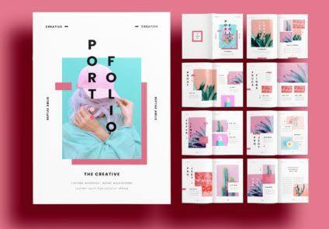
POTFOLIO DESIGN AND LAYOUT:
8

Slide 9
FEATURES AND FUNCTIONALITY: 1. User Profile Management: * Students can create and manage their personal profiles. * Add details like name, photo, contact info, career objectives, and education background.

Slide 10
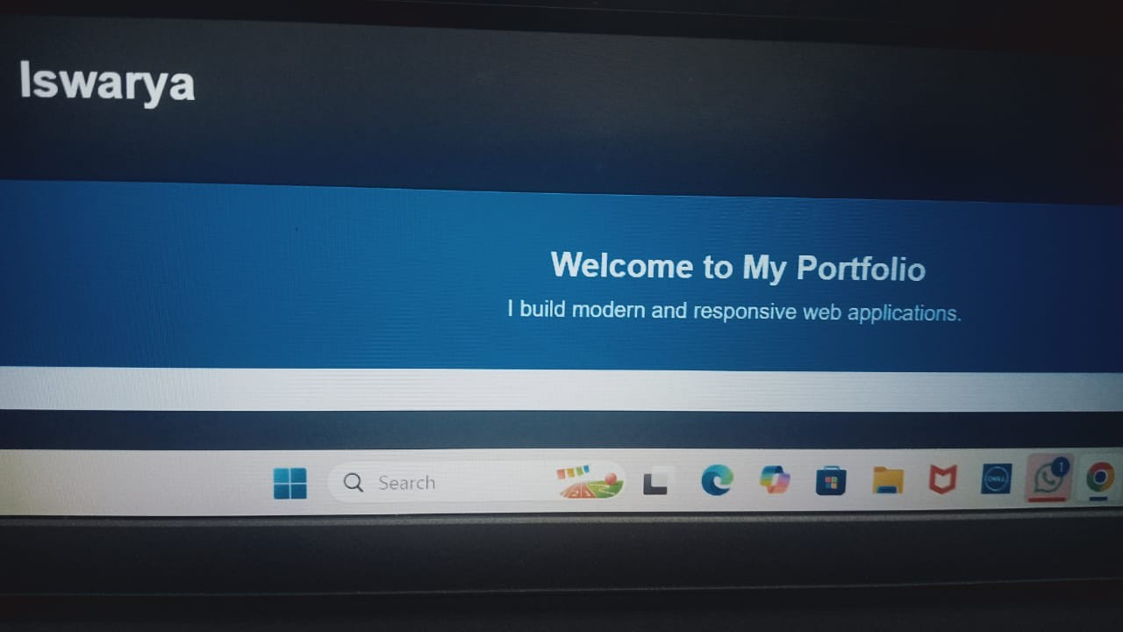

RESULTS AND SCREENSHOTS:
The proposed digital portfolio system was successfully developed and implemented. It provides students with an interactive platform to showcase their academic achievements, skills, and projects in a structured and visually appealing way.
3/21/2024 Annual Review
10

Slide 11
CONCLUSION:
A digital portfolio's conclusion is a reflective piece that summarizes your
overall learning journey, growth, and key insights gained throughout the creation process.
11

