Slide 1
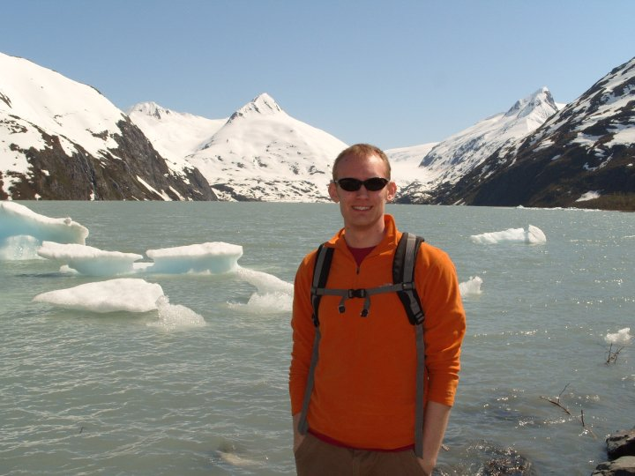
David Kochevar
Alumni of the Month

Slide 2
What does your job entail?
I'm a General Forecaster at the NWS Forecast Office in Anchorage, AK. In my job I issue public, marine and aviation forecasts, as well as any Watch, Warning. or Advisory products in our Area of Responsibility. This area covers southern Mainland Alaska, the Aleutian Islands, as well as much of the Bering Sea and Gulf of Alaska. I am also an aviation focal point where I follow policy, work with TAF verification, and participate in outreach events with the aviation community.

Slide 3
What did you get out of the ISU AMS?
I first visited an NWS office while with the ISU AMS. It was after this visit that I decided to volunteer at the Des Moines office as a junior, which was critical to obtain my first job in the NWS. I also used my affiliation with the ISU AMS two attend AMS national conferences as a student assistant, which was a great way to meet others in a more professional capacity.

Slide 4
What do you think everyone should get out of ISU AMS?
I think ISU AMS is a great resource for students to meet others in the department early in their college careers, who may not necessarily be in their classes. This is beneficial not only for underclassmen to be helped by upperclassmen with their tough courses in the first few years of the program, but also to develop relationships with fellow students with similar interests (both personally and professionally). I also think students will get alot out of participating in ISU AMS outreach events. This is an activity most students will be asked to do at some point in their careers. Having prior knowledge on how to plan, set up, and run these events can be very beneficial in the long run.

Slide 5
Any other advice for undergraduates?
While planning your career and setting goals is very important, it is equally important to keep your mind open to other options when they become available. This was one of the big lessons I learned early in my career. While I still keep many of the interests I had professionally upon graduation, my strongest interest and where I bring the most expertise to my office (aviation) is a topic that I had very little knowledge of prior to moving to Alaska. Don't be afraid to try something new!

