Slide 1
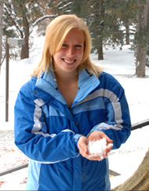
Alumni of the Month
JoBeth Minniear

Slide 2
What is your job currently?
I'm currently working as a Quality Assurance Engineer at Bechtel Power Corporation in Frederick, MD. In this position, I make sure people are following procedures and guidelines for nuclear, renewable, and fossil power plants, as well as transmission lines.

Slide 3
How Has the ISU AMS Helped You After Graduation?
Through my different positions in the AMS, I learned how to speak well in front of an audience. The club also helped hone my leadership skills.

Slide 4
Any Advice About the Meteorology Program?
My advice would be to learn as much as possible. Take as many classes as possible in areas that interest you, even those outside of meteorology. Even if a meteorology class doesn't sound extremely exciting, take it. Learn about it. It could open your eyes to an area of meteorology you didn't know about and want to know more about. You never know what information will be useful in a future job, so use your time now to learn as much as possible.

Slide 5
What is your favorite part about your current job?
There are so many things I love about my job! I meet new people daily through my work, and I also will be traveling both domestically and internationally starting early 2013. I enjoy learning new things about all the aspects of engineering that go into a power plant. I also get to play around with a lot of interesting software.

Slide 6
Contact Information
jominnie11@gmail.com

