Slide 1
AMS Alumni of the Month
Nick Carletta

Slide 2


Slide 3
My job is Graphics:
So I use a GIS software program to generate maps to convey various types of weather information and write some text products.
My duties are:
Surface analysis of US, Canada, Atlantic, Pacific, South America, Europe, Mexico, and Asia
Surface front forecasts for the entire world 24, 36, 48, and 60 hours out (US also has days 3-5).
Travel Hazards (fog, snow, high wind).
High Impact (rain, tropical storm, high wind, heat, snow, ice/ fzra)
Maps similar to spc convective hpc flash flood, and cpc climate outlooks.
Text forecasts for Spain, South Carolina, and Ontario, Canada.
Forecast jets

Slide 4
Q: What are the pros of working in the private sector compared to working a government job such as the NWS?

Slide 5
A:
“You can work in larger groups than a WFO, Telvent has approx 40-50 mets.
You can specialize in specific industries, Telvent has customers in the aviation, professional sports, energy, and transportation industries. Some clients include Tampa Bay Buccaneers, Minnesota Twins, Chicago White Sox, Ohio State University, Iowa DOT, MN DOT, and many others. While for the NWS they have to make general forecasts and issues for warnings for their whole CWA and a station has to forecast for their entire viewing area. For private sector you can forecast specifically for say Target Field.”

Slide 6
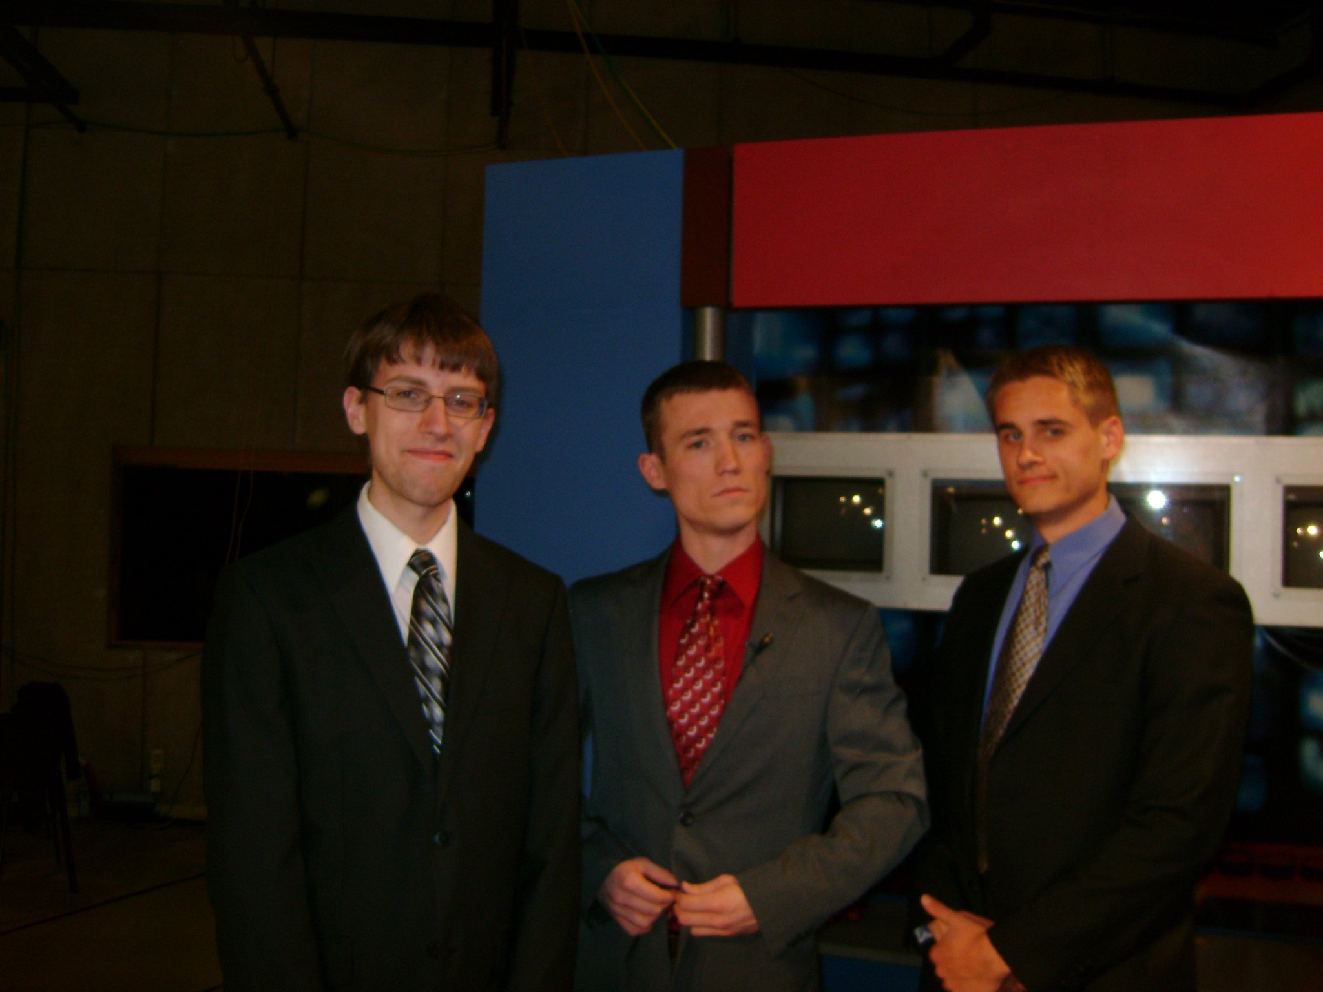

Slide 7
Q: What are some cons associated with the job?

Slide 8
A:
“Job is dependent on contracts so new contracts= new employees and losing contracts= furloughs, pink slips, ect.
Supply is higher than demand right now for private sector jobs so starting and mid level pay is not as good as a government job but if you can get up the corporate ladder you can make much more.”

Slide 9


Slide 10
Q: How did you end up in the private sector?

Slide 11
A: “Telvent gives out 1 or 2 internships every summer for graduating seniors. I found out about this by going to the AMS Conference in Seattle, WA where they had a booth. So I highly recommend going to conferences and meeting with people with or without a job fair. At a conference you could meet your future boss! Also if you are a national member of the AMS in the back of BAMS they have a list of meteorology companies under Corporate and Institutional Members so you can get a list of companies to contact to look for a job.”

Slide 12


Slide 13
Q: What advice would you give to aspiring young meteorologists who wish to succeed in this field?

Slide 14
A: “Be outgoing and make the first step. The number one reason why I landed the internship was that I took the initiative to ask for a tour of the office. As mentioned previously conferences are helpful. If you want to be in operational meteorology make sure to practice so be active in forecast contests. Also there is a reason why we do analysis in 311/411/417 since I do it 2-3 times a day. We do have a program to plot the isobars for us though, we just draw the fronts, highs, lows, and troughs. In the end be outgoing and make sure to practice forecasting because if you know some of their tools already such as the model animator that is one less thing for them to teach you. Also volunteer at the NWS if you want to be in operational meteorology even if you do not want to work for the NWS.”

Slide 15


Slide 16
Q: What are some details about the company you work for?

Slide 17
A: “The Burnsville, MN weather office has been a part of many companies through the years. Currently it is a part of Telvent which was recently acquired by the French company Schneider Electric. Schneider is basically Europe's version of General Electric. Telvent is an information company that provides data for a variety of purposes. The weather group is in the environment vertical of the company. I detailed meteorology operations pretty well in the pros above. Here is the website if people wish to learn more http://www.telvent.com/en/business_areas/environment/.

Slide 18


Slide 19
Contact Information!
Cell: 651-210-8776
E-mail: ncarlett@gmail.com

Slide 20
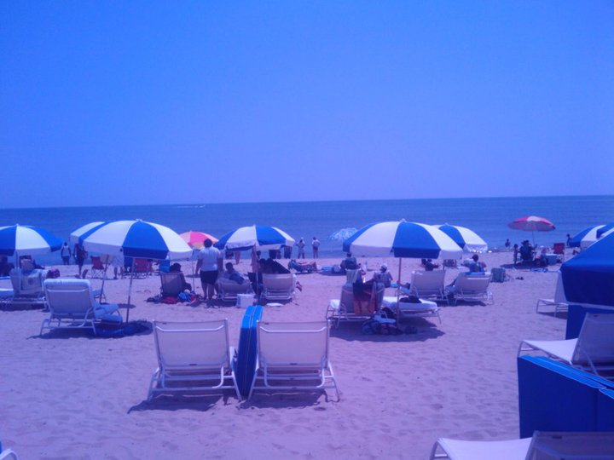
Hampton VA – where Nick did his REU

