Slide 1
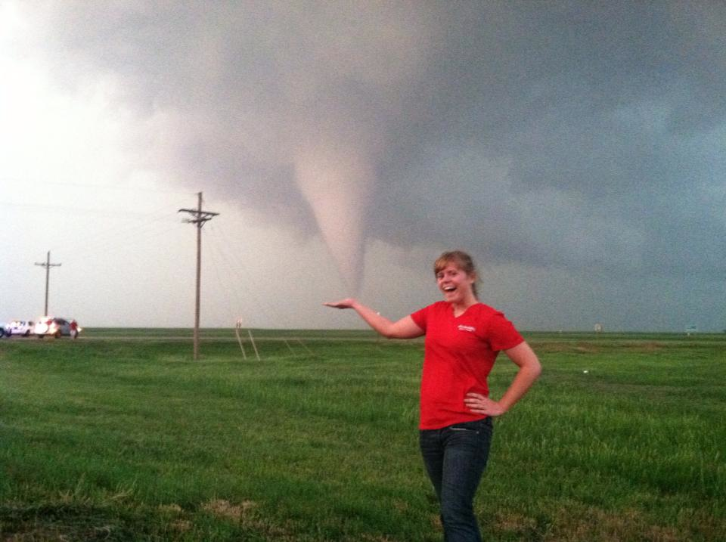
Alum of Month Brittany Peterson
I'm currently a 2nd year graduate student working towards my master's degree in atmospheric science at the University of North Dakota in Grand Forks, ND. I'm also in my second year of a teaching assistantship. This year I'm the lab coordinator for our equivalent of ISU's Meteorology 206 class, so I'm in charge of the other TA's as well as teaching two sections myself.
I'd say to get involved and really enjoy your undergrad experience. Really get to know your classmates and upper/underclassmen. ISU AMS is like a family. They'll help you get through the difficult classes (dynamics, calculus, physics, etc.), be your chasing buddies, and encourage you as you go into the job market, graduate school, etc!
I'd also encourage people to follow what they're passionate about. You don't have to fall in love with every meteorology class for it to be the right field for you. You'll find your niche, whether it's that you love tornadoes, blizzards, broadcasting, forecasting, research, a combination, etc.

