Slide 1
AMS Alumni of the month
Rachel Hatteberg

Slide 2
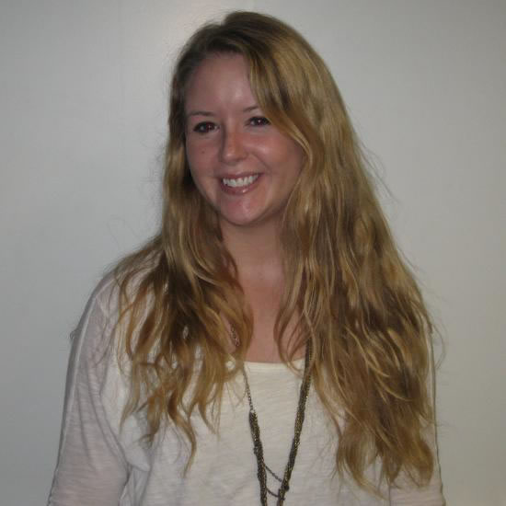

Slide 3
Q: What made you want to attend graduate school?

Slide 4
A: “I never considered graduate school until my senior year while working on my senior thesis with Dr. Takle and came to the realization that I enjoyed doing research.”

Slide 5
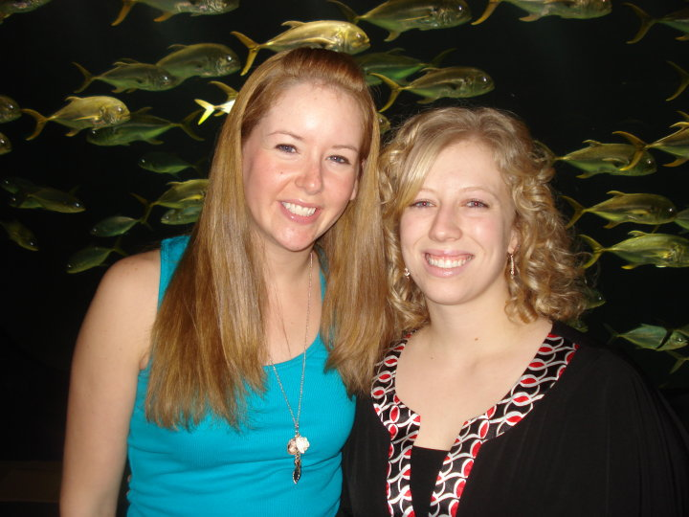

Slide 6
Q: What was the process of getting into grad school like?

Slide 7
Knew interests
E-mailed professors with similar interests from desired schools:
Introduce yourself
Ask them for details about their current research
Inquire whether they will have funding to hire a new student
Tell them about what research you have previously done

Slide 8
Q: Did you apply anywhere else?

Slide 9
Applied to University of Wisconsin – Madison, and University of Alaska – Fairbanks.
Decided to stay in Iowa because of SCEP offer with the NWS and because of the great program here

Slide 10
Q: What kind of research work do you do?

Slide 11
Look at various Regional Climate Models and analyze their ability to simulate both high and low-end winds.
Inspired from my senior thesis that looked at models’ capabilities to simulate derechos in the Midwest.
We also have been looking at model-calculated near-surface wind speed climatologies for the Midwest as well as analyzing their temporal trends through the year 2070.”

Slide 12
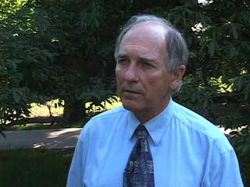

Slide 13
Q: What is it like working for the National Weather Service?

Slide 14
Worked part time at the NWS in Des Moines for a year and a half now
I work several days a week, usually from 4:00 pm to midnight or from 6:00 am to 2:00 pm.
Forecaster training with severe weather, winter weather, aviation, as well as participating in outreach events like spotter talks in the spring.”

Slide 15


Slide 16
Q: Any other useful information?

Slide 17
A: “If you are interested in operational meteorology, I highly encourage you to apply as a volunteer or SCEP at an NWS office. Don’t feel restricted to just volunteering in Des Moines; Chanhassen also has a great program for students. Visit http://www.crh.noaa.gov/dmx/?n=students for more information and contact information.”

Slide 18
Contact Information
E-mail address: rah@iastate.edu

