Slide 1
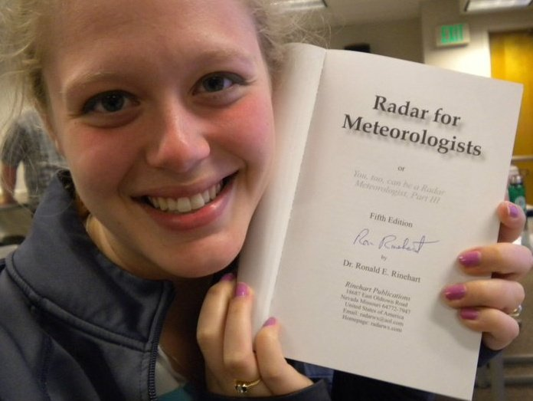
Alumni of the Month
Sam Tushaus

Slide 2
What was your favorite part of being in the ISU AMS?
Getting to know people the first few years--most of my best friends are ISU meteorologists
Race for the Cure!
Fall/spring dinners/picnics

Slide 3
What has the ISU AMS taught you?
Teamwork is key
Networking is also key! Go to meetings if you can. I met my Ph.D. adviser at a conference and chose him because of his work that was presented at AMS last January.
Being involved = lots of fun + getting to know peers and professors. Those connections are invaluable as you move through undergrad and out into the real world...or put off the real world and go to grad school :)
Apply for all the scholarships and fellowships you can--you'll be surprised at the number of opportunities out there if you're willing to travel and explore different areas of meteorology.

Slide 4
What are you doing after graduation, and how did you get interested in your field?
I've always loved the weather and wanted to know why it worked. I've also always liked all types of math and science. When I found out meteorology combined all of those things, it was easy to choose that as a major!
I am in the atmospheric science Ph.D. program at the University of Michigan, which typically lasts 4-5 years if you come in straight from undergrad. Due to a heavy course load, I haven't been able to do much in the way of research. When I start, I'll be using dual-polarization radar throughout the Great Lakes to analyze winter precipitation systems.
After grad school, I hope to teach meteorology at the collegiate level. Other than that...I don't really know, I suppose I'll see what comes along as grad school winds down :)

Slide 5
Any tips concerning academics, college life, etc...?
Be a part of AMS and other campus organizations, because it's harder to do so after undergrad--you get a lot busier.
Go to conferences! They're awesome, and they help you figure out what you want to do with your life after college.
You have to be smart and hardworking to get through the meteorology program at ISU, which means all of you reading this have great potential. Don't be afraid to try an internship that's a bit outside your comfort level--if you like hurricanes but you want to try researching cloud microphysics, do it! Or if you're a broadcaster who wants to give research a shot, go for it!
Make sure you enjoy what you're doing, since it's going to be for the rest of your life.

Slide 6
Contact Information
sam.tushaus@gmail.com
http://www-personal.umich.edu/~ssanteiu

