Slide 1
ALUMNI OF THE MONTH
SEAN STELTEN

Slide 2
Questions asked
1. Name one of your fondest memories made at Iowa State.
Would have to be a tie between being in band when we beat No. 2 ranked Oklahoma State in football to go to a bowl game my sophomore year and seeing one storm spawn 7 different tornadoes in one night my freshman year (one of which was a mile wide EF4).
2. What were the classes you struggled the most with as an undergrad?
DYNAMICS. Also, any lower level humanities course, because they were so easy that I always forgot about assignments....
3. Who is your favorite faculty member at Iowa State?
Geez, loaded question..... so....... ALL OF THE METEOROLOGY FACULTY!!!!!!!!!!!!!!!!!!!!!!!!!! Also as for non-departmental faculty, Dr. Richards, associate director of bands my junior/senior year.

Slide 3
Questions asked (continued)
4. What general advice would you give to meteorology majors about grad school?
Assuming you get some sort of assistantship (teaching or research), don't get too comfortable with your money. For example, even though a TA position at Iowa State pays ~$1500 a month (after taxes), you only get paid once a month. So it disappears VERY quickly.
5. Name the AMS event that you had the best experience at as an undergrad.
AMS National conference in Austin, TX.

Slide 4
PICTURES OF THE MONTH

Slide 5
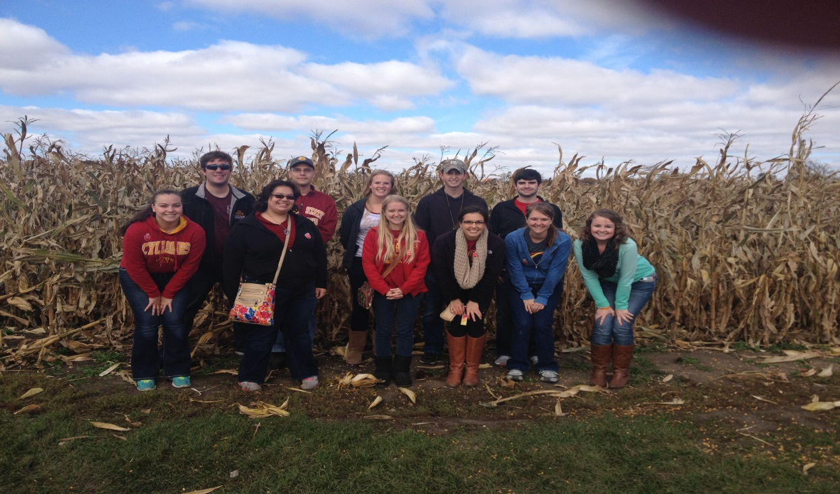
OPTION #1

Slide 6
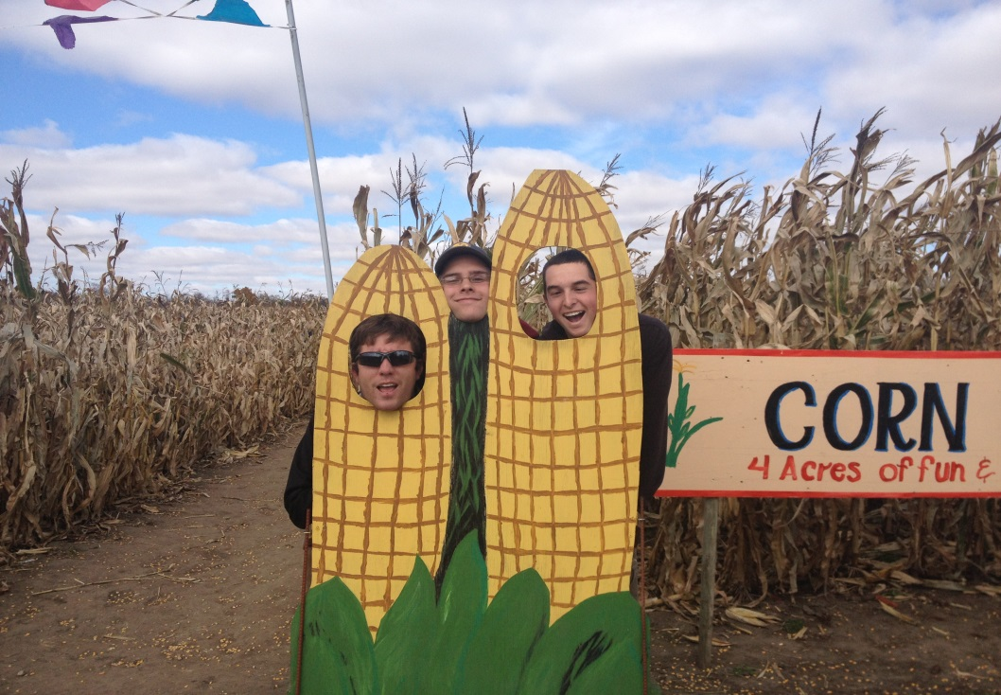
OPTION #2

Slide 7
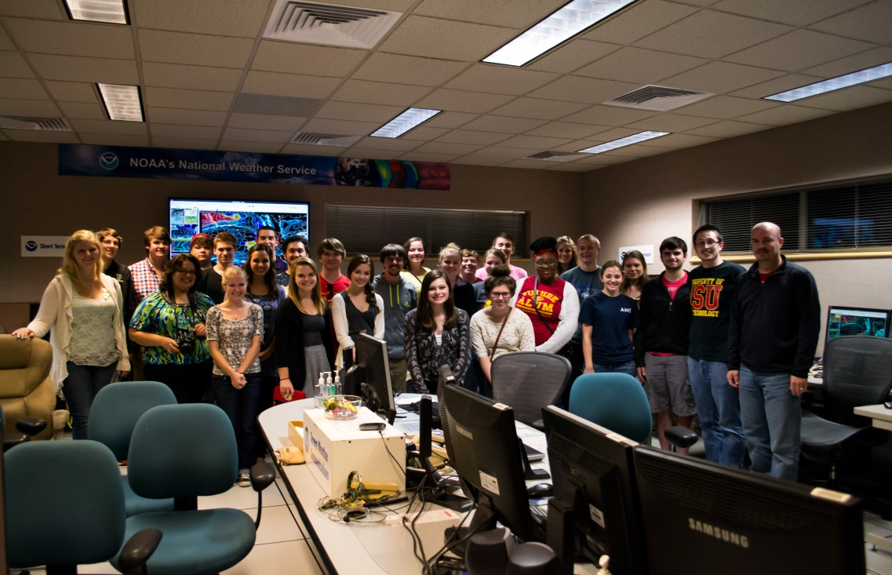
OPTION #3

