Slide 1
AMS Alumni of the Month
Tyler Roney

Slide 2
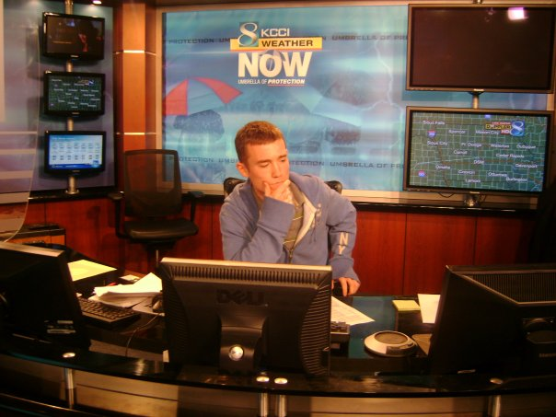

Slide 3
Question: How has AMS helped you with your academics?

Slide 4
Answer: “AMS helped me with academics because of the older students’ desire to help the younger ones out. It was great that they took time to do that so they could learn from a new perspective. The study and review sessions were always a lot of fun too because everyone felt more comfortable to ask more questions. It also was a way for classes to connect more of course... always a plus!”

Slide 5
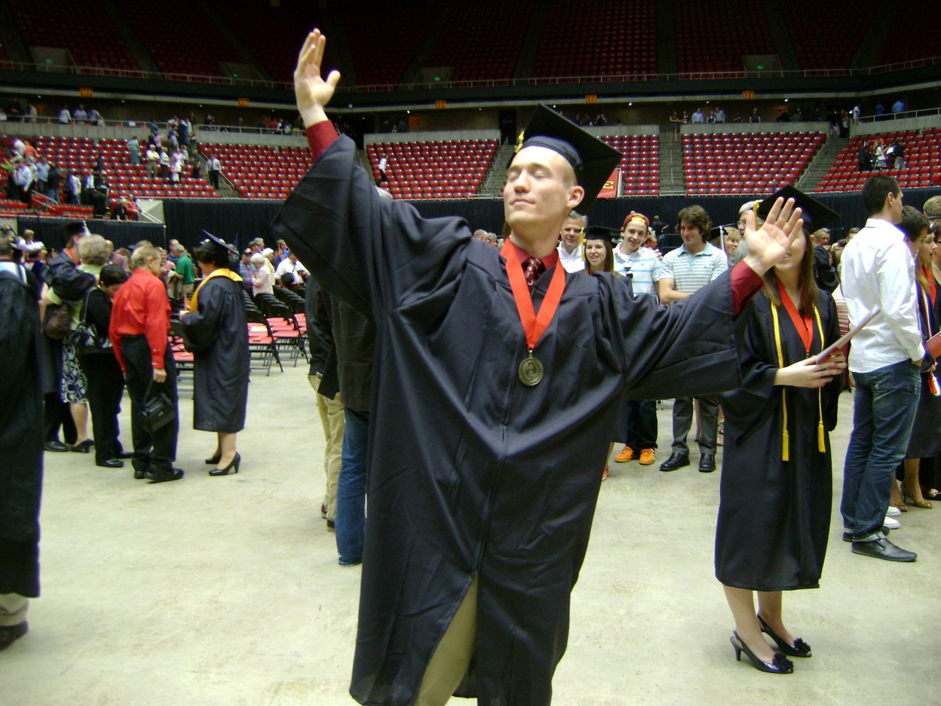

Slide 6
Question: How has AMS helped you connect and interact with other students in meteorology?

Slide 7
Answer: “Getting everyone together in a group like this with similar interests helps you branch out on meeting not just new people but new friends. With everything that AMS does from meetings to social events, getting involved in something that is centered around your major and interests really produces never ending fun and great memories.”

Slide 8
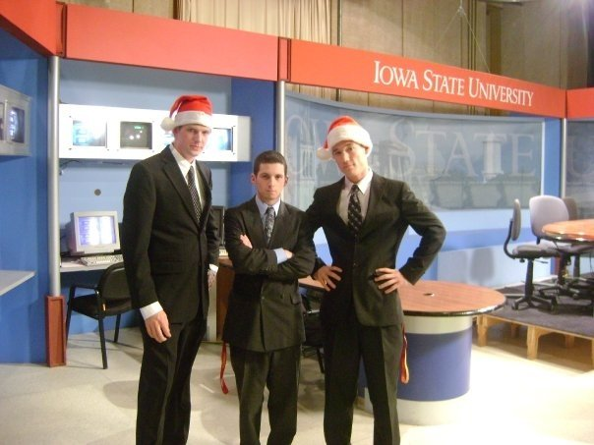

Slide 9
Question: Do you have any words of advice for those looking to go into broadcast?

Slide 10
Answer: “Broadcasting is a popular option in the meteorology field and if you have the motivation, passion, and the will to be in that position someday then never give up on your dreams. The hard work you put into all of your meteorology classes and college as a whole will pay off for you in the long run. I can't stress enough to really take advantage of Cy's Eyes on the Skies. I know our graphics machine is tired but you can learn and grow as a broadcaster the more you go on the show. The older kids will always be willing to give a helpful critique that helps to benefit you in the long run.

Slide 11
Also, taking advantage of internships whether you turn to Des Moines or if you go home for the summer and want to try to get on at a station near your home are incredibly beneficial! Speaking as a broadcast meteorologist now, going to "work" really isn't work because it's something I love to do and I look forward each day being able to tell people what the weather is going to be like and it all started with a dream and grew exponentially throughout my years at Iowa State and being involved in AMS/Cy's Eyes on the Skies.”

Slide 12
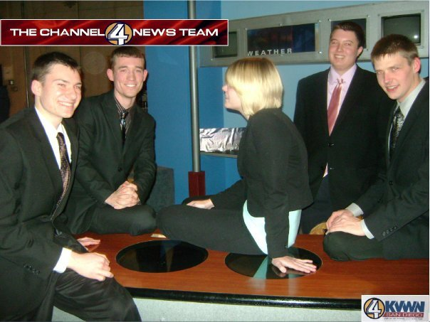

Slide 13
Contact information: phone: 712.229.9175 e-mail: tylerjroney@gmail.com company: KIMT News 3

